Slide 1
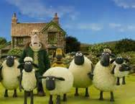
Look at teacher 看着老师 Kànzhe Lǎoshī Listen to teacher 听老师说 Tīng Lǎoshī shuō Answer teacher 回答老师 Huídá Lǎoshī Be quiet 安靜 Ānjìng Sit down 坐下 Zuò xià
Neil Teacher 外國老師 Wàiguó lǎoshī
You follow the rules and we have fun & watch video 你遵循规则，我们玩得开心 + 观看视频.. Nǐ zūnxún guīzé, wǒmen wán dé kāixīn + guānkàn shìpín
Shaun the sheep 小羊肖恩

Slide 2
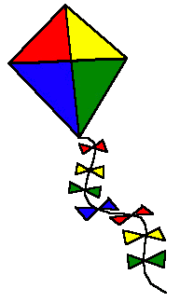
SHAPES

Slide 3
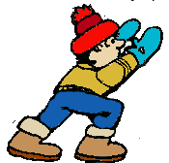
Shapes
CIRCLE

Slide 4
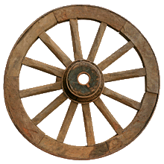
Shapes
How many circle shaped things can you say?
a doughnut
a wheel
a clock

Slide 5
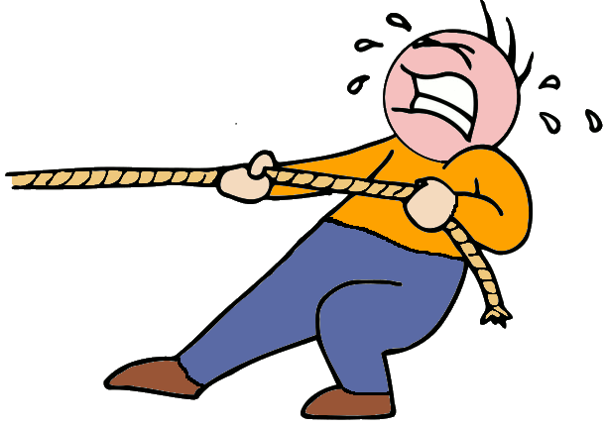
Shapes
SQUARE

Slide 6
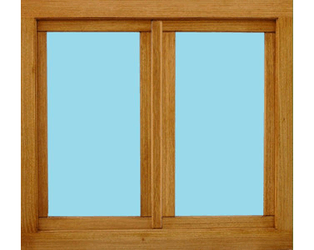
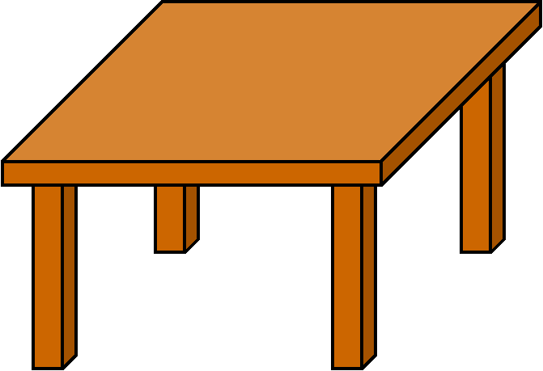
Shapes
How many square shaped things can you say?
a window
a table

Slide 7
Shapes
RECTANGLE

Slide 8
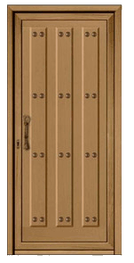
Shapes
How many rectangle shaped things can you say?
a blackboard
a notebook
a door

Slide 9
Shapes
TRIANGLE

Slide 10
Shapes
How many triangle shaped things can you say?
a danger sign
a Christmas tree
a roof

Slide 11
Shapes
STAR

Slide 12
Shapes
How many star shaped things can you say?
a star
a starfish

Slide 13
Shapes
Let’s sing a song shapes by pancake manor https://www.youtube.com/watch?v=dsR0h50BiFQ
Notes:
13

Slide 14
What shape is it?

Slide 15
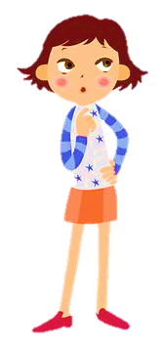
Click on the star
1 | 2 | 3 | 4
A
B
C
D
GREAT!
NEXT

Slide 16
Click on the circle
1 | 2 | 3 | 4
A
B
C
D
GREAT!
NEXT

Slide 17
Click on the square
1 | 2 | 3 | 4
A
B
C
D
GREAT!
NEXT

Slide 18
Click on the triangle
1 | 2 | 3 | 4
A
B
C
D
GREAT!
NEXT

Slide 19
Click on the rectangle
1 | 2 | 3 | 4
A
B
C
D
GREAT!
NEXT

Slide 20
Click on the heart
1 | 2 | 3 | 4
A
B
C
D
GREAT!
NEXT

Slide 21
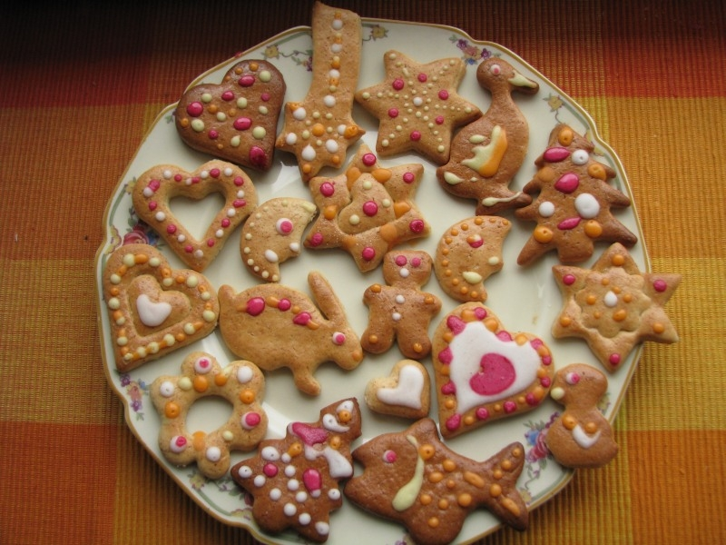
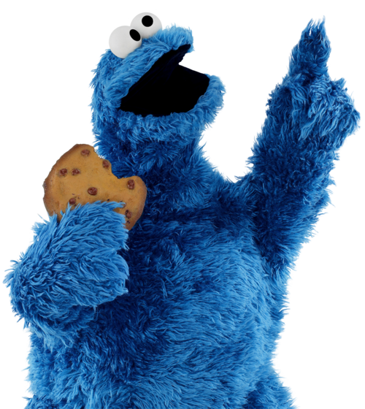
Biscuits!

Slide 22
Circle
Look at my biscuit. It’s a _ _ _ _ _

Slide 23
Square
Look at my biscuit. It’s a _ _ _ _ _

Slide 24
Rectangle
Look at my biscuit. It’s a _ _ _ _ _

Slide 25
Triangle
Look at my biscuit. It’s a _ _ _ _ _

Slide 26
Star
Look at my biscuit. It’s a _ _ _ _ _

Slide 27
Heart
Look at my biscuit. It’s a _ _ _ _ _

Slide 28
Shapes
Let’s sing a song shapes song by little kids https://www.youtube.com/watch?v=XlcX3G_2UvA
Notes:
28

Slide 29
Making Shapes
Let’s play a game
Notes:
29

