Slide 1
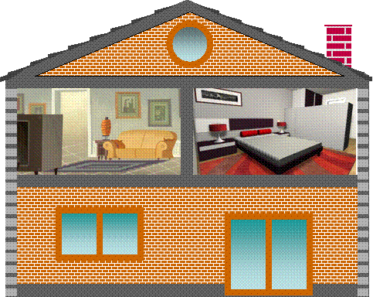
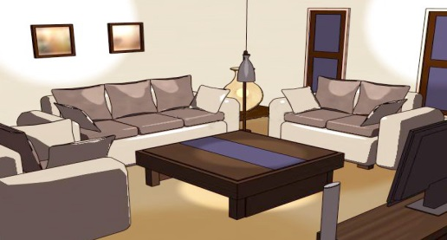
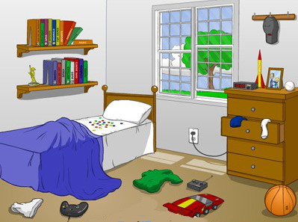
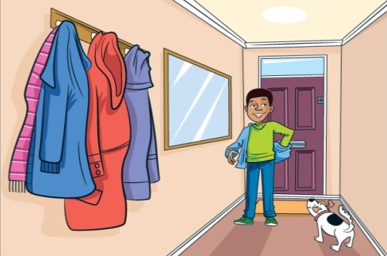
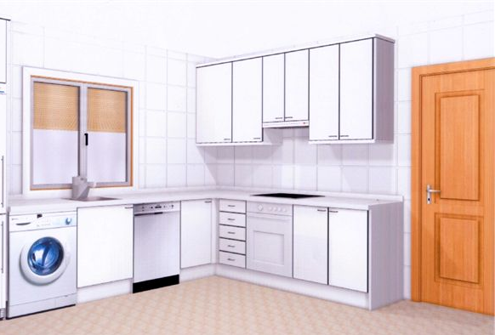
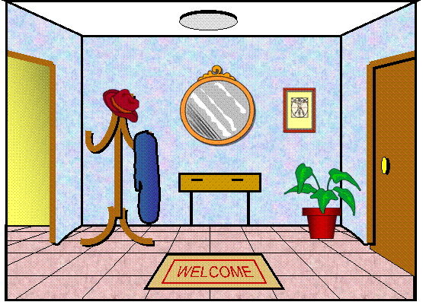

Slide 2
living room

Slide 3
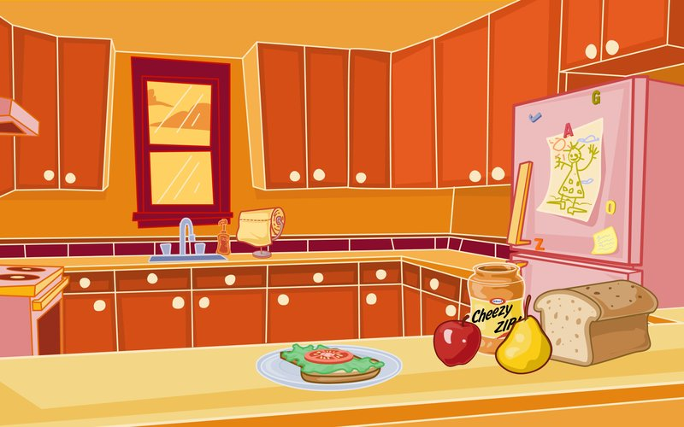
kitchen

Slide 4
bedroom

Slide 5
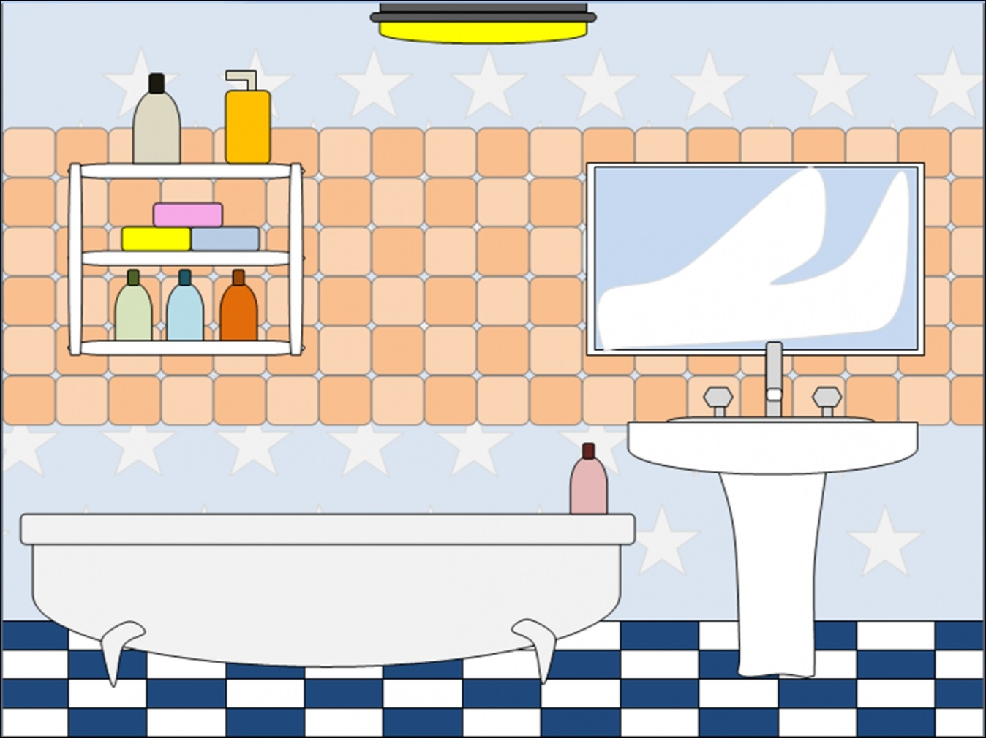
bathroom

Slide 6
I wash my hair in the …
bathroom

Slide 7
I’m tired so I sleep in the…
bedroom

Slide 8
My parents cook dinner in the …
kitchen

Slide 9
I watch TV with my family in the …
living room

Slide 10
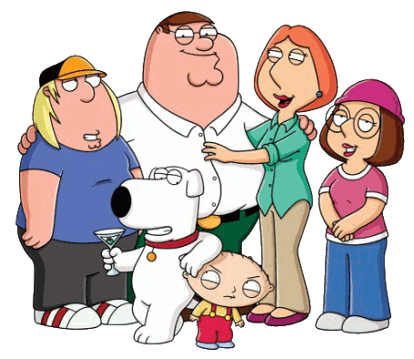
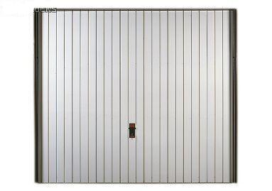
Let’s chant. Rooms in the house by super english https://www.youtube.com/watch?v=qsmlxP8T720

Slide 12
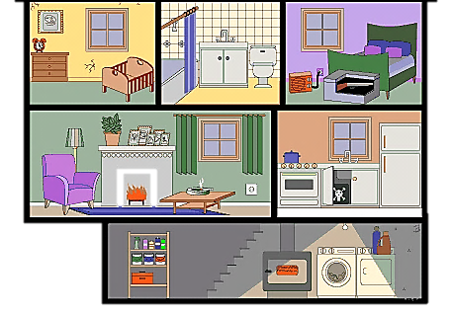
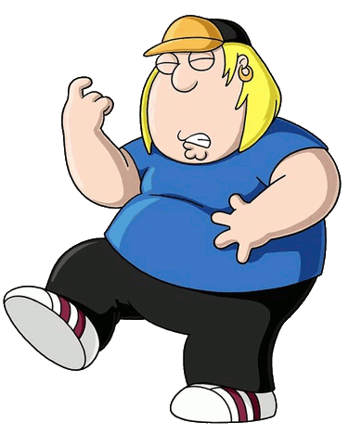
Click on the correct family member
The mother is in the bathroom
NEXT

Slide 13
Click on the correct family member
The brother is in the kitchen
NEXT

Slide 14
Click on the correct family member
The sister is in the living room
NEXT

Slide 15
Click on the correct family member
The father is in the bedroom
NEXT

Slide 16
The mother is in the …
NEXT
kitchen
Living room
bathroom
bedroom

Slide 17
The father is in the …
NEXT
kitchen
Living room
bathroom
bedroom

Slide 18
The brother is in the …
NEXT
kitchen
bedroom
bathroom
Living room

Slide 19
The sister is in the …
NEXT
kitchen
living room
bathroom
bedroom

Slide 20
Let’s sing. My house by pink fong https://www.youtube.com/watch?v=_XratfoopkI

Slide 21
START
What’s behind the wall?
BRICKS DOWN
PARTS OF THE HOUSE

Slide 22
living room
NEXT
CHECK

Slide 23
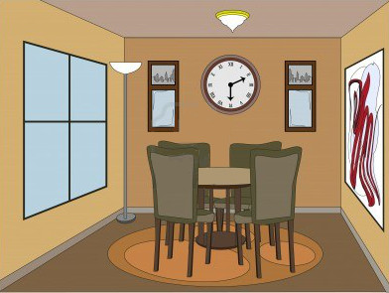
dining room
NEXT
CHECK

Slide 24
kitchen
NEXT
CHECK

Slide 25
bedroom
NEXT
CHECK

Slide 26
bathroom
NEXT
CHECK

