Slide 1
Reading Courseware
for Teachers
Chapter 3 People who help me
Learn to Read

Slide 2
Functions | 21st Century Knowledge and Skills | Values and Attitudes
Talking about feelings about others Describing others | Civic literacy | Following rules Being friendly and helpful
Reading Skills
Relating the text to self Giving personal responses to the text Making guesses/predictions about the text Inferring unknown words from contextual/pictorial cues or base words Locating specific information in response to questions

Slide 3
Reading
Pre-reading | – Introducing the characters
First reading | – Shared reading
Second reading | – Reading aloud – Activity 1: Assessment for learning
Post-reading | – Activity 2: Readers’ theatre – Activity 3: Fill in the blanks – Activity 4: Who do you like?

Slide 4
Today we are going to read a story. Let’s look at some pictures!
Pre-reading

Slide 5
Peter
Charlie
Peter and Charlie are playing at recess.
The boys meet some people at recess.
Notes:
Say Today we are going to read a story about Peter and Charlie! Say This is Peter and this is Charlie. They are at school. Ask What are they doing? (Playing.) That’s right. Charlie and Peter are playing at recess. [Click to show the narration] – observing
Ask Do you know what recess is? (Yes. / No.) Tell pupils to look at their timetables and point out their recess in the timetab;es. Say You can rest, eat and play at recess. Ask What do you do at recess?– relating the text to self
[Click to show the narration] Say Charlie and Peter meet some people at recess. Let’s see who they meet.

Slide 6
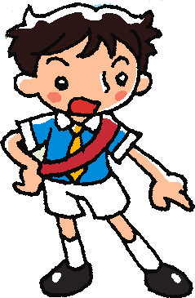
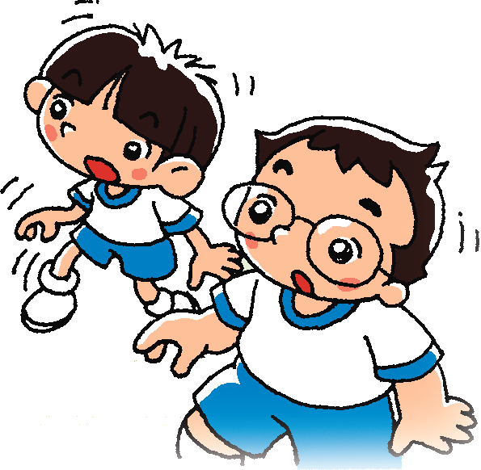
Sam
Charlie
Peter
Charlie and Peter meet a prefect.
Does Sam look friendly?
Notes:
Say Charlie and Peter meet a prefect — Sam. Ask Do you know what a prefect is? (Yes. / No.) Say A prefect is a pupil too, but he/she makes sure you follow the school rules. They may tell you to keep quiet or wear your uniform correctly. Ask Are there prefects in our school? (Yes. / No.) Do you know any prefects? (Yes ./ No.) – relating the text to self / giving personal responses
[Click to show the question] Say Look at Sam. Mime Sam’s expression and point a finger at the pupils. Ask Does Sam look friendly? (Yes. / No.) I think he looks angry. Do you think so? (Yes. / No.) – observing / giving personal responses
Ask Do Charlie and Peter like Sam? Can you guess? – guessing

Slide 7
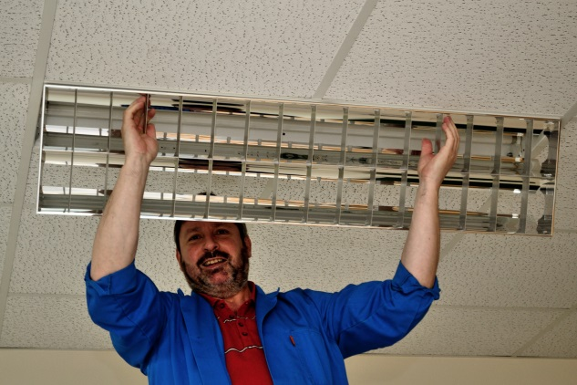
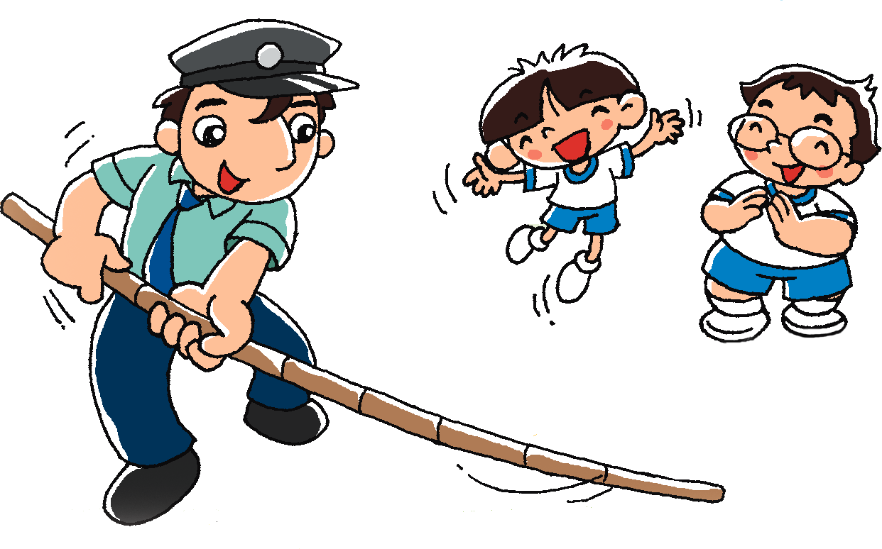
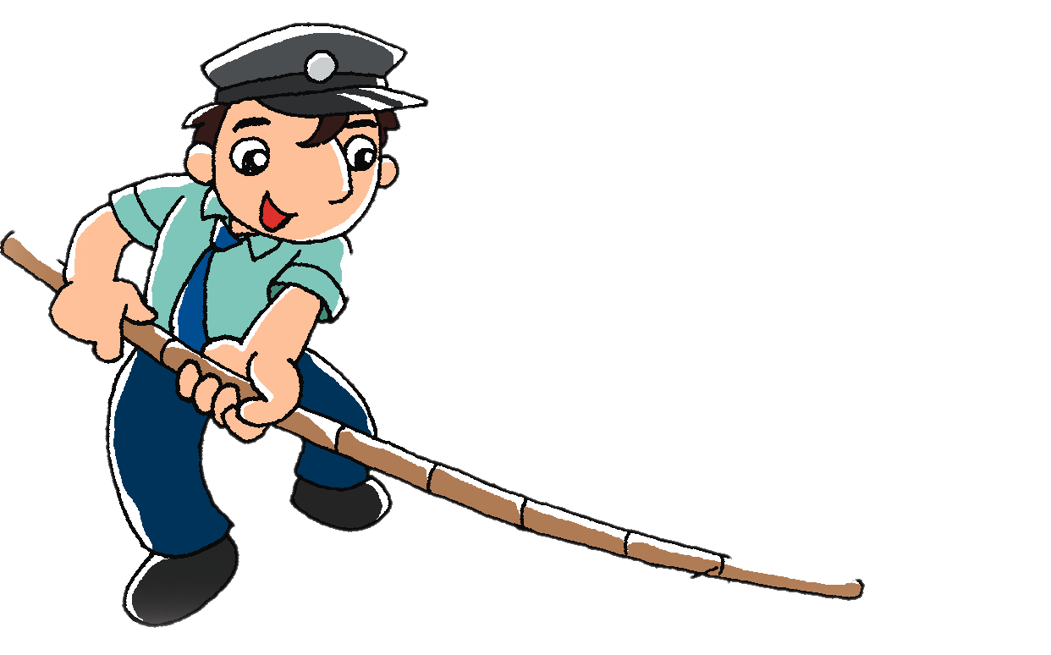
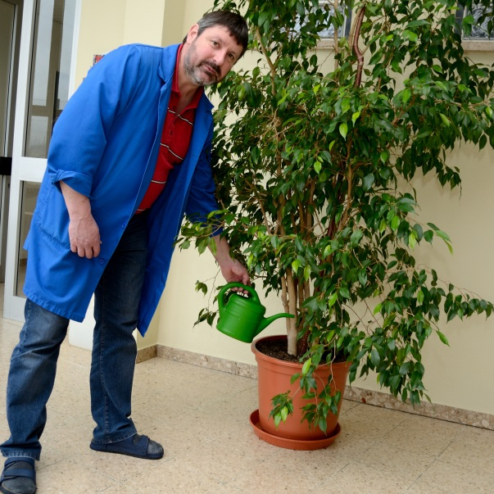
Mr Ho
Charlie and Peter also meet the caretaker.
Does Mr Ho look friendly?
Notes:
Say Charlie and Peter also meet the caretaker — Mr Ho.
Ask Do you know what a caretaker is? (Yes / No.) A caretaker takes care of the school. [Click to show the pictures] For example, he fixes things and waters the plants. Is there a caretaker in our school? (Yes / No.) – relating the text to self
Say Let’s look at Mr Ho. [Click to show the question] Ask Does he look friendly? (Yes. / No.) Do the boys like Mr Ho? Can you guess? (Yes. / No.) – observing / guessing

Slide 8
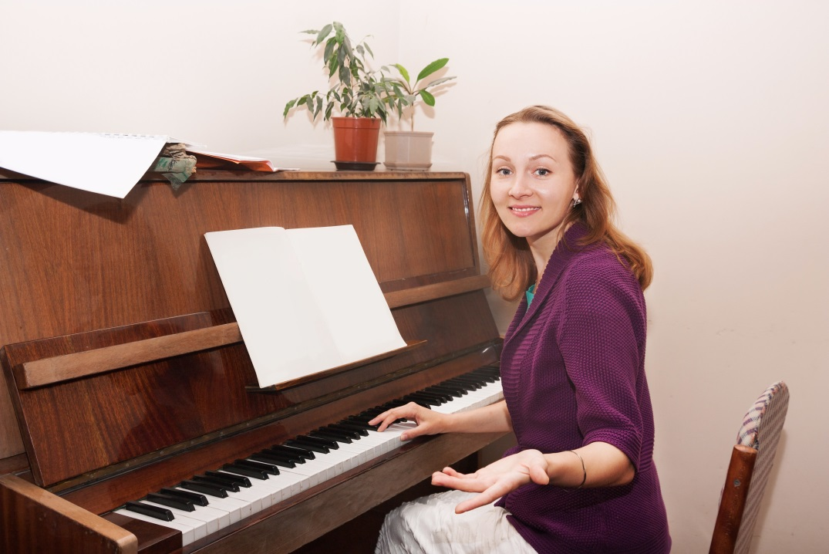
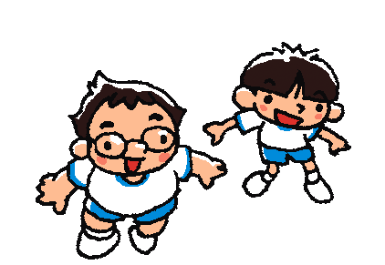
Mrs Tam
Charlie
Peter
Then the boys meet their Music teacher.
Does Mrs Tam look friendly?
Notes:
Say Then the boys meet their Music teacher — Mrs Tam. She teaches music. [Click to show the picture]
Say Look at Mrs Tam. [Click to show the question] Ask Does she look friendly? (Yes. / No.) Do Peter and Charlie like Mrs Tam? Can you guess? (Yes. / No.) – observing / guessing
Say Let’s read the story and find out who the boys like!

Slide 9
Let’s read the story!
First reading

Slide 10
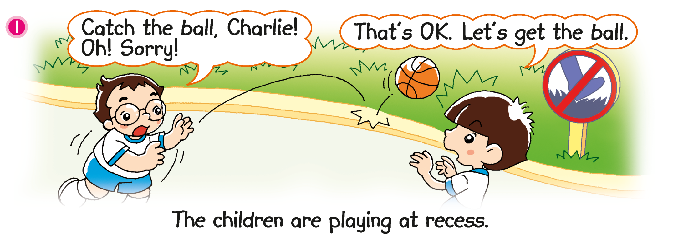
What does the sign mean?
Can Charlie and Peter get the ball?
Do not walk on the grass.
Notes:
21st century knowledge: civic literacy / Attitude: following rules
Point at the sign and say Look. There is a sign on the grass. [Click to show the question] Do you know what it means? Draw pupils’ attention to the shoe, grass and red line on the sign. Say It means ‘Do not walk on the grass.’ [Click to show the answer] – observing
Say Look at the ball. [Click to circle the ball] Ask Does Charlie catch the ball? (No.) Where does the ball go? (On the grass.) [Click to show the question] Can Charlie and Peter get the ball? (No. They can’t walk on the grass.) – observing / inferring

Slide 11
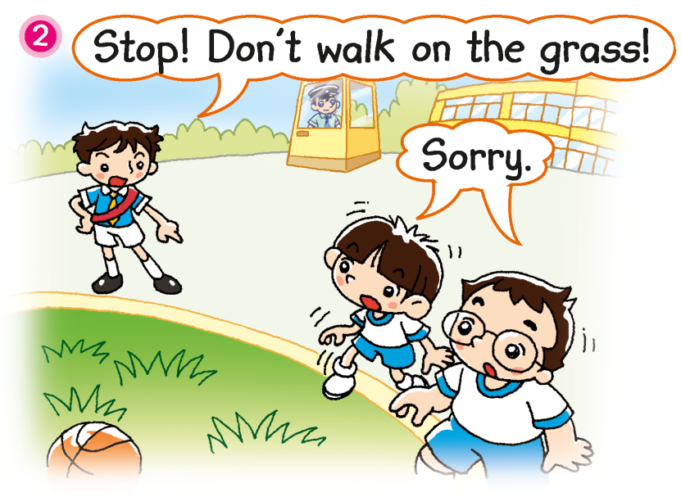
Why do Charlie and Peter say ‘Sorry’?
Are Charlie and Peter following the rules?
Notes:
Say Oh no! Charlie and Peter don’t see the sign! They walk on the grass to get the ball. Sam sees Charlie and Peter walking on the grass.
[Click to show the question] Ask Why do Charlie and Peter say ‘Sorry’? Are they doing something wrong? (Yes. They are walking on the grass.) [Click to show the question] Are they following the rules? (No.) Is that why Sam looks angry? (Yes.) – inferring

Slide 12
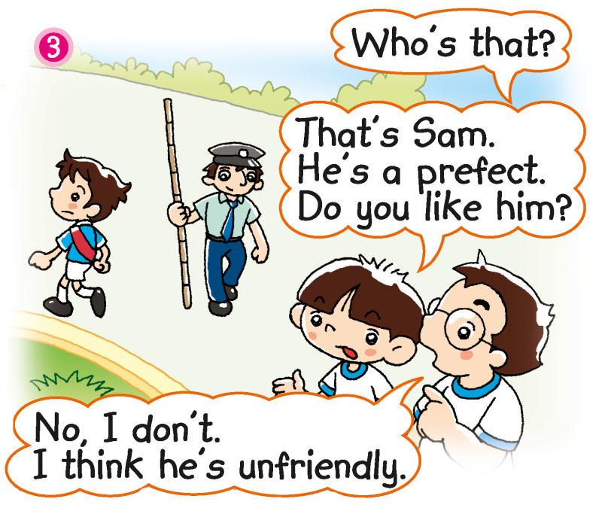
Why doesn’t Peter like Sam?
Notes:
Say Charlie and Peter stop walking on the grass.
Ask Does Peter like Sam? (No.) [Click to show the question] Why? (Peter thinks Sam is unfriendly.) [Click to underline the answer] Ask Is ‘unfriendly’ good or bad? (Bad.) Say That’s right. ‘Unfriendly’ means ‘not friendly’. – locating specific information / inferring unknown words
Ask Can Charlie and Peter get the ball? (No.) Say Look. [Click to circle the caretaker] Here comes Mr Ho, the caretaker. Will he help Charlie and Peter? (Yes. / No.) – inferring / predicting

Slide 13
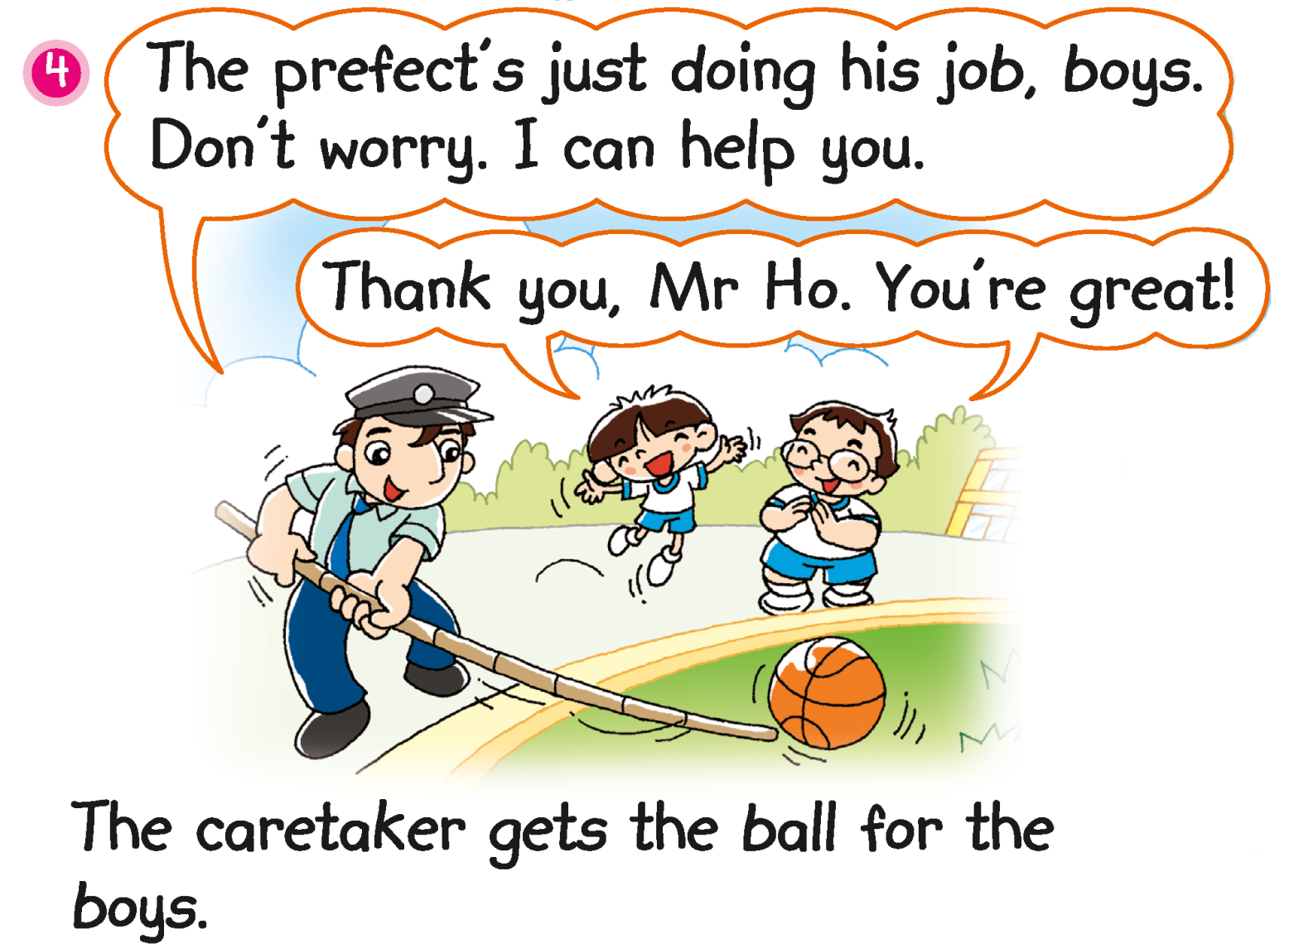
Do the boys like Mr Ho? How do you know?
Notes:
Ask Does Mr Ho help the boys? (Yes.) What do you think about Mr Ho? He is … (Helpful.) [Click to show the questions] Ask do the boys like Mr Ho? (Yes, they do.) How do you know? (They look happy. / They say ‘You’re great!’) [Click to underline the answer] – observing / inferring / supporting

Slide 14
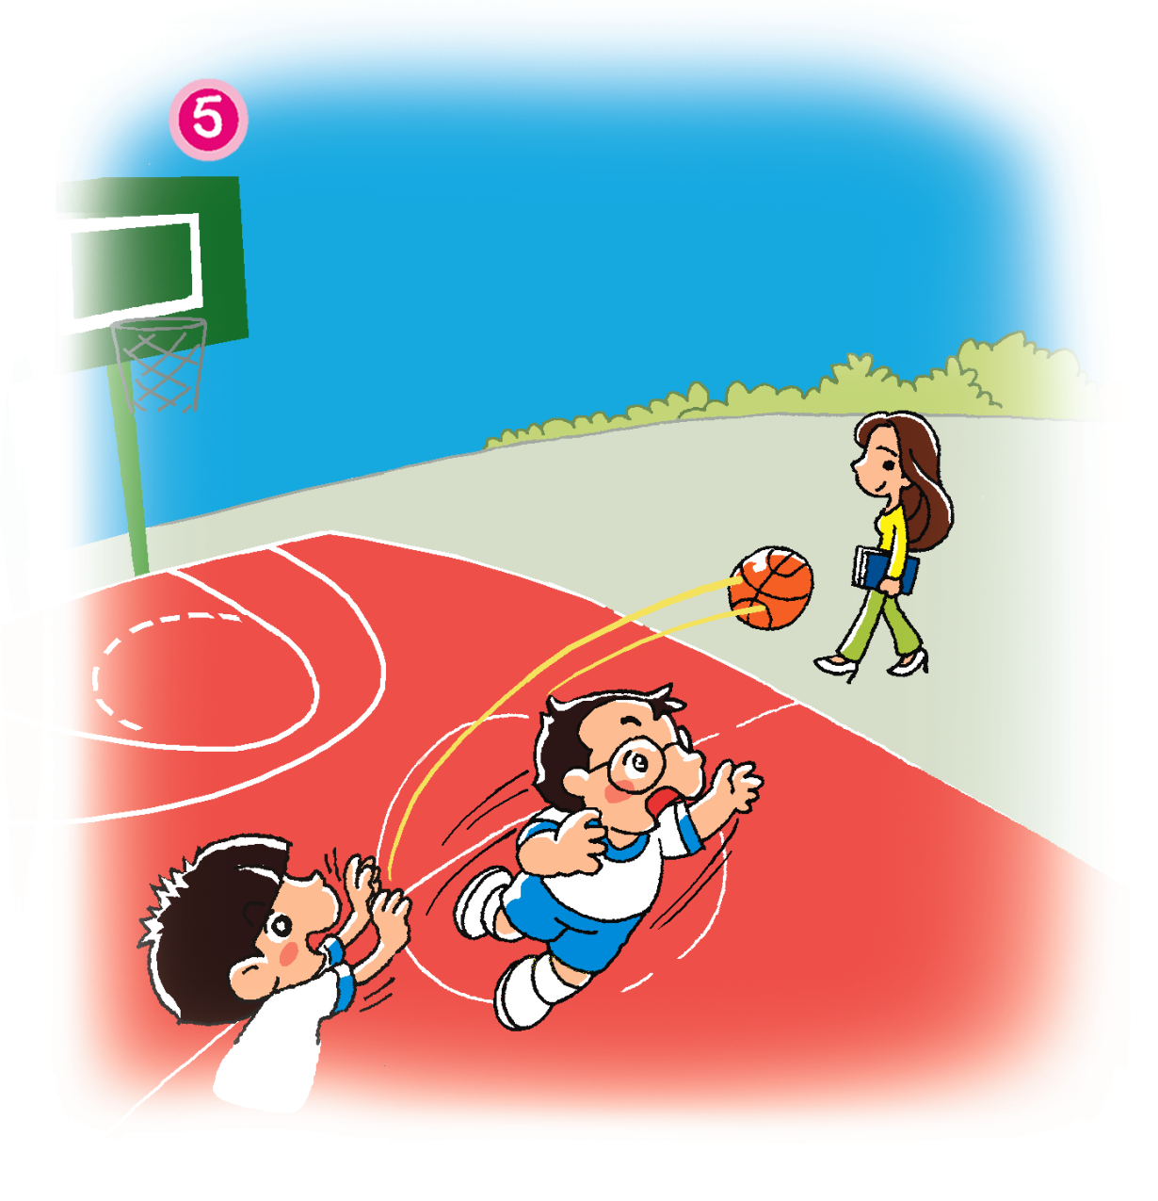
Does Mrs Tam see the ball?
Notes:
Say Charlie and Peter get the ball back. They play again. Charlie throws the ball. The ball flies towards Mrs Tam, their Music teacher.
Ask Who is Peter talking to? (Mrs Tam.) [Click to circle Mrs Tam] Does Mrs Tam see the ball? (No.) Say Peter says ‘Look out!’ to tell her to watch out for the ball. – observing / inferring

Slide 15
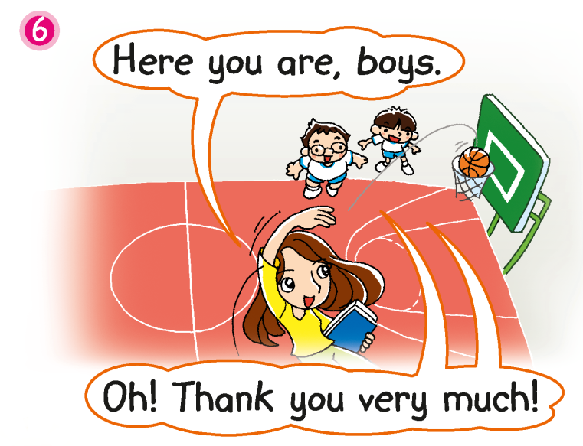
Mrs Tam catches the ball. She throws it back to Peter and Charlie.
Notes:
Say Mrs Tam catches the ball. She throws it back to Peter and Charlie.

Slide 16
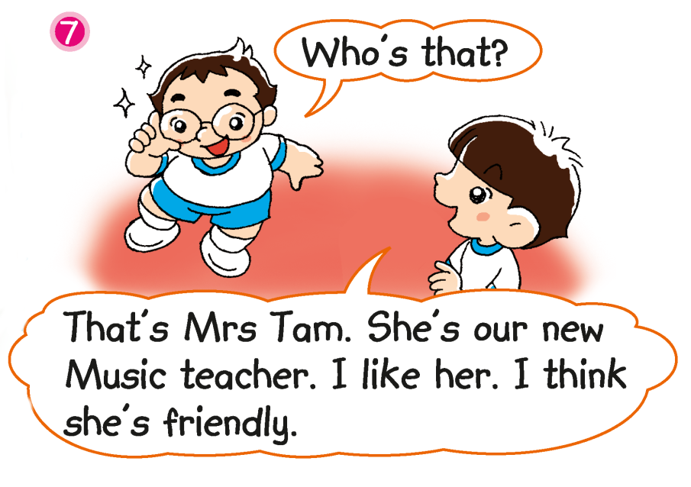
Do the boys like Mrs Tam? Why?
Notes:
[Click to show the questions] Ask Do the boys like Mrs Tam? (Yes, they do.) Why? (She is friendly.) [Click to underline the answer] – locating specific information
Ask Is ‘friendly’ good or bad? (Good.) Do you want to be friendly or unfriendly? (Friendly.) – giving personal responses

Slide 17
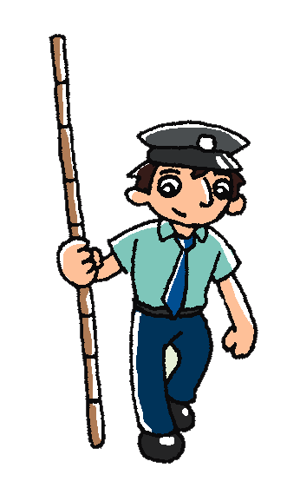
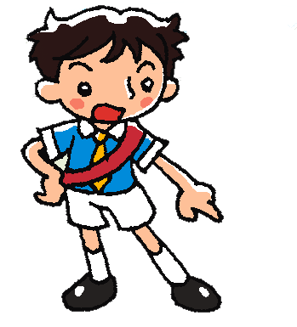
Mr Ho
Sam
Mrs Tam
Click on the characters!
Notes:
Read the post-reading question aloud and elicit the answer from pupils. Ask pupils to recall why the boys like or do not like each character.
Click on each character to reveal if the boys like him/her.

Slide 18
Let’s watch the video and read the story again!
Second reading

Slide 19
unfriendly
helpful
friendly
Answers
Notes:
Instruct pupils to complete Part D individually in their books. The activity can be completed in class or for homework. – inferring unknown words

Slide 20
Let’s do some more activities!
Post-reading

Slide 21
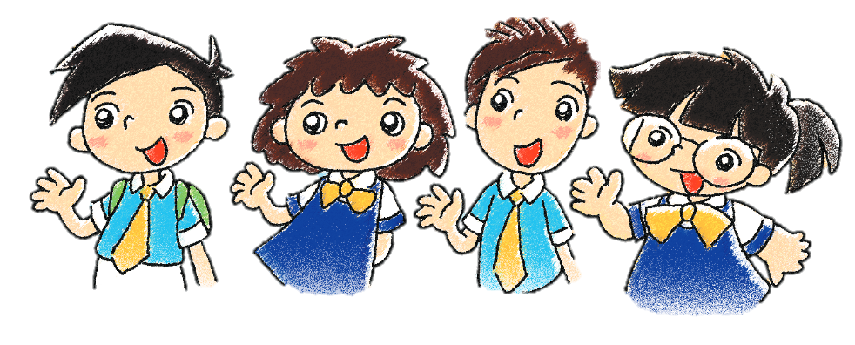
Readers’ theatre
Notes:
Put pupils into groups and assign each group a character. Ask each group to read their part aloud.

Slide 22
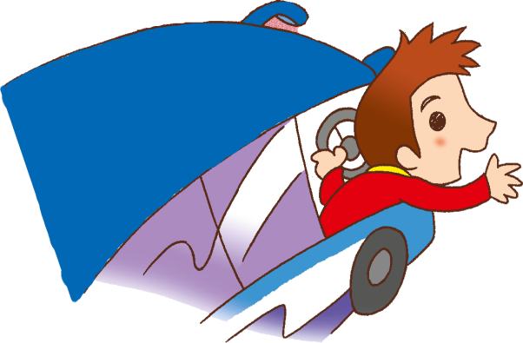
Good morning! How are you?
like
I ________ our driver.
I think he is _________.
friendly
Answers
Notes:
Say The children are talking about the people in their school! Let’s see what they say.
Read the dialogues aloud. Instruct pupils to fill in the blanks with the correct words.

Slide 23
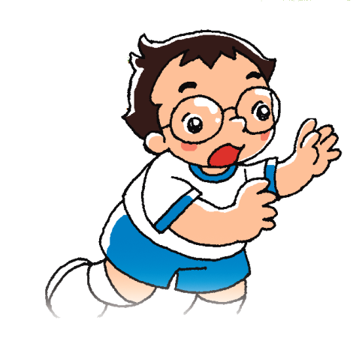
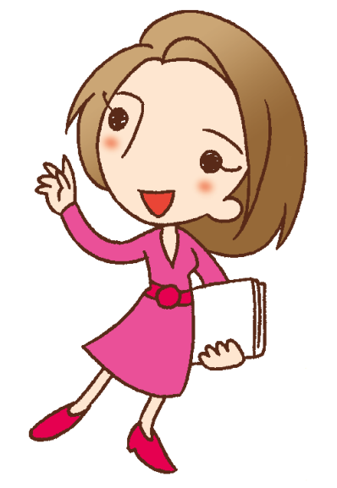
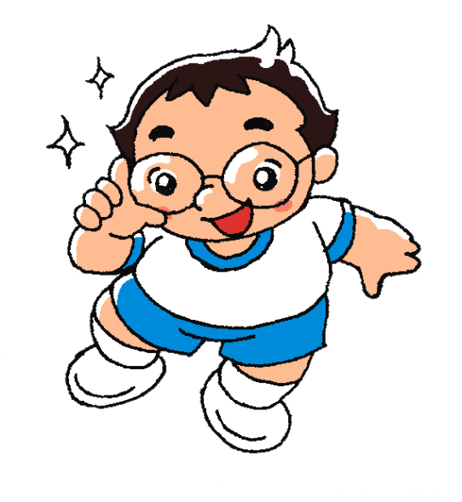
I can help you.
like
I ________ our teacher.
I think she is _________.
helpful
Answers
Notes:
Read the dialogues aloud. Instruct pupils to fill in the blanks with the correct words.

Slide 24
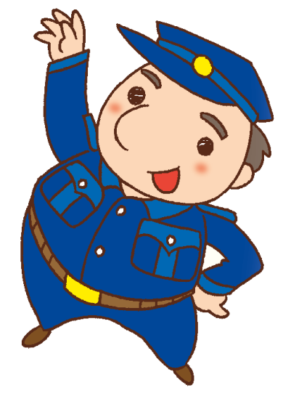
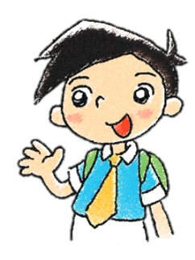
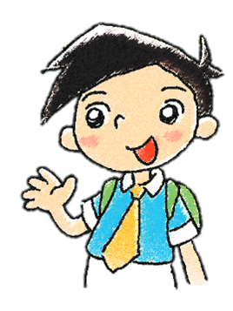
Goodbye!
like
I ________ our caretaker.
I think he is _________.
friendly
Answers
Notes:
Read the dialogues aloud. Instruct pupils to fill in the blanks with the correct words.

Slide 25
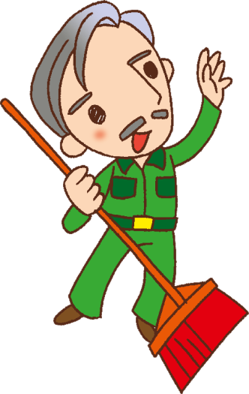
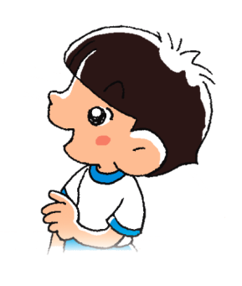
Hi, children. Be careful!
like
I ________ our cleaner. I think he is _________ and __________.
friendly
helpful
Answers
Notes:
Read the dialogues aloud. Instruct pupils to fill in the blanks with the correct words.

Slide 26
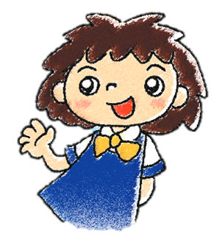
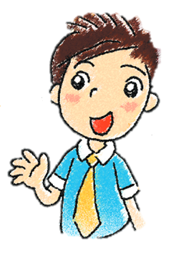
Who do you like?
Why?
Notes:
Instruct pupils to think of someone they like at their school and why they like them, e.g. Who do you like? Why? (I like _____. I think he’s / she’s _____.)
Divide pupils into groups of three to four. Instruct pupils to interview each other, e.g. Who do you like? and to share their responses.
At the end of the activity, you may invite pupils to share who they/their group members like.

Slide 27
Acknowledgements
We are grateful to the following for permission to reproduce copyright illustrations:
© alho007 - Fotolia.com for slide 7
© lozochka - Fotolia.com for slide 8
© blueringmedia - Fotolia.com for slide 23
Every effort has been made to trace copyright, but in the event of any accidental infringement, we shall be pleased to come to a suitable arrangement with the rightful owner.

