Slide 1
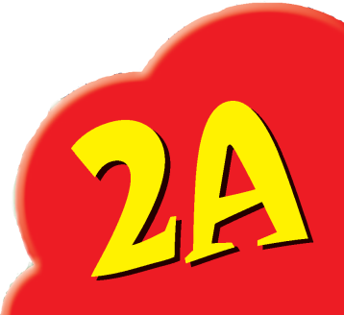
Reading Courseware
for Teachers
Chapter 5 Signs we see
Learn to Read

Slide 2
Functions | 21st Century Knowledge and Skills | Values and Attitudes
Talking about rules | Critical thinking Civic literacy | Following rules
Reading Skills
Making guesses/observations about the text/pictures Relating the text to self Giving personal responses to the text Locating specific information in response to questions Inferring unknown words from contextual/pictorial cues

Slide 3
Reading
Pre-reading | – Introducing the setting
First reading | – Shared reading
Second reading | – Reading aloud – Activity 1: Assessment for learning
Post-reading | – Activity 2: Readers’ theatre – Activity 3: Guess the signs – Activity 4: More park signs

Slide 4
Today we are going to read a story. Let’s look at some pictures!
Pre-reading

Slide 5
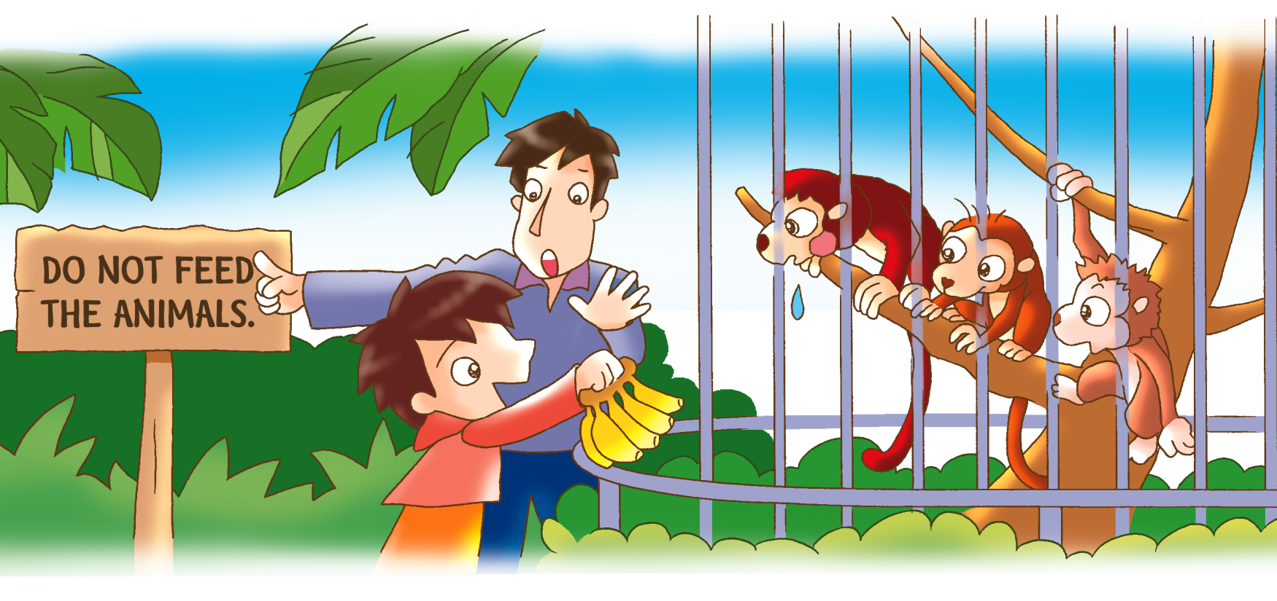
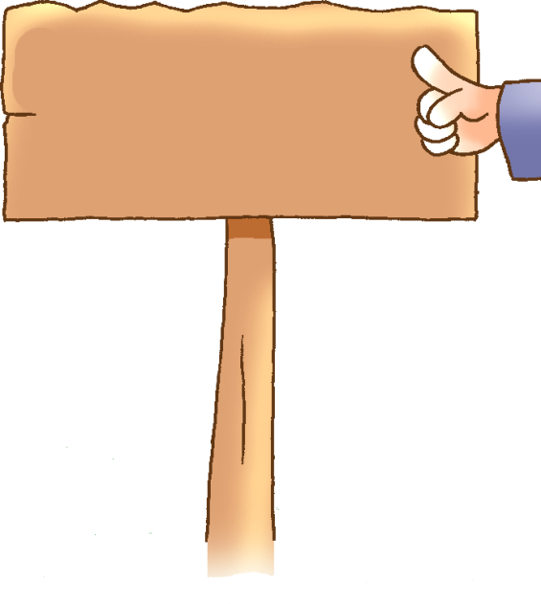
Can you guess what the sign says?
Why can’t we feed the animals?
Notes:
Say This boy and his father are in the park today. When we are in the park, we must follow the rules. Do you remember any park rules? – recalling
Say Let’s look at this picture. This boy has some bananas. [Click to circle the bananas] Ask Does he want to feed the monkeys? (Yes.) Say Look at his father. Mime the boy’s father’s body actions and point at the sign. He is pointing to a sign. [Click to show the question] Can you guess what the sign says? [Click to show the answer and read it aloud.] – observing / guessing
Say Look at the monkeys. They really want to eat the bananas. [Click to show the question] Ask Do you know why we can’t feed them? Let’s find out why. – eliciting information

Slide 6
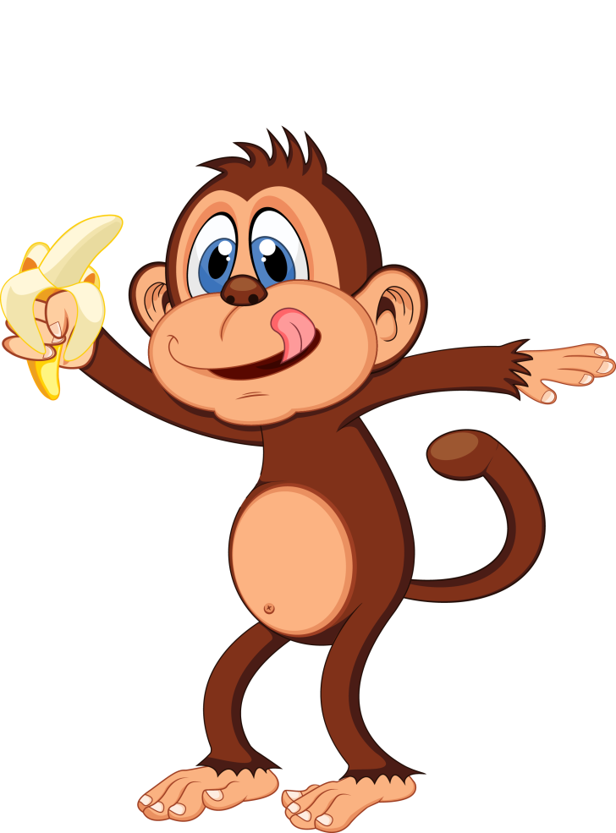
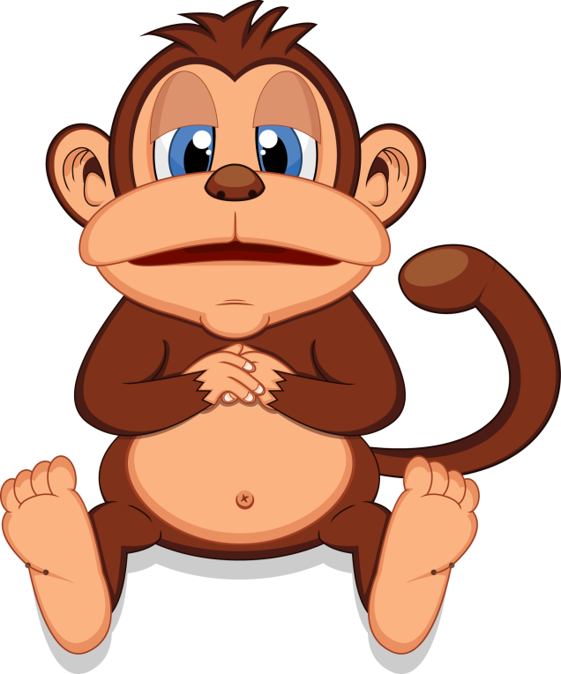
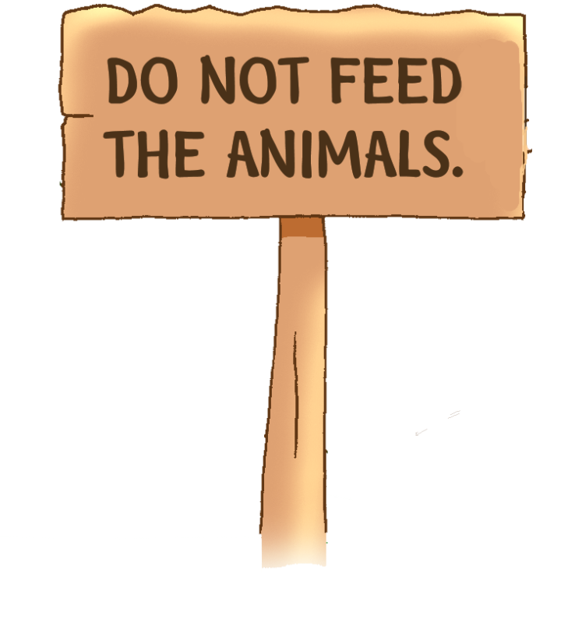
The animals may eat too much and be sick!
Notes:
Say The monkey is eating a banana. It likes the banana, and eats more and more and more. [Click to show a sick monkey] Oh no! The monkey eats too many bananas. Ask Do you know how much the animals in the park can eat? (No.) [Click to show the explanation] Say You may give them too much food. The animals may eat too much and get sick. Ask Is that good or bad? (Bad.) Do you want to make the animals sick? (No.) So can we feed them? (No.) – relating the text to self / giving personal responses

Slide 7
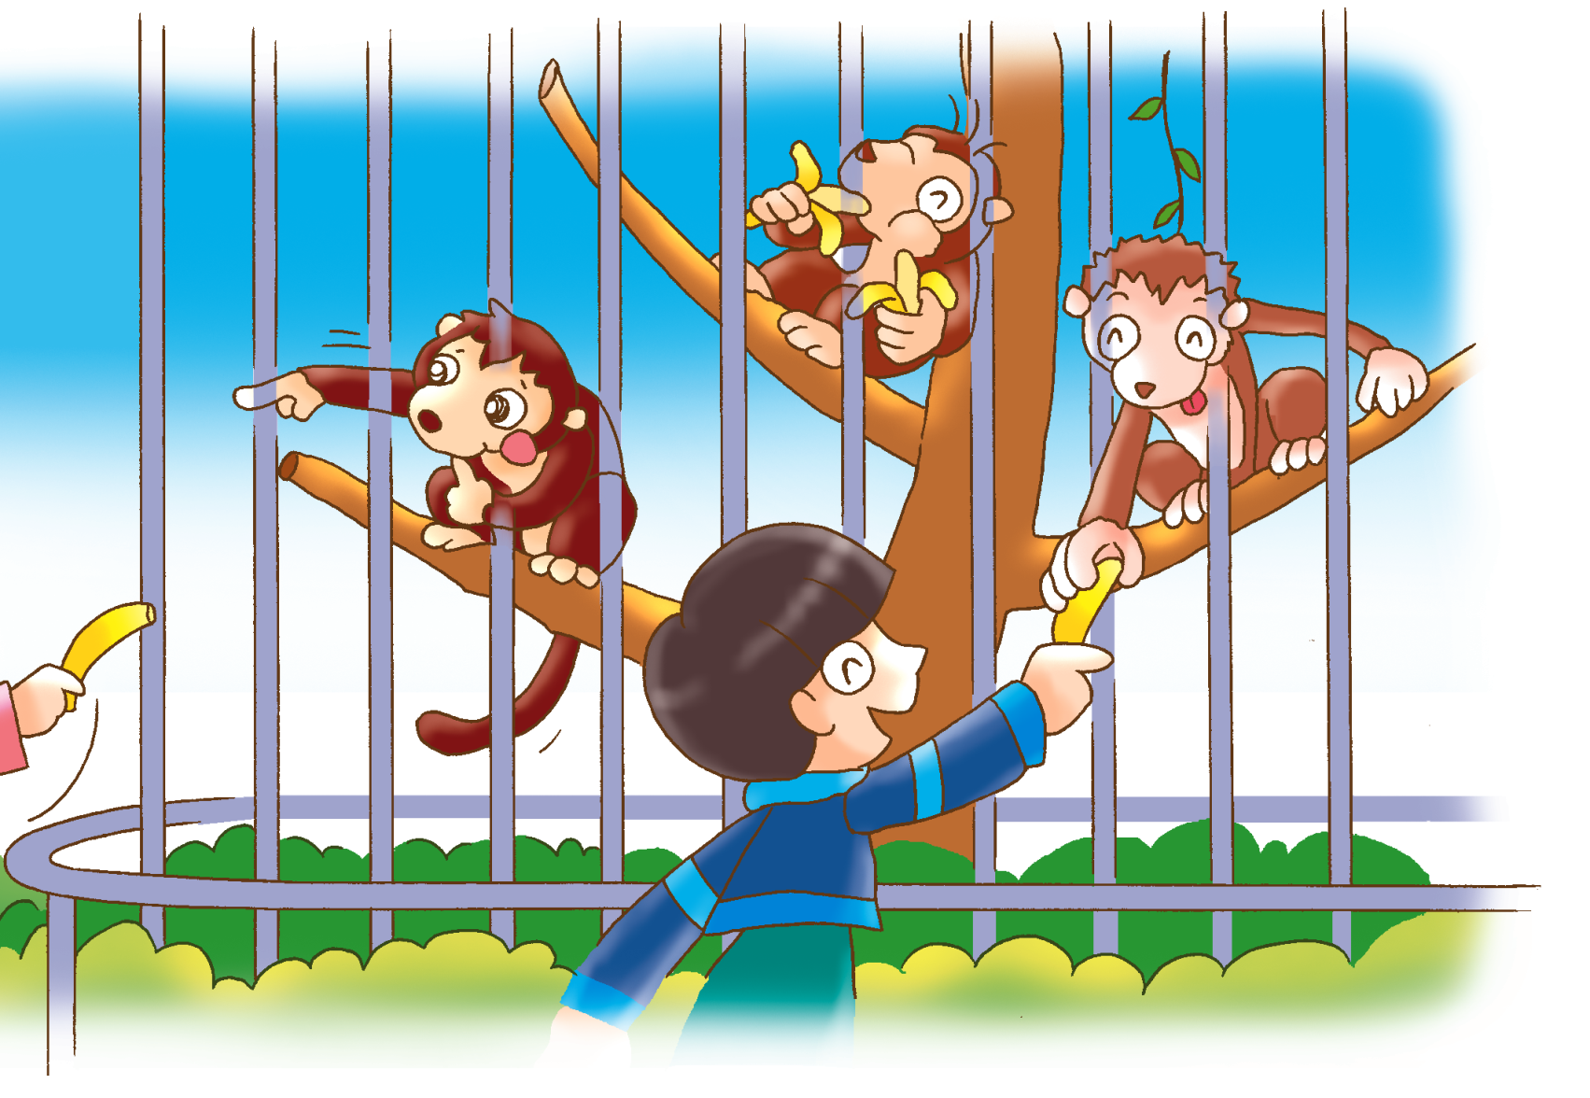
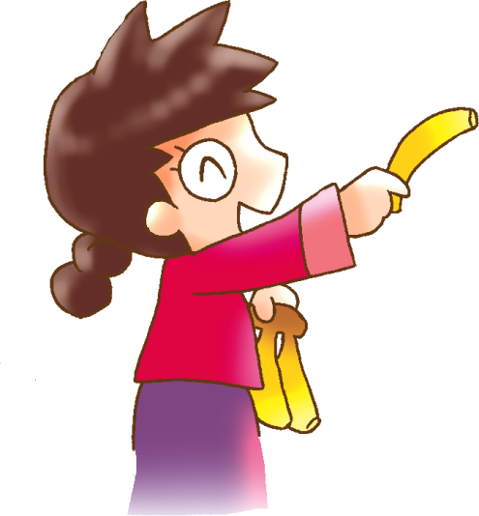
Why are the children feeding the monkeys?
Are the children following the rules?
Notes:
Say Look at this picture now. Ask What are the children doing? (Feeding the animals / monkeys.) Is that good or bad? (Bad.) Say That’s right. The monkeys may eat too much and get sick. [Click to show the questions] Ask Why are they feeding the monkeys? Are they following the rules? (No.) – observing / inferring
Say Let’s read the story and find out why the children are feeding the monkeys.

Slide 8
Let’s read the story!
First reading

Slide 9
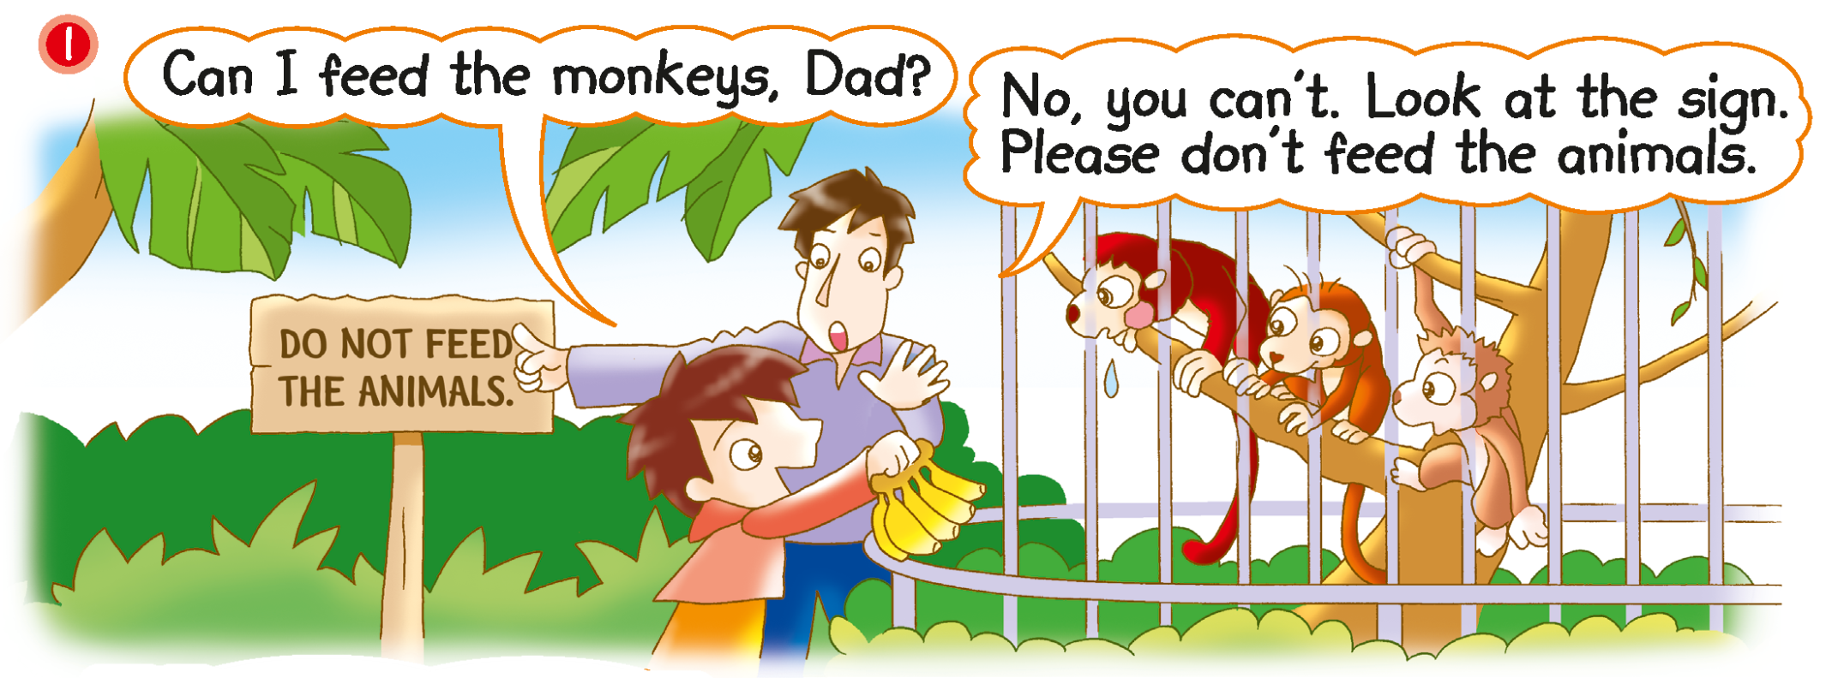
Notes:
Say This boy and his father are in the park today! Let’s see what they are saying.

Slide 10
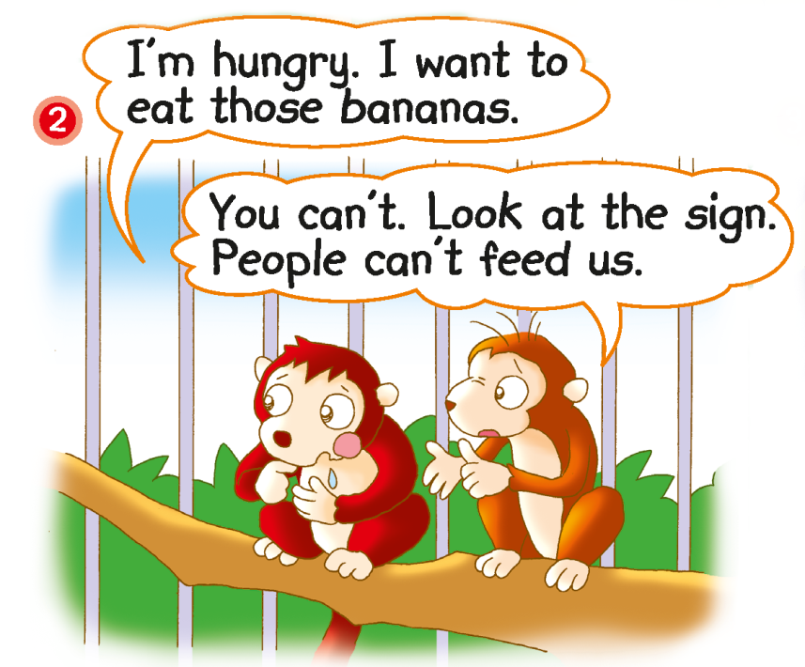
Can they eat the bananas?
Notes:
Say The monkeys are talking. Let’s see what they are saying.
[Point at the left monkey] Ask Does this monkey want to eat the bananas? (Yes.) That’s right. He is hungry. [Click to highlight the word‘hungry’] Rub your stomach with your hand and mime a hungry expression. [Click to show the question] Ask Can the monkeys eat the bananas? (No.) Why not? Can people feed them? (No.) [Click to underline the answer] – locating specific information / inferring

Slide 11
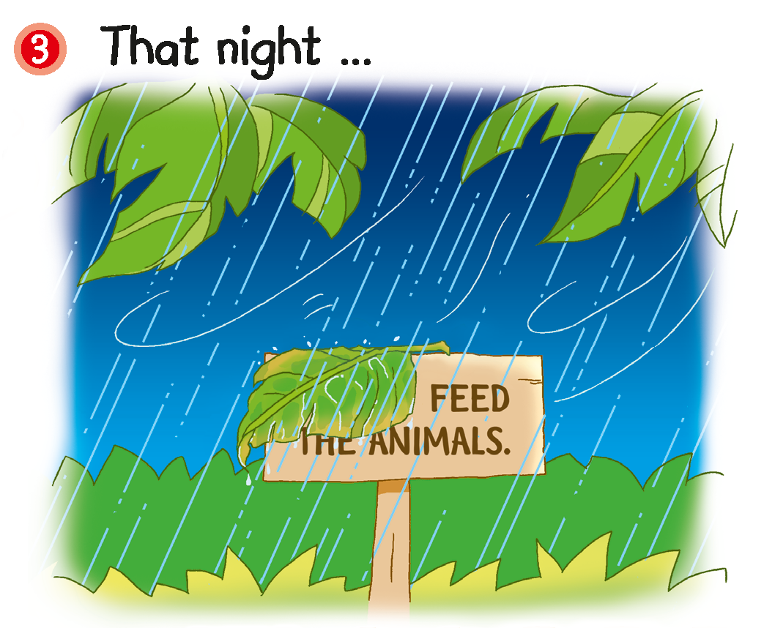
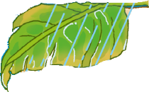
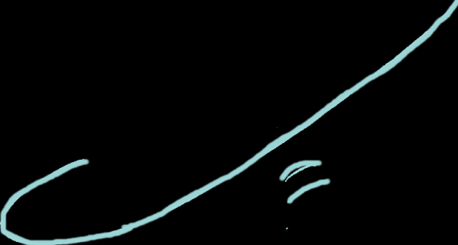
Notes:
Say Later at night, it rains! The wind blows. [Click to show the animation] A leaf falls on the sign.
Ask What does the sign say now? (Feed the animals.) Which words can’t we see? (DO NOT.) – observing / recalling

Slide 12
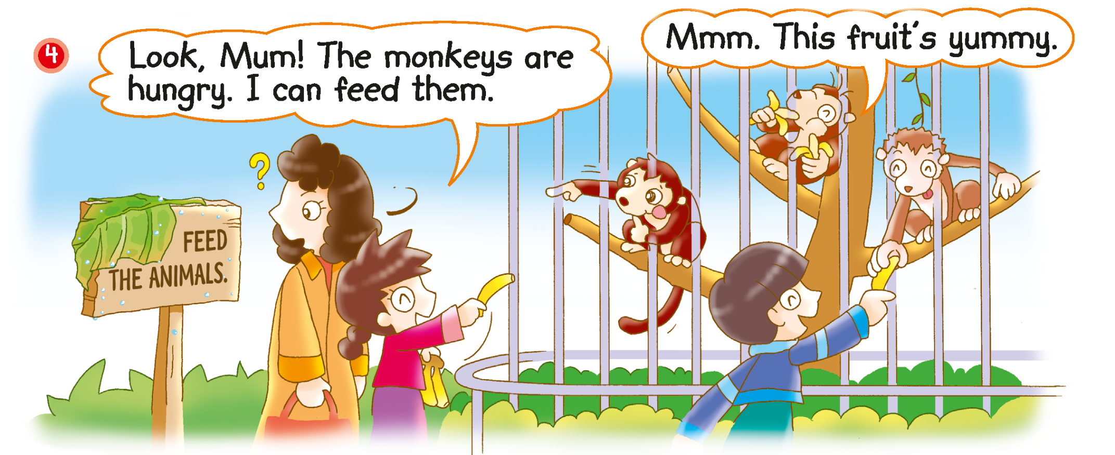
What sign do the people see?
Notes:
Say The next day, some people are in the park. [Click to show the question] Ask What sign do they see? (Feed the animals.) Can they see the words ‘DO NOT’? (No.) Point at the sign and ask Does this mean they can feed the monkeys? (Yes.) – observing / inferring
Rub your stomach with your hand and say The monkeys are hungry! The children feed the monkeys some bananas. [Click to circle the bananas] Mime a satisfied expression and say The monkeys say ‘Mmm. This fruit’s yummy.’ Make a thumbs-up gesture when you say the word ‘yummy’.

Slide 13
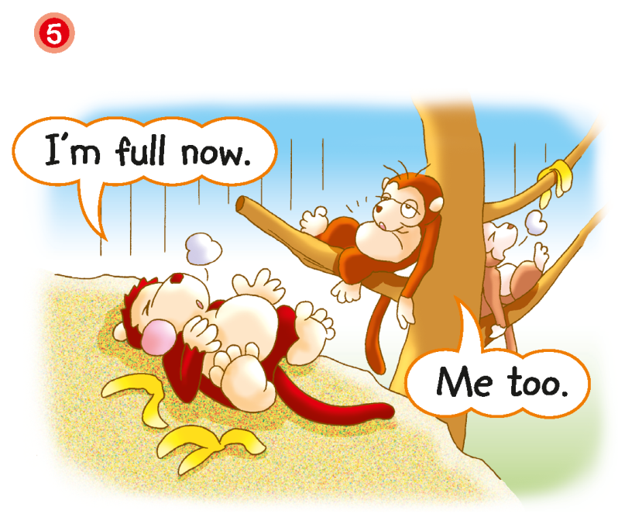
Are the monkeys hungry now?
Notes:
Say The monkeys like the bananas very much. They eat lots and lots of bananas. Look at the monkeys. They eat too much and can’t move.
[Click to show the question] Ask Are the monkeys hungry now? (No.) [Click to underline the answer] Use your hand to outline a full belly and say, The monkeys are full. They don’t want any more bananas.– inferring unknown words

Slide 14
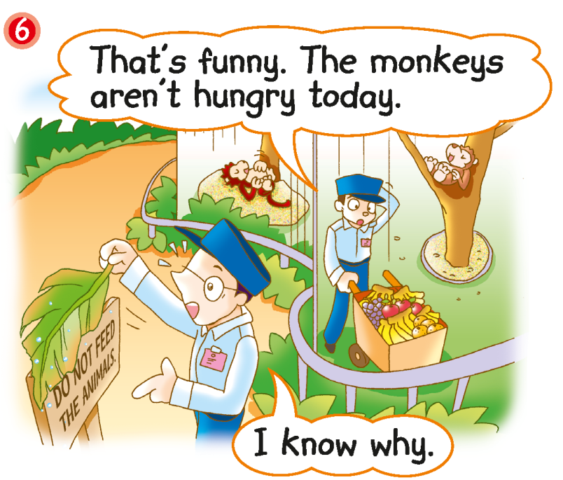
Notes:
21st century skill: Critical thinking
Say The park keepers are going to feed the monkeys. They have lots of fruit for the monkeys. [Click to circle the fruit]
Ask Are the monkeys eating the fruit? (No.) Why not? Are they hungry? (No.) Say That’s right. The monkeys are full! Use your hand to outline a full belly when you say the word ‘full’. – observing / inferring
[Click to show an arrow pointing towards the park keeper on the right] Scratch your head and mime a puzzled expression. Ask Does this park keeper know why the monkeys aren’t hungry? (No.) – inferring
[Click to show an arrow pointing towards the park keeper on the left] Ask What is this park keeper looking at? (The sign.) What does he say? (I know why.) Does he know why the monkeys are full? (Yes.) – observing / locating specific information
Click to show the post-reading question and read it aloud, How does the park keeper know? For less able pupils, you may prompt them by asking What does he see? (The sign.)

Slide 15
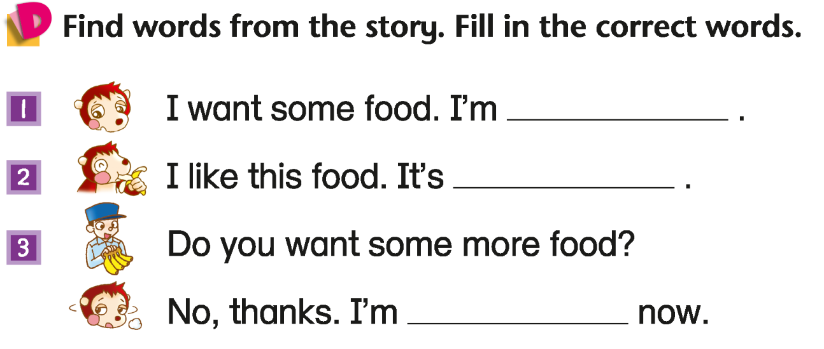
hungry
yummy
full
Answers
Notes:
Instruct pupils to complete Part D individually in their books. The activity can be completed in class or for homework.– inferring unknown words

Slide 16
Let’s do some more activities!
Post-reading

Slide 17
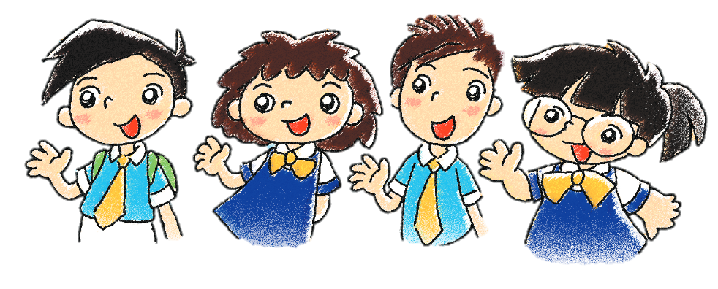
Readers’ theatre
Notes:
Put pupils into groups and assign each group a character. Ask each group to read their part aloud.

Slide 18
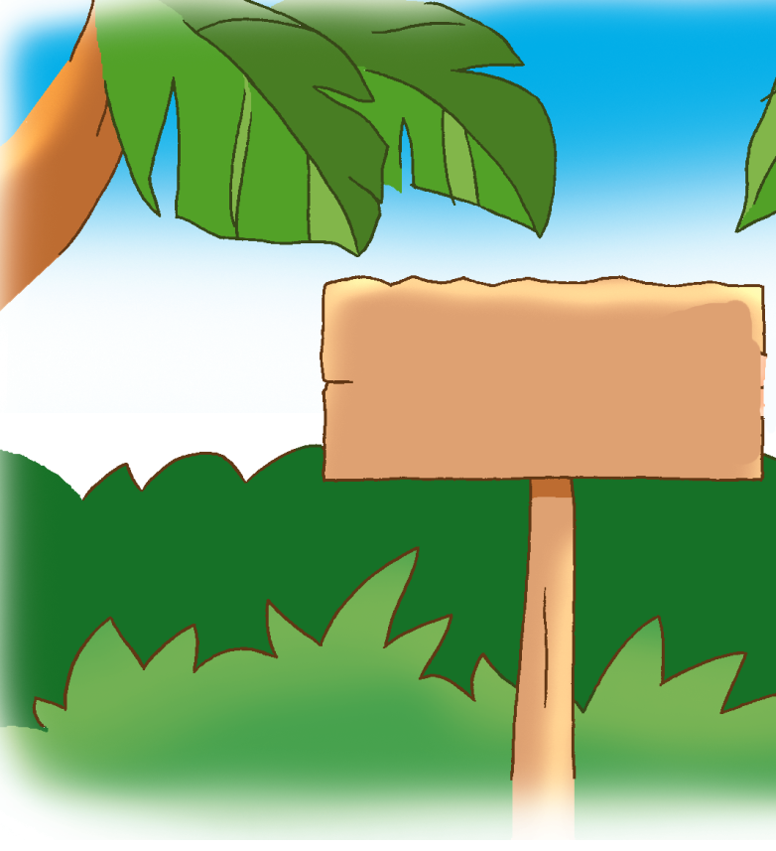
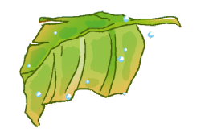
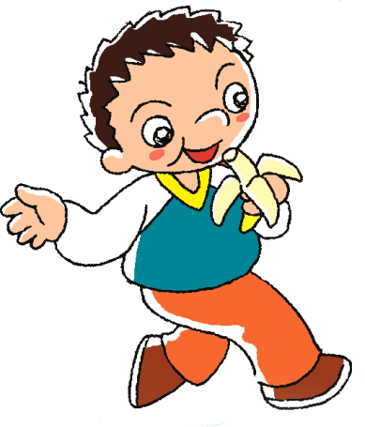
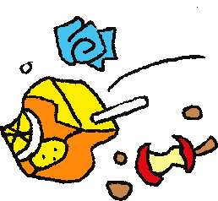
DO NOT THROW LITTER.
Notes:
Say Oh no! Look at the other signs in this park. We can’t see some words on them. Let’s see if you can remember the words!
Ask pupils to guess what each sign says. [Click to show each answer]

Slide 19
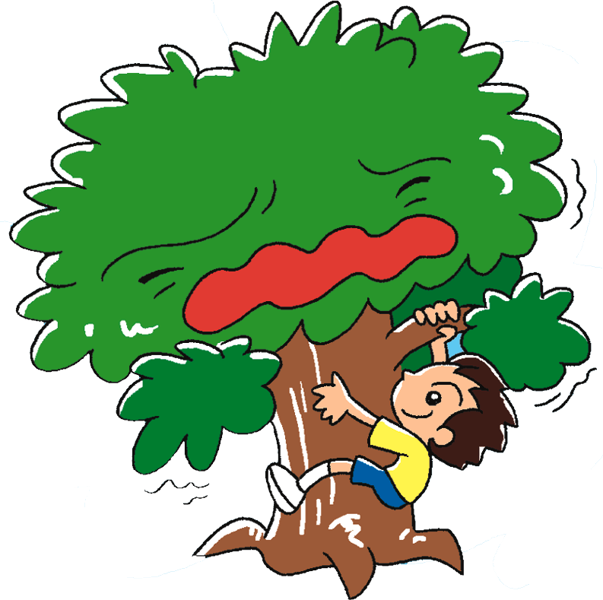
DO NOT CLIMB THE TREES.

Slide 20
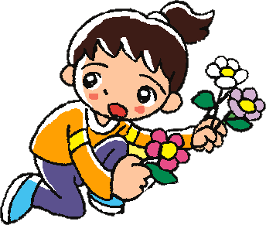
DO NOT PICK THE FLOWERS.

Slide 21
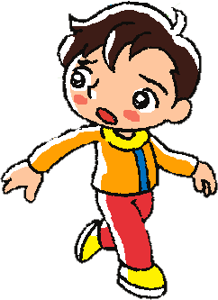
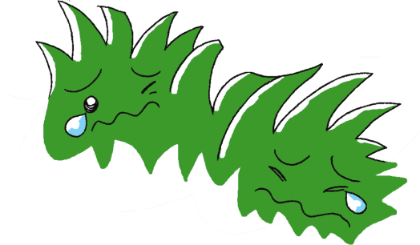
DO NOT WALK ON THE GRASS.

Slide 22
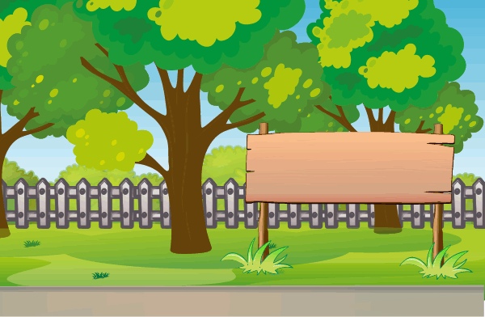
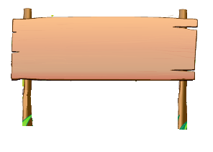
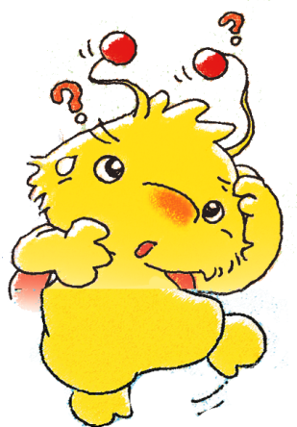
Do you know these signs?
Notes:
Say Beeno goes to a park. He sees some signs in the park. He doesn’t know what they mean. Let’s look at the signs.

Slide 23
Do not pick the flowers.
Do not bring your pets.
Do not walk on the grass.
Do not ride a bicycle.
Do not feed the animals.
Do not throw litter.
Notes:
Say Do you know what all of the signs mean? Can you tell Beeno what they mean?
Elicit the meanings of the signs from pupils. Allow pupils to guess the meanings of the new signs. [Click to show the meaning of each sign]
You can wrap up this activity by asking pupils if they know any other park rules.

