Slide 1
Reading Courseware
for Teachers
Chapter 6 Places in the park
Learn to Read

Slide 2
Functions | 21st Century Knowledge and Skills
Describing locations | Critical thinking / information literacy
Reading Skills
Giving personal responses to the text Making predictions / observations about the text / pictures Inferring meaning from the text Relating the text to self Locating specific information in response to questions

Slide 3
Reading
Pre-reading | – Introducing the setting
First reading | – Shared reading
Second reading | – Reading aloud – Activity 1: Assessment for learning
Post-reading | – Activity 2: Readers’ theatre – Activity 3: Complete the map – Activity 4: Find the characters

Slide 4
Today we are going to read a story. Let’s look at some pictures!
Pre-reading

Slide 5
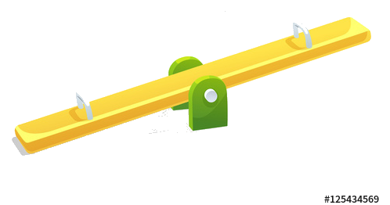
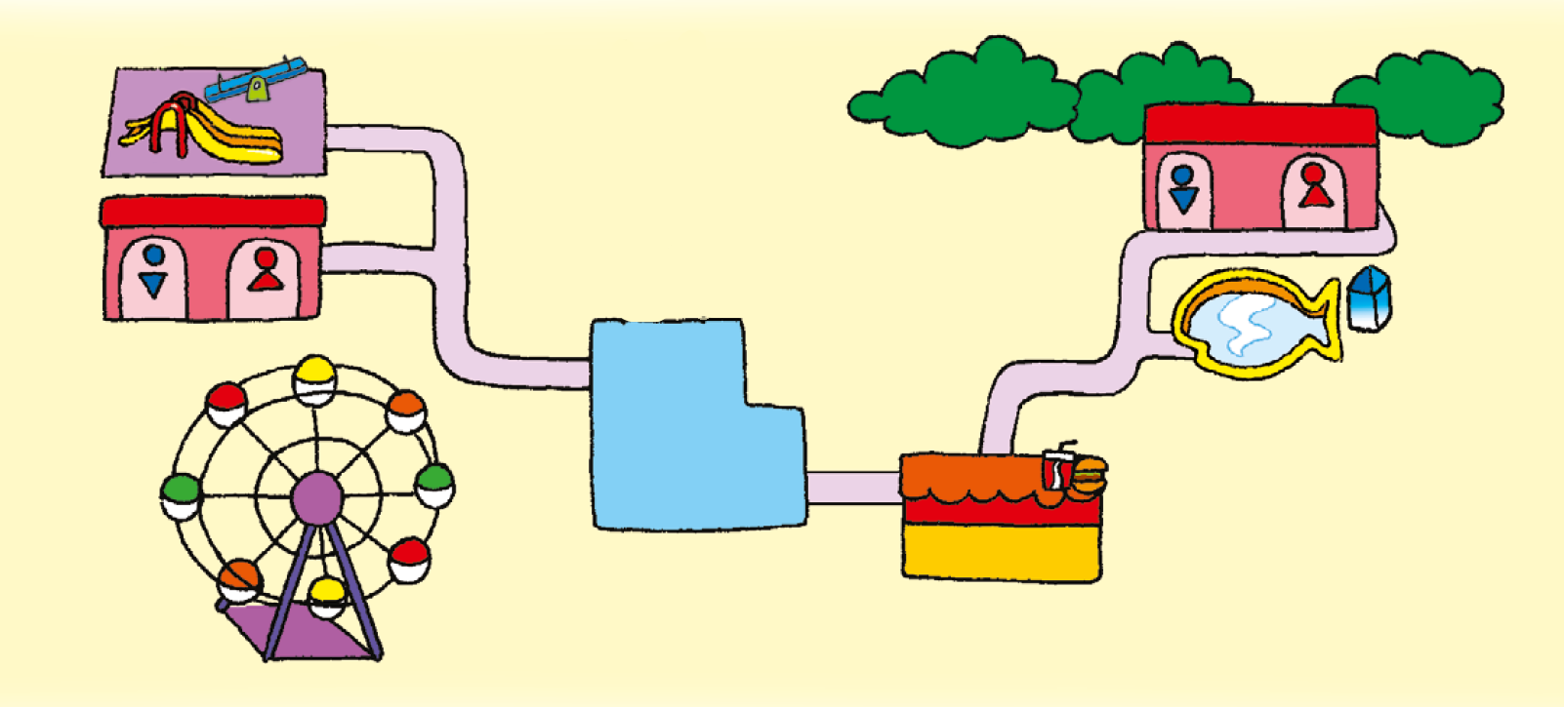
What places can you see?
Click on each place to see their names.
slide
see-saw
playground
toilets
toilets
pond
snack bar
Ferris wheel
Notes:
Say Today we are going to read a story about Charlie and Cherry. They are in the park with their parents.
Say Let’s look at the park. What places can you see? Ask pupils to recall the places in the park. Click on the pictures of the playground, snack bar, pond and toilets to reveal their names. Teach the new vocabulary ‘slide’, ‘see-saw’ and ‘Ferris wheel’ by clicking on the related pictures. Demonstrate how to say the words and drill pronunciation.
Ask What places do you go to in the park?– giving personal responses
Ask Where are Charlie and his family? (In front of the Ferris wheel.) Say Let’s look at what they are doing! – observing

Slide 6
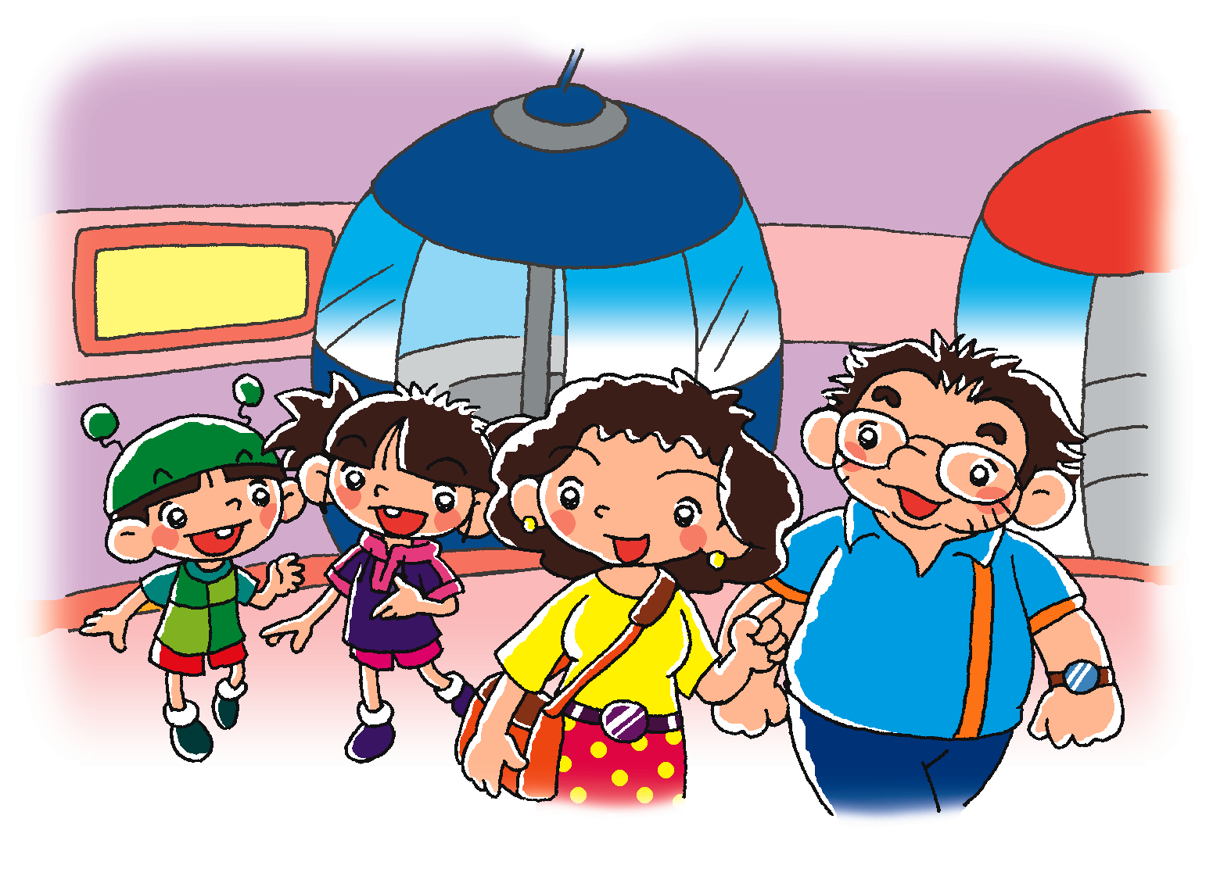
Charlie
Cherry
Do you go to the park with your mum and dad?
Mrs Chow
Mr Chow
Notes:
Say Charlie, Cherry and their dad and mum, Mr and Mrs Chow, are in the park. Ask Are Charlie and Cherry happy to go to the park? (Yes.) – inferring
[Click to show the question] Ask Do you go to the park with your dad and mum? Do you like going to the park? (Yes. / No.) – relating the text to self / giving personal responses

Slide 7
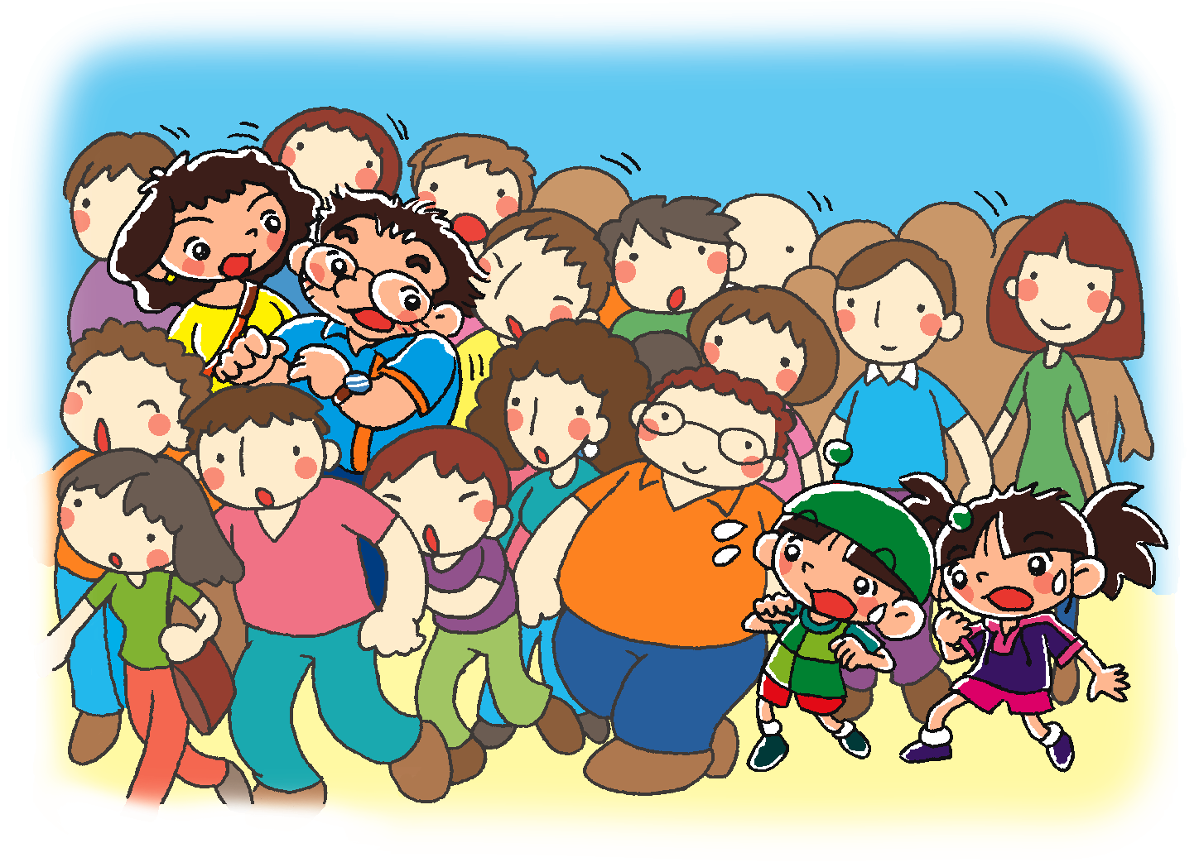
Charlie and Cherry can’t see their mum and dad!
Can you guess what happens next?
Notes:
Say Oh no, there are a lot of people in the park!
Ask Can you see Charlie and Cherry? Invite a pupil to come to the screen to point at them. [Click to circle Charlie and Cherry] Are they with their dad and mum? (No.) How do they feel? (e.g. Afraid / worried.) Can you see Mr and Mrs Chow? Invite a pupil to come to the screen to point at them. [Click to circle Mr and Mrs Chow] – observing / inferring
[Click to show the narration and the question] Say Charlie and Cherry can’t see their dad and mum! Ask Can you guess what happens next?– predicting
Say Let’s read the story and find out what happens to Charlie and Cherry.

Slide 8
Let’s read the story!
First reading

Slide 9
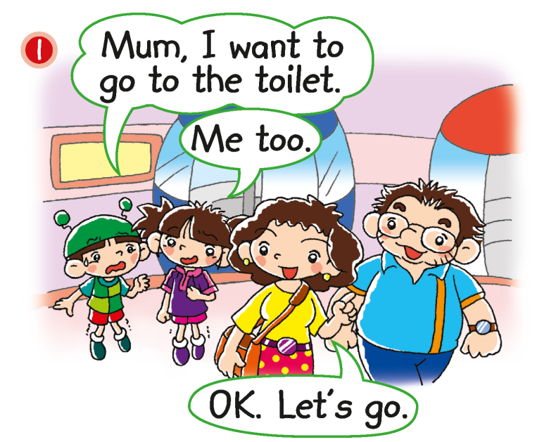
Where does Charlie want to go?
Does Cherry want to go to the toilet?
Notes:
Say Charlie and Cherry go to the park with their dad and mum.
[Click to show the question] Ask Where does Charlie want to go? (The toilet.) [Click to underline the answer] Does Cherry want to go to the toilet? (Yes.) How do you know? What does she say? (Me too.) [Click to underline the answer] – locating specific information

Slide 10
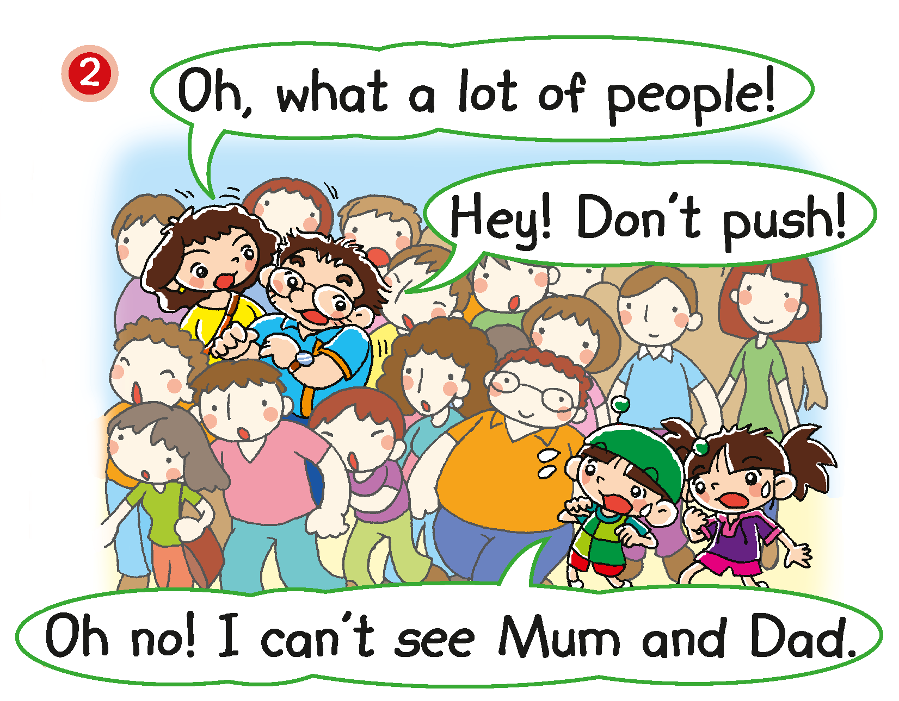
Notes:
Say The family goes to the toilets. Oh no! Look! There are a lot of people.
[Click to highlight ‘push’] Say There are a lot of people. They want to go on the Ferris wheel. Is that why they push? (Yes.) Use your hands to mime pushing when you say ‘push’. – inferring
Ask Where do Charlie and Cherry want to go? (The toilets.) Where do their dad and mum want to go? (The toilets.) Do you think Charlie and Cherry can meet their dad and mum at the toilets? (Yes. / No.) – recalling / predicting

Slide 11
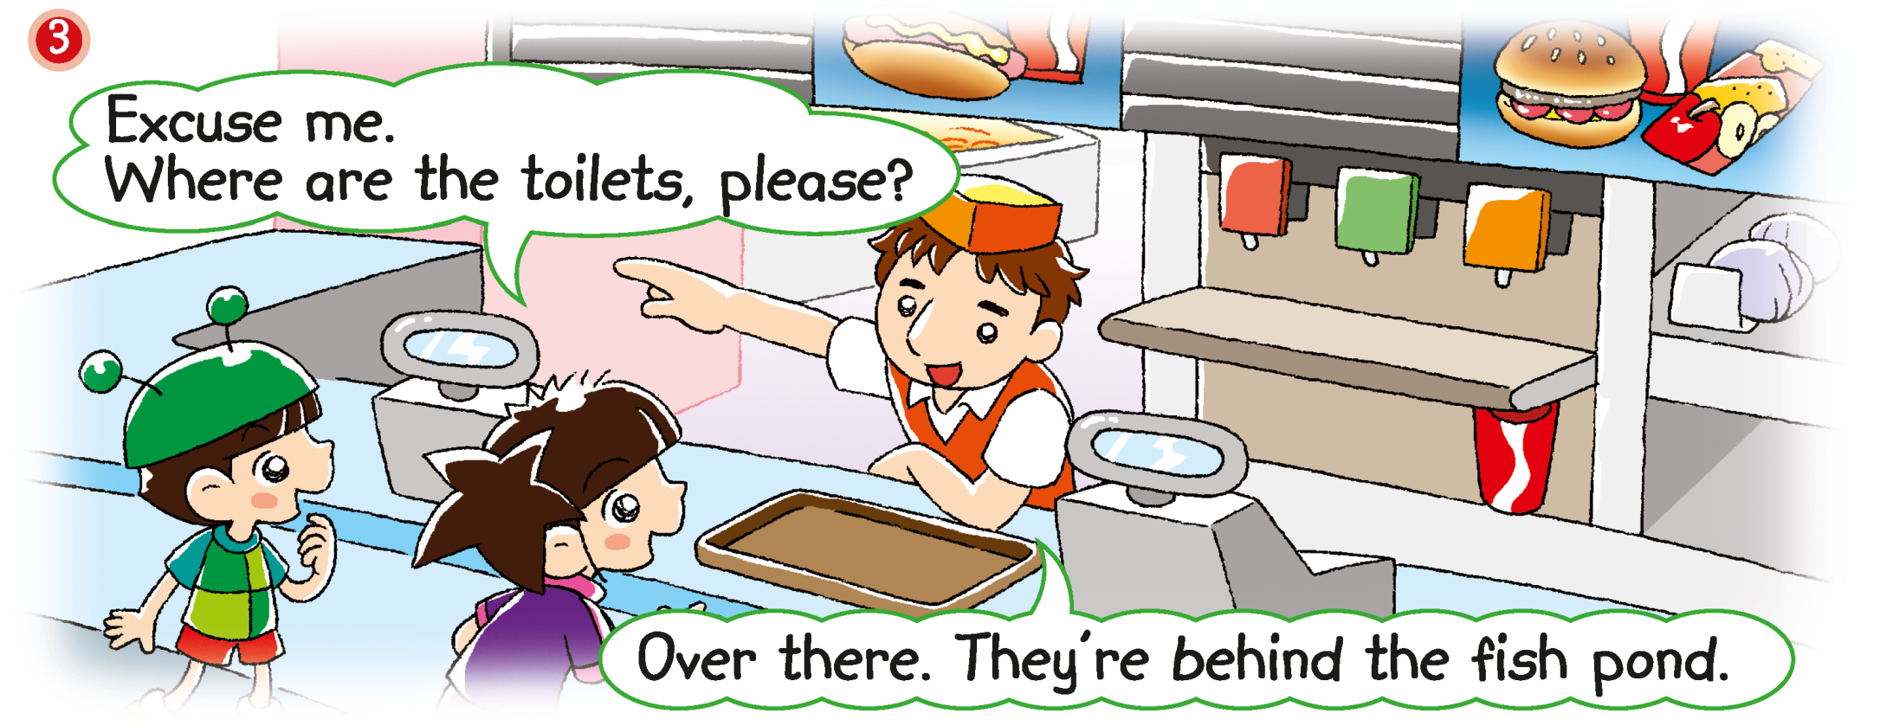
Where are Charlie and Cherry?
Where are the toilets?
Notes:
Say Charlie and Cherry don’t know where the toilets are, so they ask someone.
[Click to show the question] Ask Where are Charlie and Cherry? (At the snack bar.) [Click to show the question] Where are the toilets? (Behind the fish pond.) [Click to underline the answer] – observing / locating specific information

Slide 12
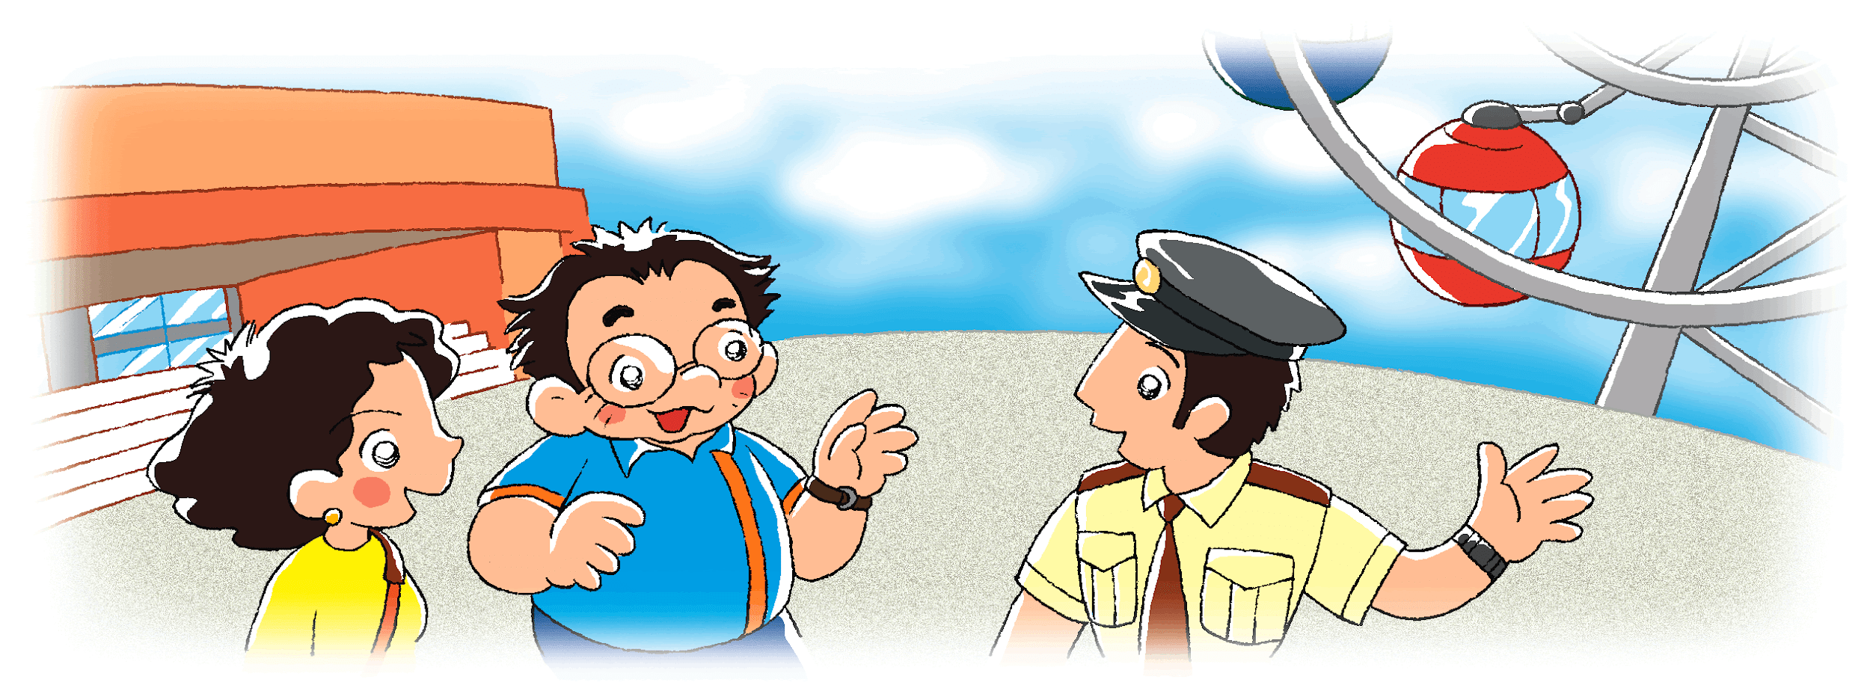
Where are Mr and Mrs Chow?
Where are the toilets?
Notes:
Say Mr and Mrs Chow also ask someone where the toilets are.
[Click to show the question] Ask Where are Mr and Mrs Chow? (In front of the Ferris wheel.) [Click to show the question] Where are the toilets? (In front of the see-saw and the slide.) [Click to underline the answer] – observing / locating specific information

Slide 13
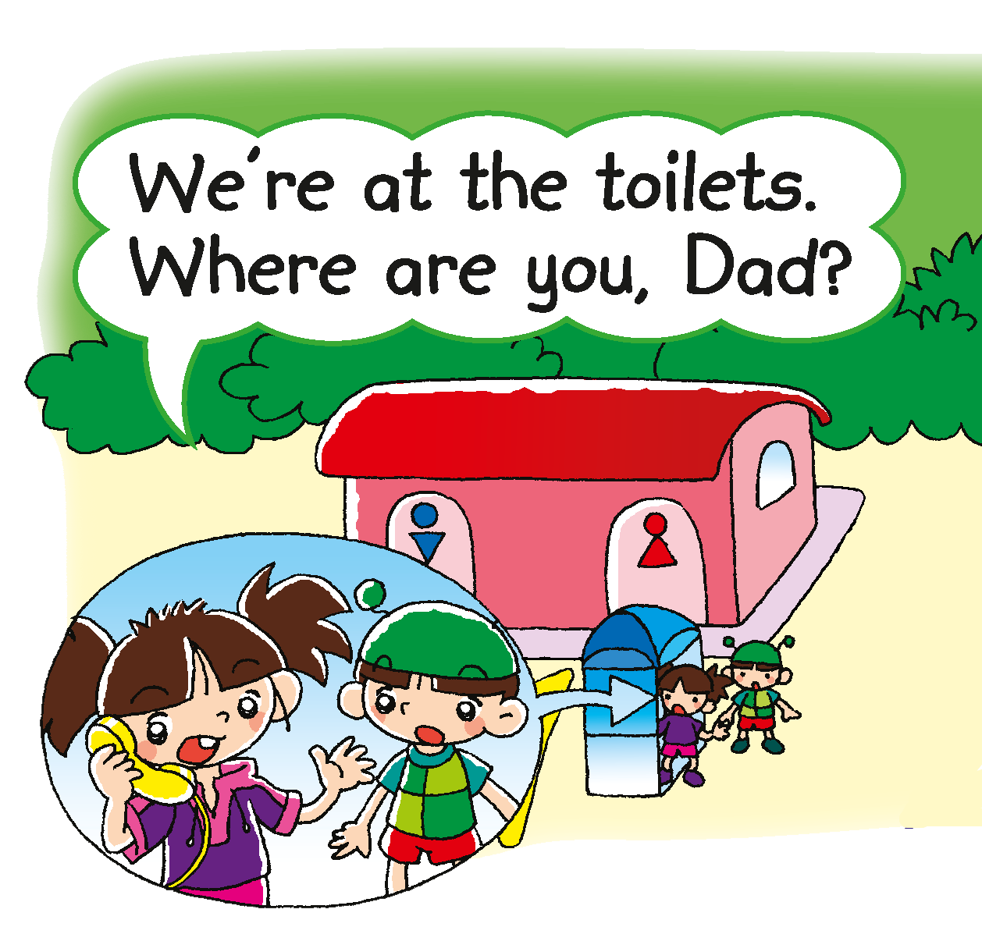
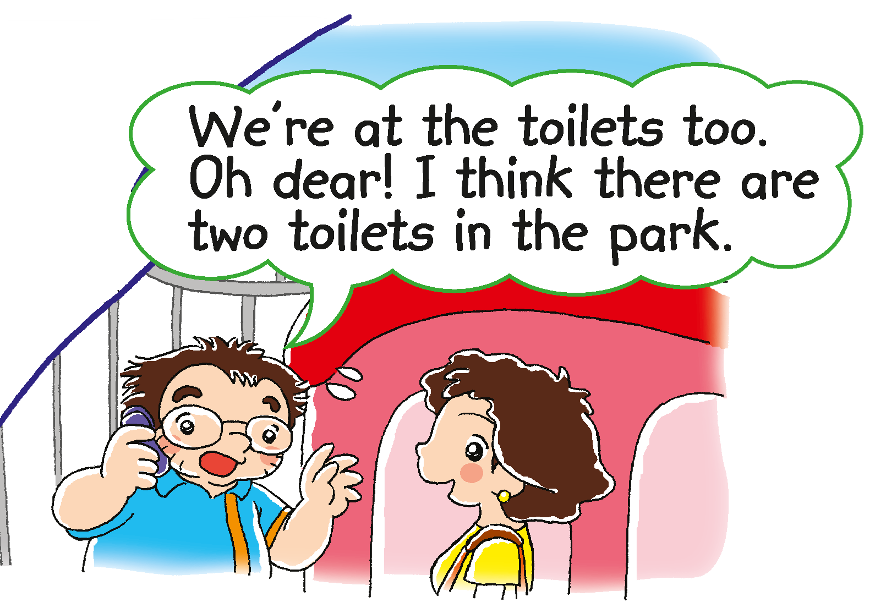
Why can’t Charlie and Cherry see their mum and dad?
Notes:
21st century skill: Critical thinking
Say Charlie and Cherry are at the toilets. Are their dad and mum at the toilets too? (No.) Charlie and Cherry can’t see their dad and mum. They call their dad and mum. Mime holding a phone to your ear when you say ‘call’. – observing
[Click to show the second picture] Ask Where are their dad and mum? (At the toilets.) [Click to show the question] Why can’t Charlie and Cherry see them? (There are two toilets. / They are not at different toilets.) [Click to underline the answer] – locating specific information / inferring
[Click to show the post-reading question] Read the question aloud, How can Mr and Mrs Chow find Charlie and Cherry? (e.g. Ask someone. / Look at the map of the park.) For less able pupils, you may prompt them by asking Can Mr and Mrs Chow ask someone? (Yes.) / Can Mr and Mrs Chow look at the map of the park? (Yes.)

Slide 14
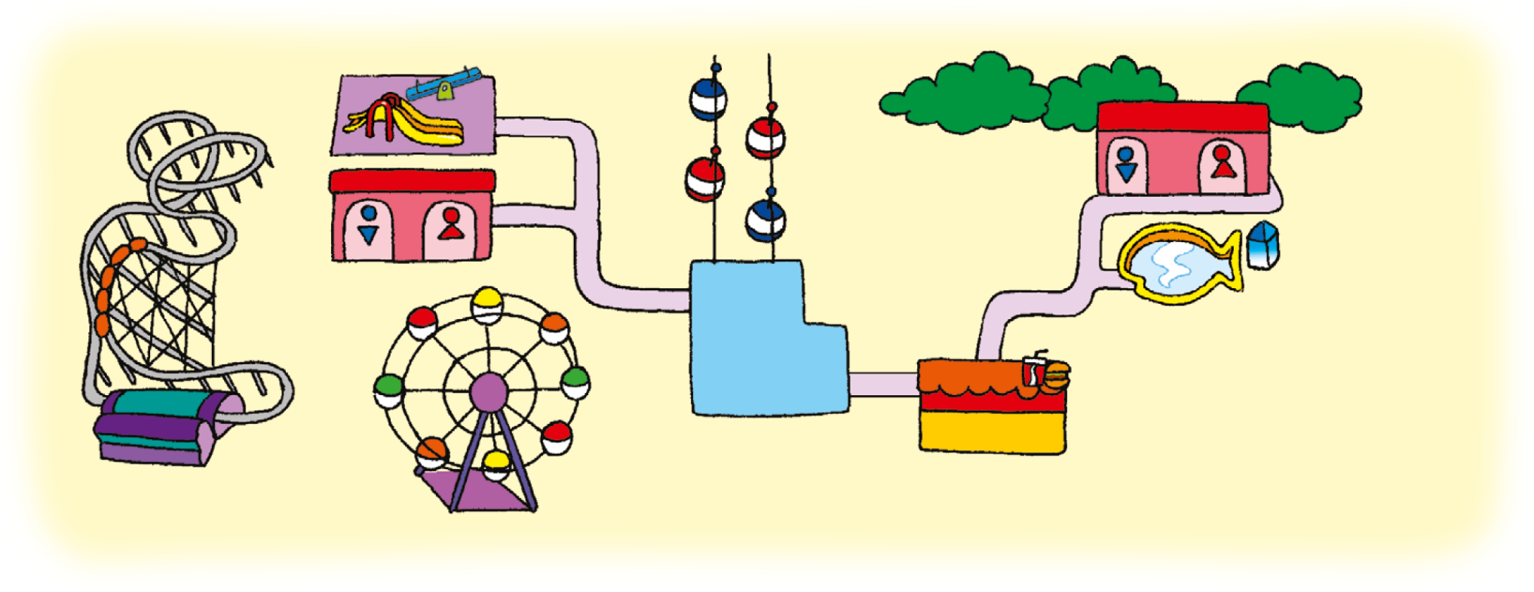
Answers
Notes:
21st century skill: Information literacy
Instruct pupils to complete Part D individually in their books. The activity can be completed in class or for homework.

Slide 15
Let’s do some more activities!
Post-reading

Slide 16
Readers’ theatre
Notes:
Put pupils into groups and assign each group a character. Ask each group to read their part aloud.

Slide 17
Where’s the ___________ ?
?
?
?
Park A
You are here.
Notes:
21st century skill: Information literacy
Prepare sets of complete and torn maps of Park A as shown on Slides 18 – 19.
Tell pupils that the map of Park A is torn and some places are missing. Put pupils into groups of four. Ask one pupil in each group to act out the role of the park keeper. Give each park keeper a complete map. Give the other pupils of each group some torn maps. Point at the missing place in the question at the top of the map on the slide. Demonstrate how to ask the park keeper questions and have one pupil answer you, e.g. Where’s the fish pond? (It’s behind the playground.)
Instruct pupils to do the activity. Go around the class to check pupils’ understanding. At the end of the activity, click on the question marks on Slide 18 to show the answers.
You can also do this activity again by using Park B on Slides 20 – 21.

Slide 18
Park A
You are here.

Slide 19
Where’s the ______________ ?
?
?
?
Park B
You are here.

Slide 20
Park B
You are here.

Slide 21
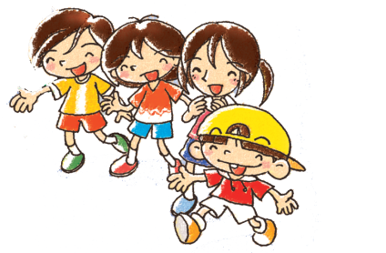
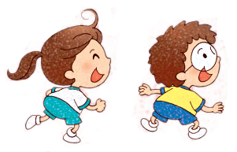
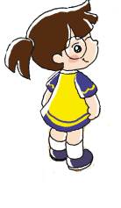
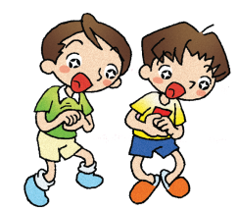
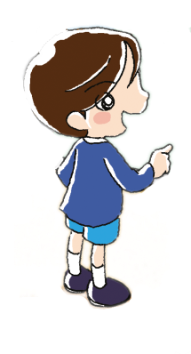
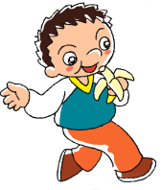
Notes:
21st century skill: Information literacy
Say The children go to the park with their teacher. But there are a lot of people in the park! Their teacher can’t find some of the children. Let’s help her find the children.
Prepare cutouts of some of the characters on the slide. Stick them on the board one at a time. Pupils have to find each character in the park and describe each character’s location, e.g. He’s / She’s in front of the snack bar. Pupils win a point for each correct answer.

