Slide 1
Reading Courseware
for Teachers
Storytime
Hard Life Farm

Slide 2
Functions | 21st Century Knowledge and Skills | Values and Attitudes
Expressing feelings | Civic literacy | Being kind
Reading Skills
Making guesses/predictions about the text Inferring meaning from the text Relating the text to self Inferring unknown words from contextual/pictorial cues Locating specific information in response to questions

Slide 3
Reading
Pre-reading | – Doing a picture walk
First reading | – Shared reading
Second reading | – Reading aloud
Post-reading | – Activity 1: Readers’ theatre – Activity 2: Sort the words – Activity 3: Find the pairs – Task

Slide 4
Today we are going to read a story. Let’s look at some pictures!
Pre-reading

Slide 5
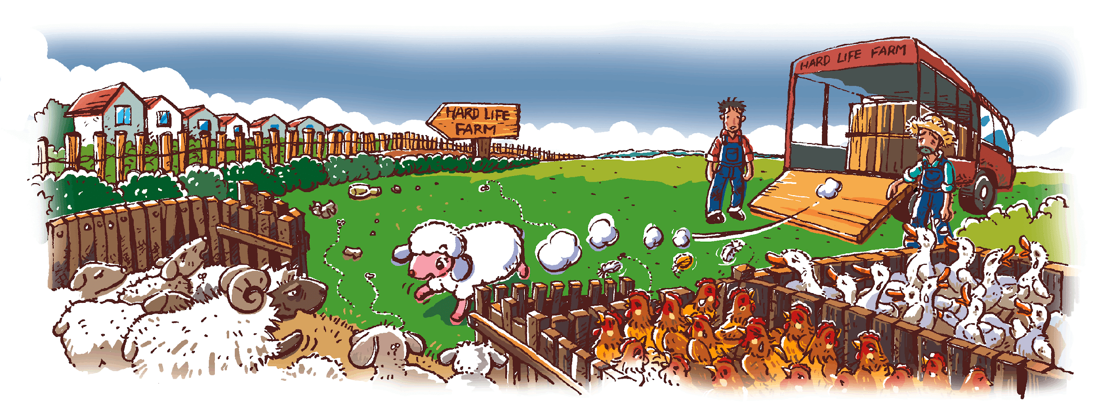
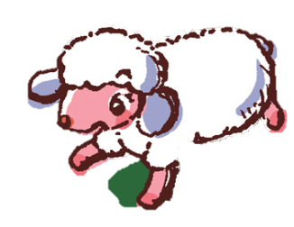
Is Hard Life Farm a happy farm?
Notes:
Say Today we are going to read a story. It is called ‘Hard Life Farm’. Ask Can you guess what the story is about?–guessing
Say Let’s look at Hard Life Farm. What animals do you see? (Sheep, chickens, ducks.) Point out to pupils that the plural form of ‘sheep’ remains ‘sheep’. – eliciting information / observing
Say Look at the farm. Ask Can you see the litter on the farm? Invite a pupil to come to the screen to point at the litter. Say There is a lot of litter on the farm. It is very dirty.
Say Let’s look at the animals. Ask Do they look happy? (No. They look sad.) [Click to show the question] Is Hard Life Farm a happy farm? Can you guess? (Yes. / No.) – observing / guessing
[Click to show the new sheep] Say Look. A new sheep comes to the farm. Her name is Jenny. She wants to know more about the farm.

Slide 6
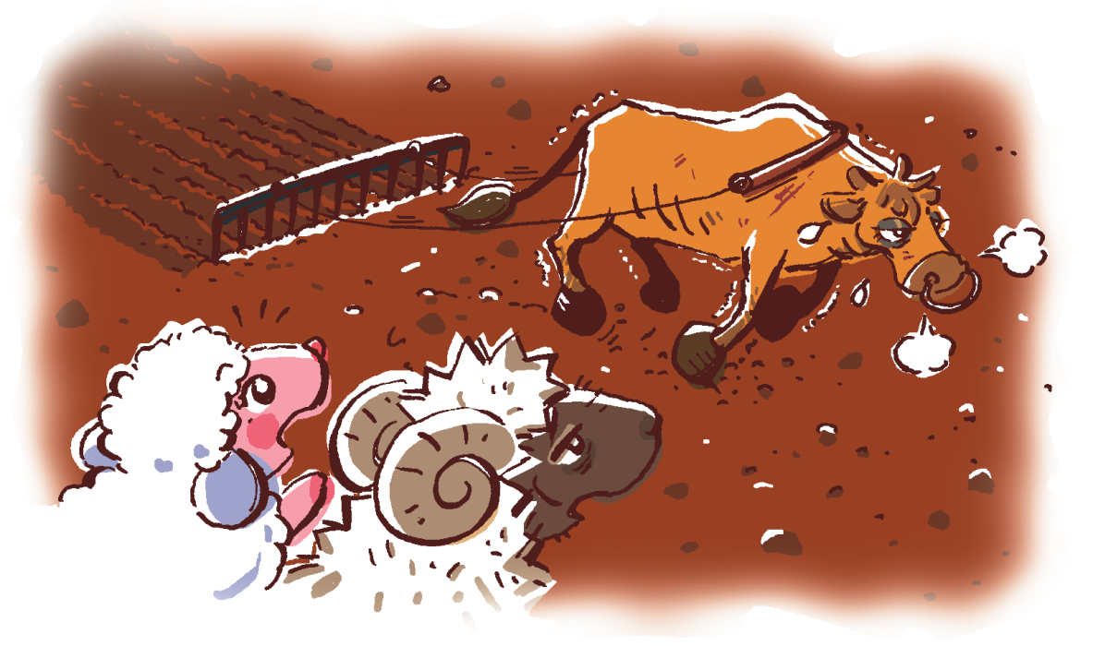
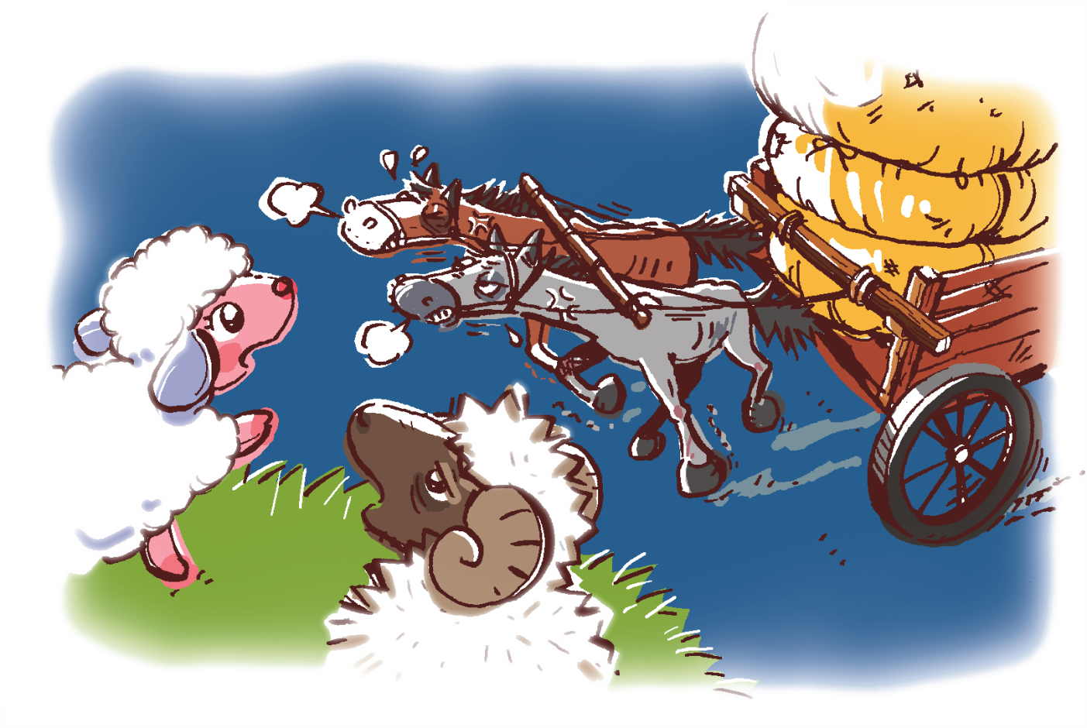
The sheep are looking around the farm.
Are the animals working hard?
Notes:
Say Now the sheep are looking around the farm. Ask What animals do the sheep see? (A cow and two horses.) [Click to show the question] Are the animals working hard? (Yes.) Do they look happy? (No.) – observing

Slide 7
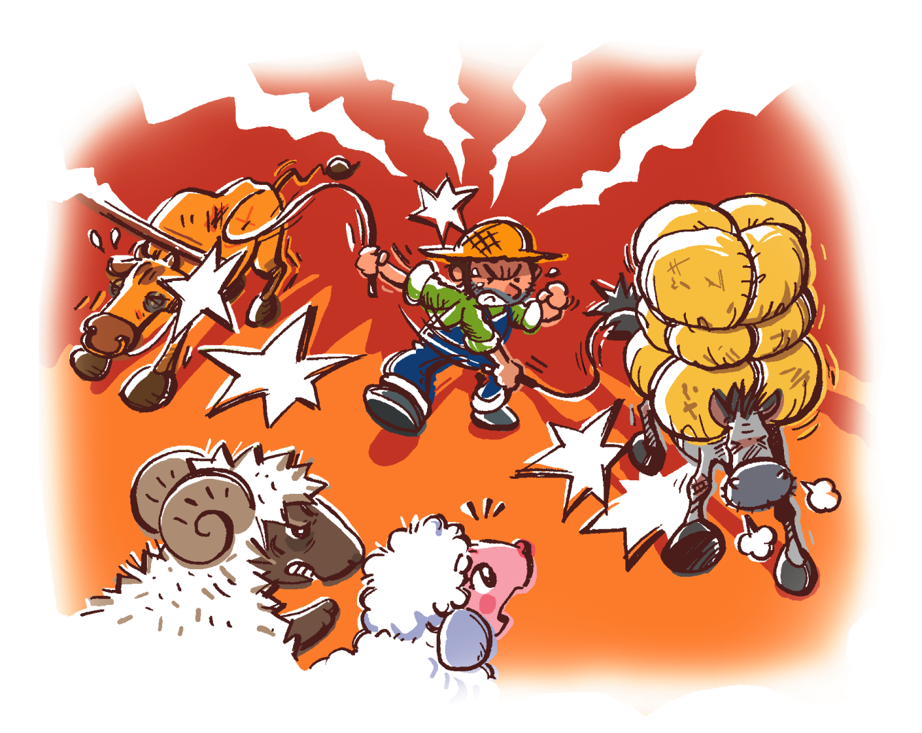
Is Farmer Lee kind?
Do you want to live on Hard Life Farm?
Notes:
Say Then the sheep see Farmer Lee. [Click to circle Farmer Lee] Oh no! He is hitting the animals! Ask Is Farmer Lee kind? (No. He is unkind.) – inferring
Say Farmer Lee is unkind to the animals. He makes them work very hard. The animals have a hard life on Hard Life Farm. [Click to show the question] Ask Do you want to live on Hard Life Farm? (No.) – relating the text to self

Slide 8
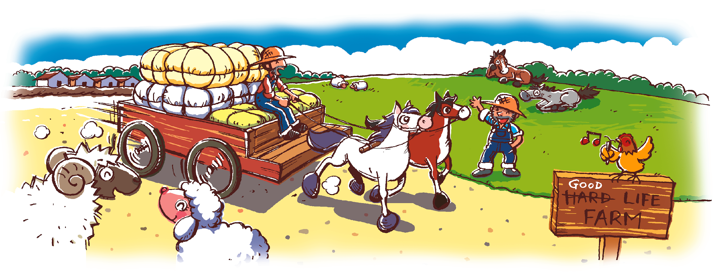
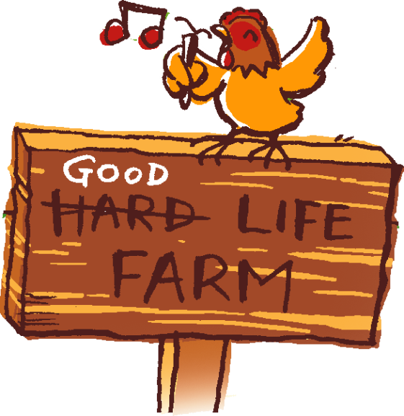
Something happens to the farm.
How does Hard Life Farm become Good Life Farm?
Is Good Life Farm a happy farm?
Notes:
Say In the story, something happens to the farm. Point at the sign and ask What is the new name of the farm? (Good Life Farm.) Direct pupils’ attention to the animals, in particular the singing chicken and the resting horses. Ask Do the animals look happy now? (Yes.) [Click to show the question] Is Good Life Farm a happy farm? (Yes.) [Click to show the question] Mime thinking aloud and ask How does Hard Life Farm become Good Life Farm? Can you guess?– observing / inferring / predicting
Say Let’s read the story and find out what happens.

Slide 9
Let’s read the story!
First reading

Slide 10
Who is the new sheep?
There is a lot of litter on this farm. It is
very …
Notes:
[Click to show the question] Ask Who is the new sheep? Is that Andy or Jenny? (Jenny.) [Click to circle the new sheep] – verifying
[Click to show the question] Say There is a lot of litter on this farm. It is very … (Dirty.) [Click to highlight ‘dirty’] – inferring unknown words

Slide 11
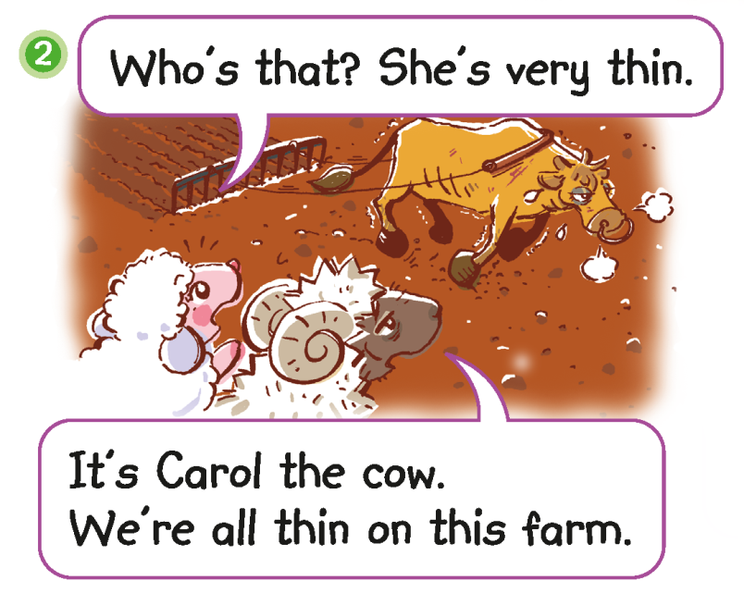
Why are the animals thin?
Notes:
Say Andy and Jenny look around the farm. They see a cow.
[Click to highlight ‘thin’] Mime thinking aloud and ask Why are the animals thin? Do they work very hard? (Yes.) Do they have lots of food to eat? (No.) – inferring

Slide 12
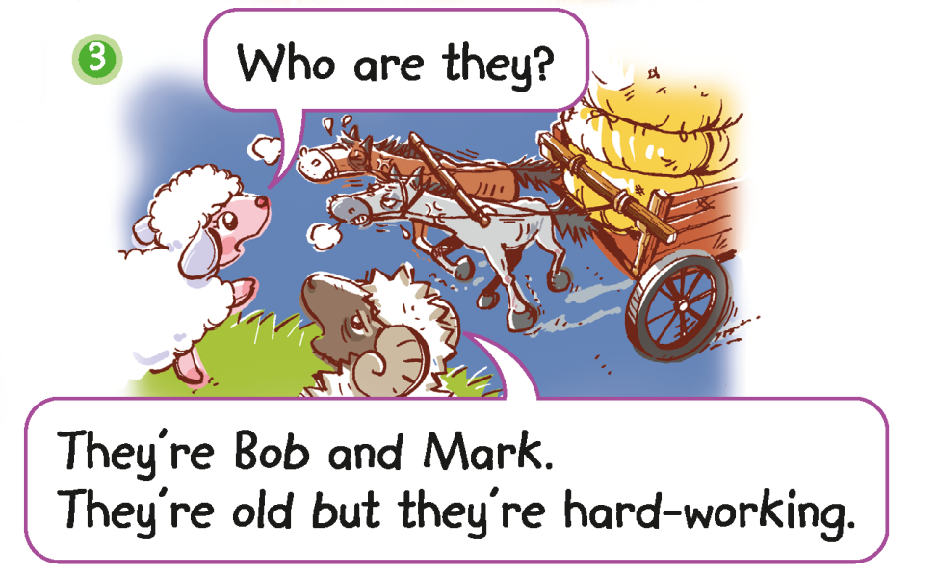
The animals work hard.
Notes:
Say Then the sheep see two horses working very hard.
[Click to highlight ‘hard-working’] Ask Can you guess what this means? (They work hard.) [Click to show the narration] That’s right. The horses, Bob and Mark, work hard. They are hard-working. [Click to show the picture] Ask Does Carol the cow work hard too? (Yes.) Say Yes, Carol is hard-working too. All the animals on the farm are hard-working. – inferring unknown words

Slide 13
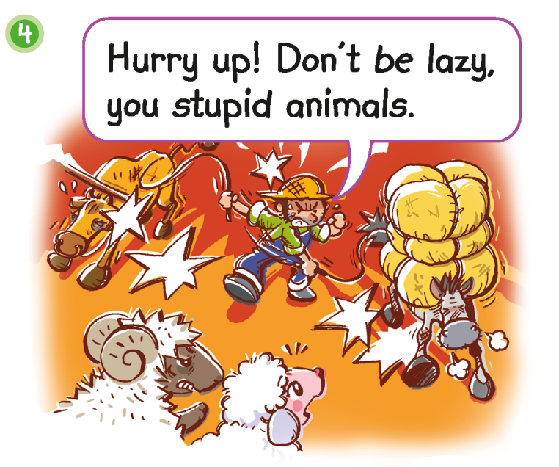
Is Farmer Lee kind?
Notes:
Say The sheep see Farmer Lee with Bob and Mark.
Say Farmer Lee says the animals are lazy and stupid. [Click to highlight the words] Ask Is it nice to say ‘lazy’ and ‘stupid’? (No.) That’s right. It is unkind to say these words. [Click to show the question] Ask Is Farmer Lee kind? (No. He is unkind.) – inferring

Slide 14
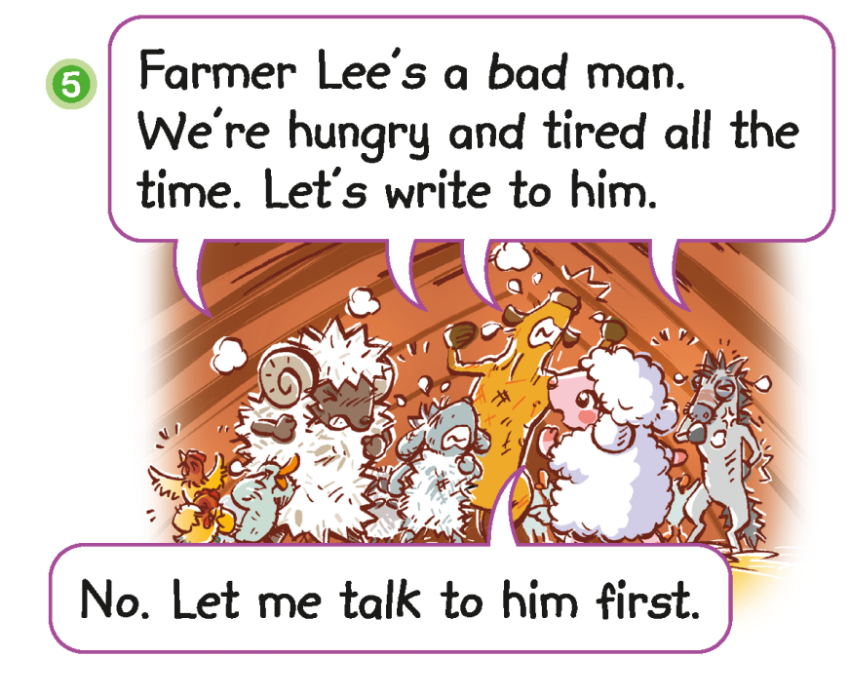
What do the animals want to tell Farmer Lee?
What does Jenny want to do?
Notes:
Say At night, the animals talk to each other. They don’t like Farmer Lee. They work very hard and they are hungry and tired. Mime a tired expression and slump your shoulders when you say ‘tired’.
Say They think Farmer Lee is a bad man. Why? (He is unkind.) [Click to show the question] What do the animals want to tell Farmer Lee? (They are hungry and tired all the time.) [Click to underline the answer] Do they want him to be kind? (Yes.) What does Jenny want to do? (Talk to Farmer Lee.) [Click to underline the answer] Do you think that’s a good idea?– inferring / locating specific information

Slide 15
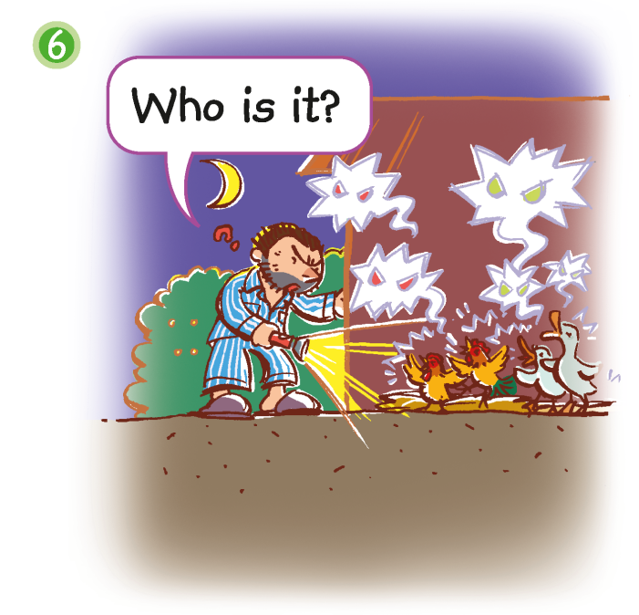
Farmer Lee hears a noise.
Notes:
Say Farmer Lee hears a noise. He comes to see who is talking.

Slide 16
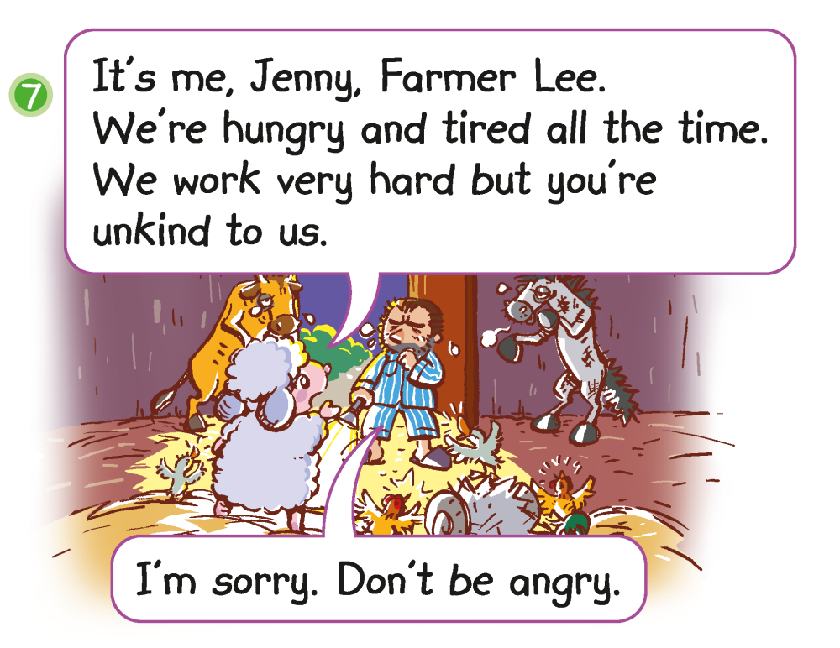
How does Farmer Lee feel?
Notes:
Say Jenny and the animals talk to Farmer Lee. They tell Farmer Lee how they feel.
[Click to show the question] Ask How does Farmer Lee feel? (e.g. Sad, sorry.) How do you know? (He says, ‘I’m sorry.’) [Click to underline the answer] Will he be kind now? (Yes. / No.) Say Let’s find out. – inferring / supporting / predicting

Slide 17
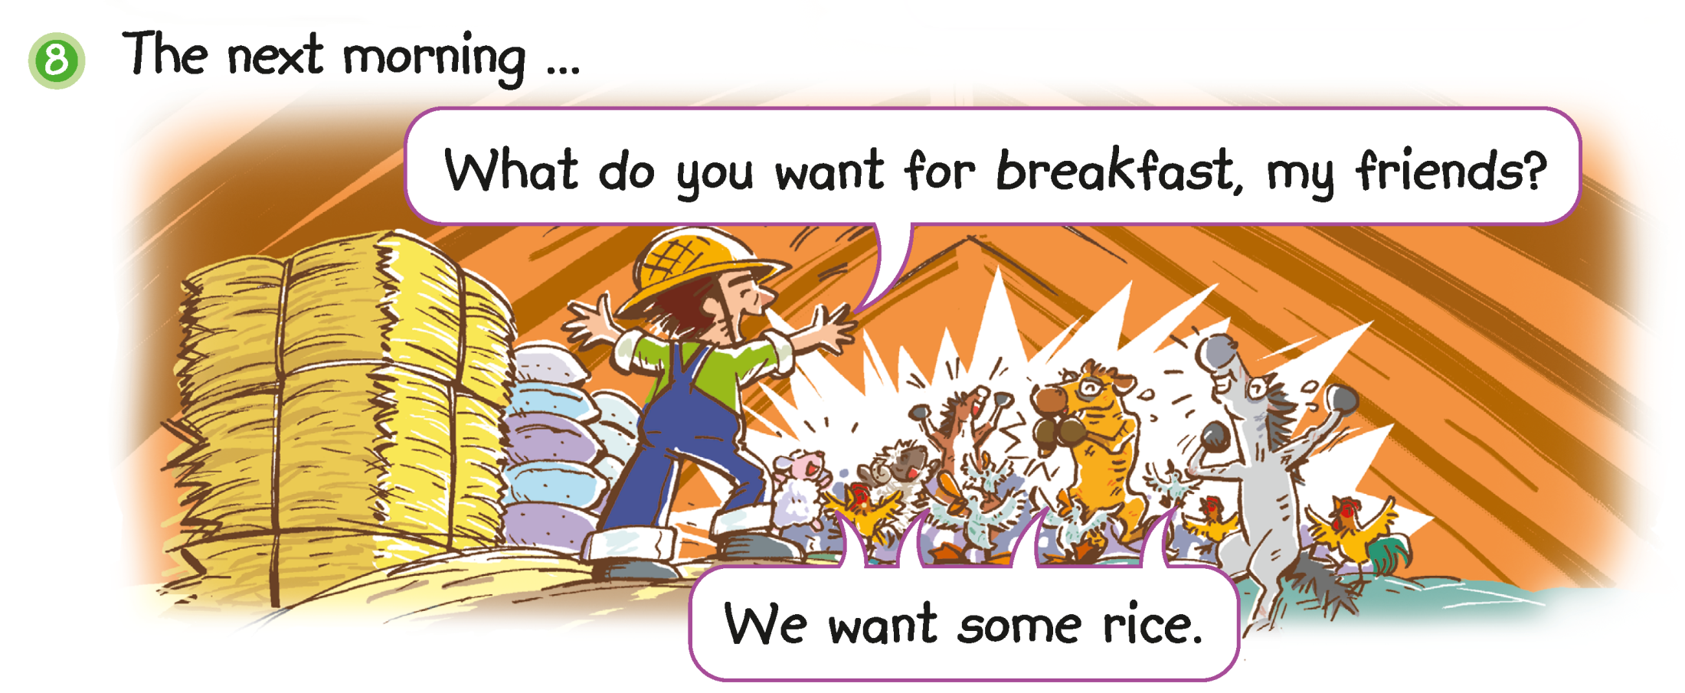
Is Farmer Lee kind or unkind now?
Notes:
Say The next morning, Farmer Lee wants to give the animals a good breakfast.
[Click to show the question] Ask Is Farmer Lee kind or unkind now? (Kind.) Are the animals happy? (Yes.) – inferring

Slide 18
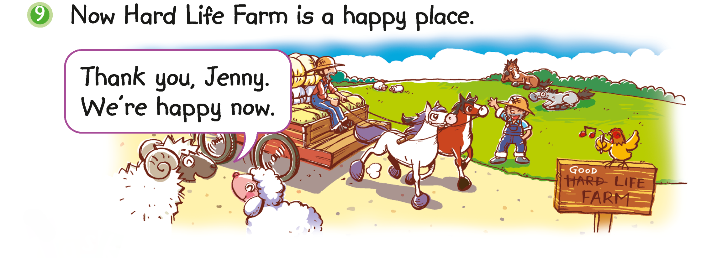
Are the animals happy on Good Life Farm?
Notes:
Say Hard Life Farm becomes Good Life Farm.
[Click to show the question] Ask Are the animals happy on Good Life Farm? (Yes.) [Click to underline the answer] Is Farmer Lee kind on Good Life Farm? (Yes.) Do the animals have a hard life or a good life now? (Good life.) – locating specific information / inferring

Slide 19
Let’s do some more activities!
Post-reading

Slide 20
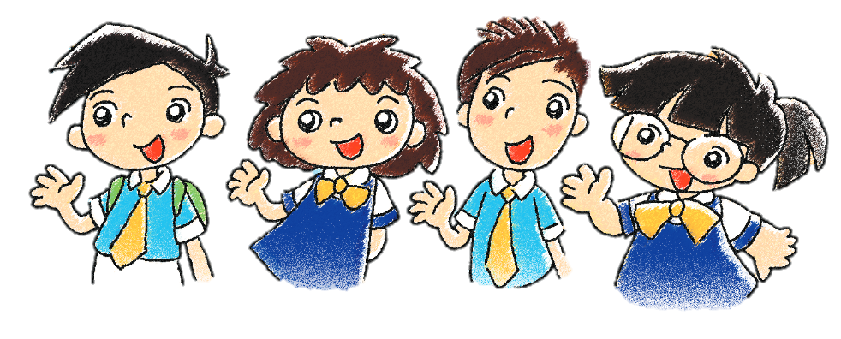
Readers’ theatre
Notes:
Put pupils into groups and assign each group a character. Ask each group to read their part aloud.

Slide 21
Hard Life Farm
Good Life Farm
unkind
happy
hungry
kind
tired
dirty
thin
angry
Answers
Notes:
21st century knowledge: Civic literacy / Value: Being kind
Stick the table of Hard Life Farm and Good Life Farm on the board (Slide 22). Ask Do you remember the characters on Hard Life Farm and Good Life Farm? Can you describe them?
Invite pupils to come to the board to stick the cutouts ‘unkind / hungry / tired / dirty / thin / angry’ (Hard Life Farm) and ‘happy / kind’ (Good Life Farm) under the correct columns.
You can also get pupils to do this activity in groups.

Slide 22
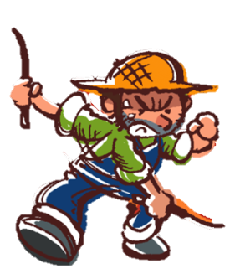
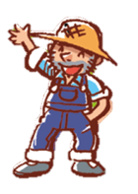
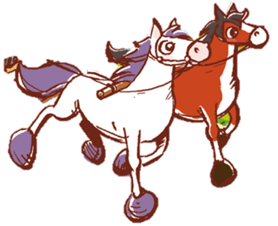
clean, good life
dirty, hard life
Hard Life Farm
Good Life Farm
unkind
kind
thin, hungry, tired, angry
healthy, happy
Notes:
Explain to pupils that on Hard Life Farm, the animals have a hard life because Farmer Lee is unkind. Ask pupils to recall how unkind Farmer Lee is (e.g. He doesn’t give them enough food. / He makes them work very hard. / He hits animals.) Thus, the animals are thin, hungry, tired and angry. On Good Life Farm, the animals have a good life because Farmer Lee is kind. Thus, the animals are healthy and happy. Ask pupils to recall how kind Farmer Lee is. (e.g. He makes animals breakfast. / He takes care of the animals.)
Ask Which farm do you want to live on – Hard Life Farm or Good Life Farm? – relating the text to self

Slide 23
1
2
3
4
5
hard-working
bad
kind
fat
thin
6
7
8
9
10
hungry
unkind
full
good
lazy
Notes:
Tell pupils that they are going to play a matching game. Instruct pupils to find the matching as listed below. Say There are five pairs of opposite words on these cards. For example, fat and thin. Let’s find them. Invite pupils to take turns to choose two cards at a time, e.g. Card 1 and Card 3. Click on the little blue triangle at the bottom left corner of each card to reveal the cards. If the cards do not match, click again on the little blue triangle to conceal the second card the pupil chose. Ask the pupil to choose another card until the matching card is found. Repeat the above procedure until all the cards have been matched.
1. thin – fat
2. hungry – full
3. lazy – hardworking
4. kind – unkind
5. good – bad

Slide 24
Notes:
In groups, pupils write a letter to Farmer Lee to express their feelings and needs.
Instruct pupils to read the story again individually up to Picture 5. While reading, pupils should make notes about life on the farm in Part A on p.2 of the Task Sheets.
Then tell pupils that they are the animals on the farm. Instruct them to write what they want for breakfast in Part B on p.2 of the Task Sheets.
Put pupils into groups. Instruct each group to write a letter to Farmer Lee to express their feelings and needs in Part C on p.3 of the Task Sheets. Say In the story, Jenny and her friends want to write to Farmer Lee. What do they want to say to Farmer Lee?

