Slide 1
Reading Courseware
for Teachers
Chapter 4 More about animals
Learn to Read

Slide 2
Functions | 21st Century Knowledge and Skills
Describing wild animals: appearance, abilities Talking about what animals are doing | Critical thinking Civic literacy
Reading Skills
Giving personal responses to the text Inferring meaning from the text Making observations from pictures Supporting inferences or judgments about the text with reasoning Verifying information and ideas in the text

Slide 3
Reading
Pre-reading | – Introducing the setting
First reading | – Shared reading
Second reading | – Reading aloud – Activity 1: Assessment for learning
Post-reading | – Activity 2: Readers’ theatre – Activity 3: Guess the animals – Activity 4: What are they doing?

Slide 4
Today we are going to read a story. Let’s look at some pictures!
Pre-reading

Slide 5
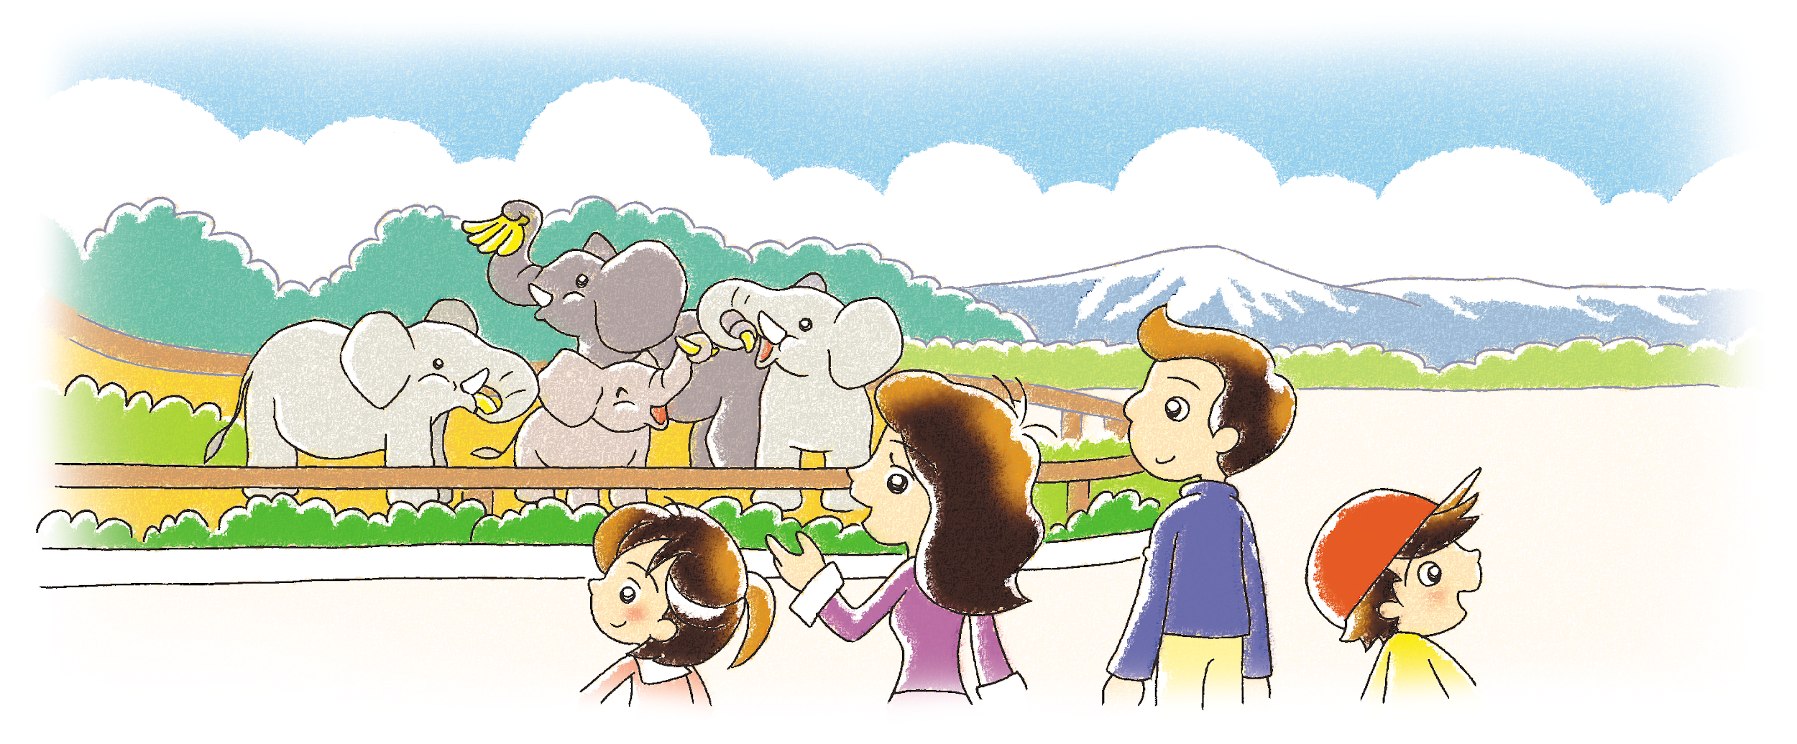
Milly
Mum
Dad
Danny
Milly and her family are at the zoo.
What animals can you see in a zoo?
Notes:
Say Today we are going to read a story about Milly's family.
Display the picture and say Look! Here is Milly's family. These people are Milly, Mum, Dad and Danny. Can you guess where they are? (At the zoo.) Say That’s right! [Click to show the narration] Milly and her family are at the zoo. – inferring
Say Look at the picture. How do they feel? Happy or sad? (Happy.) Why? (e.g. They see some animals in the zoo.) What about you? Are you happy when you go to the zoo? – observing / giving personal responses
[Click to show the question] Ask What animals can you see in a zoo? (e.g. Lions, monkeys, tigers, elephants, pandas.) – eliciting information / relating the text to the world

Slide 6
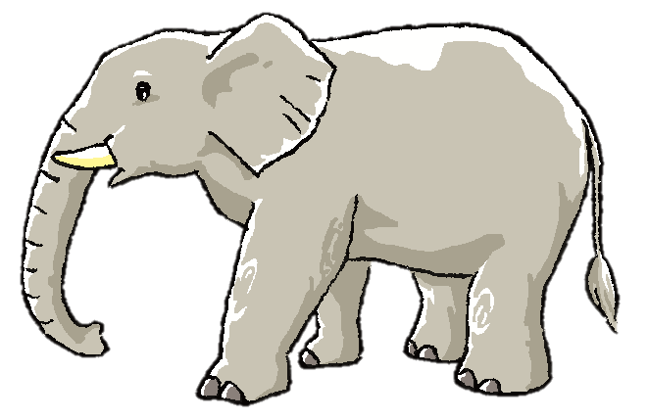
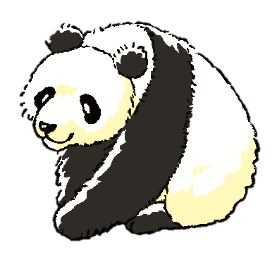
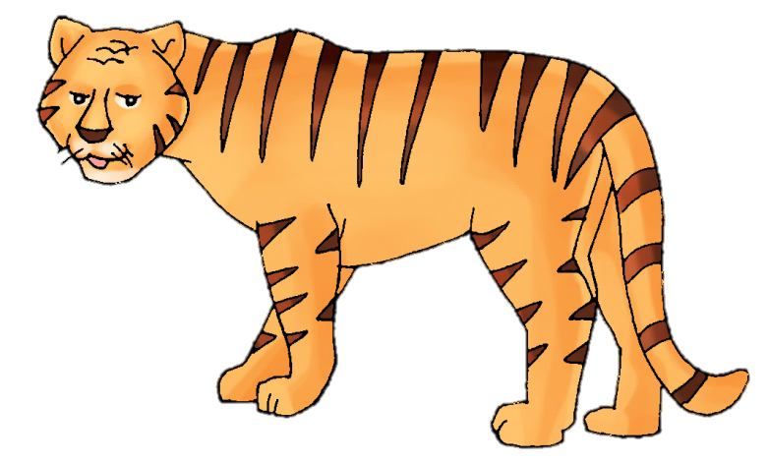
Let’s look at some animals in the zoo!
What are they?
Notes:
Say Let’s look at some animals in the zoo! What are they?
[Click to show the panda] Ask What animal is this? (A panda.) – observing
Say Let’s look at the next animal!
Continue to introduce the elephant and the tiger. [Click to show each animal]

Slide 7
fly
run
climb
What can the animals do? Do you know?
Notes:
Ask What can the animals do? Do you know?
Point at each animal and elicit guesses from pupils. Ask Can the panda fly? Run? Climb? Mime each action to help pupils understand the verbs. – guessing
You may press the keys ‘Ctrl + p’ to activate the pen tool and draw red lines from the animals to their abilities according to pupils’ guesses. To deactivate the pen tool, press the keys ‘Ctrl + a’.
Ask Do you want to know what the animals can do? (Yes.)
Say Let’s read the story and find out!

Slide 8
Let’s read the story!
First reading

Slide 9
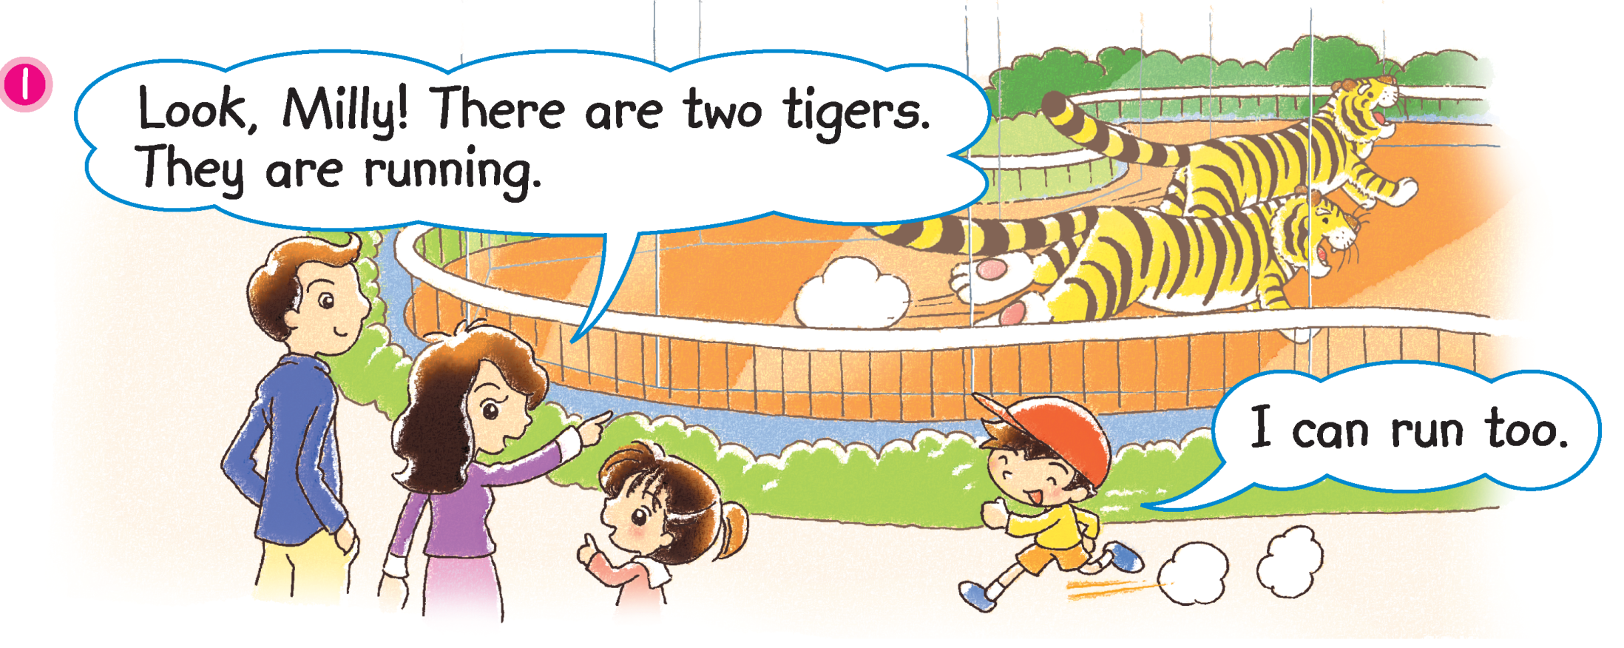
Milly and her family are looking at the tigers.
What about you? Can you run?
Notes:
Say Milly and her family are looking at the tigers.
Guide pupils to complete the sentence. Ask How many tigers are there? (Two.) [Click to reveal the answer] Ask What do the tigers look like? (e.g. They have long tails. They are big and strong.) – observing
Mime running and say The tigers are running.
[Click to circle Danny] Say Look! Danny can run too!
[Click to show the question] Ask What about you? Can you run? – relating the text to self

Slide 10
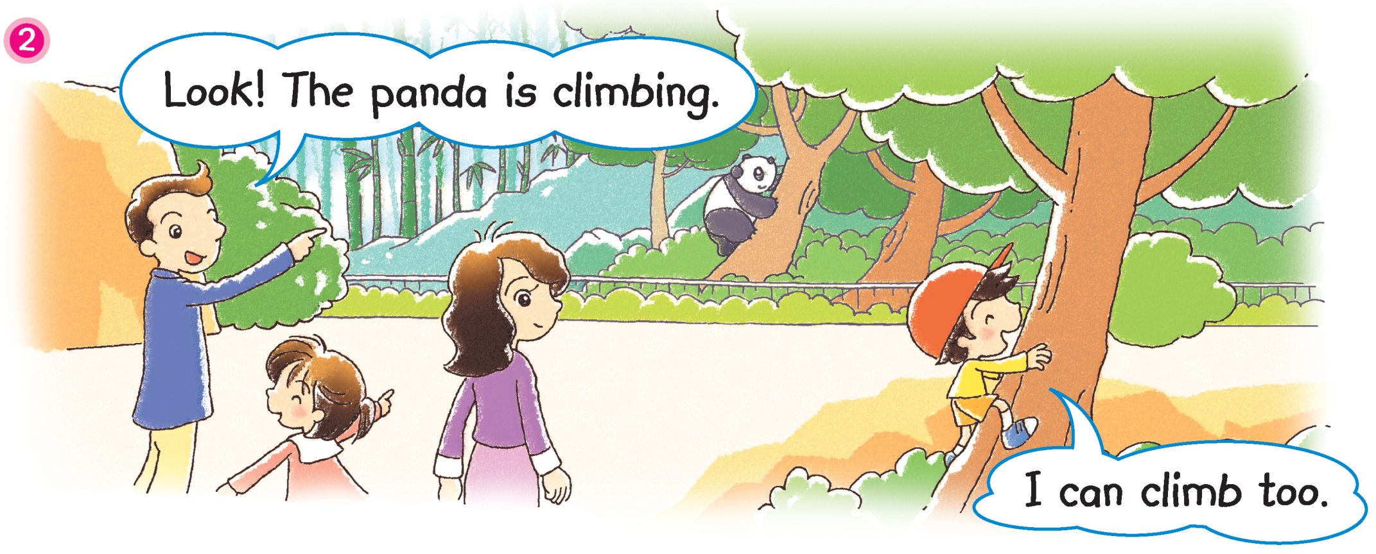
What animal are Milly and her family looking at now?
What about you? Can you climb?
Notes:
Ask What animal are Milly and her family looking at now? (A panda.) [Click to circle the panda] Ask What colour is the panda? (Black and white.) – observing
Mime climbing and say The panda is climbing! Wow! Pandas can climb trees!
[Click to circle Danny] Guide pupils to complete the sentence. Ask Can Danny climb too? (Yes.) [Click to reveal the answer]
[Click to show the question] Ask What about you? Can you climb? – relating the text to self

Slide 11
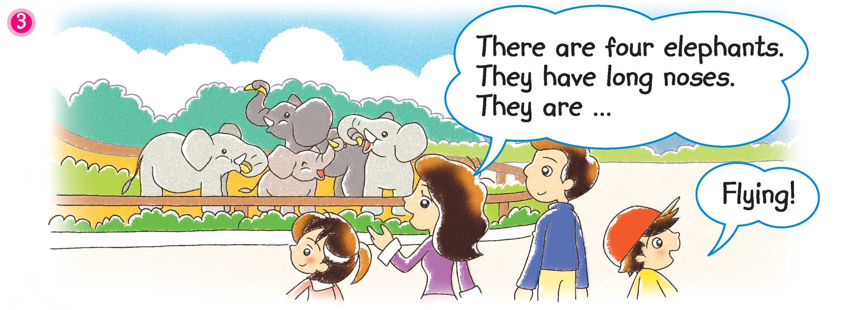
Mum is telling Milly about the elephants.
Is Danny looking at the elephants?
Notes:
21st century skill: Critical thinking
Guide pupils to complete the sentence. Say Now Milly and her family are looking at the … (Elephants.) Ask How many elephants are there? (Four.) [Click to reveal the answer] – observing
[Click to show the narration] Say Listen! Mum is telling Milly about the elephants. She says that the elephants have … (Long noses.) – locating specific information
Say Suddenly Danny says, ‘Flying!’ Mime flying by flapping your arms.
[Click to show the post-reading question] Read the question aloud, Is Danny right about the elephants? Why? Why not? (e.g. No. Elephants can’t fly.) Elicit answers from pupils. – predicting
[Click to circle Danny and show the question] Mime thinking aloud and say Hmm, look at Danny. Is Danny looking at the elephants? (No.) What is Danny looking at? – observing / guessing

Slide 12
Dad says that elephants can’t fly!
Is Dad right about the elephants?
Notes:
Say Dad says that elephants can’t fly.
[Click to show the question] Ask Is Dad right about the elephants? Can elephants fly? – inferring / supporting
Say Let’s find out who is right!

Slide 13
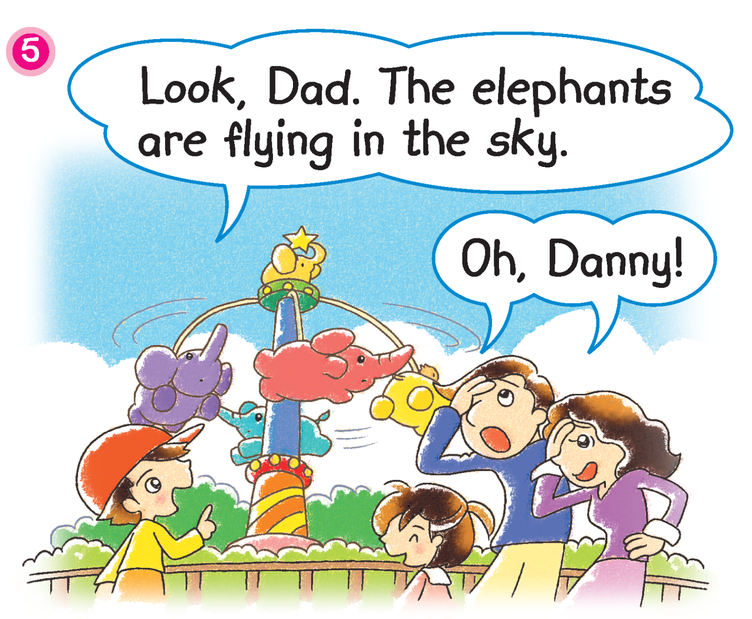
Oh! Danny is looking at an elephant ride.
Is Danny right about the elephants at the ride?
Notes:
Say Oh! Danny is looking at an elephant ride. Ask Are the elephants there real? (No.) – verifying
[Click to show the question] Ask Is Danny right about the elephants at the ride? Are they flying? (Yes.) – verifying / observing

Slide 14
Dad is looking at real elephants.
Real elephants can’t fly.
Notes:
Say Danny is looking at the elephant ride. The elephants at the ride can fly. [Click to show the narration] Dad is looking at real elephants. Ask Can real elephants fly? (No.) – verifying
Say That’s right! [Click to show the narration] Real elephants can’t fly.

Slide 15
Let’s watch the video and read the story again!
Second reading

Slide 16
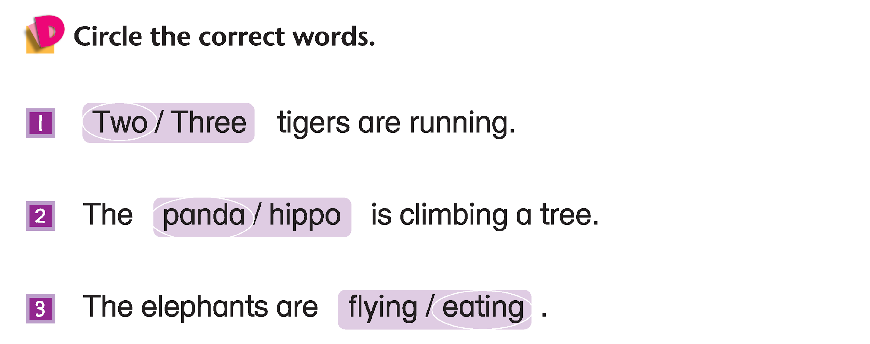
Two / Three
panda / hippo
panda / hippo
flying / eating
Answers
Notes:
Instruct pupils to complete Part D individually in their books. The activity can be completed in class or for homework.

Slide 17
Let’s do some more activities!
Post-reading

Slide 18
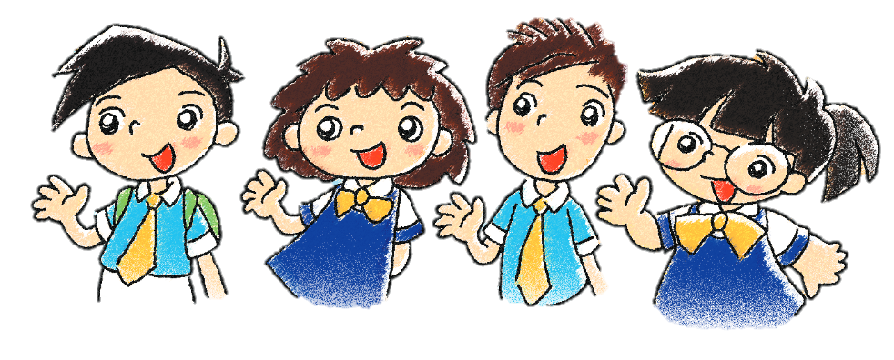
Readers’ theatre
Notes:
Put pupils into groups and assign each group a character / paragraph / section / scene. Ask each group to read their part aloud.

Slide 19
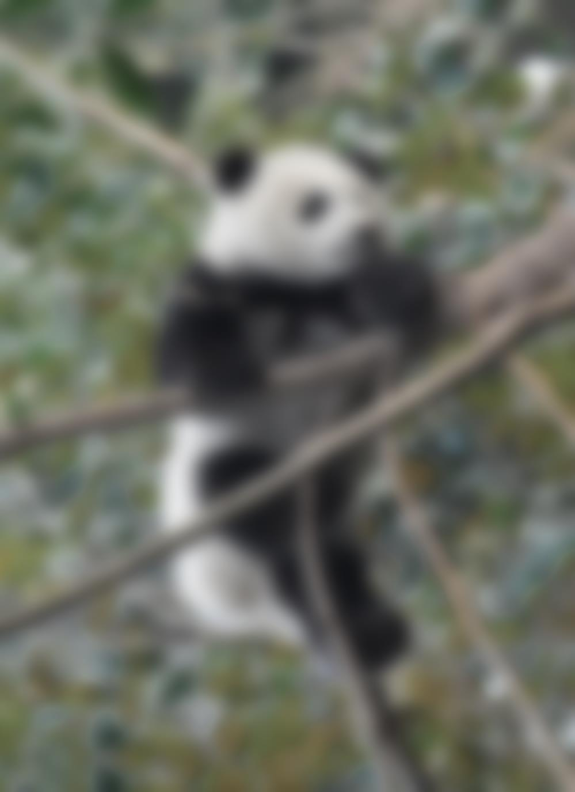
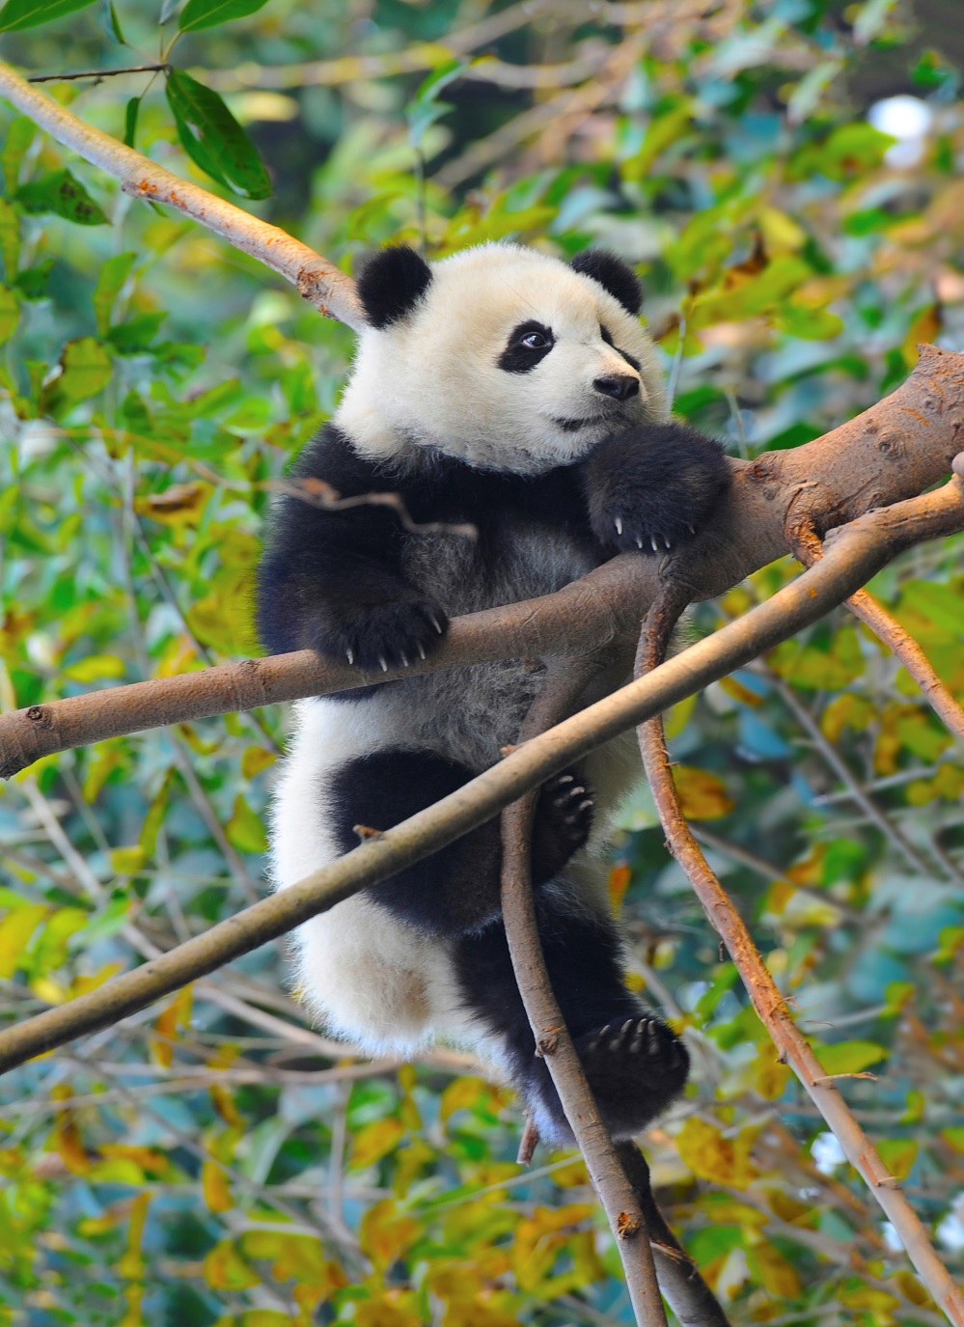
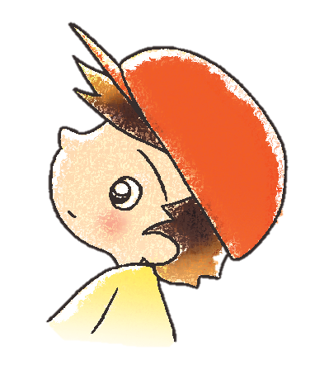
Panda
Notes:
Say Look! Here are some photos of zoo animals but they are not clear. Can you guess what animals are in the photos?
Elicit guesses from pupils. Ask What is it? / What are they? [Click to make each photo clear and show each answer]

Slide 20
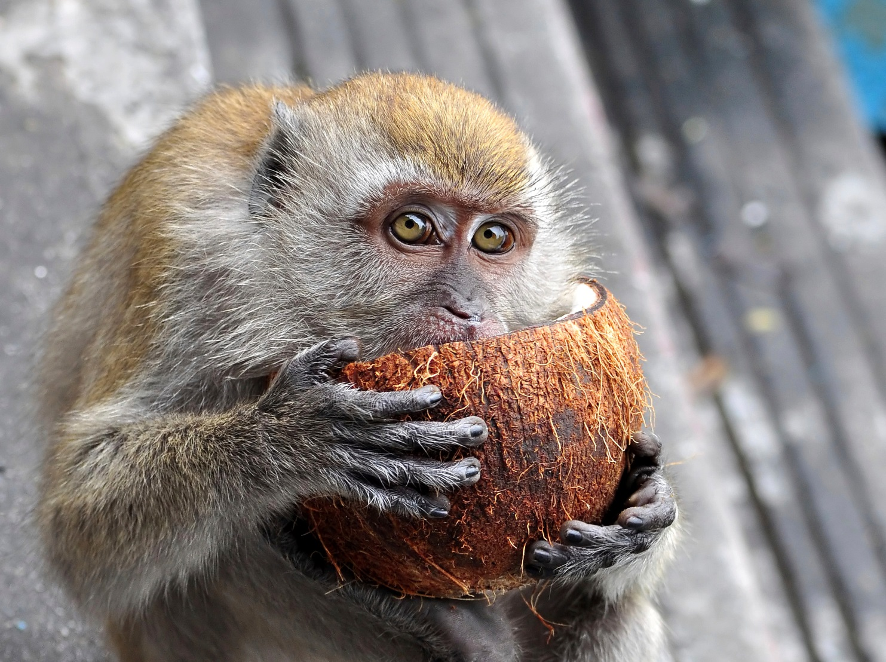
Monkey

Slide 21
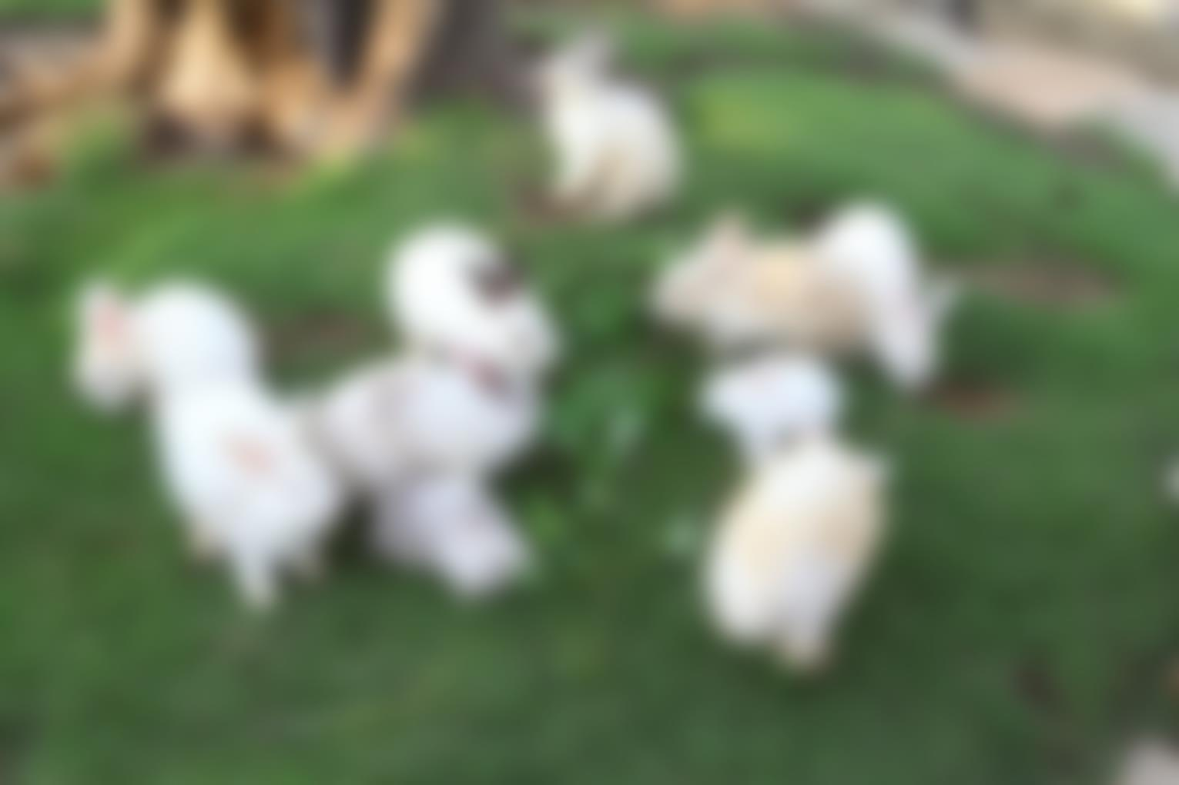
Rabbits

Slide 22
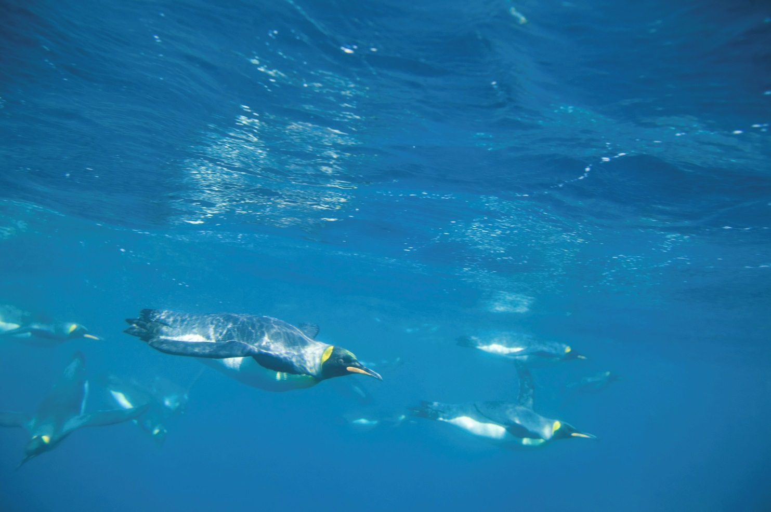
Penguins

Slide 23
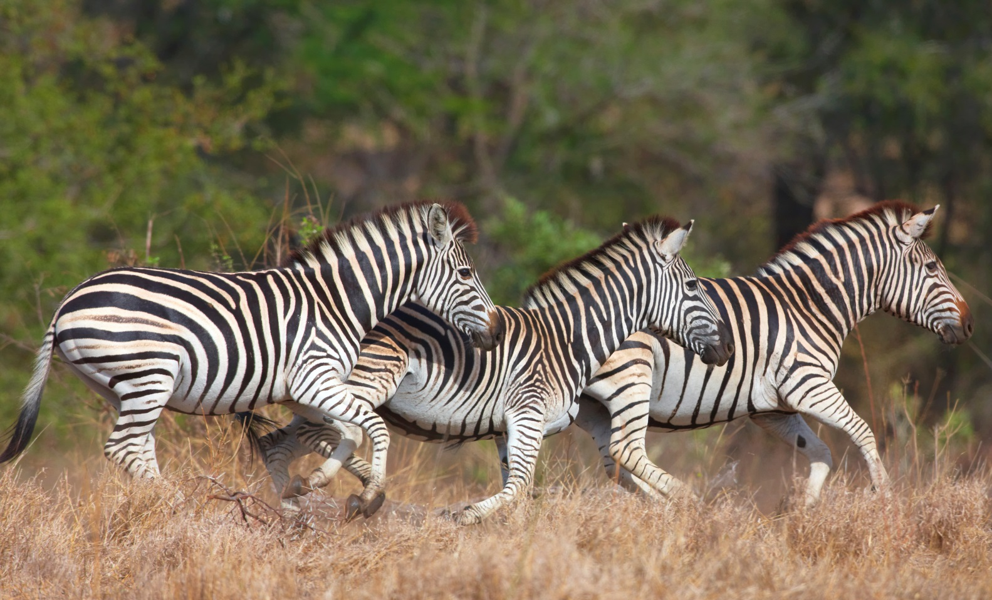
Zebras

Slide 24
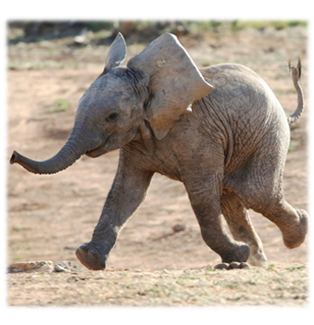
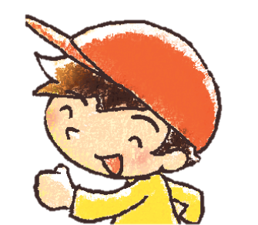
sleeping
swimming
eating
flying
climbing
running
elephant
running
The ________ is / are ________.
Notes:
Say Danny is finding out what the zoo animals are doing in the photos. Can you help him? Let’s look at the photos and finish the captions.
Ask pupils to complete the captions. [Click to show the answers]

Slide 25
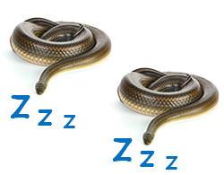
sleeping
swimming
eating
flying
climbing
running
snakes
sleeping
The ________ is / are ________.
Notes:
Say Now, you make two silly sentences!
Put pupils in pairs. Instruct pupils to make two silly sentences and write them on their notebooks, e.g. The tiger is hopping. They may use the helping words on the screen to help them.
At the end of the activity, invite pairs to come to the front of the class to present one silly sentence.

Slide 26
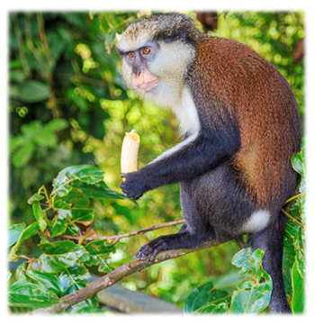
sleeping
swimming
eating
flying
climbing
running
monkey
eating
The ________ is / are ________.
Notes:
Say Now, you make two silly sentences!
Put pupils in pairs. Instruct pupils to make two silly sentences and write them on their notebooks, e.g. The tiger is hopping. They may use the helping words on the screen to help them.
At the end of the activity, invite pairs to come to the front of the class to present one silly sentence.

Slide 27
sleeping
swimming
eating
flying
climbing
running
penguins
swimming
The ________ is / are ________.
Notes:
Say Now, you make two silly sentences!
Put pupils in pairs. Instruct pupils to make two silly sentences and write them on their notebooks, e.g. The tiger is hopping. They may use the helping words on the screen to help them.
At the end of the activity, invite pairs to come to the front of the class to present one silly sentence.

