Slide 1
Reading Courseware
for Teachers
Chapter 4 People at work
Learn to Read

Slide 2
Functions | 21st Century Knowledge and Skills | Values and Attitudes
Describing jobs | Civic literacy | Helping others at work
Reading Skills
Making guesses/predictions about the text Locating specific information in response to questions Inferring meaning/unknown words from contextual/pictorial cues or base words Making observations from pictures Giving personal responses to the text

Slide 3
Reading
Pre-reading | – Introducing the setting
First reading | – Shared reading
Second reading | – Reading aloud – Activity 1: Assessment for learning
Post-reading | – Activity 2: Readers’ theatre – Activity 3: Help others at work – Activity 4: Who am I?

Slide 4
Today we are going to read a story. Let’s look at some pictures!
Pre-reading

Slide 5
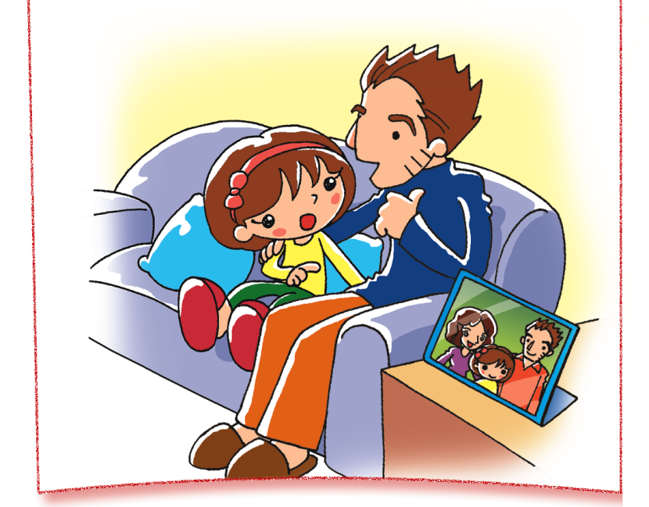
Mike
Cindy
What is Mike’s job? Can you guess?
Notes:
Say Today we are going to read a story about Cindy’s father, Mike. Look at this picture. This is Cindy and this is her father, Mike. We are going to find out what Mike does in his job.
[Click to show the questions] Ask What is Mike’s job? Can you guess?– guessing

Slide 6
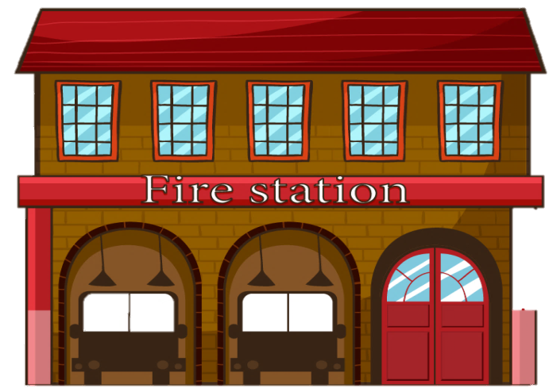
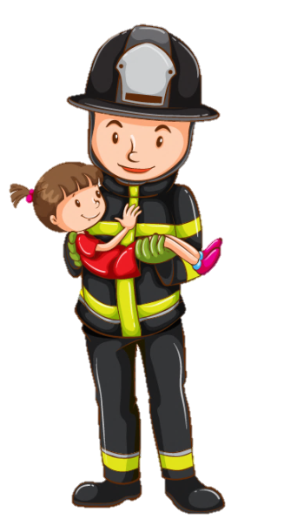
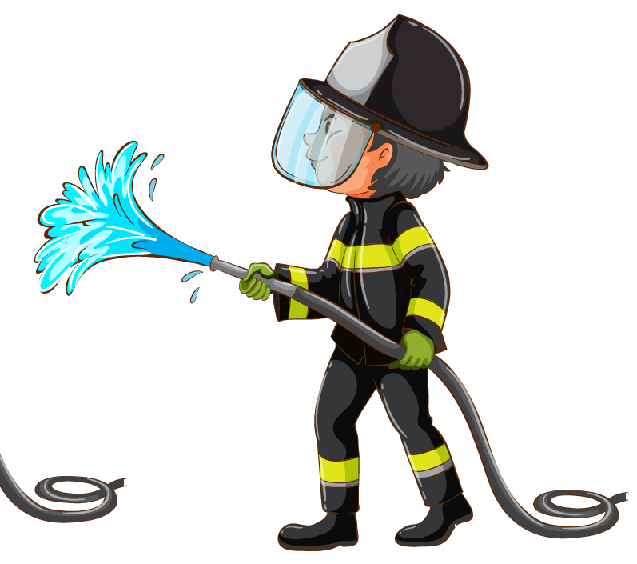
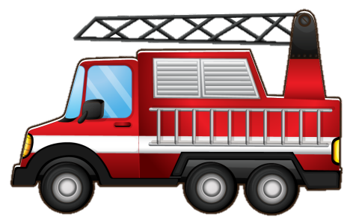
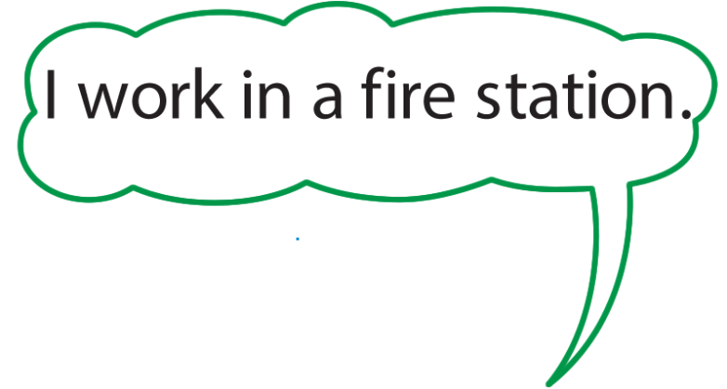
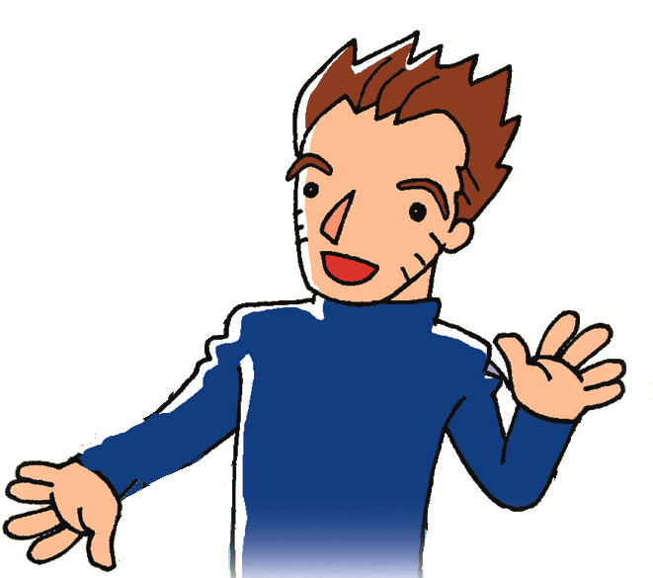
What is Mike’s job?
Notes:
Say Let’s look at some clues!
[Click to show each clue] Read the clues aloud, I save people. / I work in a fire station. / I put out fires. [Click to show the question] Ask pupils if they know what Mike’s job is now.
Say Let’s read the story and find out more about Mike’s job.

Slide 7
Let’s read the story!
First reading

Slide 8
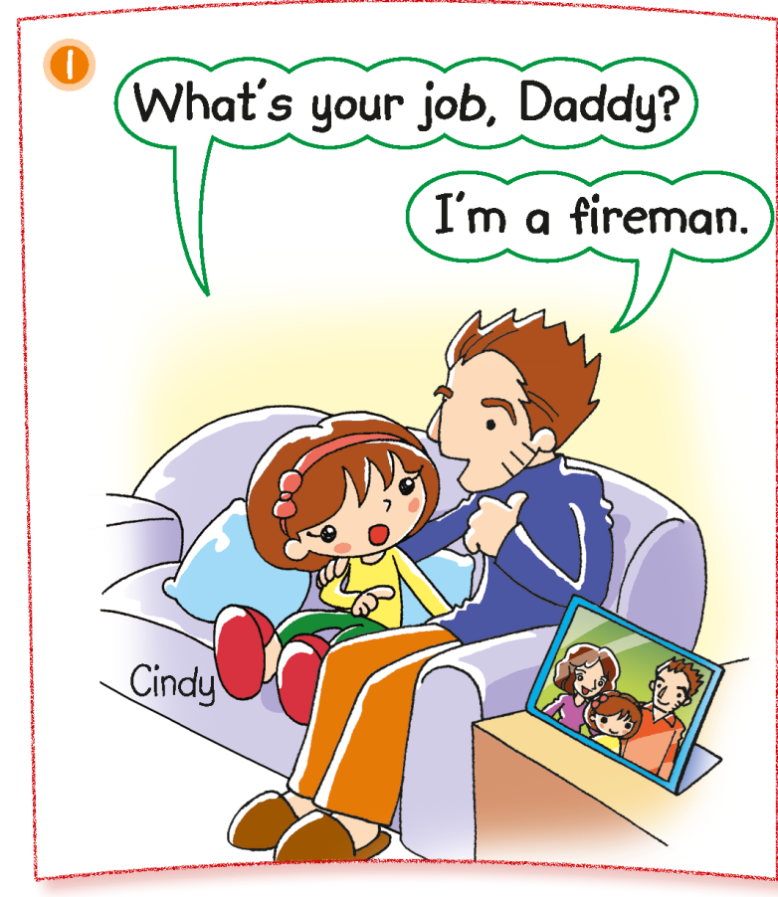
Notes:
Say Cindy is asking her father, Mike, about his job.
What does he say?
Ask pupils to complete the sentence. Say I’m a … (Fireman.)
Say That’s right. He says, ‘I'm a fireman.’[Click to show the answer]

Slide 9
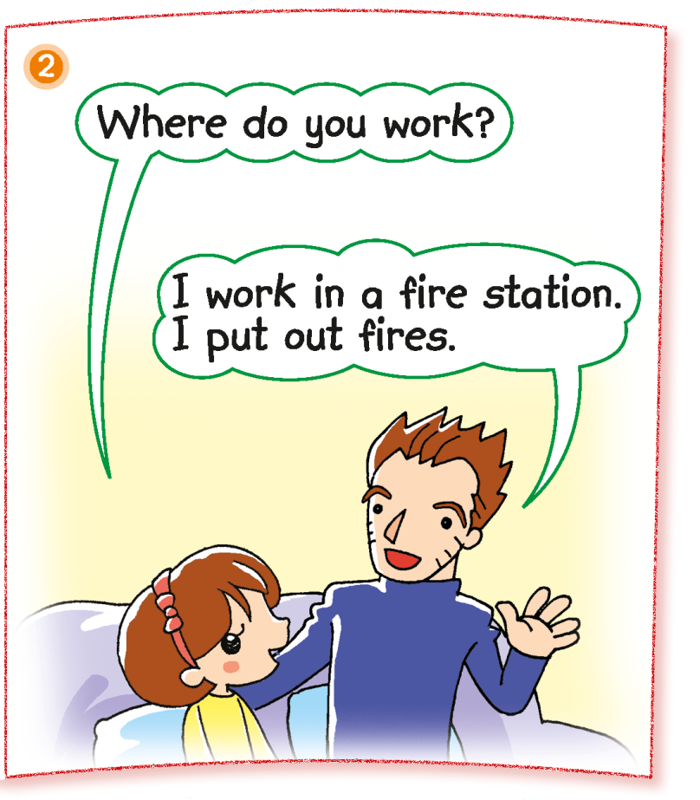
Notes:
Ask Where does Mike work? (In a fire station.) – locating specific information

Slide 10
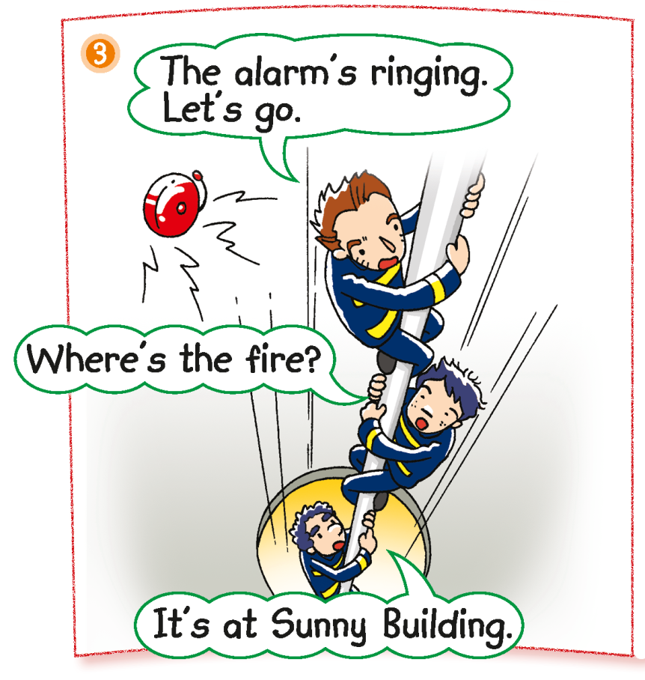
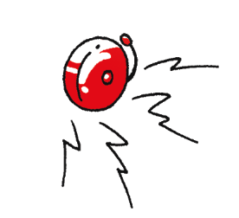
Where’s the fire?
Notes:
Say The next day, Mike goes to work at the fire station. The alarm rings. [Click to show animation] Mime the alarm ringing. Ask Do you know what that means? Say It means there is a fire! Now the firemen are getting ready for work.– eliciting information
[Click to show the question] Ask Where’s the fire? (At Sunny Building.) [Click to underline the answer] Are the firemen going there? (Yes.) What will the firemen do at Sunny Building? (e.g. put out the fire, save people.) – locating specific information / verifying / predicting

Slide 11
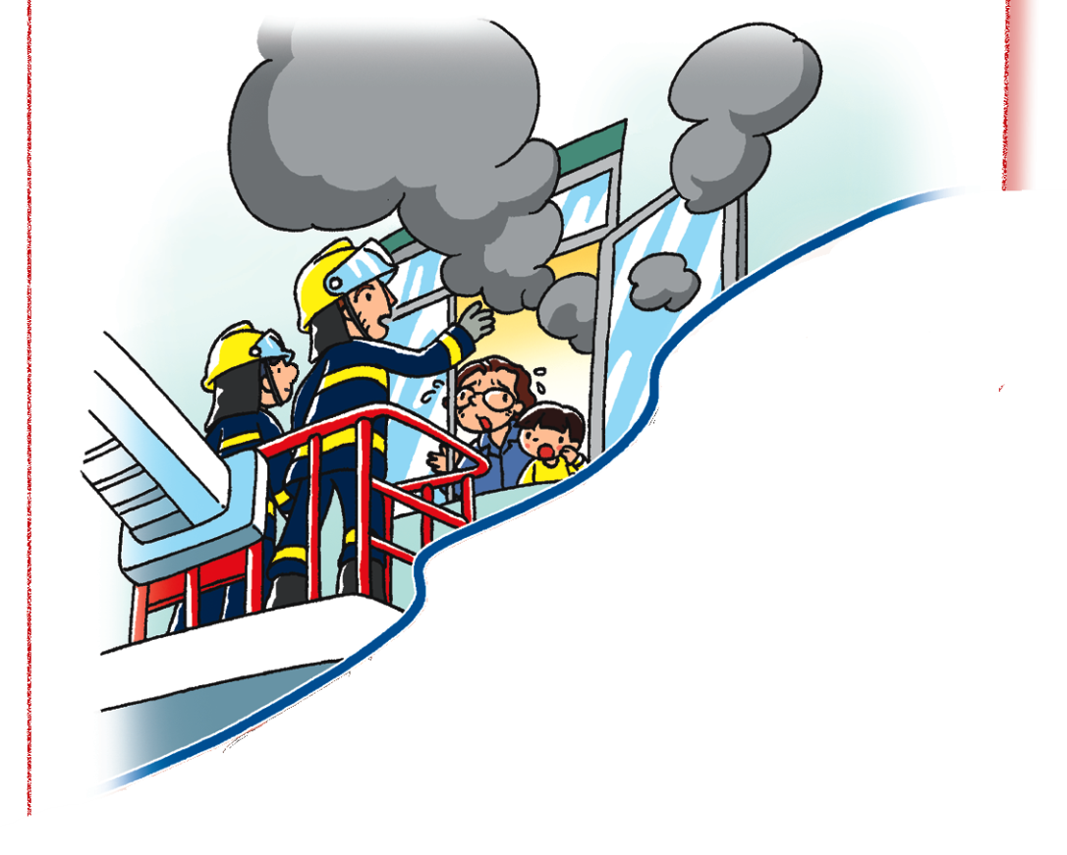
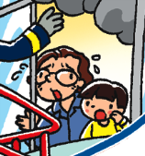
Can the firemen help them?
Notes:
Say The firemen are at Sunny Building. They are helping the people inside the building. [Click to zoom in on the people]
Ask How do the people feel? (Afraid.) Why are they afraid? (There is a fire.) [Click to show the question] Can the firemen help them? (Yes.) [Click to underline the answer] – inferring / locating specific information

Slide 12
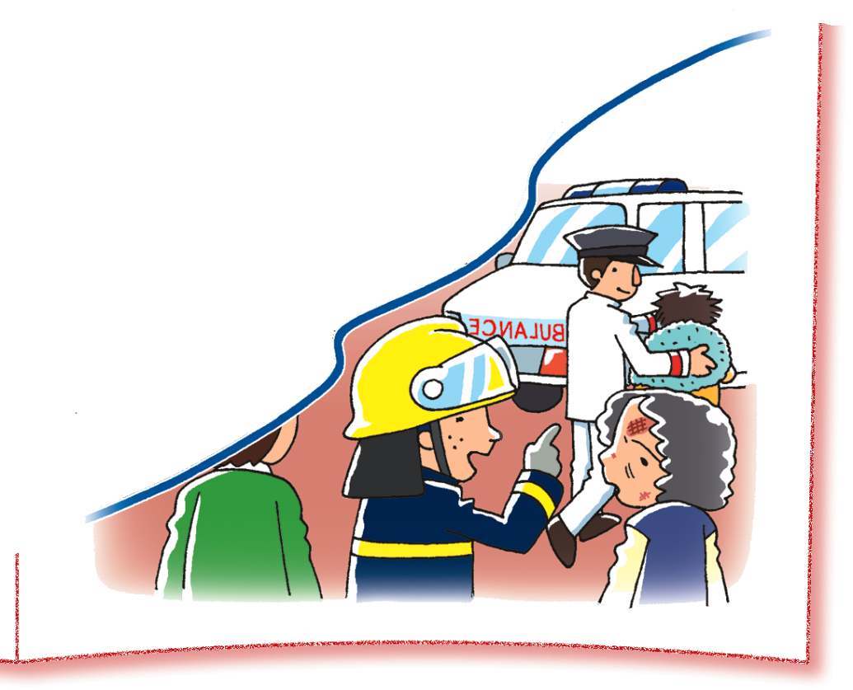
Can the nurse help her?
Notes:
Say Look. There is a nurse with the firemen. He is helping the people too. [Click to draw an arrow pointing towards the nurse]
[Click to circle the woman] Say Look at this woman. Ask Is she OK? (No.) Say She is hurt – because of the fire. Point at her wounds. Then touch your own face and mime a pained expression. [Click to show the question] Can the nurse help her? (Yes.) [Click to underline the answer] Say That’s right. A nurse helps people who are sick or hurt. – observing / locating specific information

Slide 13
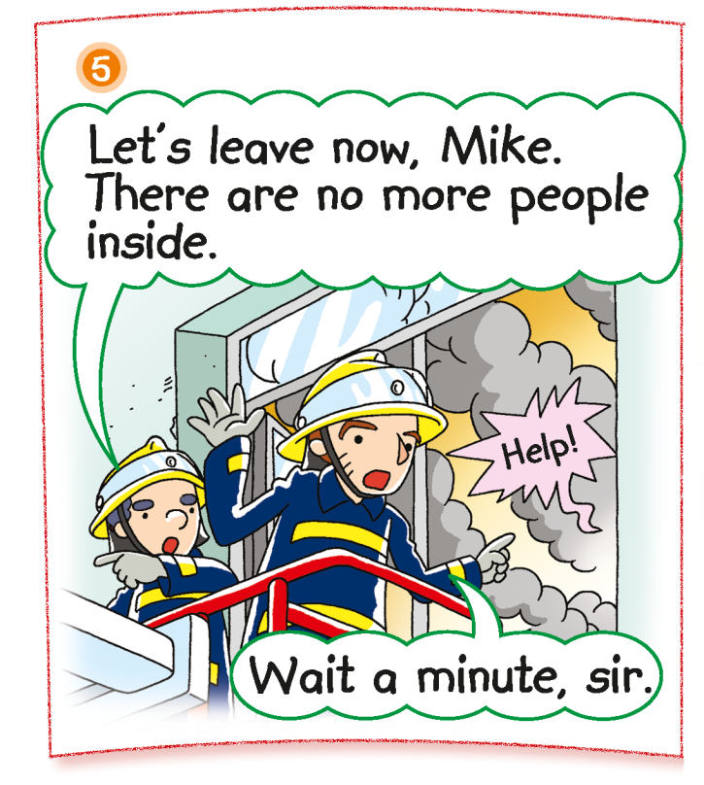
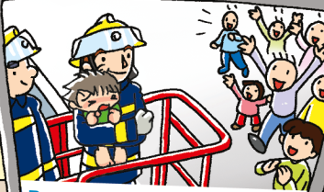
Is someone inside the building?
Notes:
Say The firemen help the people get out of the building.
Say This fireman says there is no one else inside. But Mike hears a noise. Ask What does he hear? (Help!) [Click to show the animation and the question] Is someone else inside the building? (Yes.) Can the person get out? (No.) Is that why the person says ‘Help’? (Yes.)– locating specific information / inferring
Ask What will Mike do? Will he save the person inside? (Yes. / No.)– predicting
[Click to show the second picture] Say Mike goes inside the building and saves a little boy! Ask Is Mike brave? (Yes.) – inferring

Slide 14
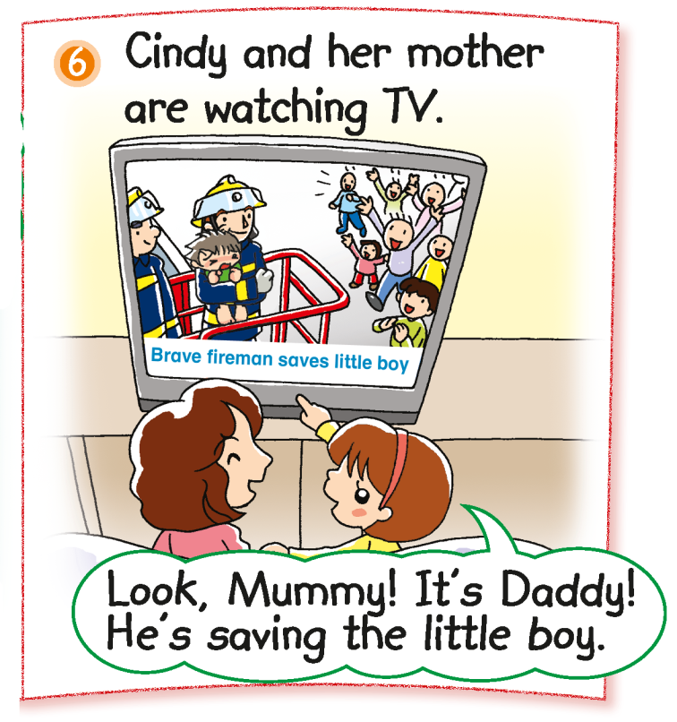
How do Cindy and her mother feel? Why?
Notes:
Say Look. Mike is on TV! Cindy and her mother are at home. They see him on TV.
[Click to show the questions] Ask How do Cindy and her mother feel? (Happy.) Why are they happy? (Mike is brave. / They see Mike saving a little boy.) – inferring

Slide 15
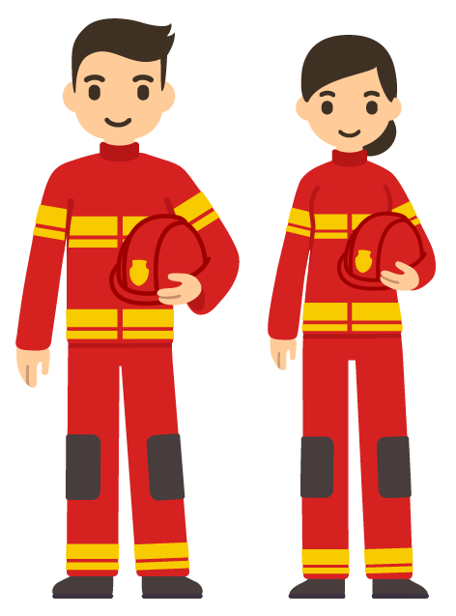
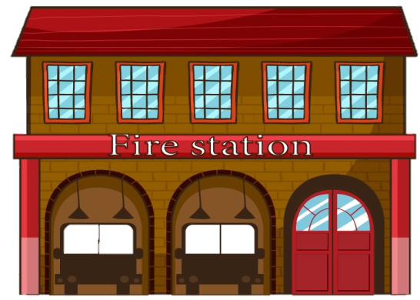
firemen
fire station
policemen
police station
?
Notes:
Read the post-reading question aloud. Point at the highlighted words to elicit the answer. [Click to show the answer] – inferring unknown words

Slide 16
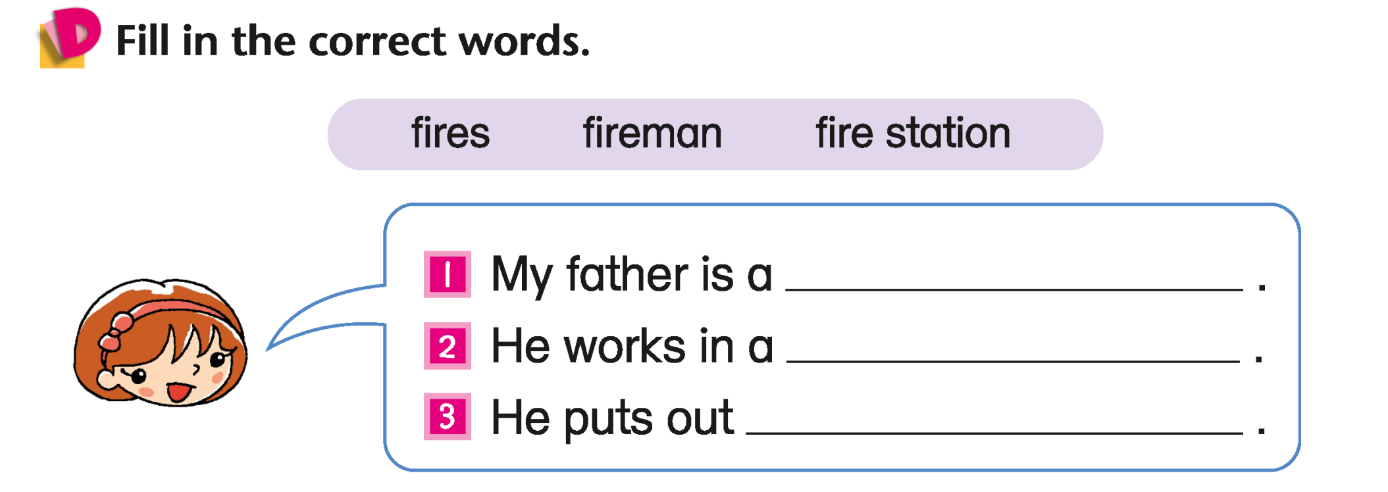
fireman
fire station
fires
Answers
Notes:
Instruct pupils to complete Part D individually in their books. The activity can be completed in class or for homework. – locating specific information

Slide 17
Let’s do some more activities!
Post-reading

Slide 18
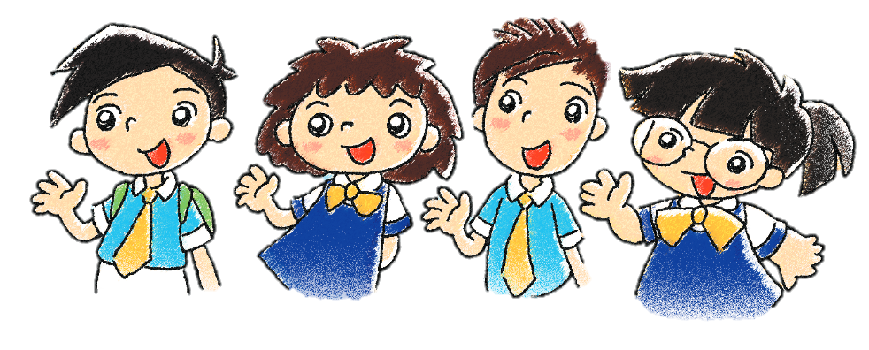
Readers’ theatre
Notes:
Put pupils into groups and assign each group a character. Ask each group to read their part aloud.

Slide 19
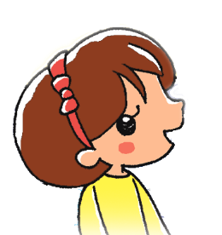
I save people.
a fireman
Cindy
Notes:
Say The children’s parents are at school to talk about their jobs! Let’s see what their jobs are.
Say Cindy’s father is a … (Fireman.) [Click to show the answer] Ask Does he help others? (Yes.) He saves people. [Click to show the speech bubble]

Slide 20
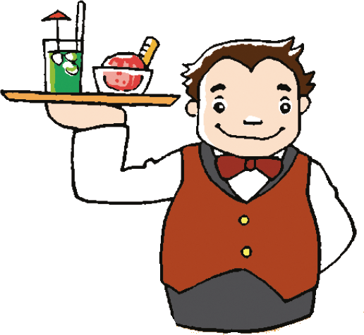
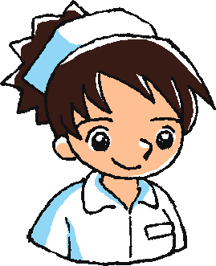
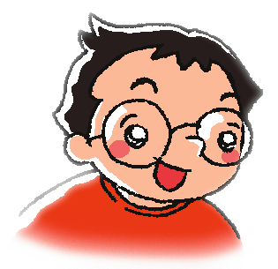
I serve food to people.
a waiter
a nurse
I help sick people.
Peter
Notes:
Say Peter’s father is a … (Waiter.) [Click to show the answer] Ask Does he help people? (Yes.) Say A waiter serves food to people. [Click to show the speech bubble]
[Click to show Peter’s mother] Say Peter’s mother is a ... (Nurse.) [Click to show the answer] Ask Who does a nurse help? (Sick people.) [Click to show the speech bubble]

Slide 21
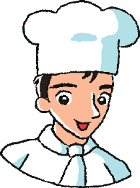
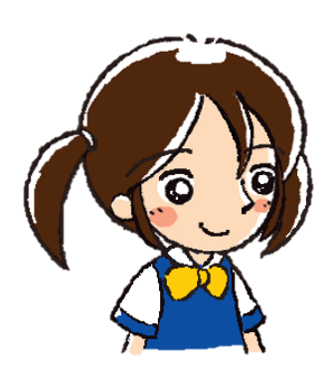
I cook food for people.
a cook
Sally
Notes:
Say Sally’s father is a … (Cook.) [Click to show the answer] Ask Does he help people? (Yes.) Say That’s right. A cook cooks food for people. [Click to show the speech bubble]

Slide 22
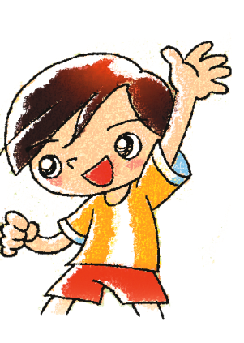
I help sick people.
a doctor
Tom
Notes:
Say Tom’s mother is a … (Doctor.) [Click to show the answer] Ask Does she help people? (Yes.) Say That’s right. A doctor helps sick people. [Click to show the speech bubble]

Slide 23
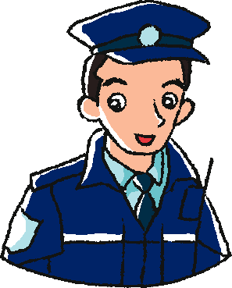
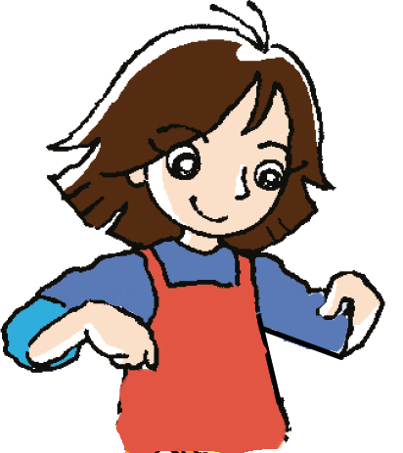
I look after my family.
a policeman
a housewife
I catch bad people.
Mary
Notes:
Say Mary’s father is a … (Policeman.) [Click to show the answer] Ask How does he help people? He catches … (Bad people.) [Click to show the speech bubble]
[Click to show Mary’s mother] Say Mary’s mother is a … (Housewife.) [Click to show the answer] Ask Does she help people? (Yes.) Say A housewife looks after her family. She helps her family. [Click to show the speech bubble]
Say Peter, Sally, Tom and Mary’s parents aren’t firemen. They have other jobs. Ask Do they help people? (Yes.) Say You don’t have to be a fireman to help people. You can help people in other jobs!

Slide 24
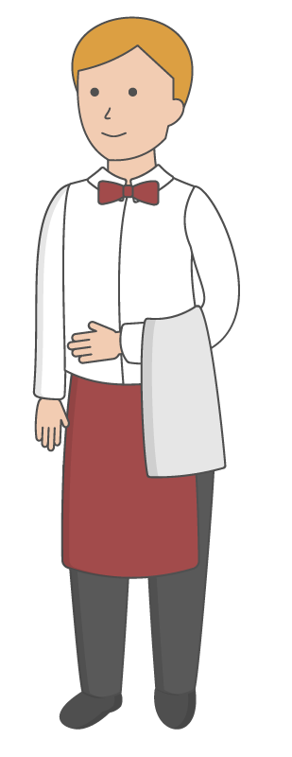
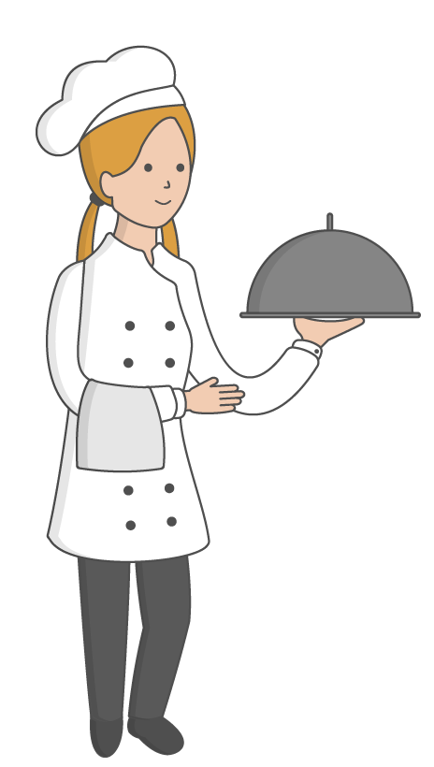
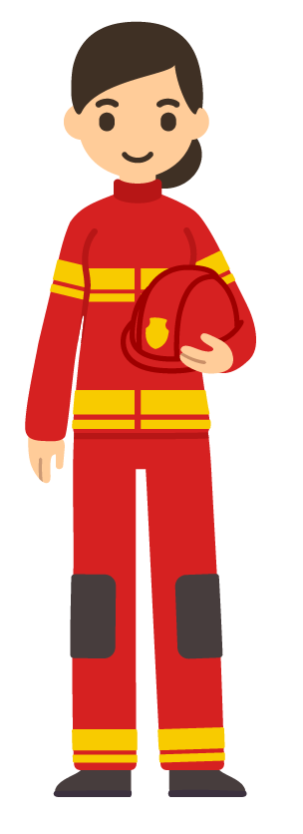
I catch bad people.
Notes:
Prepare sets of cutouts of the characters as shown on slide 25.
Divide pupils into groups of four to five. Distribute to each group a set of cutouts. When you read aloud the job descriptions listed below, each group has to hold up the matching character. Award the groups a point for each correct answer. The group with the most points wins the game.
1. I catch bad people.
2. I help sick people.
3. I cook food for people.
4. I put out fires.
5. I serve food to people.

Slide 25
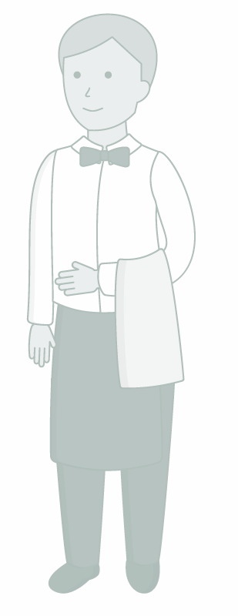
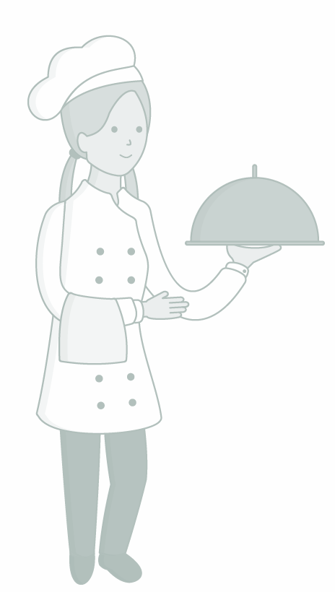
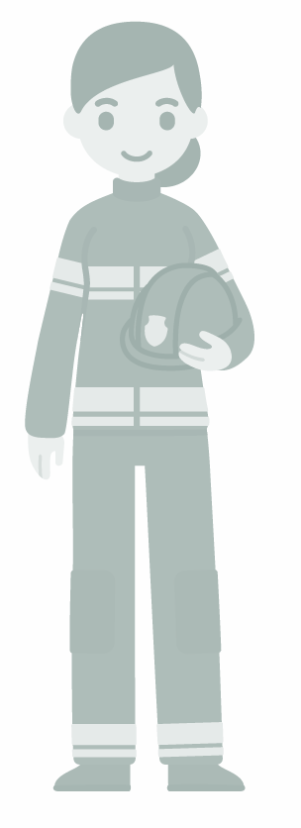
I catch bad people.

Slide 26
I help sick people.

Slide 27
I help sick people.

Slide 28
I cook food for people.

Slide 29
I cook food for people.

Slide 30
I put out fires.

Slide 31
I put out fires.

Slide 32
I serve food to people.

Slide 33
I serve food to people.

