Slide 1
Reading Courseware
for Teachers
Chapter 5 Happy moments
Learn to Read

Slide 2
Functions | 21st Century Knowledge and Skills
Talking about activities at home Talking about places at home | Critical thinking
Reading Skills
Giving personal responses to the text Inferring meaning from the text Making guesses about the text Identifying pronoun references Supporting inferences or judgments about the text with reasoning

Slide 3
Reading
Pre-reading | – Introducing the setting
First reading | – Shared reading
Second reading | – Reading aloud – Activity 1: Assessment for learning
Post-reading | – Activity 2: Readers’ theatre – Activity 3: Retell the story – Activity 4: What is Charlie doing?

Slide 4
Today we are going to read a story. Let’s look at some pictures!
Pre-reading

Slide 5
Dad
a video recorder
What is Dad doing?
Notes:
Say Today we are going to read a story about Charlie and his family.
Say Look! Here is Dad. [Click to show an arrow pointing towards the video recorder] Ask What is this? Do you know? Say It is a video recorder! [Click to show the picture of a video recorder] – observing
Say Some people like using a video recorder to make videos. We can also use a camera or mobile phone to make videos.
Show pupils a camera / mobile phone. Say This is a camera / mobile phone. Start shooting a video. Say Now I am making a video! You may have pupils wave their hands and say ‘Hi’ to the camera. Say I like making videos because I can watch them anytime I want to. Do you like watching videos? (Yes. / No.) You may show pupils the video you made. – giving personal responses
Say Let’s look at Dad. [Click to show the question] Ask What is Dad doing? (Making a video.) Say That’s right. He is making a video at home. – observing
Say Let’s look at another picture in the story.

Slide 6
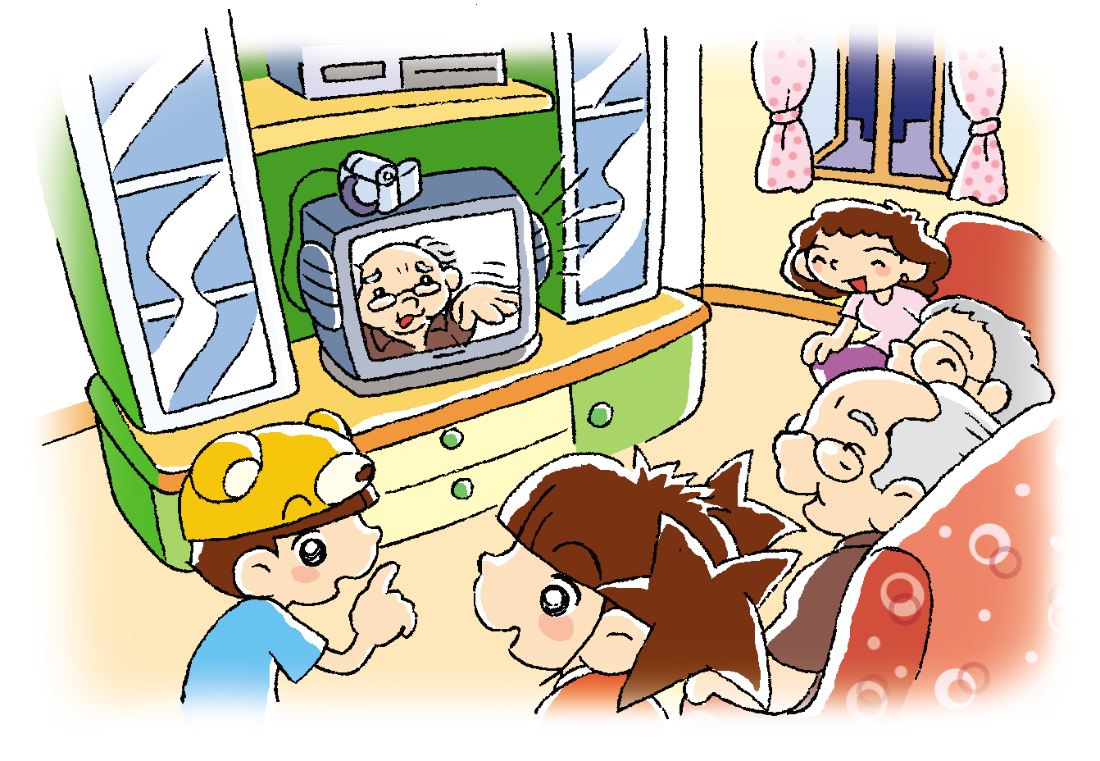
Look! This is Dad’s home video.
It is Grandpa! Who is in Dad’s home video too?
Notes:
Say Look! This is Dad’s home video. The family are watching it.
[Click to circle the TV screen] Ask Who is that? (Grandpa.) [Click to show the narration] Say It is Grandpa! Who is in Dad’s home video too? Can you guess? (e.g. Mum, Dad.) – guessing
Say Let’s read the story and find out!

Slide 7
Let’s read the story!
First reading

Slide 8
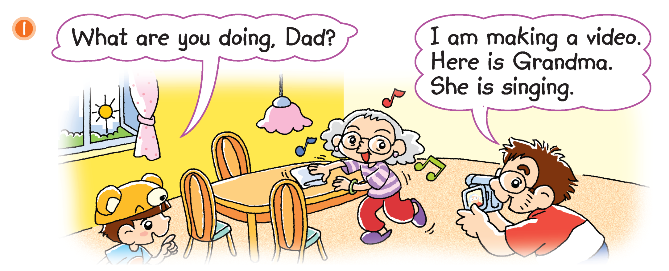
Oh! Grandma is in the video.
What is Grandma doing?
Notes:
Say Oh! Grandma is in the video.
[Click to show the question] Ask What is Grandma doing? (Singing.) [Click to underline the answer] – locating specific information
Ask Is Grandma happy to be in the video? (Yes.) – observing

Slide 9
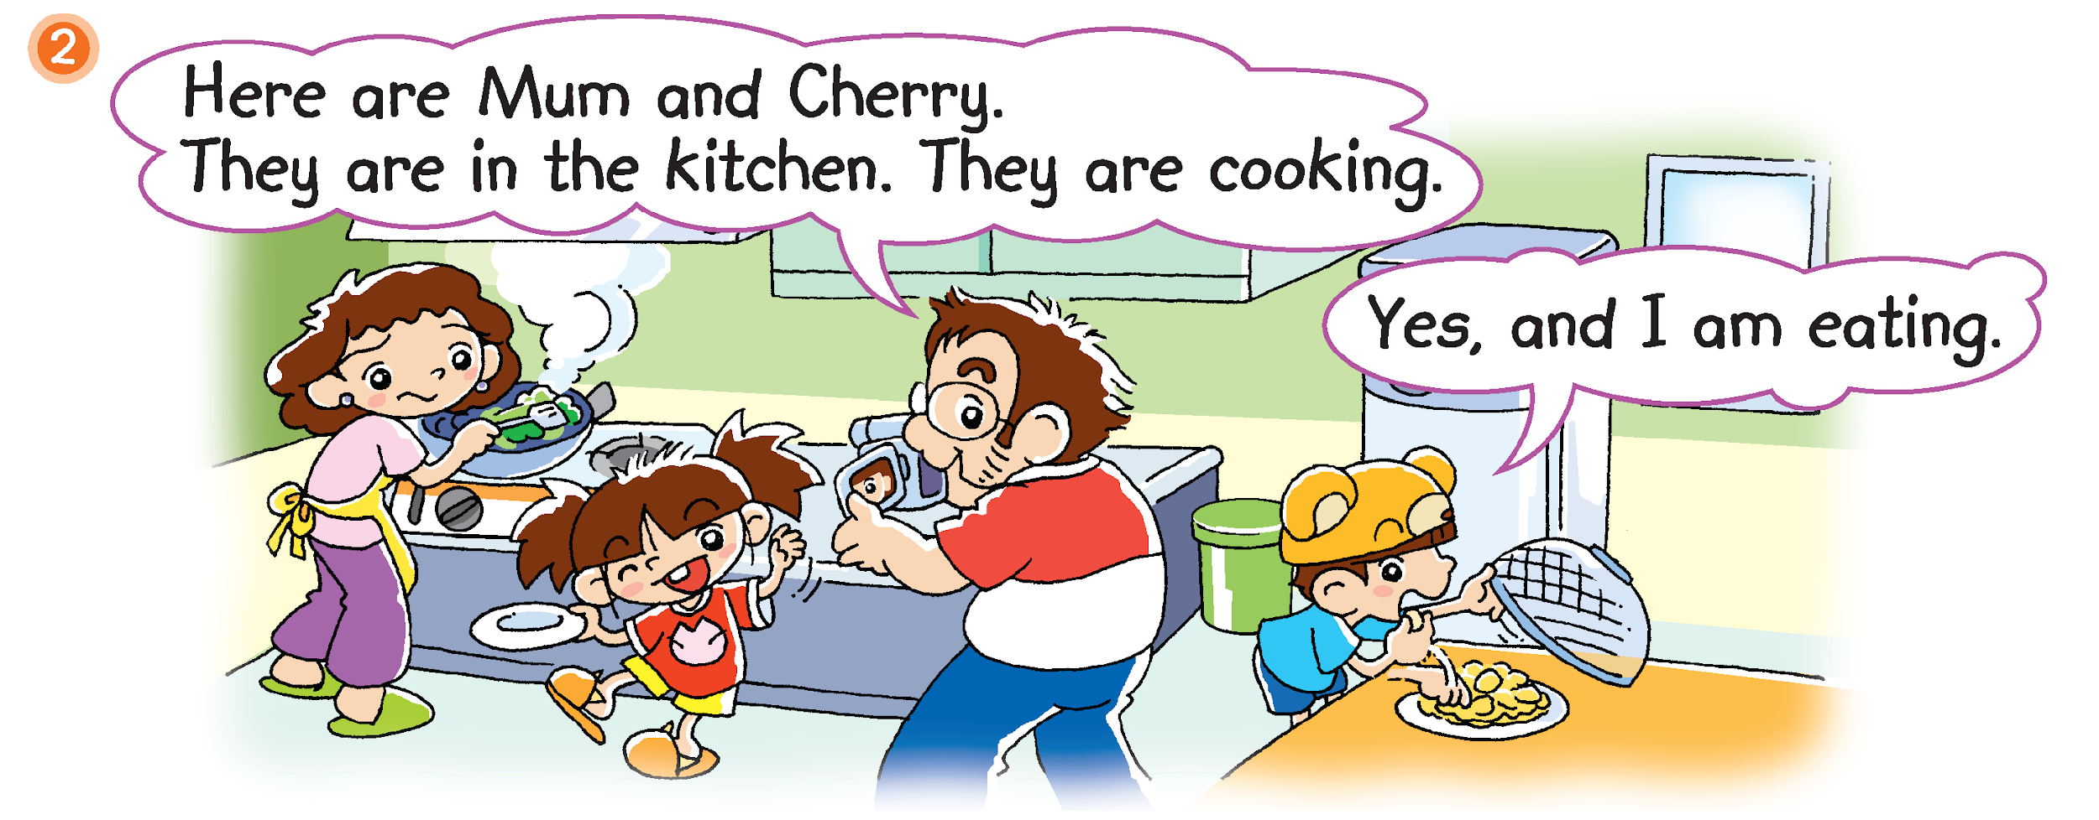
What are Mum and Cherry doing?
Is Charlie cooking?
Notes:
Say Oh! Mum and Cherry are in the video too.
Say Mum and Cherry are in the kitchen. [Click to show the question] Ask What are Mum and Cherry doing? (Cooking.) [Click to underline the answer] Look! Who is in the kitchen too? (Charlie.) [Click to circle Charlie and show the question] Ask Is Charlie cooking? (No. He is eating.) – locating specific information

Slide 10
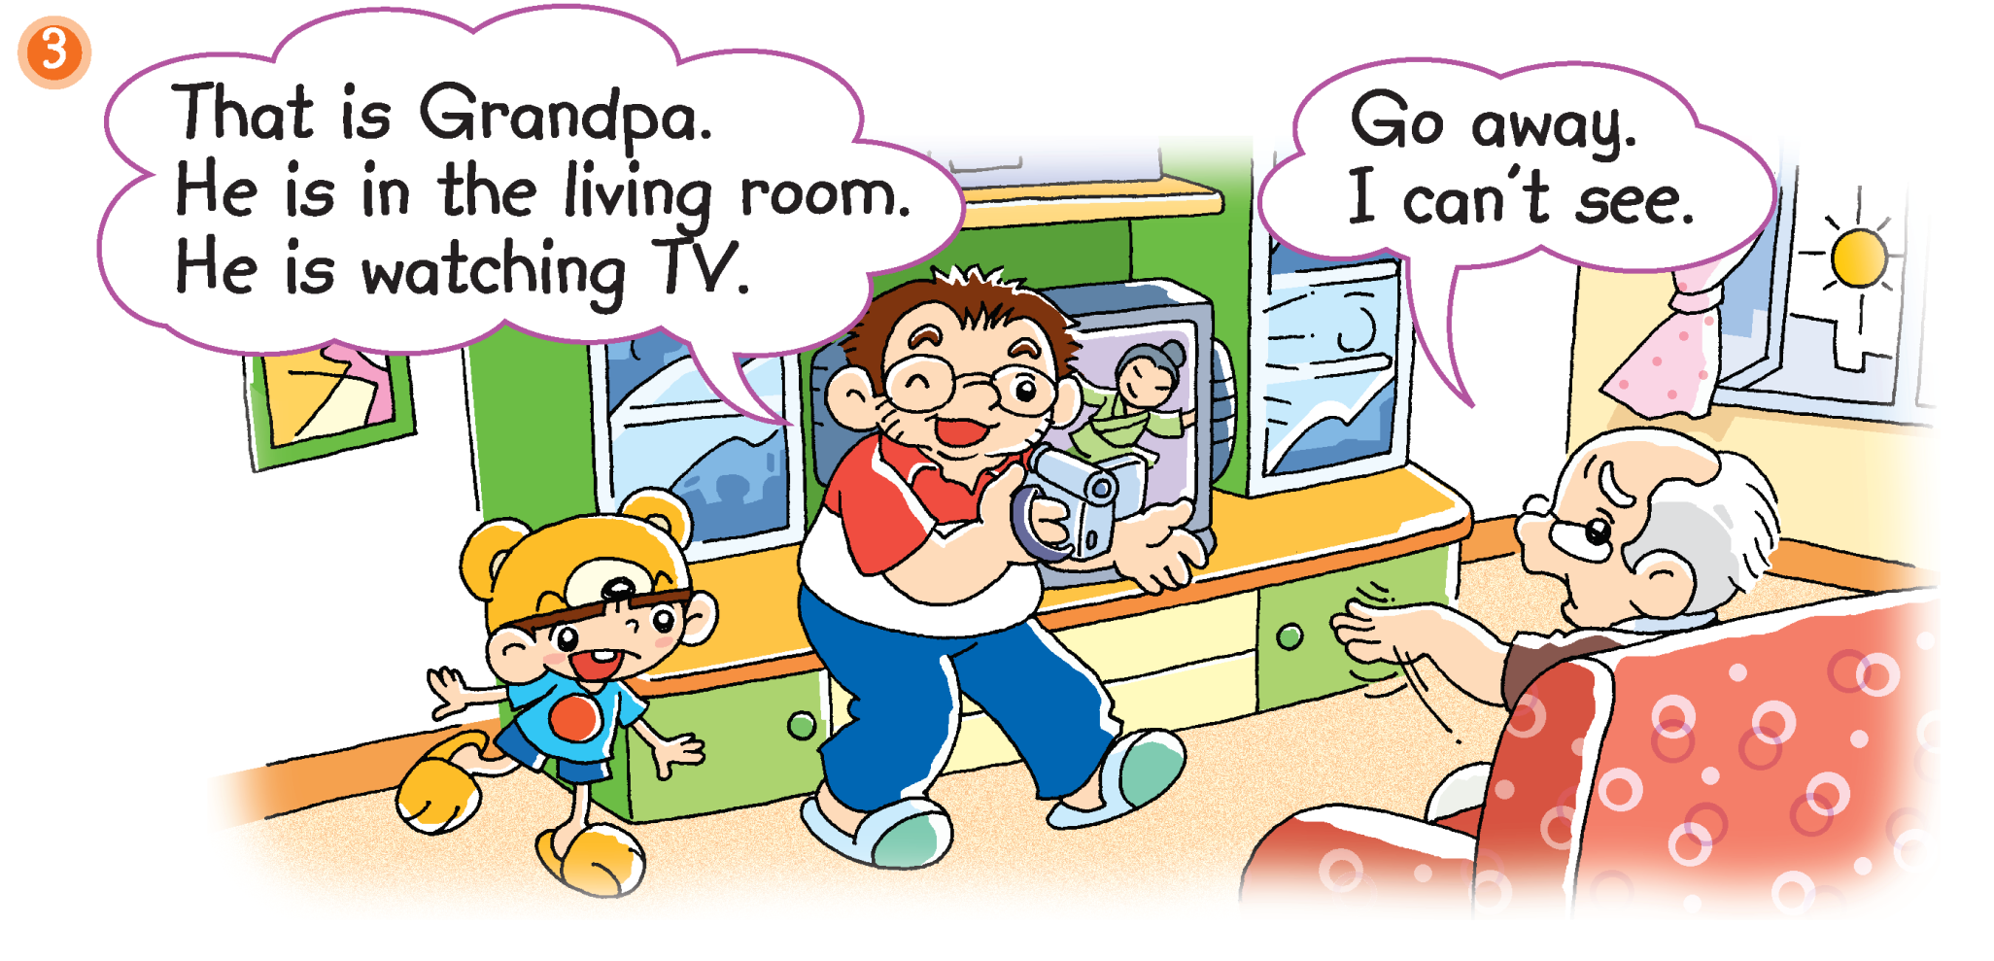
Who is in Dad’s video now?
Does Grandpa want to be in the video?
Notes:
[Click to show the question] Ask Who is in Dad’s video now? (Grandpa.) What is Grandpa doing? (Watching TV.) Where is he watching TV? (In the living room.) – observing / locating specific information
[Click to show the question] Ask Does Grandpa want to be in the video? (No.) How do you know? What does he say? (Go away.) [Click to underline the answer] Say That’s right. Grandpa just wants to watch TV. – inferring / supporting

Slide 11
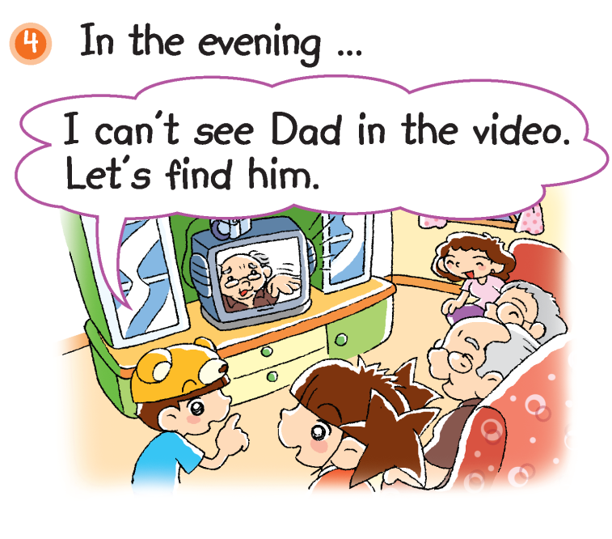
The family are watching the video.
Who is in the video? Do you remember?
Notes:
Say It is evening now. The family are watching Dad’s home video in the living room.
Say Look at Charlie and his family! Do they look happy? (Yes). – observing
[Click to show the questions] Ask Who is in the video? Do you remember? (Grandma, Mum, Cherry, Grandpa.) Ask Is Dad in the video? (No.) Say Right. Dad shot the video. – recalling / inferring
Say Oh! Dad isn’t in the living room. Charlie wants to find him. Mime thinking aloud and ask Where is Dad?
Say Let’s find out!

Slide 12
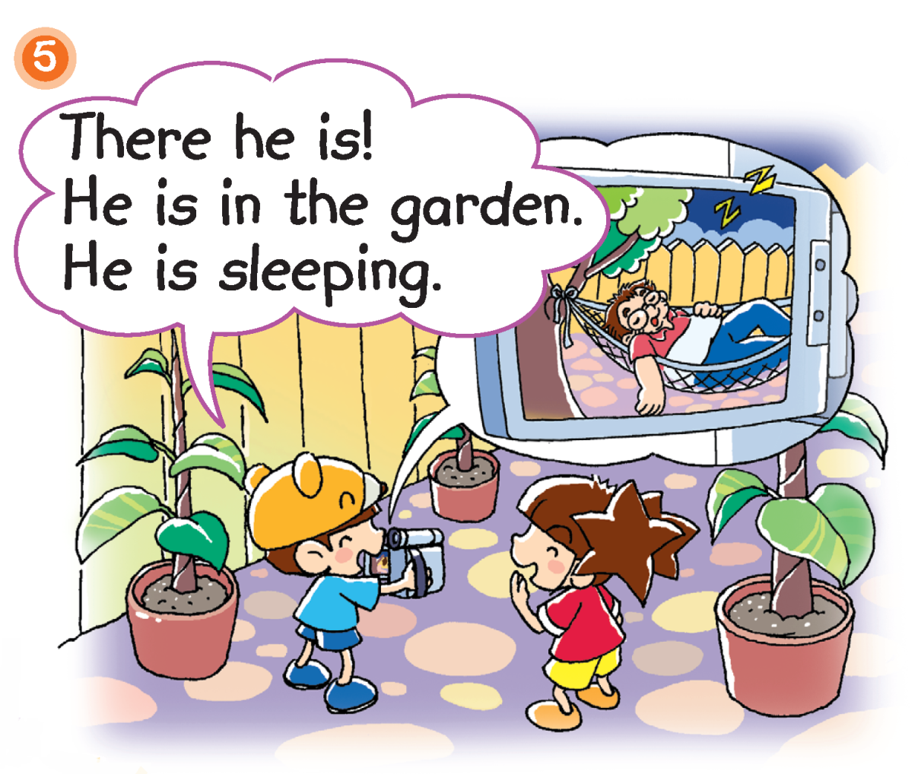
What is Dad doing?
Now Dad is also in the vide.
Notes:
21st century skill: Critical thinking
Say The children see Dad.
Ask Where is Dad? (In the garden.) [Click to show the question] What is Dad doing? (Sleeping.) [Click to underline the answer] Say That’s right. Dad is sleeping. Charlie thinks Dad is funny, so he is filming Dad. [Click to show the narration] Say Now Dad is also in the video. – locating specific information
[Click to show the post-reading questions] Read the questions aloud, Who is not in the video? Why? (Charlie. He is helping Dad make the video.)

Slide 13
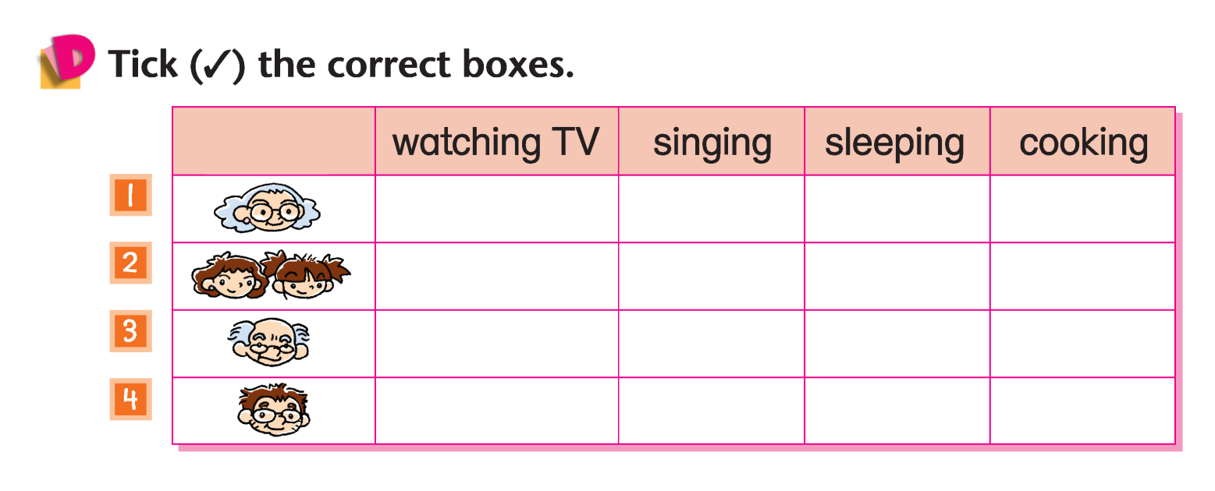
Answers
Notes:
Instruct pupils to complete Part D individually in their books. The activity can be completed in class or for homework.

Slide 14
Let’s do some more activities!
Post-reading

Slide 15
Readers’ theatre
Notes:
Put pupils into groups and assign each group a character / paragraph / section / scene. Ask each group to read their part aloud.

Slide 16
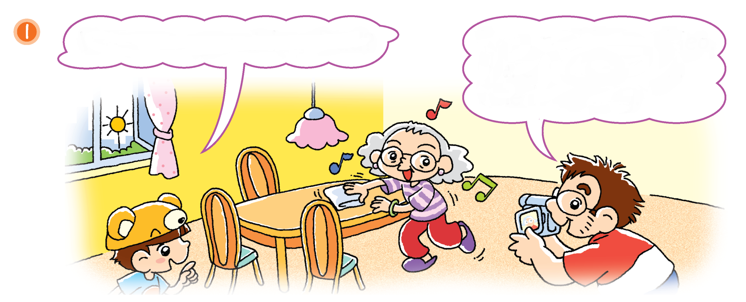
What are you doing, Dad?
I am making a video.
Here is Grandma.
She is cooking.
singing
Notes:
Say I am going to read the story again. Listen carefully. Say ‘Stop’ if you hear anything wrong.
Retell the story with mistakes in each picture, e.g. Here is Grandma. She is cooking. Make sure that pupils say Stop. Elicit the correct sentence from pupils, e.g. She is singing. [Click to show the correct answer]

Slide 17
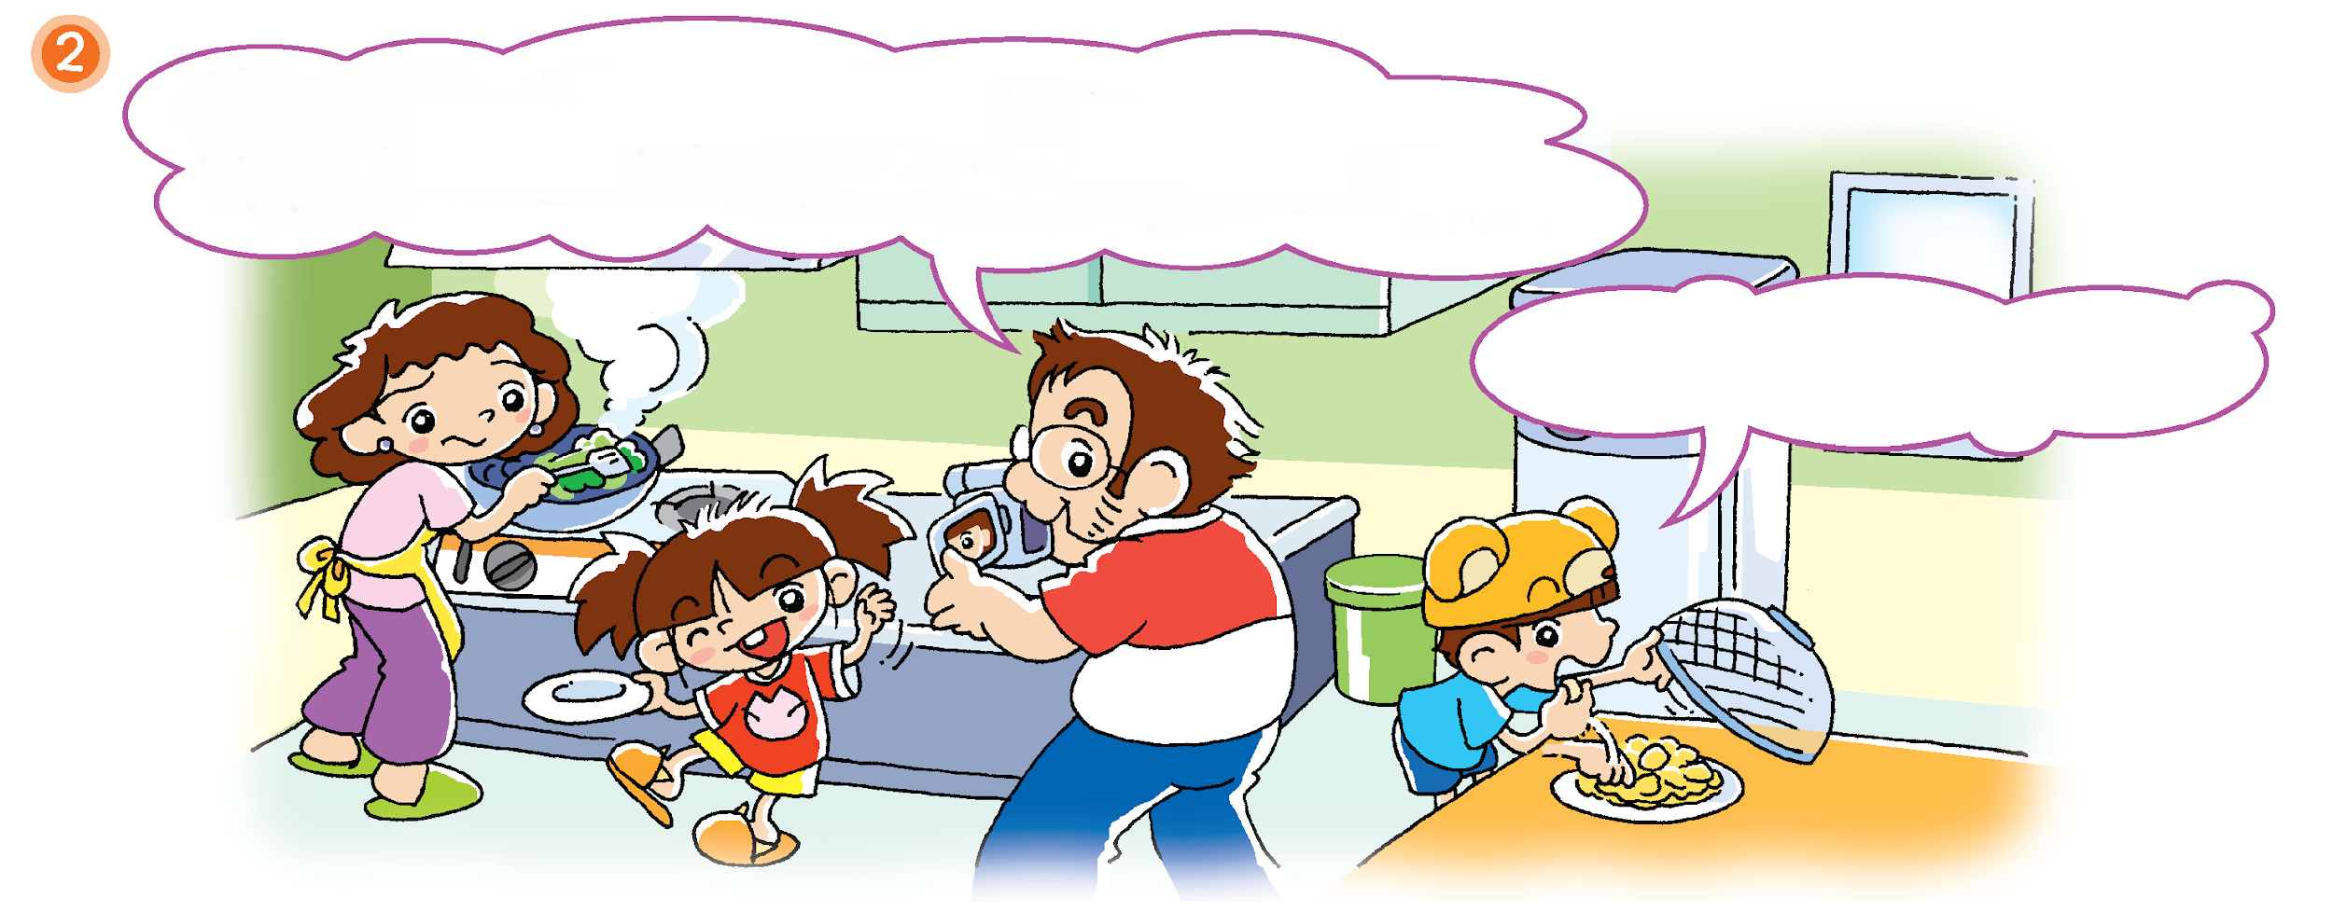
Here are Mum and Cherry.
They are in the kitchen. They are eating.
cooking
Yes, and I am eating.

Slide 18
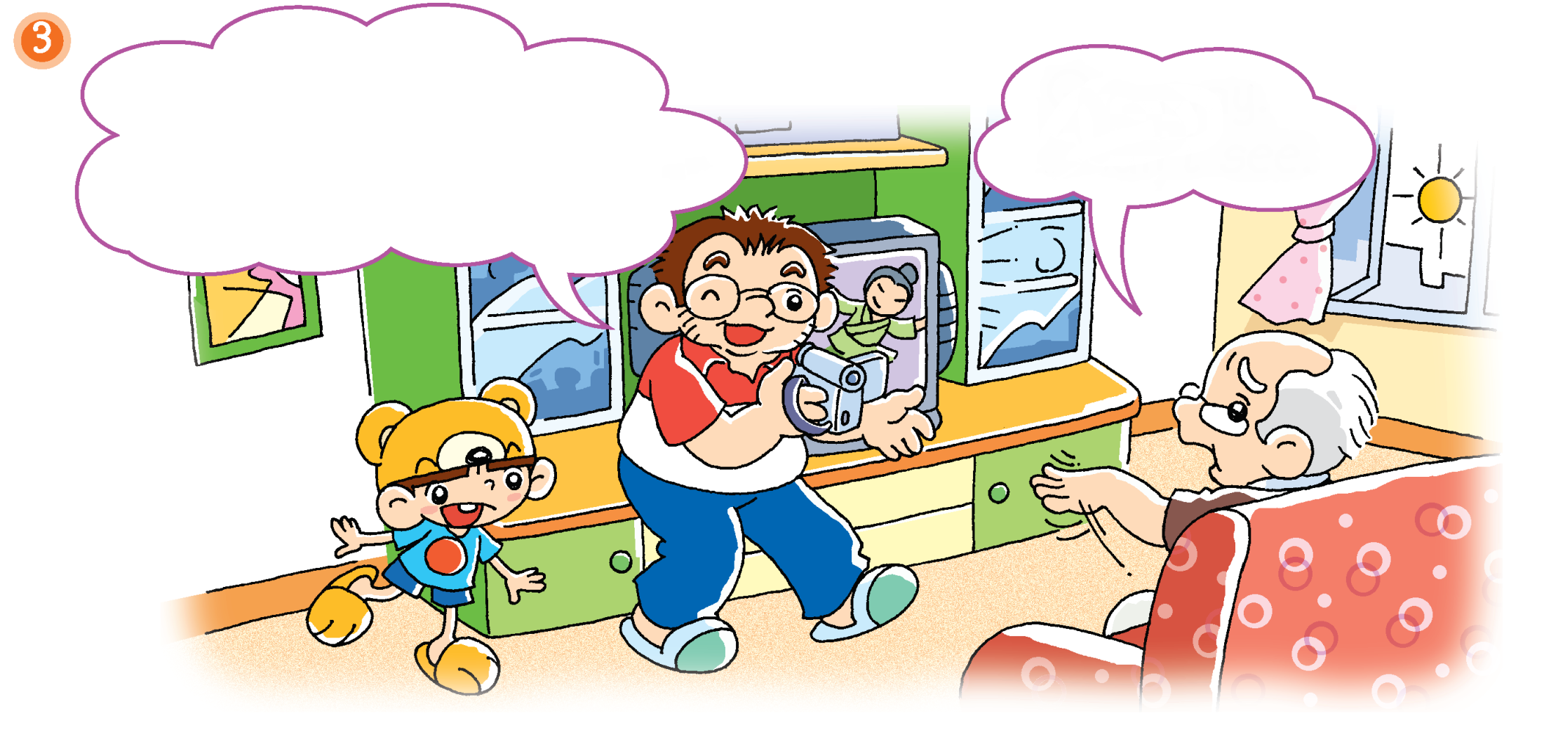
That is Grandpa.
He is in the living room.
He is sleeping.
Go away.
I can’t see.
watching TV

Slide 19
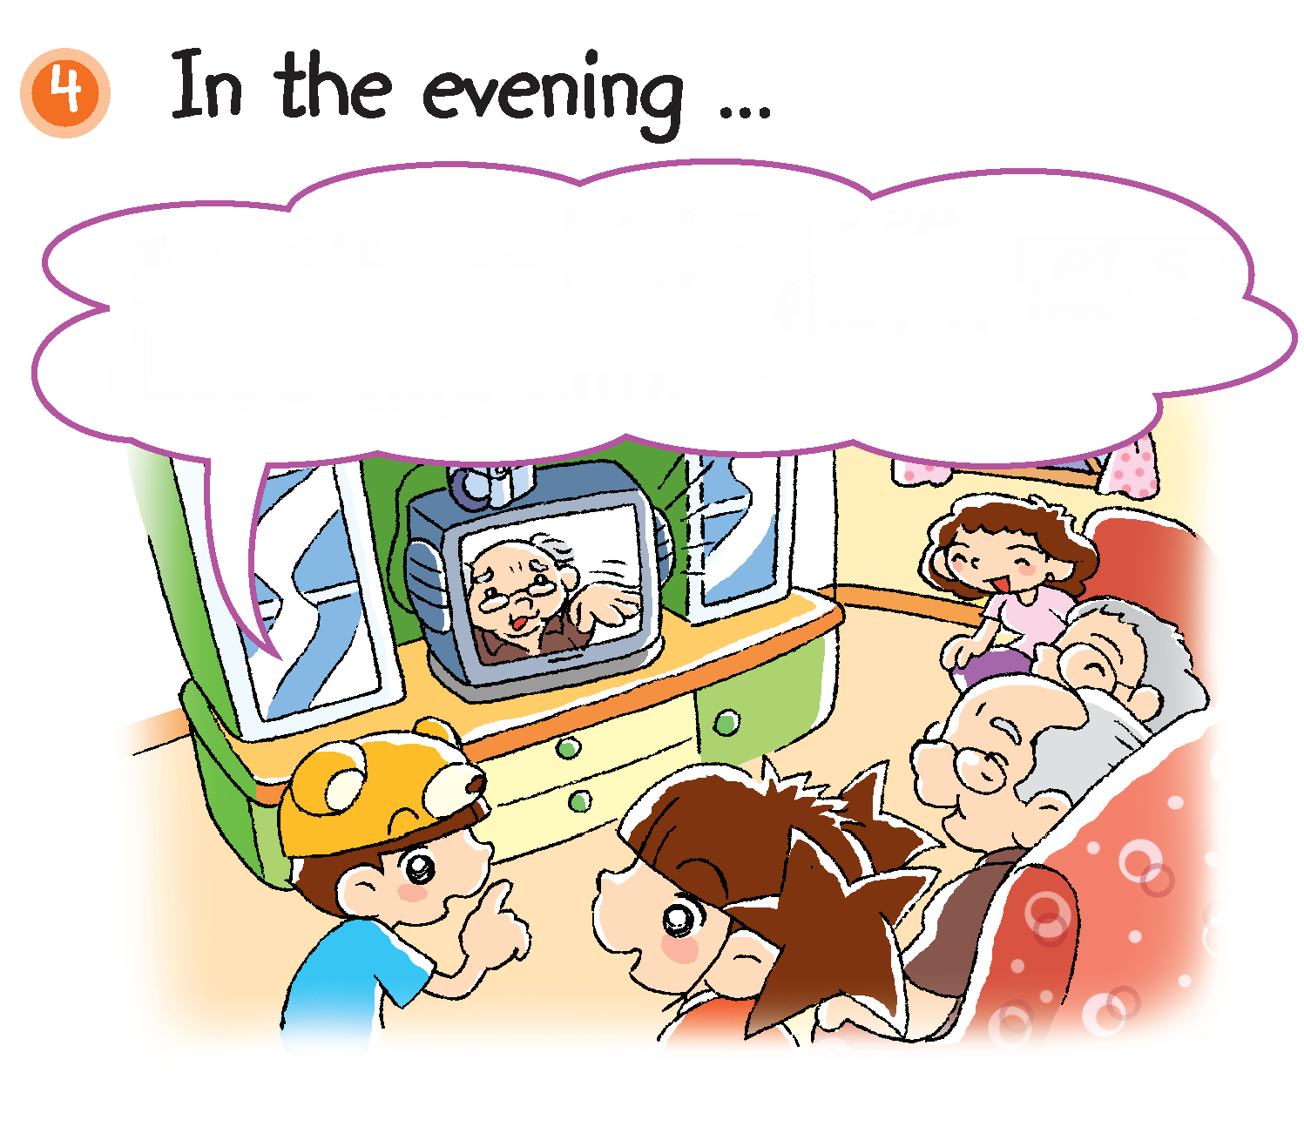
I can’t see Dad in the video.
Let’s find him.

Slide 20
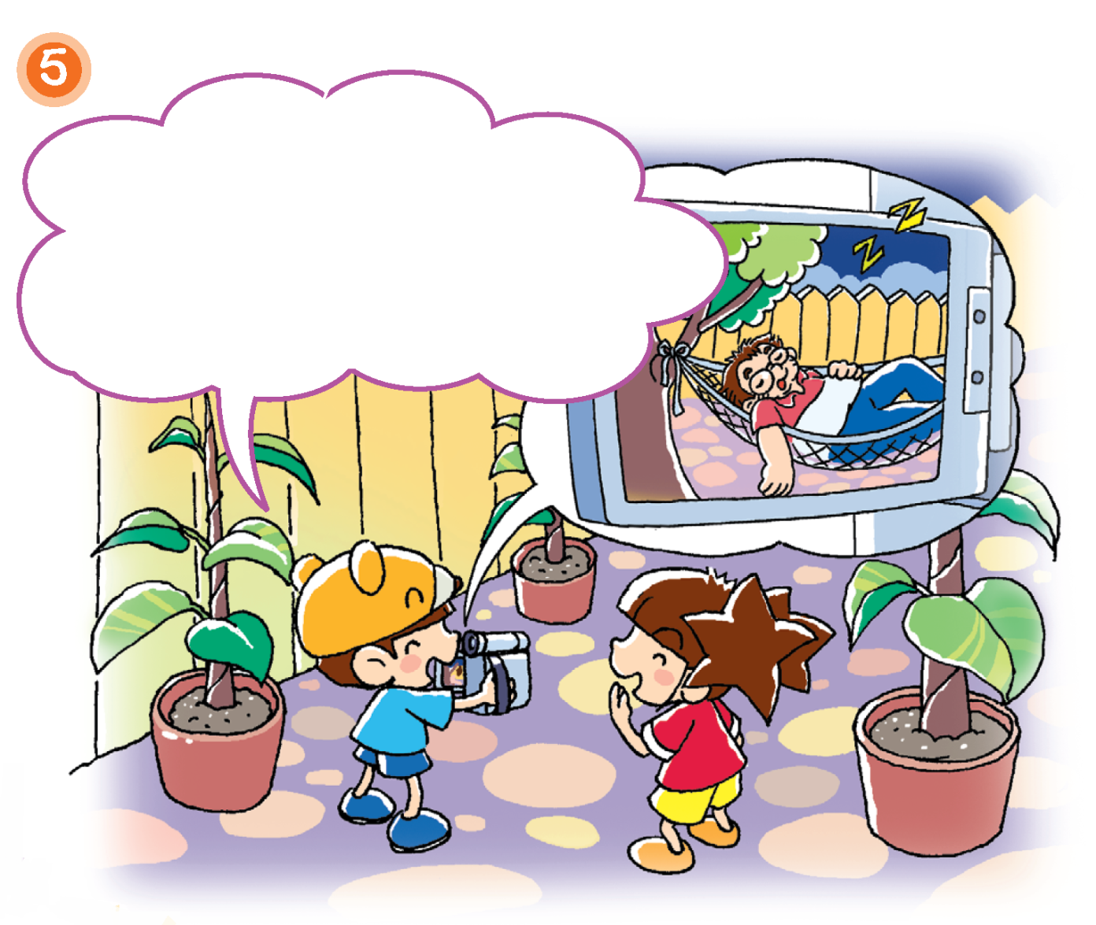
There he is! He is in the kitchen.
He is sleeping.
garden

Slide 21
Here is Charlie.
He is in the _____________. He is ___________.
Notes:
Ask Who is not in the video? Do you remember? (Charlie.)
Say Dad is making a video of Charlie now.
Ask What is Charlie doing in the video? Elicit responses from pupils, e.g. Dancing, running, playing football. Say Now draw and write your answer here.
Print the template for each pupil. Instruct pupils to write their answers in the blanks. When pupils have finished writing, instruct them to draw their answers in the box.
At the end of the activity, you may invite some pupils to come to the front of the class to present their work. You may also choose to display pupils’work.

