Slide 1
Reading Courseware
for Teachers
Chapter 6 A fashion show
Learn to Read

Slide 2
Functions | Values and Attitudes
Talking about what people are wearing | Being polite
Reading Skills
Evaluating the text Giving personal responses to the text Inferring meaning from the text Locating specific information in response to questions Making predictions about the text

Slide 3
Reading
Pre-reading | – Introducing the setting
First reading | – Shared reading
Second reading | – Reading aloud – Activity 1: Assessment for learning
Post-reading | – Activity 2: Readers’ theatre – Activity 3: What colour are the clothes? – Activity 4: Fashion show

Slide 4
Today we are going to read a story. Let’s look at some pictures!
Pre-reading

Slide 5
Cherry
Charlie
a skirt
a T-shirt
Cherry and Charlie are wearing Mum and Dad’s clothes!
Do you like wearing your mum and dad’s clothes?
Notes:
Say Today we are going to read a story about Cherry and Charlie.
Say Here is Cherry and this is Charlie. [Click to show an arrow pointing towards the skirt] Say Look! What is Cherry wearing? (A skirt.) [Click to show the answer] [Click to show an arrow towards the T-shirt] Ask What is Charlie wearing? (A T-shirt.) [Click to show the answer] – observing
Ask Hmm … do their clothes look funny? (Yes.) Are their clothes too big? (Yes.) [Click to show the narration] Say Cherry and Charlie are wearing Mum and Dad’s clothes! They like doing that. – observing
[Click to show the question] Ask What about you? Do you like wearing your mum and dad’s clothes? – giving personal responses

Slide 6
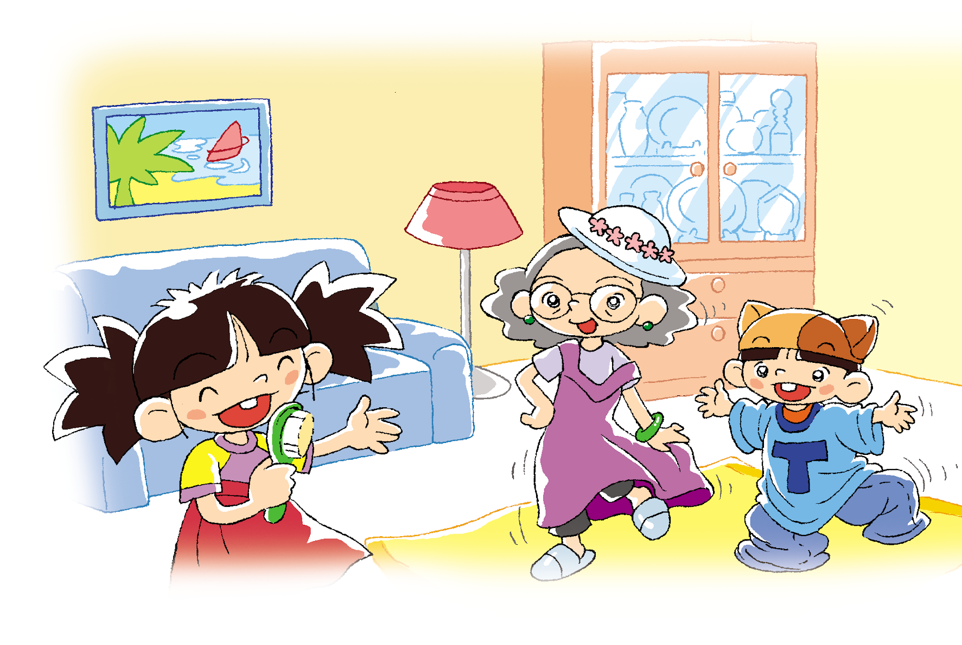
Cherry and Charlie are having a fashion show at home!
Is she in the fashion show too?
Notes:
Say Look! Cherry and Charlie are having a fashion show at home.
[Click to circle Grandma] Ask Oh! Who is this old lady? (Grandma.) [Click to show the question] Ask Is she in the fashion show too? (Yes.) – inferring
Say Let’s read the story and find out about the fashion show!

Slide 7
Let’s read the story!
First reading

Slide 8
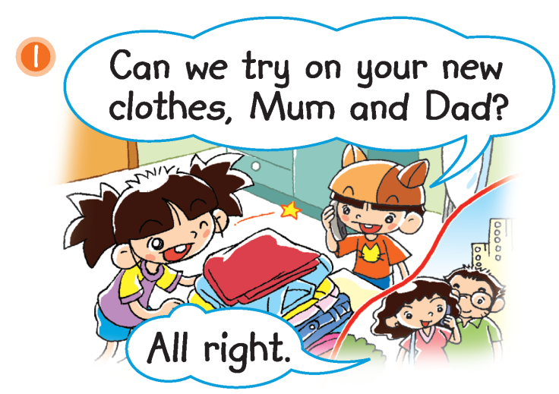
Charlie and Cherry are calling Mum and Dad.
Does this phrase mean
‘yes’ or ‘no’?
Notes:
Mime making a phone call and say Charlie and Cherry are calling Mum and Dad.
Ask Where are Charlie and Cherry? (At home.) Are Mum and Dad at home? (No.) Ask Why is Charlie calling? (He and Cherry want to try on Mum and Dad’s new clothes.) – locating specific information
Ask What do Mum and Dad say? (All right.) [Click to highlight ‘All right.’] Does this phrase mean ‘yes’ or ‘no’? (Yes.) That’s right. ‘All right’ means ‘yes’. – locating specific information / inferring unknown words

Slide 9
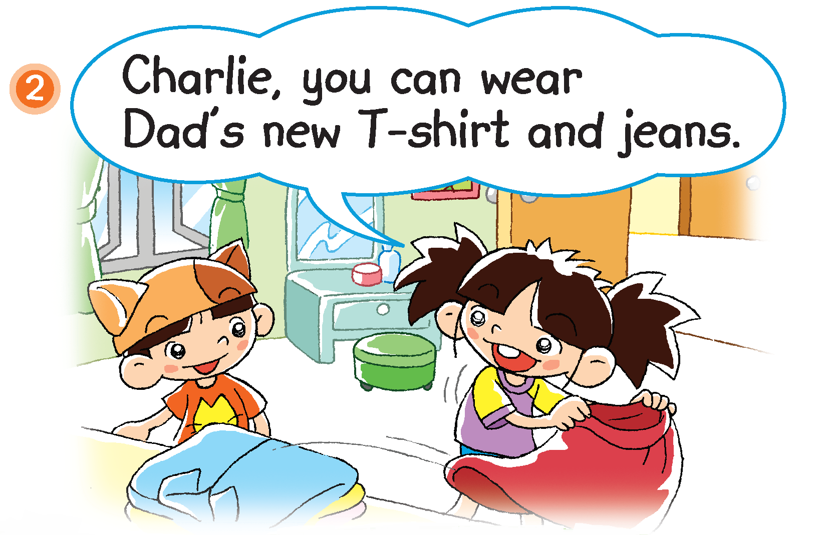
What can Charlie wear?
What can Cherry wear?
Notes:
Say Charlie and Cherry are talking about what clothes they can wear.
[Click to show the question] Ask What can Charlie wear? (Dad’s new T-shirt and jeans.) [Click to underline the answer] – locating specific information
[Click to show the question and an arrow pointing towards the skirt] Ask What about Cherry? What can she wear? (A skirt.) That’s right. Look! Cherry is holding the skirt that she likes. Whose skirt is it? Can you guess? (Mum’s skirt.) – observing / inferring

Slide 10
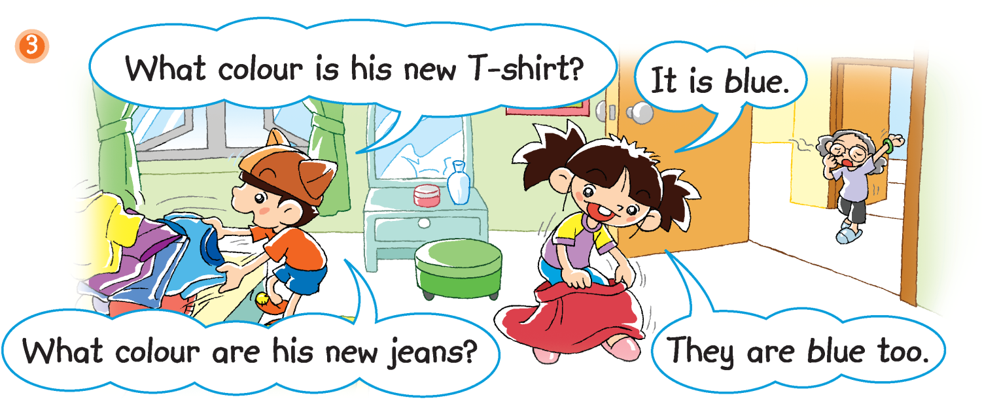
Grandma
Charlie is looking for Dad’s new T-shirt and jeans.
Notes:
Say Charlie is looking for Dad’s new T-shirt and jeans.
Ask What colour is Dad’s new T-shirt? (Blue.) What colour are Dad’s new jeans? (Blue.) – locating specific information
[Click to show an arrow pointing towards Grandma] Say Look! There is Grandma.

Slide 11
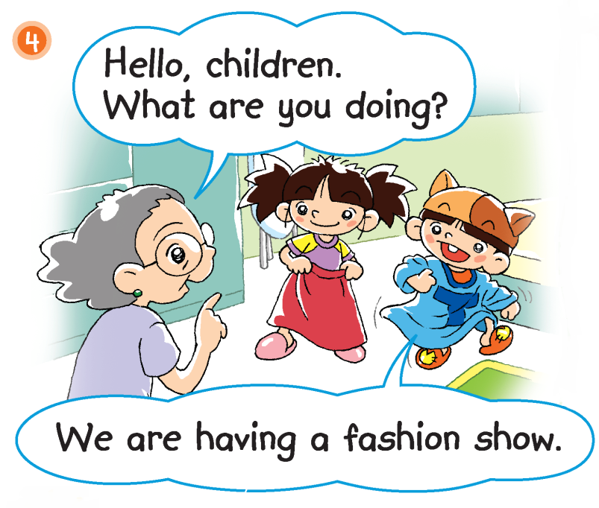
What are the
children doing?
Are they having fun?
Notes:
[Click to show the question] Ask What are the children doing? (Having a fashion show.) [Click to underline the answer and show the question] Ask Are they having fun? (Yes.) – locating specific information / inferring

Slide 12
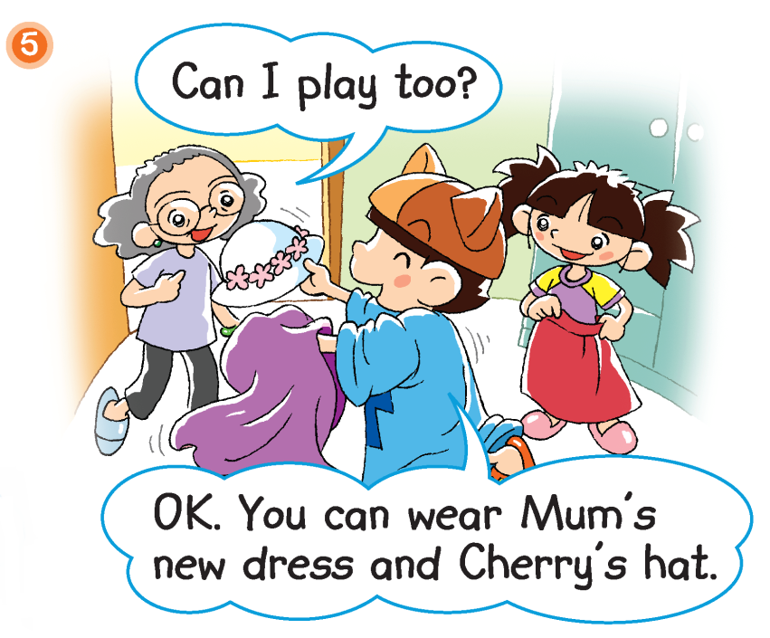
What does Grandma want to do?
What can Grandma wear?
Notes:
[Click to show the question] Ask What does Grandma want to do? (Join in the fashion show.) Say That’s right. She asks, ‘Can I play too?’ She wants to join in the fashion show! – inferring
[Click to show the question] Ask What can Grandma wear? (Mum’s new dress and Cherry’s hat.) [Click to underline the answer] – locating specific information

Slide 13
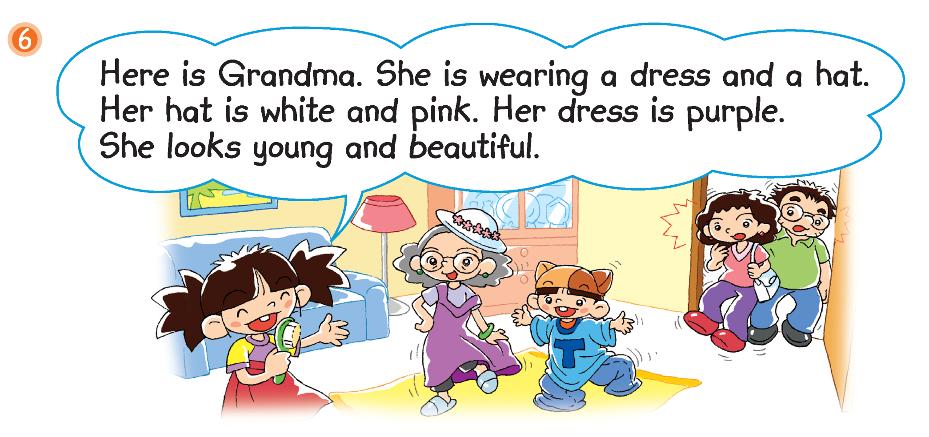
Look! The fashion show is
taking place in the living room.
Mum and Dad are home now. How do they feel?
Notes:
Say Look! The fashion show is taking place in the living room. Grandma is showing her clothes.
Guide pupils to complete the sentences. Her … is white and pink. (Hat.) [Click to reveal the answer] Her … is purple. (Dress.) [Click to reveal the answer] Say Wow, look at Grandma! Ask Does she look nice? (Yes.) Grandma looks young and beautiful! – observing
Ask Are Cherry, Charlie and Grandma having fun? (Yes.) – observing
[Click to circle Mum and Dad] Say Look! Mum and Dad are home now. How do they feel? (Surprised.) Say Mum and Dad are surprised to see the fashion show! – observing

Slide 14
Answers
Notes:
Instruct pupils to complete Part D individually in their books. The activity can be completed in class or for homework.

Slide 15
Let’s do some more activities!
Post-reading

Slide 16
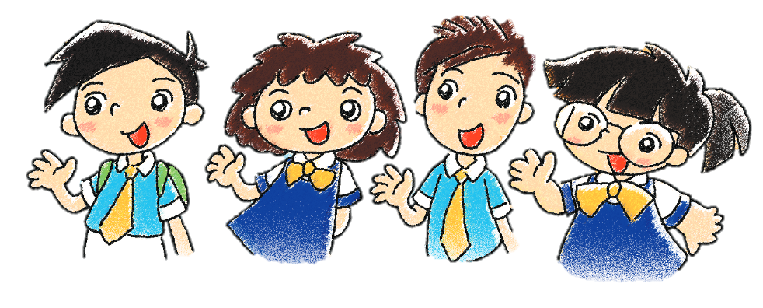
Readers’ theatre
Notes:
Put pupils into groups and assign each group a character / paragraph / section / scene. Ask each group to read their part aloud.

Slide 17
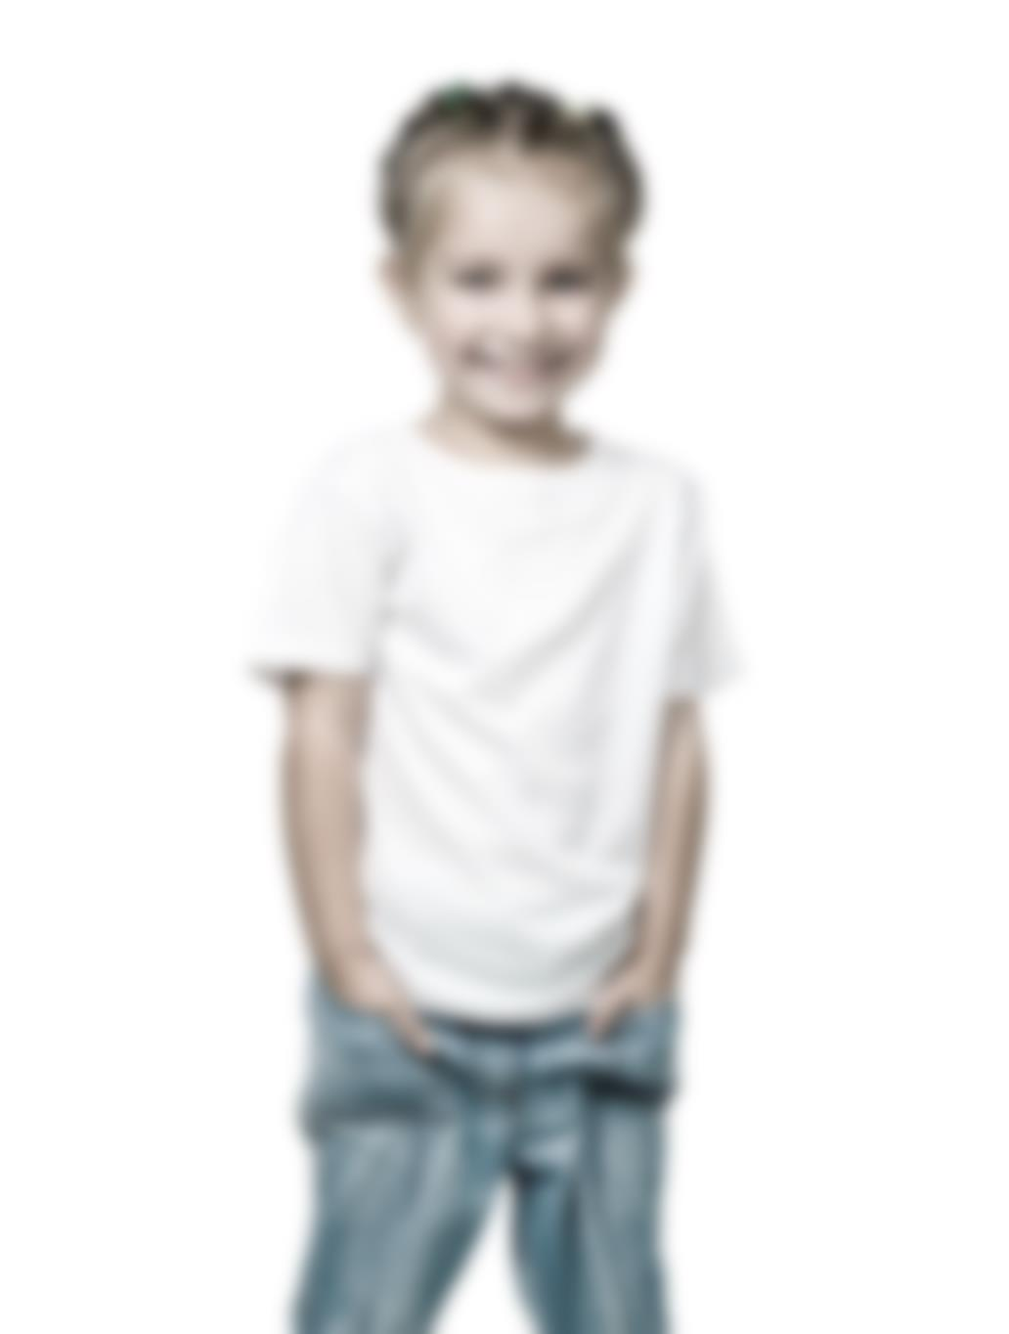
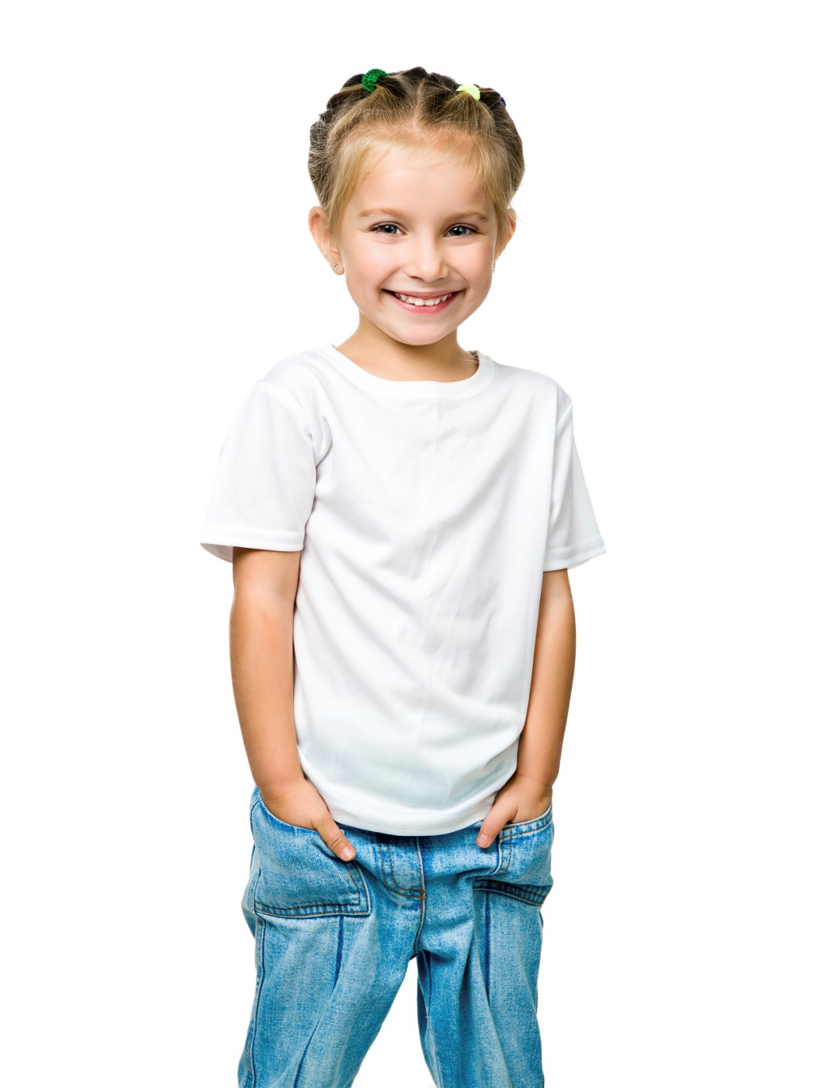
3
blue
What colour are her jeans?
Notes:
Say Charlie and Cherry are guessing the colour of the children’s clothes. Do you want to join them?
[Click to show the question] Ask What colour are her jeans? (Blue.) Elicit guesses from pupils. [Click to make the photo clear and show the answer] Provide feedback for pupils, e.g. Great work!
Repeat the above steps for the next four photos.

Slide 18
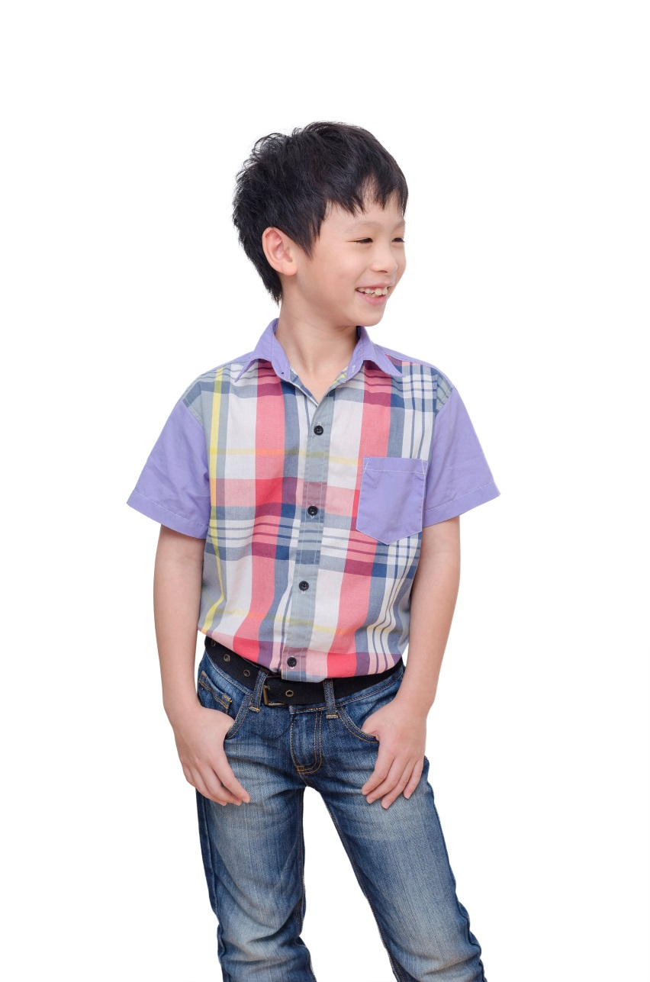
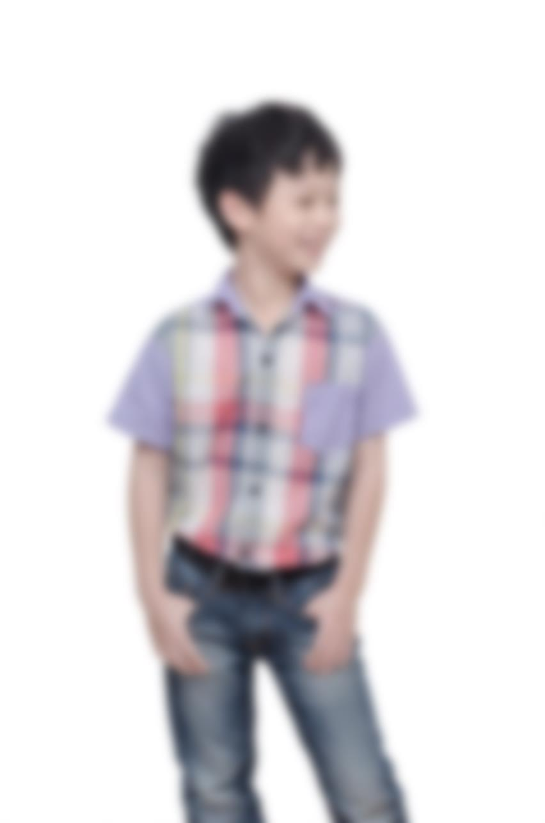
3
purple, red, yellow, white, grey and blue
What colour is his shirt?

Slide 19
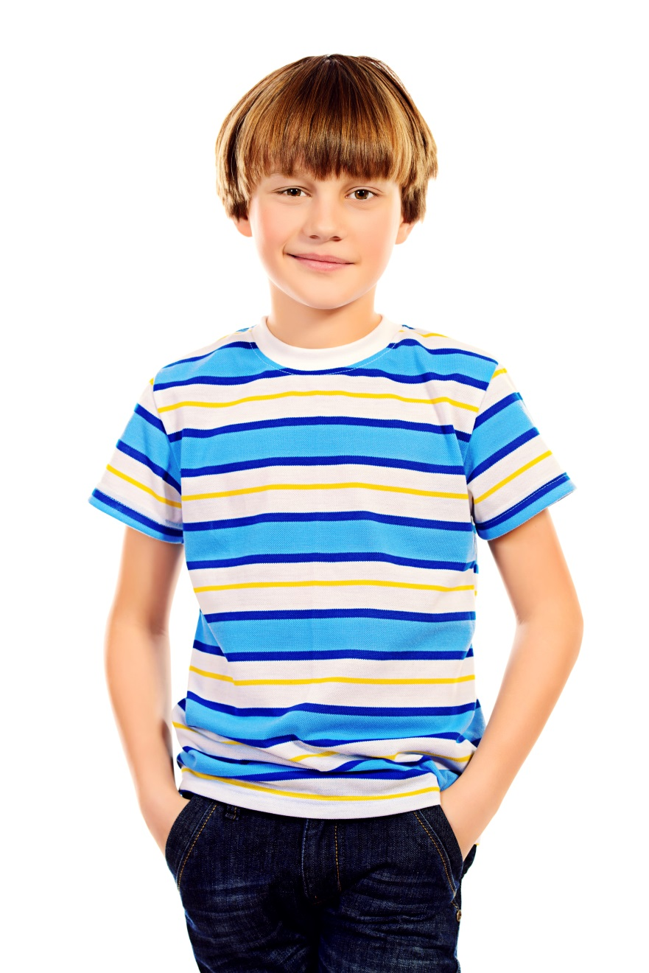
3
white, blue and yellow
What colour is his T-shirt?

Slide 20
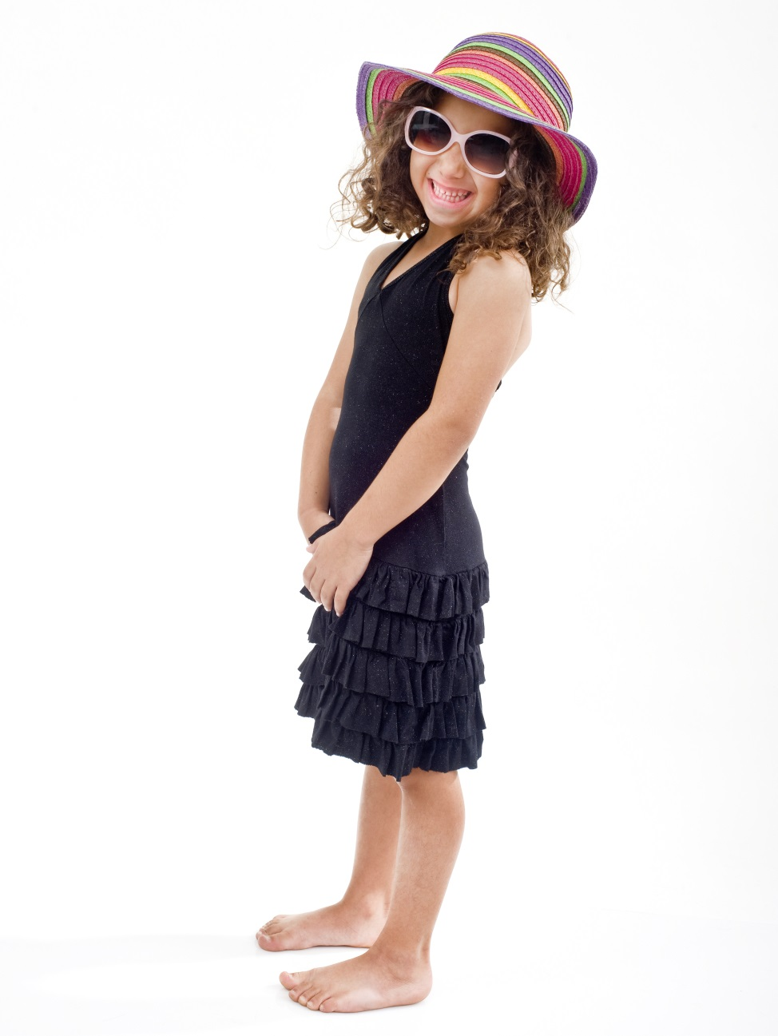
3
black
What colour is her dress?

Slide 21
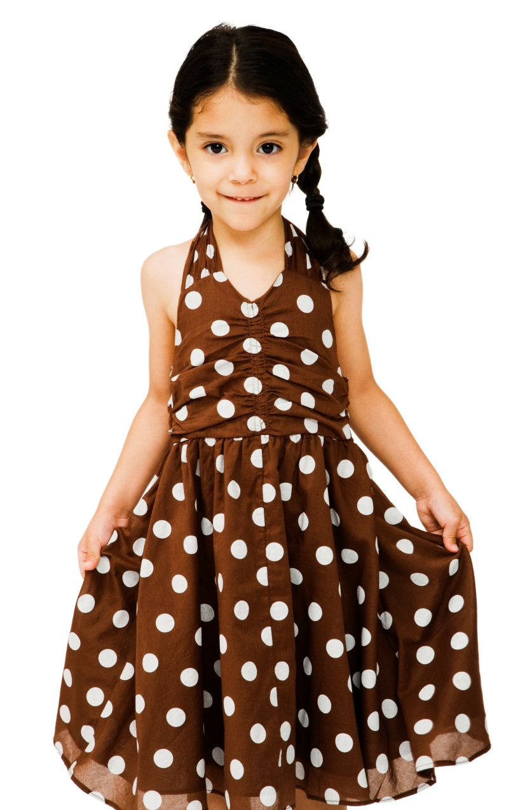
3
brown and white
What colour is her dress?

Slide 22
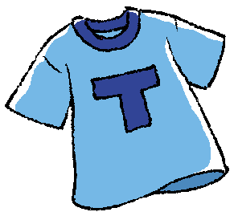
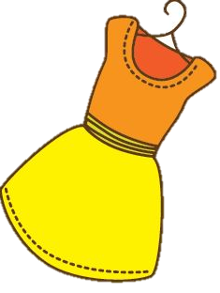
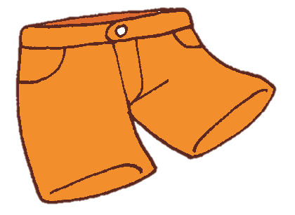
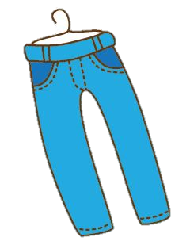
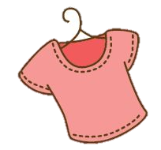
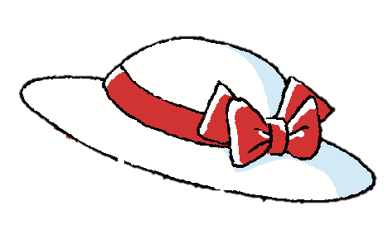
4
Fashion show
Notes:
Say We are going to have our own fashion show! Prepare several sets of clothing for pupils, e.g. T-shirts, shirts, skirts, shorts, hats, caps.
Invite several pupils to take part in the fashion show. Prepare a ‘backstage area’, e.g. outside the classroom, where you can have the pupils put on the clothing.
Then invite the pupils to come into the classroom one at a time. Invite the class to say something about each pupil, e.g. She is wearing a hat. Her hat is white and red.

