Slide 1
Reading Courseware
for Teachers
Chapter 2 About me
Learn to Read

Slide 2
Functions | 21st Century Knowledge and Skills
Talking about where people live Talking about telephone numbers | Critical thinking
Reading Skills
Making predictions about the text Locating specific information in response to questions Inferring meaning from the text Making observations from pictures Supporting inferences or judgments about the text with reasoning

Slide 3
Reading
Pre-reading | – Introducing the setting
First reading | – Shared reading
Second reading | – Reading aloud – Activity 1: Assessment for learning
Post-reading | – Activity 2: Readers’ theatre – Activity 3: Make a chart – Activity 4: Guess the character – Activity 5: Pass the number

Slide 4
Today we are going to read a story. Let’s look at some pictures!
Pre-reading

Slide 5
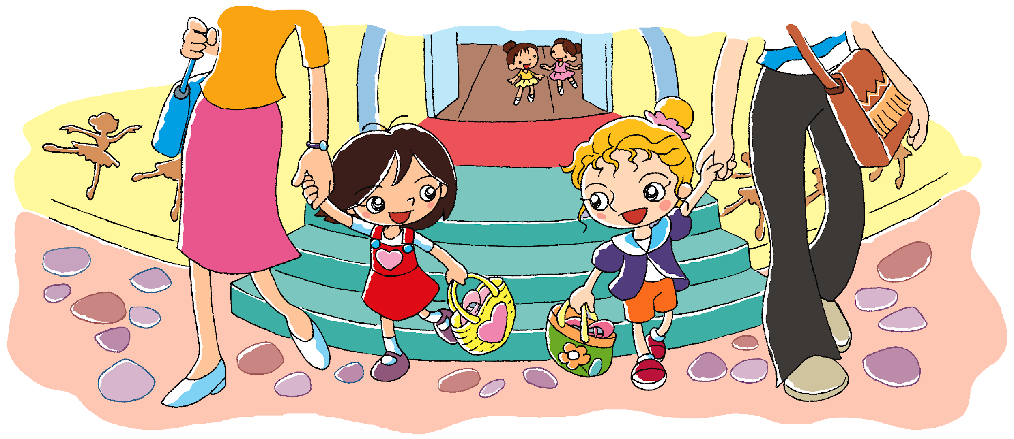
Mary
Kitty
Mary makes a new friend.
What does Mary ask her new friend?
Notes:
Say Today we will read a story about two girls, Mary and Kitty.
[Click to show the name‘Mary’] Say This is Mary. She is living in a new place. Today she goes to a new dance school. Draw pupils’ attention to the dancing figures on the wall, and the dancing shoes in Mary’s bag.
[Click to show the narration] Say In this story, Mary makes a new friend at the dance school. [Click to show the name ‘Kitty’] This is Mary’s new friend, Kitty. [Click to show the guiding question] What does Mary ask her new friend? Can you guess? Stick the cutout of the guiding question at the top of the board. Write pupils’ responses on one side of the board, e.g. What’s your name? – predicting
Say Let’s read the story and find out what Mary asks her new friend!

Slide 6
Let’s read the story!
First reading

Slide 7
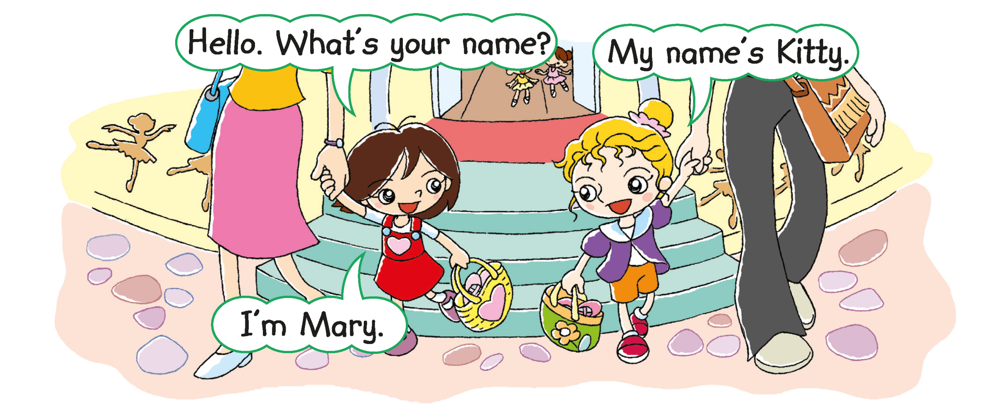
= I am
What does Mary ask?
Notes:
Say Mary and Kitty finish dancing. They are going home with their mothers. Mary sees Kitty and says ‘Hello’.
[Click to show the guiding question] Ask What does Mary ask? (What’s your name?) [Click to underline the answer] Explain that ‘What’s your name?’ means ‘What is your name?’ – locating specific information
Stick the cutout of‘What’s your name?’ on the board under the guiding question ‘What does Mary ask her new friend?’
[Click to highlight ‘I’m’] Explain that ‘I’m Mary.’ means ‘I am Mary.’

Slide 8
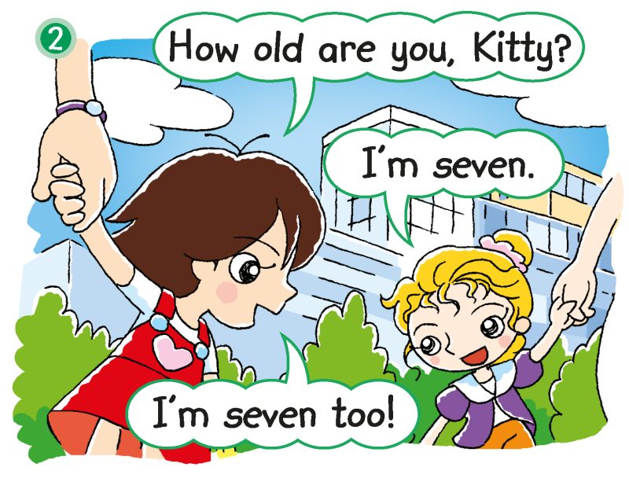
What does Mary ask?
Notes:
[Click to show the guiding question] Ask What does Mary ask? (How old are you [,Kitty]?) [Click to underline the answer] How old is Kitty? (Seven.) – locating specific information
Stick the cutout of‘How old are you?’ on the board under ‘What’s your name?’

Slide 9
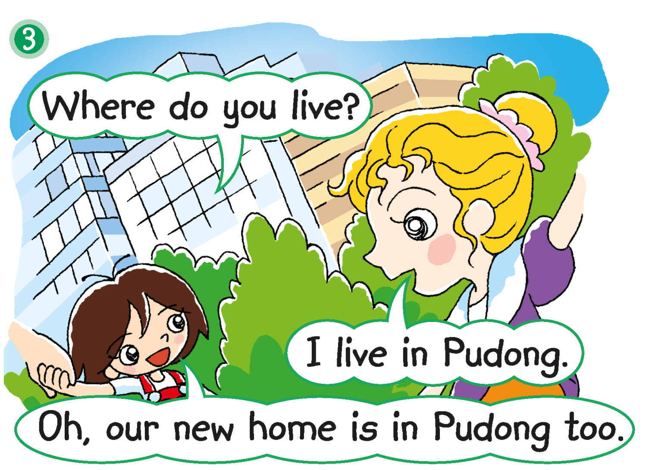
What does Mary ask?
Notes:
[Click to show the guiding question] Ask What does Mary ask? (Where do you live?) [Click to underline the answer] – locating specific information
Stick a cutout of ‘Where do you live?’ on the board under ‘How old are you?’

Slide 10
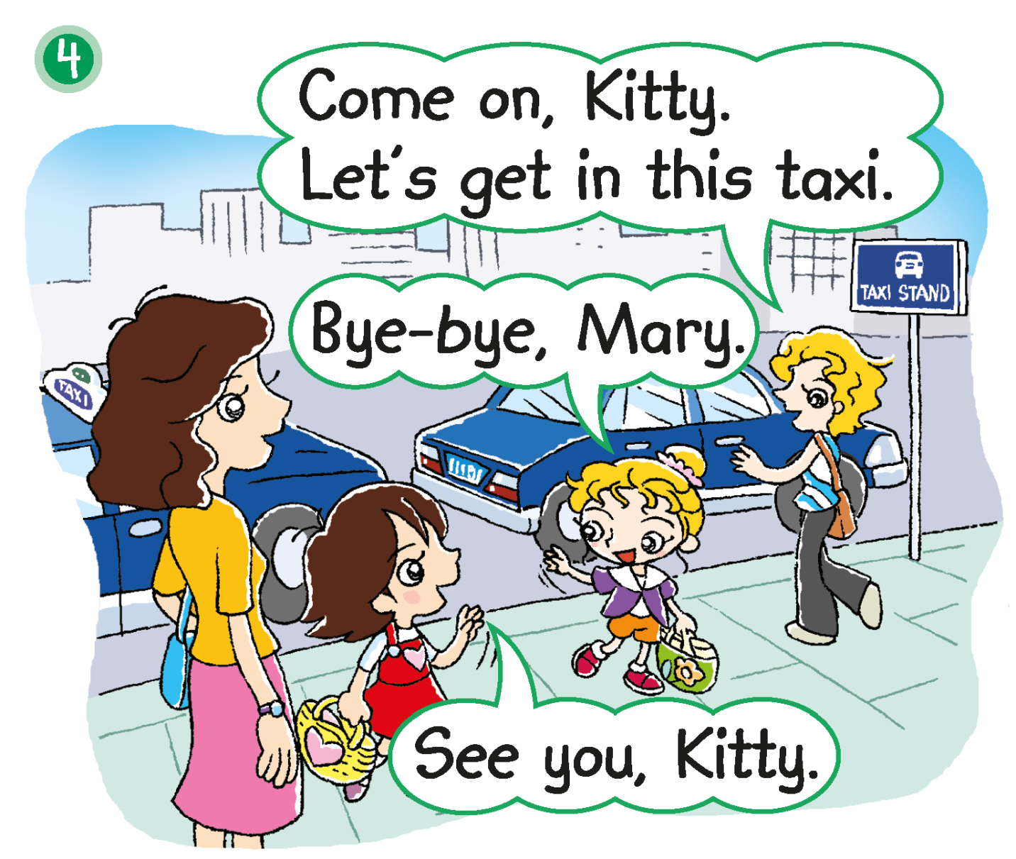
The girls and their mothers are going home.
Notes:
Say The girls and their mothers are going home. Kitty and her mother see a taxi.
Ask How do they go home? (By taxi.) – inferring

Slide 11
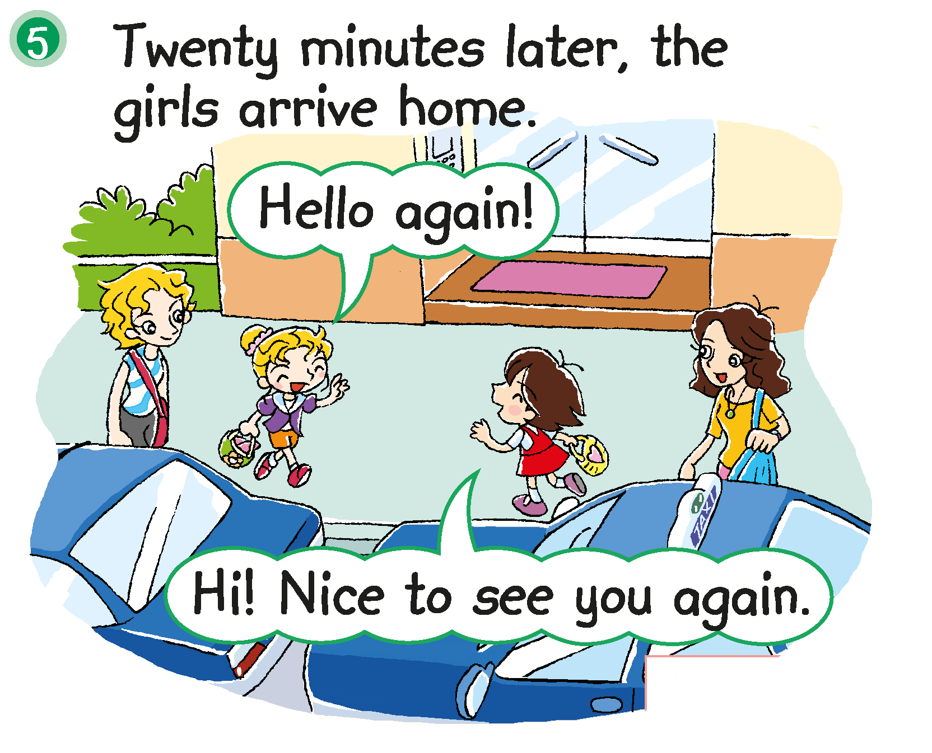
Mary and Kitty live in the same place!
Notes:
Say Kitty and her mother are home. They get out of the taxi. Mime a surprised face and say, They see Mary and her mother! Mary and her mother are getting out of another … (Taxi.)– observing
Ask Where does Kitty live? (Pudong.) Where does Mary live? (Pudong.) Say That’s right. They live in Pudong. They live in the same place! [Click to show the explanation] – recalling
Ask Is Kitty happy to see Mary? (Yes.) How do you know? (She is smiling. / She looks happy.) That’s right. She also says ‘Nice to see you again.’ – inferring / supporting

Slide 12
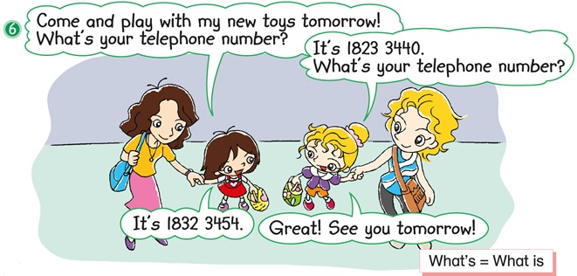
What does Mary ask?
Notes:
21st Century Skill: Critical thinking Say Mary and Kitty live in the same place. They can play together!
Ask What are they going to do tomorrow? (Play with Mary’s new toys.) – locating specific information
[Click to show the guiding question] Ask What does Mary ask? (‘What’s your telephone number?’) [Click to underline the answer] Can she call Kitty and talk to her? (Yes.) – locating specific information / inferring
Stick the cutout of‘What’s your telephone number?’ on the board under ‘Where do you live?’
[Click to show the post-reading questions] Read the post-reading question aloud. Elicit answers from pupils. You may prompt them by asking What do you want to ask a new friend? For less able pupils, you may point to the cutouts on the board and ask them to recall how Mary makes friends with Kitty, e.g. What does Mary ask Kitty? Do you want to ask a new friend these questions? (What else do you want to ask?)

Slide 13
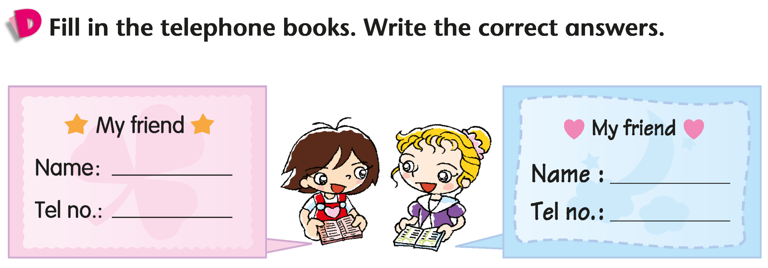
Kitty
Mary
1823 3440
1832 3454
Answers
Notes:
Instruct pupils to complete Part D individually in their books. The activity can be completed in class or for homework. – locating specific information

Slide 14
Let’s do some more activities!
Post-reading

Slide 15
Readers’ theatre
Notes:
Put pupils into groups and assign each group a character. Ask each group to read their part aloud.

Slide 16
Get into groups. Make a chart!
Where we live
Name
Name
Name
Name
Name
Name
Pudong
Puxi
Baoshan
Notes:
Divide pupils into groups of four or five. Instruct pupils to find out where their friends live by asking Where do you live? Each group then makes a chart.
When groups have finished their charts, invite them to come to the front of the class to present their chart, e.g. One pupil lives in Pudong. Two pupils live in Puxi.
You may also choose to display pupils’ work.

Slide 17
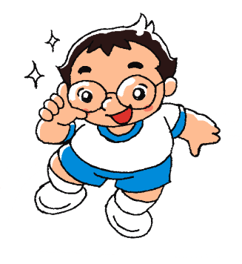
Name: Peter
Age: eight
Where I live: Baoshan
Name: Mary
Age: seven
Where I live: Pudong
Name: Beeno
Age: seven
Where I live: Baoshan
Name: Tom
Age: eight
Where I live: Puxi
Name: Betty
Age: eight
Where I live: Pudong
Name: Cherry
Age: seven
Where I live: Puxi
Notes:
Prepare character cards with each character’s name, age and living place as shown in the slide.
Invite a pupil to come to the front of the class to sit in a ‘hot seat’ that faces the class. Give the pupil a character card.
Display the character profiles. The class has to figure out which character the pupil is by taking turns to ask questions, i.e. How old are you? Where do you live? The pupil should respond with the information on the character card, e.g. I’m seven.

