Slide 1
Reading Courseware
for Teachers
Chapter 2 Our pet friends
Learn to Read

Slide 2
Functions | 21st Century Knowledge and Skills | Values and Attitudes
Talking and asking about location or position | Critical thinking | Caring for pets
Reading Skills
Inferring meaning from the text Locating specific information in response to questions Making guesses about the text Making observations from pictures Relating the text to self

Slide 3
Reading
Pre-reading | – Introducing the setting
First reading | – Shared reading
Second reading | – Reading aloud – Activity 1: Assessment for learning
Post-reading | – Activity 2: Readers’ theatre – Activity 3: Let’s find Ricky – Activity 4: Our pet friends

Slide 4
Today we are going to read a story. Let’s look at some pictures!
Pre-reading

Slide 5
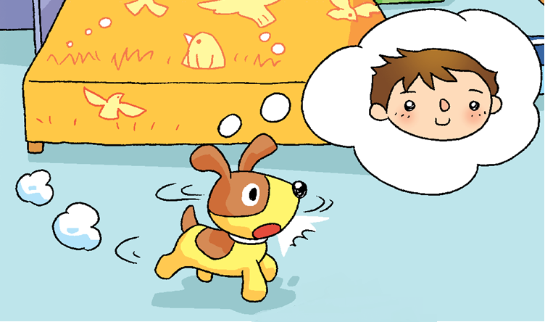
Bob
Ricky
Ricky is Bob’s pet.
Notes:
Say Today we are going to read a story about Bob and his dog Ricky.
Say Look. This is Ricky.
[Click to show the narration] Say Ricky is Bob’s pet. Ask What is Ricky? (A dog.) Do you have a pet? What is your pet? (e.g. A dog. / A cat.) – observing / relating the text to self

Slide 6
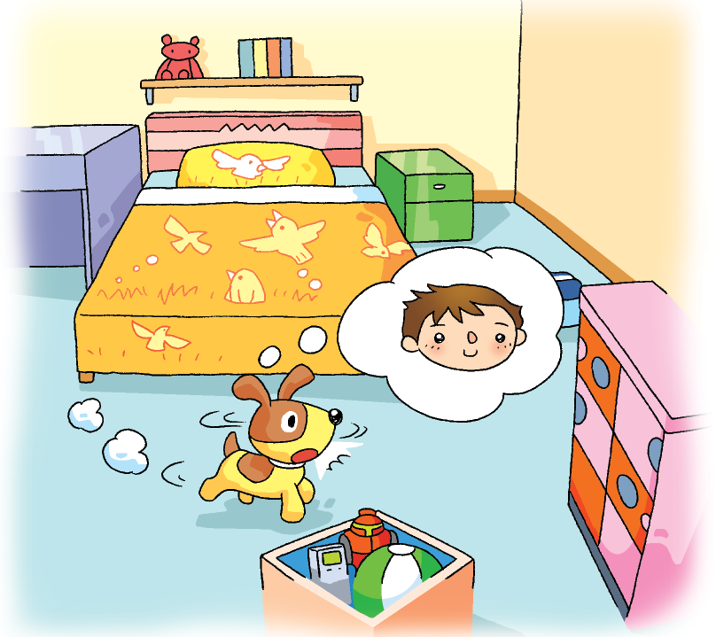
a shelf
a bed
a table
a cupboard
What can you see in Bob’s bedroom?
a box
Notes:
Say Ricky is in Bob’s bedroom.
[Click to show the question] Ask What can you see in Bob’s bedroom? (e.g. A bed. / A cupboard.) [Click to review the vocabulary] Demonstrate how to say each vocabulary item and drill pronunciation. Make sure pupils pronounce ‘bed’ correctly, e.g. /bed/, not /bæd/.

Slide 7
Bob
Ricky
Bob
What is Ricky thinking about?
Ricky
Is Bob here?
Notes:
Say Ricky is thinking about something. [Click to show Bob] [Click to show the question] Ask What is Ricky thinking about? (Bob.) Say That’s right. I think he wants to find Bob. – inferring
[Click to show the question] Mime a sad face and ask Is Bob here? (No.) – observing
Ask Where is Bob? Can you guess? – guessing

Slide 8
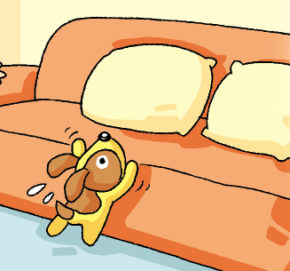
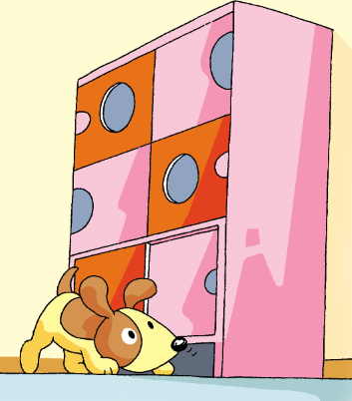
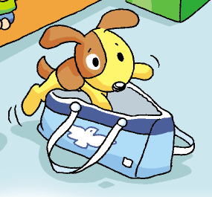
Where is Bob?
Notes:
Say In the story, Ricky looks for Bob in many places. Where does Ricky look for Bob? (Under the cupboard. In the bag. On the sofa.) – observing
[Click to show the question] Mime thinking aloud and ask Where is Bob?
Say Let’s read the story and find out where Bob is.

Slide 9
Let’s read the story!
First reading

Slide 10
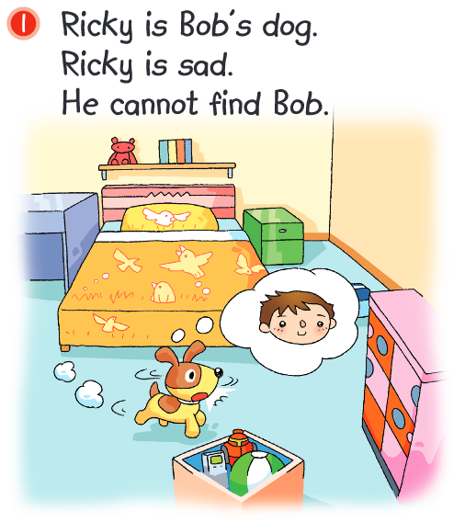
Look at Ricky. How does he feel?
Why is Ricky sad?
Notes:
[Click to show the question] Say Look at Ricky. How does he feel? (Sad.) [Click to underline the answer] – locating specific information
[Click to show the question] Ask Why is Ricky sad? (He can’t find Bob.) [Click to underline the answer] – locating specific information

Slide 11
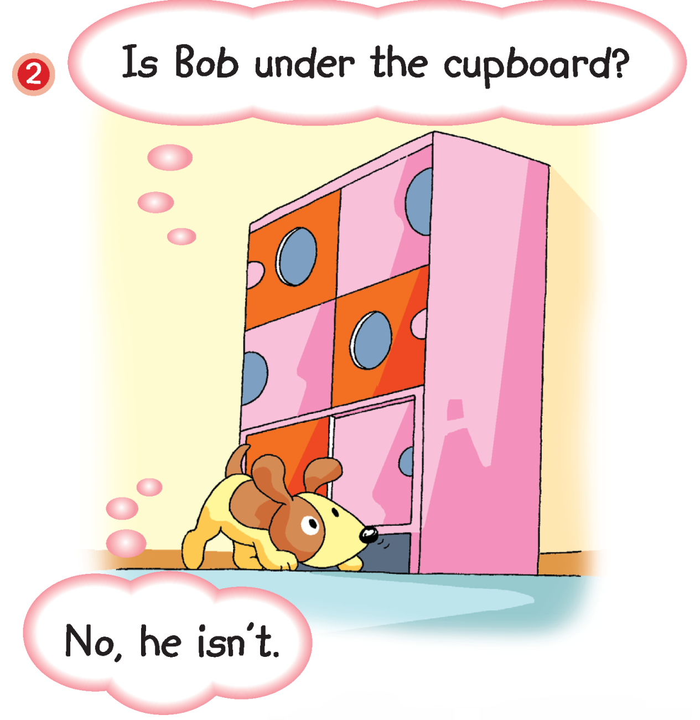
Ricky is looking for Bob.
Is Bob under the cupboard?
= is not
Notes:
Say Look! Ricky is looking for Bob.
Guide pupils to complete the question. Say Ricky is looking for Bob under the … (Cupboard.) [Click to reveal the answer] – locating specific information
[Click to show the question] Ask Is Bob under the cupboard? (No.) [Click to highlight ‘isn’t’] Remind pupils that ‘isn’t’ means ‘is not’. Say That’s right. ‘Isn’t’ means ‘is not’. – locating specific information

Slide 12
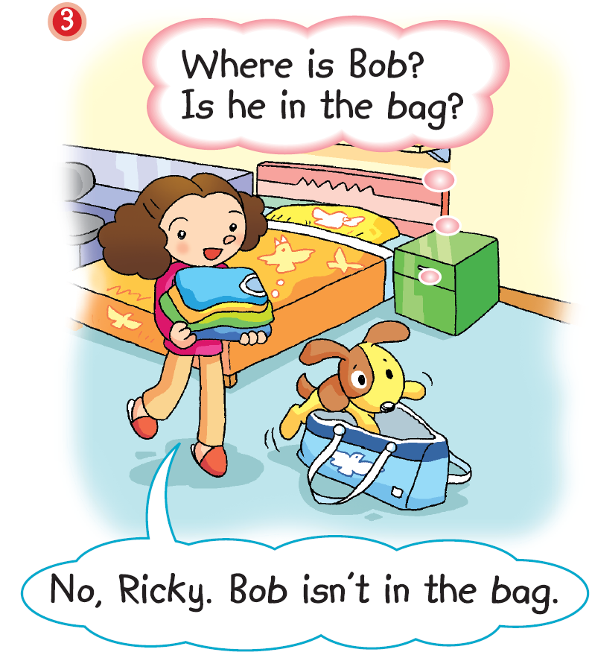
Bob's mum
Is Bob in the bag?
Does Mum know where Bob is?
Notes:
Ask Where is Ricky looking for Bob now? (In the bag.) – locating specific information
[Click to show the question] Ask Is Bob in the bag? (No.) – locating specific information
Say Ricky can’t find Bob. Look at Ricky. Mime Ricky’s expression and ask How does he feel? (e.g. Worried.) – observing
Say Look at Bob’s mum. Is she worried? (No.) [Click to show the question] Does Mum know where Bob is? – observing / inferring
[Click to circle the clothes] Say Look. Mum has some clothes. Mime thinking aloud and ask Hmm … Whose clothes are they? Can you guess? (They are Bob’s.) – inferring

Slide 13
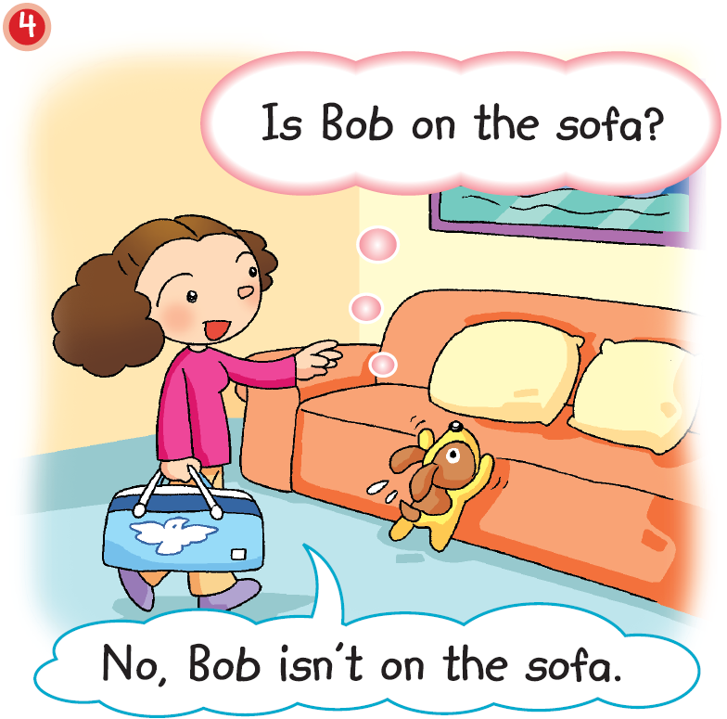
What does Mum say?
Does Mum know where Bob is?
Notes:
21st century skill: Critical thinking
Say Oh! Ricky is looking at the sofa.
[Click to show the question] Ask What does Mum say? Can you guess? [Click to show the answer] Say Oh! She says, ‘No, Bob isn’t on the sofa.’ – predicting
Say Look, Mum is carrying a bag. [Click to circle the bag] Ask Hmm … What is in the bag? Can you guess? (e.g. Bob’s clothes.) – inferring / guessing
[Click to show the question] Say Does Mum know where Bob is? – inferring / guessing
[Click to show the post-reading question] Read the question aloud, Where is Bob? Can you guess? Elicit guesses from pupils.

Slide 14
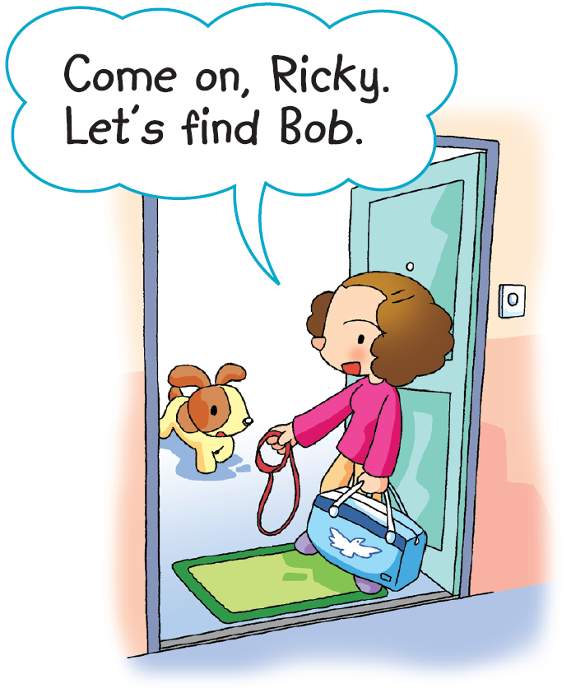
= Let us
Oh! Mum is going out.
Is Mum going to find Bob?
Notes:
Say Oh! Mum is going out.
Say Mum says, ‘Let’s find Bob.’ [Click to highlight ‘Let’s’] Remind pupils that ‘Let’s’ means ‘Let us’.
Mime thinking aloud and ask Does Mum know where Bob is? Is Bob at home? (No.) [Click to show the question] Is Mum going to find Bob? (Yes.) – inferring / guessing
Say Let’s find out where Mum is going!

Slide 15
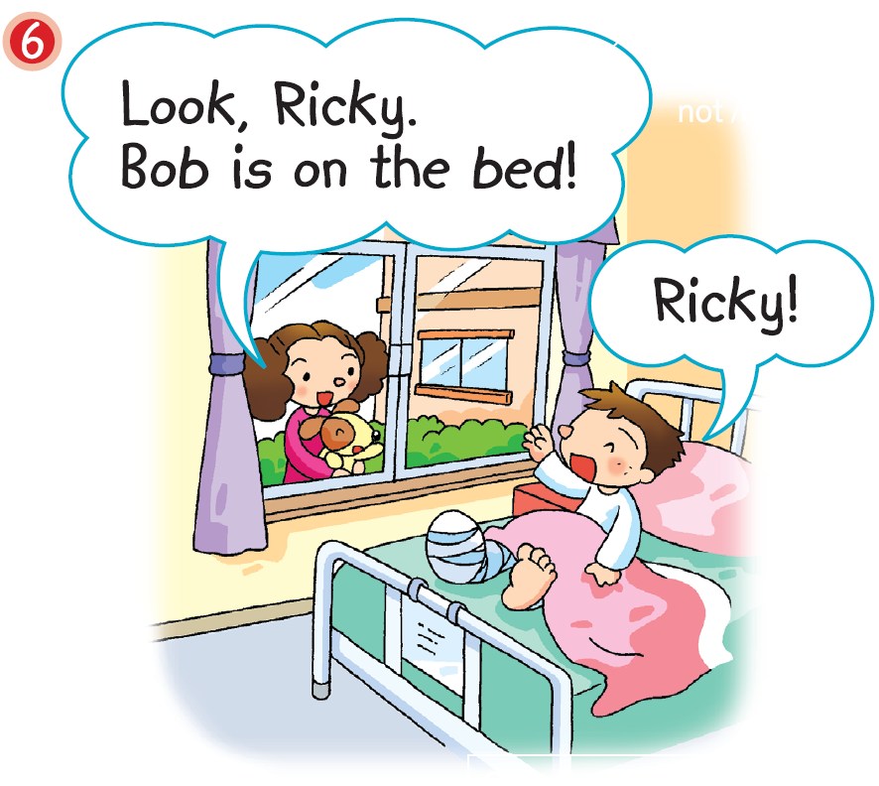
Look! Here is Bob!
Is Bob happy to see Ricky?
Notes:
Say Look! Here is Bob!
Ask Is Bob at home? (No.) Say That’s right. He isn’t at home. Can you guess where Bob is? (In the hospital.) – observing / inferring
[Click to circle Bob’s leg] Say Oh! Look at Bob’s leg. Is Bob OK? (No.) That’s right. Bob’s leg is broken. Can he walk? (No.) – observing / inferring
[Click to show the question] Ask Is Bob happy to see Ricky? (Yes.) Are Ricky and Mum happy? (Yes.) – inferring

Slide 16
Answers
Notes:
Instruct pupils to complete Part D individually in their books. The activity can be completed in class or for homework.

Slide 17
Let’s do some more activities!
Post-reading

Slide 18
Readers’ theatre
Notes:
Put pupils into groups and assign each group a character / paragraph / section / scene. Ask each group to read their part aloud.

Slide 19
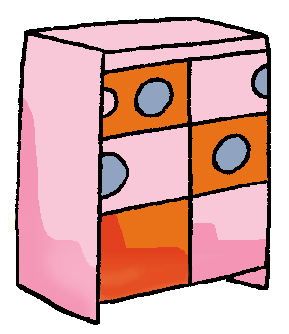
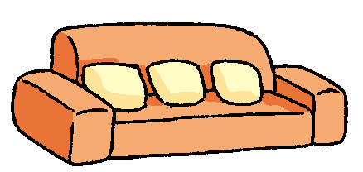
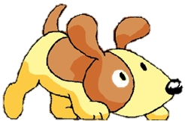
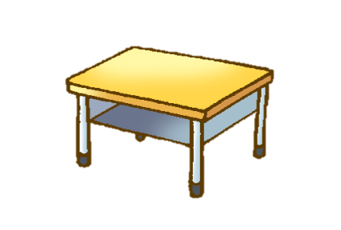
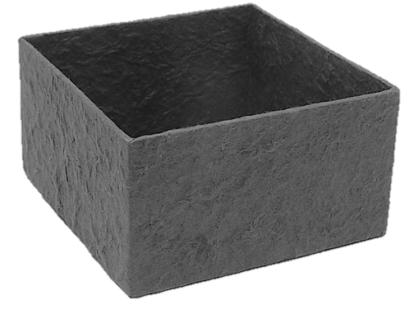
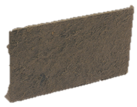
It is morning. Where is Ricky?
Notes:
Say Bob’s dog Ricky hides in different places in the living room in a day.
Say It is morning. Where is Ricky? Invite pupils to tell you where Ricky is, e.g. Ricky is on the sofa.
Repeat the above steps for the other times of the day, i.e. noon / afternoon / evening.

Slide 20
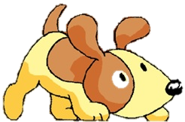
It is noon. Where is Ricky?

Slide 21
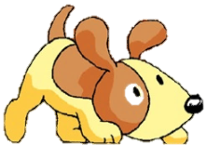
It is afternoon. Where is Ricky?

Slide 22
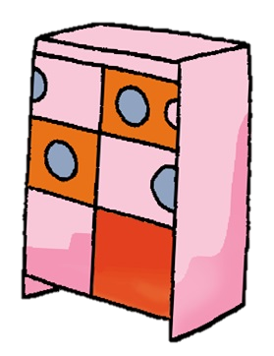
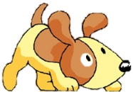
It is evening. Where is Ricky?

Slide 23
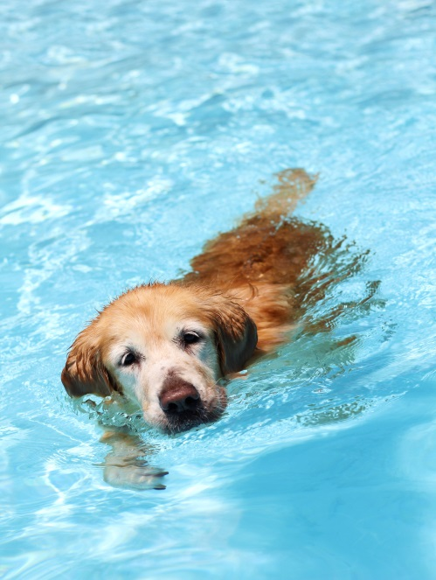
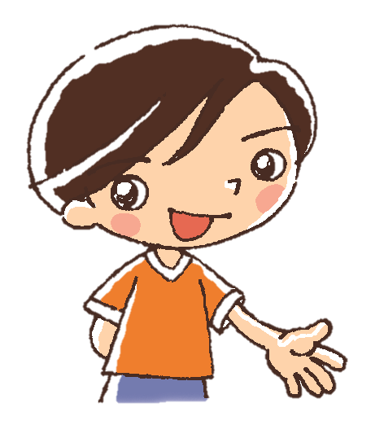
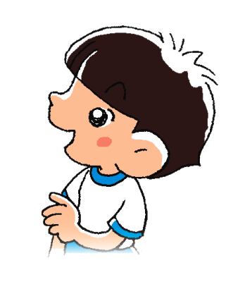
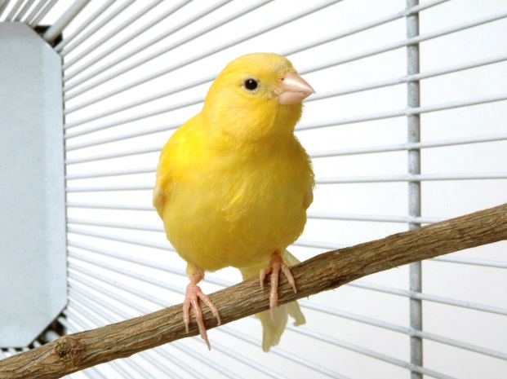
I swim with my pet dog.
I play with my pet cat.
My pet dog
My pet cat
I sing with my pet bird.
Let’s look at what the children do with their pets!
My pet bird
Notes:
Value: Caring for pets
Say In the story, Bob and Ricky are friends. They play together!
[Click to show the narration] Say Let’s look at what the children do with their pets!
Go through each picture and ask what the children do with their pets, e.g. I swim with my pet dog. / I play with my pet cat. / I sing with my pet bird. [Click to show each answer]

Slide 24
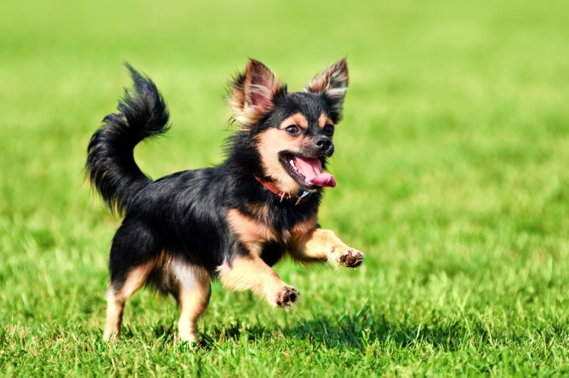
Our pet friends
I like my pet very much.
____ is a ____.
I ___ with my pet.
She
dog
run
What do you do with your pet friend?
Notes:
Value: Caring for pets
Ask How about you? What do you do with your pet friend?
Put pupils in pairs. Instruct each pair of pupils to tell each other about their pet, e.g. I like my pet very much. ____ is a _____. I _____ with my pet.
At the end of the activity, you may invite some pairs to tell the class about their pets.
Ask Does your pet make you happy? (Yes.)
Say Pets are our good friends! We should care for them.

