Slide 1


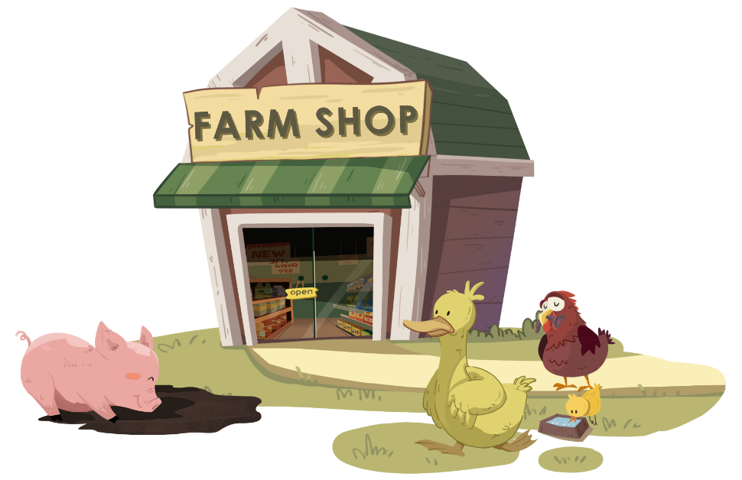


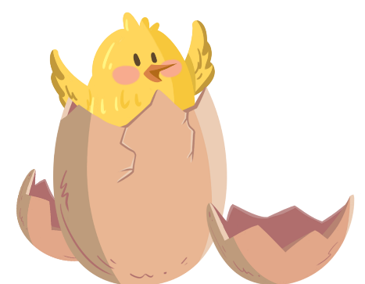

LO: Get to know their partners; get a basic idea about
the topic of today’s lesson;
1. Say hello to Ss; ask Ss to introduce themselves and
greet each other.
2. Introduce the topic of the lesson.
TG
0:30

Slide 2
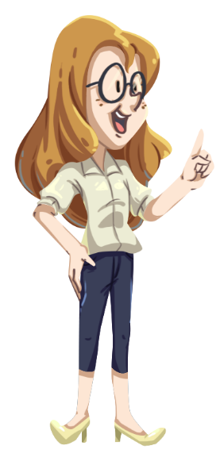
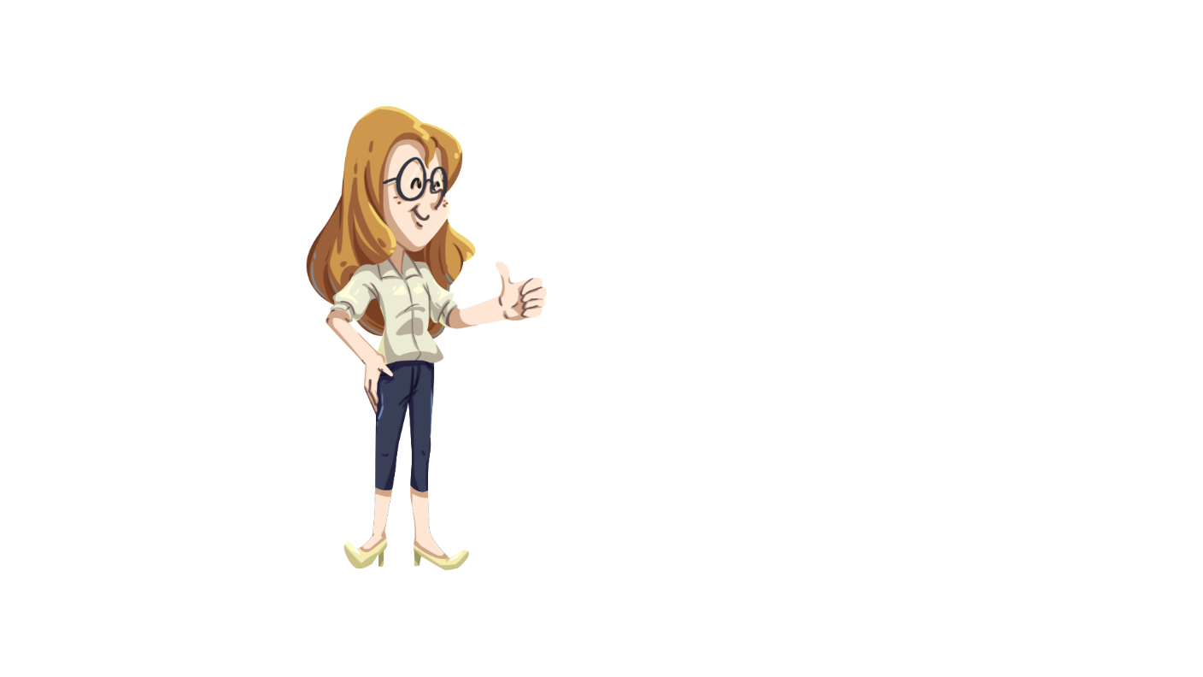


LO: Get to know and understand the class rules.
1. Go through and explain the class rules by doing the
actions.
2. Demonstrate the actions and ask Ss to follow you.
3. Check Ss’ understanding of these rules by doing actions.
TG
Class Rules
Please
1. Listen carefully!
2. Raise your hand!
3. Speak loudly!
0:30
2/30

Slide 3


Learning
Goals
TG
LO: Get to know and understand what will be learned
in this lesson.
Go through the learning goals with Ss.
We are going to . . .
Identify and segment syllables in multi-syllable words.
Learn the key words farm, chick, hatch, lamp, fan, and duckling, and make sentences with them.
Read the story The Odd Egg and identify key details with prompts and support.
Practice using the sentence structure _____ had ________.
1:00
3/30

Slide 4
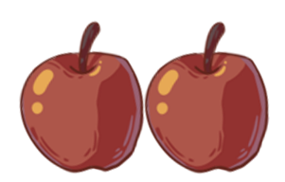
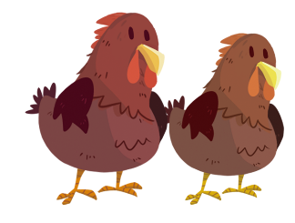
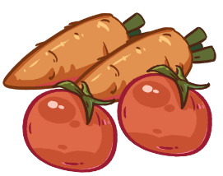
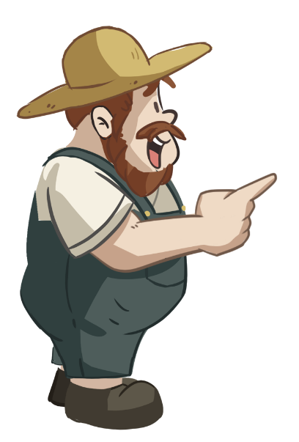
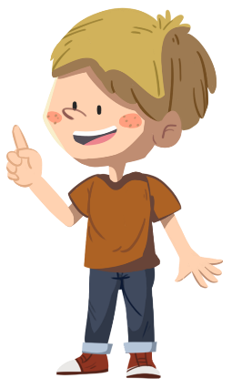

LO: Increase Ss’ attention in listening and speaking; talk
about what a farm has.
Ask Ss the given questions and look at the picture; encourage Ss to use the sentence structure to answer it.
Click the object they answer and the object will fly into the basket.
Guide Ss to think about what else a farm has.
TG
Warm-up
Let’s play!
What can you see on the farm?
I can see ______.
What else can you see on the farm?
2:00
4/30

Slide 5
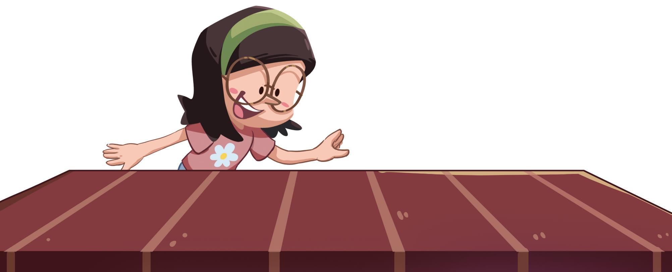
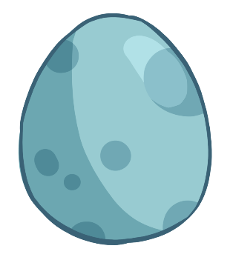
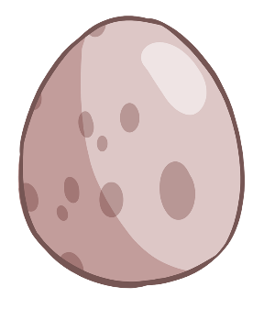
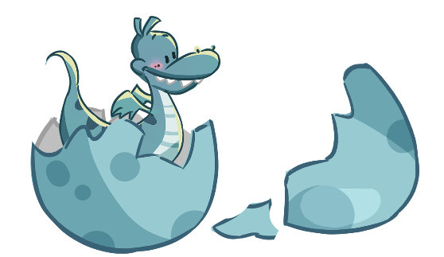
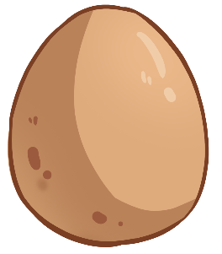
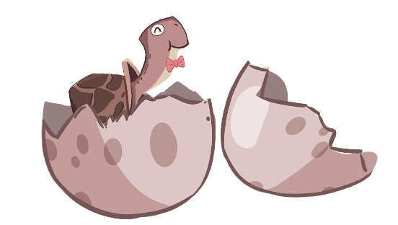
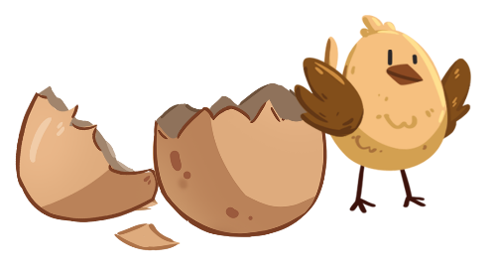
LO: Identify and segment syllables in multi-syllable words.
1. Tell Ss to help the girl discover what is inside each egg
by finding out how many syllables each word has.
2. Click and read the word turkey like tur-key, turkey to
Ss; guide Ss to count the number of syllables in this
word by clapping hands.
3. Read the rest of the two words to Ss; ask Ss to listen
and count the number of syllables in each word.
4. Guide Ss to read each word in this way: tur-key, turkey.
TG
Phonics
Let’s listen and speak!
don
donkey
tur
ling
key
turkey
duck
key
duckling
How many syllables does the word have?
What’s inside each egg?
2:00
5/30

Slide 6
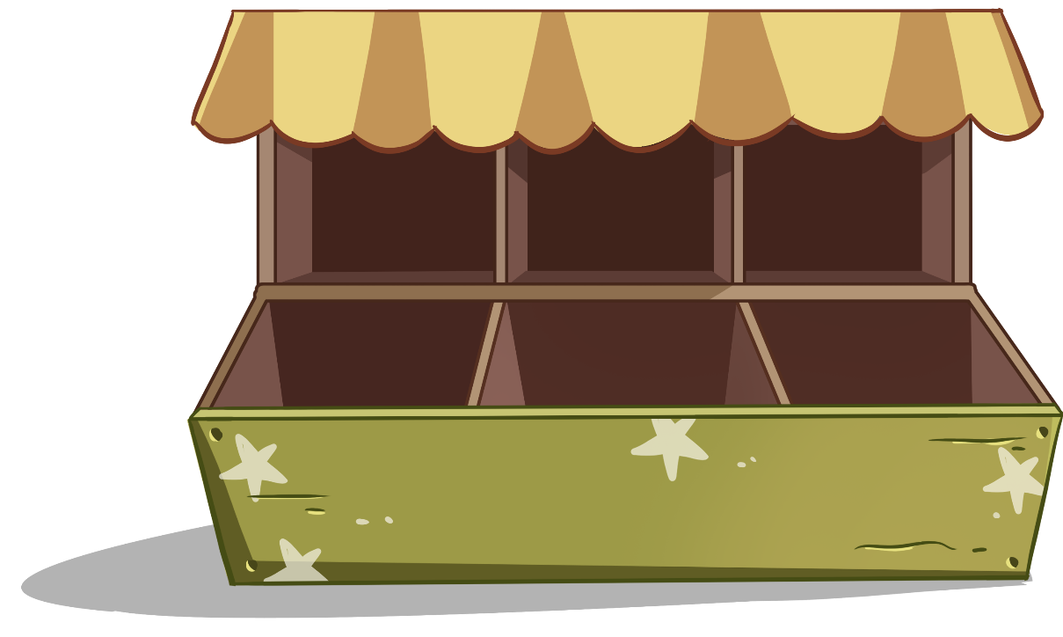
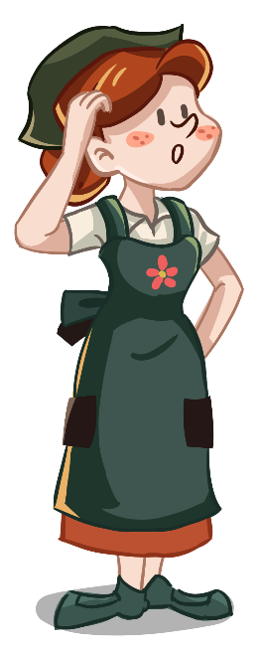
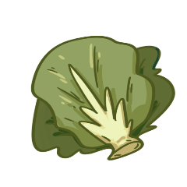

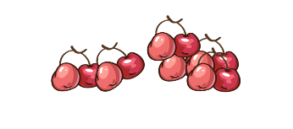
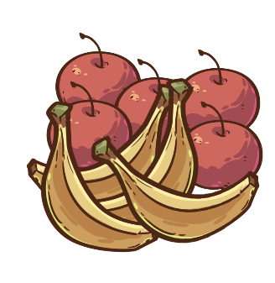
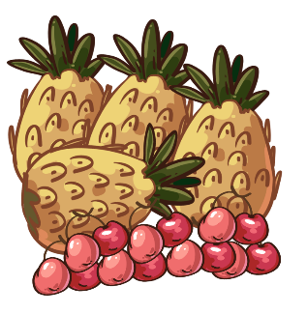
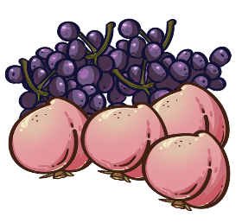
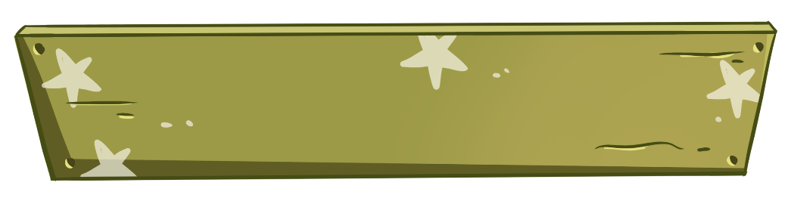
LO: Identify and segment syllables in multi-syllable words.
1. Tell Ss to help the shop assistant fill the shop shelves by
reading the words aloud and identifying the number of
syllables each word has.
2. Click each word that appears and read the words
(swimming, raining & donkey) to Ss in this way: swim-
ming, swimming; ask Ss to listen and count the number
of syllables in each word.
3. Guide Ss to read each word in this way: rain-ing, raining.
TG
Phonics
Phonics
Phonics
Let’s listen and speak!
run
ning
swim
raining
running
swimming
ming
rain
ing
How many syllables does each word have?
Can you help me fill the shelves?
2:00
6/30

Slide 7
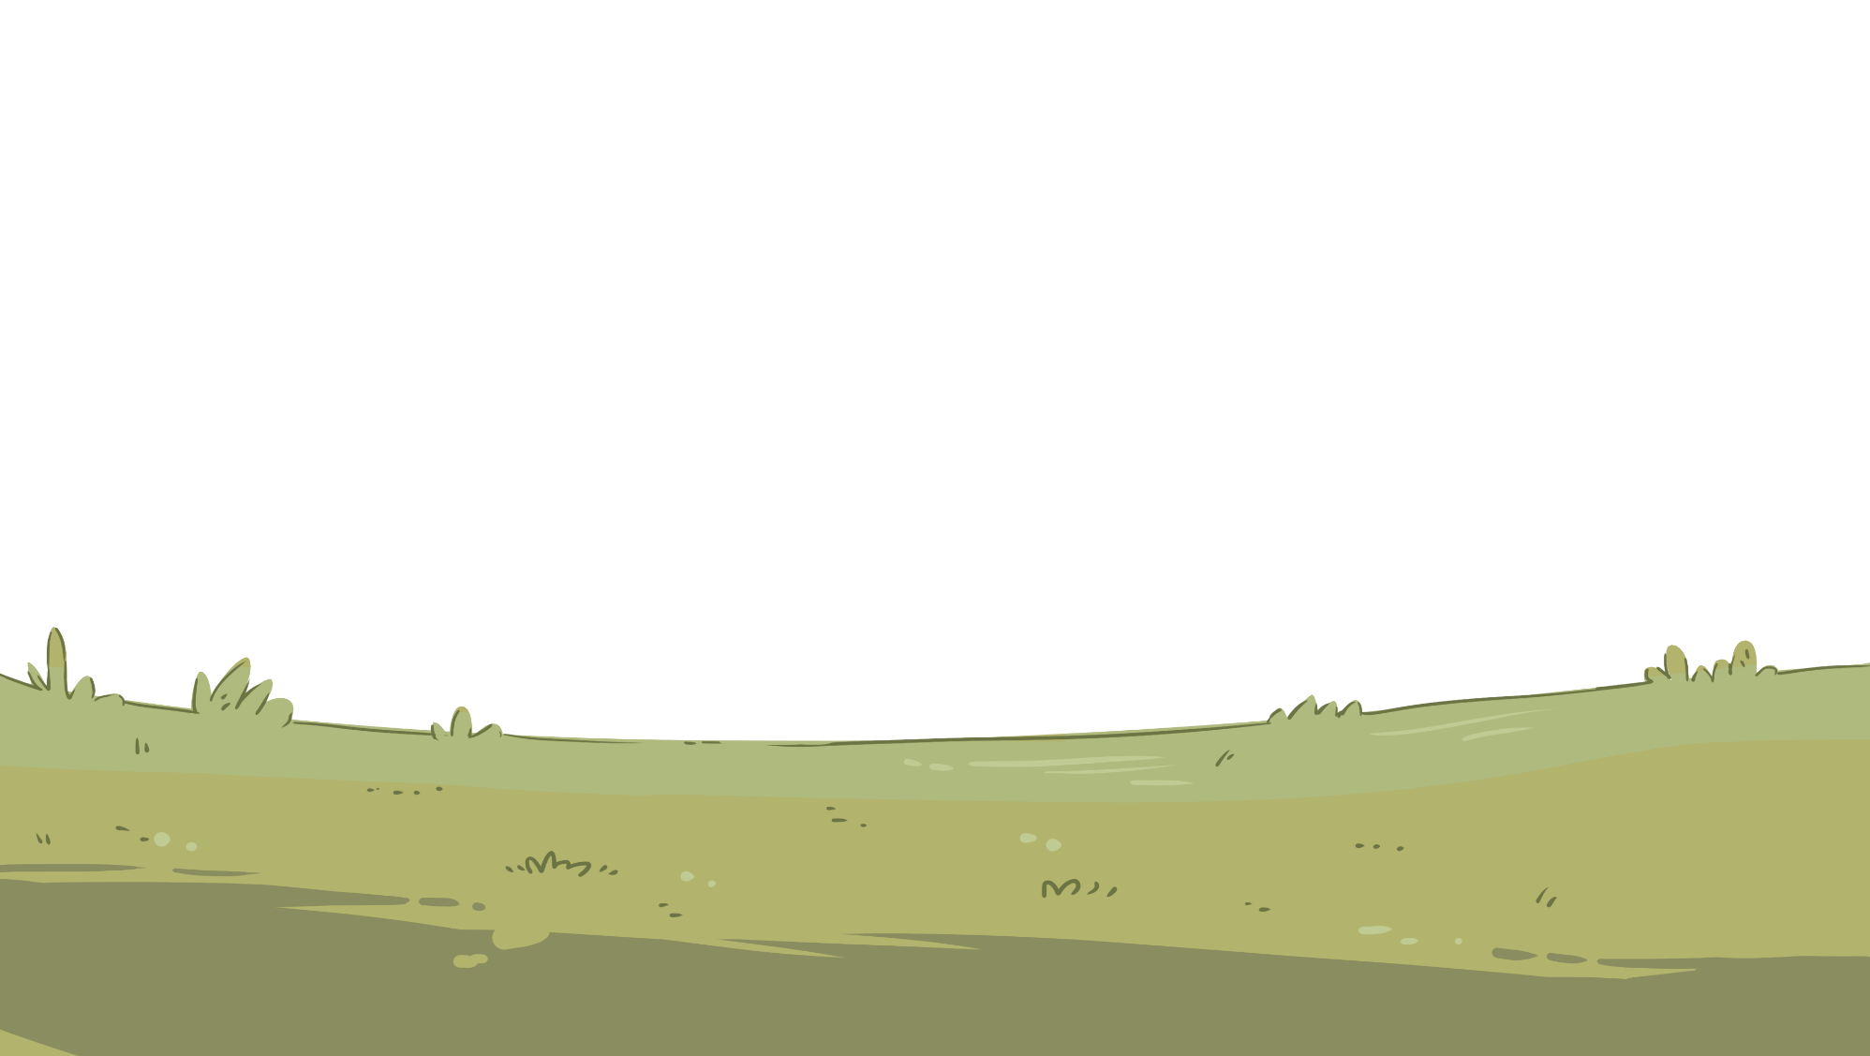


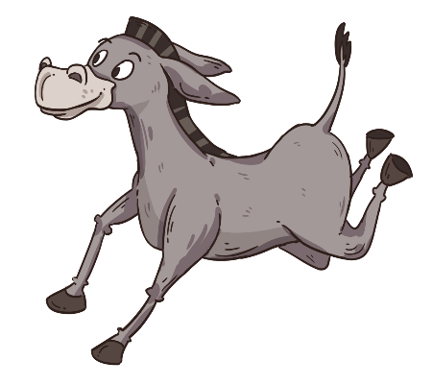
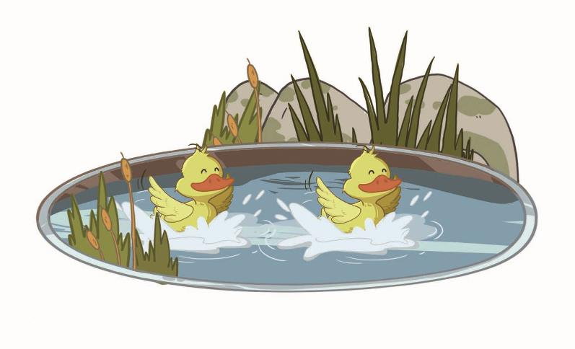
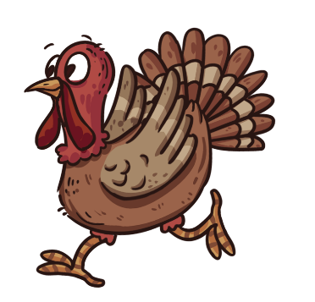
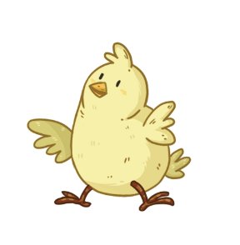
LO: Read the chant fluently; decode the words learned
in the text.
1. Read the chant to Ss with rhythm; let Ss observe
the picture and the highlighted words. (Such as
donkey and donkey’s picture)
2. Guide Ss to repeat after you; ask them to take turns
reading one sentence at a time.
3. Give feedback.
TG
Phonics
Let’s chant!
Here comes a donkey.
Here comes a turkey.
Why are they running?
Oh, it is raining.
Where are the ducklings?
They are still swimming.
2:00
7/30

Slide 8
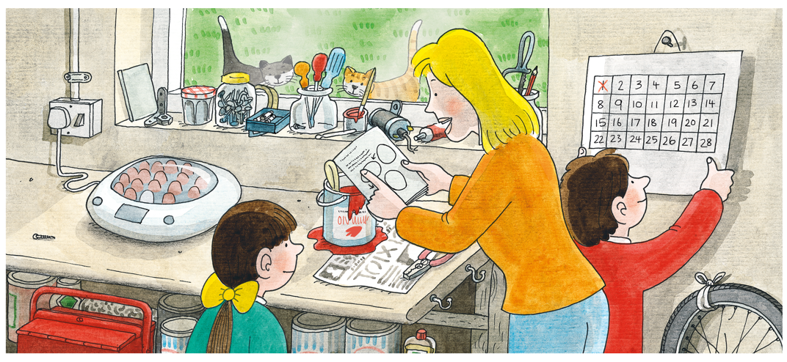
LO: Get to know the main characters in the story .
1. Guide Ss to recognize the main characters in the
story.
2. Ask Ss to name the characters they know in the
picture and match the characters with their names on
the right.
TG
Introduction
Let’s meet the characters!
Who are they in the story?
Mum
Biff
Chip
1:00
8/30

Slide 9
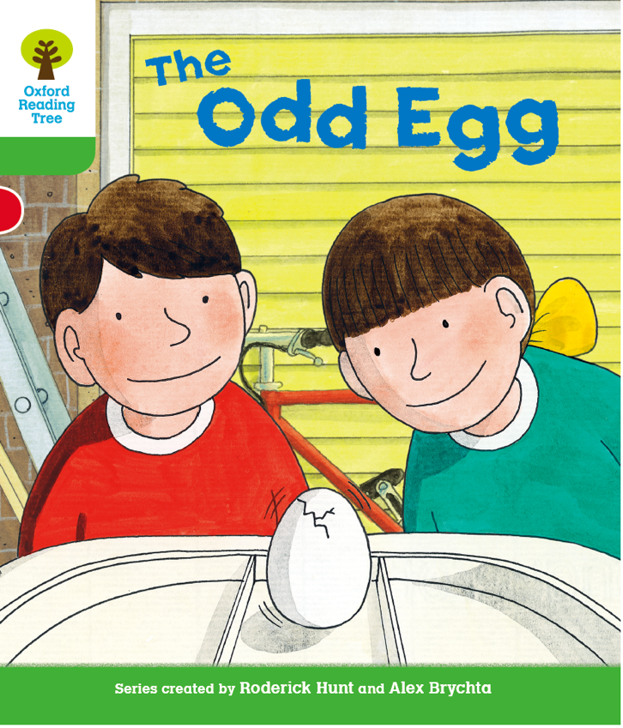
LO: Get to know the title, author, and illustrator of the
book; use pictures to identify details and make
predictions.
1. Explain what the author and the illustrator refer to in a
book and ask Ss to point them out; click and display
the answer.
2. Guide Ss to look at the book cover closely and to
share with the class everything they see.
3. Encourage Ss to talk about the given questions.
TG
Lead-in
Title: _______________
Author: _______________
Illustrator: _______________
The Odd Egg
Roderick Hunt
Alex Brychta
What are Biff and Chip doing on the cover?
Look at the title. What will the story be about?
Connections
What animals do you know come from eggs?
Written by Roderick Hunt
Illustrated by Alex Brychta
2:00
9/30

Slide 10
LO: Make predictions about the story using the pictures;
motivate Ss’ interest in reading the story.
1. Explain the concept of predicting and ask them to
make guesses prior to reading the story by looking
at the pictures.
2. Model how to use I see . . . and I think . . . to make
predictions.
3. Guide Ss to talk about the given questions with the
given sentence structures.
TG
Reading
Let’s predict!
Before Reading
What do you see in the picture?
What do you think Mum, Biff, and Chip will do?
?
I see _______.
I think ______.
1:30
10/30

Slide 11
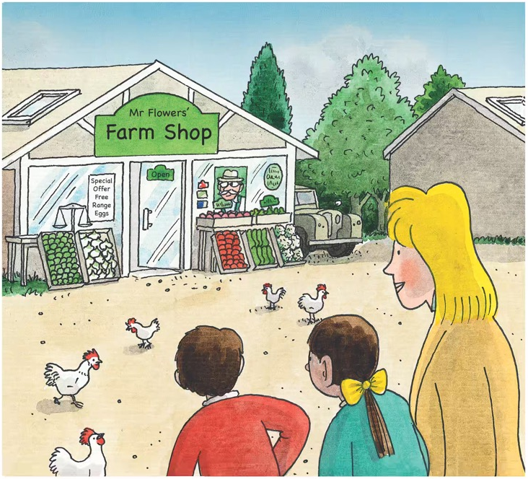
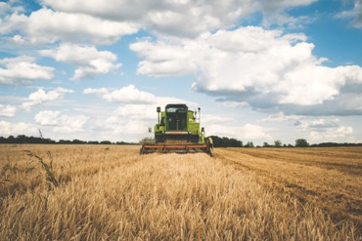

TG
Reading
LO: Understand the meaning of the key vocabulary word farm and make
sentences with it; identify key details with prompts and support.
Read the text aloud to Ss; ask Ss to observe the illustration and discuss the details questions.
Ask one S to find the word farm in the text and the other S to find the farm in the illustration; click the button and explain it; have Ss read the word and make sentences with it.
Ask Ss the comprehension question and have them make predictions.
The Odd Egg
Vocabulary
Details
Where did Biff and Chip go?
Comprehension
farm
What do you think they would see in this place?
My grandpa lives on a farm.
Biff and Chip went to the farm with Mum.
farm
2:00
11/30

Slide 12
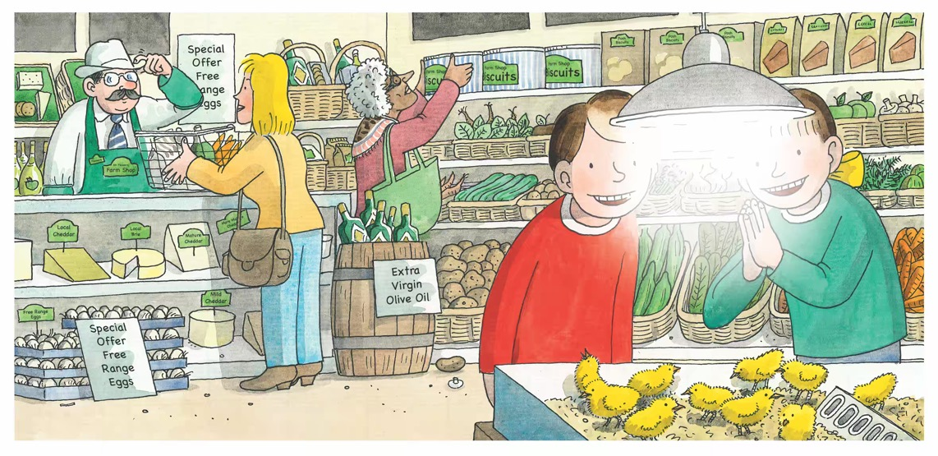
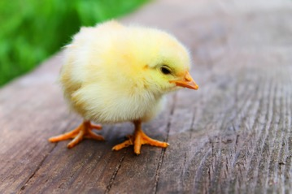

LO: Understand the meaning of the key vocabulary word chick and make
sentences with it; understand the meaning of the word pen and identify
unfamiliar words with the use of pictures; identify key details with prompts and
support; read at an appropriate rate.
Ask Ss to look at the picture; read the text aloud.
Have Ss talk about the details question.
Lead Ss to find the word chick in the text. After that, click the button and explain it; then have Ss read the word and make sentences with it.
Guide Ss to guess the meaning of pen by using the illustration and context clues.
Model reading aloud the first sentence two times: the first time with quite a slow pace, and the second time with a more natural pace; ask Ss which way is better; tell Ss that they should read at an appropriate rate to sound natural; have Ss take turns reading the story at an appropriate rate, and then give feedback.
TG
Reading
The Odd Egg
Details
Vocabulary
What did the farm have? Look for clues in the illustration.
Comprehension
What does the word pen mean? Where is the pen in the picture?
chick
I have a chick at home.
Decoding
The farm had chicks to sell.
It had chicks in a pen.
Read at an appropriate rate.
2:00
chick
12/30

Slide 13
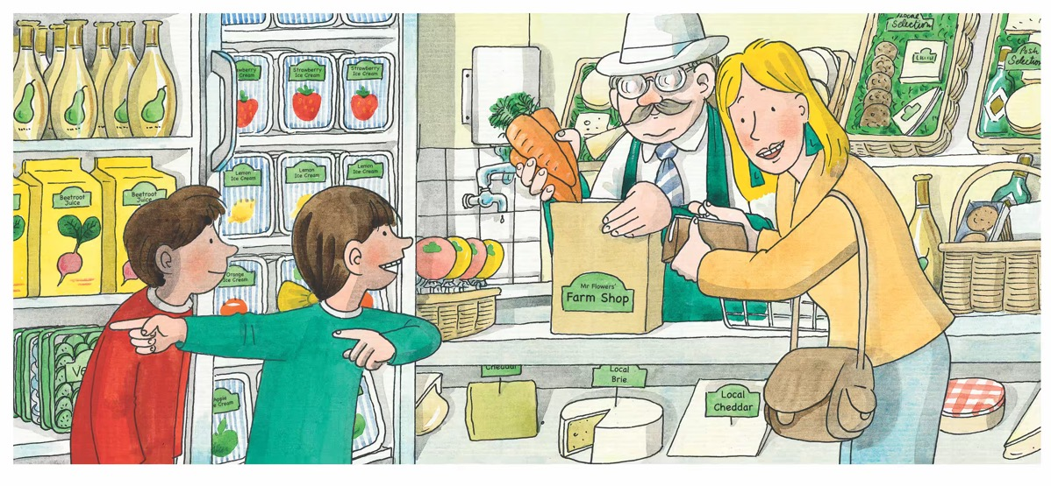
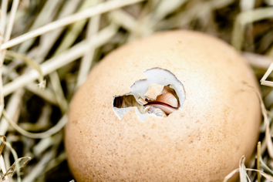
LO: Understand the meaning of the key vocabulary
word hatch and make sentences with it; identify key
details with prompts and support; read the text fluently.
1. Ask Ss to look at the illustration; read the text aloud.
2. Lead Ss to find the word hatch in the text; click the
button and explain it; have Ss read the word and
make sentences with it.
3. Have Ss talk about the given questions; have Ss do
the role play and read the text aloud, and then give
feedback.
TG
Reading
The Odd Egg
Vocabulary
Details
What did Biff and Chip want to do?
What did Mum want to do?
hatch
The egg is going to hatch.
“Can we get chicks, Mum?” said Biff.
“We can hatch chicks,” said Mum.
hatch
2:00
13/30

Slide 14
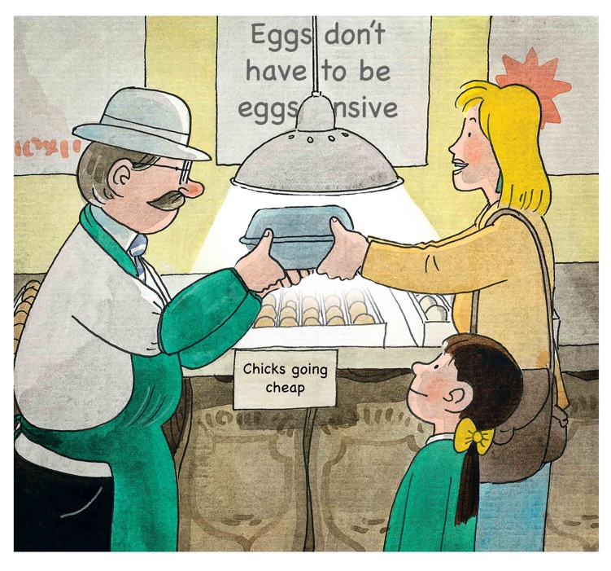
LO: Identify key details with prompts and support; read
the text fluently.
1. Ask one S to read the text aloud and the other S to
look at the illustration.
2. Have Ss answer the comprehension questions in turns.
3. Encourage Ss to talk about the questions in the
connections section in pairs.
TG
Reading
The Odd Egg
Comprehension
What would Mum do with the eggs?
What would the eggs turn into in the end?
Connections
If you were Biff or Chip, would you hatch chicks or buy chicks to keep?
Mum got the eggs.
2:00
14/30

Slide 15
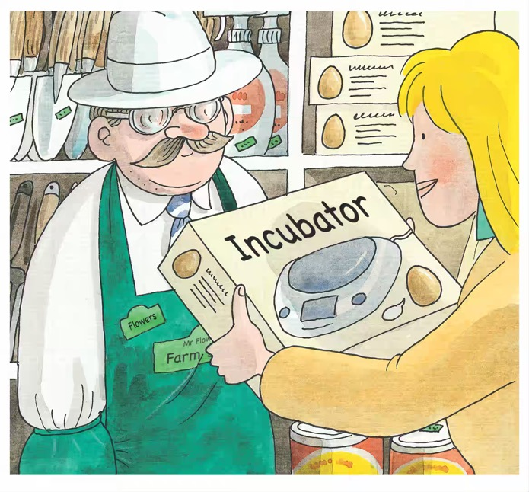
LO: Understand the unfamiliar word incubator using the
illustration; identify key details with prompts and
support; read the text fluently.
1. Read the text aloud to Ss; have Ss observe the
illustration and talk about the given questions;
explain the meaning of incubator; encourage Ss to
look for more clues in the illustration.
2. Ask Ss to read the text aloud in unison, and then give
feedback.
TG
Reading
The Odd Egg
Details
What did Mum get?
Why did Mum want to put the eggs in it? Look for clues in the illustration.
She got an incubator to put the eggs in.
1:30
15/30

Slide 16
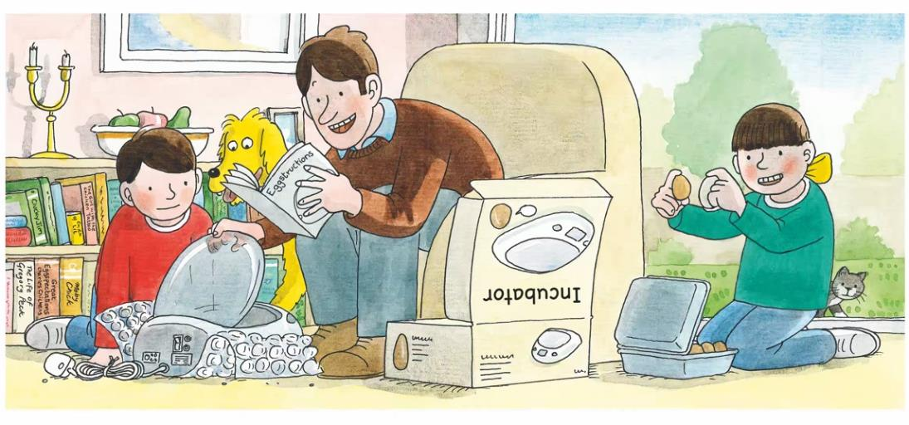
TG
LO: Understand the meaning of the word odd using the illustration and
text; identify key details with prompts and support; read the text
fluently.
Read the first sentence to Ss and ask Ss to look at the illustration closely; have Ss talk about the first question; ask Ss to read the second sentence in unison; have them talk about the second details question.
Guide Ss to find out the meaning of the word odd by observing the illustration and by listening to the guiding questions.
Ask Ss to work in pairs to talk about the questions in the connections section.
Have Ss do the role play and read the text fluently.
Reading
The Odd Egg
Details
What did Biff have in her hands? What were they like?
Comprehension
What does the word odd mean? Look for clues in the illustration.
Connections
“It’s fun to hatch chicks,” said Dad.
“This is an odd egg,” said Biff.
If you were Chip, how would you feel about hatching chicks?
2:30
16/30

Slide 17
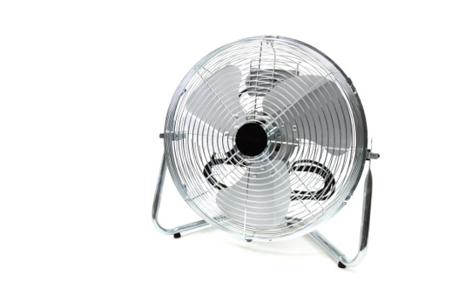

LO: Understand the meaning of key vocabulary words
lamp and fan and make sentences with them; identify
key details with prompts and support; read the text at an
appropriate rate.
1. Read the text aloud; ask each S to find one key word
(fan or lamp); click the buttons and explain them; have
Ss read the words and make sentences with them.
2. Have Ss talk about the given questions; have them
take turns reading the first sentence at an
appropriate rate to get familiar with the __ had __.
sentence structure, and then give feedback.
TG
Reading
Reading
The Odd Egg
Details
Vocabulary
Vocabulary
What did the incubator have?
What would happen to the eggs in the incubator?
fan
lamp
Decoding
It is a table lamp.
Let’s turn on the fan.
Read at an appropriate rate.
The incubator had a lamp and a fan.
“It will turn the eggs,” said Mum.
fan
lamp
3:00
17/30

Slide 18
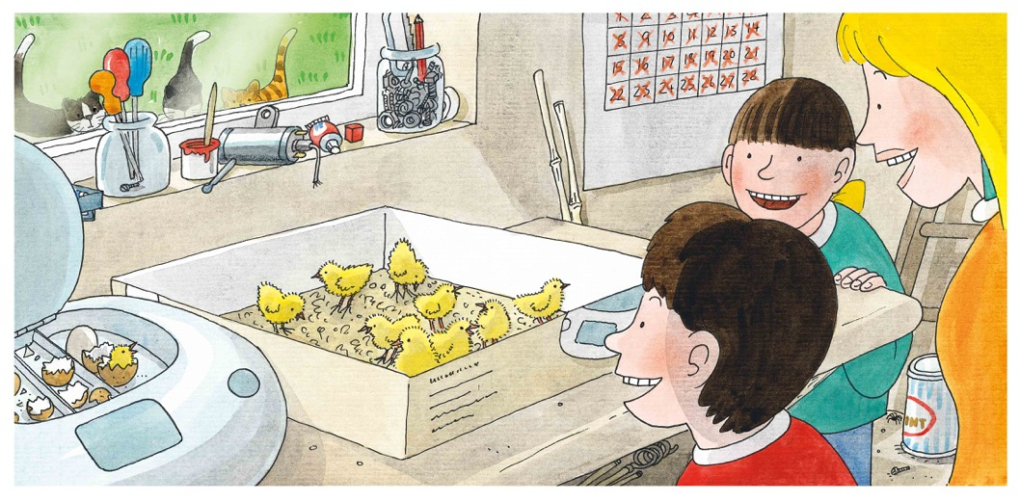
LO: Identify key details with prompts and support;
decode the sight word did in the text; read the text
fluently.
1. Ask Ss to take turns reading the text aloud.
2. Ask Ss to find the sight word did in the text and guide
them to read it accurately;
3. Have Ss talk about the details questions using the
illustrations. Encourage Ss to look at the illustration
closely for clues, especially the calendar.
TG
Reading
The Odd Egg
Details
How many chicks did Biff and Chip have?
Sight Word
did
Ten eggs did hatch.
They had ten chicks.
1:00
18/30

Slide 19
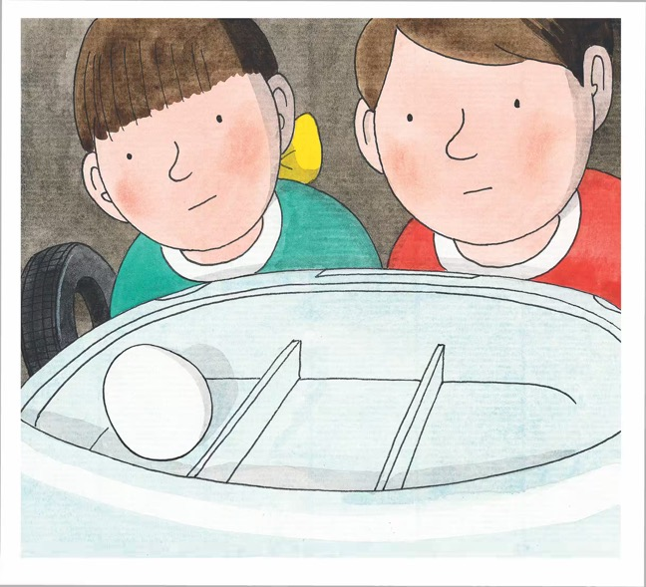
LO: Identify key details with prompts and support; read
the text fluently.
1. Have Ss read the text in unison.
2. Have Ss talk about the questions using the illustration.
3. Encourage Ss to talk about the question in the
connections section.
TG
Reading
The Odd Egg
Details
What was left in the incubator? Did it look like other eggs?
Connections
If you were Biff or Chip, what would you do with the egg?
But the odd egg did not hatch.
1:30
19/30

Slide 20
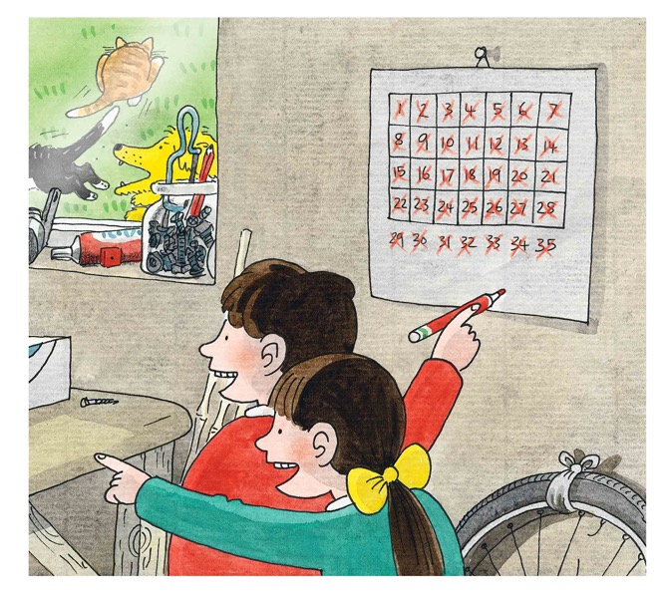
LO: Identify key details with prompts and support;
decode the sight word did in the text; read the text
fluently.
Ask Ss to take turns reading the text aloud.
Have Ss talk about the given questions using the illustration, especially the calendar.
Ask Ss to find out the sight word did in text and guide Ss to read the sight word accurately.
TG
Reading
The Odd Egg
Details
Did the egg hatch? How did Chip and Biff feel about it?
How many days did the egg take to hatch? Look for clues in the illustration.
Sight Word
At last it did hatch.
But it was not a chick.
did
1:30
20/30

Slide 21
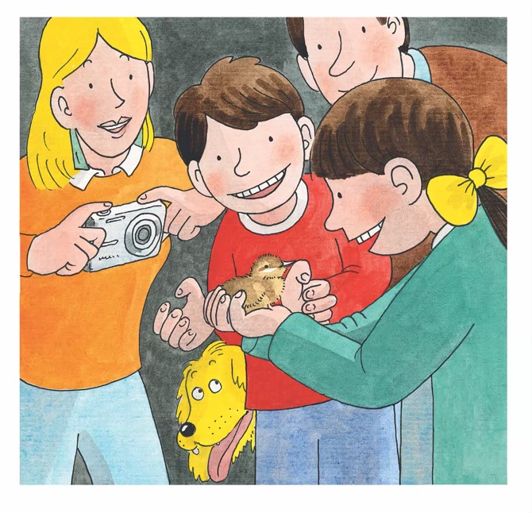
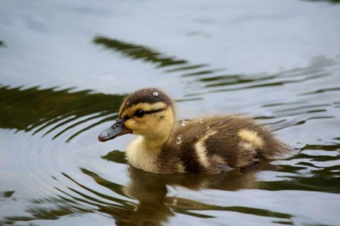
Reading
TG
LO: Understand the meaning of the key vocabulary word
duckling and make sentences with it; identify key
details with prompts and support; read the text fluently.
Ask Ss to take turns reading the text aloud.
Lead Ss to find the word duckling in the text; click the button and explain it, and then have Ss read the word and make sentences with it.
Have Ss talk about the details questions in turns.
Encourage Ss to talk about the connections section.
The Odd Egg
Details
Vocabulary
What did the egg hatch?
Did the family like the duckling? How do you know?
duckling
Connections
Did you hatch eggs or something similar? What was it like?
The duckling is swimming.
It was a duckling.
duckling
2:30
21/30

Slide 22






TG
LO: Retell the story with the visual support and
assistance.
1. Ask Ss to work in pairs to ask and answer the given
questions; have them work in pairs to recall the
details of the story in the correct sequence order;
model first.
2. Have Ss work together to retell the story in turns
using the given visual aid.
TG
Reading
Let’s retell!
1
2
Where did Chip and Biff go?
What did Chip and Biff want?
What did Mum get?
What did Mum want to do?
3
4
What did the eggs hatch?
How many days did it take?
What was left in the incubator?
What did it hatch?
2:30
22/30

Slide 23
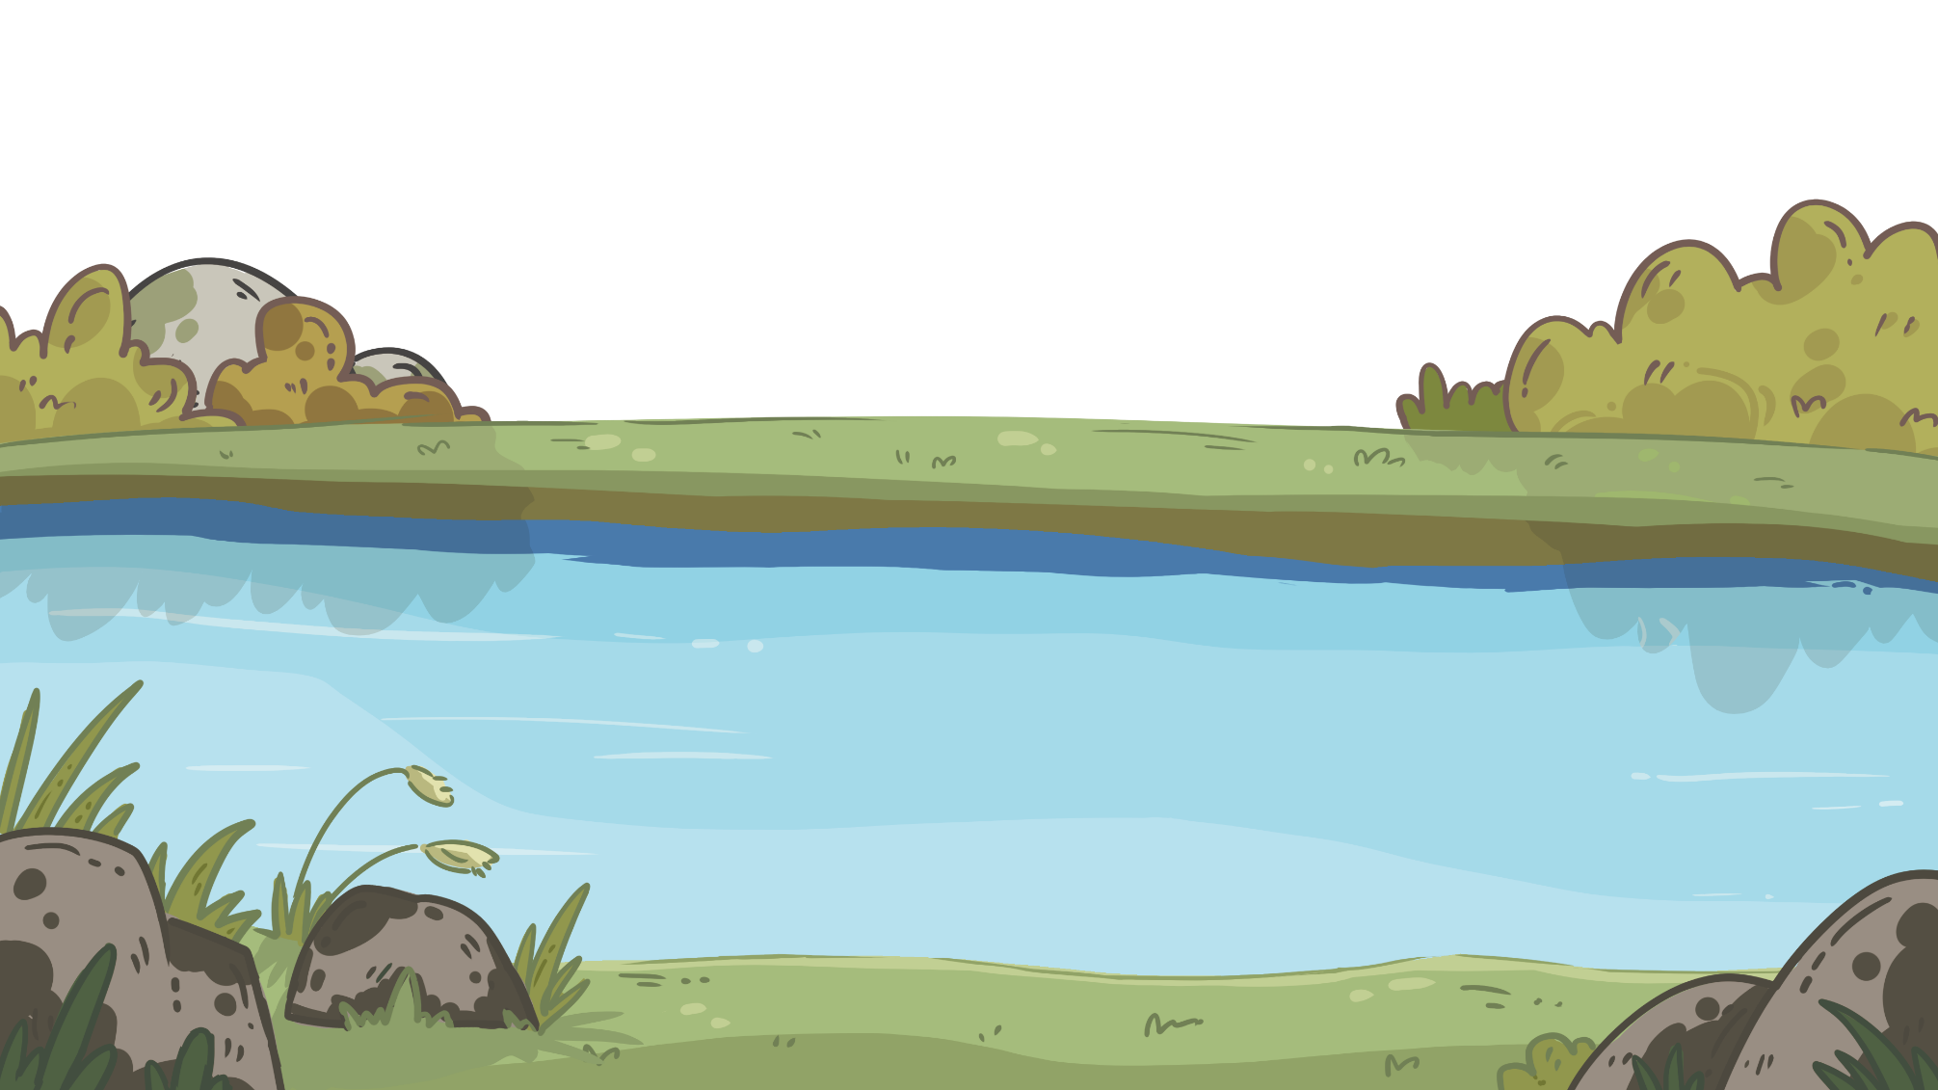


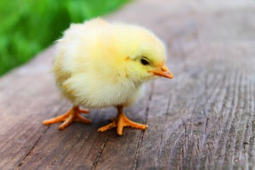
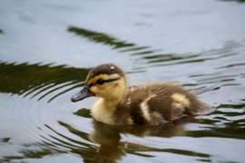


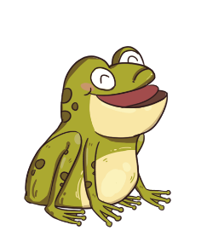

LO: Check the understanding of the words in this lesson.
1. Ask Ss to work together to help the frog cross the river.
2. Click and ask Ss to take turns to guess the words by looking at
the pictures.
3. Click to show the answer.
TG
Let’s review the words!
Vocabulary
lamp
chick
hatch
duckling
farm
fan
Please help me cross the river.
1:30
23/30

Slide 24

LO: Talk about the words learned in this lesson using the
given sentence structures.
1. Have Ss work in pairs to talk about the given illustration
using the sentence structure and helping words; model
first.
2. Assist Ss if necessary.
TG
Listening & Speaking
Let’s talk!
—What did the ______ have? （farm, incubator）
—The _____ had ____________.
Helping Words
duckling
chick
fan
lamp
2:00
24/30

Slide 25

TG
LO: Talk about what they can see at the farm shop using
the given sentence structure.
1. Ask Ss to talk about what a shop has; encourage them
to look at the illustration closely and find as many
objects as they can in the shop.
2. Click Let’s talk! and show the sentence structure; ask Ss
to work in pairs to ask and answer questions about the
given illustration using the given language structure;
model first; ask each S to ask and answer at least 3 times.
3. Assist Ss if necessary.
Note: T can click Let’s Talk to present the sentence
structure, and T can click again to make it disappear.
Let’s talk!
Listening & Speaking
—What does the shop have?
—The shop has _______________.
tomatoes onions carrots . . .
2:00
25/30

Slide 26



LO: Talk about looking after pets.
1. Ask Ss the given question; model first.
2. Guide Ss to talk about the question with the help of
the given pictures; encourage Ss to talk more about
loving animals.
TG
Value
How should you look after your pet?
feed the pet on time
spend time with the pet
2:00
26/30

Slide 27


LO: Talk about what they’ve learned from the story using
the given support.
1. Guide Ss to talk about what they’ve learned about the
odd egg.
2. Ask Ss to think about the given questions; help Ss to
organize ideas from the story with the given visual
support.
3. Model the first question, and then ask Ss to take turns
presenting their answers.
TG
Oral Writing
Get ready to present!
Talk about the odd egg in the story with your partner by using the following aid.
1. How did they
get the odd egg?
3. What happened to
the odd egg at last?
2. How was the odd
egg different?
27/30
2:00

Slide 28


LO: Understand what the homework is.
1. Explain the writing task to Ss and check their
understanding.
2. Tell Ss that they should finish their writing before next class.
Make sure they know they can send their homework to
the platform. They will present their work next class.
3. Remind Ss to watch the post-class video and finish the
writing task.
TG
Writing
Let’s draw and write!
Now, please follow the steps to finish your homework and present it in the next class:
Draw a picture of a farm animal.
Write three sentences about it.
Let’s make a poster!
Watch the post-class video about the writing task.
1:00
28/30

Slide 29
LO: Review today’s lesson
1. Guide Ss to review the phonics.
2. Guide Ss to review the words.
3. Guide Ss to review the sentence
structure.
TG
Review
Let’s review!
Review
Phonics:
duckling/donkey/turkey/swimming/running/raining
Sentence Structure:
___ had _____.
Vocabulary: farm/chick/hatch
lamp/duckling/fan
0:30
29/30

Slide 30


LO: End the lesson and encourage Ss to perform better
in the next class.
1. Give brief comments on Ss.
2. Say goodbye to Ss.
3. Ask Ss to preview the next lesson.
TG
0:30
30/30

