Slide 1
Reading Courseware
for Teachers
Chapter 5 We can do it!
Learn to Read

Slide 2
Functions | Values and Attitudes
Talking about abilities | Trying your best
Reading Skills
Relating the text to self Giving personal responses to the text Making guesses / predictions about the text Making observations from pictures Locating specific information in response to questions

Slide 3
Reading
Pre-reading | − Introducing the setting
First reading | − Shared reading
Second reading | − Reading aloud − Activity 1: Assessment for learning
Post-reading | − Activity 2: Readers’ theatre − Activity 3: True or False − Activity 4: Draw and tell

Slide 4
Today we are going to read a story. Let’s look at some pictures!
Pre-reading

Slide 5
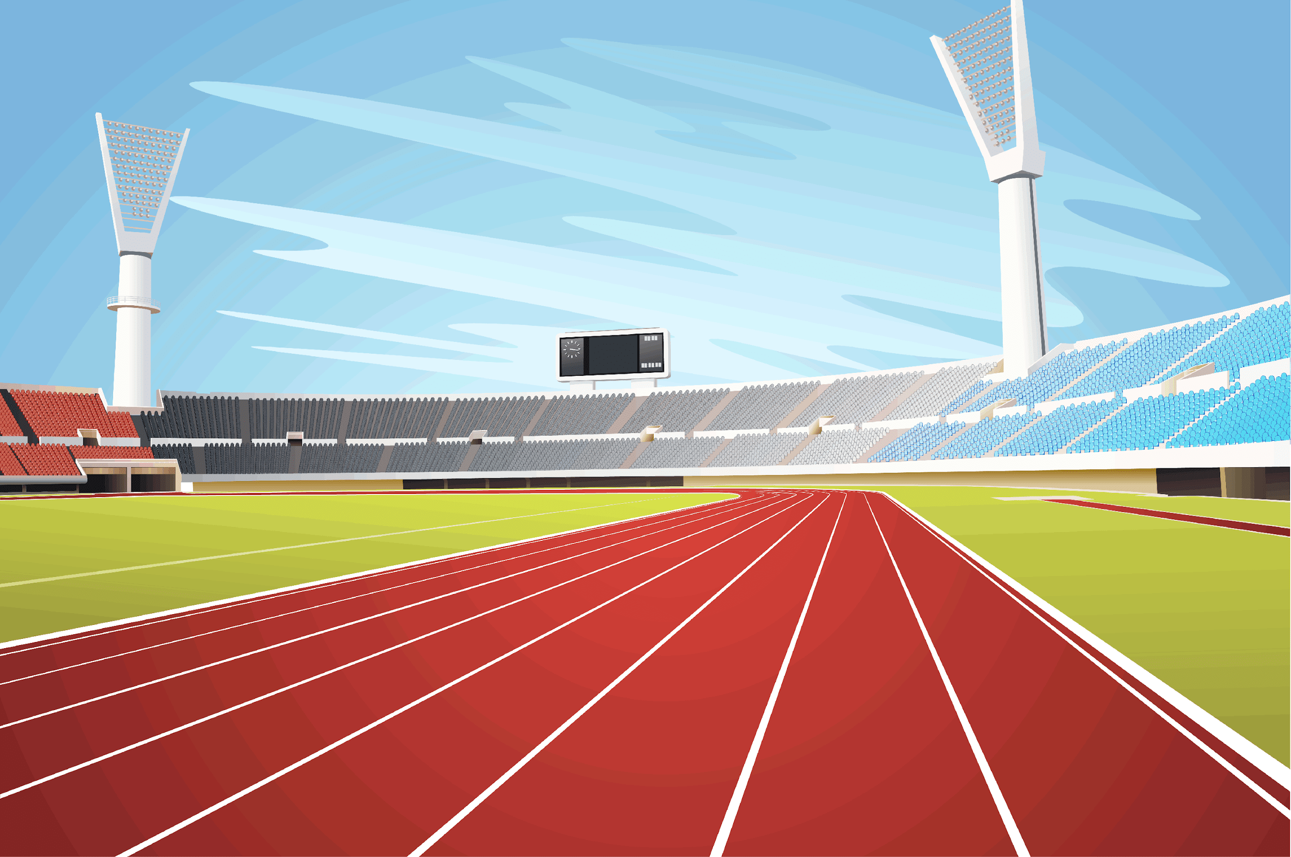
What do you do on Sports Day?
Some animals are going to run in a race!
Notes:
Say Today’s story is about Sports Day. Ask What do you do on Sports Day? (e.g. Run. / Jump.) Do you like Sports Day? (Yes. / No.) You may also show pictures of your school’s Sports Day. – relating the text to self / giving personal responses
[Click to show the narration] Say In the story, some animals are going to run in a race! Mime running when you say ‘race’. Ask When we run in a race, do we want to be fast or slow? (Fast.) Mime running fast and slowly when you say ‘fast’ and ‘slow’. Say That’s right. We want to run fast in a race. Mime running fast. – eliciting information

Slide 6
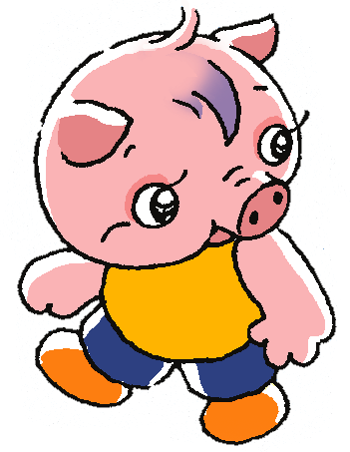
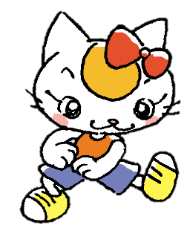
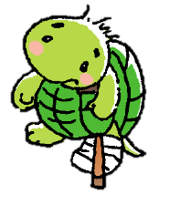
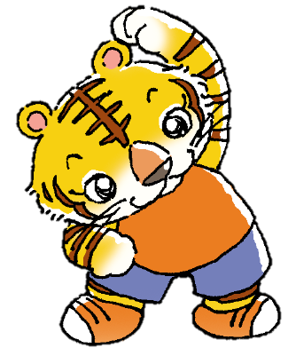
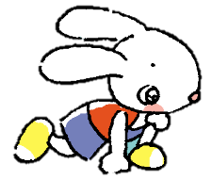
Coco
Ricky
Kelly
Who will win the race?
Tiger
Rabbit
Notes:
Say Let’s meet some of the animals. They are Coco, Ricky, Kelly, Tiger and Rabbit. Point at each animal and ask Can he / she run fast? Can you guess? (Yes, he / she can. / No, he / she can’t.) Allow pupils to answer using Yes. or No. in their responses but repeat and extend their responses by saying Yes, he / she can. or No, he / she can’t. – guessing
[Click to show the question] Ask Who will win the race? [Hold up your forefinger to indicate number one.] You may ask pupils to write their guesses on their paper. – predicting
Say Let’s read the story and find out who wins the race!

Slide 7
Let’s read the story!
First reading

Slide 8
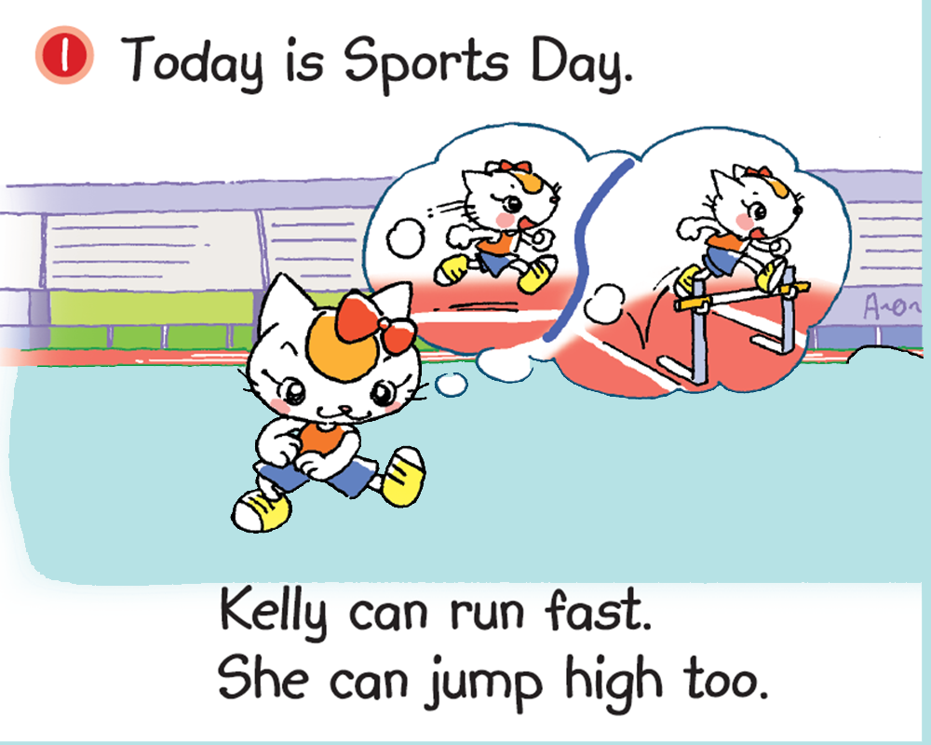
A
B
Notes:
Say The animals are getting ready on Sports Day.
Ask Can Kelly run fast? (Yes, she can.) [Click to underline ‘Kelly can run fast.’] Invite a pupil to point at the picture that shows Kelly running fast. [Click to show the answer] – locating specific information
[Click to underline ‘She can jump high too.’] Say Kelly can jump high too. Mime jumping high.

Slide 9
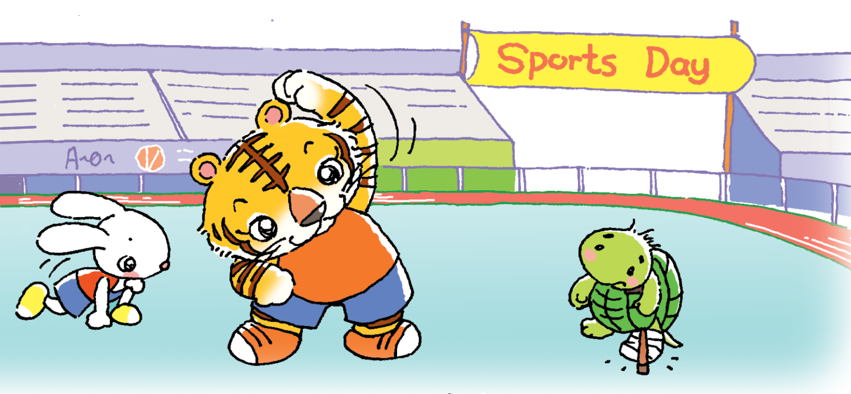
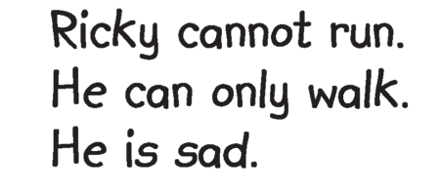
Can Ricky run?
Why not?
Notes:
[Click to show the questions] Ask Can Ricky run? (No, he can’t.) [Click to underline the answer] Why not? Allow pupils to respond by pointing at Ricky’s broken leg. [Click to show an arrow pointing towards Ricky’s broken leg] Say That’s right. Ricky has a broken leg, so he can’t run. He can only walk. Mime walking with a broken leg. – observing / inferring
[Click to highlight ‘sad’] Ask Is Ricky happy? (No.) Say He isn’t happy. He is sad. Mime a sad expression. – inferring unknown words

Slide 10
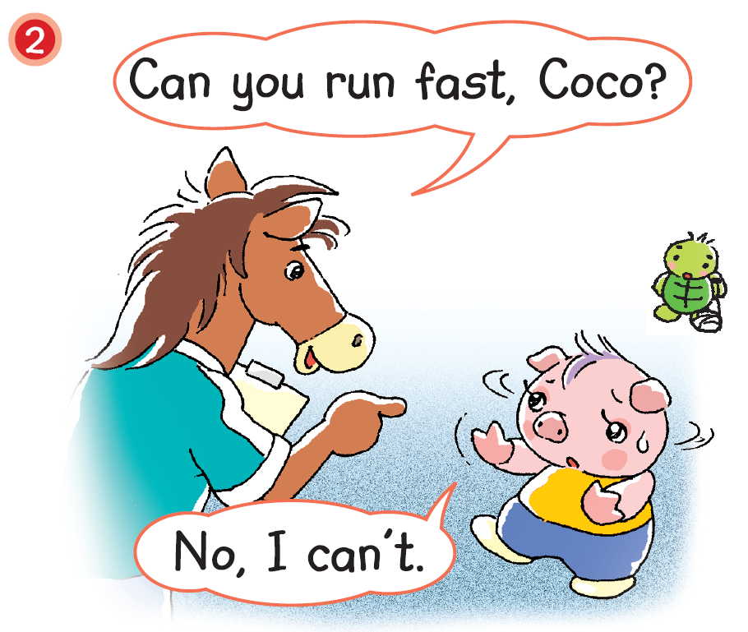
Can Coco run fast?
What can she do?
Notes:
Say Here is Coco. Horse is talking to her.
[Click to show the questions] Ask Can Coco run fast? (No, she can’t.) [Click to underline the answer] Mime thinking aloud and say Hmm… Coco and Ricky can’t run in the race. What can they do? – locating specific information / guessing
Say Let’s see what they can do.

Slide 11
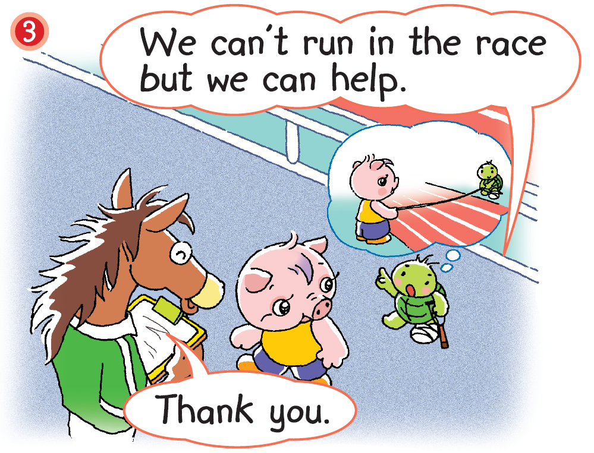
Notes:
Say Oh! Ricky has a good idea.
Say Coco and Ricky can’t run in the race but they can help. [Click to show an arrow pointing towards Ricky’s thought bubble] Say They can hold the finishing line!

Slide 12
Where is Coco?
Notes:
Say It is time for the race now!
Say Here is Ricky. He is helping with the race. Ask Who is helping with the race too? (Coco.) [Click to circle the other end of the finishing line] Ask Is Coco here? (No.) Point at Rat. Ask Can Rat find Coco? (No.) [Click to show the picture of Coco and the question] Ask Where is Coco? Can you guess?– recalling / observing / guessing

Slide 13
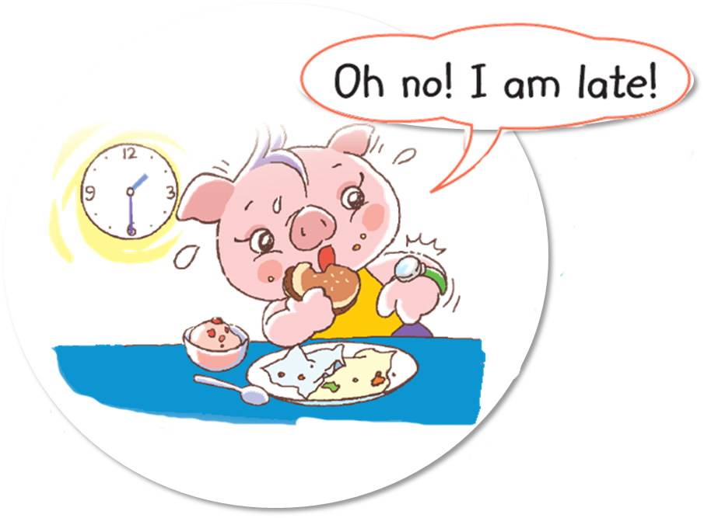
The race begins!
Can Coco be late?
Notes:
Say Look! Here is Coco.
Ask What is Coco doing? (Eating.) [Click to show the narration] Say The race begins! Coco is late. [Click to show the question] Say Coco has to help with the race. Can she be late? (No.) – observing / inferring

Slide 14
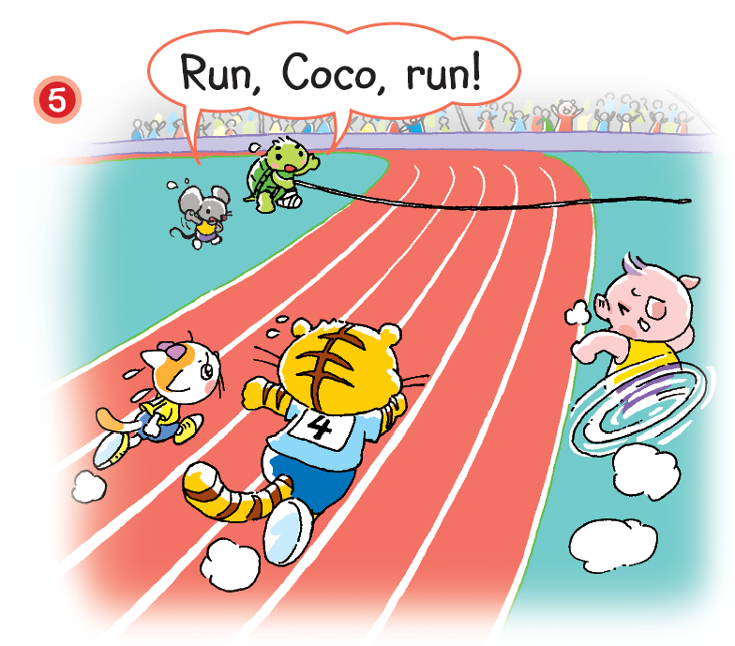
The animals are racing!
Notes:
Say The animals are racing! [Click to circle the animals] Coco is late. She runs fast so that she can help with the race!
[Click to show an arrow pointing towards Coco] Say Wow! Coco runs so fast!

Slide 15
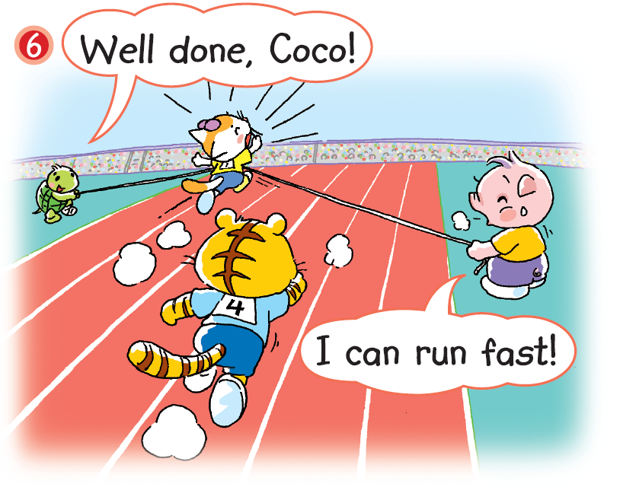
Who wins the race?
Notes:
Say Look! Who wins the race? (Kelly.) [Click to circle Kelly] You may get pupils to take out the paper they wrote their guesses on (from the Pre-reading section) and provide feedback for their guesses, e.g. Smart guess!– observing
Ask What about Coco? Can she help with the race in the end? (Yes.) [Click to highlight ‘Well done, Coco!’] Say Coco can help in the end. Ricky says, ‘Well done, Coco!’ Make a thumbs-up gesture when you say ‘Well done’. Say This shows he is happy with Coco’s good work. – observing

Slide 16
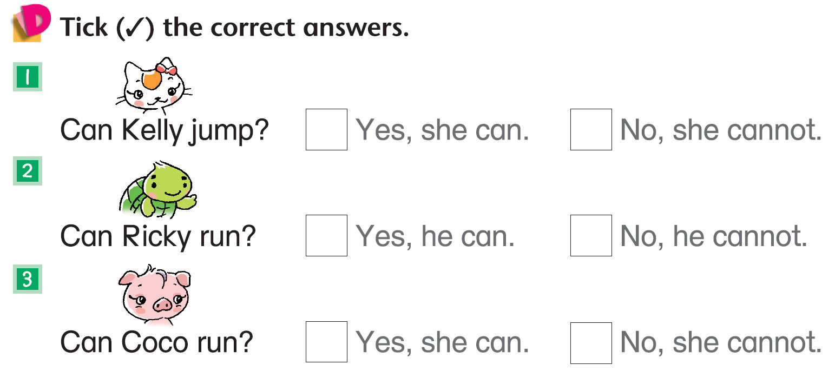
Answers
Notes:
Instruct pupils to complete Part D individually in their books. The activity can be completed in class or for homework. – locating specific information

Slide 17
Let’s do some more activities!
Post-reading

Slide 18
Readers’ theatre
Notes:
Put pupils into groups and assign each group a character. Ask each group to read their part aloud.

Slide 19
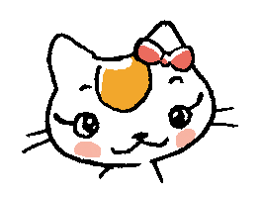
Kelly can run fast.
True
False
Notes:
Tell pupils that they are going to play a game now.
Read each sentence aloud, e.g. Kelly can run fast. Pupils have to decide if each sentence is true or false. Invite a pupil to come to the screen to point at the correct sign ‘True’(✔) or‘False’(🗶 ). [Click to show each answer]

Slide 20
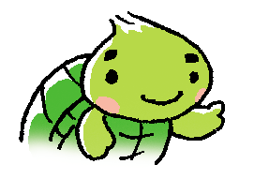
Ricky can walk.
True
False

Slide 21
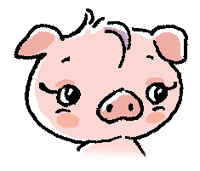
Coco cannot help.
True
False

Slide 22
Kelly cannot run fast.
True
False

Slide 23
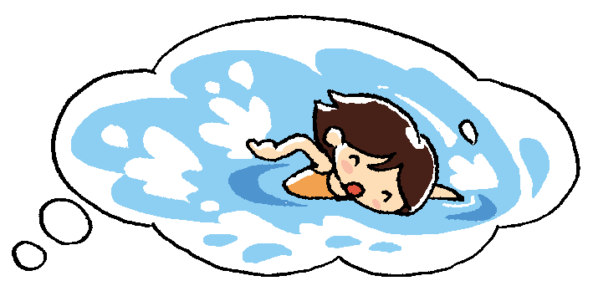
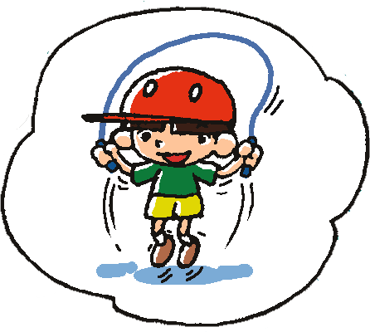
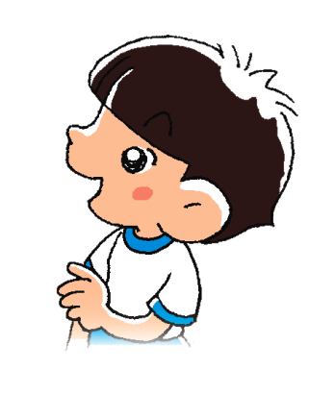
I can swim.
I can skip.
Notes:
Say Let’s look at what the children can do on Sports Day. [Click to show what Mary can do.] Say Mary can swim. [Click to show what Mary says] [Click to show what Charlie can do] Say Charlie can skip. [Click to show what Charlie says]

Slide 24
What can you do on Sports Day?
Draw and write your answer.
I _______________________.
Notes:
Provide each pupil with an A4-sized piece of paper. Ask What about you? What can you do on Sports Day? Draw your answer on the paper. Then write your answer below your picture. For example, you can write ‘I can swim.’
When pupils have finished drawing and writing their answers, invite some pupils to come to the front of the class to present their work. You may also choose to display certain pupils’ work.

