Slide 1
Reading Courseware
for Teachers
Chapter 6 Look at me!
Learn to Read

Slide 2
Functions
Describing physical appearances
Reading Skills
Making observations from pictures Inferring meaning / unknown words from the text Giving personal responses to the text Making guesses about the text Identifying pronoun references

Slide 3
Reading
Pre-reading | – Introducing the setting
First reading | – Shared reading
Second reading | – Reading aloud – Activity 1: Assessment for learning
Post-reading | – Activity 2: Readers’ theatre – Activity 3: Twins Show – Activity 4: Guess who?

Slide 4
Today we are going to read a story. Let’s look at some pictures!
Pre-reading

Slide 5
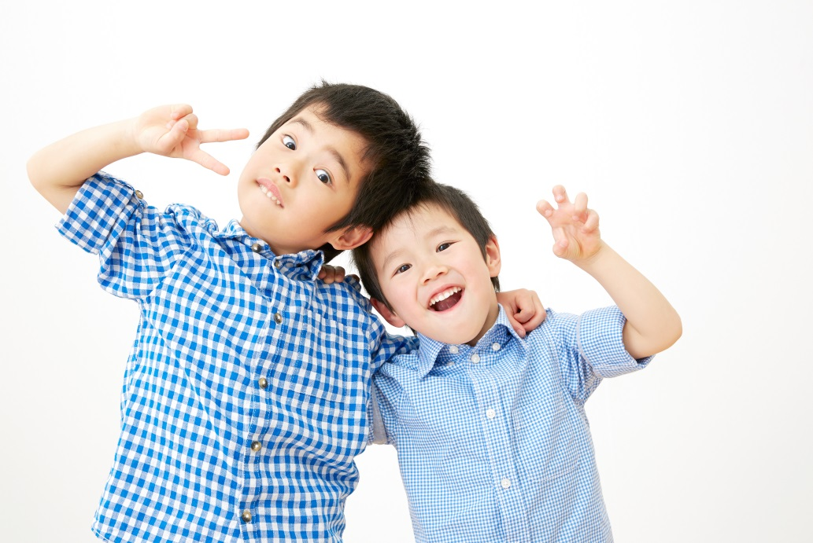
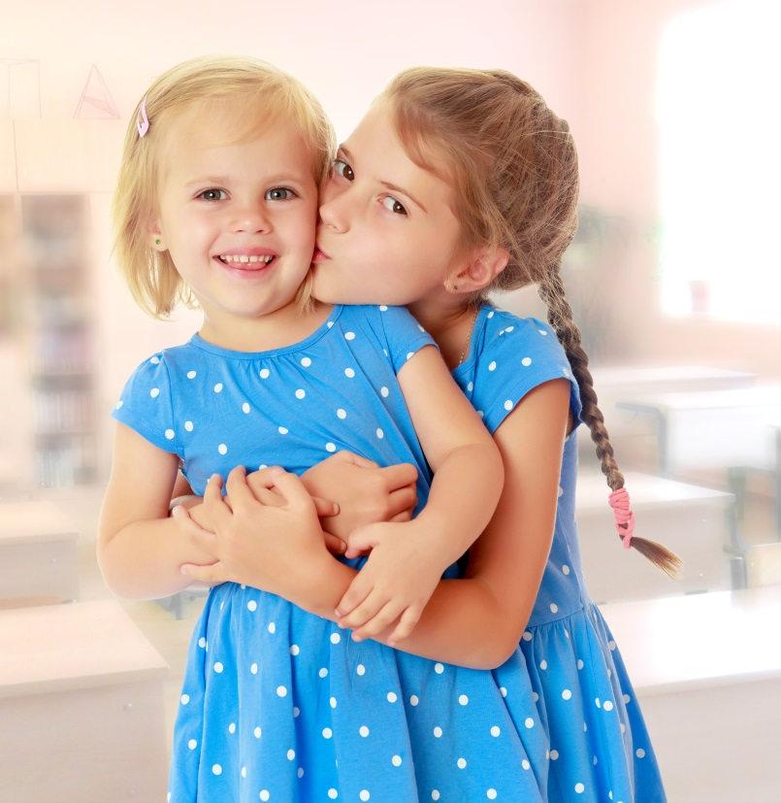
Are they brother and sister / brothers / sisters?
Notes:
Say Let’s look at some children. Point at each picture. Ask Are they brother and sister / brothers / sisters? (Yes.) That’s right. They look like each other! Ask Do you have any brothers or sisters? Do you look like your brother / sister?– observing / inferring / giving personal responses

Slide 6
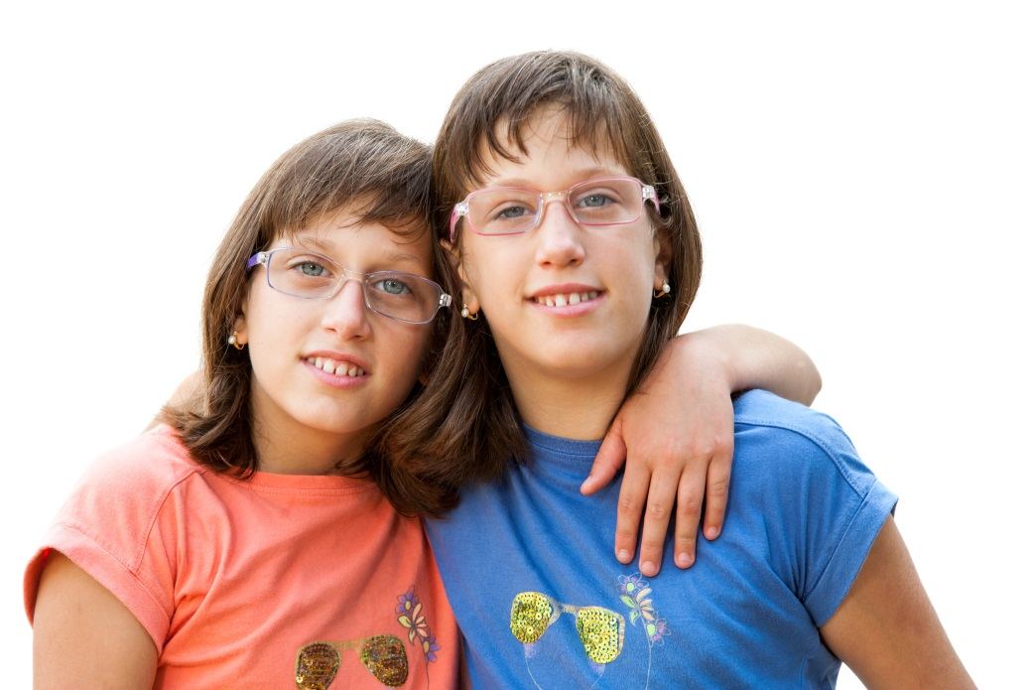
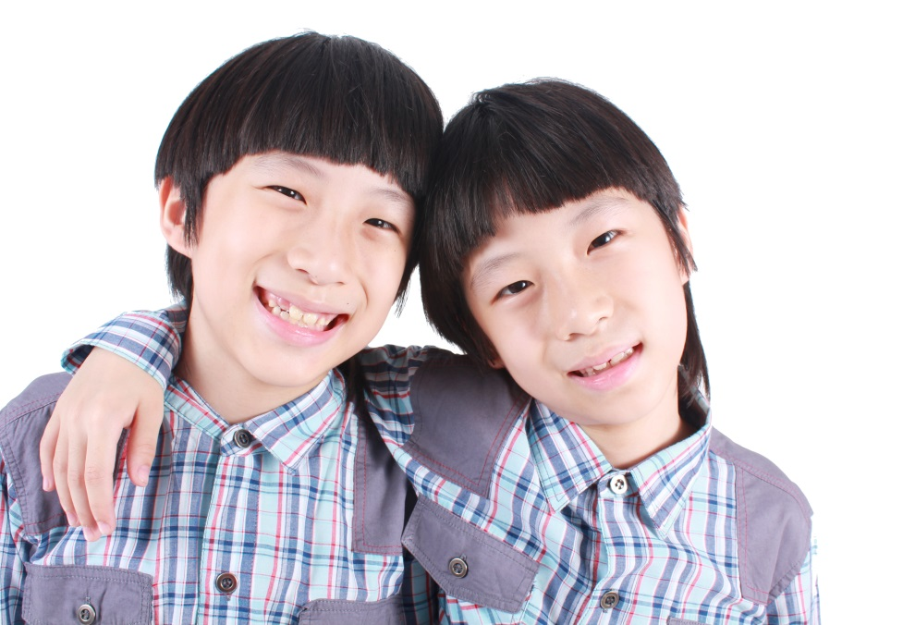
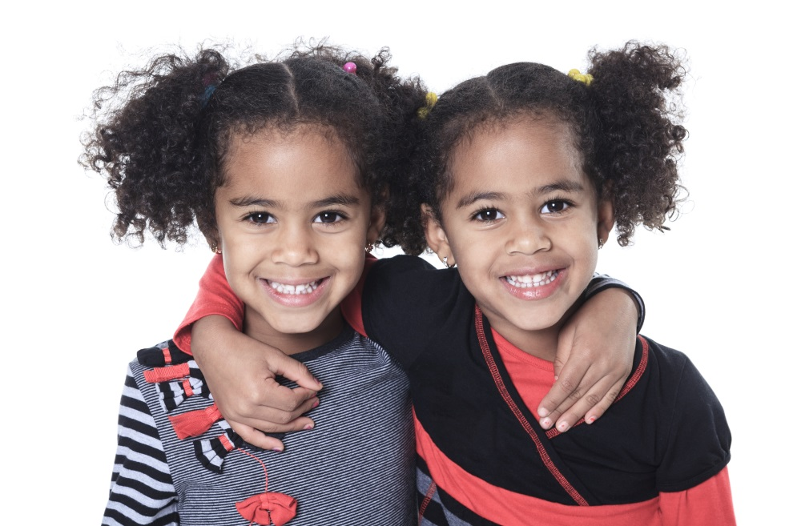
They are twins.
Notes:
Say Now let’s look at some special brothers and sisters. Ask Do they look like each other? (Yes.) Yes, they look the same! Draw pupils’ attention to each pair of twins and ask pupils to describe each pair of twins, e.g. They have small eyes. – observing
Draw pupils’ attention to the second pair of twins. Say Look at these girls. Make circles around your eyes to indicate glasses. Ask What do the girls have? Do you know? (Yes. / No.) Say They have glasses. Write the word ‘glasses’ on the board. You may bring a pair of glasses and put them on when teaching the word. You may also ask pupils if they wear glasses.
Draw pupils’ attention to the third pair of twins and say Look at these girls’ hair. They have curly hair. Twirl your hair to indicate ‘curly’. Write ‘curly hair’ on the board. You may bring a wig with curly hair and put it on when teaching the words. You may also ask pupils if they have curly hair.
Mime thinking aloud and ask Why do they look the same? Do you know? Say These children are special brothers and sisters. They have the same birthday! We call them ‘twins’. [Click to show the explanation] Ask Do you know any twins? – eliciting information / giving personal responses

Slide 7
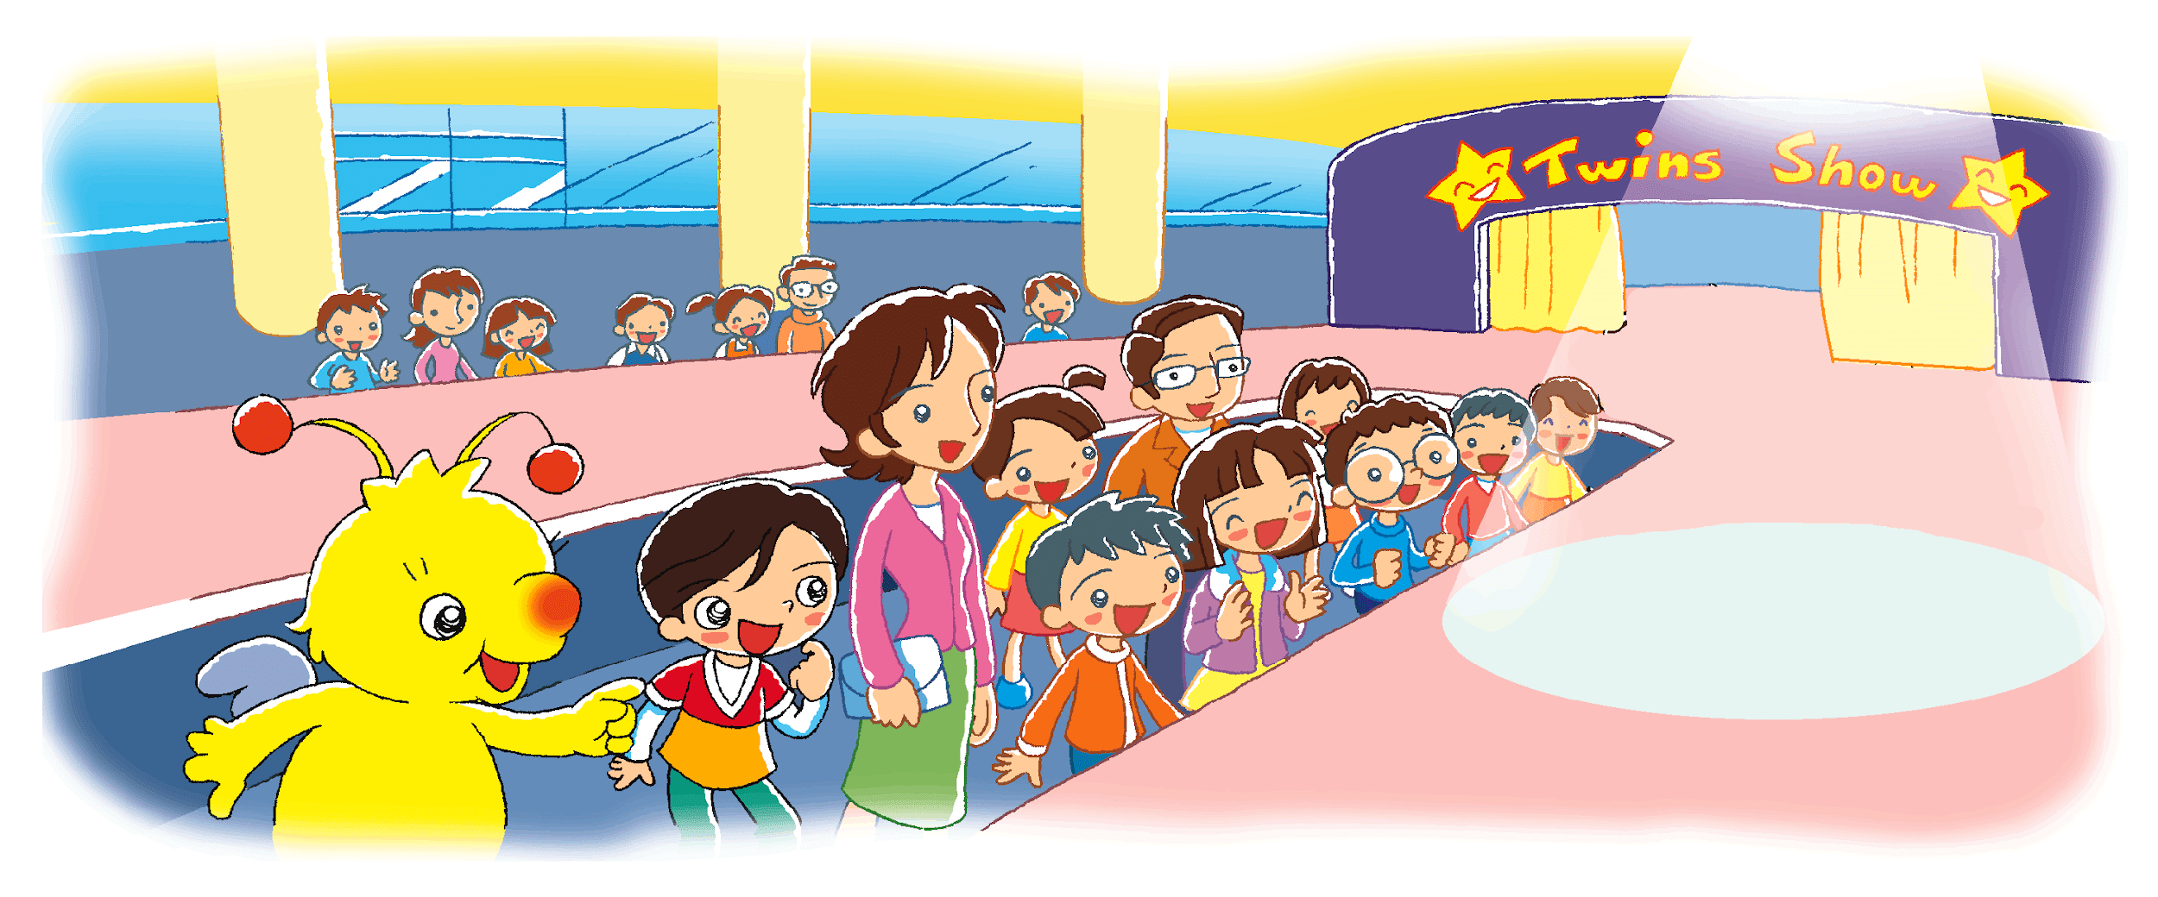
Beeno and Tom are watching a show.
What is the show about?
Notes:
Say In this story, Beeno and Tom are watching a show. Ask Can you see Beeno and Tom? Invite a pupil to come to the screen to point at Beeno and Tom. Ask What show is this? Can you guess? (Twins Show.) [Click to circle the banner] [Click to show the question] Say Yes, it is a Twins Show! What is the show about? Ask Do you want to watch the show? (Yes.) Say Ssh! Be quiet. The show will start soon. – observing / guessing

Slide 8
Let’s read the story!
First reading

Slide 9
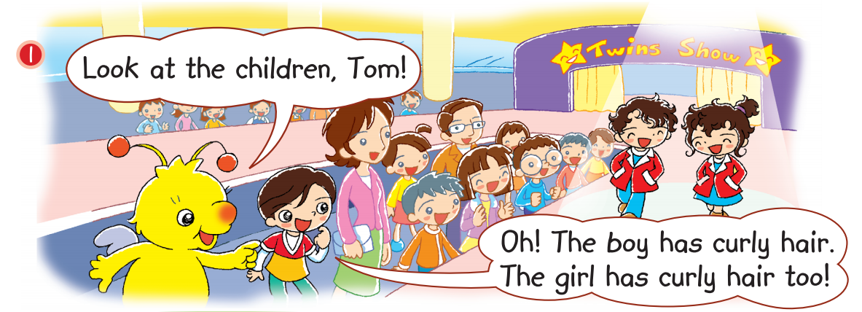
curly hair
Notes:
Say The first pair of children come. [Click to highlight ‘curly hair’] Say Look. The children have curly hair. Twirl your hair to indicate ‘curly’. You may bring a wig with curly hair and put it on when teaching the words.

Slide 10
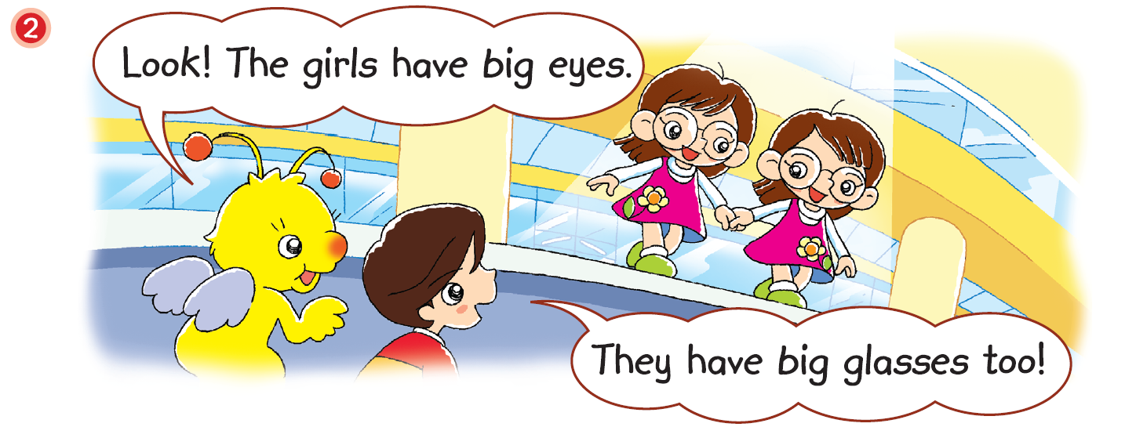
glasses
Notes:
Say Here come another pair. [Click to highlight ‘They’] Say ‘They’refers to … (The girls.) [Click to underline the answer] Say The girls have big glasses. [Click to highlight ‘glasses’] Invite a pupil to come to the screen to point at the girls’ glasses. [Click to show an arrow pointing towards the glasses] You may bring a pair of glasses and put them on when teaching the word. – identifying pronoun references / inferring unknown words

Slide 11
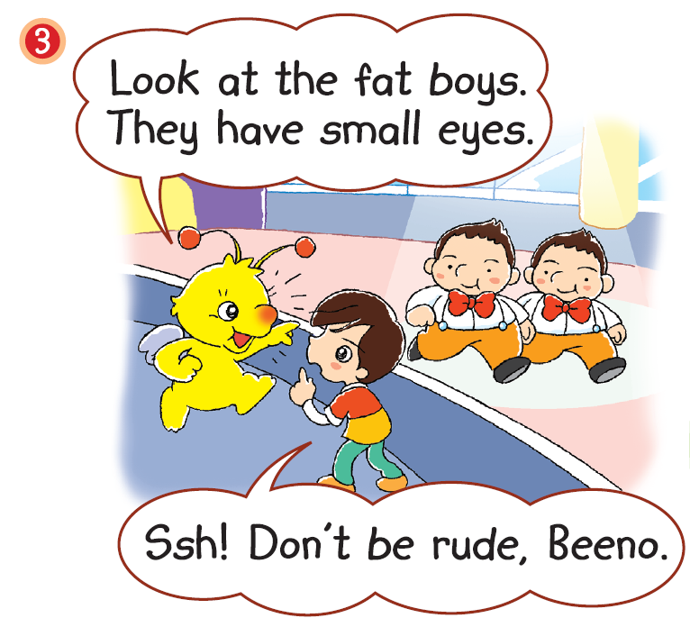
= Do not
It is rude to say the boys are fat.
Notes:
Say Now the third pair come.
Say Beeno says, ‘Look at the fat boys.’ [Click to underline the sentence]
Ask Is it nice to say this? (No.) Say That’s right. It isn’t nice to say this. It is rude. [Click to highlight ‘rude’ and show the explanation] ‘Rude’ means ‘not nice’ or ‘not polite’. – inferring / inferring unknown words
Say Look at Tom. He says, ‘Ssh! Don’t be rude … ’ Place a finger against your lips. [Click to highlight ‘Don’t’] Say ‘Don’t’ means‘ Do not’.

Slide 12
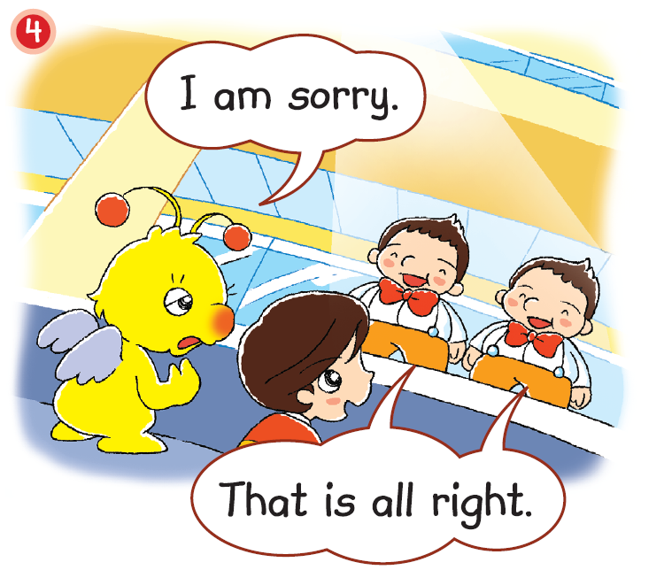
Are the boys angry with Beeno?
Notes:
Say Beeno says sorry to the boys.
[Click to show the question] Ask Are the boys angry with Beeno? (No.) How do you know? (They are smiling.) Say They also say, ‘That is all right.’ [Click to highlight ‘That is all right.’] This means ‘That is OK.’ They aren’t angry with Beeno. – inferring

Slide 13
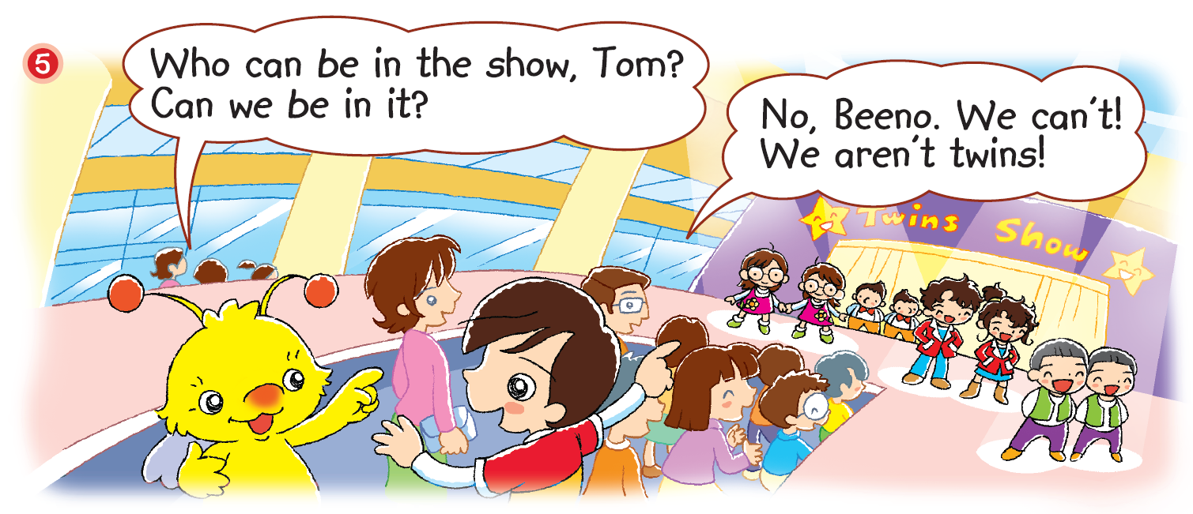
What does Tom say?
Notes:
Say Now all the pairs are on the stage. [Click to show the question] Ask What does Tom say? Can you guess? – guessing
Prompt pupils by asking Who can be in the Twins Show? (Twins.) Can Beeno and Tom be in the show? (No.) Why? (They aren’t twins.) [Click to show the answer] Say That’s right. They aren’t twins! They are just friends. – recalling / inferring

Slide 14
Answers
Notes:
Instruct pupils to complete Part D individually in their books. The activity can be completed in class or for homework. – locating specific information

Slide 15
Let’s do some more activities!
Post-reading

Slide 16
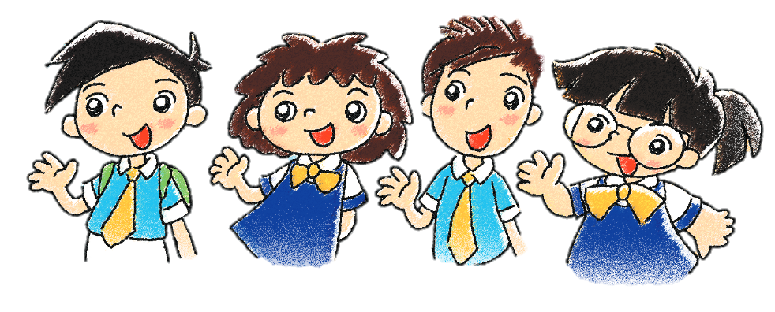
Readers’ theatre
Notes:
Put pupils into groups and assign each group a character. Ask each group to read their part aloud.

Slide 17
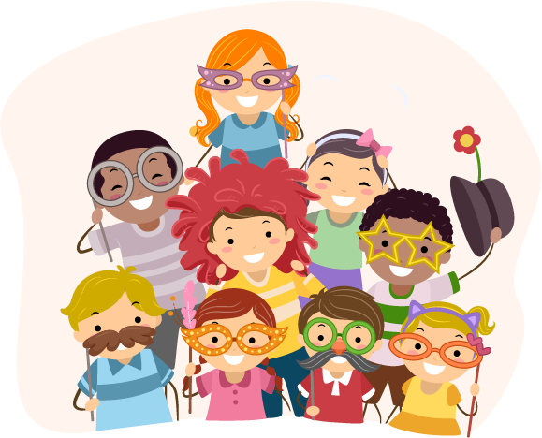
Twins Show
Notes:
Tell pupils that they are going to have their own Twins Show. Prepare props for the show, e.g. wigs, glasses (two items per prop).
Invite six to ten pupils to take part in the Twins Show. Prepare a ‘backstage area’, e.g. outside the classroom, where you can assign pupils into pairs of ‘twins’ and have them put on the props such as wigs, glasses, etc.
Then invite each pair of ‘twins’ to come into the classroom, one pair at a time. Instruct the class to say something about the ‘twins, e.g. They have curly hair.

Slide 18
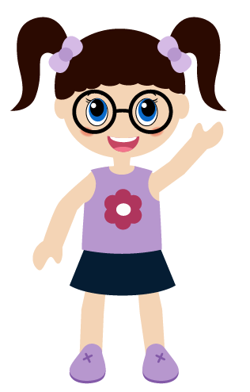
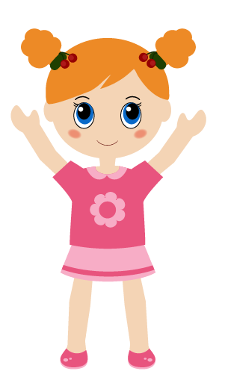
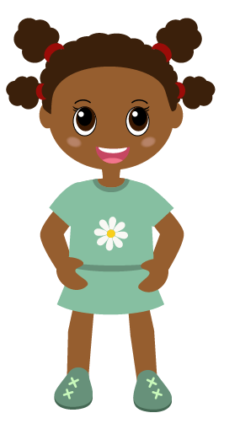
I am short.
I have black hair.
Who am I?
Notes:
Tell pupils that they are going to play a guessing game now.
[Click to show each sentence in each riddle] Read aloud each riddle, one sentence at a time.
Invite a pupil to come to the screen to point at the matching character after you have finished reading each riddle.
[Click to show the answer for each riddle]

Slide 19
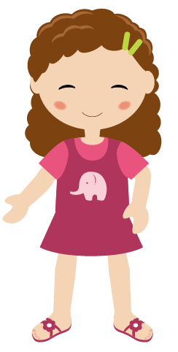
I have curly hair.
I have big glasses.
Who am I?

Slide 20
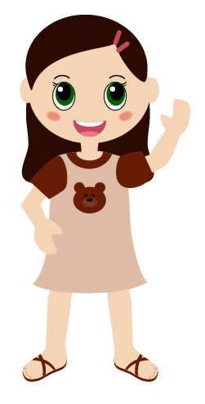
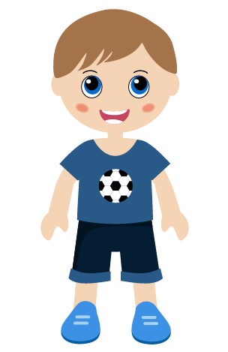
I have long hair.
I have big eyes.
Who am I?

Slide 21
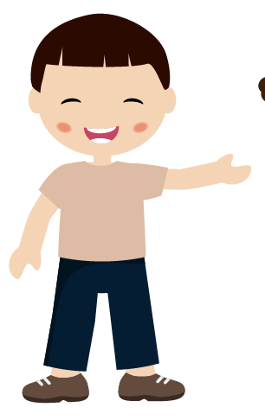
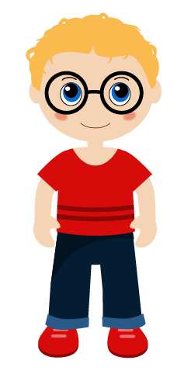
I am tall.
I have black hair.
I have red glasses.
Who am I?

