Slide 1
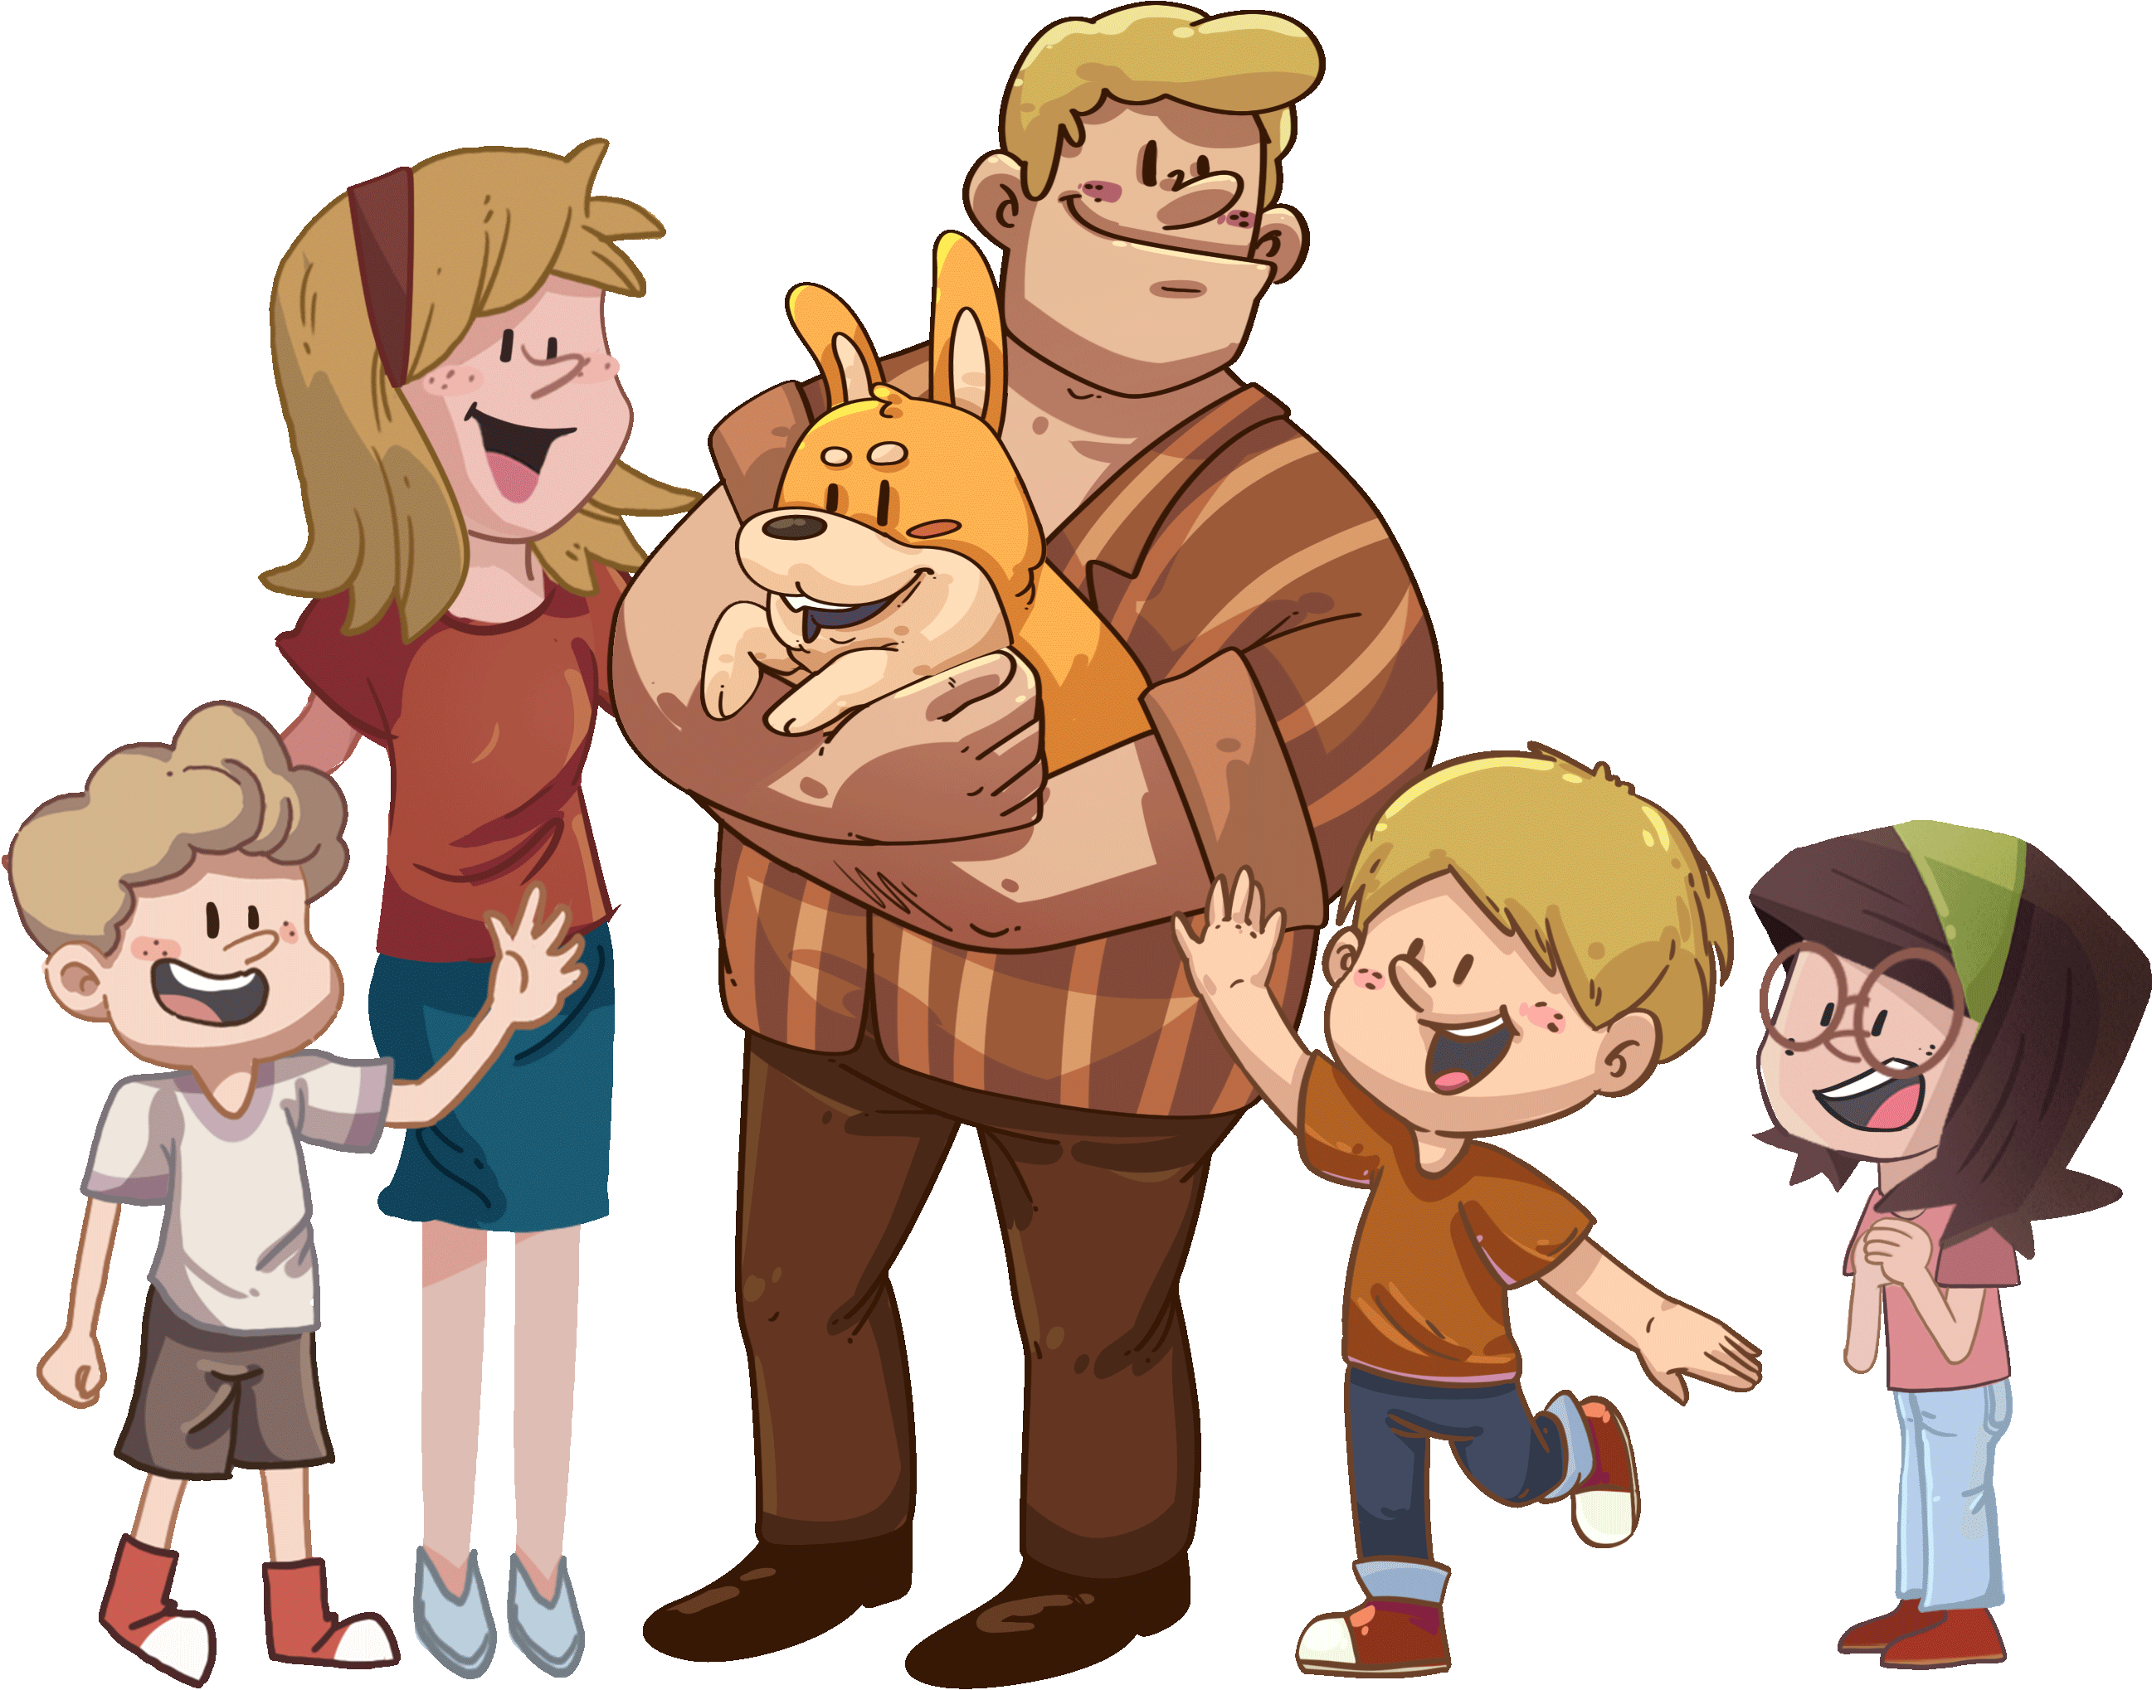
LO: Greet T and their partner; get a basic idea about the topic of
this lesson.
Greet Ss.
Ask Ss to greet T and their partner.
Introduce the topic to Ss.
Guide Ss to talk about the pictures on the slide.
TG
00:30
1/26

Slide 2
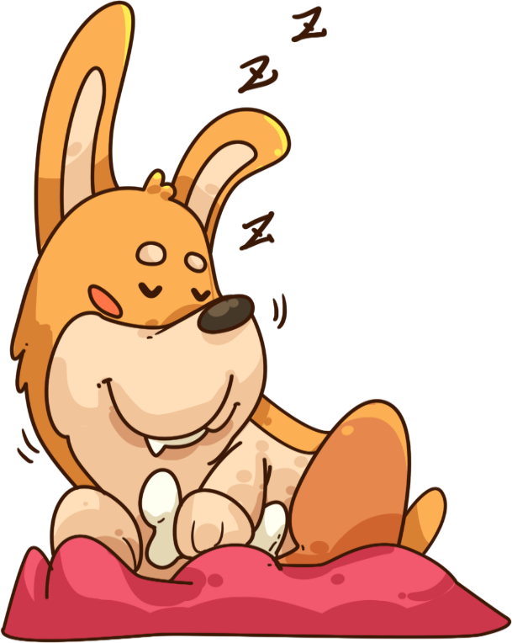
LO: Know the learning goals of this lesson.
Briefly go through the learning goals with Ss.
TG
We are going to . . .
Learning Goals
Learn and practice the consonant sound m in simple words.
Learn the key words dog, new, big, little, and strong, and use them in sentences.
Read the story A New Dog and identify
details in the pictures.
Practice using the sentence structure
_____ was too _____.
00:30
2/26

Slide 3
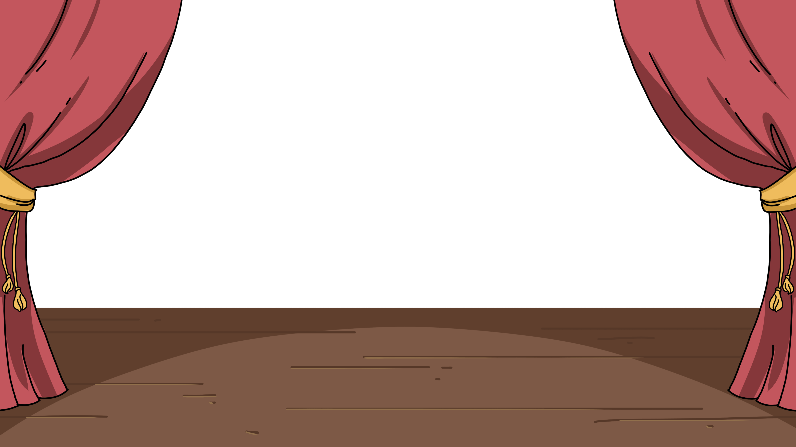
LO: Present homework; talk about what they have drawn.
Ask Ss to present their homework.
Encourage Ss to describe their homework.
Give feedback.
TG
Let’s Show
Presentation
Did you draw the activity you like best?
Now, show it and say, “I like _____ best.”
02:00
3/26

Slide 4
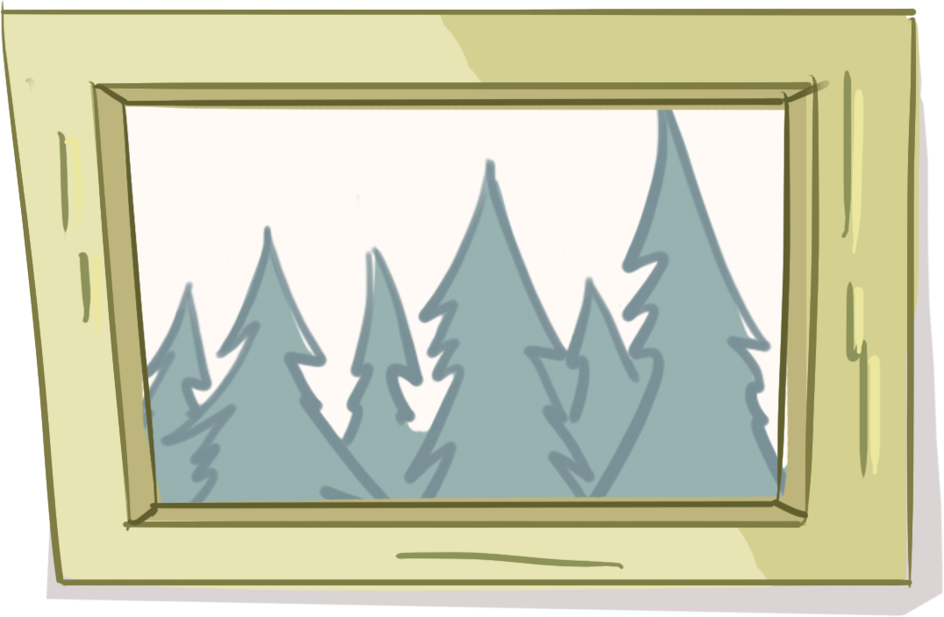
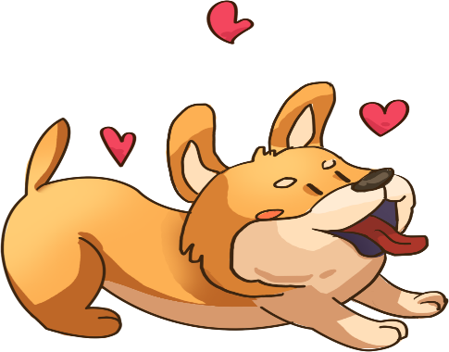
LO: Identify the consonant sound m.
Click and read each word on the bag to Ss like this: m-m-mad.
Click and guide Ss to read the sound m like this: m-m-m.
Note: On this slide, Ss don’t need to read the words after T.
TG
Let’s Listen
Phonics
milk
mad
must
mom
match
mess
m-m-m
02:30
4/26

Slide 5
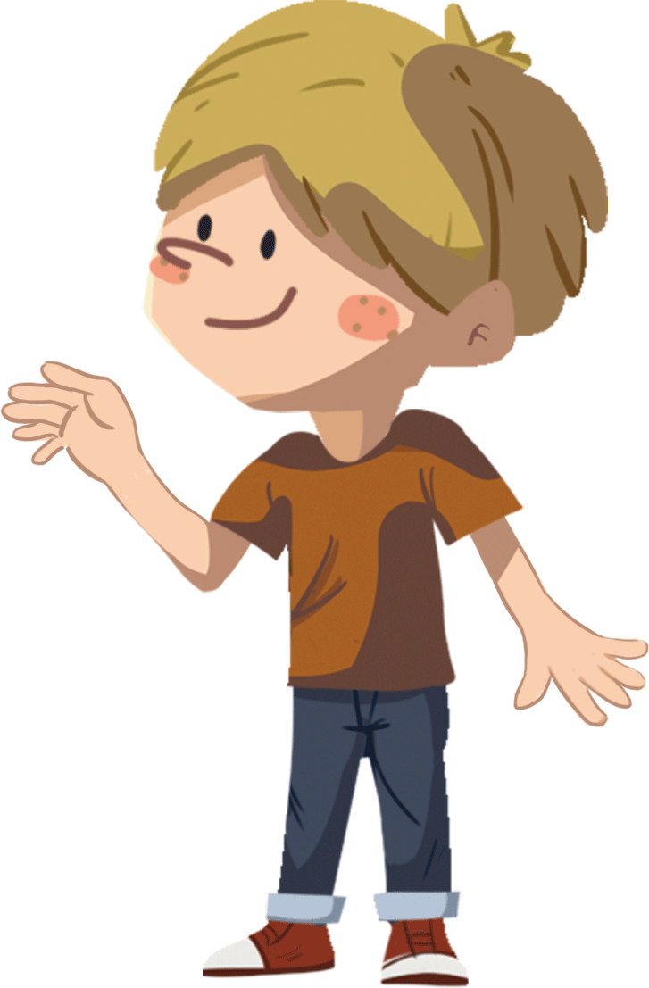
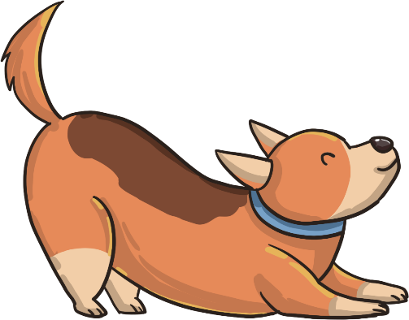
LO: Pronounce the words with the sound m.
Click and have Ss read each word together after T like this: m-m-mad. Note: After Ss read the words correctly, click and throw a bone to the dog.
TG
Let’s Say
Phonics
mad
must
mom
milk
mess
match
02:30
5/26

Slide 6
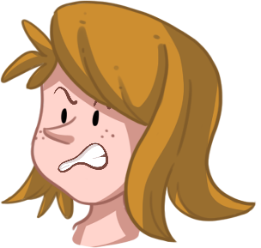
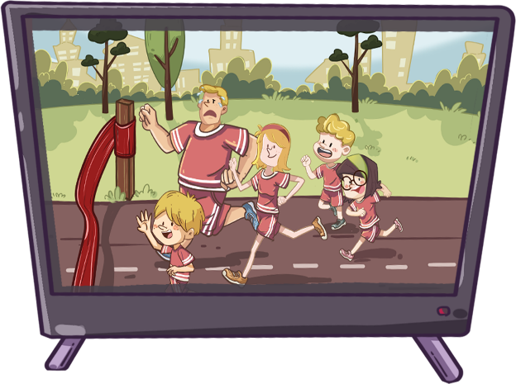
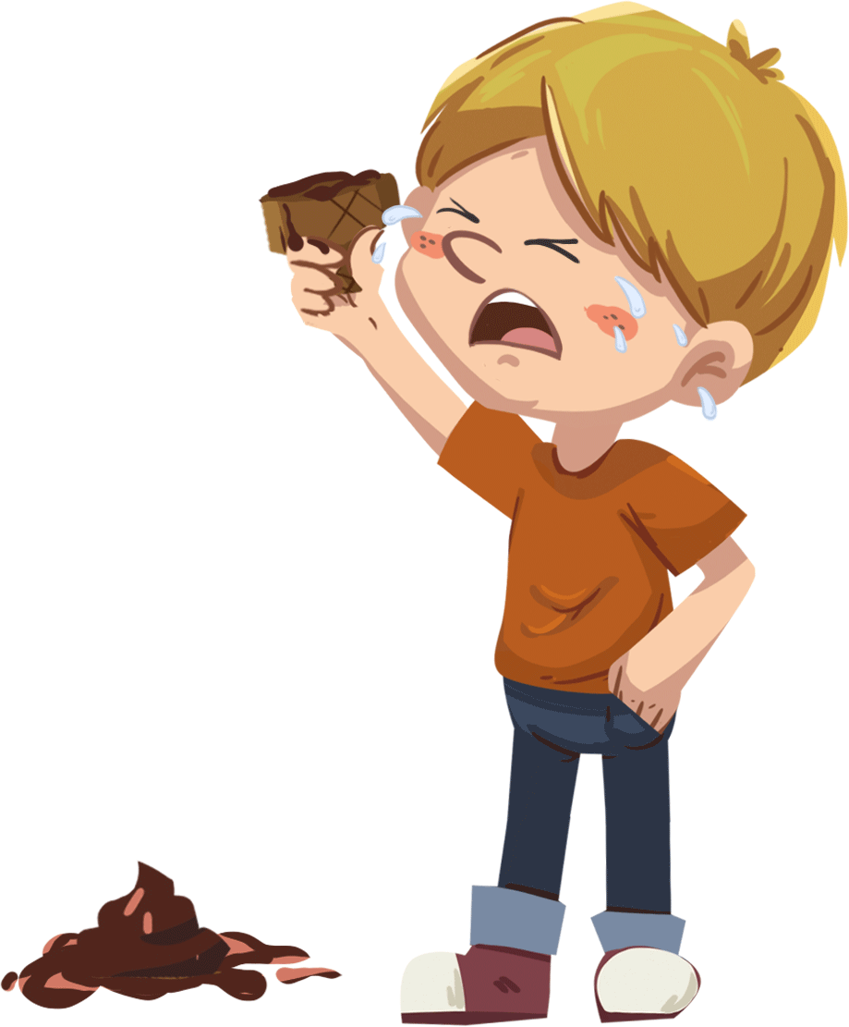
LO: Decode the words learned in the text.
Click and read the chant to Ss with rhythm.
Guide Ss to repeat after T; ask them to take turns reading one sentence.
Give feedback.
TG
Let’s Chant
Phonics
Mom is in a match.
Milk is on a mat.
Jack is in a mess.
Mom must be mad.
02:00
6/26

Slide 7
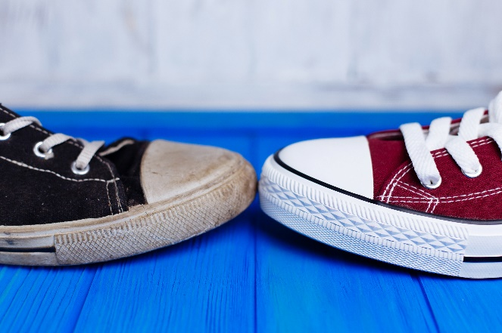
LO: Get to know the title, author, and illustrator of the book; use
the book cover to identify details and make predictions;
know the meaning of the key vocabulary word and make
sentences with it.
Guide Ss to look at the book cover and encourage them to talk about what they see.
Ask Ss to find the title, author, and illustrator;
Explain the key vocabulary word and the example sentence; encourage Ss to make sentences with the key vocabulary word.
Guide them to talk about the given questions.
Note: On this slide, Ss don’t need to say the names of the author and the illustrator.
TG
Introduction
Let’s Begin
Who can you see on the book cover?
What animals can you see on the book cover?
How many animals can you see?
Which one do you think Chip will take?
Vocabulary
new
The red shoe is new.
Vocabulary
Written by Roderick Hunt
Illustrated by Alex Brychta
02:00
7/26

Slide 8
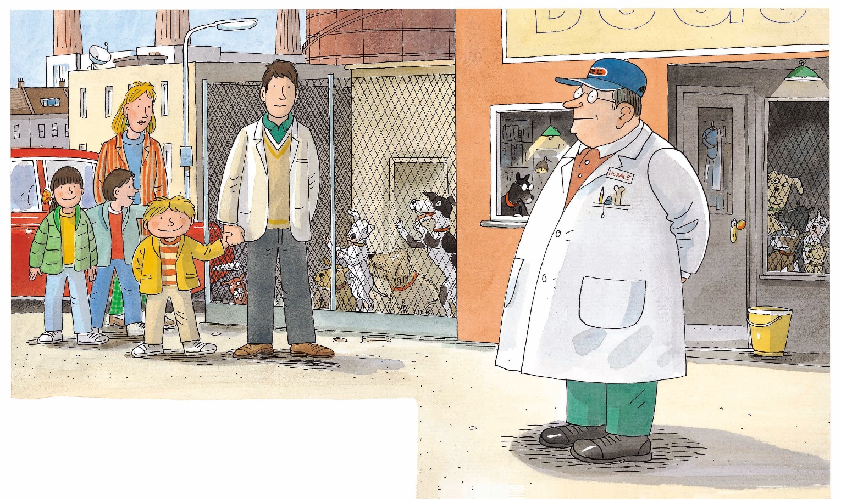
Let’s Predict
LO: Use the illustration to identify details and make predictions
about the story.
Guide Ss to look at the illustration and talk about what they see.
Ask Ss the given questions and encourage them to make predictions.
TG
Lead-in
1. Where will the family go?
I think _____.
2. Why do you think they
want to go there?
I think _____.
02:00
8/26

Slide 9
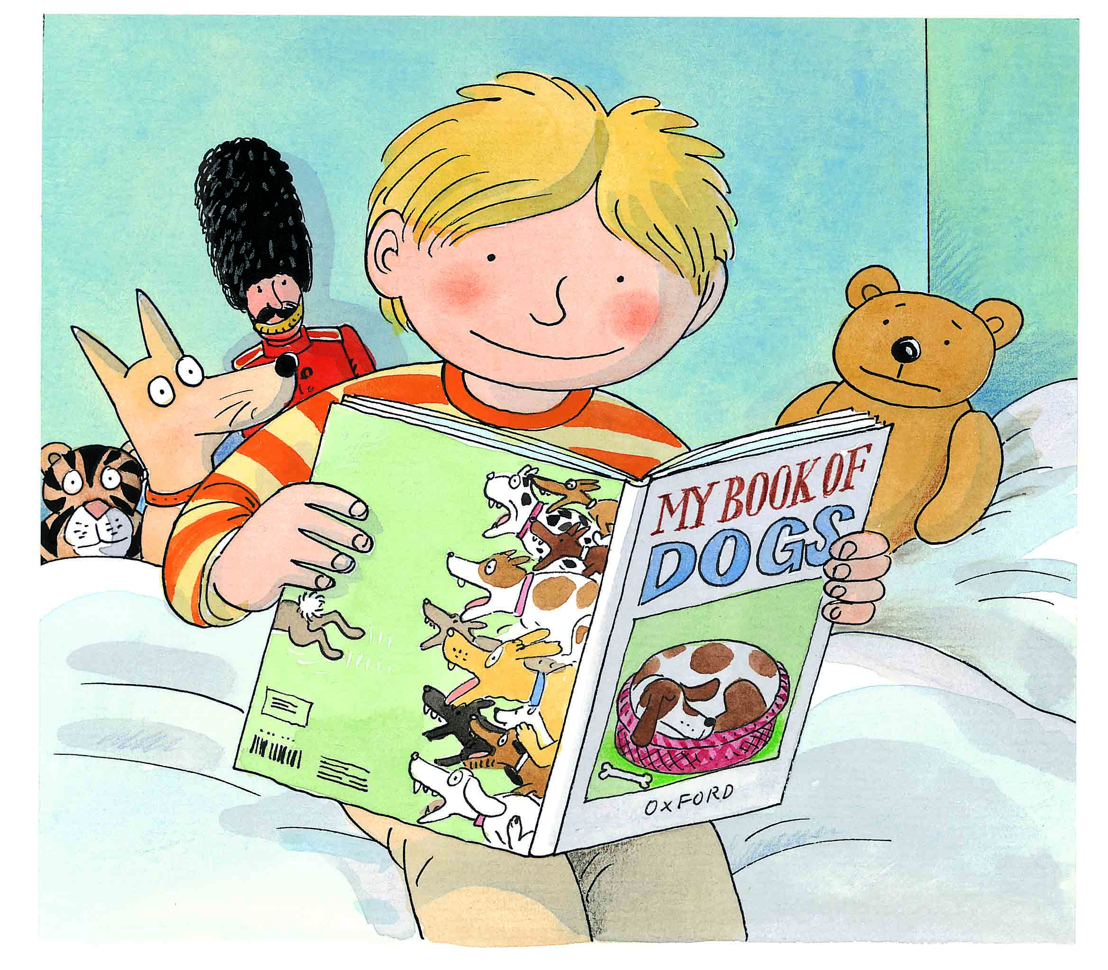
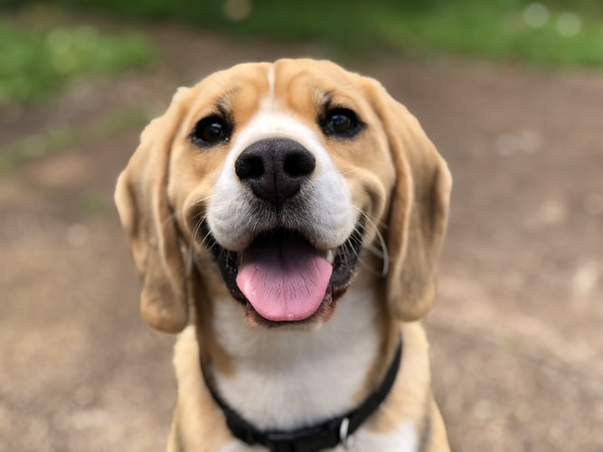
A New Dog
LO: Identify details using the illustration; know the meaning of
the key vocabulary word and make sentences with it;
understand the text.
Read the text to Ss.
Explain the key vocabulary word and the example sentence; encourage Ss to make sentences with the key vocabulary word.
Guide Ss to look at the illustration and talk about the given questions with complete sentences.
Guide Ss to read the text together.
TG
Reading
Vocabulary
Details
What book was Kipper reading?
What was Kipper’s book about?
What did Kipper want?
dog
It is a cute dog.
Vocabulary
Kipper wanted a dog.
02:00
9/26

Slide 10
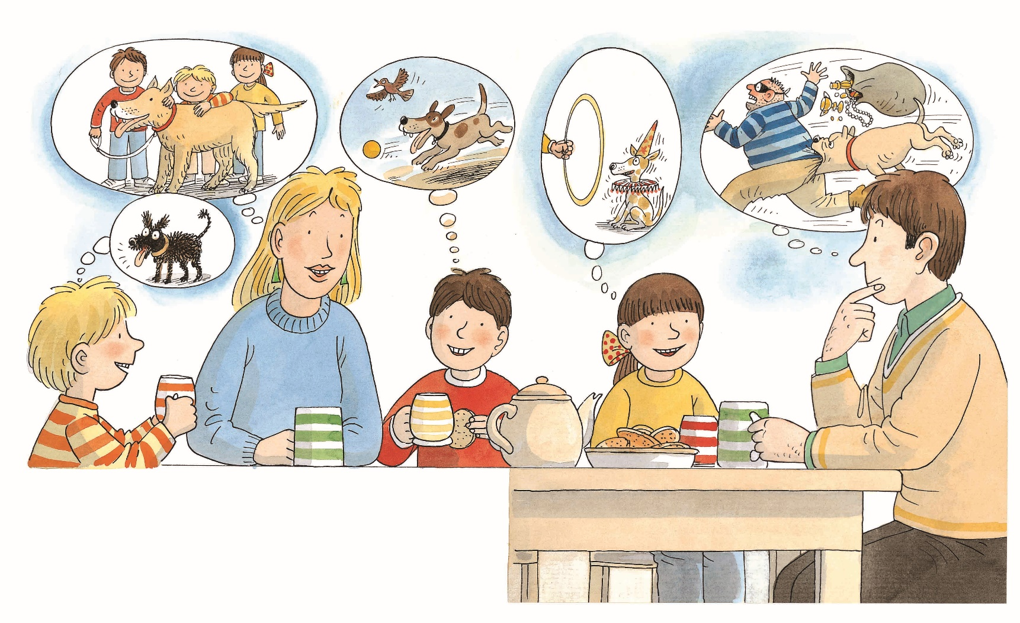
A New Dog
LO: Identify details using the illustration; understand the text;
read the text accurately.
1. Read the text to Ss.
2. Guide Ss to look at the illustration and talk about the given
questions with complete sentences.
3. Guide Ss to take turns reading the text.
4. Check Ss’ accuracy and give feedback.
TG
Reading
Details
What did the family want? They wanted ___.
Why did Dad want to have one? Look for clues in the illustration.
Decoding
Read accurately.
Everyone wanted a dog.
02:00
10/26

Slide 11
A New Dog
LO: Identify details using the illustration; comprehend the story;
understand the text; read the text accurately.
1. Read the text to Ss.
2. Guide Ss to look at the illustration and talk about the given
questions with complete sentences.
3. Ask Ss to talk about the comprehension question.
4. Guide Ss to take turns reading the text together.
5. Check Ss’ accuracy and give feedback.
TG
Reading
Details
Where did the family go?
They went to ___.
Comprehension
Why did the family go to
the dogs’ home?
Decoding
They went to the dogs’ home.
Read accurately.
02:00
11/26

Slide 12
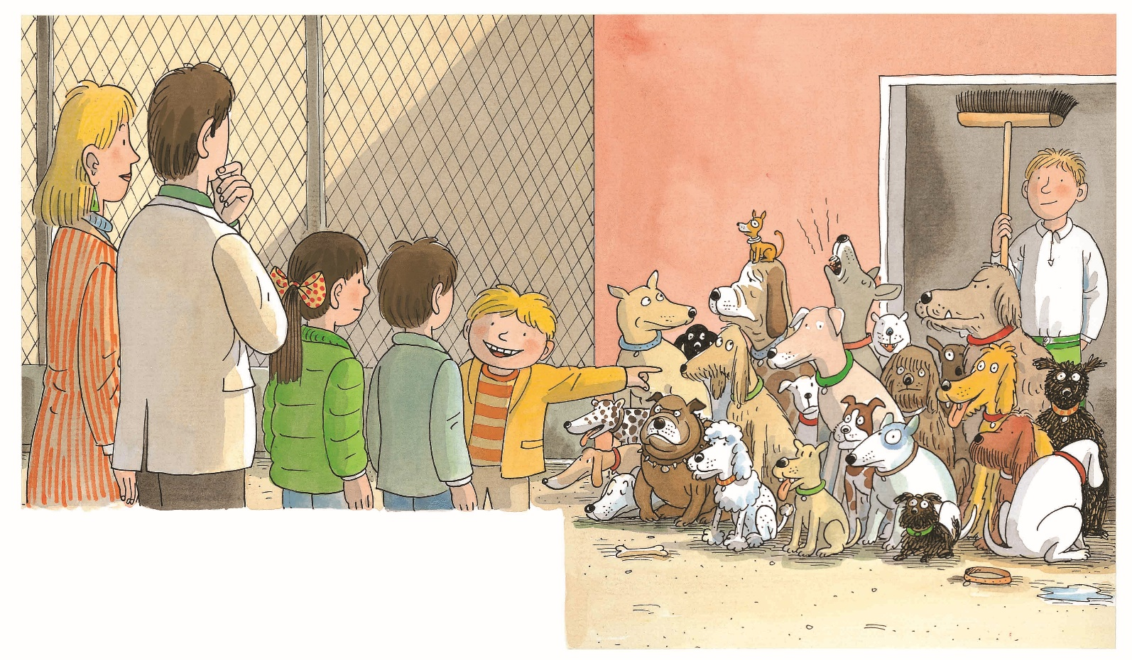
A New Dog
LO: Identify details using the illustration; understand the text; make
connections.
Read the text to Ss.
Guide Ss to look at the illustration and talk about the given questions in complete sentences.
Guide Ss to read the text and do the action of “look at” together.
Guide Ss to talk about the connections question; model first; encourage them to take turns talking more about themselves.
TG
Reading
Details
What did the family do?
How were these dogs different? Which one do you think everyone in the family would choose?
Connections
Which dog would
you choose?
They looked at the dogs.
02:00
12/26

Slide 13
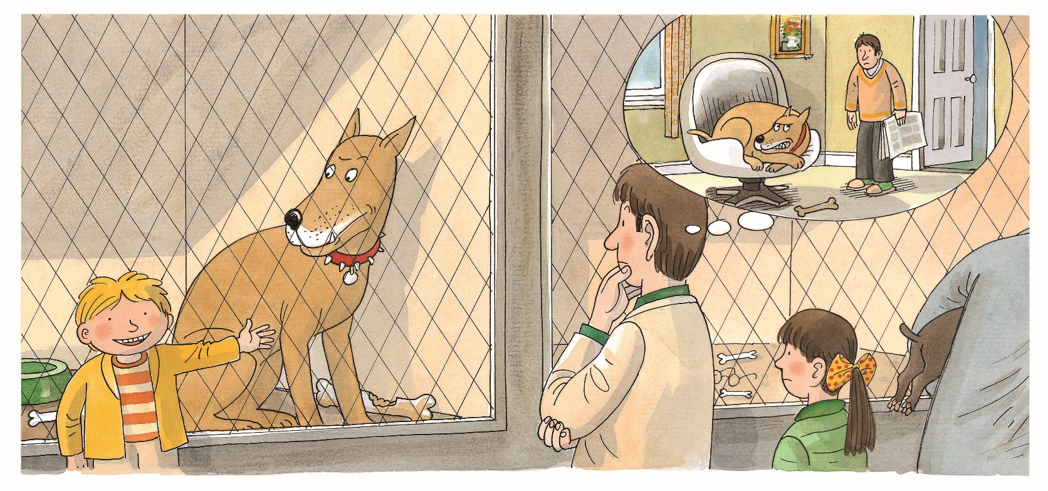
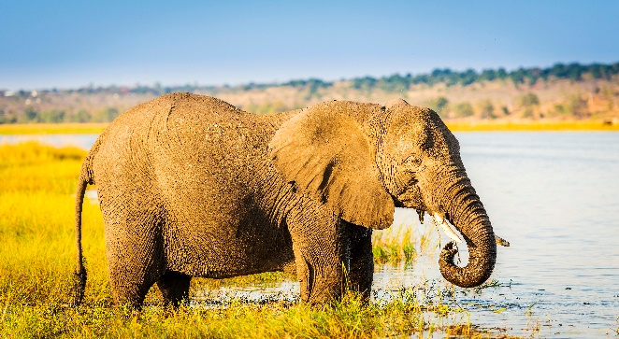
A New Dog
LO: Identify details using the illustration; know the meaning of
the key vocabulary word and make sentences with it;
decode the sight word; understand the text.
Read the text to Ss.
Explain the key vocabulary word and the example sentence; encourage Ss to make sentences with the key vocabulary word.
Guide Ss to read the sight word and have them repeat it.
Guide Ss to look at the illustration and talk about the given questions in complete sentences.
Guide Ss to read the text and do the action of “too big” together.
TG
Reading
Vocabulary
Sight Word
Details
Who wanted the dog?
Did Dad want this dog? What was the problem with this dog? It was too _______.
too
big
The elephant is big.
Kipper wanted this dog. It was too big.
Vocabulary
Sight Word
02:30
13/26

Slide 14
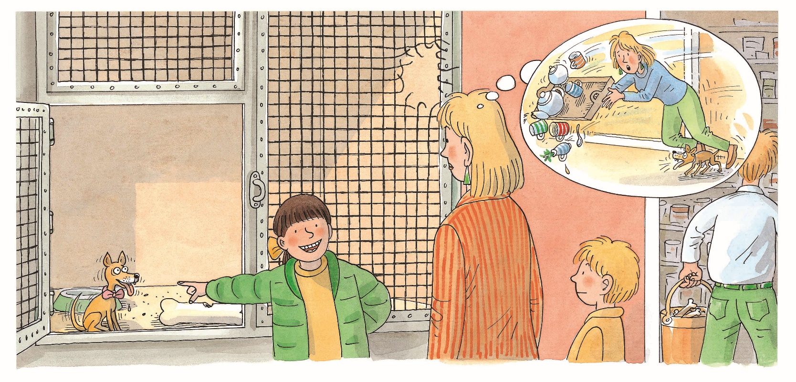
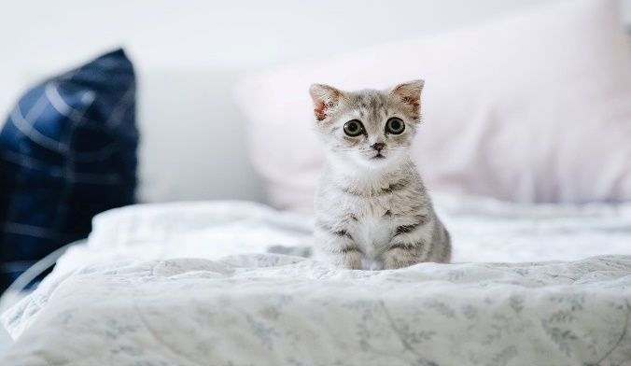
A New Dog
LO: Identify details using the illustration; know the meaning of the key
vocabulary word and make sentences with it; understand the text;
make connections.
Read the text to Ss.
Explain the key vocabulary word and the example sentence; encourage Ss to make sentences with the key vocabulary word.
Guide Ss to look at the illustration and talk about the given questions with complete sentences.
Guide Ss to read the text and do the action of “too little” together.
Guide Ss to talk about the connections question; model first; encourage them to take turns talking more about themselves.
TG
Reading
Details
Who wanted the dog?
Who did not want this dog?
What was the problem with the dog? It was too _______.
Vocabulary
little
It’s a little cat.
Connections
Do you like big dogs or little dogs? Why?
Biff wanted this dog. It was too little.
Vocabulary
02:30
14/26

Slide 15
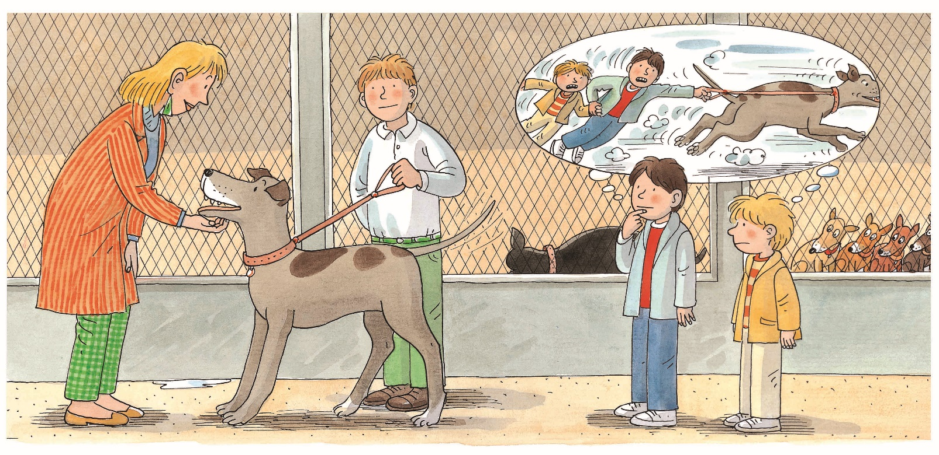
A New Dog
LO: Identify details using the illustration; know the meaning of the
key vocabulary word and make sentences with it; understand
the text.
Read the text to Ss.
Explain the key vocabulary word and the example sentence; encourage Ss to make sentences with the key vocabulary word.
Guide Ss to look at the illustration and talk about the given questions with complete sentences.
Guide Ss to read the text; use the body language to demonstrate what the word “strong” means.
TG
Reading
Details
Vocabulary
Who wanted to have this dog?
How did Kipper and Chip feel about the dog?
What was the problem with the dog? It was too _______.
strong
He is very strong.
Mum wanted this dog. It was too strong.
vocabulary
02:00
15/26

Slide 16
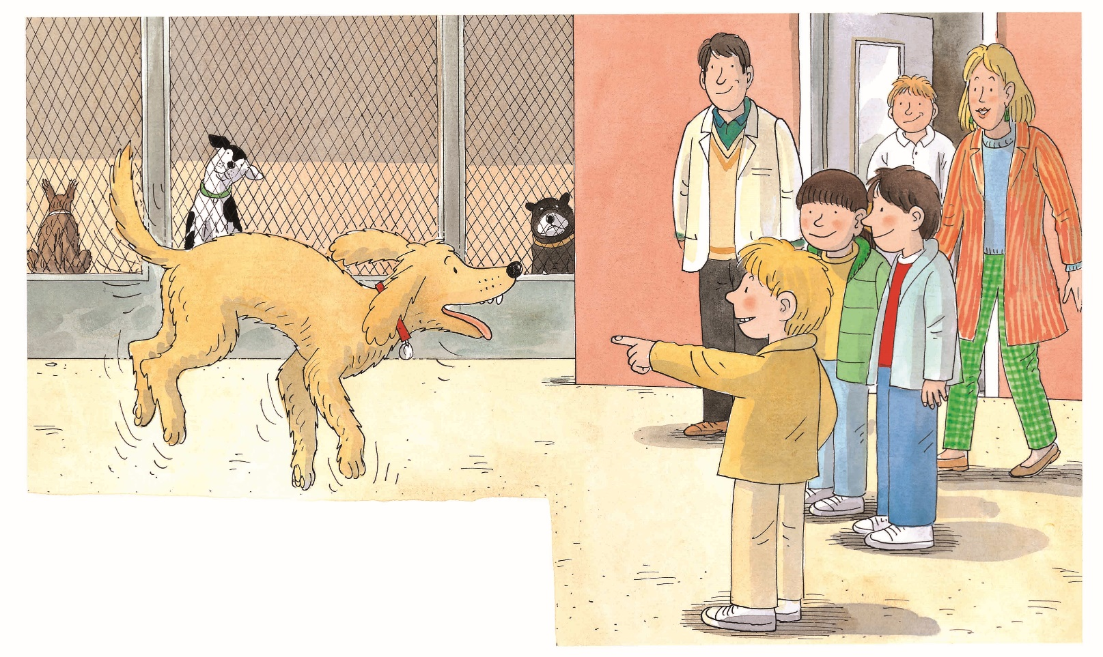
A New Dog
LO: Identify details using the illustration; understand the text; make
connections.
Read the text to Ss.
Guide Ss to look at the illustration and talk about the given questions with complete sentences.
Guide Ss to read the text.
Guide Ss to talk about the connections question; model first; encourage them to take turns talking more about themselves.
TG
Reading
Details
Did everyone in the family want this dog? How do you know?
Connections
Which dog would you like to keep in this story?
Everyone liked this dog.
02:00
16/26

Slide 17
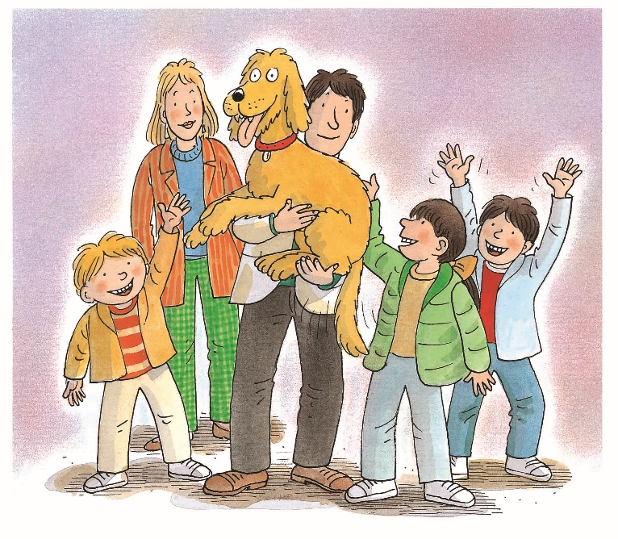
A New Dog
LO: Identify details using the illustration; understand the text; make
connections.
Read the text to Ss.
Guide Ss to look at the illustration and talk about the given questions in complete sentences.
Guide Ss to read the text.
Guide Ss to talk about the connections question; model first; encourage them to take turns talking more about themselves.
TG
Reading
Details
How did Chip and Kipper feel?
Where did the family take the dog?
Connections
If you were in the family, which dog would you choose, Floppy or one of the other dogs?
They took the dog home.
02:00
17/26

Slide 18
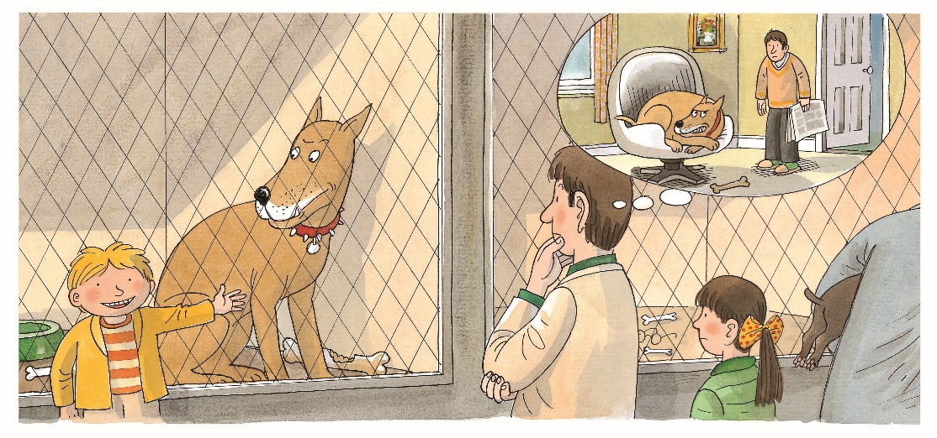
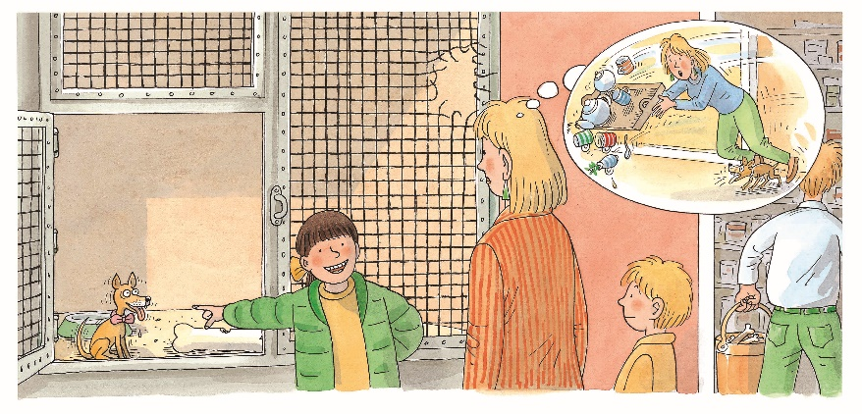
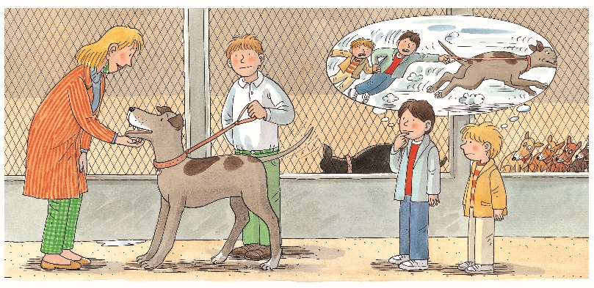
LO: Retell the story with the given sentence structure.
Guide Ss to recall some details in the story.
Click and model first; have Ss work together to retell the story using the given illustrations and helping words.
Give feedback.
TG
Reading
Let’s Retell
Helping Words
the dogs’ home
too big
too little
too strong
like
1
2
3
4
5
18/26
03:00

Slide 19
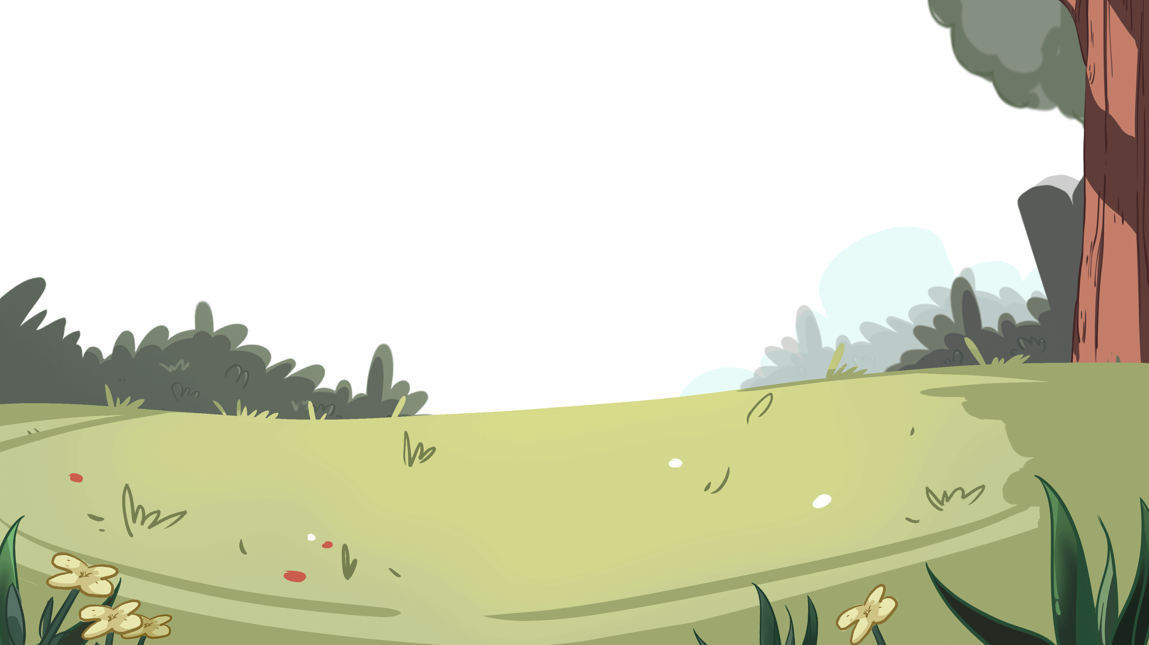
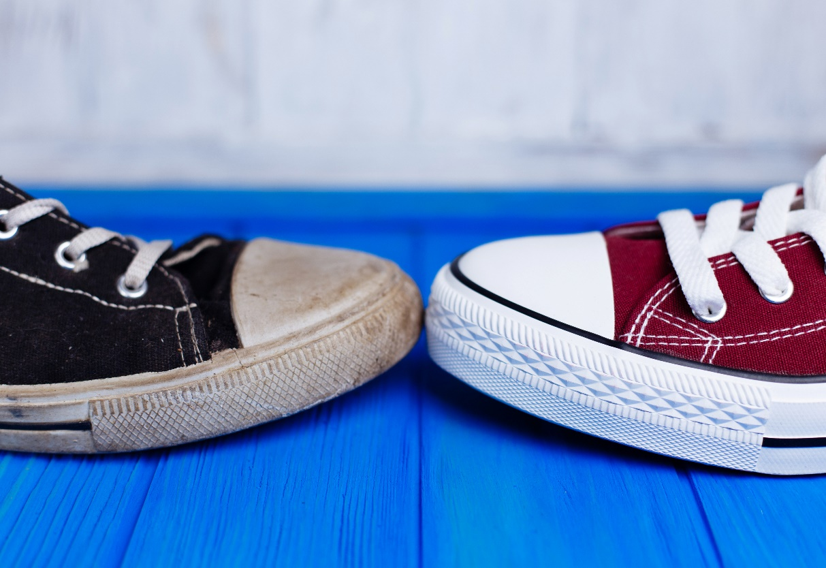
LO: Check Ss’ understanding of the key vocabulary learned in
the lesson.
Guide Ss to say the key vocabulary words with the help of the pictures; give one point to the first S who answers correctly.
Click to show the right answers.
Announce the winner.
TG
Let’s Guess
Vocabulary
new
strong
big
little
dog
02:00
19/26

Slide 20
LO: Talk about the illustrations with the given sentence structure.
Ask Ss to look at the illustrations and identify the characters.
Read the given question and ask Ss to take turns answering each question.
Give feedback.
Note: Ss should use complete sentences.
TG
Listening &
Speaking
Let’s Talk
—What was the problem with the dog?
—The dog was too ______.
Reading
big
strong
little
01:30
20/26

Slide 21
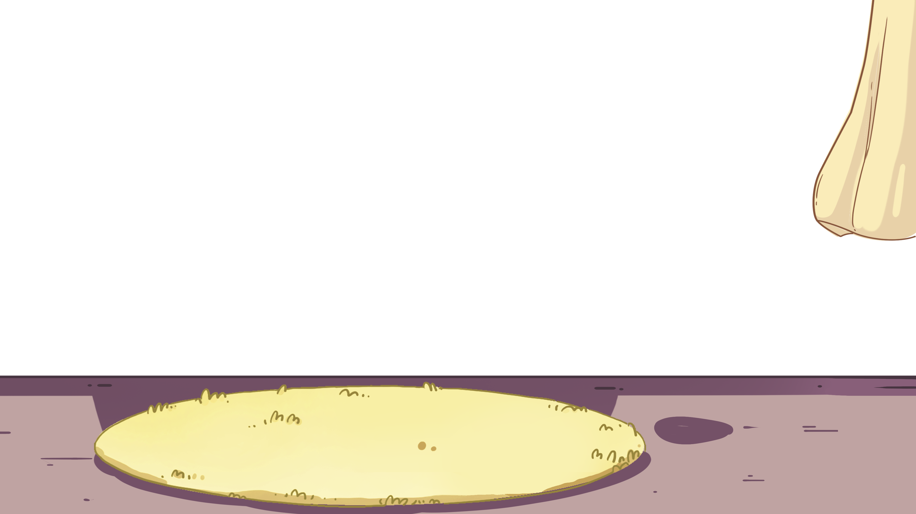
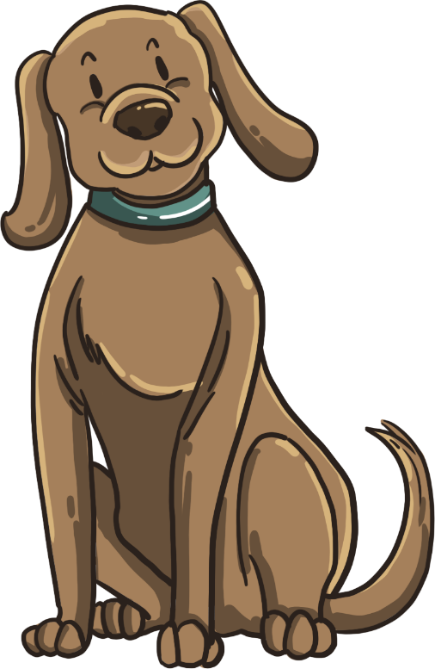
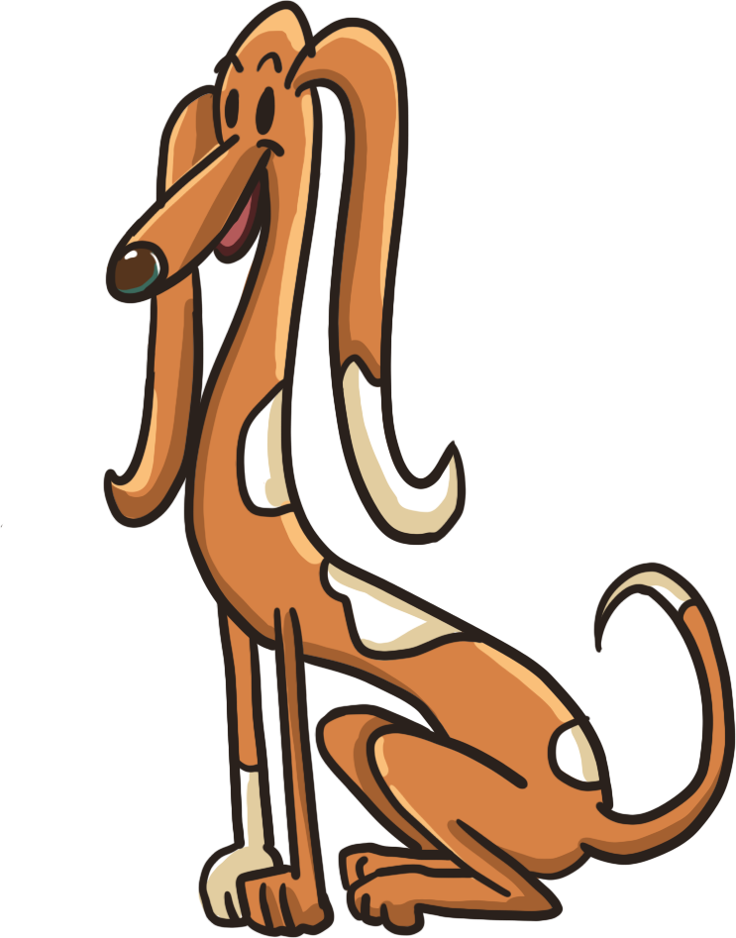
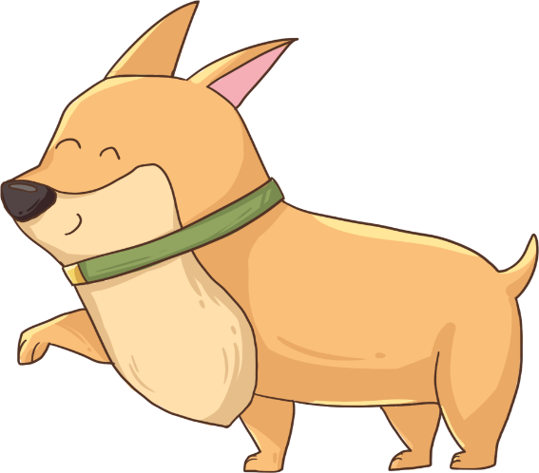
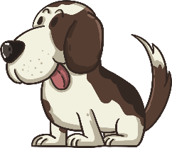
LO: Talk about the given pictures using the given sentence
structure.
Guide Ss to look at the pictures to talk about what they see.
Model first; have Ss take turns talking about the given question.
Note: Each S should say at least two sentences.
TG
Listening &
Speaking
Let’s Talk
What is the problem with the dog?
It is too _____.
Helping Words
· tall
· tiny
· spotted
· fat
02:00
21/26

Slide 22
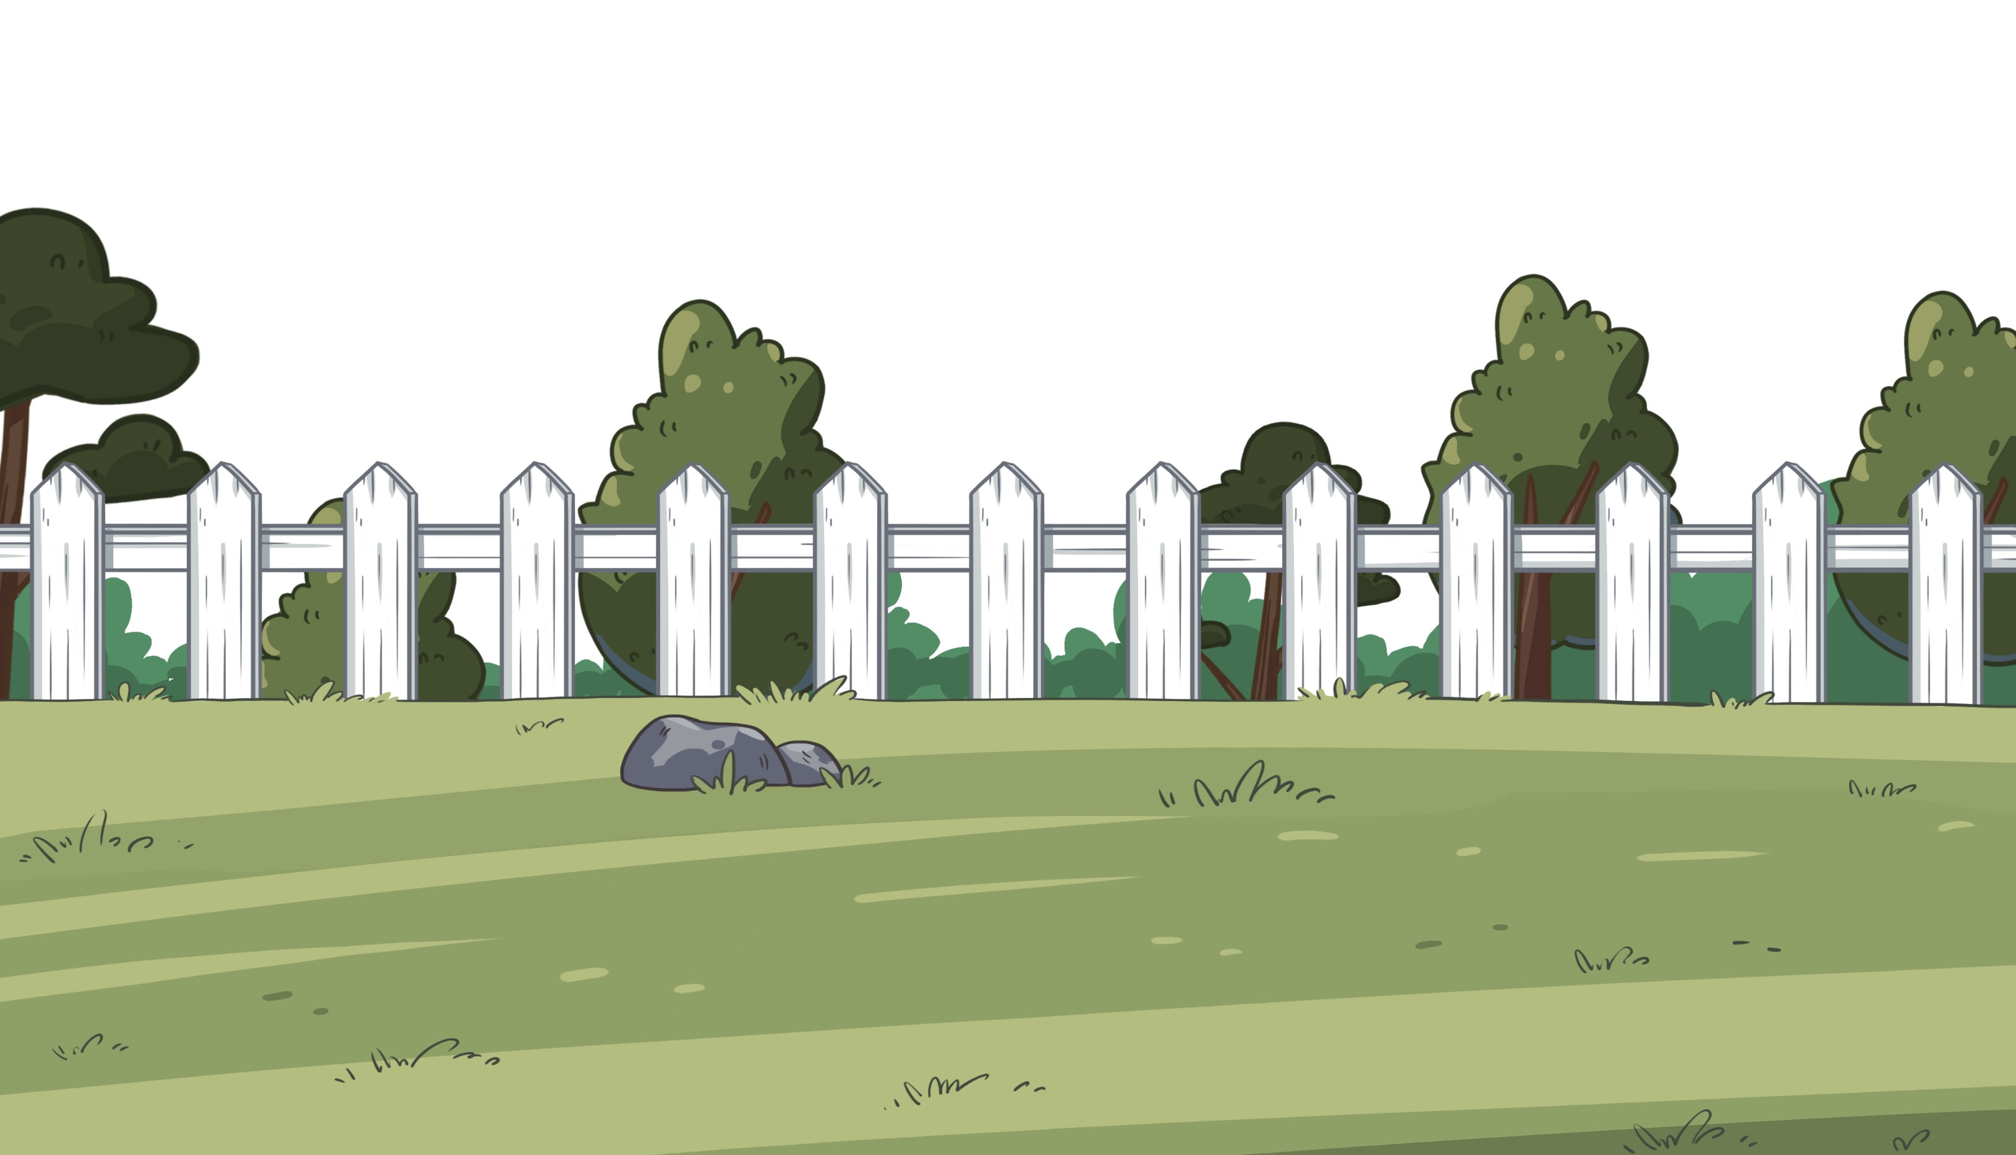
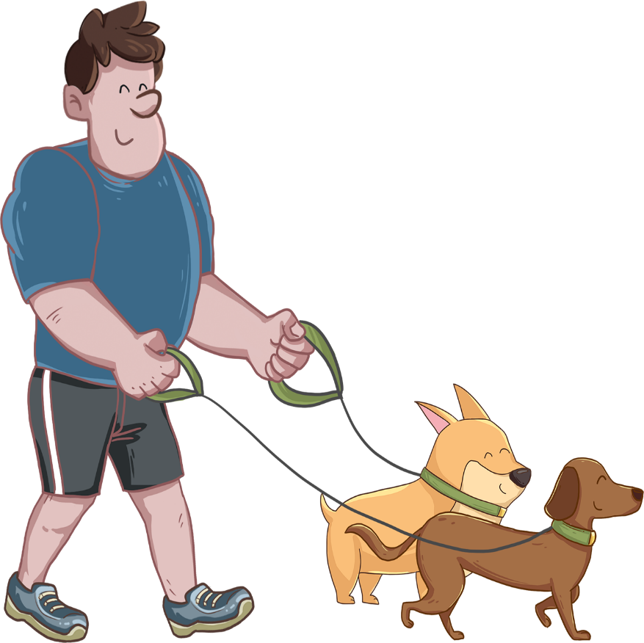
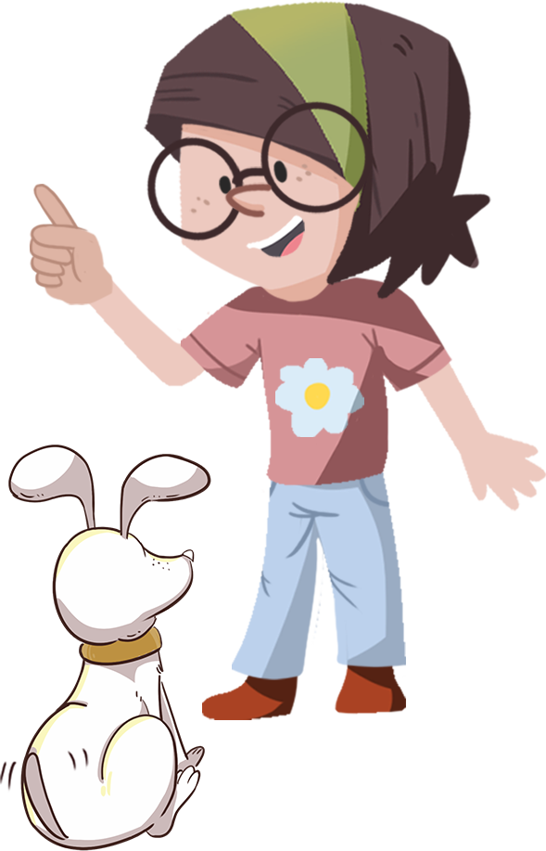
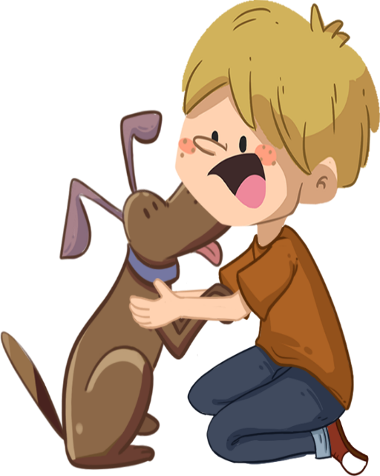
Let’s Discuss
LO: Build their awareness of loving dogs.
Guide Ss to look at the picture; ask them the given question.
Click and show the answers; invite Ss to share their answers
with others; make sure Ss know that they should love dogs
instead of hurting them.
TG
Value
Do they love their dogs?
1
2
3
02:00
22/26
17/22

Slide 23
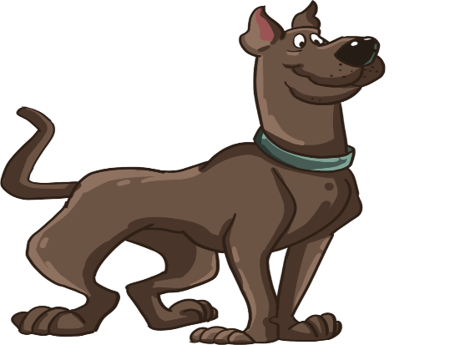
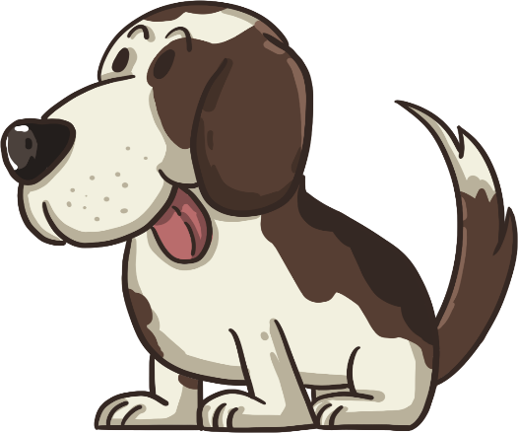
Get Ready to Present
LO: Talk about what they’ve learned from the story.
Ask Ss the given question and guide them to think about it.
Model first; guide Ss to talk about the question with the visual aids.
TG
Oral Writing
How did the family choose
Floppy as their pet?
Dad
Mum
Kipper
Biff
the family
02:00
23/26

Slide 24
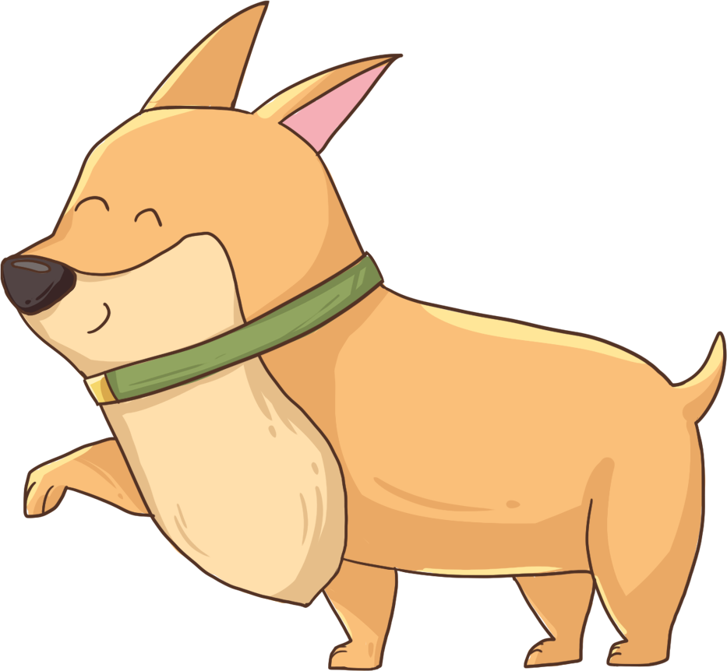
Let’s Draw & Say
LO: Understand what the homework is; know the post-class
video will help them finish their homework.
Explain the writing task to Ss and remind them to watch the post-class video before doing the homework.
Remind Ss to get ready to present their homework next class.
TG
Writing
Opinion Writing
Now you will prepare for your writing task:
Draw a picture of your favorite pet.
Label it with the right name.
You can say, “My favorite pet is _____.”
a dog
Tip: Remember to watch the post-class video.
01:00
24/26

Slide 25
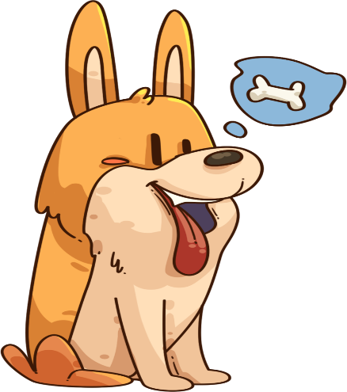
Let’s Review
LO: Get a better idea of what they’ve learned in this lesson.
Ask Ss to read the words in the phonics section; correct Ss’ pronunciation if necessary.
Ask Ss to read the key vocabulary words; help Ss with the struggling words if necessary.
Have each S make a sentence in turn using the sentence structure.
TG
Review
Phonics:
mom/mess/match/ must/mad/milk
Vocabulary:
dog/new/big/little/strong
Sentence Structure:
_____ was too _____.
02:00
25/26

Slide 26
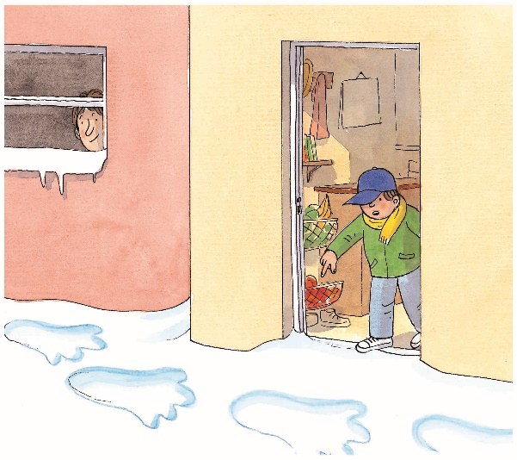
Briefly comment on Ss' progress and praise them for doing a good job.
Say goodbye to Ss.
TG
00:30
26/26

