Slide 1
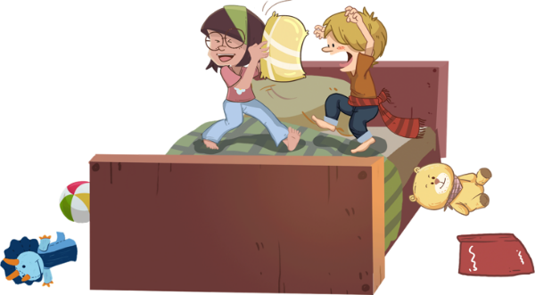
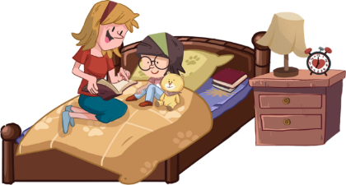
TG
LO: Get to know their partners; get a basic idea about the
topic of today’s lesson;
1. Say hello to Ss; ask Ss to greet each other.
2. Guide Ss to describe or discuss the pictures on the first page.
3. Introduce the topic of the lesson.
1:00
1/27

Slide 2
Learning
Goals
TG
LO: Get to know and understand what will be learned in this
lesson.
Go through the learning goals with Ss.
We are going to . . .
Identify and produce rhyming words that end with all.
Learn the different words and phrases babysitter, books, sandwich, pillow fight, and downstairs, and make sentences with them.
Read the story The Baby-sitter and learn to ask questions about a story using the text or the pictures.
Practice using the sentence structure ____ wanted ____.
0:30
2/27

Slide 3
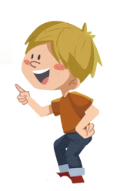
TG
Presentation
LO: Present and share the writing assignment from last lesson;
1. Invite Ss to take turns presenting their homework. If time is limited, tell
Ss they have one or two mins to present their writing.
2. Encourage Ss to listen carefully and to ask questions.
3. After both of the Ss have finished, give them feedback and awards
(Click the book picture beside the boy or the girl so that they can get
some awards).
4. Click and give each S a trophy to mark their good performance.
Note: You can click the picture of the boy or the girl to give Ss the trophy.
Let’s show!
This is what I want to bring to the beach.
2:00
3/27

Slide 4
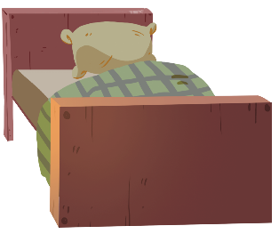
Phonics
TG
LO: Identify the rhyming words that end in all.
Ask Ss to talk about what they can see in the picture; click and have a pillow
fight at bedtime with the children in the picture.
2. Click and read each word to Ss when the word appears; click and ask Ss to tell what each
word ends with.
3. Click and ask Ss to tell what sound the letter team all makes; ask Ss to read the sound
after you.
4. Tell Ss that the room is too messy after the pillow fight.
Let’s listen!
ball
hall
wall
tall
Let’s have a pillow fight!
ok
mall
small
What do these words rhyme with? Can you read it?
2:30
4/27

Slide 5
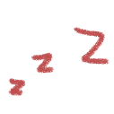
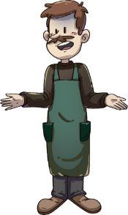
TG
LO: Pronounce the rhyming words; produce the rhyming words using all.
1. Click and ask Ss to help the children in the picture clean the room.
2. Ask Ss what sound the letter team all makes; click and guide Ss to decode each word
ending with all; if Ss are capable of reading these words, ask them to take turns reading
each word; click again to make the letters disappear and help the children in the picture
clean the room.
3. After showing and decoding the six words, encourage Ss to produce more rhyming words
that rhyme with all (Clues: fall, shall, pall); guide students to read the new words correctly.
4. Click and help the children in the picture go back to bed; help Ss develop a good habit
before going to bed.
sm
w
b
m
h
t
all
Well done, kids! It's time to go back to bed!
Kids, it’s time to clean your room!
2:30
5/27

Slide 6
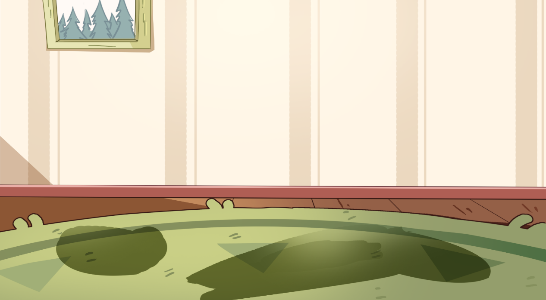
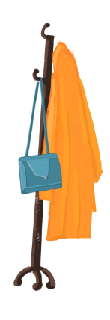
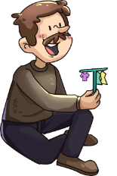
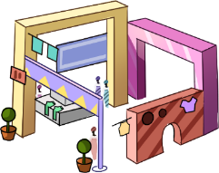
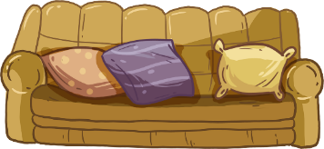
Phonics
TG
Let’s chant!
LO: Read the text fluently; decode the words learned in the text.
1. Click and read the text to Ss with rhythm.
2. Guide Ss to take turns reading the highlighted words. Guide Ss to read
together after you; ask them to take turns reading one sentence at a
time; give feedback.
There is a ball.
The ball is on the wall.
The wall is tall.
There is a hall.
The hall is in the mall.
The mall is small.
2:00
6/27

Slide 7
Let’s meet the characters!
TG
Introduction
LO: Get to know the main characters in the story.
1. Help Ss to recognize the main characters in the story.
2. Ask Ss to name the characters they know in the pictures and match
the pictures with their names on the right.
Mum
Dad
Chip
Biff
Babysitter
0:30
7/27

Slide 8
TG
Lead-in
TG
LO: Activate Ss’ interest to read; use pictures to identify details; make
connections.
1. Guide Ss to look at the book cover closely and to share what they
saw on it.
2. Encourage Ss to talk about the given connections questions.
3. Have Ss predict what the story will be about.
Before Reading
What are Kipper and the man doing?
Connections
What is a babysitter? Have you ever had a babysitter?
Written by Roderick Hunt
Illustrated by Alex Brychta
2:00
7/26

Slide 9
Let’s predict!
TG
Reading
LO: Make predictions about the story using the pictures; motivate Ss’
interest in reading.
Remind Ss to make guesses prior to reading the story by looking at
the illustrations.
2. Have Ss talk about the given questions by observing the illustration
closely.
Before Reading
What might the children want to do?
What do you think the man will do in the story?
2:00
8/26

Slide 10
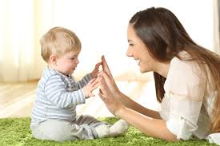
The Baby-sitter
TG
Baby-sitter and babysitter are two spelling variants of a noun that refers to a person who cares for children when their parents are not home. In British English, baby-sitter is widely used. In American English, babysitter is commonly used.
Reading
LO: Understand the meaning of the vocabulary word babysitter and make sentences with it;
understand the text; read the text fluently.
Read the text aloud to Ss; click the penguin button to explain the word babysitter; have Ss
read the word aloud and have them make sentences with it; click the card at the top and
guide Ss to distinguish the spellings of the word babysitter between British English and
American English.
2. Have Ss talk about the comprehension questions using the illustration.
3. Ask Ss to take turns reading the text.
Note: Click the penguin button to display the key vocabulary you’re going to teach; click
it again to make it disappear.
Vocabulary
baby-sitter vs. babysitter
Comprehension
Who came to Chip’s home? Why did the man come here?
What do you think Mum said to the man? What would the man do?
babysitter
The babysitter is playing with the baby.
The baby-sitter came.
babysitter
2:30
9/26

Slide 11
The Baby-sitter
TG
Reading
LO: Understand the text; make connections; read the text fluently.
1 Read the text aloud to Ss; ask them to talk about the first comprehension question using the
illustration and the text clues;
2. Have Ss talk about the connections question.
3. Ask Ss to read the text aloud in turns as if they were Dad and give feedback.
Comprehension
What did Dad ask the children to do?
Would the children go to bed when Dad and Mum left home?
Connections
What do you often do when your mom and dad are not at home?
“Go back to bed,” said Dad.
2:30
10/26

Slide 12
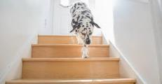
The Baby-sitter
Reading
TG
LO: Understand the meaning of the vocabulary word downstairs and make sentences with it; ask
questions about the story using the illustration and the text clues; understand the text; read the
text fluently.
Read the text aloud to Ss; click the penguin button to explain the word downstairs; have Ss read it and make sentences with it;
2. Ask Ss to talk about the comprehension question.
3. Have Ss talk about the questioning question; guide each of them to ask their partner question.
(Note: The answer of the question they ask is “Deep-thinking” question, in which the reader must
use clues such as pictures, or the text feature to figure out the answer of the question.)
4. Have Ss read the text accurately and fluently in turns.
Comprehension
What did the children do after Dad and Mum left? Why?
The children came downstairs.
Vocabulary
Questioning
Please ask your partner a question about the babysitter.
e. g. , What was the babysitter doing?
(Tips: What? Where? When? Who? Why? How?)
downstairs
The dog is walking downstairs.
“We couldn’t sleep,” they said.
2:30
downstairs
11/26

Slide 13
The Baby-sitter
Reading
TG
LO: Understand the meaning of the vocabulary word books and make sentences with it; ask
questions about the story using the illustrations and the text clues; read the sight word accurately;
understand the text; read the text fluently.
1. Have Ss take turns reading the text aloud; click the penguin button to explain the word books;
have them read the word and make sentences with it;
2. Ask ss to observe the illustration carefully and talk about the comprehension question;
3. Have Ss talk about the questioning question; help them ask the partner a question. (Note: The
question they ask is “Deep-thinking” question, in which the reader must use clues such as pictures,
or the text feature to figure out the answer of the question.)
4. Have Ss find the sight word wanted and read it accurately.
Comprehension
Vocabulary
What did Kipper want to do?
Kipper got his books.
Questioning
Please ask your partner a question about Chip.
e. g. , What did Chip want to do?
(Tips: What? Where? When? Who? Why? How?)
books
There are many books on the shelves.
He wanted a story.
Sight Words
wanted
2:30
books
12/26

Slide 14
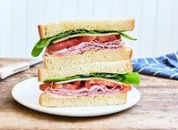
The Baby-sitter
TG
Reading
LO: Understand the meaning of the vocabulary word sandwich and make sentences with it; ask
questions about the story using the illustrations and the text clues; understand the text; read the
text accurately and fluently.
Read the text to Ss loudly; click the penguin button to explain the word sandwich; have Ss read it
and make sentences with it;
2. Ask ss to observe the illustration carefully and talk about the comprehension question;
Have Ss talk about the questioning question; help them ask the partner a question. (Note: The
question they ask is “Deep-thinking” question, in which the reader must use clues such as pictures,
or the text feature to figure out the answer of the question.)
4. Have Ss take turns reading the text accurately and fluently.
Comprehension
Vocabulary
What did Biff want to do? Why?
How did the babysitter feel?
Biff was hungry.
Questioning
sandwich
Please ask your partner a question about the details of the picture.
(Tips: What? Where? When? Who? Why? How?)
This sandwich is delicious.
They made a sandwich.
Decoding
sandwich
Read accurately.
3:00
14/27

Slide 15
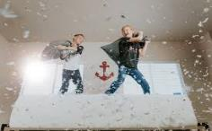
The Baby-sitter
Reading
TG
LO: Understand the meaning of the vocabulary word pillow fight and make sentences with it;
understand the text; talk about connections questions; read the text fluently.
1. Read the text aloud to Ss; click the penguin button to explain the word pillow fight; have Ss read it
and make sentences with it;
2. Ask Ss to talk about the comprehension questions one by one using the illustration and the text
clues; encourage Ss to talk about the connections question.
3. Ask Ss to read the text fluently and give a feedback.
Comprehension
1. What did Chip want to do?
Who joined Chip?
2. How did the children feel
about it?
3. Did the children think the
man was a good
babysitter? Why?
Chip wanted a pillow fight.
Vocabulary
pillow fight
Connections
They are having a pillow fight.
Do you want to have a pillow fight? Who do you want to have one with?
Everyone joined in.
3:00
pillow fight
15/27

Slide 16
The Baby-sitter
TG
Reading
LO: Understand the text; read the text fluently.
1. Read the text aloud to Ss;
2. Ask Ss to talk about the two comprehension questions one by one using the
illustration and the text clues;
3. Ask Ss to read the text fluently and give feedback.
The children went back to bed.
Comprehension
What did the children do after the pillow fight?
How was the room? What would the babysitter do with it?
“What a mess!” said the
baby-sitter.
2:00
16/27

Slide 17
The Baby-sitter
TG
Reading
LO: Understand the text; read the text fluently.
1. Read the text aloud to Ss;
2. Ask Ss to talk about the three comprehension questions one by one using the
illustrations and the text clues;
3. Ask Ss to read the text fluently and give feedback.
Mum and Dad came back.
Comprehension
1. How was the room?
2. What did Mum say?
3. What do you think
the babysitter did?
“Was everyone good?”
said Mum.
2:00
17/27

Slide 18
TG
Reading
The Baby-sitter
LO: Understand the text; talk about the discussion questions.
1. Read the text aloud to Ss and have them talk about the first comprehension
question;
2. Encourage Ss to talk about the second comprehension question
using the illustration and text clues; talk about the connections questions.
3. Ask Ss to read the text fluently and give feedback.
Comprehension
What did the babysitter say to Mum? What did he mean?
Do you think Mum and Dad knew what happened? Why?
Discussion
Do you want this babysitter to look after you? What do you like and dislike about the babysitter?
“Yes and no,” said the
baby-sitter.
2:00
18/27

Slide 19
Let’s retell!
TG
Reading
LO: Retell the story with the visual support and assistance;
1. Have Ss work in pairs to recall the story; model first.
2. Have Ss work together to retell the story using the visual aids.
3. Help Ss if necessary.
2:00
___ wanted___ .
19/27

Slide 20
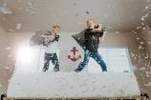
TG
Vocabulary
LO: Check Ss’ understanding of the words in this lesson.
1. Ask Ss to compete to review all the learned words in this lesson.
2. Tell Ss to play a game named Hit the Shrewmice.
3. The steps are as follows:
Click to move the hammer to hit the shrew and present the picture; ask Ss to guess
the words; click again to show the word of the picture.
4. Announce the winner of the competition.
Note: If time is limited, skip this section.
downstairs
Let’s play!
pillow fight
babysitter
sandwich
books
1:00
20/27

Slide 21
Listening &
Speaking
TG
Let’s talk!
LO: Talk about what the children did before they went to bed.
Have Ss work in pairs to talk about the given illustration using the sentence
structures and helping words; model first.
2. Assist Ss if necessary.
—What did ___ want?
—___ wanted ___.
Helping Words
Kipper Biff Chip | sandwich pillow fight story
a sandwich
2:00
21/27

Slide 22
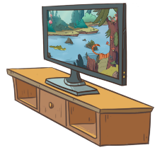
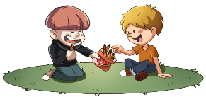
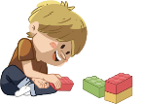
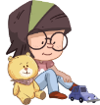
Listening &
Speaking
TG
LO: Use the given sentence structures to talk about the picture.
1. Tell Ss to observe the picture carefully and talk about the activities the children
want to do at bedtime.
2. Have Ss take turns saying at least three activities they want to do at bedtime;
model first;
3. Have Ss work in pairs to ask and answer questions about the given picture using the
given language structure; assist Ss if necessary.
Notes: T can click Let’s talk! to present the sentence structure, and then click again
to make it disappear.
Please name at least three activities.
Let’s talk!
—What do you want to do at
bedtime?
—I want to ______ at bedtime.
brush teeth;
play with building blocks;
have a snack
. . .
2:00
22/27

Slide 23
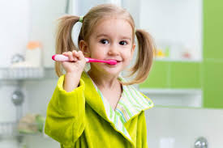
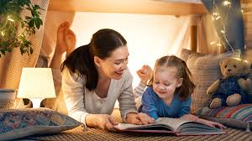
TG
Value
LO: Talk about the values presented in the lesson: doing proper things at bedtime and
developing a good habit.
1. Ask Ss the given question; model first.
2. Guide Ss to talk about the question using the given pictures.
3. Encourage Ss to talk more about the activities they can do at bedtime.
Notes: T can click three times to present sentence structure and the two phrases.
Name the things you can do at bedtime.
brush teeth
read a bedtime story
2:00
23/27

Slide 24
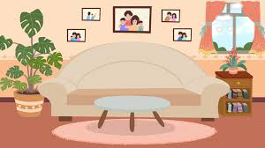
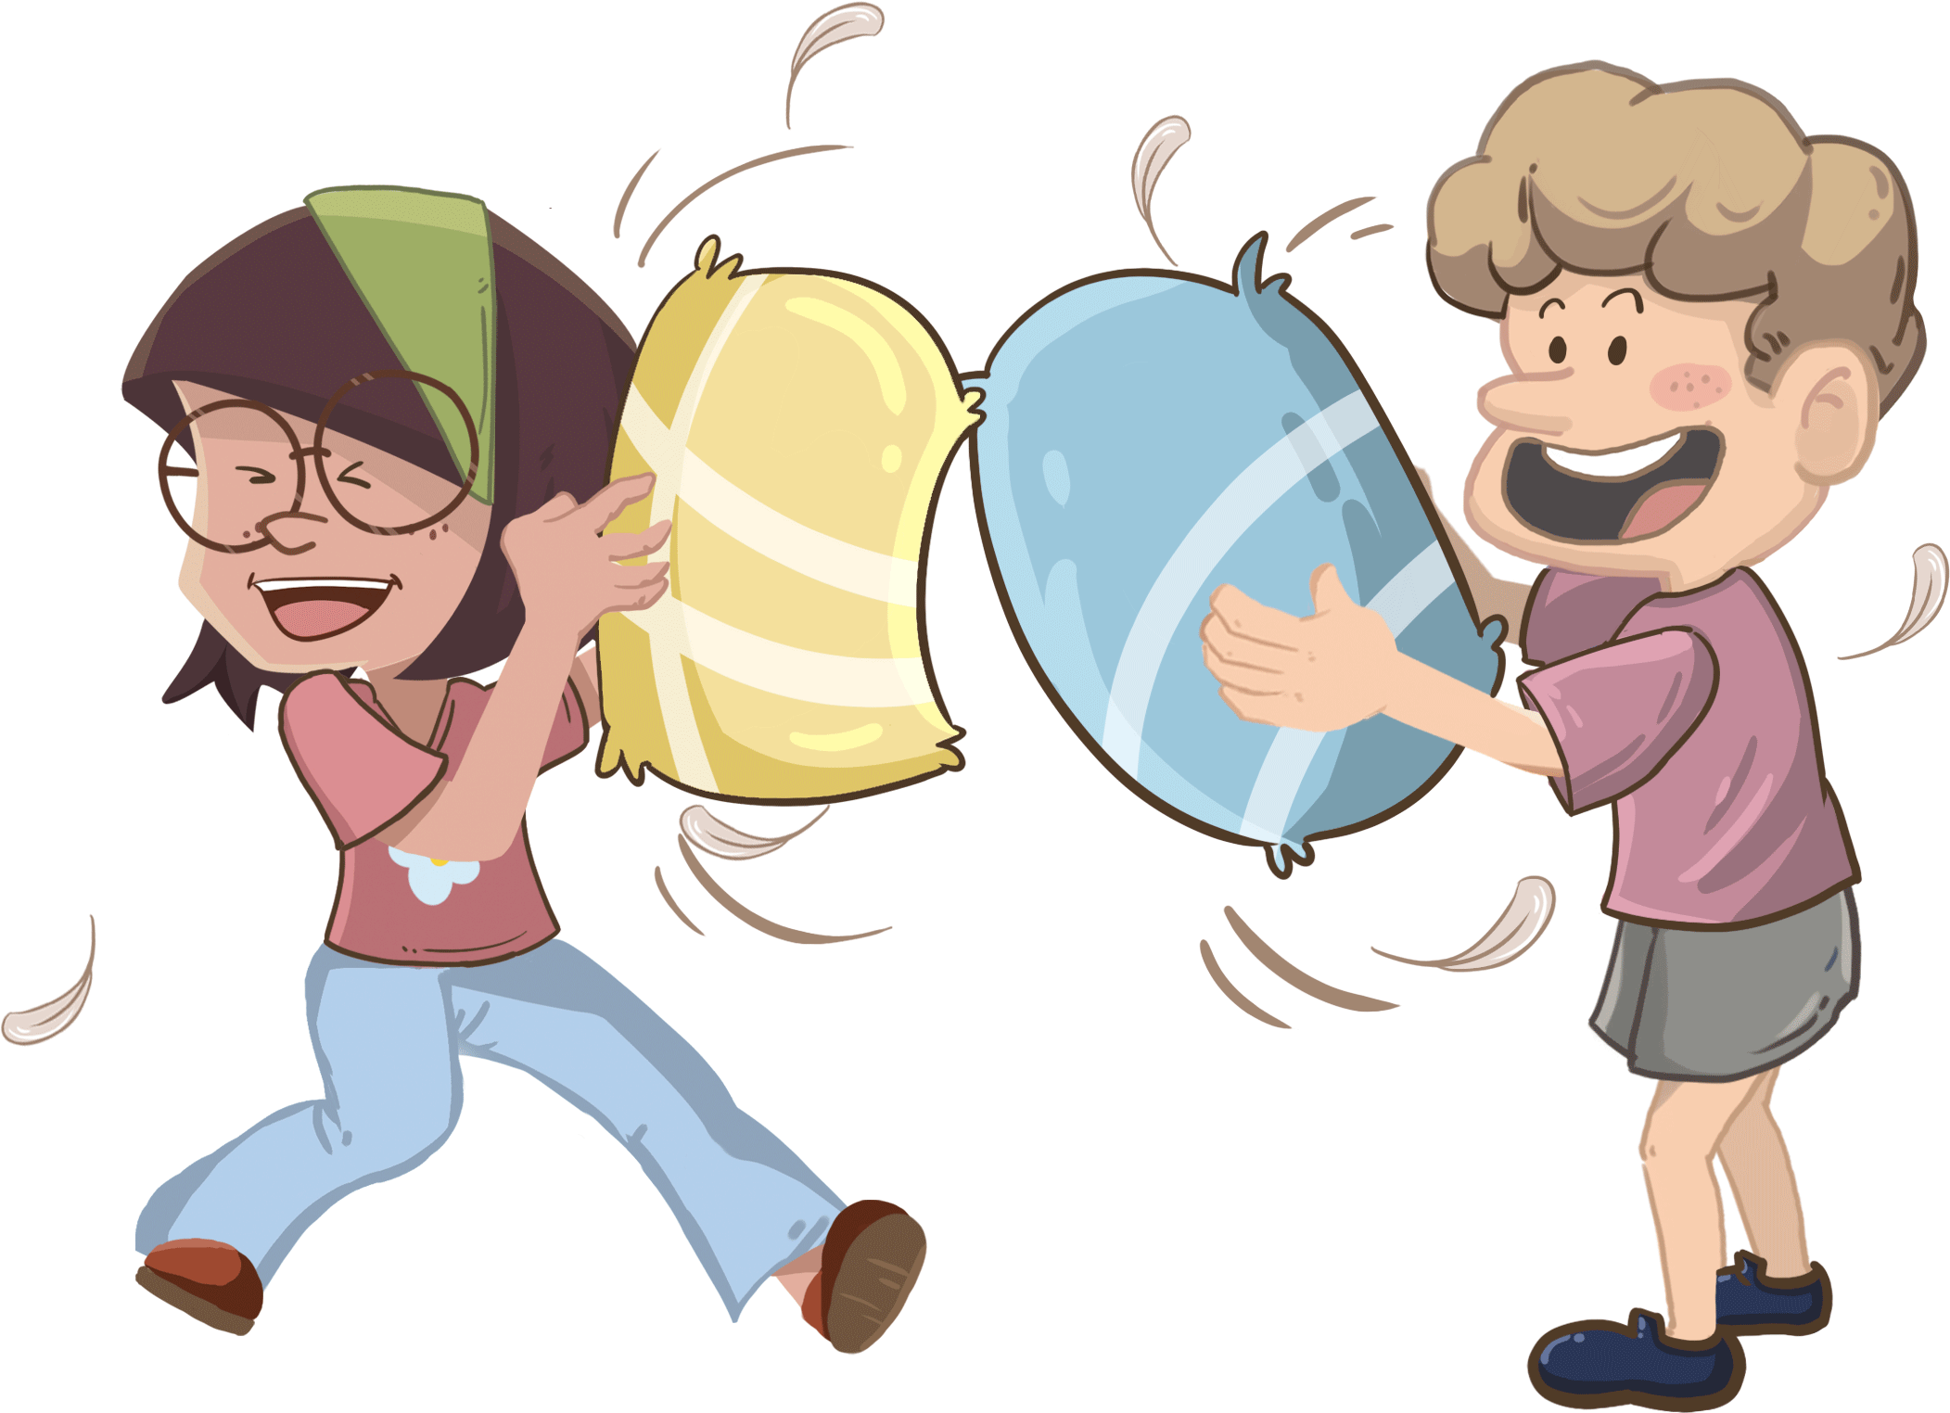
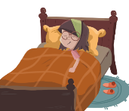
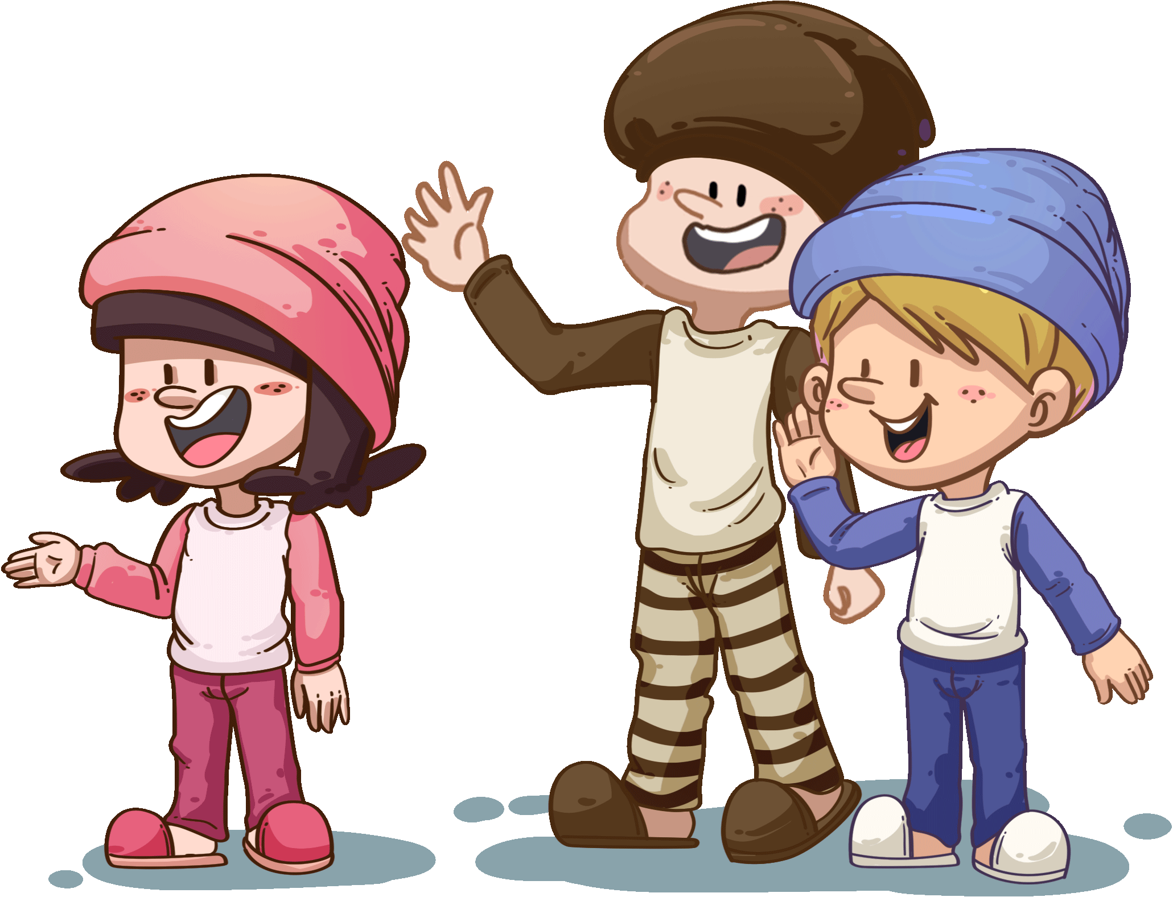
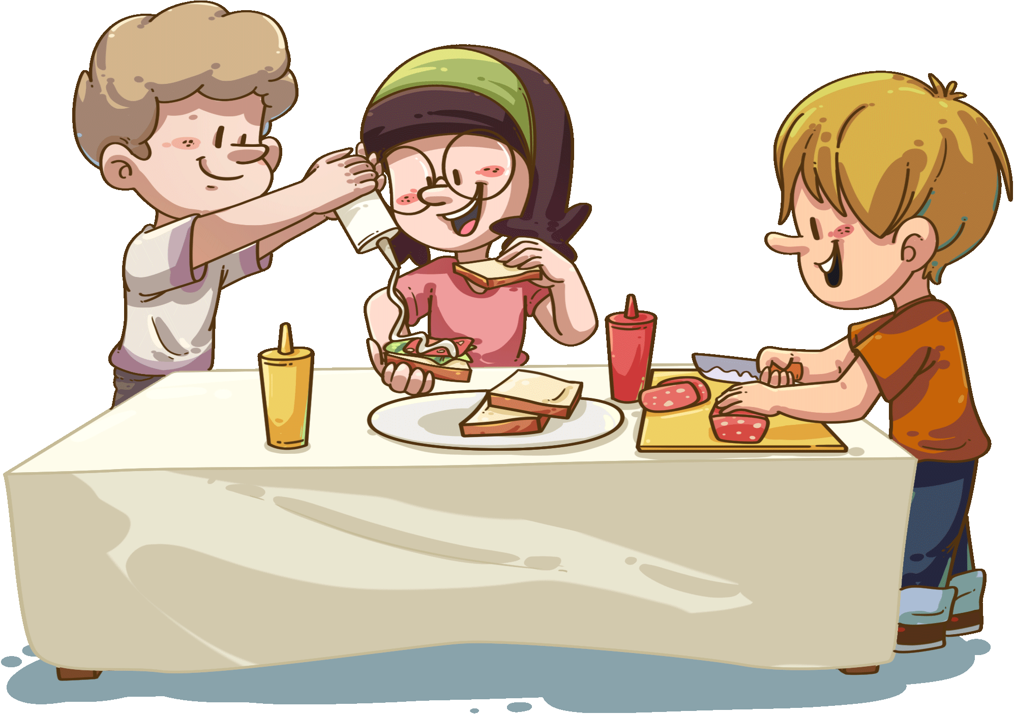
TG
Oral Writing
LO: Talk about what they’ve learned from the story using the given structure and
language support.
1. Guide Ss to talk about what they’ve learned from the book The Baby-sitter.
2. Ask Ss to think about the given questions; help Ss to organize ideas from the story
with the given visual support and tell them, “This is a practice before your homework.”
3. Model the questions; ask Ss to work together to present their answers..
Get ready to present!
The Babysitter at Kipper's Home
Kipper
Biff
Chip
How did the babysitter take care of the children?
The babysitter helped ___.
24/27
2:00

Slide 25
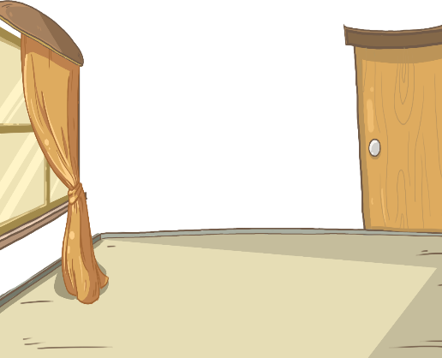
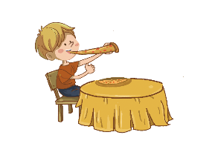
TG
LO: Understand what the homework is.
1. Explain the writing task to Ss and check their understanding.
2. Tell Ss that they should finish their writing before next class. Make sure they know they
can upload their homework to the platform. They will present their work next class.
3. Remind Ss to watch the post-class video and finish the writing task.
Writing
Descriptive Writing
Let’s draw and write!
Now, please follow the steps to finish your homework, and present it in the next class:
Draw a picture of one thing you did at bedtime last night.
Write at least one phrase to describe it.
Watch the post-class video about the writing task.
0:30
25/27

Slide 26
TG
LO: Review today’s lesson.
1. Guide Ss to review the phonics by asking Ss to read the words.
2. Guide Ss to review the words by asking Ss to make sentences with some of them.
3. Guide Ss to review the sentence structure by asking each S to make a sentence with
it.
Review
Review
Let’s review!
Phonics: ball/wall/mall/ hall/tall/small
Sentence Structure:
___ wanted ___.
Vocabulary:
babysitter/books/ sandwich/pillow fight/downstairs
1:00
26/27

Slide 27
TG
LO: End the lesson and encourage Ss to prepare well in the next class.
1. Give brief comments on Ss.
2. Say goodbye to Ss.
3. Ask Ss to preview the next lesson.
0:30
27/27

