Slide 1

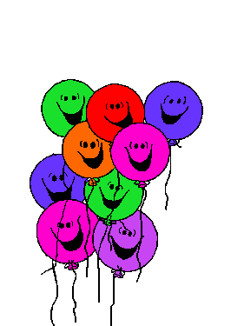


Happy Birthday!

Slide 2


Birthday cake.

Slide 3
How old are you?
I’m five (5) year’s old.

Slide 4
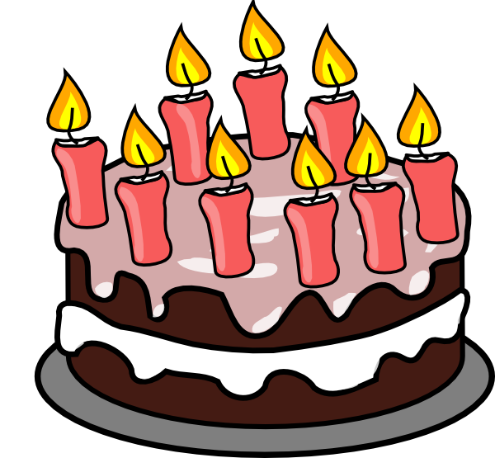


I’m (6) six
year’s old
How old are you?
I’m (8) eight
year’s old
I’m (9) nine
year’s old
NEXT

Slide 5
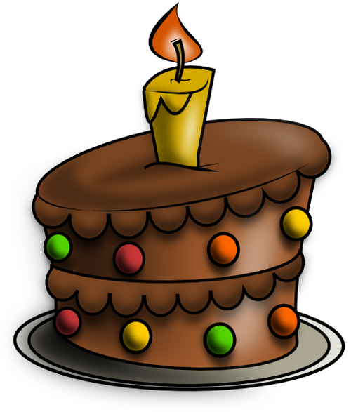
I’m (1) one
year’s old
How old are you?
I’m (10) ten
year’s old
I’m (2) two
year’s old
NEXT

Slide 6
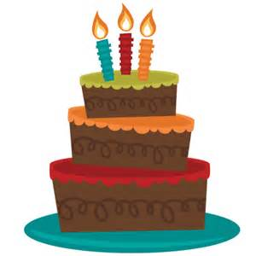
I’m (2) two
year’s old
How old are you?
I’m (3) three
year’s old
I’m (4) four
year’s old
NEXT

Slide 7
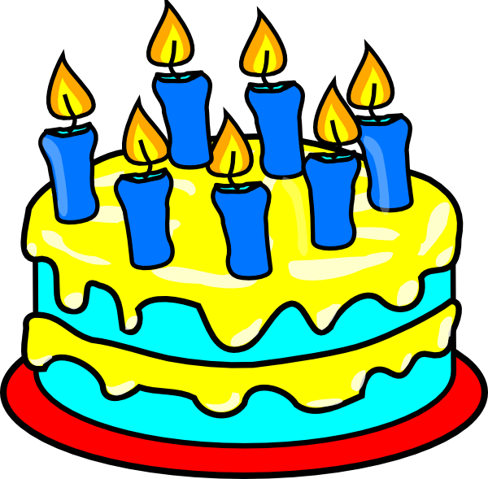
I’m (7) seven
year’s old
How old are you?
I’m (10) ten
year’s old
I’m (6) six
year’s old
NEXT

Slide 8
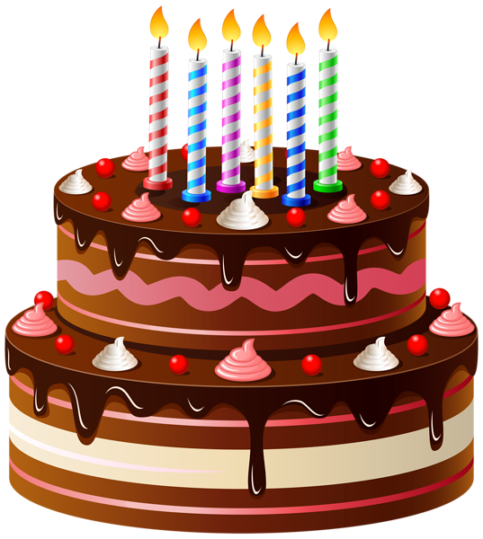
I’m (5) five
year’s old
How old are you?
I’m (6) six
year’s old
I’m (4) four
year’s old
NEXT

Slide 9
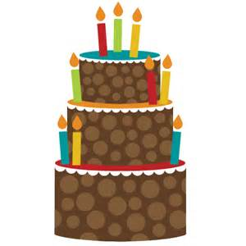
I’m (6) six
year’s old
How old are you?
I’m (8) eight
year’s old
I’m (9) nine
year’s old
NEXT

Slide 10
Let’s sing a
birthday song!
Happy Birthday - The Kiboomers
https://www.youtube.com/watch?v=90w2RegGf9w

Slide 11
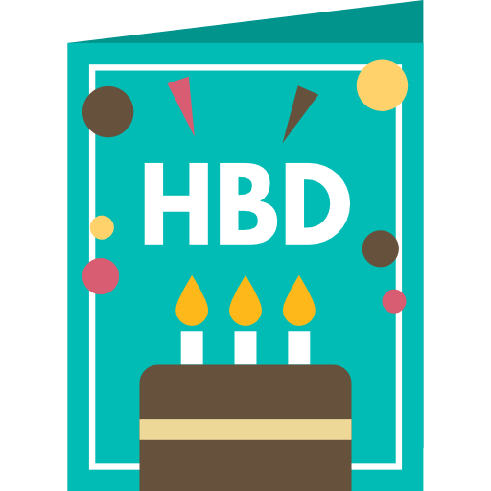
Birthday card.

Slide 12
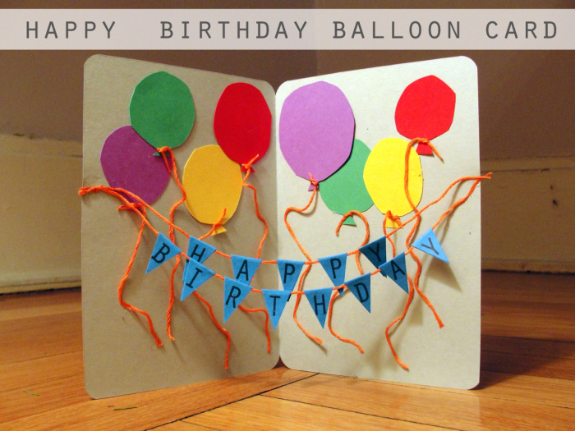


Happy birthday!
Here’s a card for you.
No.
I don’t like it.
Thank you!
I like it.

Slide 13
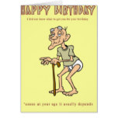
Happy birthday!
Here’s a card for you.
No.
I don’t like it.
Thank you!
I like it.

Slide 14
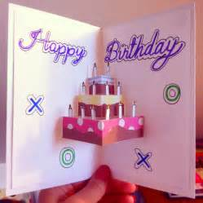
Happy birthday!
Here’s a card for you.
No.
I don’t like it.
Thank you!
I like it.

Slide 15
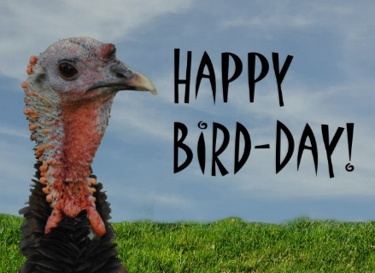
Happy birthday!
Here’s a card for you.
No.
I don’t like it.
Thank you!
I like it.

Slide 16
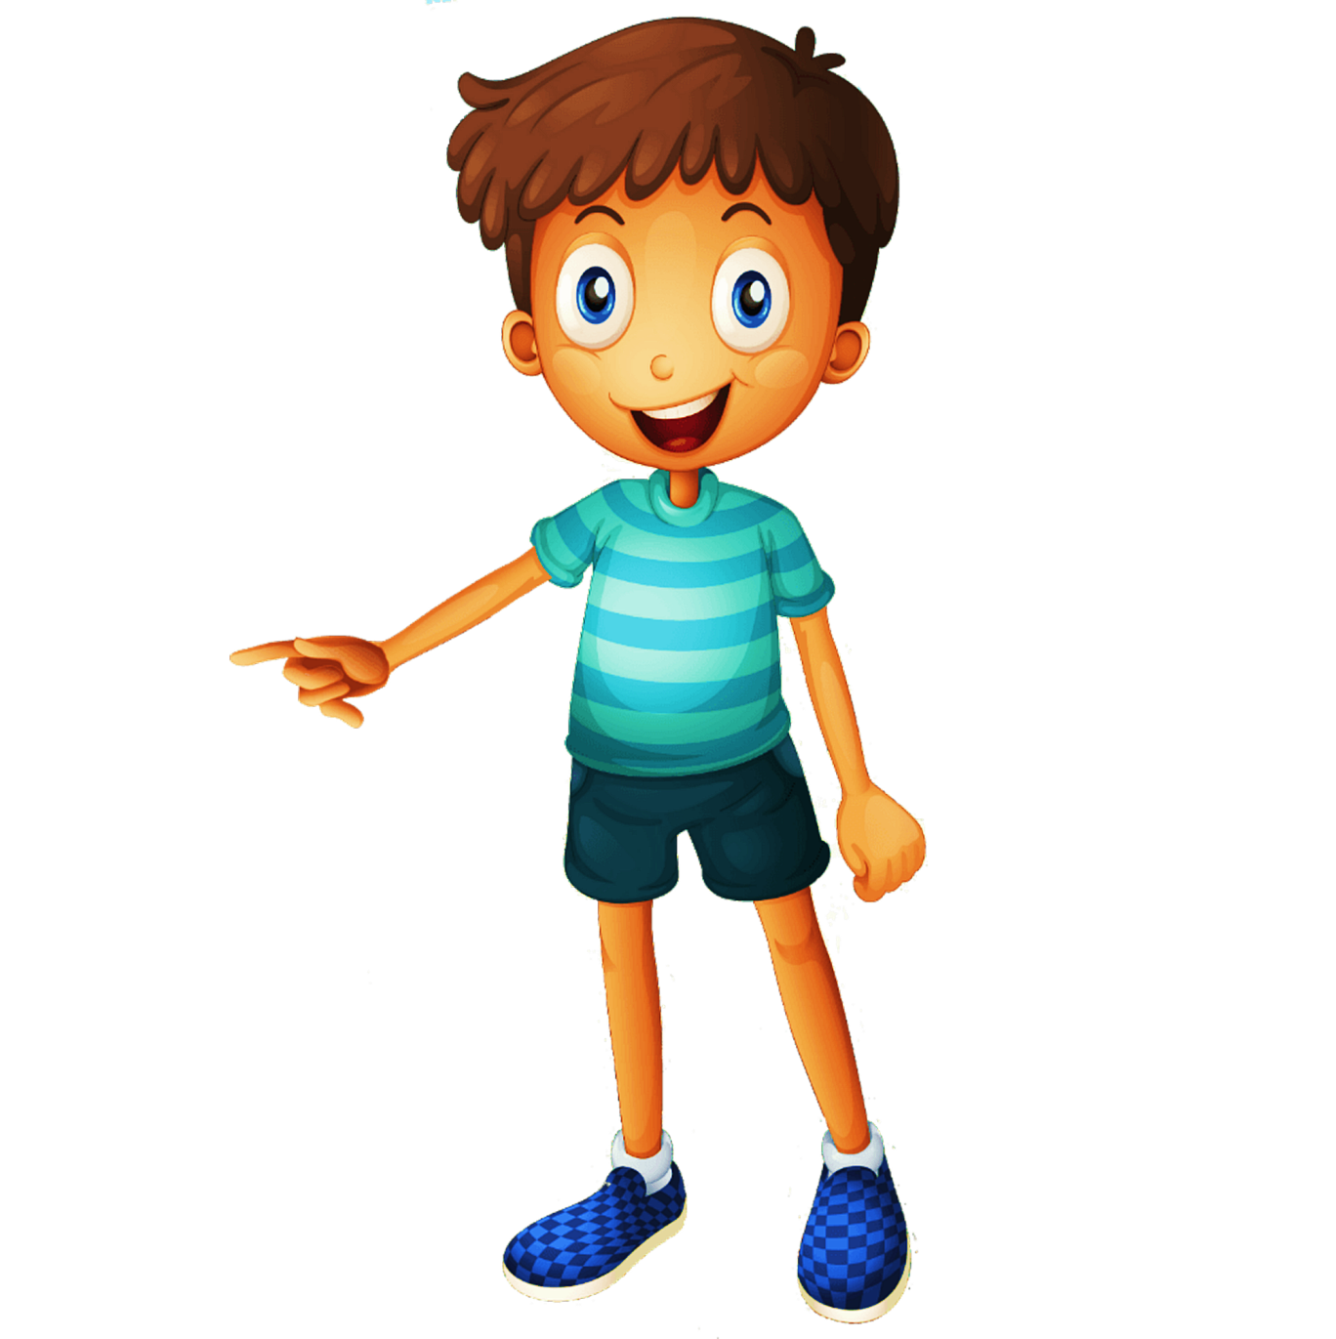

Birthday gift
(present).

Slide 17

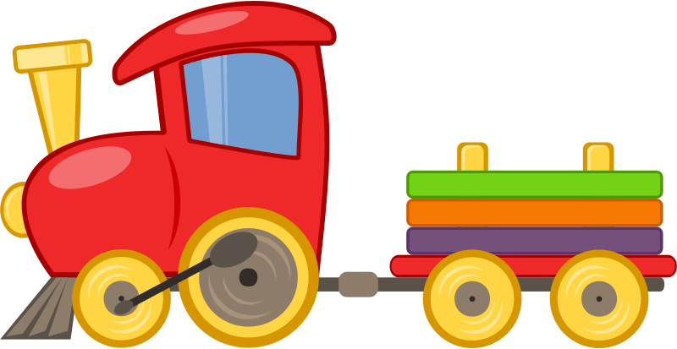
It’s a …
1/16
TOY TRAIN
Click here to guess what’s in the box

Slide 18
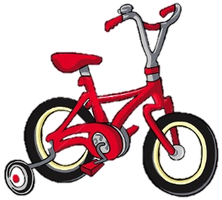
It’s a …
4/16
BICYCLE
Click here to guess what’s in the box

Slide 19
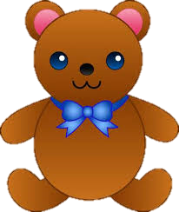
It’s a …
7/16
TEDDY BEAR
Click here to guess what’s in the box

Slide 20
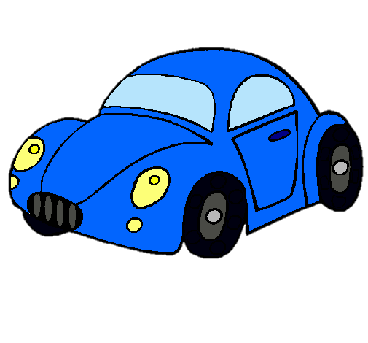
It’s a …
2/16
TOY CAR
Click here to guess what’s in the box

Slide 21
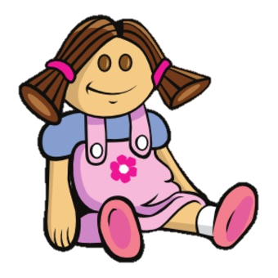
It’s a …
8/16
DOLL
Click here to guess what’s in the box

Slide 22
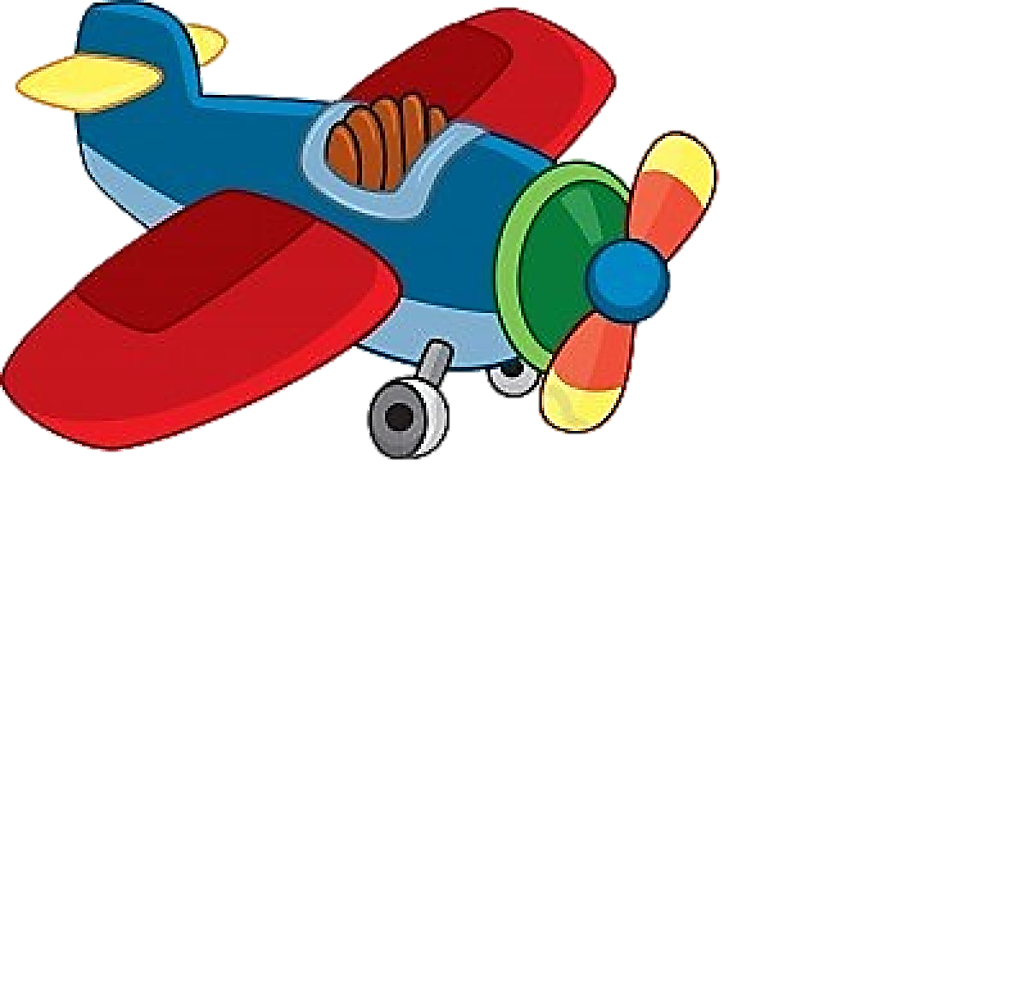
It’s an …
3/16
TOY PLANE
Click here to guess what’s in the box

Slide 23
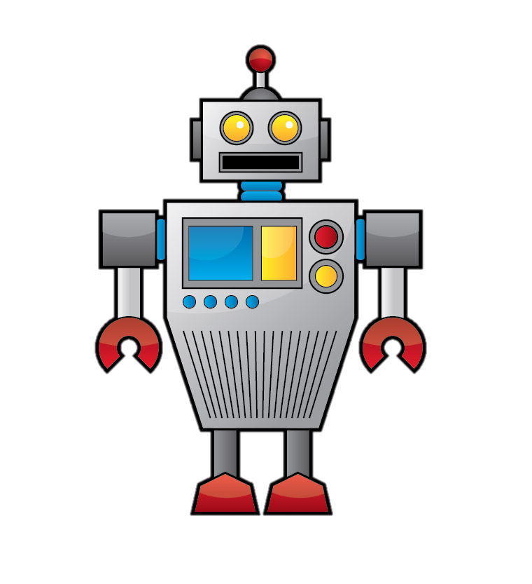
It’s a …
10/16
ROBOT
Click here to guess what’s in the box

Slide 24

It’s a …
11/16
BALL
Click here to guess what’s in the box

Slide 25
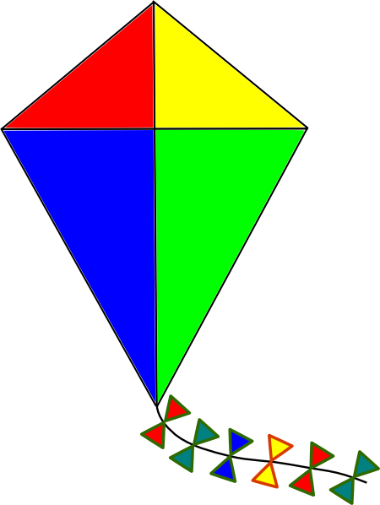
It’s a …
12/16
KITE
Click here to guess what’s in the box

Slide 26
Let’s sing a
birthday song!
Birthday Song - The Pancake Manor

Slide 27
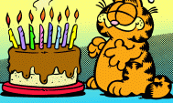
Lets read a story.

Slide 28
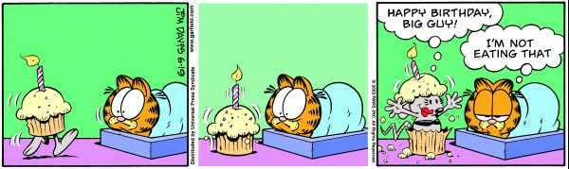
It is cat’s birthday.

Slide 29
What is it?
…

Slide 30
Here’s a birthday cake for you, cat.
I don’t like mouse cake
…

Slide 31
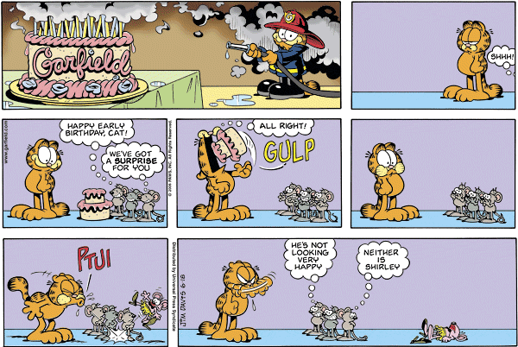
Later in the day…

Slide 32
Happy birthday, cat!
Make a wish.
…

Slide 33
Thank you!
…

Slide 34
Oh no, Blow!
…

Slide 35
…

Slide 36
Mother is not happy, too.
He is not happy
…

Slide 37






I want a ….
ball
doll
robot
kite
bicycle
toy bear
toy train
ipad
phone
computer
book
What birthday present
do you want?

Slide 38
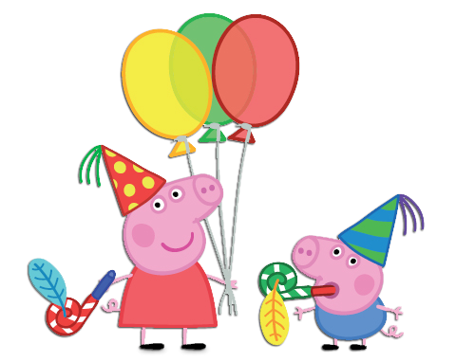
Let’s watch a video.
Peppa Pig birthday

Slide 39

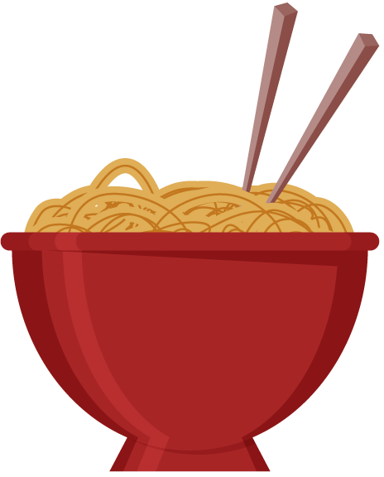
You eat for breakfast.
They’re long.
noodles
They’re white
What is it?
They’re soft.

Slide 40
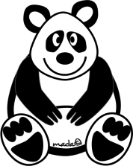
It’s black
and white
It’s an animal
It’s in the forest
It’s big
panda
It’s soft
What is it?
It likes grass

Slide 41

It’s small
It’s hard
It’s in a pencil case
pencil
What is it?
It can write

Slide 42
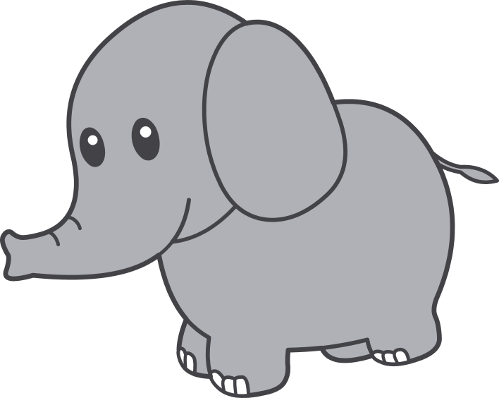
It’s grey.
It’s an animal
It has a long nose.
It’s big
elephant
It’s strong
What is it?
It likes grass.

Slide 43

It’s small
It’s soft
It’s in a forest
bird
What is it?
It can fly

Slide 44

It’s green
and brown
It’s in the forest
It’s big
tree
It’s hard
What is it?
It’s in the street

Slide 45

It’s very big
It’s yellow
sun
What is it?
It’s in the sky

Slide 46
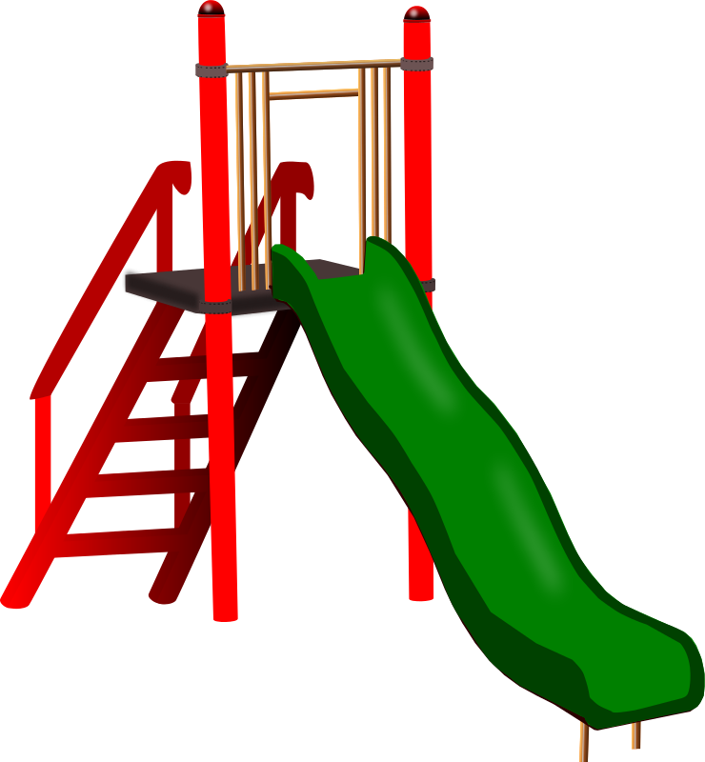
It’s big
It’s fun
boys and girls
like it
slide
What is it?
It’s in the playground

Slide 47
He’s/She’s a….
ball
doll
robot
kite
bicycle
toy bear
toy train
ipad
phone
computer
book
What birthday gift
is he / she?

