Slide 1
TG
LO: Get to know their partners; get a basic idea about the topic of today’s lesson.
1. Say hello to Ss; ask Ss to introduce themselves and greet each other.
2. Introduce the topic of the lesson.
0:30
1/26

Slide 2
Learning
Goals
TG
LO: Get to know and understand what will be learned in this lesson.
Go through the learning goals with Ss.
We are going to . . .
Isolate and pronounce the initial, medial vowel, and final sounds (phonemes) in three-phoneme (CVC) words.
Learn the key words week, author, dressed up, picnic, lettuce, and sale, and make sentences with them.
Read the story Book Week and use context clues to understand unknown words.
Practice using the sentence structure _____ dressed up as a _____.
0:30
2/26

Slide 3
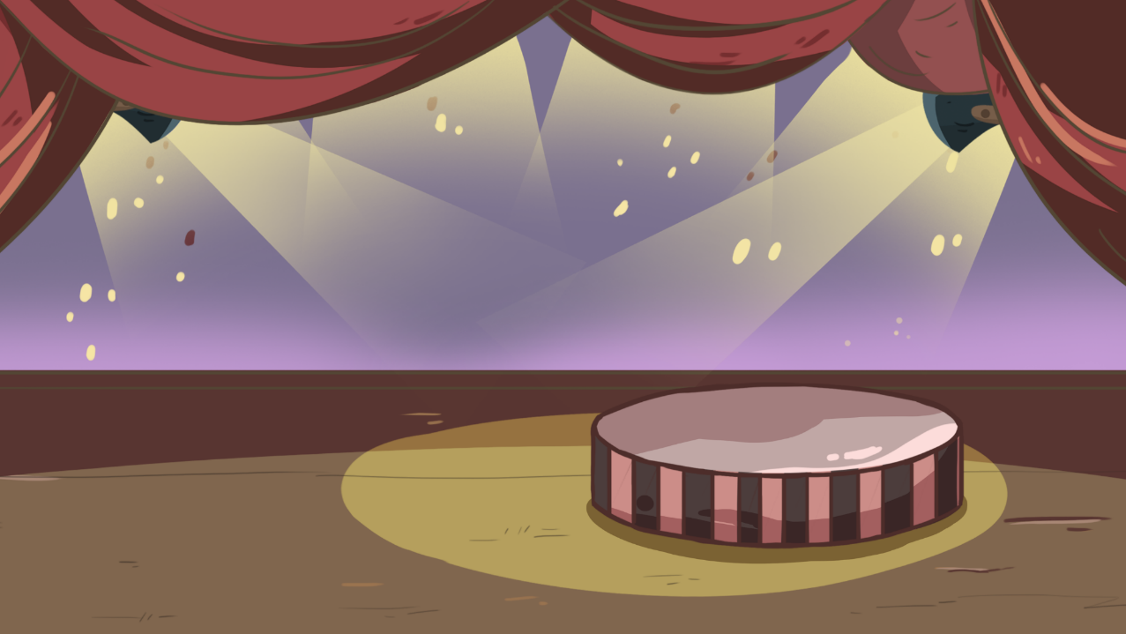
TG
LO: Present the writing assigned in the last lesson.
1. Let Ss present in turns.
2. Give feedback.
Presentation
Let’s show!
Share your writing from last lesson with your partner!
2:00
3/26

Slide 4
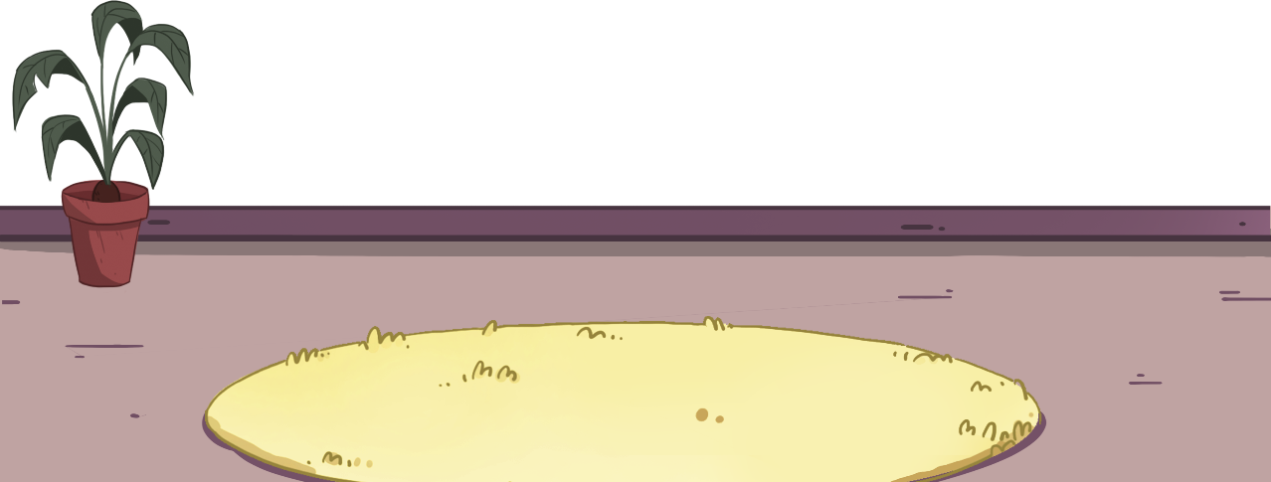
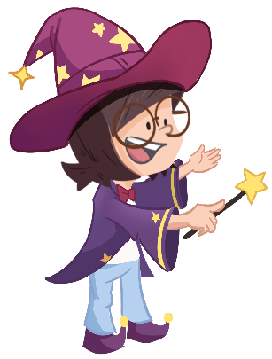
TG
LO: Isolate and pronounce the initial, medial vowel, and final sounds (phonemes) in three-phoneme
(CVC) words.
1. Have Ss help the girl in the picture make a book by repeating the different word sounds.
2. Read the word cat to Ss in this way: c-a-t, cat; model how to identify the sounds and have Ss read with
you.
3. Read the word hut in this way: h-u-t, hut; have Ss listen to the sounds in the word and encourage Ss to
repeat the sounds they hear; click to show the word, then have Ss read with you: h-u-t, hut; Ss don’t
have to identify every sound in a CVC word.
4. Repeat practice with the word mat.
Phonics
Let’s listen and speak!
m
a
h
a
c
u
t
t
t
?
?
?
?
?
?
?
?
?
mat
cat
hut
What sounds can you hear in the word?
Could you help me make the books?
2:00
2:30
4/26

Slide 5
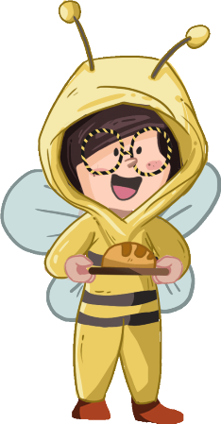
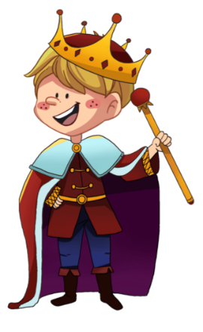
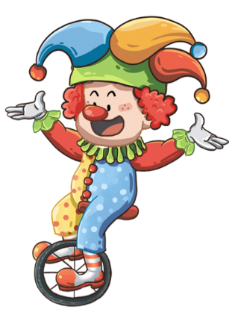
TG
LO: Isolate and pronounce the initial, medial vowel and final sounds (phonemes) in three-
phoneme (CVC) words.
1. Have Ss help the children dress up as different characters by pronouncing the correct sounds in
the following CVC words.
2. Read the word hat in this way: h-a-t, hat; have Ss listen to the sounds in the word and
encourage Ss to repeat the sounds they hear. Click to show the word, then lead Ss to read with
you: h-a-t, hat; Ss don’t have to identify every sound in a CVC word.
3. Repeat practice with the words cut and nut.
Phonics
Let’s listen and speak!
h
a
t
c
u
t
n
u
t
Could you help us dress up like the characters in the book?
What sounds can you hear in the word?
2:30
5/26

Slide 6
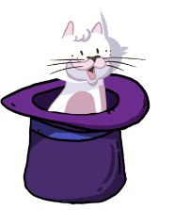
TG
Phonics
LO: Read the chant fluently; decode the words learned in the text.
1. Read the chant to Ss with rhythm; let Ss observe the picture and the highlighted words.
2. Guide Ss to repeat after you; ask them to take turns reading one sentence at a time.
3. Give feedback.
Let’s chant!
I like to read on the mat.
The book is about a cat in a hat.
The story happened in a hut.
The cat wanted to eat a nut.
But the nut was hard to cut.
2:00
6/26

Slide 7
Lead-in
TG
LO: Use the book cover to identify details and make predictions.
1. Guide Ss to look at the book cover closely and talk about the given questions.
2. Encourage Ss to talk more about the connections question.
Before Reading
What does Kipper dress up as?
Look at the title. What do you think the story will be about?
Connections
What is your favorite book? What is it about?
Written by Roderick Hunt
Illustrated by Alex Brychta
2:00
7/26

Slide 8
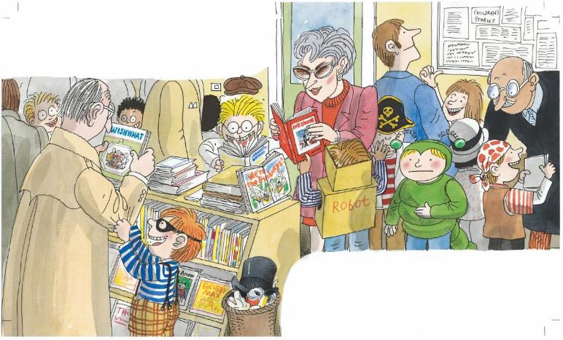
Let’s predict!
LO: Make predictions about the story using the illustration; motivate Ss’ interest in reading the
story.
1. Guide Ss to recall what it means to predict, and ask them to make guesses prior to reading the
story by looking at the pictures.
2. Guide Ss to talk about the given questions in question 2; lead Ss to model Kipper’s action and
to guess what happened to Kipper.
Reading
TG
Before Reading
Where are the children? What are the children doing?
What does Kipper look like? Why is he touching his stomach?
2:00
8/26

Slide 9
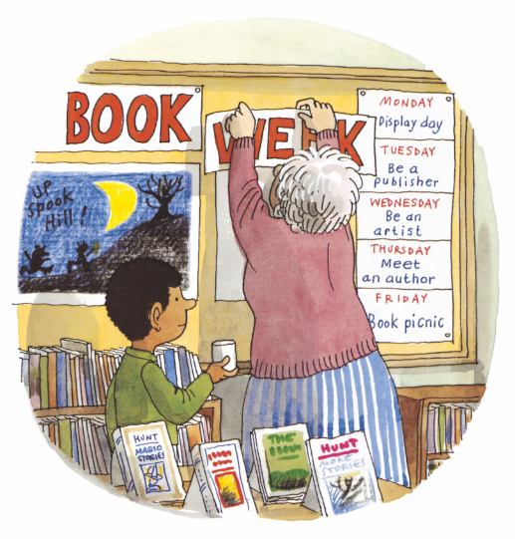
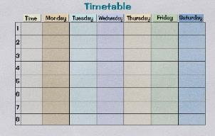
Book Week
TG
LO: Use context clues to understand unknown words; understand the meaning of the key
vocabulary word week, and make sentences with it; understand the text; read the text fluently.
1. Read the text aloud to Ss.
2. Help Ss uncover the meaning of unknown words by observing the illustration.
3. Ask Ss to find the word week in the text and the illustration; have Ss read the word and make
sentences with it.
4. Have Ss observe the illustration and talk about the comprehension questions.
5. Have Ss read the text fluently; give feedback.
Note: Click the penguin button to show the vocabulary card.
Reading
Vocabulary
Comprehension
Define Unfamiliar Words
What would the children do from Monday to Friday during the week? Look for clues in the illustration.
What does the phrase book week mean? What kind of week was it? Use illustration clues.
week
It is a timetable for the week.
It was book week.
week
2:00
9/26

Slide 10
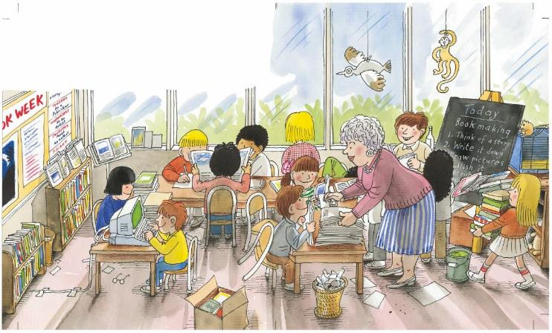
Book Week
TG
Reading
LO: Understand the text; read the text fluently.
1. Ask Ss to read the text aloud in turns.
2. Have Ss observe the illustration and the text; talk about the comprehension questions.
The children made books.
Comprehension
Comprehension
What did the children do? What words in the text can give us the answer?
How did the children make books? Look for clues in the illustration.
Can you guess what day it was in the book week?
2:00
10/26

Slide 11
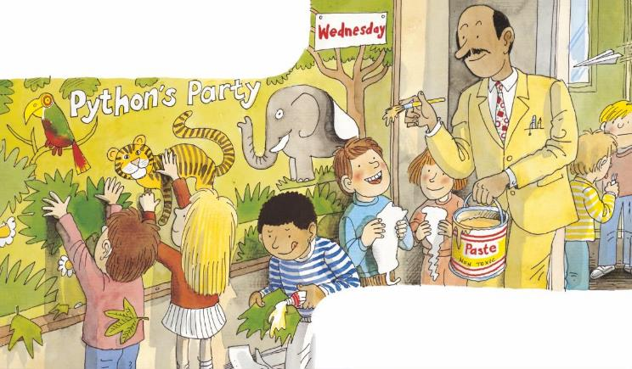
Book Week
TG
Reading
LO: Understand the text; read the text fluently.
1. Have Ss observe the illustration and talk about the comprehension questions.
2. Encourage Ss to talk more about the connections question.
3. Have Ss take turns reading the text fluently.
Comprehension
Connections
They made a big picture.
What did the children do to be artists on that day?
How did they make their art? Look for clues in the illustration.
Did you do similar things like the children in the story? What did you make?
They put it on the wall.
Decoding
Fluency
2:00
11/26

Slide 12
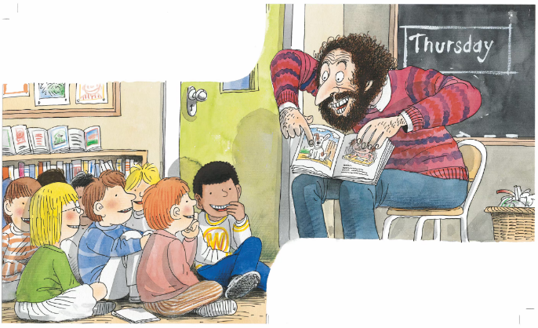
Book Week
TG
LO: Understand the meaning of the key vocabulary word author, and make sentences with it;
understand the text; read the text fluently.
1. Read the text aloud to Ss.
2. Ask Ss to find the word author in the text and in the illustration; have Ss read the word and make
sentences with it.
3. Have Ss observe the illustration and talk about the comprehension questions.
4. Encourage Ss to talk more about the connections question.
5. Have Ss read the text fluently; give feedback.
Note: Click the penguin button to show the vocabulary card.
Reading
Vocabulary
Comprehension
Connections
An author came.
If you were an author, what story would you want to write?
Who came to the school? What did he bring?
Did the children like the man? Why? Look for clues in the illustration and the text.
author
The author is writing his new book.
He made everyone laugh.
author
2:00
12/26

Slide 13
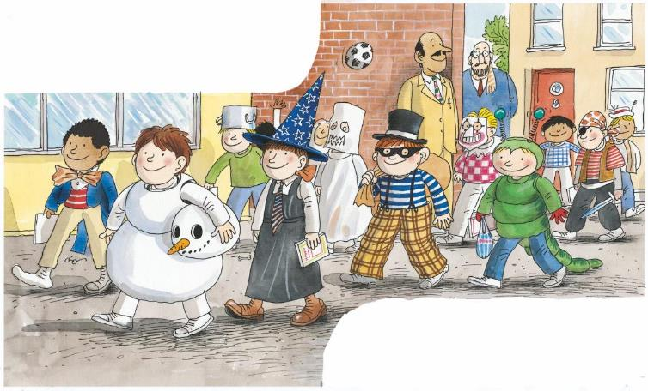
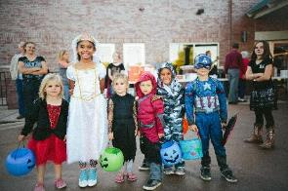
Book Week
Reading
TG
LO: Understand the meaning of the key vocabulary phrase dressed up and make sentences with
it; understand the text; read the text fluently.
1. Read the text aloud to Ss.
2. Ask Ss to find dressed up in the text and in the illustration; have Ss read the word and make
sentences with it.
3. Have Ss observe the illustration and talk about the comprehension questions.
4. Encourage Ss to talk more about the connections question.
5. Have Ss read the text fluently and give feedback.
Note: Click the penguin button to show the vocabulary card.
Comprehension
Which day was it in the book week? Why did the children all dress up?
Vocabulary
The children
dressed up.
Connections
When should you dress up? What do you want to dress up as?
dressed up
The children dressed up for Halloween.
Kipper was a caterpillar.
Decoding
Fluency
3:00
dressed up
13/26

Slide 14
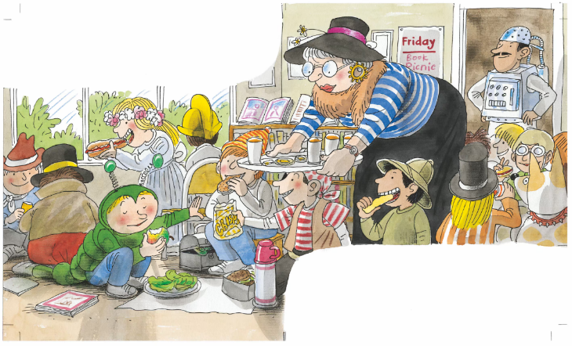
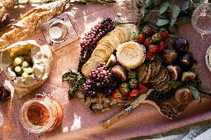
Book Week
Reading
TG
LO: Understand the meaning of the key vocabulary word picnic, and make sentences with it;
understand the text; read the text fluently; decode the sight word accurately.
1. Read the text aloud to Ss.
2. Ask Ss to find the sight word ate in the text and guide them to read it accurately.
3. Ask Ss to find picnic in the illustration; have Ss read the word and make sentences with it.
4. Have Ss observe the illustration and talk about the comprehension questions.
5. Have Ss read the text fluently and give feedback.
Note: Click the penguin button to show the vocabulary card.
Comprehension
Vocabulary
What did the children do on this day? What day was it?
What did Kipper eat? Did Kipper eat any other food that Mrs. May offered him? Why?
He ate an apple.
picnic
We prepared a lot of food for the picnic.
They had a book party.
Sight Words
ate
picnic
2:00
14/26

Slide 15
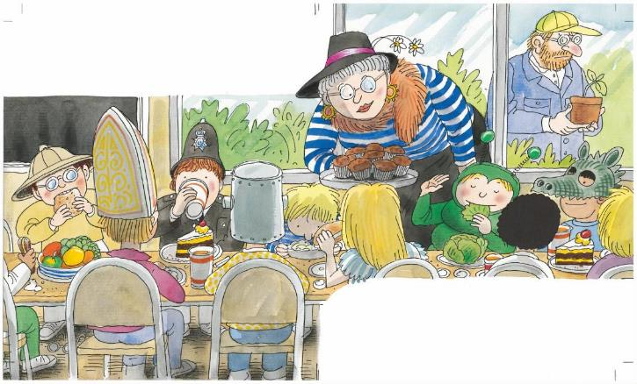
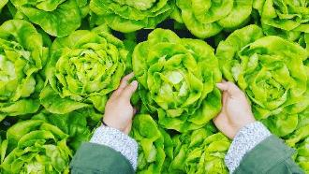
Book Week
Reading
TG
LO: Use context clues to understand unknown words; understand the meaning of the key
vocabulary word lettuce, and make sentences with it; understand the text; read the text
fluently; decode the sight word accurately.
1. Read the text aloud to Ss.
2. Ask Ss to find the sight word ate in the text and guide them to read it accurately.
3. Help Ss uncover the meaning of unknown words by observing the illustration.
4. Have Ss read the word lettuce and have them make sentences with it.
5. Have Ss observe the illustration and talk about the comprehension questions.
6. Have Ss read the text fluently; give feedback.
Note: Click the penguin button to show the vocabulary card.
Vocabulary
Define Unfamiliar Words
Kipper ate a lettuce.
Comprehension
What does the word lettuce mean? Use illustration clues.
(Tips: Can you point it out in the illustration?)
What did Kipper eat this time? What did the other children eat? Why?
lettuce
He is picking a lettuce in the field.
Sight Words
He was the hungry caterpillar.
ate
lettuce
2:00
15/26

Slide 16
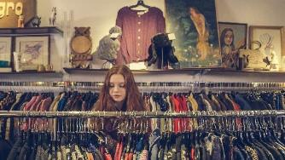
Book Week
Reading
TG
LO: Use context clues to understand unknown words; understand the meaning of the key
vocabulary word sale, and make sentences with it; understand the text; read the text fluently.
1. Read the text aloud to Ss.
2. Help Ss uncover the meaning of unknown words by observing the illustration.
3. Have Ss read the word sale and have them make sentences with it.
4. Have Ss observe the illustration and talk about the comprehension questions.
5. Have Ss read the text fluently; give feedback.
Note: Click the penguin button to show the vocabulary card.
Vocabulary
Comprehension
There was a book sale.
What was there after the book party? What did the children do?
Did Kipper do the same thing as the other children? How did he feel?
Define Unfamiliar Words
Comprehension
What does sale mean?
Use context clues.
(Tips: What do people
often do at a sale?)
Why was Kipper still hungry after eating many things?
sale
She wanted to buy clothes at a sale.
Kipper was hungry.
sale
2:00
16/26

Slide 17
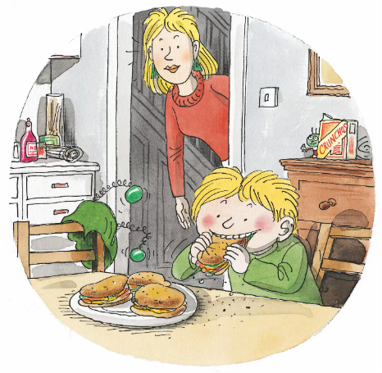
Book Week
Reading
TG
LO: Understand the text; read the text fluently.
1. Ask Ss to read the text aloud in turns.
2. Have Ss observe the illustration and talk about the comprehension questions.
3. Encourage Ss to talk more about the connections question.
Comprehension
Did Kipper call himself the caterpillar at home? What did he do? Why?
Connections
If your school had a book week, what would you do?
Decoding
“I am a hungry Kipper,” he said.
Fluency
2:00
17/26

Slide 18
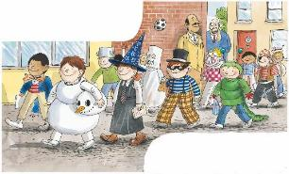
TG
Reading
LO: Retell the story with the visual support and assistance.
1. Ask Ss to work in pairs and talk about the given questions; have them work in pairs to recall
the details of the story in the correct sequence order; model first.
2. Have Ss take turns retelling the story using the visual aids.
Let’s retell!
1
2
What kind of week was it?
What did the children make?
What did the children do?
What did Kipper dress up as?
3
4
What did the children do on this day?
What did Kipper eat?
What activity can you see in the illustration?
How was Kipper? Why?
2:00
18/26

Slide 19
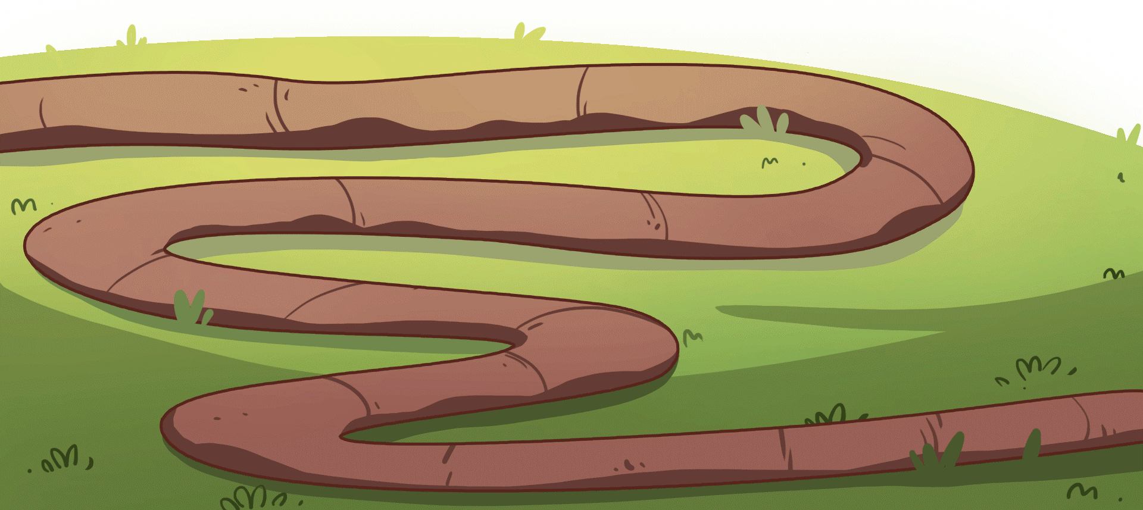
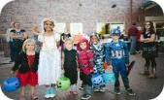
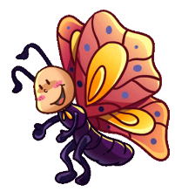
Let’s review the words!
TG
Vocabulary
LO: Check their understanding of the words in this lesson.
1. Ask Ss to take turns reading the words aloud using the pictures for reference.
2. Click to show the answers.
author
picnic
lettuce
dressed up
sale
2:00
19/26

Slide 20
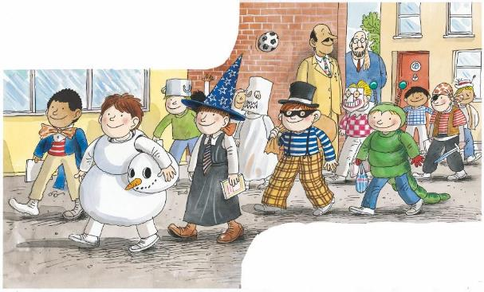
Let’s talk!
TG
Listening & Speaking
LO: Talk about what everyone dressed up as in the story using the given sentence structure.
1. Have Ss work in pairs to talk about the given illustration using the sentence structure and
helping words; model first.
2. Assist Ss if necessary.
Kipper, Chip, Biff, Wilf . . .
—What did _____ dress up as?
—______ dressed up as a _________.
Helping Words
snowman
caterpillar
witch
pirate
ghost
2:00
20/26

Slide 21
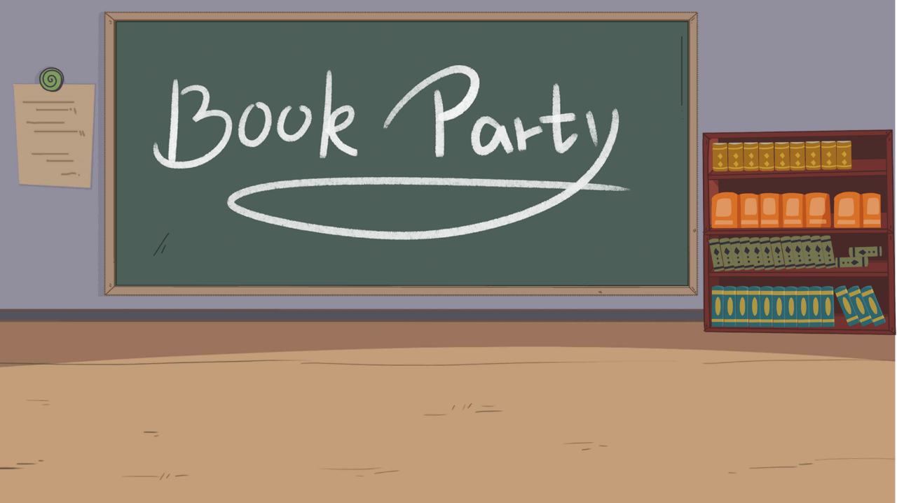
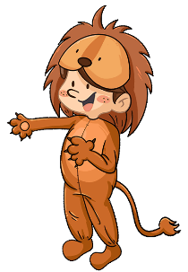
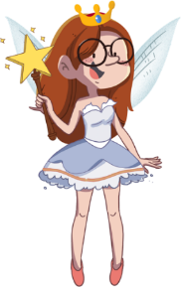
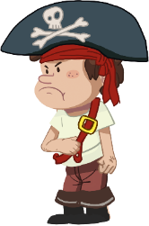
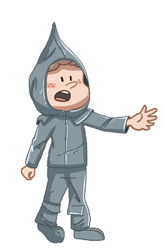
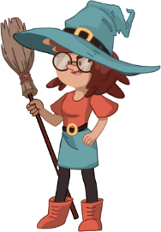
TG
LO: Talk about what you want to dress up as using the given sentence structure.
1. Ask Ss to talk about what they want to dress up as; encourage them to speak more.
2. Ask Ss to work in pairs to talk about the given picture using the given sentence structure; each S
has at least three chances to talk; model first.
3. Assist Ss if necessary.
Notes: T can click Let’s Talk to present the sentence structure, and T can click it again to make it
disappear.
Listening & Speaking
Let’s talk!
—What do you want to dress up as?
—I want to dress up as a _______.
fairy clown prince
3:00
21/26

Slide 22
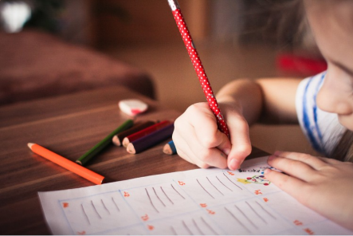
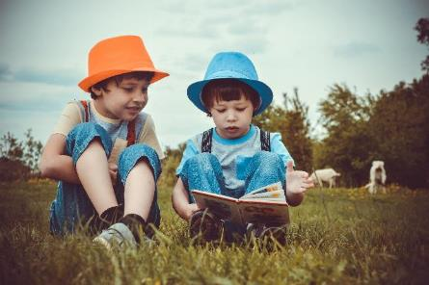
Value
TG
Value
LO: Talk about the topic: what can you do to be a good reader?
1. Ask Ss to think about the given question; model first.
2. Guide Ss to talk about the question with the help of the given pictures. Encourage Ss to talk
more about the topic.
What can you do to be a good reader?
learn to take notes
read a book with your friend
2:00
22/26

Slide 23
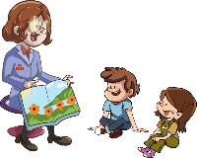
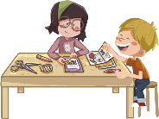
TG
LO: Talk about what the children did during the book week using the given support.
1. Guide Ss to talk about what they’ve learned about the book week.
2. Ask Ss to think about the given questions; help Ss to organize ideas with the given visual
support; model the first question, and then ask Ss to complete the task in turns.
Oral Writing
Get ready to present!
Talk about what the children did in the book week.
Book Week
Monday | Tuesday | Wednesday | Thursday | Friday
Display Day | Be a Publisher | Be an Artist | Meet an Author | Book Picnic
3:00
23/26
Notes:
她们的

Slide 24
TG
LO: Understand the homework assignment.
1. Explain the writing task to Ss and check their understanding.
2. Tell Ss that they should finish their writing before next class; make sure they know to upload
their homework to the platform; they will present their homework next class.
3. Remind Ss to watch the post-class video and finish the writing task.
Writing
Let’s draw and write!
A Journal Entry
Let’s write a journal entry!
Directions:
Draw a picture of the character you would want to dress up as at a book party.
Write at least three sentences to describe the character.
Watch the post-class video about the writing task.
1:30
24/26

Slide 25
TG
LO: Review today’s lesson.
1. Guide Ss to review the phonics by asking Ss to read the words aloud.
2. Guide Ss to review the words by inviting Ss to read and explain some of the words.
3. Guide Ss to review the sentence structure by asking each S to make sentences with it.
Review
Review
Let’s review!
Phonics:
mat/hat/cat/hut/nut/cut
Sentence Structure:
____ dressed up as ________.
Vocabulary:
week/author/dressed up/picnic/lettuce/
sale
2:00
25/26

Slide 26
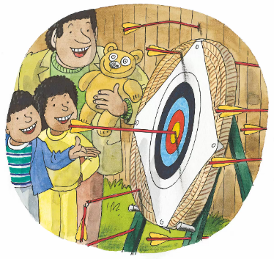
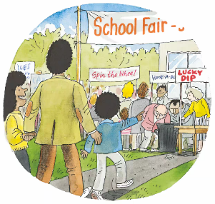
TG
LO: End the lesson and encourage Ss to perform better in the next class.
1. Briefly comment on Ss.
2. Say goodbye to students.
3. Ask Ss to preview the next lesson.
0:30
26/26

