Slide 1
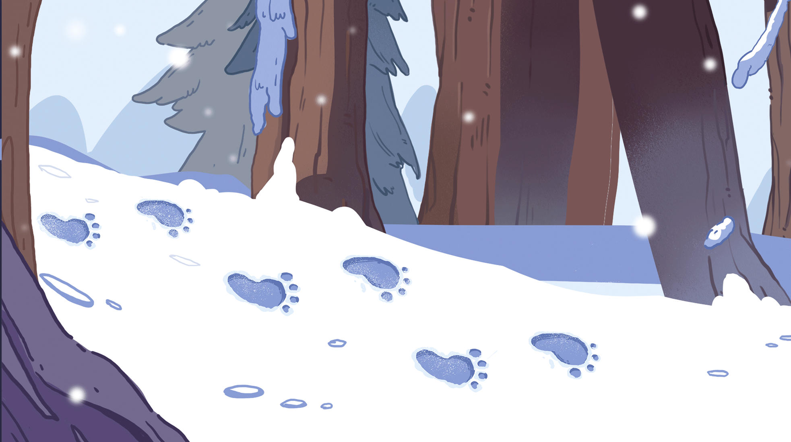
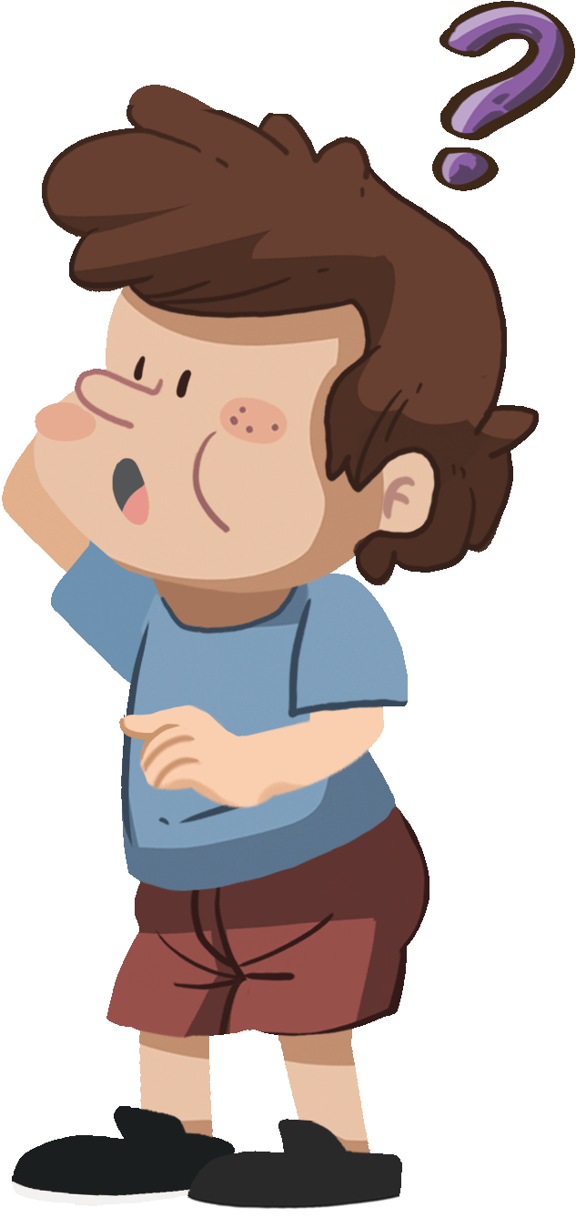
LO: Greet T and their partner; get a basic idea about the topic of the
lesson.
Greet Ss.
Ask Ss to greet T and their partner.
Introduce the topic to Ss.
Guide Ss to talk about the pictures on the slide.
TG
00:30
1/22

Slide 2
We are going to . . .
LO: Know the learning goals of the lesson.
Briefly go through the learning goals with Ss.
TG
Learning Goals
Learn and practice the consonant sound n
in simple words.
Learn the key words feet, monster, dinosaur, and giant, and use them in sentences.
Read the story Big Feet, make predictions using pictures, and identify details in the pictures.
Practice using the sentence structure Is it a big _____?
00:30
2/22

Slide 3
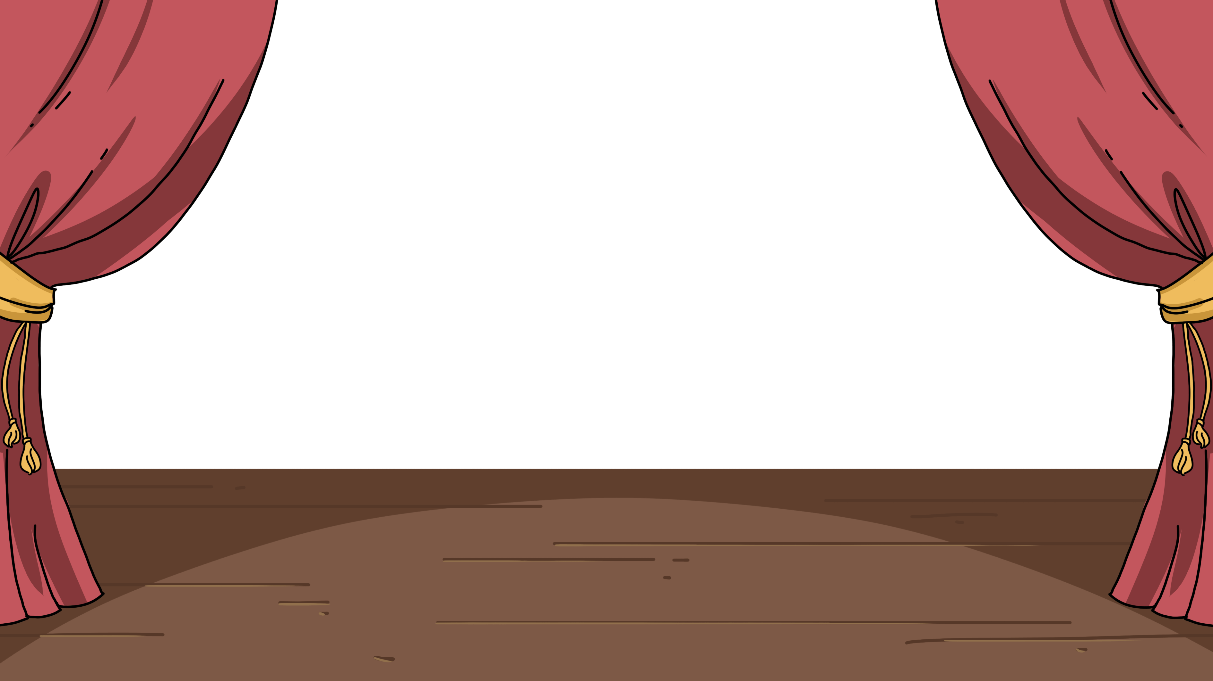
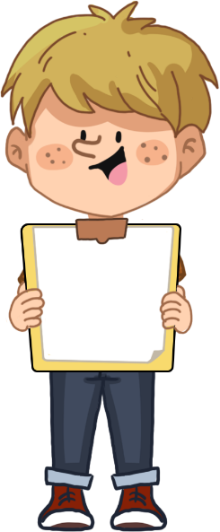
LO: Present homework; talk about what they have drawn.
Ask Ss to present their homework.
Encourage Ss to describe their homework.
Give feedback.
TG
Presentation
Let’s Show
Did you draw your favorite pet?
Now, show it and say, “My favorite pet is _______.”
02:00
3/22

Slide 4
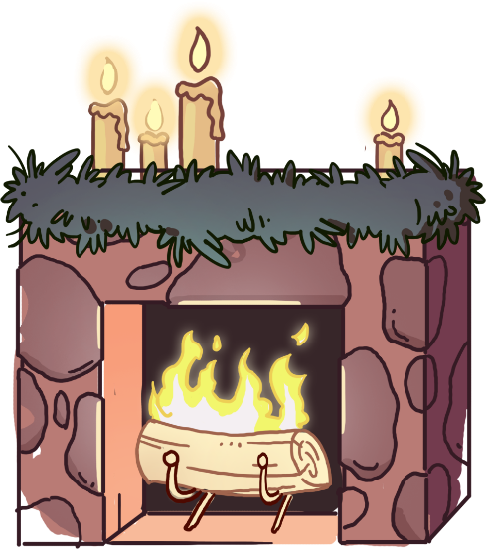
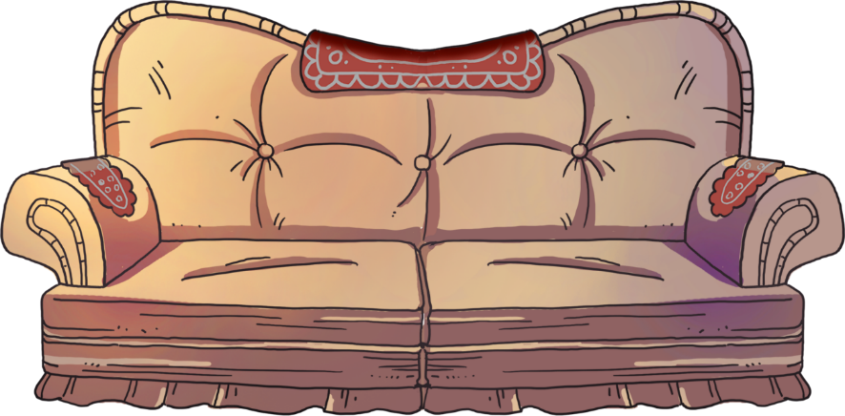
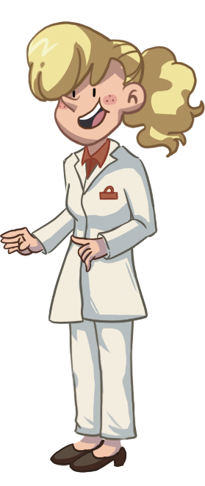
LO: Identify the consonant sound n.
Click and read each word to Ss like this: n-n-no.
Click and guide Ss to read the sound n like this: n-n-n.
Note: On this slide, Ss don’t need to read the words after T.
TG
Let’s Listen
Phonics
n-n-n
no
nine
nice
nut
nurse
net
02:30
4/22

Slide 5
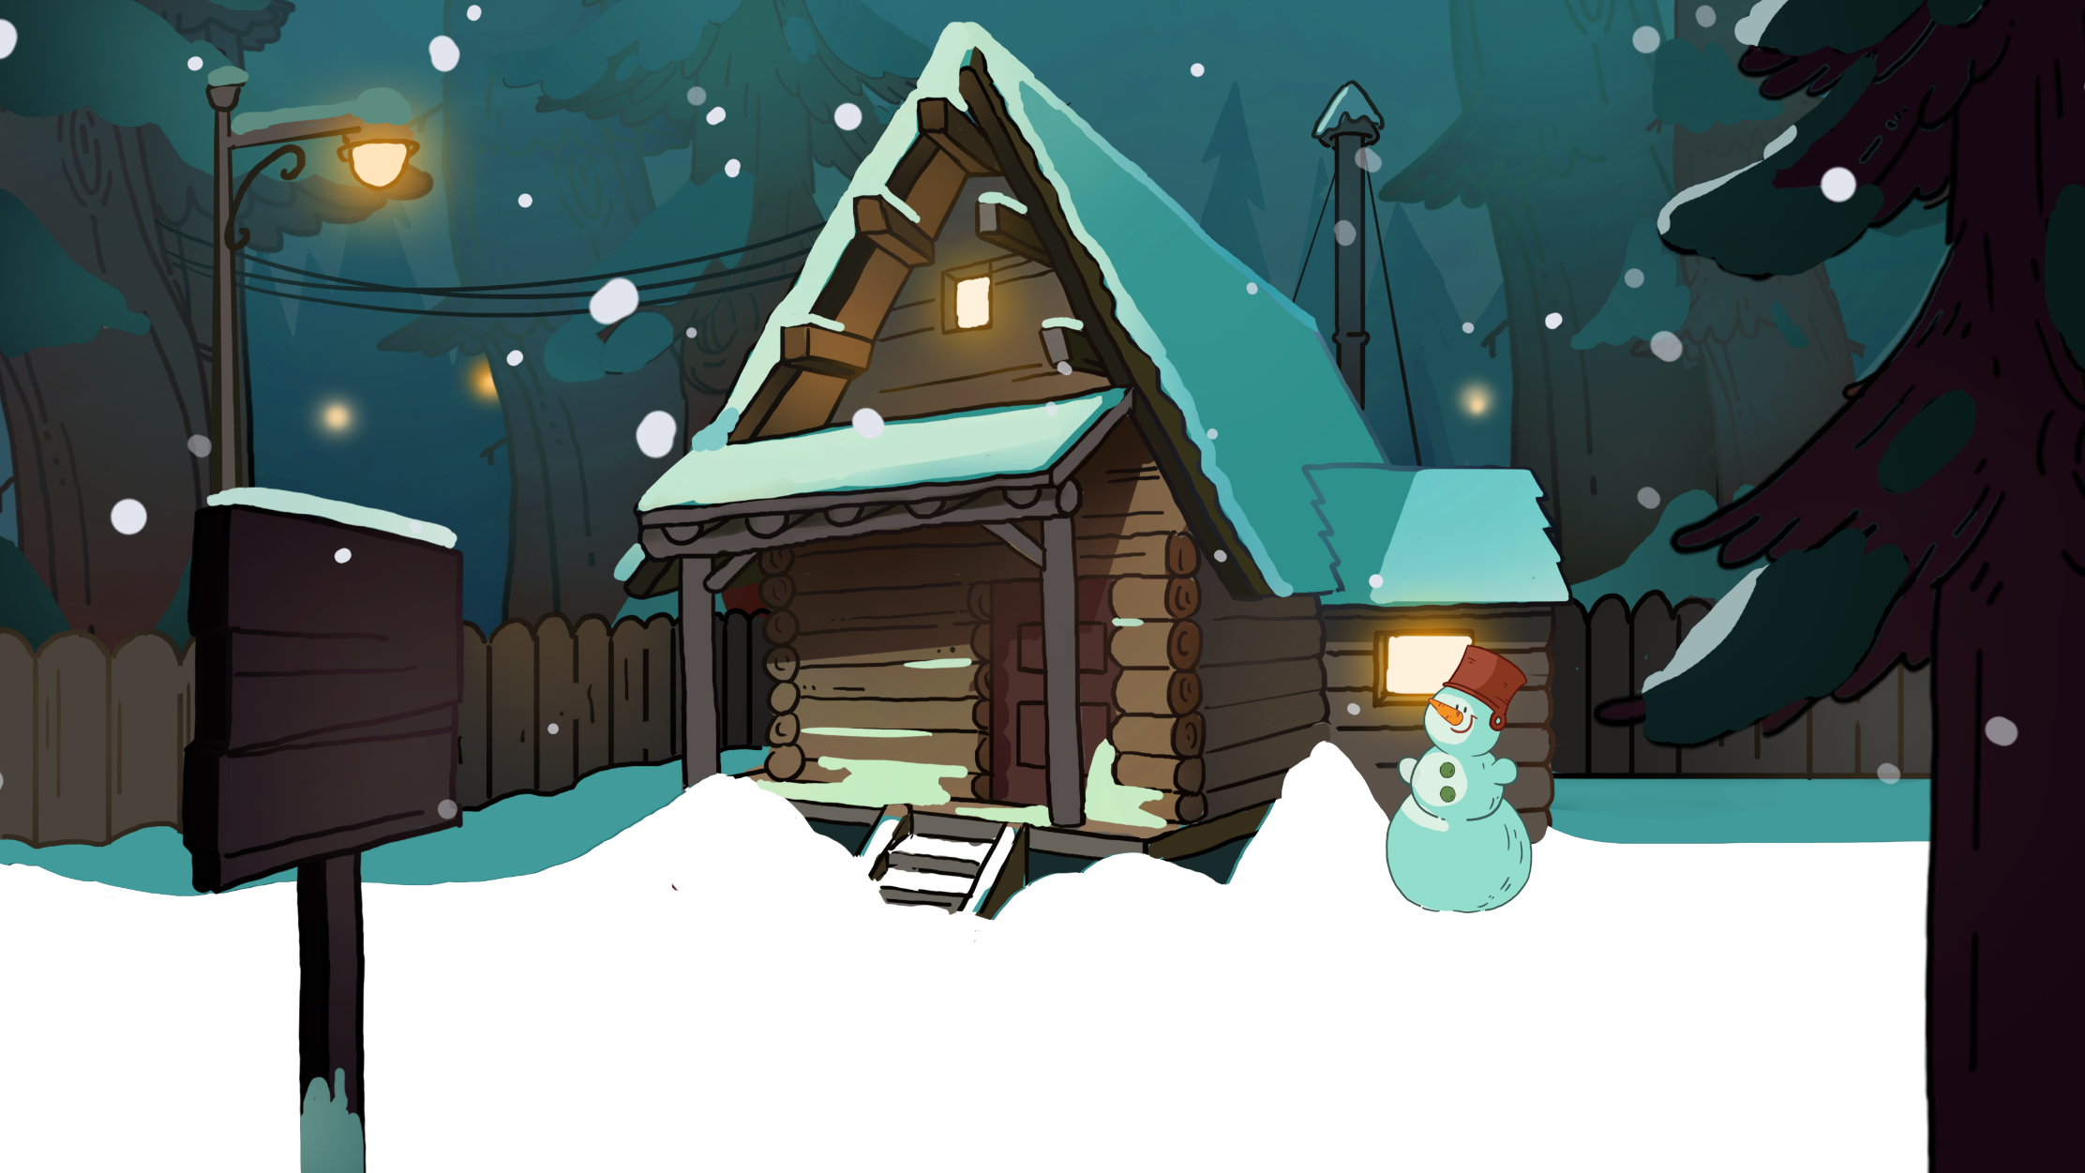
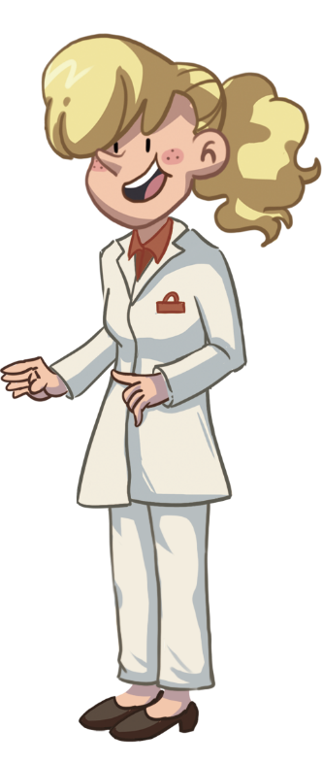
LO: Pronounce the words with the sound n.
Click and have Ss read each word together after T like this: n-n-no.
Note: After Ss read the words correctly, click to see the animation of the bird giving nuts to the nurse.
TG
Let’s Say
Phonics
no
nine
nice
nut
nurse
net
02:30
5/22

Slide 6
TG
LO: Decode the words learned in the text.
Click and read the chant to Ss with rhythm.
Guide Ss to repeat after T; ask them to take turns reading each sentence.
Give feedback.
Let’s Chant
Phonics
The bird has no nest.
The nurse has no nuts.
The nurse offers a nice nest.
The bird pays with nine nuts.
02:00
6/22

Slide 7
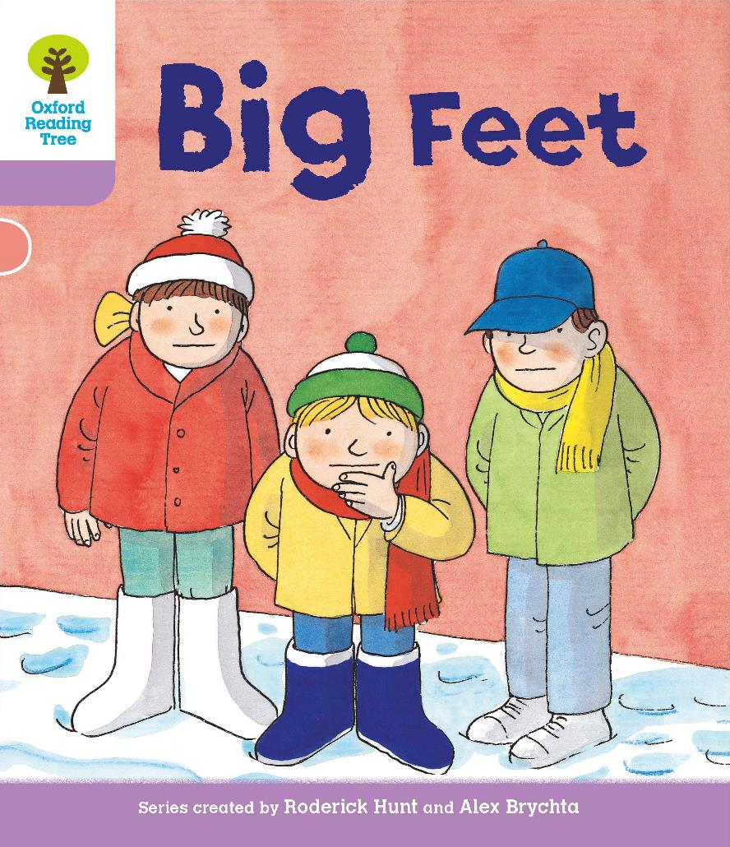
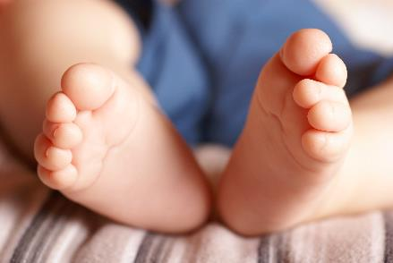
LO: Get to know the title, the author, and the illustrator of the book; use the book cover to identify details and make predictions; know the meaning of the key vocabulary word and make sentences with it.
Guide Ss to look at the book cover and encourage them to talk about what they see.
Ask Ss to find the title, the author, and the illustrator.
Explain the key vocabulary word and the example sentence; encourage Ss to make sentences with the key vocabulary word.
Guide them to talk about the given questions.
TG
Introduction
Let’s Begin
Who can you see on the book cover?
How is the weather? Is it hot?
Look at the book cover. What season do you think it is? How do you know?
A. Spring. B. Summer. C. Fall. D. Winter
Vocabulary
feet
I can see a baby’s feet.
Vocabulary
Written by Roderick Hunt
Illustrated by Alex Brychta
03:00
7/22

Slide 8
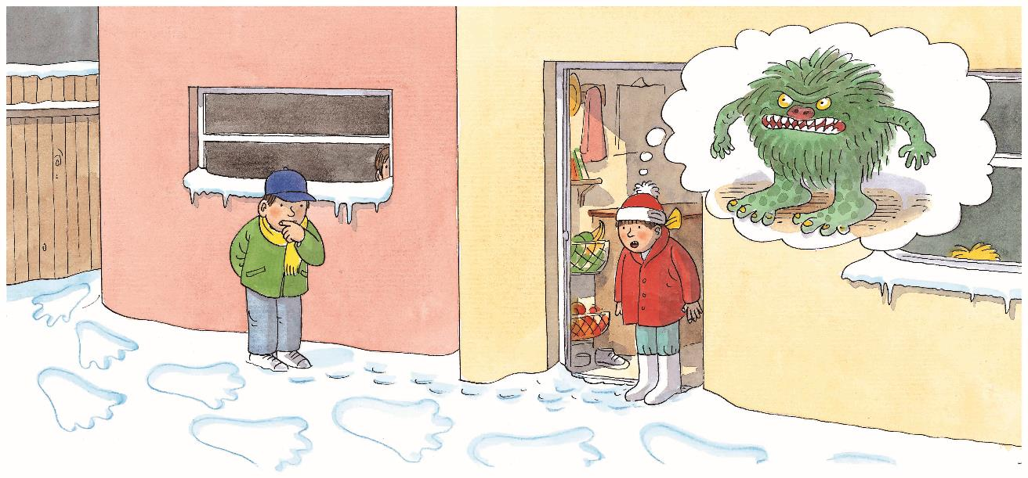
LO: Use the illustration to identify details and make predictions about
the story.
Guide Ss to look at the illustration and talk about what they see.
Ask Ss the given questions and encourage them to make predictions.
TG
Lead-in
Let’s Predict
What are Biff and Chip looking at?
They are looking at _____.
What does Biff think made them?
Biff thinks _____.
02:00
8/22

Slide 9
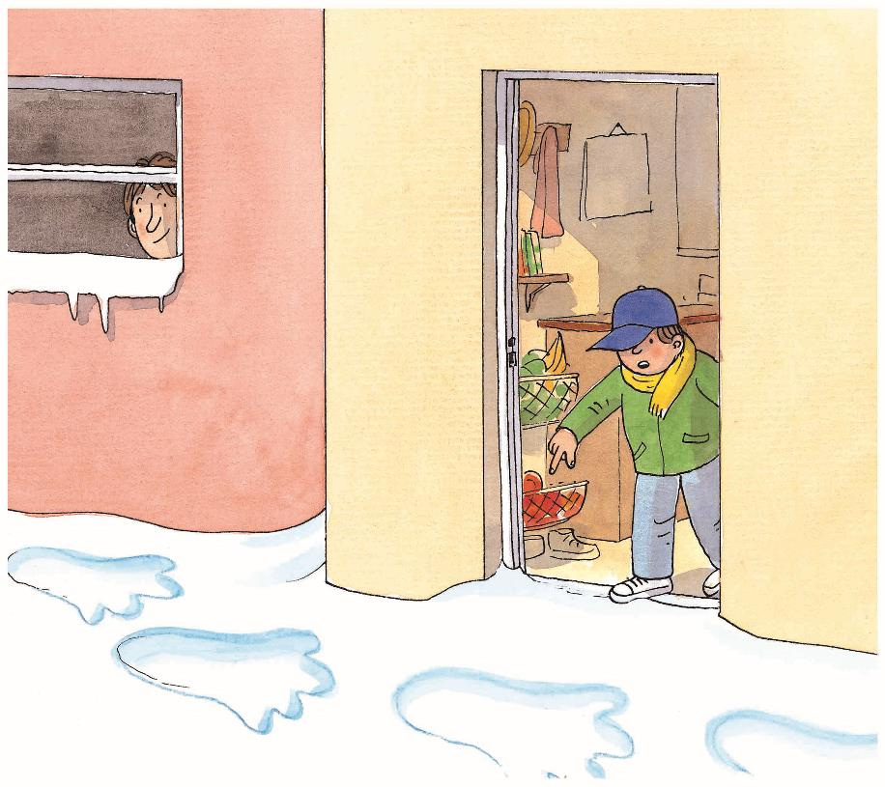
LO: Identify details using the illustration; decode the sight words;
understand the text.
Read the text to Ss.
Read the sight words for Ss and have Ss repeat them.
Guide Ss to look at the illustration and talk about the given questions with complete sentences.
Guide Ss to read the text together, pretending they are surprised.
TG
Reading
Big Feet
Details
Sight Word
Sight Word
What did Chip find in the snow?
What did Chip ask everyone to do?
What do you think Dad was doing?
and
come
Sight Word 1
Sight Word 2
Come and look at this.
02:00
9/22

Slide 10
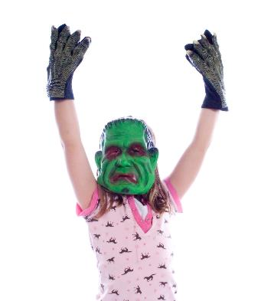
TG
LO: Identify details using the illustration; know the meaning of the key
vocabulary word and make sentences with it; understand the text;
read the text accurately.
Read the text to Ss.
Explain the key vocabulary word and the example sentence; encourage Ss to make sentences with the key vocabulary word.
Guide Ss to look at the illustration and talk about the given questions with complete sentences.
Guide Ss to take turns reading the text and pretending they are confused.
Check Ss’ accuracy and give feedback.
Reading
Big Feet
Details
Vocabulary
What did Biff ask everyone to do?
How did Biff feel?
What did Biff think might have made the footprints?
Did Dad come outside the house?
monster
The kid is wearing a monster mask.
Decoding
Come and look at this.
Is it a big monster?
Read accurately.
Vocabulary
03:00
10/22

Slide 11
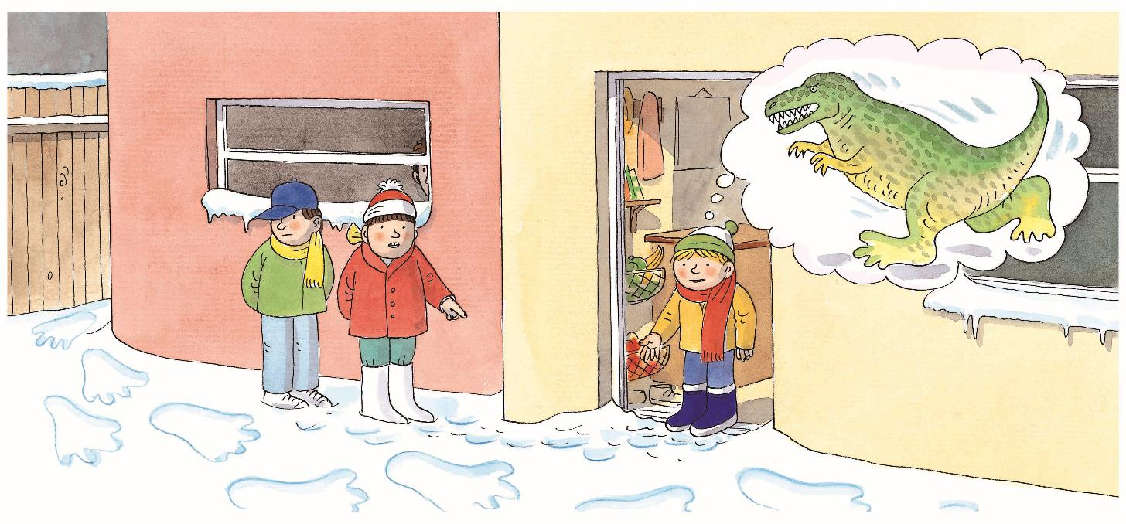
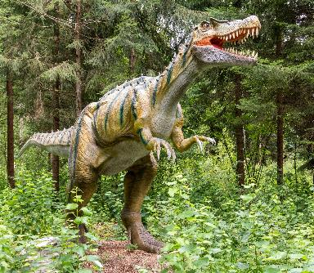
TG
LO: Identify details using the illustration; know the meaning of the key
vocabulary word and make sentences with it; understand the text;
read the text accurately; make predictions.
Read the text to Ss.
Explain the key vocabulary word and the example sentence; encourage Ss to make sentences with the key vocabulary word.
Guide Ss to look at the illustration and talk about the given questions with complete sentences.
Guide Ss to take turns reading the text.
Check Ss’ accuracy and give feedback.
Guide Ss to talk about the prediction question using the illustration.
Reading
Big Feet
Details
What did Kipper think might have made the footprints?
Vocabulary
Decoding
Read accurately.
Predictions
dinosaur
Who might come and look at the
footprints next？
I can see a dinosaur in the park.
Come and look at this.
Is it a big dinosaur?
Vocabulary
03:00
11/22

Slide 12
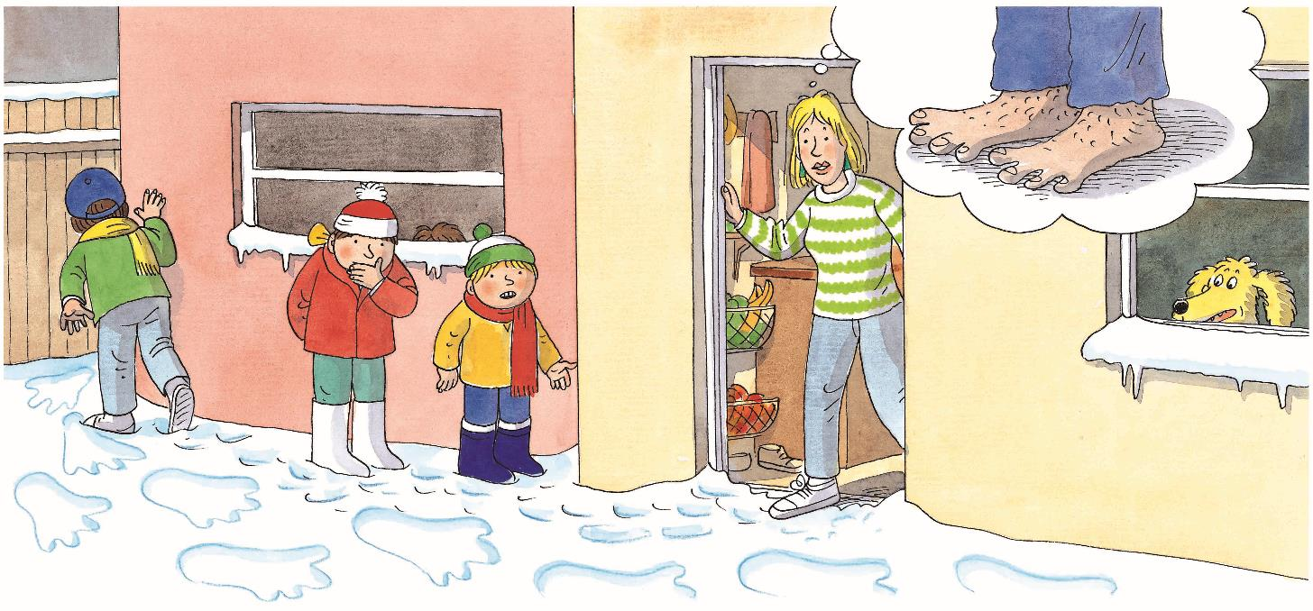
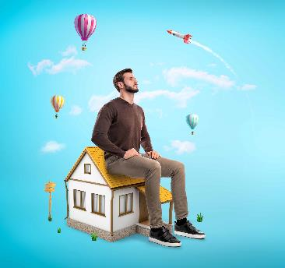
LO: Identify details using the illustration; know the meaning of the key
vocabulary word and make sentences with it; understand the text;
make predictions.
Read the text to Ss.
Explain the key vocabulary word and the example sentence; encourage Ss to make sentences with the key vocabulary word.
Guide Ss to look at the illustration and talk about the given questions with complete sentences.
Guide Ss to read the text—one S for one sentence.
Guide Ss to talk about the prediction question using the illustration.
TG
Reading
Big Feet
Vocabulary
Details
What did Mum think might have made the footprints?
What was Chip looking for?
giant
A giant is sitting on a house.
Predictions
Look for clues in the illustration. Who would Mum ask to come and look at the footprints?
Come and look at this.
Is it a big giant?
Vocabulary
03:00
12/22

Slide 13
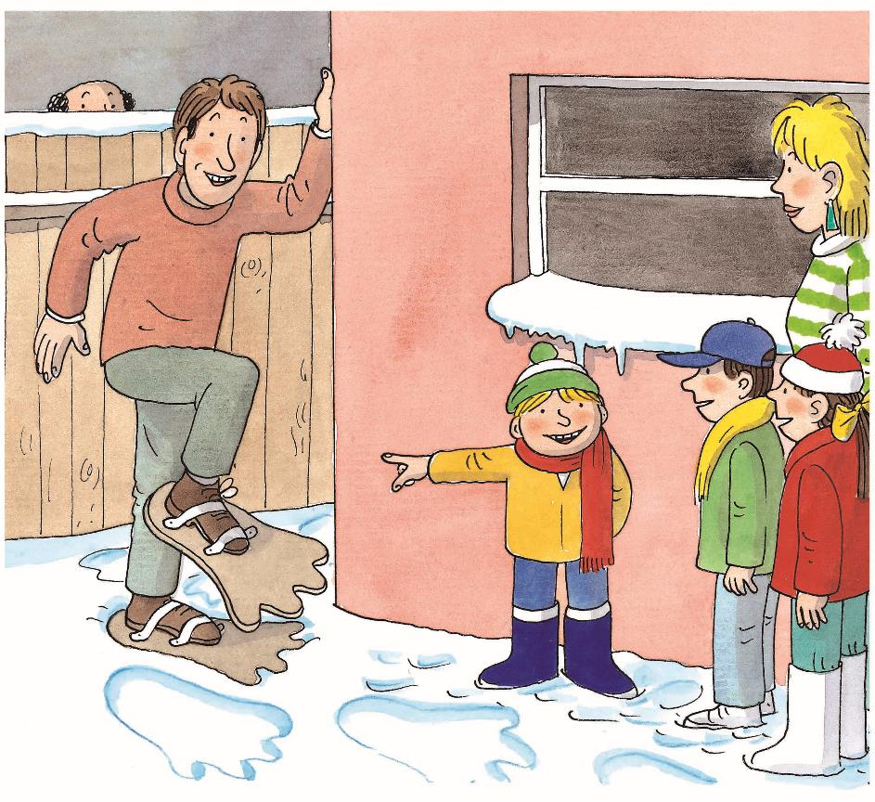
LO: Identify details using the illustration; understand the text; make
connections.
Read the text to Ss.
Guide Ss to look at the illustration and talk about the given questions with complete sentences.
Guide Ss to read the text together.
Guide Ss to talk about the connections question; model first; encourage them to take turns talking more about themselves.
TG
Reading
Big Feet
Details
Who made the footprints?
How do you think everyone felt?
Connections
What do you like to do in the snow?
A. Go skiing.
B. Make a snowman.
C. Others.
No. It is Dad.
03:00
13/22

Slide 14
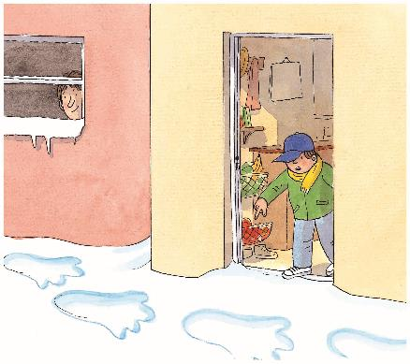
LO: Retell the story.
Guide Ss to recall some details of the story.
Click and model first; have Ss work together to retell the story using the given illustrations and helping words.
Give feedback.
TG
Reading
Let’s Retell
Helping Words
monster
dinosaur
giant
1
2
3
4
5
03:00
14/22

Slide 15
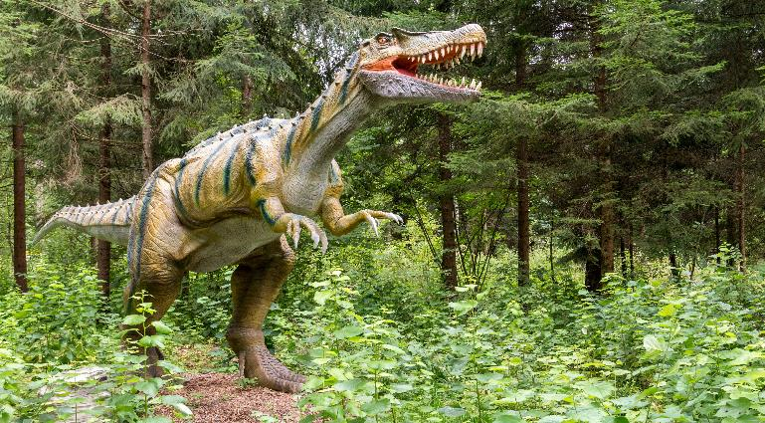
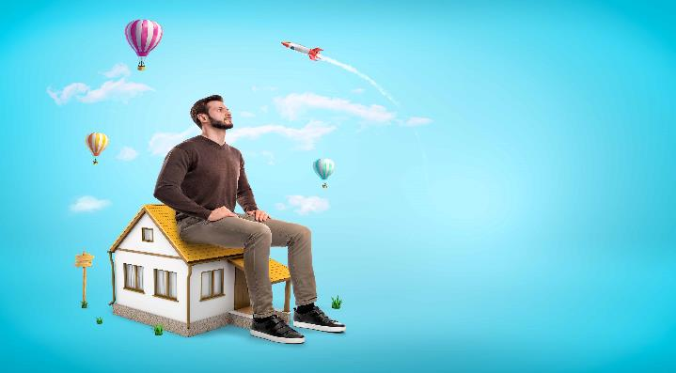
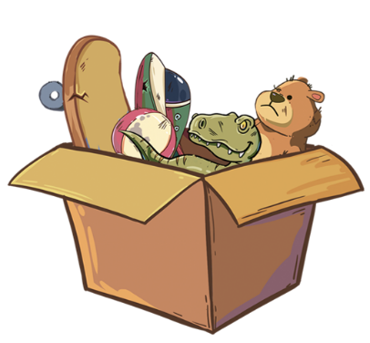
LO: Check Ss’ understanding of the key vocabulary words learned in
the lesson.
Click and guide Ss to say the key vocabulary words with the help of the pictures.
Click to show the key vocabulary words; click again to make pictures and words disappear.
Give feedback.
TG
Vocabulary
Let’s Say
giant
dinosaur
feet
monster
02:00
15/22

Slide 16
LO: Talk about the illustrations with the given sentence structure.
Ask Ss to look at the illustrations and identify the characters.
Guide Ss to take turns completing the sentence structure—one S for one illustration.
Give feedback.
Note: Ss should use complete sentences.
TG
Listening &
Speaking
Let’s Talk
Is it a big _____?
Reading
dinosaur
monster
giant
02:00
16/22

Slide 17
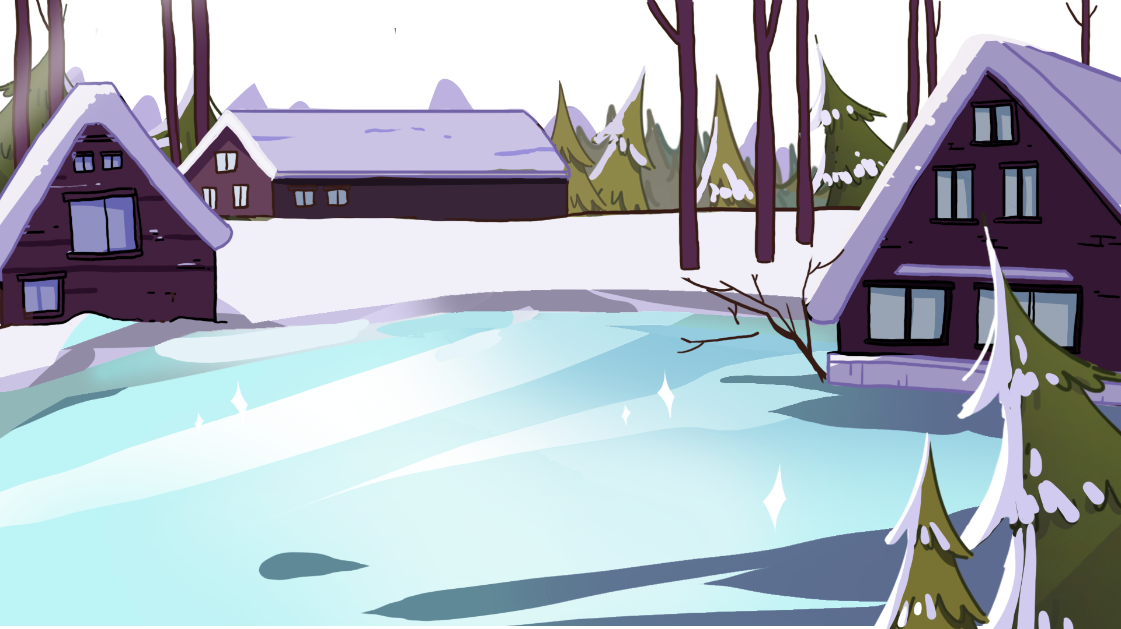
LO: Talk about the given pictures using the given sentence structure.
Guide Ss to look at the pictures and talk about what they see.
Model first; have Ss take turns talking about the given question.
Note: Each S should say at least two sentences; remind Ss to play safely when playing on the ice.
TG
Let’s Talk
Listening &
Speaking
What do you like to do in winter?
I like to _____.
Helping Words
make a snowman
have a snowball fight
play ice hockey
go skiing
03:00
17/22

Slide 18
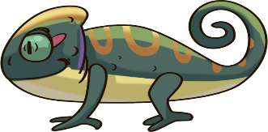
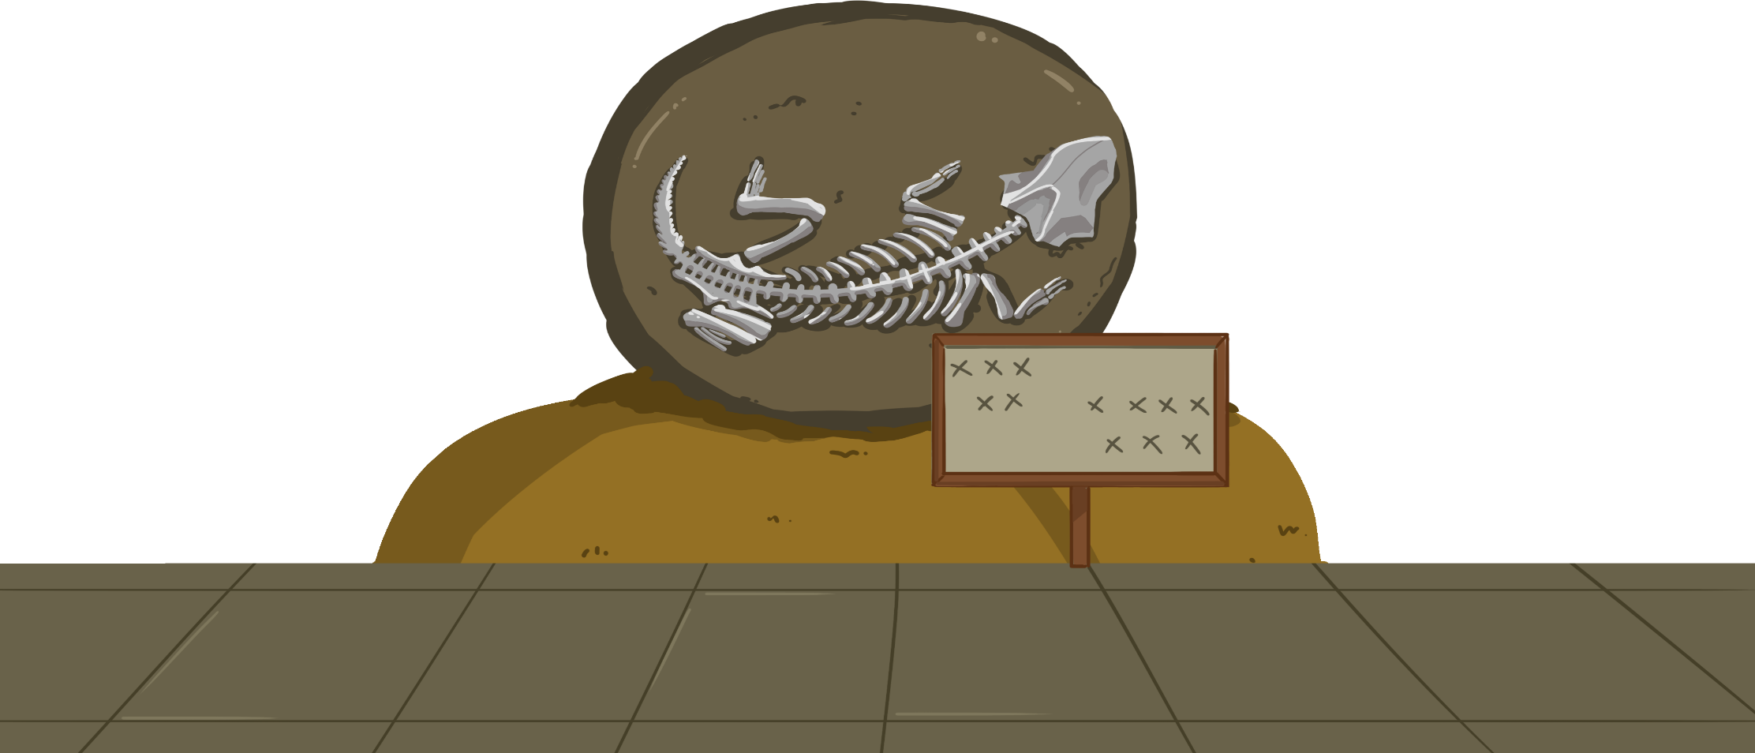
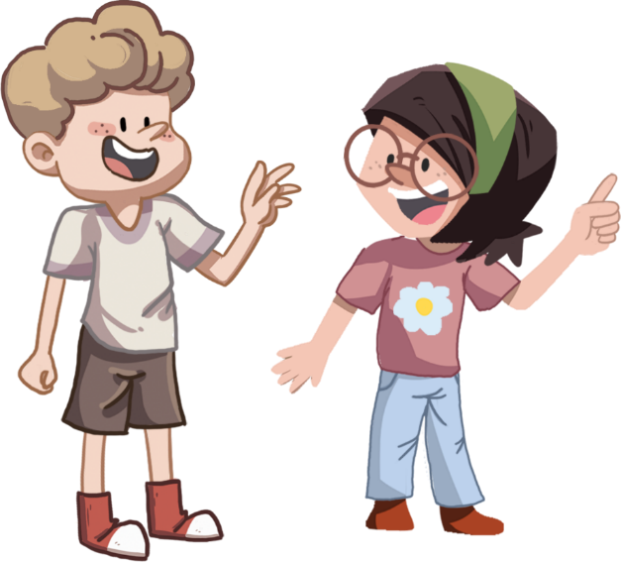
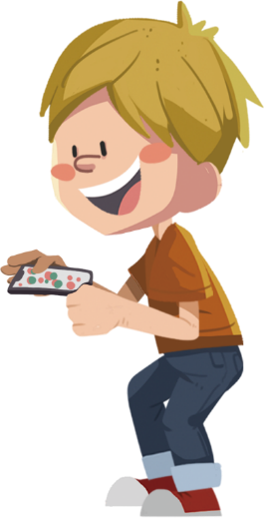
LO: Build their awareness of what it means to be curious and
thoughtful.
Guide Ss to look at the picture and ask them the given question.
Click and show the answers; make sure Ss know that they should be curious and thoughtful; invite Ss to share their answers with others.
TG
Let’s Discuss
Value
Do they like to think?
1
2
03:00
18/22

Slide 19
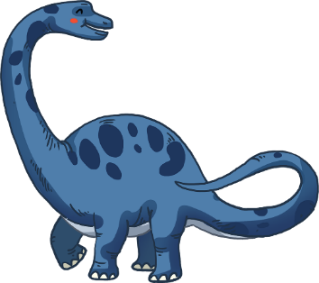
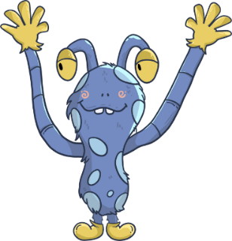
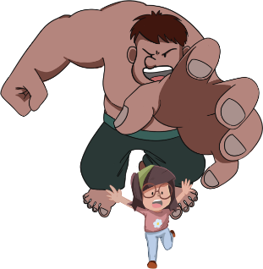
LO: Talk about what they’ve learned from the story.
Ask Ss the given question and guide them to think about it.
Model first; guide Ss to talk about the question with the visual aids and sentence structure.
TG
Oral Writing
Get Ready to Present
What did everyone think might have made the big footprints?
_____ thought a _____ might have made the footprints.
Kipper
Biff
Mum
03:00
19/22

Slide 20
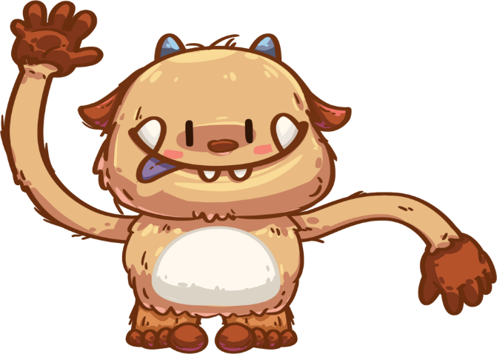
Let’s Draw & Say
LO: Understand what the homework is; know that the post-class video will
help them finish their homework.
Explain the writing task to Ss and remind them to watch the post-class video before doing homework.
Remind Ss to get ready to present their homework next class.
TG
Writing
Opinion Writing
Now you will prepare for your writing task:
Draw a monster you like.
Trace the word.
You can say, “I like this monster.”
monster
Tip: Remember to watch the post-class video.
02:00
20/22

Slide 21
LO: Get a better idea of what they’ve learned in this lesson.
Ask Ss to read the words in the phonics section; correct Ss’ pronunciation if necessary.
Ask Ss to read the key vocabulary words; help Ss with the words they are struggling with if necessary.
Have each S take turns making a sentence using the sentence structure.
TG
Review
Let’s Review
Phonics:
no/nest/nurse/
nut/nice/nine
Vocabulary:
feet/monster/
dinosaur/giant
Sentence Structure:
Is it a big _____?
02:00
21/22

Slide 22
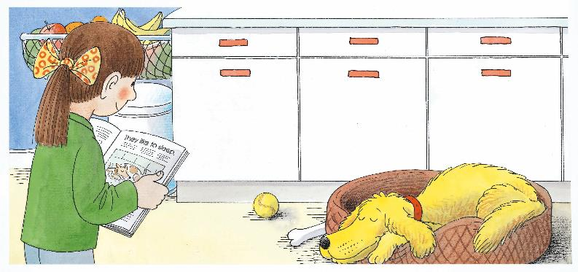
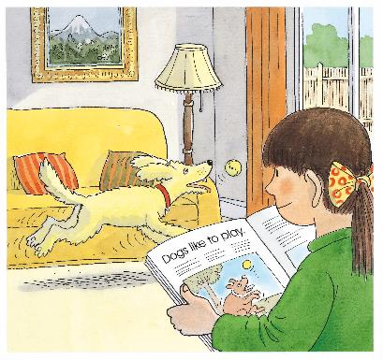
LO: End the lesson and encourage Ss to perform better in the next class.
1. Give brief comments on Ss.
2. Say goodbye to Ss.
3. Ask Ss to preview the next lesson.
TG
01:00
22/22

