Slide 1
What can you see ... the ….?
in the sea
at the beach
NEXT

Slide 2
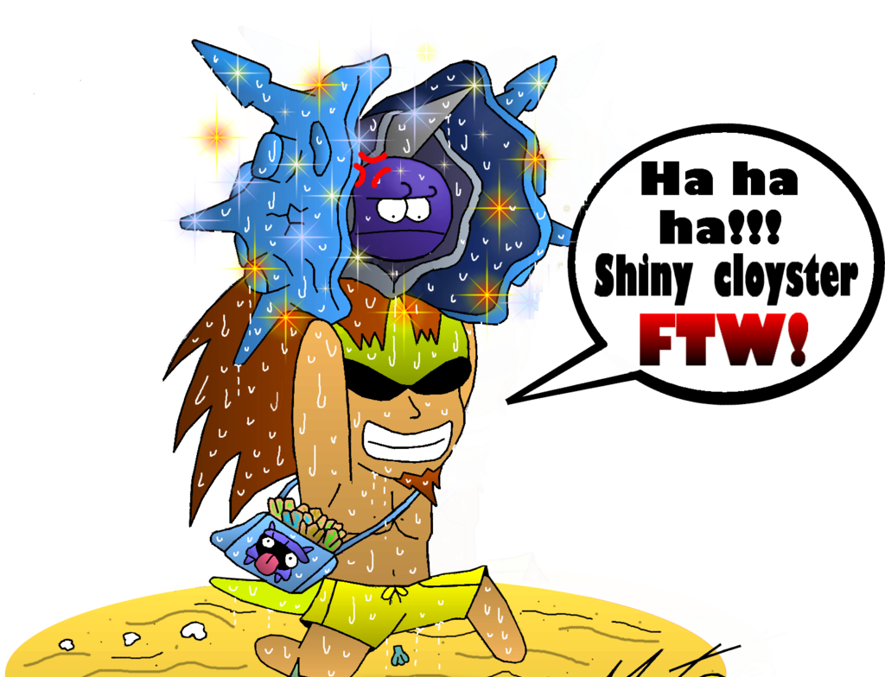
He is collecting shells.
SHELLS!
NEXT

Slide 3
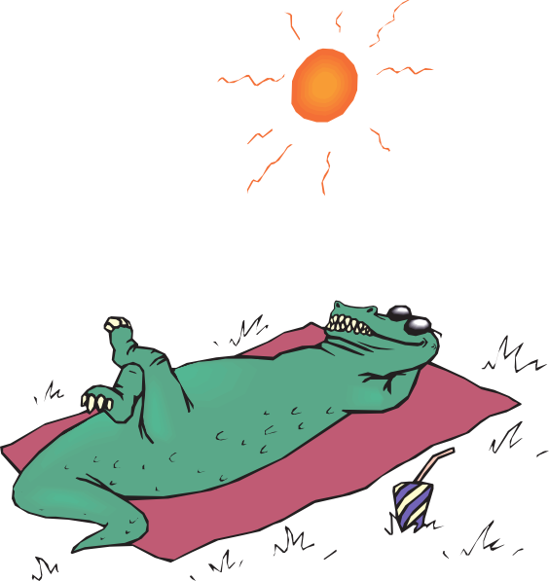
It is enjoying the sun.
NEXT

Slide 4
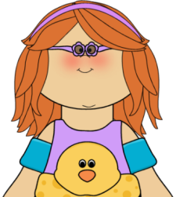
She is swimming.
NEXT

Slide 5
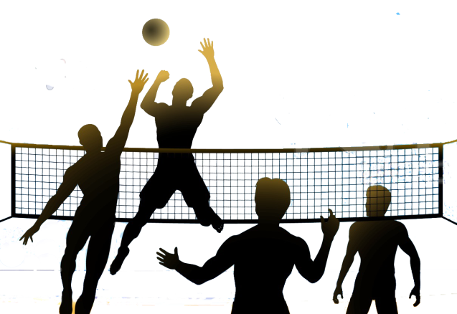
They are playing volleyball.
NEXT

Slide 6
Let’s watch a video. At the beach, present continuous https://www.youtube.com/watch?v=AAZBDgAqNHQ
NEXT

Slide 7
Choose you coconut game!!!
Let’s play a game!

Slide 8
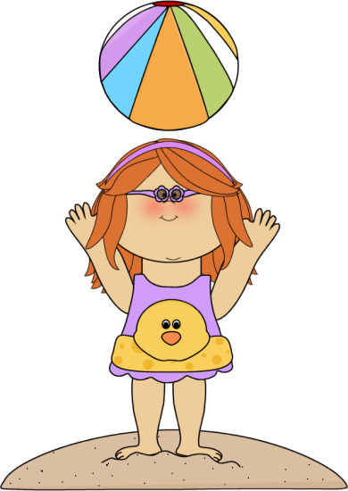
Is she reading a book?
No, she isn’t.
Yes, she is.
Well Done!
Yes, they are.
NEXT

Slide 9
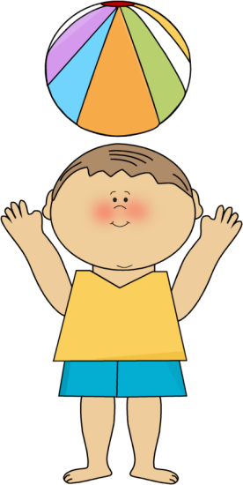
Is he playing volleyball?
No, he isn’t.
Well done!
Yes, he is.
Yes, they are
NEXT

Slide 10
Are they collecting shells?
No, he isn’t.
Well done!
No, they aren’t.
Yes, they are
NEXT

Slide 11
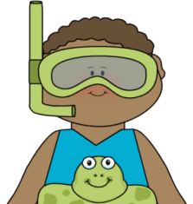
Is he swimming?
Yes, he is
Yes, she is.
Well Done!
No, they aren’t.
NEXT

Slide 12
Are they throwing a bottle?
No, we aren’t
Well done!
Yes, they are.
No, they aren’t
NEXT

Slide 13
Is it writing a letter?
No, they aren’t.
Yes, they are.
Well done!
No, it isn’t.
NEXT

Slide 14
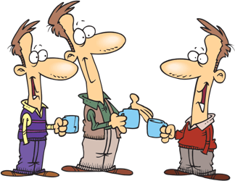
Are they talking?
Yes, they are
No, he isn’t
Well Done!
No, they aren’t
NEXT

Slide 15
Is he sitting beside a tree?
No, she isn’t.
Well done!
No, he isn’t
Yes,
he is.
NEXT

Slide 16
START

Slide 17
Look at the picture and make a sentence in the present continuous tense by clicking
on the right words.
NEXT

Slide 18
ERROR
ERROR
ERROR
They
She
He
are
am
is
talking
singing
playing
1/10
He
am
playing
She
is
talking
They
are
singing

Slide 19
ERROR
ERROR
ERROR
He
She
They
is
am
are
running
singing
playing
2/10
He
am
running
She
is
playing
They
are
singing

Slide 20
ERROR
ERROR
ERROR
She
He
They
is
am
are
singing
drinking
playing
3/10
He
am
drinking
She
is
playing
They
are
singing

Slide 21
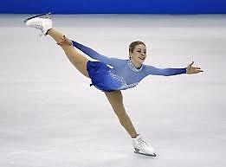
ERROR
ERROR
ERROR
I
We
They
am
is
are
skating
eating
playing
4/10
I
am
eating
We
is
skating
They
are
playing

Slide 22
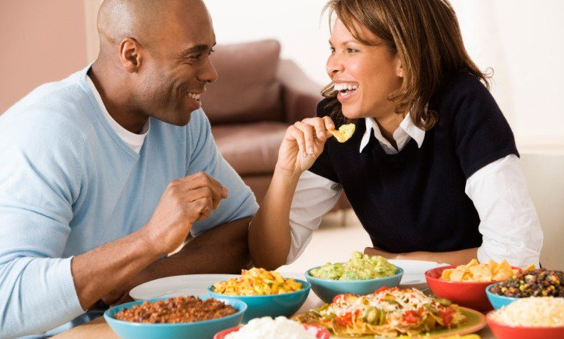
ERROR
ERROR
ERROR
We
He
she
are
is
am
eating
drinking
playing
5/10
She
am
eating
He
is
drinking
We
are
playing

Slide 23
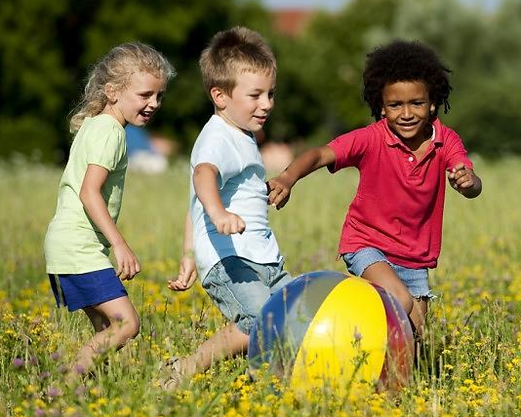
ERROR
ERROR
ERROR
They
He
she
are
is
am
playing
drinking
jumping
6/10
She
am
jumping
He
is
drinking
They
are
playing

Slide 24
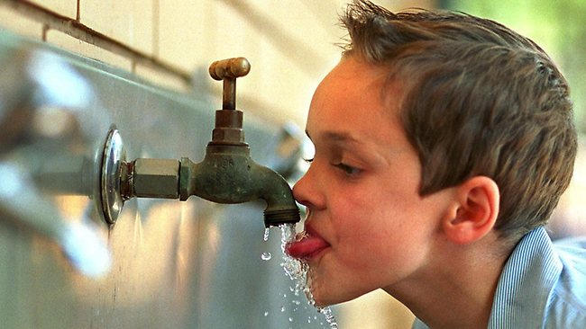
ERROR
ERROR
ERROR
He
They
she
is
are
am
drinking
reading
jumping
7/10
She
am
jumping
He
is
drinking
They
are
reading

Slide 25
ERROR
ERROR
ERROR
You
They
We
are
is
am
reading
writing
jumping
8/10
You
am
jumping
We
is
writing
They
are
reading

Slide 26
ERROR
ERROR
ERROR
He
They
We
is
are
am
writing
dancing
jumping
9/10
We
am
writing
He
is
dancing
They
are
jumping

Slide 27
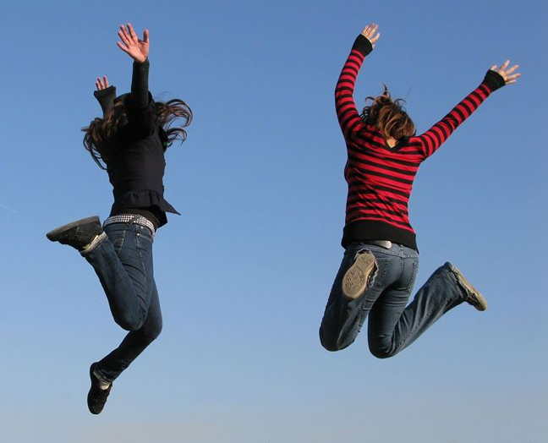
ERROR
ERROR
ERROR
They
He
I
are
is
am
jumping
dancing
driving
EXIT
10/10
I
am
dancing
He
is
jumping
They
are
driving

Slide 28
Let’s play the ‘pirates of the present progressive’ game.

