Slide 1
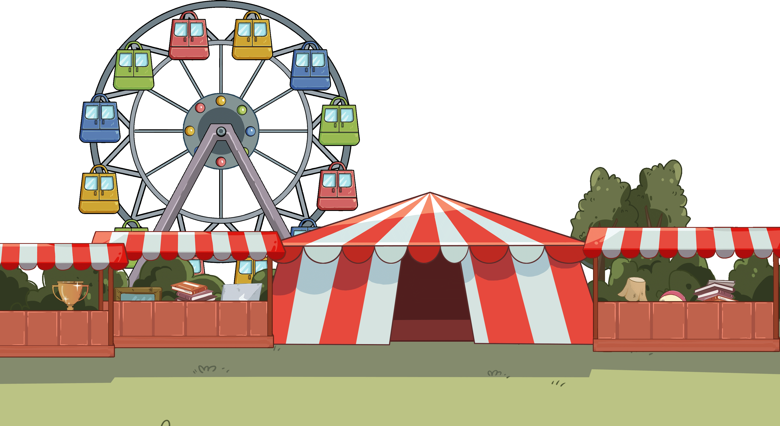
TG
LO: Get to know their partners; get a basic idea about the topic of today’s lesson.
1. Say hello to Ss; ask Ss to introduce themselves and greet each other.
2. Introduce the topic of the lesson.
0:30
1/26

Slide 2
Learning
Goals
TG
LO: Get to know and understand what will be learned in this lesson.
Go through the learning goals with Ss.
We are going to . . .
Isolate and pronounce the initial, medial vowel, and final sounds (phonemes) in three-phoneme (CVC) words.
Learn the key words and phrases bull’s-eye, school fair, won, gym, display, and watch, and make sentences with them.
Read the story Bull’s-eye! and identify the characters of a story with prompt and support.
Practice using the sentence structure
_____ wanted to _____.
0:30
2/26

Slide 3
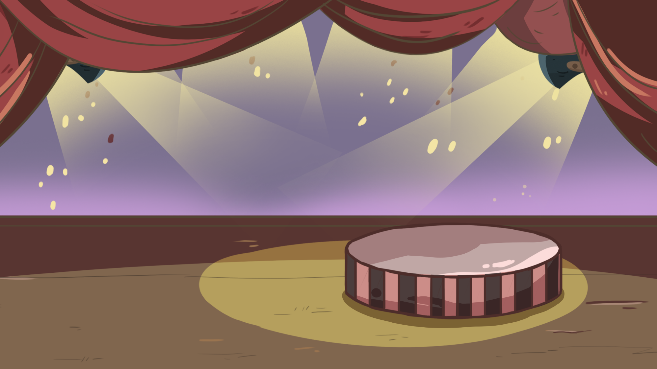
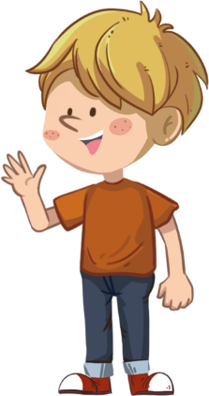
TG
LO: Present the writing assigned last lesson.
1. Let Ss present in turns.
2. Give feedback.
Presentation
Let’s show!
Share your writing from last lesson with your partner!
2:00
3/26

Slide 4
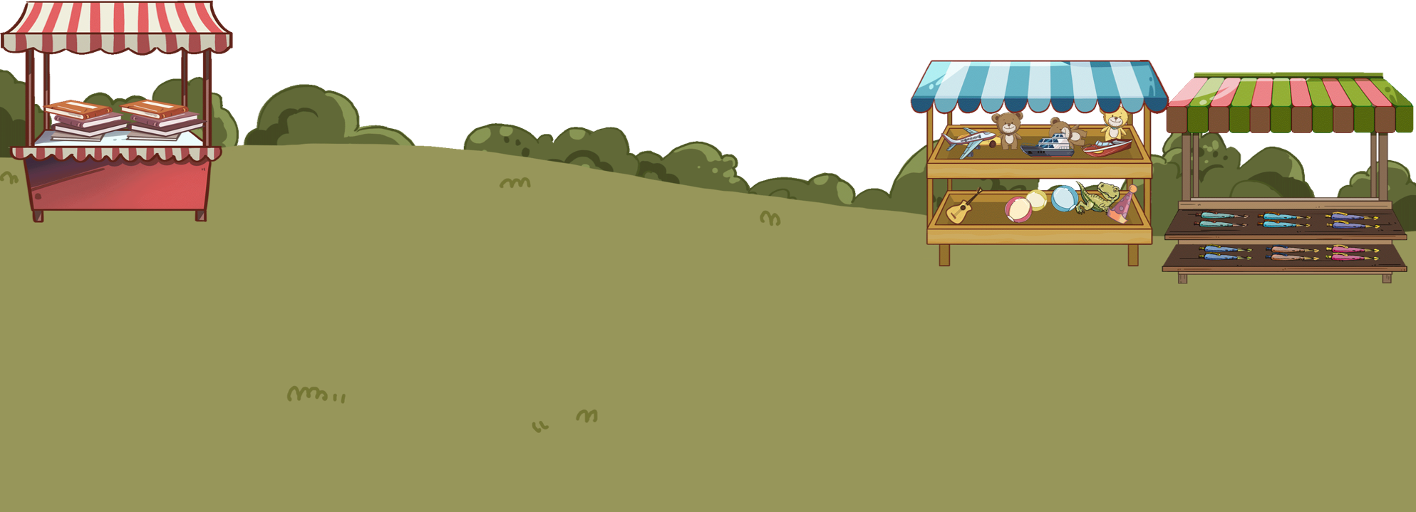
TG
LO: Isolate and pronounce the initial, medial vowel, and final sounds (phonemes) in three-
phoneme (CVC) words.
1. Have Ss help the girl in the picture play the slot machine by identifying the different word sounds.
2. Click and read the word pen to Ss; guide Ss to identify the initial, medial vowel and final sound in
word pen; then get the coin as a prize; Ss don’t have to identify every sound in a CVC word.
3. Repeat practice with the rest of the words.
Phonics
Let’s listen!
?
p
?
s
?
d
?
t
?
h
?
h
?
e
?
a
?
a
?
e
?
a
?
e
?
n
?
d
?
d
?
n
?
d
?
n
pen
sad
dad
ten
had
hen
2:30
6/26

Slide 5
TG
LO: Isolate and pronounce the initial, medial vowel, and final sounds (phonemes) in three-
phoneme (CVC) words.
1. Spin the wheel and wait for the wheel to stop; have Ss read the words.
2. Model how to read the word pen in this way: p-e-n, pen; click and read the word pen with Ss.
3. Click and ask Ss to take turns reading the rest of the words.
Phonics
Let’s speak!
had
dad
hen
sad
pen
ten
2:30
5/26

Slide 6
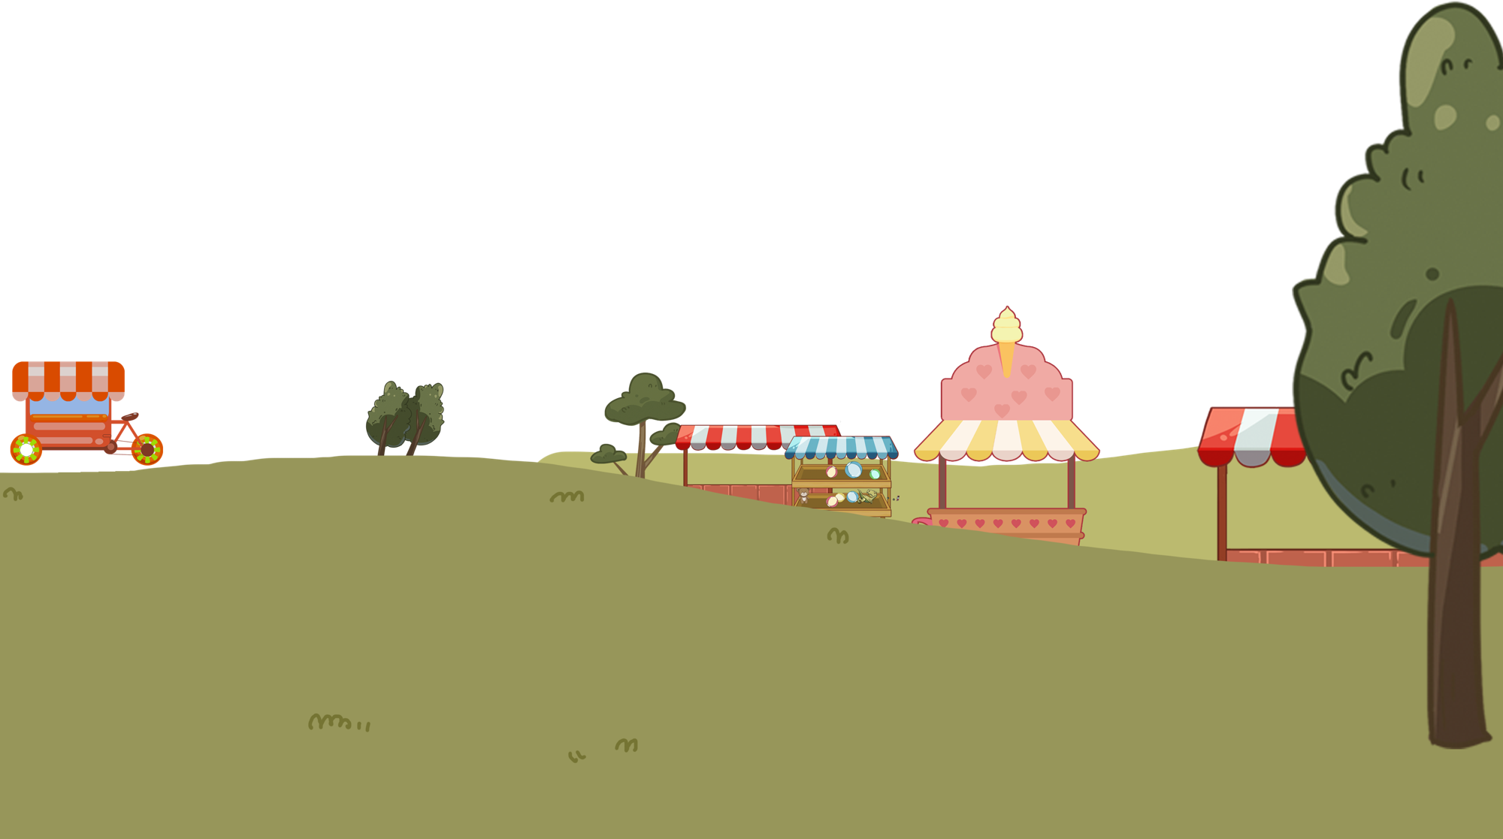
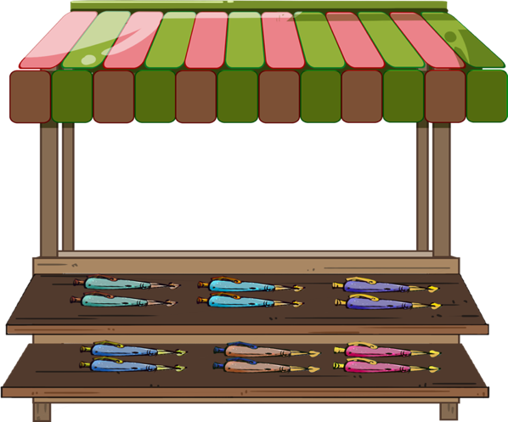
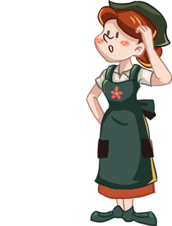
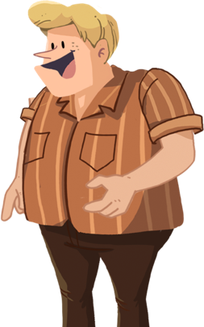
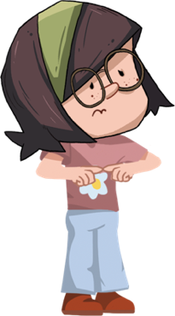
TG
Phonics
LO: Read the chant fluently; decode the words learned in the text.
1. Read the chant to Ss with rhythm; let Ss observe the picture and the highlighted words.
2. Guide Ss to repeat after you; ask them to take turns reading one sentence at a time.
3. Give feedback.
Let’s chant!
My pen was broken, and I was sad.
I went to the fair with my dad.
There were many pens, and I got ten.
I had a good time, and my dad got a hen.
2:00
6/26

Slide 7
Lead-in
TG
LO: Use the book cover to identify details and make predictions.
1. Guide Ss to look at the book cover closely and talk about the given questions.
2. Encourage Ss to talk more about the connections question.
Before Reading
What does the phrase bull’s–eye mean? Look for clues in the illustration.
Who do you think wants to play the game on the cover in the story?
Connections
What’s your favorite outdoor game?
Written by Roderick Hunt
Illustrated by Alex Brychta
2:00
7/26

Slide 8
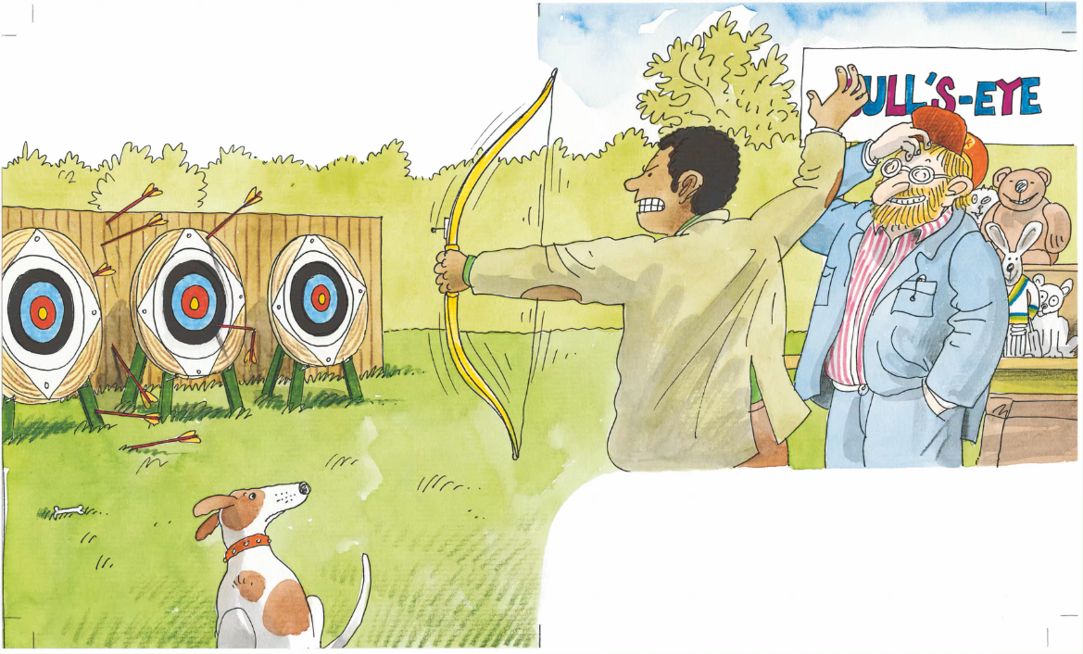
Let’s predict!
Reading
TG
Reading
LO: Make predictions about the story using the illustration; motivate Ss’ interest in reading the story.
1. Guide Ss to recall what predicting means and ask them to make guesses prior to reading the
story by looking at the pictures.
2. Guide Ss to talk about the given questions.
Before Reading
What is Dad doing?
Why does Dad get angry? What does he want to win? Will he win the game?
2:00
8/26

Slide 9
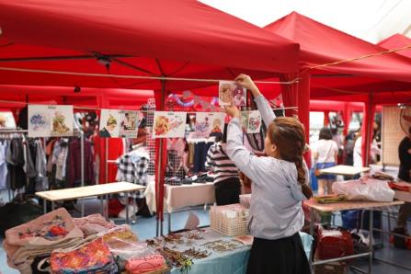
Bull’s-eye!
TG
Reading
LO: Understand the meaning of the key vocabulary phrase school fair, and make
sentences with it; understand the text; read the text fluently; Identify the major
characters of the story.
1. Read the text aloud to Ss.
2. Ask Ss to find school fair in the text and the illustration; have Ss read the phrase and make
sentences with it.
3. Have Ss observe the illustration and talk about the comprehension questions and character
questions.
4. Have Ss read the text fluently and give feedback.
Note: Click the penguin button to show the vocabulary card.
Vocabulary
Character
Who went to the school fair? Look for clues in the illustration.
Comprehension
school fair
What can people do at the school fair? Look for clues in the illustration.
She is preparing for the school fair.
Everyone went to the school fair.
school fair
2:30
9/26

Slide 10
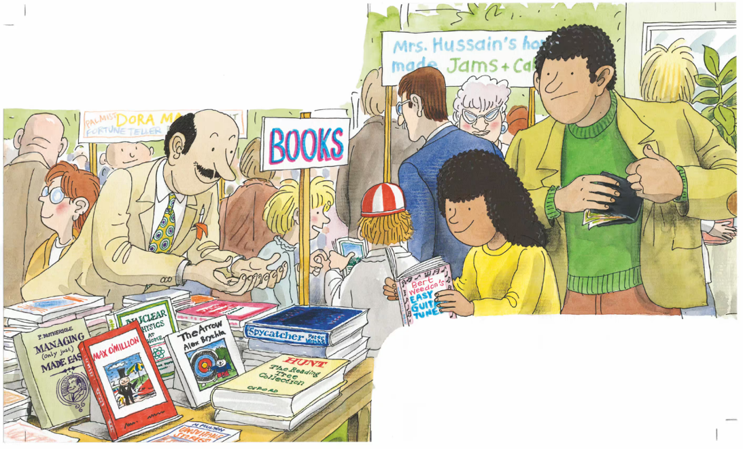
TG
LO: Understand the text; read the text fluently.
1. Ask Ss to read the text aloud in turns.
2. Have Ss observe the illustration and talk about the comprehension questions.
Reading
Bull’s-eye!
Comprehension
Wilma wanted a book.
What did Wilma want at the school fair?
How did Wilma get it? What did Dad do for Wilma?
Her dad bought it for her.
2:00
10/26

Slide 11
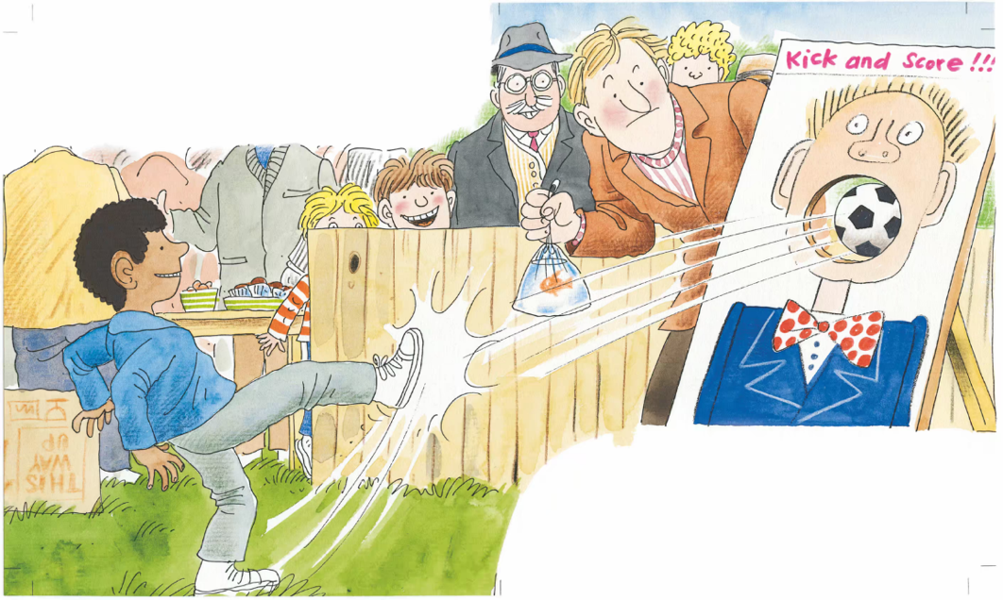
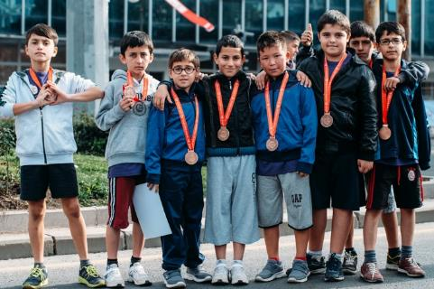
Bull’s-eye!
TG
LO: Understand the meaning of the key vocabulary word won, and make sentences
with it; understand the text; read the text fluently.
1. Read the text aloud to Ss.
2. Ask Ss to find won in the text and the illustration; have Ss read the word and make
sentences with it.
3. Have Ss observe the illustration and talk about the comprehension questions.
4. Have Ss read the text fluently and give feedback.
5. Encourage Ss to talk more about the connections question.
Note: Click the penguin button to show the vocabulary card.
Reading
Vocabulary
Comprehension
What did Wilf do at the school fair?
What did Wilf play the game for? What did he win?
Wilf kicked the ball.
won
Connections
Did you win anything in a game before? What game was it? How did you play it?
He won a goldfish.
The boys won medals in the competition.
won
2:00
11/26

Slide 12
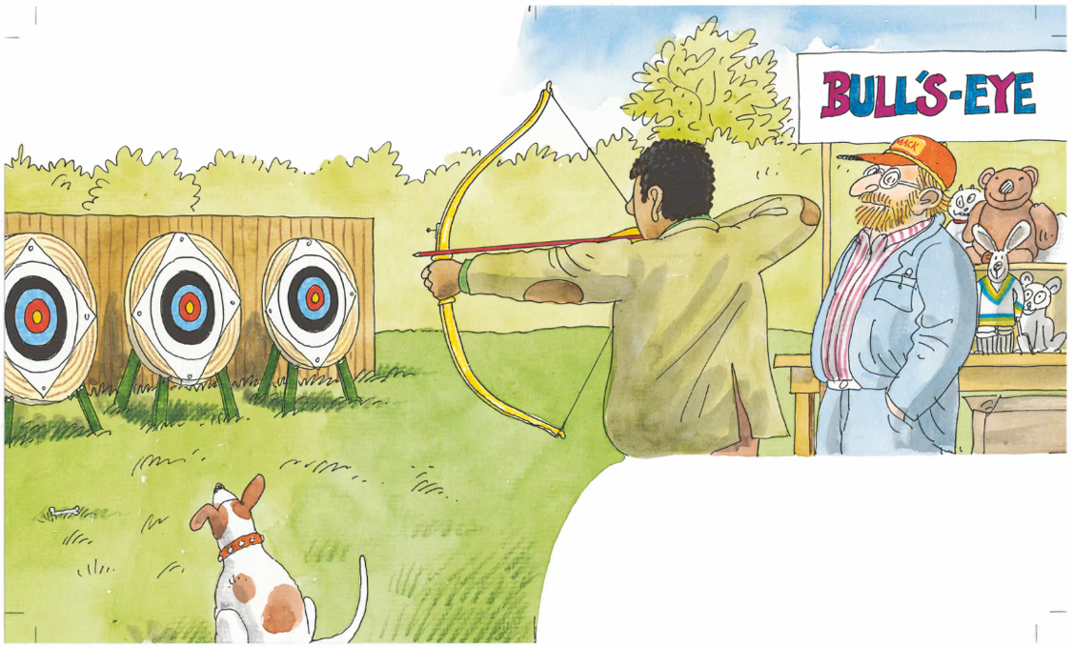
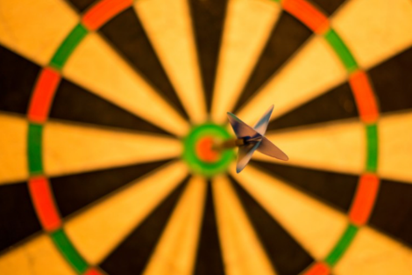
Bull’s-eye!
LO: Understand the meaning of the key vocabulary phrase bull’s-eye, and make
sentences with it; understand the text; decode the sight word accurately; read
the text fluently.
1. Ask Ss to read the text aloud in turns.
2. Ask Ss to find bull’s- eye in the text and the illustration; have Ss read the phrase and make
sentences with it.
3. Ask Ss to find the sight word teddy in the text and guide them to read it accurately.
4. Have Ss observe the illustration and the text; talk about the comprehension questions.
Note: Click the penguin button to show the vocabulary card.
TG
Reading
Vocabulary
Comprehension
Dad wanted to win
a teddy.
What did Dad do at the school fair?
What prize did Dad want?
How could Dad win the prize he wanted?
bull’s-eye
The arrow hit the bull's-eye.
He had to hit a bull’s-eye.
Sight Word
teddy
bull’s-eye
2:00
12/26

Slide 13
Bull’s-eye!
TG
LO: Understand the text; read the text with appropriate expression; identify the characters
of a story with prompts and support.
1. Read the text aloud to Ss.
2. Have Ss observe the illustration and the text; talk about the comprehension questions.
3. Encourage Ss to talk about character question.
4. Ask Ss to decode the sentence using expression (Make your voice match the meaning); notice
characters’ emotions match the expression; give feedback.
Reading
Character
Dad got cross.
Who got cross?
Comprehension
Was it easy for Dad to get the prize? Why? Look for clues in the illustration.
He couldn’t hit the bull’s-eye.
Decoding
Phrasing-Make your voice match the meaning.
2:00
13/26

Slide 14
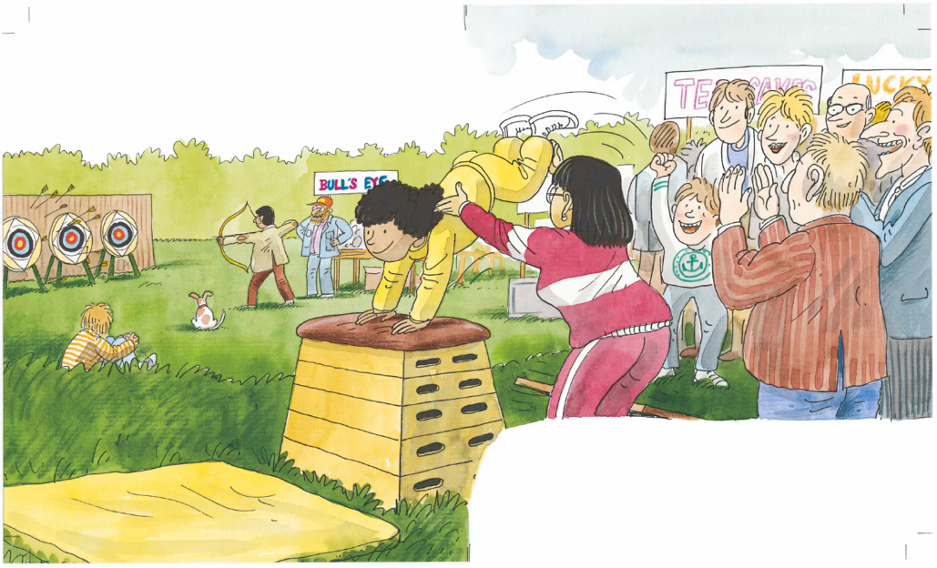
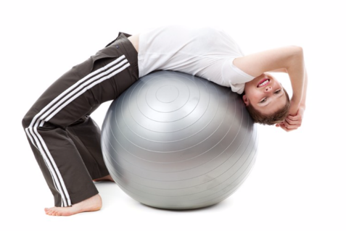
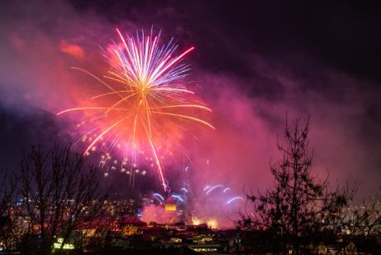
Bull’s-eye!
TG
LO: Understand the meaning of the key vocabulary words gym and display, and make
sentences with them; understand the text; read the text fluently; identify the characters
of a story with prompts and support.
1. Read the text aloud to Ss.
2. Ask Ss to find gym and display in the text and the illustration; have Ss read the word and make
sentences with it.
3. Have Ss observe the illustration and the text; talk about the comprehension questions.
4. Encourage Ss to talk about character question.
5. Have Ss read the text fluently and give feedback.
Note: Click the penguin button to show the vocabulary card.
Reading
Character
Vocabulary
Vocabulary
Who was in the gym display?
Wilma was in the gym display.
Comprehension
Did Dad and Wilf watch Wilma? What were they doing?
Did Wilma notice that Dad and Wilf were not watching her display? What would she do next?
display
gym
Wilf and Dad forgot to watch her.
There is a large firework display.
She has a gym at home.
gym
display
2:00
14/26

Slide 15
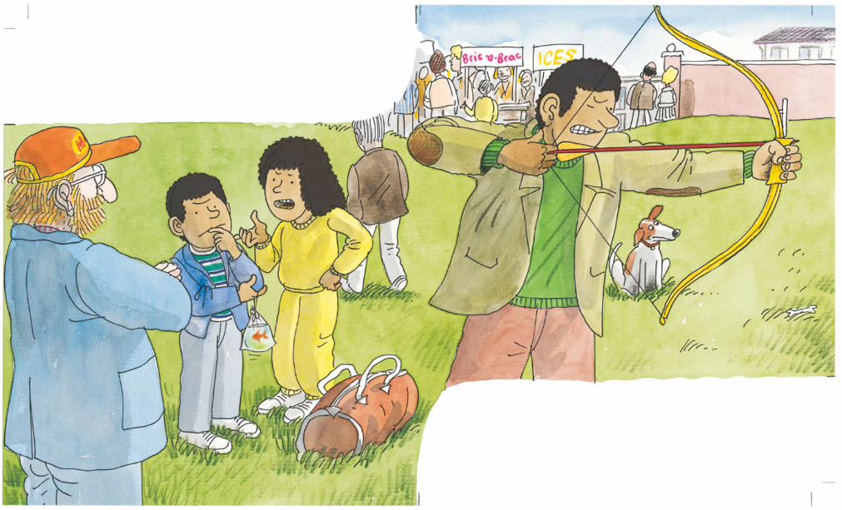
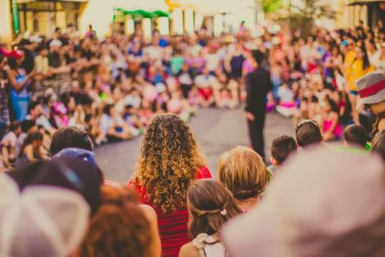
Bull’s-eye!
Reading
TG
LO: Understand the meaning of the key vocabulary word watch, and make sentences
with it; understand the text; read the text with appropriate expression; identify the
characters of a story with prompts and support.
1. Read the text aloud to Ss.
2. Ask Ss to find watch in the text and the illustration; have Ss read the word and make
sentences with it.
3. Have Ss observe the illustration and the text; talk about the comprehension questions.
4. Encourage Ss to talk about the character question.
5. Ask Ss to decode the sentence using expression (Make your voice match the meaning);
notice characters’ emotions match the expression; give feedback.
Note: Click the penguin button to show the vocabulary card.
Vocabulary
Character
Who was cross in the story?
Wilma was cross.
Comprehension
What did Wilma say to Wilf? Did Wilf listen to her carefully? What would happen next?
watch
Decoding
“You forgot to
watch,” she said.
They are excited to watch a great show.
Phrasing-Make your voice match the meaning.
watch
2:00
15/26

Slide 16
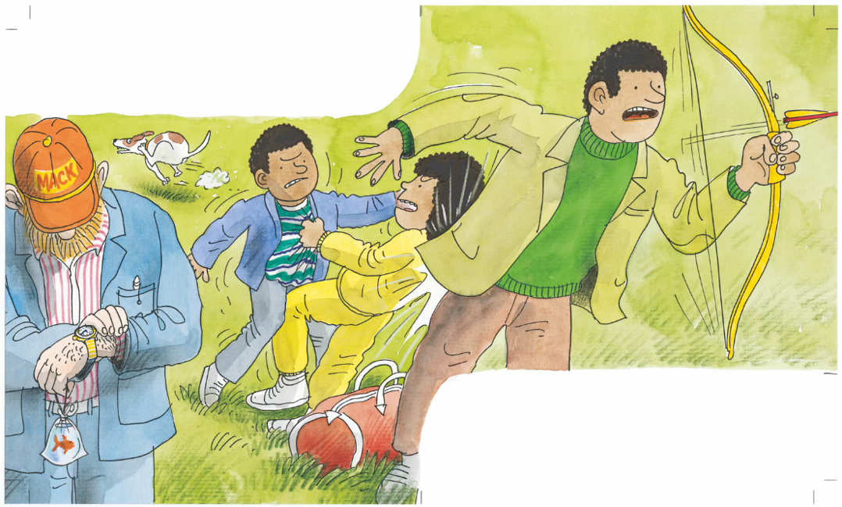
TG
LO: Understand the text; read the text fluently.
1. Ask Ss to read the text aloud in turns.
2. Have Ss observe the illustration and talk about the comprehension questions.
3. Encourage Ss to talk more about the connections question.
Reading
Bull’s-eye!
Comprehension
Wilf and Wilma had a fight.
What happened to Dad when Wilma and Wilf had their fight?
Why was the man looking at his watch? Would Dad get the teddy?
Comprehension
How did Wilf and Wilma feel? What did they do?
They bumped into Dad.
Connections
If you were unhappy with your friend, what would you do?
2:00
16/26

Slide 17
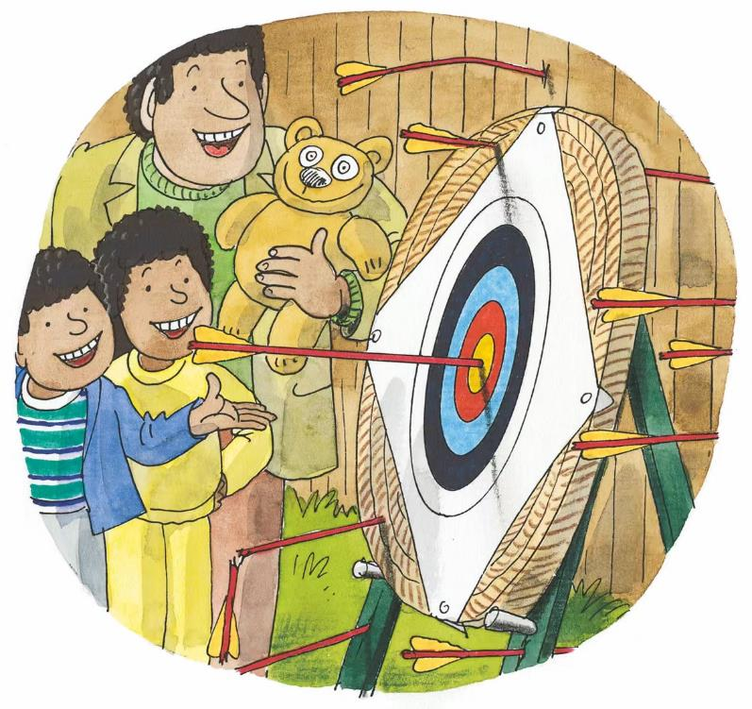
TG
Reading
LO: Understand the text; read the text fluently; decode the sight word accurately.
1. Ask Ss to read the text aloud in turns.
2. Ask Ss to find the sight word teddy in the text and guide them to read it accurately.
3. Have Ss observe the illustration and talk about the comprehension questions.
4. Encourage Ss to talk more about the connections question.
Bull’s-eye!
Comprehension
How did Dad hit the bull’s-eye?
What do you think Dad would do with the teddy bear?
Connections
What do you would you like to do at a school fair?
Sight Word
Bull’s-eye! Dad won a teddy.
teddy
2:30
17/26

Slide 18
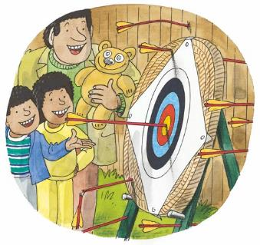
TG
LO: Retell the story with the visual support and assistance.
1. Ask Ss to work in pairs and talk about the given questions; have them work in pairs to
recall the details of the story in the correct sequence; model first.
2. Have Ss take turns retelling the story using the visual aids.
Reading
Let’s retell!
1
2
Where did the family go?
What did Wilf do?
What prize did Dad want?
How could Dad win the prize?
3
4
What did Wilf and Wilma do?
Why did they do that?
What did Dad win?
How did Dad win it?
2:30
18/26

Slide 19
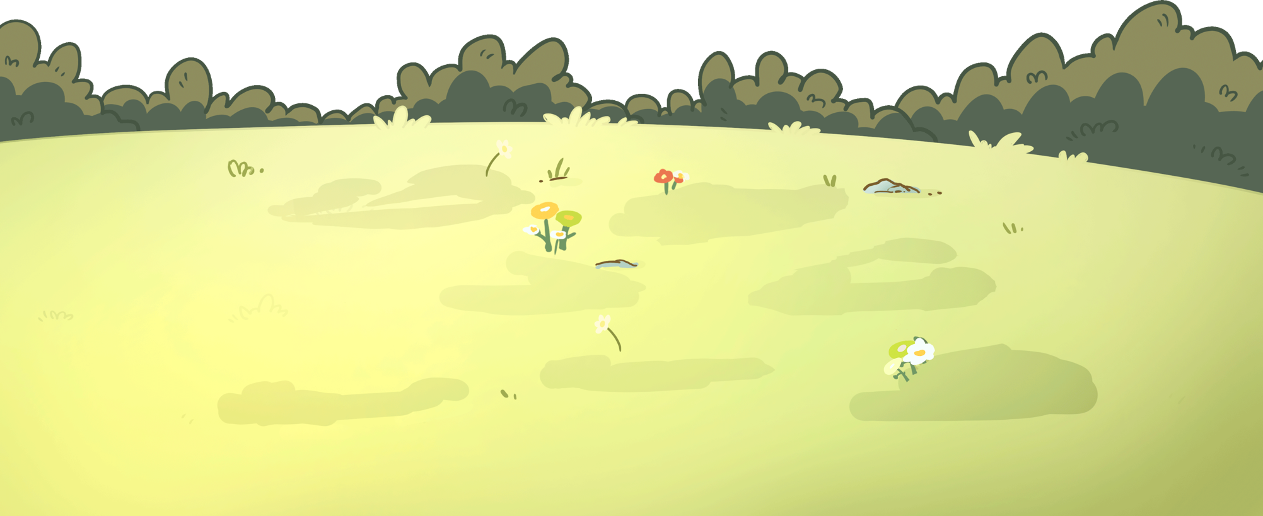
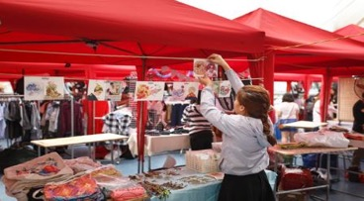
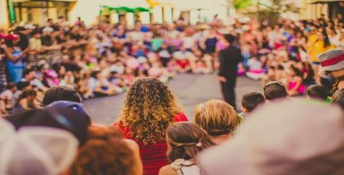
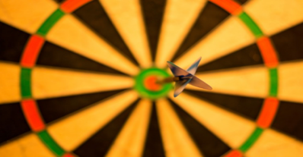
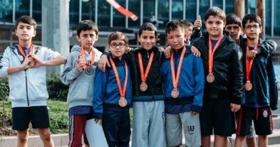
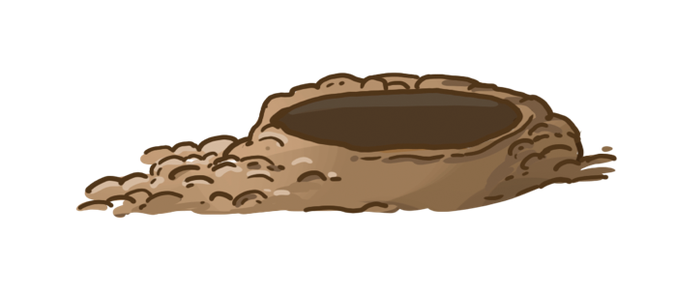
Let’s review the words!
TG
LO: Check their understanding of the words in this lesson.
1. Review the words by playing whack-a-mole game.
2. Ask Ss to say the words by looking at the pictures in turns.
3. Click the pit to show the picture; have Ss answer the word; click the pit again to show the
answer; give feedback.
Vocabulary
display
school fair
gym
bull’s-eye
watch
won
1:00
19/26

Slide 20
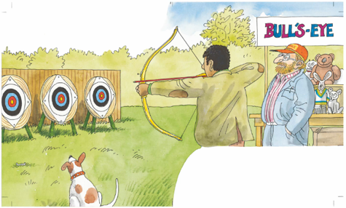
Let’s talk!
TG
LO: Talk about what the characters in the story want to do at the school fair using the
given sentence structure.
1. Have Ss work in pairs to talk about given illustration using the sentence structure and
helping words; model first.
2. Assist Ss if necessary.
Listening & Speaking
Wilma, Wilf, Dad
—What did _____ want to do at the school fair?
—____ wanted to _______.
Helping Words
hit the bull’s-eye
perform in a gym display
kick the ball
2:00
20/26

Slide 21
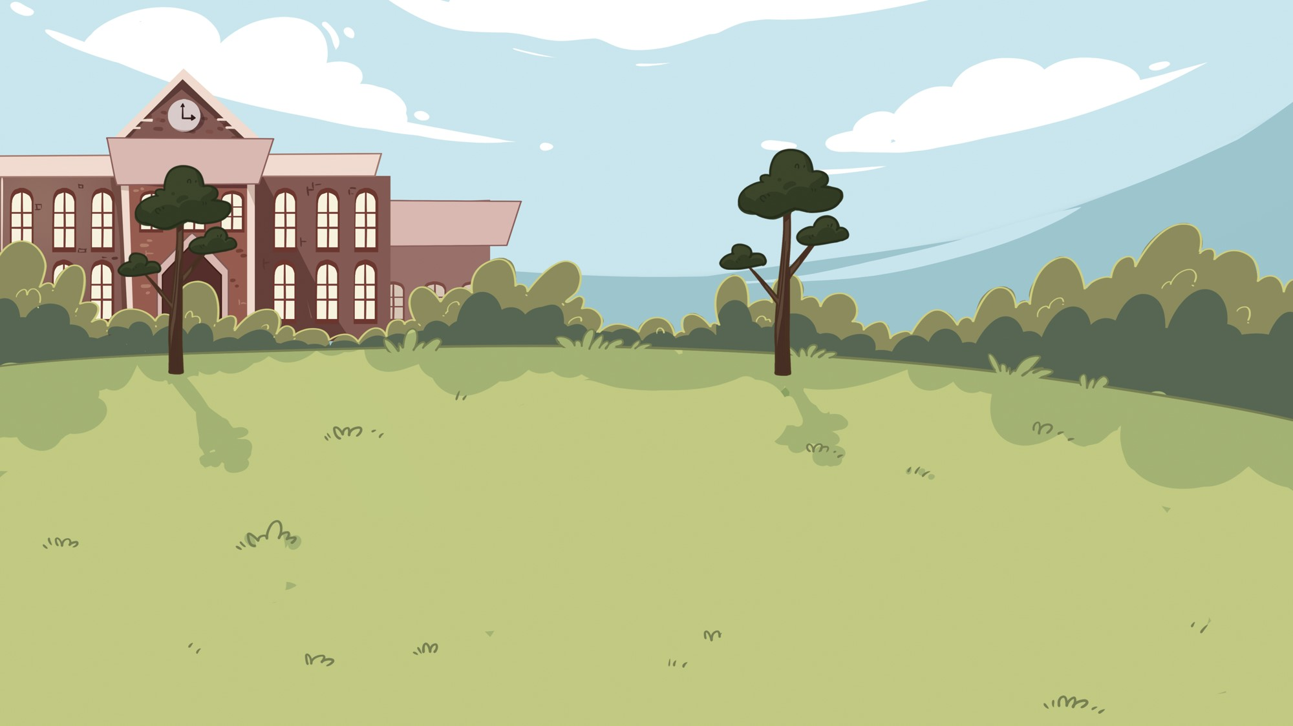
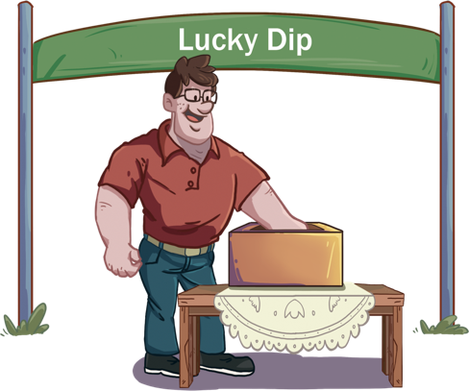
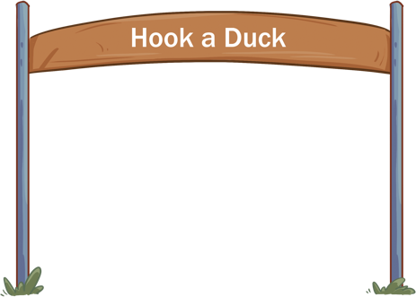
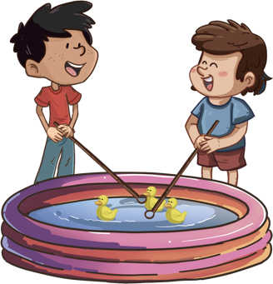
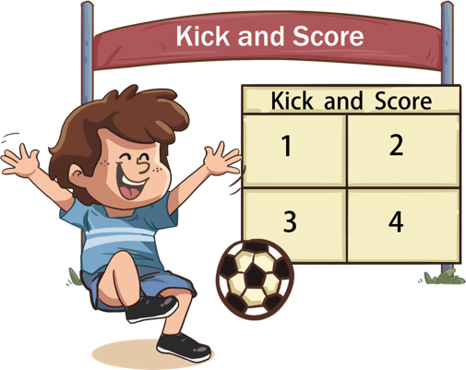
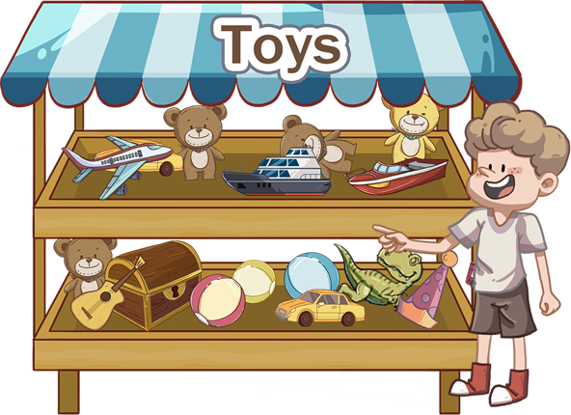
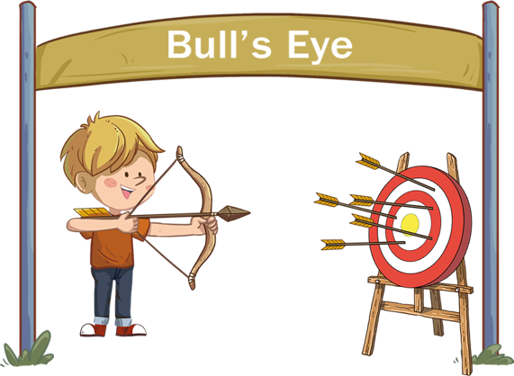
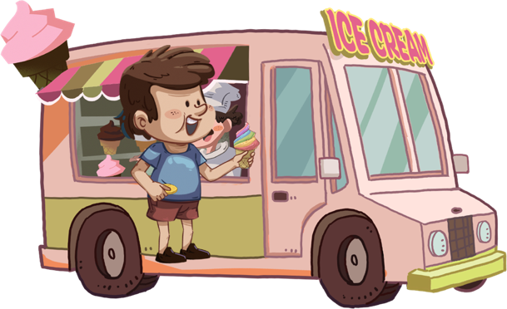
TG
Listening & Speaking
LO: Talk about what you want to do at a school fair using the given sentence structure.
1. Ask Ss to talk about what they want to do at a school fair; encourage them to speak more.
2. Ask Ss to work in pairs to talk about the given picture using the given sentence structure;
each S has at least three chances to talk; model first.
3. Assist Ss if necessary.
Notes: T can click Let’s Talk to present the sentence structure, and T can click again to
make it disappear.
Let’s talk!
—What would you like to do at a school fair?
—I would like to _______.
spin the wheel buy a book
-
3:00
21/26

Slide 22
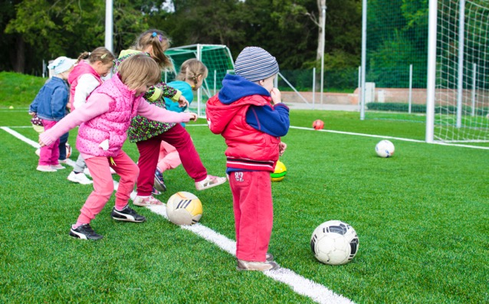
TG
LO: Talk about the topic of what you would like to do at school.
1. Ask Ss to think about the given question; model first.
2. Guide Ss to talk about the question with the help of the given pictures. Encourage Ss to
talk more about the topic.
Value
Value
What do you like to do at school?
play sports
read in the library
2:00
22/26

Slide 23
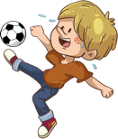
TG
LO: Talk about what they’ve read in the story using the given support.
1. Guide Ss to talk about what they’ve learned about the characters.
2. Ask Ss to think about the given questions; help Ss to organize ideas with the given visual
support; model the first question, and then ask Ss to complete the task in turns.
Oral Writing
Get ready to present!
Talk about what the characters did and how they felt in the story.
Wilf
Wilma
Dad
How was he or she?
What did he or she do?
What did he or she get?
2:00
23/26
Notes:
她们的

Slide 24
TG
LO: Understand what the homework is.
1. Explain the writing task to Ss and check their understanding.
2. Tell Ss that they should finish their writing before next class; make sure they know they can
upload their homework to the platform; they will present their homework next class.
3. Remind Ss to watch the post-class video and finish the writing task.
Writing
Let’s write!
Journal Writing
Let’s write a journal!
Directions:
Write the game you would want to play at a school fair.
Write three sentences to describe the game.
Watch the post-class video about the writing task.
0:30
24/26

Slide 25
TG
LO: Review today’s lesson.
1. Guide Ss to review the phonics by asking Ss to read the words aloud.
2. Guide Ss to review the words by inviting Ss to read and explain some of the words.
3. Guide Ss to review the sentence structure by asking each S to make sentences with it.
Review
Review
Let’s review!
Phonics:
had/sad/dad/
pen/ten/hen
Sentence Structure:
_____ wanted to _____.
Vocabulary:
bull’s-eye/won/
school fair/gym/
display/watch
1:00
25/26

Slide 26
TG
LO: End the lesson and encourage Ss to perform better in the next class.
1. Briefly comment on Ss.
2. Say goodbye to students.
3. Ask Ss to preview the next lesson.
1:00

