Slide 1
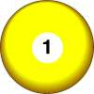
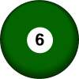
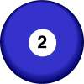
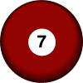
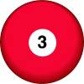
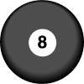
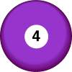
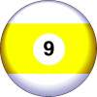
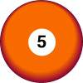
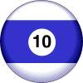
1
one
six
6
2
two
seven
7
3
three
8
eight
4
four
9
nine
5
five
10
ten

Slide 2
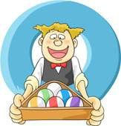
STRIKE THE NUMBER!
1
2
3
4
5
6
7
8
9
10
PLAY
NEXT

Slide 3
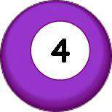
1
2
3
4
5
6
7
8
9
10
NEXT
GOOD JOB!

Slide 4
1
2
3
5
6
7
8
9
10
6
NEXT
GOOD JOB!

Slide 5
1
2
3
5
7
8
9
10
8
NEXT
GOOD JOB!

Slide 6
1
2
3
5
7
9
10
7
NEXT
GOOD JOB!

Slide 7
What's your
phone number?
B
A
TELEPHONE
0 = Zero
295321886
295321206
PLAY!
D
C
295321006
295321106
295321006

Slide 8
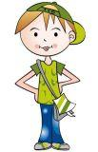
What's your phone number?
It’s two-nine-five-three-two-one-zero- zero-six.
TELEPHONE
B
A
NEXT!
OOPS!
295321886
295321206
C
D
295321006
295321106
295321006

Slide 9
What's your phone number?
It’s two-nine-six-four-seven-eight-two-one-two.
TELEPHONE
B
A
NEXT!
OOPS!
296478212
296578212
C
D
296478212
296478121
296468712

Slide 10
What's your phone number?
It’s nine-one-four-two-two-five-nine-one-one.
TELEPHONE
B
A
NEXT!
OOPS!
914225991
914425911
C
D
914225911
914225911
914422591

Slide 11
What's your phone number?
It’s nine-six-two-eight-three-one-seven-zero-seven.
TELEPHONE
B
A
NEXT!
OOPS!
962831787
962831707
C
D
962831707
962831007
963831707

Slide 12
What's your phone number?
It’s two-one-two-five-five-six-nine-zero-one.
TELEPHONE
B
A
NEXT!
OOPS!
212556981
212256901
C
D
212556901
212256901
212556901

Slide 13
What's your phone number?
It’s two-nine-seven-seven-four-double nine-one-six.
TELEPHONE
B
A
NEXT!
OOPS!
292742916
297749916
C
D
297749916
297744916
299749916

Slide 14
What's your phone number?
It’s zero-zero-one-three-six-two-five-five-seven.
TELEPHONE
B
A
NEXT!
OOPS!
001362257
201362557
C
D
914225911
001362557
221362557

Slide 15
Let’s sing a song. ‘how many apples’ singsing https://www.youtube.com/watch?v=i7bjpemlfxc

Slide 16
Let’s sing a song. ‘how many monkeys’ funenglishkids https://www.youtube.com/watch?v=bUvbOtOGeUs

Slide 17
Lets read a story

Slide 20
one

Slide 21
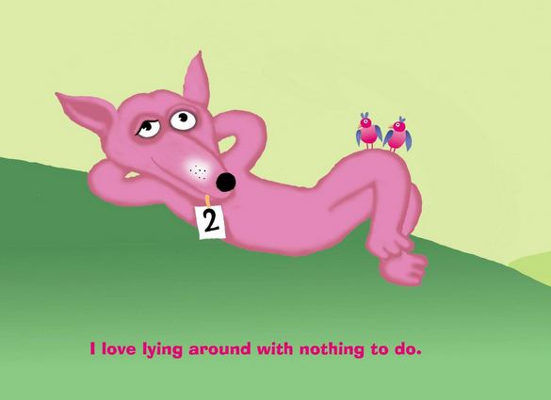

Slide 22
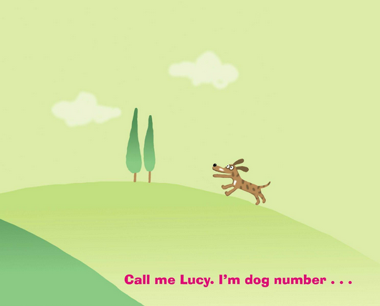
two

Slide 23
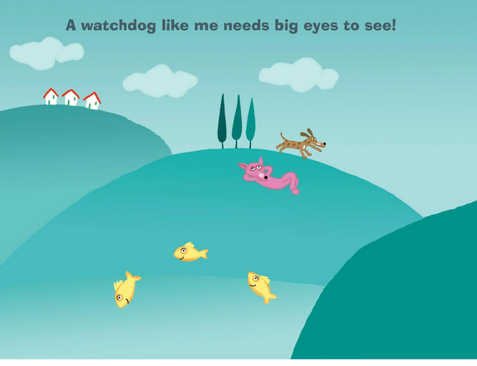

Slide 24
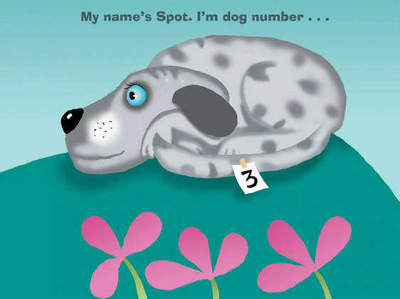
three

Slide 25
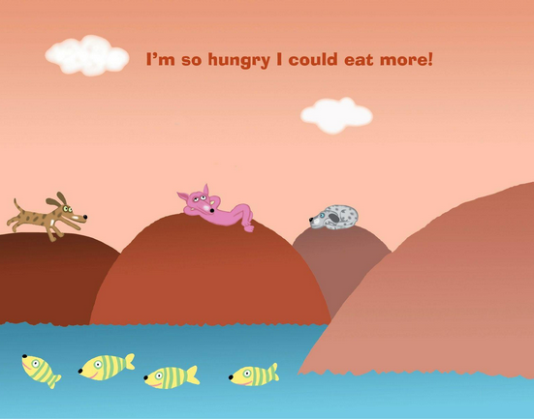

Slide 26
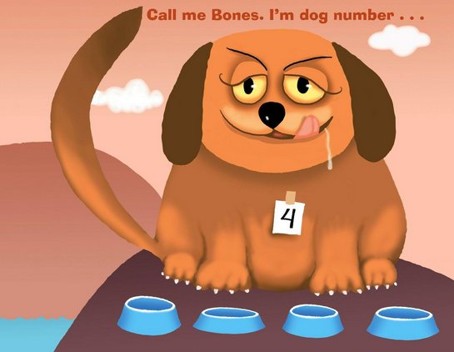
four

Slide 27
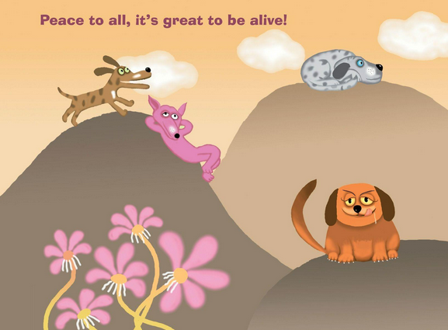

Slide 28
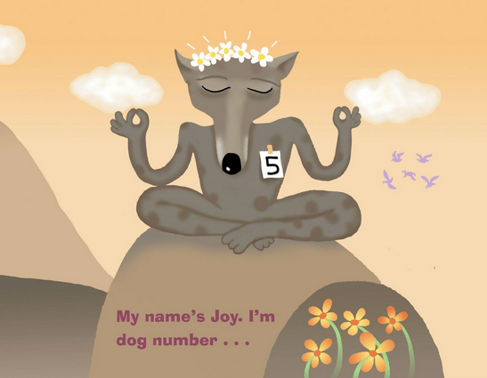
five

Slide 29
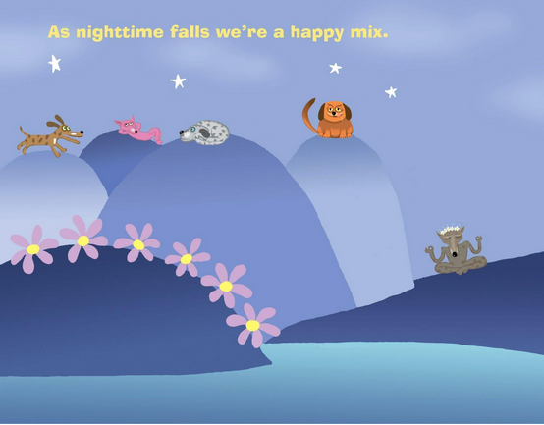

Slide 30
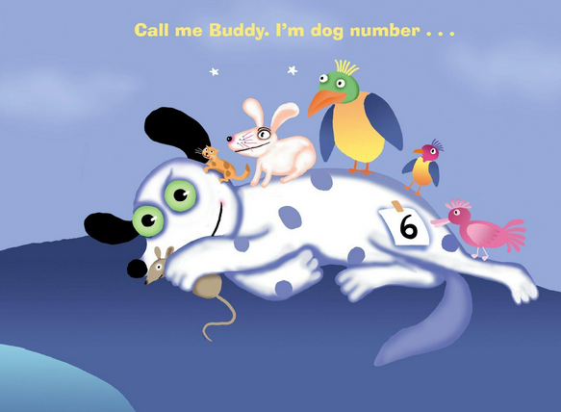
six

Slide 32
seven

Slide 34
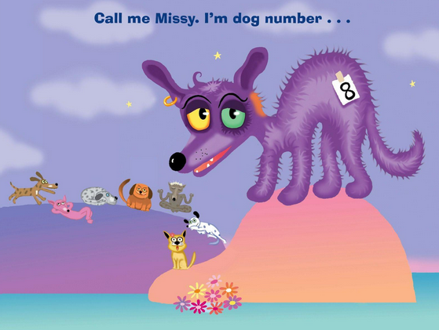
eight

Slide 35
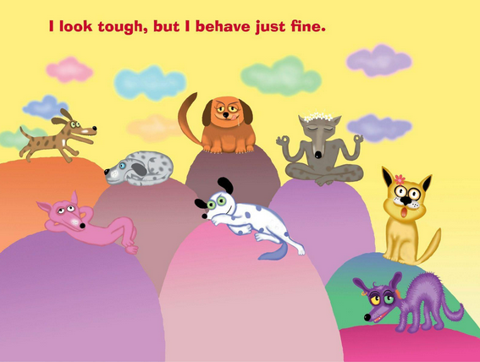

Slide 36
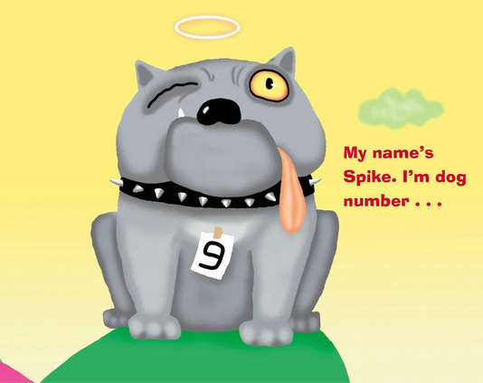
nine

Slide 38
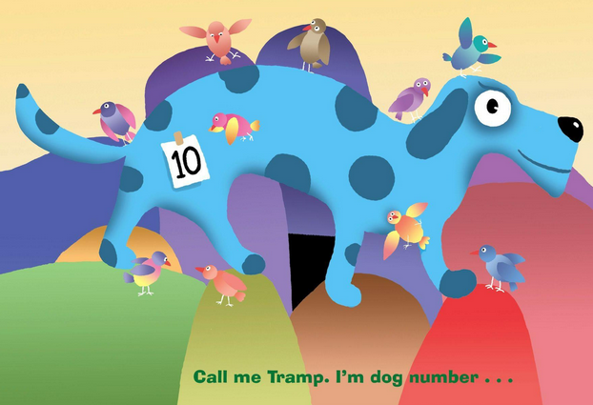
ten

Slide 40
two

Slide 42
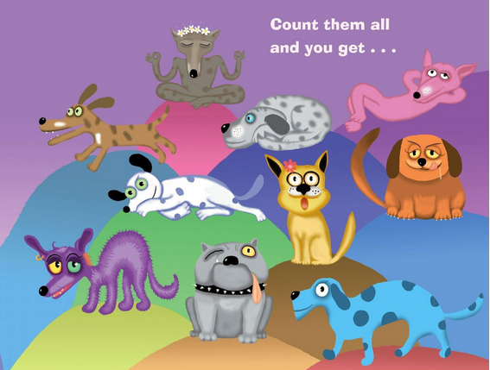
Twenty 20

Slide 43
Lets play a ‘How many...?’ Superhero game!

