Slide 1
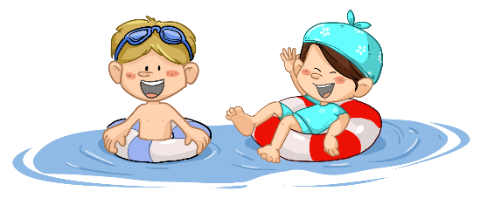
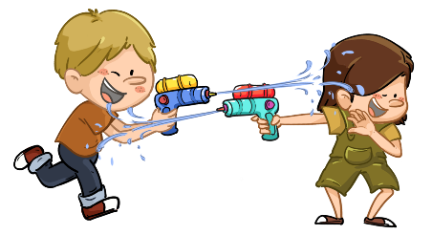
TG
LO: Greet their partners; get a basic idea about the topic of
today’s lesson;
Say hello to Ss; ask Ss to greet each other.
Guide Ss to describe the pictures on the first page.
Introduce the topic of the lesson.
00:30
1/27

Slide 2
Learning
Goals
TG
LO: Get to know and understand what will be learned in this lesson.
Go through the learning goals with Ss.
We are going to . . .
Blend syllables in spoken words.
Learn the different words and phrases swimming, paddling pool, grabbed, hose, and filled, and make sentences with them.
Read the story The Water Fight, and make predictions with the pictures.
Practice using the sentence structure
____ had/got ____.
0:30
2/27

Slide 3
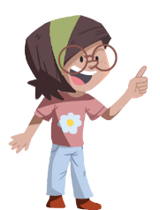
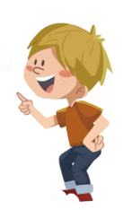
TG
Presentation
LO: Present and share writing assignments from last lesson;
Invite Ss to take turns presenting their homework. If time is limited, tell Ss they have one or two mins to present their writing.
Encourage Ss to listen carefully and to ask questions.
After both of the Ss have finished, give them feedback and awards (Click the picture of the book beside the boy or girl so that they can get some awards).
Click and give each S a trophy to mark their good performance.
Note: You can click the picture of the boy or the girl to give Ss the trophy.
Let’s show!
This is what I want to send to Kipper.
1:30
3/27

Slide 4
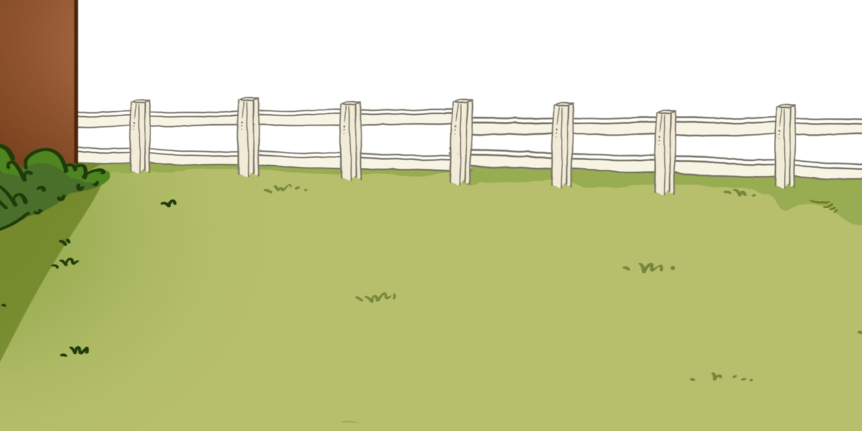
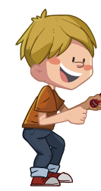
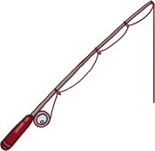
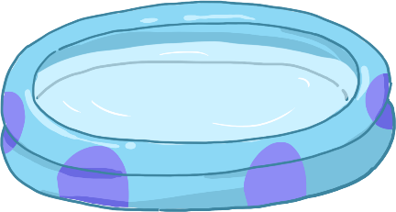
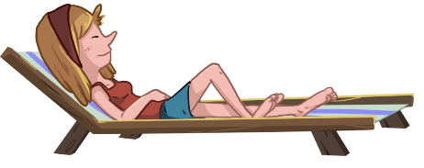
TG
Phonics
LO: Blend and pronounce the syllables in spoken words; blend and pronounce the syllables.
Ask Ss to talk about what they can see in the picture; click and play the game with the children in the picture while briefly describing it.
Click and read the syllables to Ss when the syllables of the word appear; model the blending first; then ask Ss to take turns blending the syllables.
Click and guide Ss to read each word in this way: broth-er, brother; give feedback.
Let’s listen and speak!
sister
brother
water
Let’s go finishing!
Of course!
OK!
Can you read these words?
Mom! We are happy!
broth
er
ter
wa
ter
sis
2:30
4/27

Slide 5
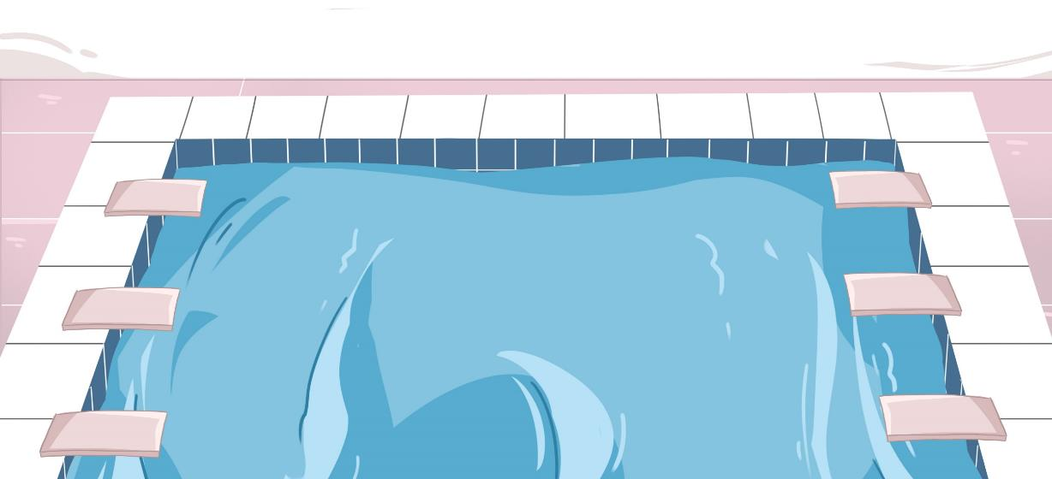
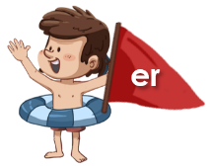
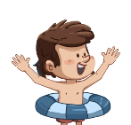
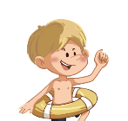
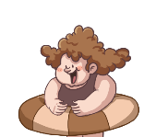
TG
Phonics
LO: Blend and pronounce the syllables in spoken words;
Ask Ss to talk about what they can see in the picture; click and begin discussing the picture while briefly describing it.
Click and read the syllables to Ss when the syllables of the word appear; model the blending first; then ask Ss to take turns blending the syllables.
Click and guide Ss to read each word in this way: riv-er, river; give feedback.
Let’s listen and speak!
river
summer
matter
It’s so hot! Let’s swim together!
So cool! We are happy!
OK!
OK!
2:30
5/27

Slide 6
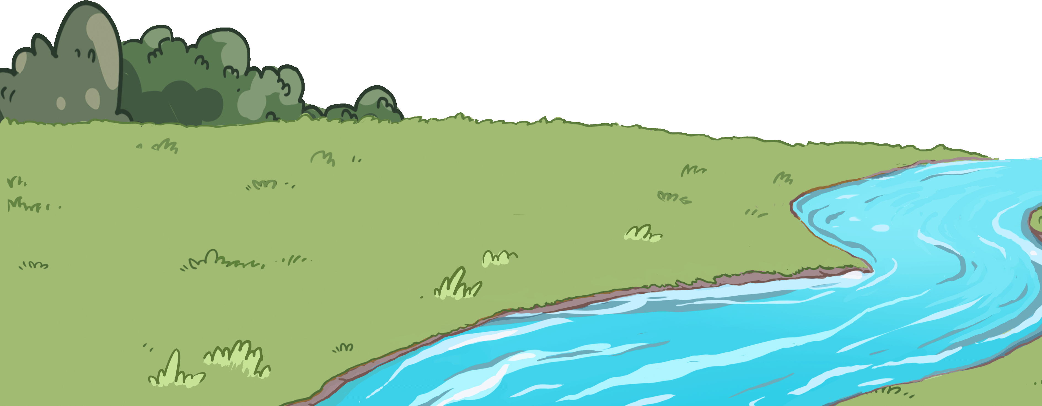
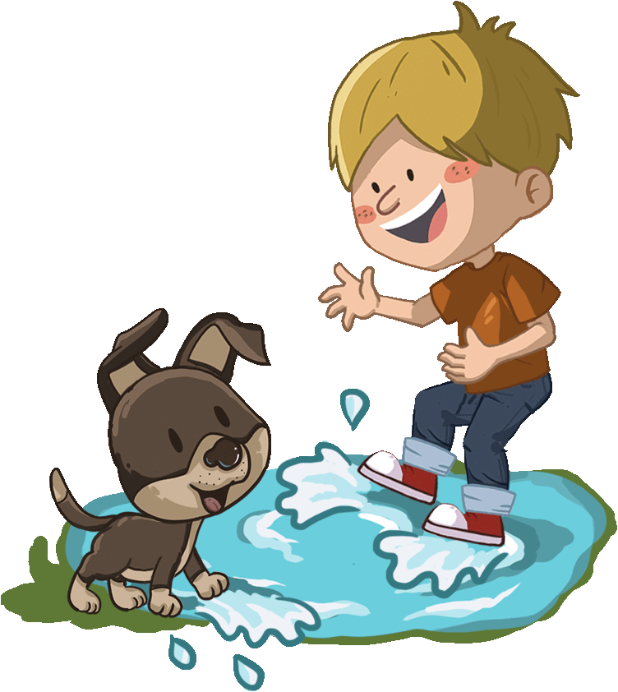
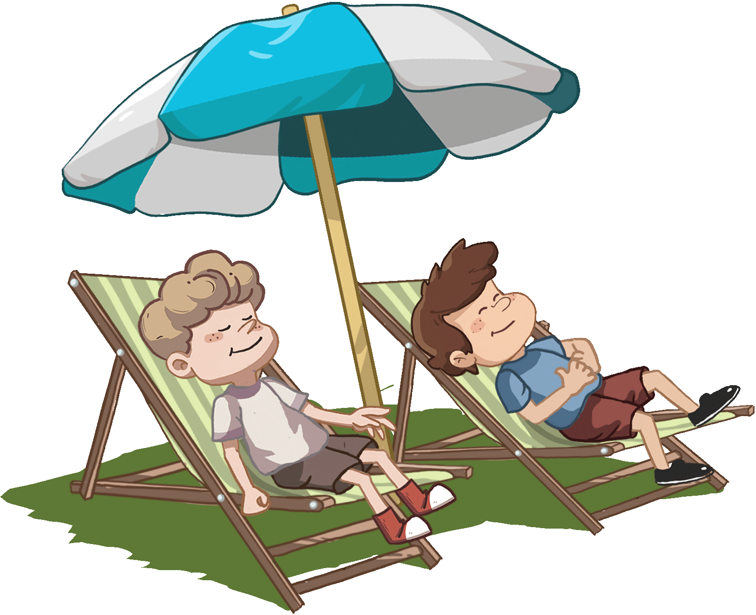
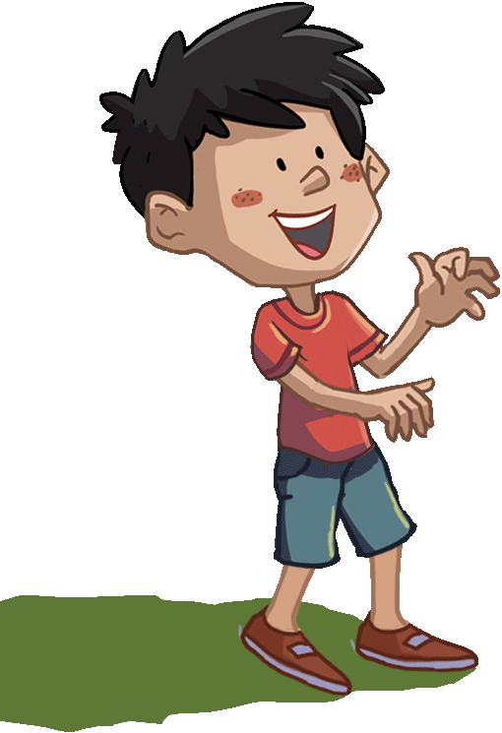
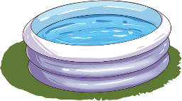
TG
Phonics
LO: Read the text fluently; blend and pronounce syllables by clapping hands.
Click and read the text to Ss with rhythm.
Guide Ss to repeat after you; ask Ss to take turns reading each sentence until they have read all of the sentences; give feedback.
Ask Ss to take turns blending the words in the first two sentences by clapping hands; model first.
Let’s chant!
I have a naughty sister.
I have a naughty brother.
We live by the river.
We all like summer.
In summer, we like to play with water.
Look! We are getting wet.
Oh! It doesn't matter.
2:00
6/27

Slide 7
TG
TG
Lead-in
TG
LO: Activate Ss’ interest in reading; use the illustration and the title to identify details and make predictions.
Have Ss look at the book cover closely and have Ss talk about the first question using the illustration and the title.
Encourage Ss to talk about the second question.
Before Reading
What is Chip doing? How does he feel? Look at the illustration.
What might the weather be like in this story? How do you know?
Written by Roderick Hunt
Illustrated by Alex Brychta
2:00
7/27

Slide 8
Let’s predict!
TG
Reading
LO: Identify details and make predictions about the story using the illustration; motivate Ss’ interest in reading.
Ask Ss to recall what it means to predict.
Have Ss observe the illustration carefully and have Ss talk about the given questions.
Before Reading
What are the children doing to Mum? How do the children feel?
What is Dad doing? What will Dad do next?
1:30
8/27

Slide 9
The Water Fight
TG
Reading
LO: Understand the text; make predictions using the illustration; read the text fluently.
1. Read the text aloud to Ss.
2. Have Ss talk about the first question using the text and illustration;
3. Ask Ss to observe the illustration carefully and have Ss talk more about
the second question.
4. Guide Ss to talk about the predictions question using the illustration.
5. Ask Ss to take turns reading the text fluently; give feedback.
Comprehension
What was the weather like that day?
How did everyone feel? What clothes did everyone wear? Look at the illustration.
Predictions
What would the children want to do next in this kind of weather?
Everyone was hot.
2:30
9/27

Slide 10
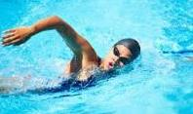
The Water Fight
TG
Reading
LO: Understand the meaning of the vocabulary word swimming and make sentences with it; understand the text; make predictions using the illustration; make connections; read the text fluently.
Read the text to Ss.
Ask one S to find the vocabulary word swimming in the text; click the penguin card and explain its meaning; have Ss read the word and make sentences with it.
Ask Ss to talk about the comprehension questions.
Guide Ss to talk about the predictions questions using the illustration.
Encourage Ss to talk about the connections question.
Ask Ss to take turns reading the text aloud and give feedback.
Comprehension
The children wanted to
go swimming.
What did the children want to do? Why did they want to do that?
Vocabulary
Predictions
Would the children do what they wanted to do successfully? Why?
swimming
He is good at swimming.
Connections
What do you like to do on hot days?
swimming
2:30
10/27

Slide 11
The Water Fight
TG
Reading
LO: Understand the text; make predictions using the illustration; read the text fluently.
Ask Ss to take turns reading the text, pretending that they are Dad.
Have Ss talk about the comprehension questions one by one by using the text and the illustration.
Guide Ss to make predictions by using the illustration;
Ask Ss to take turns reading the text; give feedback.
Comprehension
Did Dad want to go swimming?
2. Why did Dad say No?
Look at the illustration.
Predictions
How would the children feel if Dad said No?
What do you think the children would do if they couldn’t go swimming?
Dad said,“No!”
2:30
11/27

Slide 12
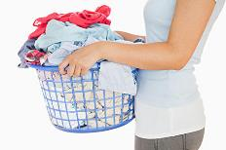
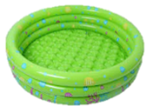
The Water Fight
TG
Reading
LO: Understand the meaning of the vocabulary word filled and phrase paddling pool make sentences with them; understand the text; make predictions using the illustration; make connections; read the text fluently.
Read the text aloud and clearly to Ss;
Ask Ss to take turns looking for the vocabulary word filled and phrase padding pool; click on the penguin cards and explain them; have Ss read the words and have Ss make sentences with them;
Ask Ss to talk about the first two questions;
Guide Ss to talk about the predictions questions by using the illustration.
Encourage Ss to talk about the connections questions;
Have Ss read the text fluently; give feedback.
Comprehension
Biff got the paddling pool.
Vocabulary
What did Biff get?
What did Kipper do?
Vocabulary
Predictions
What would Chip do next?
Why did Kipper filled the paddling pool with water? What would the children do next?
padding pool
filled
She filled the bucket with clothes just now.
This green padding pool is very beautiful.
Connections
Kipper filled it with water.
Do you have a paddling pool? How do you play in it if you
have one?
paddling pool
filled
2:30
12/27
Notes:
1. Why did Kipper filled the
padding pool with water?

Slide 13
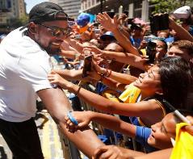
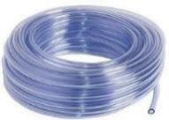
The Water Fight
TG
Reading
LO: Understand the meaning of the vocabulary words grabbed and hose and make sentences with them; understand the text; make predictions by using the illustration; read the text fluently.
Read the text aloud to Ss;
Ask Ss to take turns looking for the vocabulary words grabbed and hose; click the penguin cards and explain them; have Ss read the words and have Ss make sentences with them;
Have Ss talk about the first question using the text; then guide Ss to talk about the second question by using the illustration.
Guide Ss to talk about predictions question by using the illustration.
Have Ss read the text fluently and give feedback.
Vocabulary
Comprehension
Chip pushed Biff in the water.
What did Chip do to Biff?
Why did Chip have a hose in his hand? What happened to Kipper?
Vocabulary
grabbed
hose
Predictions
The children grabbed the man’s arm very happily just now.
What do you think Biff would do next?
This hose is thin and long.
He grabbed the hose.
grabbed
hose
2:30
13/27

Slide 14
The Water Fight
TG
Reading
LO: Understand the text; make connections; read the text fluently.
1. Ask one S to read the text; give feedback;
2. Have Ss talk about the comprehension questions by using the illustration;
3. Encourage Ss to talk about the connections questions;
4. Have the other S read the text; give feedback.
Comprehension
They had a water fight.
What did the children do? Look at the illustration.
What was Floppy doing?
What did the children look like in the man’s eyes?
Connections
What does a water fight look like in your eyes? What would you do if you had a fight with your friends?
2:30
14/27

Slide 15
The Water Fight
TG
Reading
LO: Understand the text; make predictions by using the illustration; read the text fluently.
Read the first sentence to Ss; guide Ss to talk about the first comprehension question; then click and ask Ss to talk about the second comprehension question by looking at the illustration;
Click and ask Ss to talk about the first predictions question.
Read the second sentence to Ss; click and ask Ss to talk about the third comprehension question; then click and guide Ss to talk about the second predictions question by using the text and illustration.
Have Ss read the text fluently; give feedback.
Comprehension
Mum got wet.
What happened to Mum?
2. What might Mum be
doing before she got wet?
3. What did Dad say?
Predictions
1. How do you think Mum
would feel? Would she get
angry?
“Stop it!” said Dad.
2. Would Dad join in the
water fight?
2:30
15/27

Slide 16
The Water Fight
Reading
TG
LO: Understand the text; make predictions by using the illustration; decode the sight word; read the text fluently.
Read the text aloud to Ss;
Ask Ss to talk about the first comprehension question by using the text and the illustration.
Guide Ss to talk about the second question by looking at the illustration.
Guide Ss to talk about predictions question by using the illustration.
Have Ss find the sight word and have Ss read it accurately;
Ask Ss to read the text fluently; give feedback.
Comprehension
Dad got a bucket of water.
What did Dad get? What did he do to Chip?
What did Chip do to Dad?
Predictions
What would happen between Dad and Chip next?
He chased Chip.
Sight Words
got
2:30
16/27

Slide 17
The Water Fight
Reading
TG
LO: Understand the text; make predictions by using the illustration;
Read the text to Ss; ask Ss to talk about the first comprehension question;
Guide Ss to talk about the second comprehension question by looking at the illustration;
Guide Ss to talk about the predictions questions; encourage Ss to talk briefly about their choices.
Have Ss read the text fluently; give feedback.
Comprehension
Dad threw the water at Chip.
What did Dad do to Chip?
How did the family feel when they were playing the water fight?
Predictions
Who would get wet next? How do you know?
Chip.
The man.
C. Dad.
Oh no!
2:30
17/27

Slide 18
The Water Fight
Reading
TG
LO: Understand the text; initiate a discussion and express thoughts by using the text; read the text fluently.
Read the text to Ss; encourage them to talk about the first
comprehension questions by using the given sentence structure.
2. Guide Ss to talk about the second question by looking at the illustration.
3. Encourage Ss to talk about the discussion questions; assist Ss if necessary.
4. Have Ss read the text fluently; give feedback.
Comprehension
Who got wet at the end? ___ got ___.
How do you think Dad felt at the end of the story?
Discussion
Would the family continue the water fight next?
Which part in the story is your favorite? Why?
“Sorry!” said Dad.
2:30
18/27

Slide 19
Let’s retell!
Reading
TG
LO: Retell the story with the visual support and assistance;
Guide Ss to recall the story; model first.
Have Ss work together to retell the story in turns by using the visual aids.
___ was ___.
___ got/filled___.
___ grabbed/threw/had ___.
2:00
19/27

Slide 20
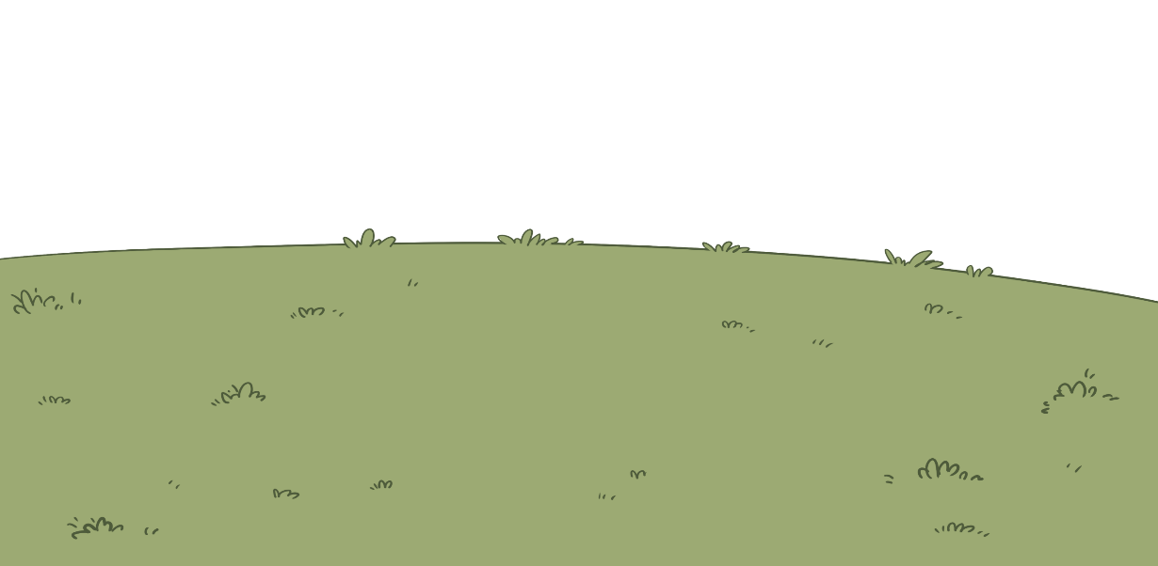
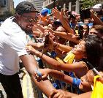
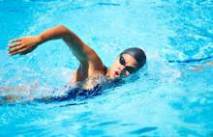
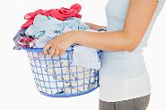
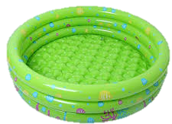
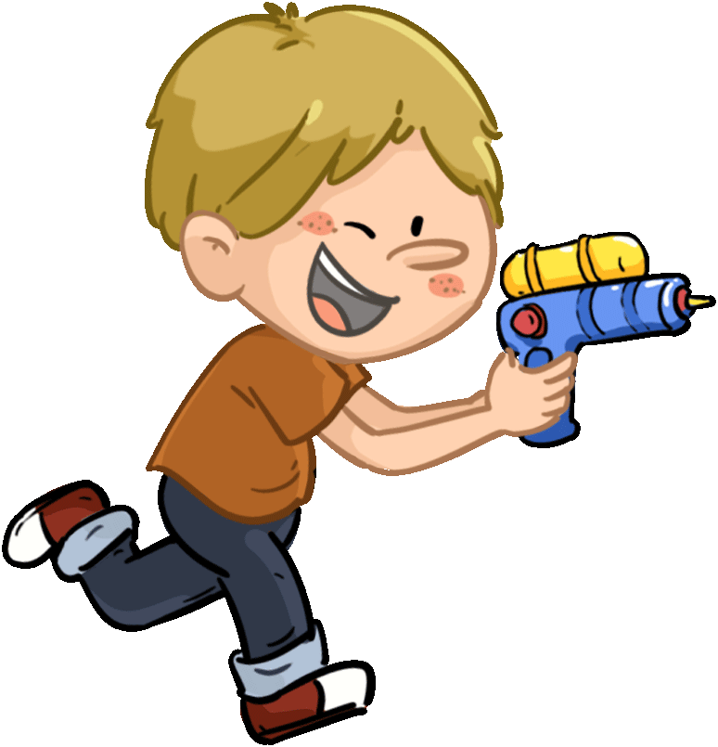
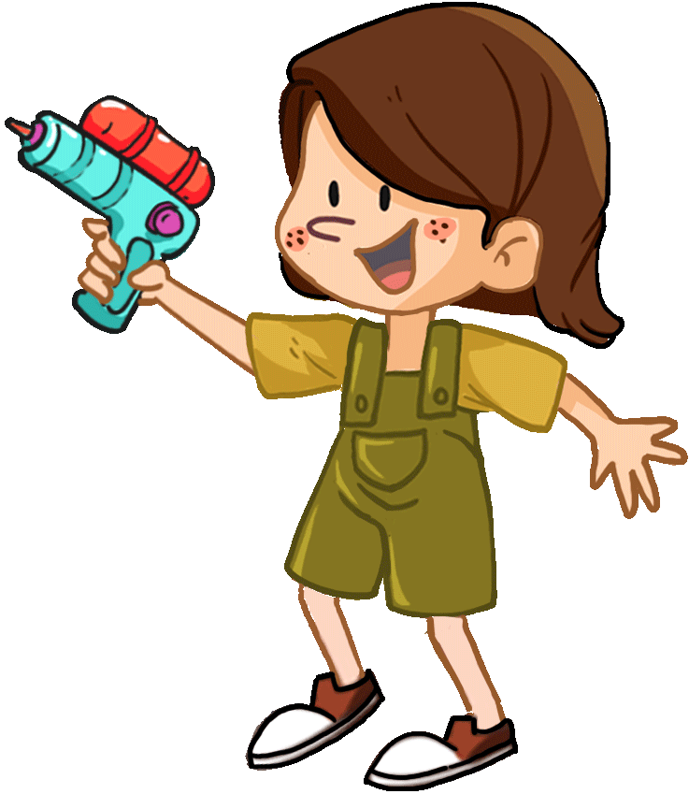
TG
Vocabulary
LO: Check Ss’ understanding of the words in this lesson.
Invite Ss to play the shooting game. The steps are as follows:
Click to shoot the paper cup and one picture will appear automatically.
Ask Ss to match the word with the picture by reading it aloud; click again and the word will appear; give feedback.
Note: There are five words on this slide and each word has the same
operational process.
Let’s play!
swimming
paddling pool
grabbed
hose
filled
Yeah! I am winner!
2:00
20/27

Slide 21
Listening &
Speaking
TG
LO: Talk about what the family did in the water fight.
Have Ss work in pairs to talk about the given illustration by using the sentence structures and helping words; model first.
Assist Ss if necessary.
Let’s talk!
—What did ___ do?
—___ had/got/grabbed/read ___.
Helping Words
Biff
Chip
Dad
Mum
paddling pool
hose
a bucket of water
book
a sandwich
2:00
21/27

Slide 22
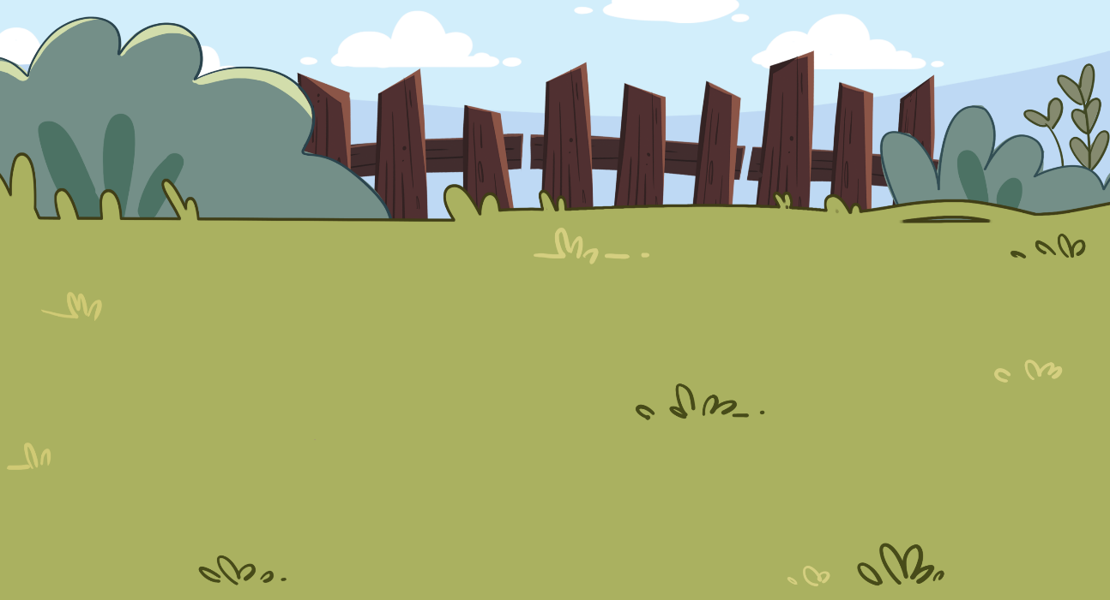
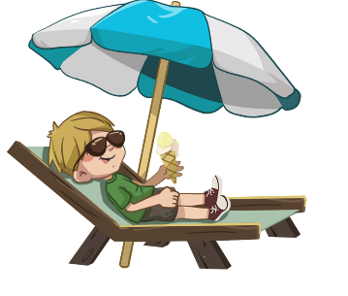
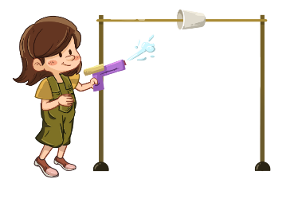
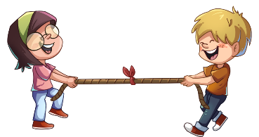
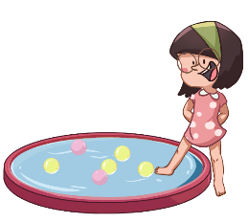
LO: Talk about what you like to do in summer by using the given sentence structures and pictures.
Tell Ss to observe the picture carefully and to talk about the activities that the children like to do in summer.
Have Ss take turns discussing at least three activities that they want to do in summer; model first;
Have Ss work in pairs to ask and answer questions about the given picture by using the given language structures; assist Ss if necessary.
Notes: T can click Let’s talk! to present the sentence structures, and then click again
to make them disappear.
TG
Please name at least three activities.
Listening &
Speaking
Let’s talk!
—What do you like to do in
summer?
—I like to ______ in summer.
have a water fight;
play the Cup Races;
play in the paddling pool;
. . .
2:30
22/26

Slide 23
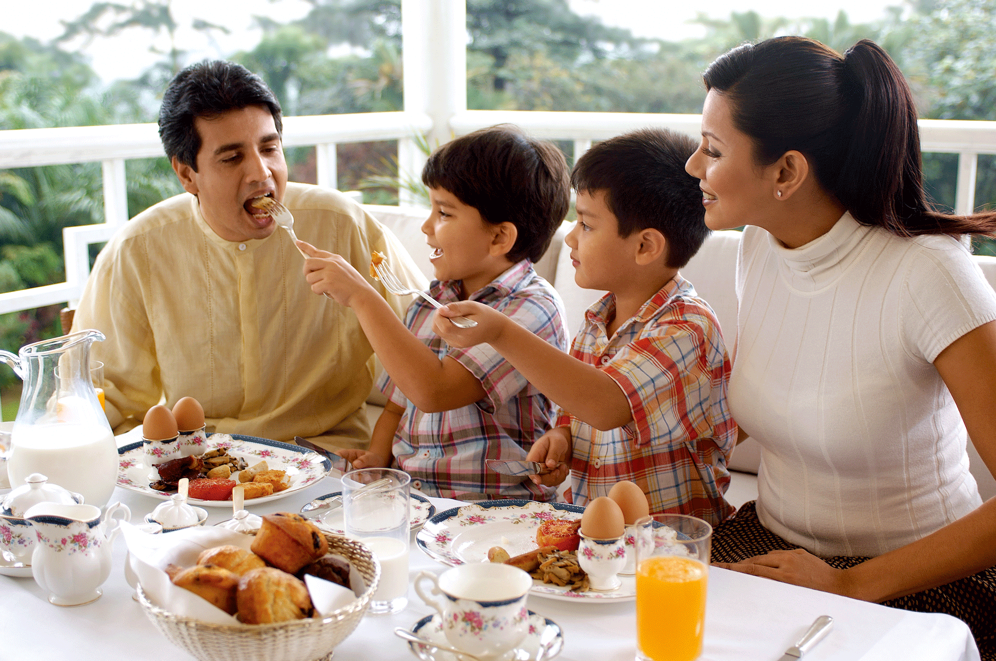
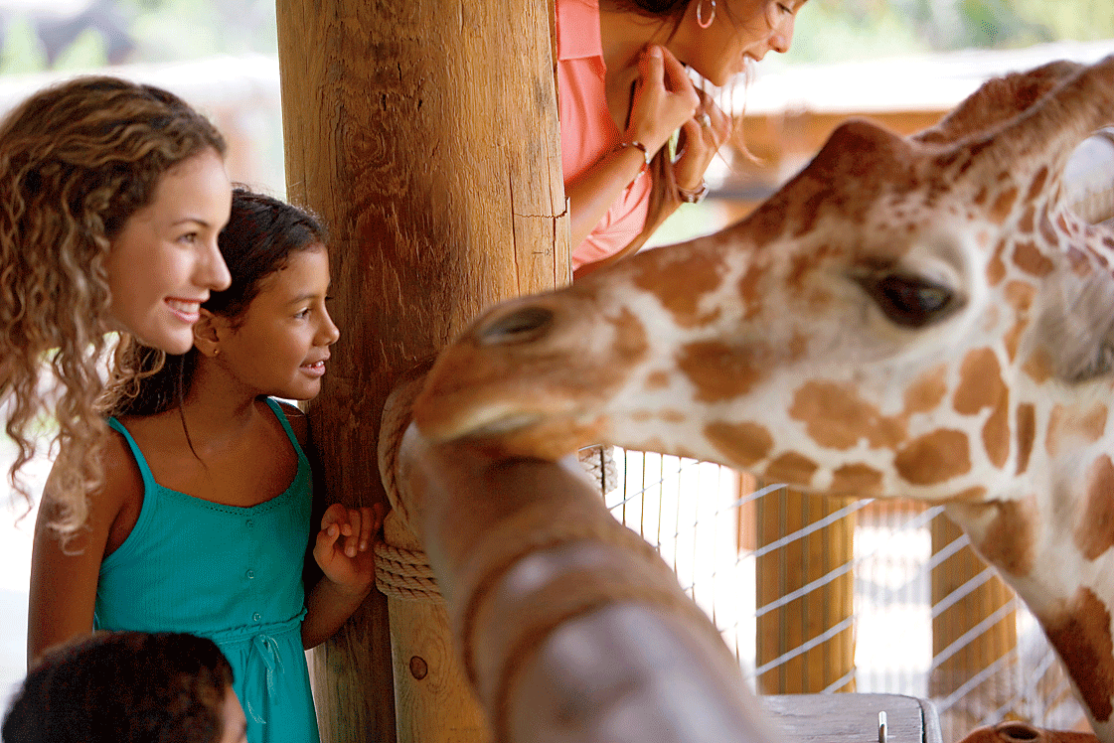
TG
TG
Value
LO: Talk about the values presented in the lesson: making others happy by doing activities on hot days.
1. Ask Ss the given question; model first.
2. Guide Ss to talk about the question by using the given pictures.
3. Encourage Ss to talk more about the activities they can do on hot days.
What can you do for fun with your friends or families on hot days?
share a meal
go to the zoo
2:00
23/27

Slide 24
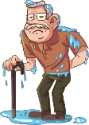
Oral Writing
TG
LO: Talk about what they’ve learned from the story by using the language support.
Guide Ss to talk about what they’ve learned from the book The Water Fight by using the given question.
Help Ss to organize ideas from the story with the given visual support and tell them, “This is practice before your homework.”
Model the questions; ask Ss to work together to present their answers.
Get ready to present!
Kipper
Chip
Biff
Water Fight
Dad
Mum
the man
What did the family do in the water fight?
2:00
24/27

Slide 25
TG
LO: Understand what the homework is.
1. Explain the writing task to Ss and check their understanding.
2. Tell Ss that they should finish their writing before next class. Make sure that they
know to upload their homework to the platform. They will present their work next
class.
3. Remind Ss to watch the post-class video and to finish the writing task.
Writing
Let’s draw and write!
Now, please follow the steps to finish your homework, and present it in the next class:
Draw a picture of an activity you like to do in summer.
Write one complete sentence to describe it.
Watch the post-class video about the writing task.
1:30
25/27

Slide 26
TG
Review
LO: Review today’s lesson.
Guide Ss to review the phonics by asking Ss to read the words.
Guide Ss to review the words by asking Ss to make sentences with them.
Guide Ss to review the sentence structures by asking each S to make a sentence with them.
Let’s review!
Review
Phonics:
sister/brother/
water/river/summer/
matter
Sentence Structure:
___ had/got ___.
Vocabulary:
swimming/paddling pool/grabbed/hose/
filled
1:00
26/27

Slide 27
TG
TG
LO: End the lesson and encourage Ss to prepare well for the next class.
1. Briefly comment on Ss.
2. Say goodbye to students.
3. Ask Ss to preview the next lesson.
0:30
27/27

