Slide 1


Don’t....

Slide 2
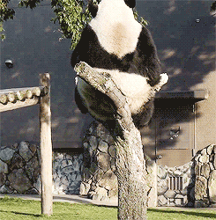
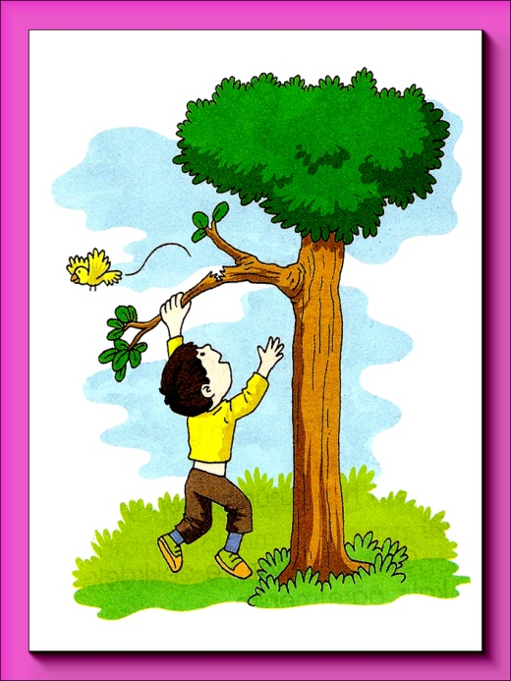
Don’t climb the tree
I’m sorry

Slide 3
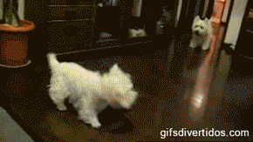
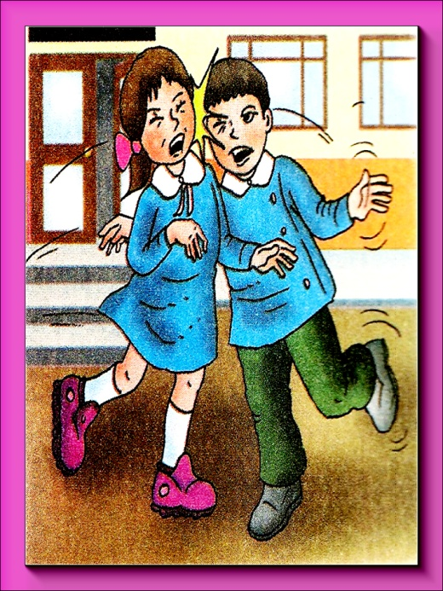
Don’t run
I’m sorry

Slide 4
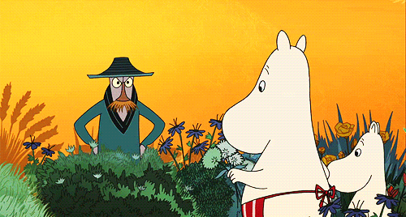
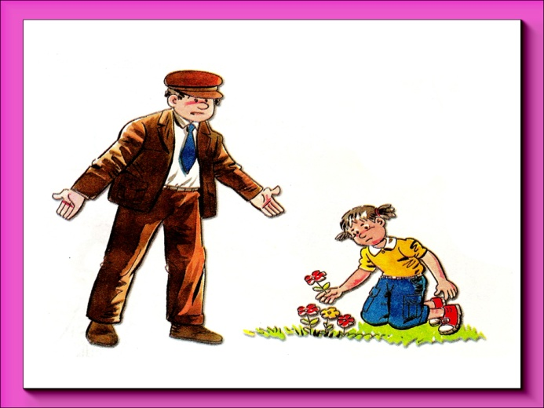
Don’t pick the flowers
I’m sorry

Slide 5
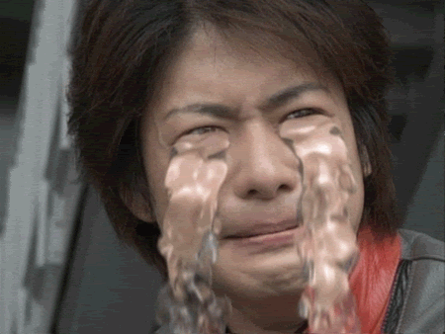
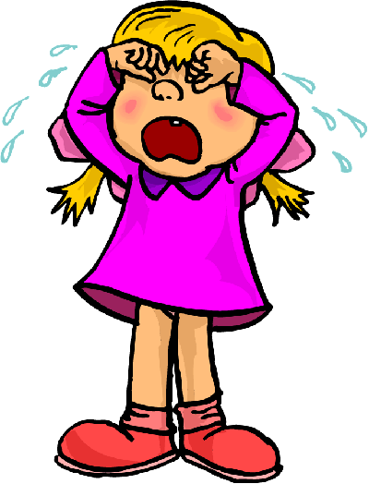
Don’t cry
I’m sorry

Slide 6
Let’s sing
a song.
‘no, don’t’
English singsing
https://www.youtube.com/watch?v=LyDl1qNmNQM

Slide 7

Don’t...
Do...

Slide 8
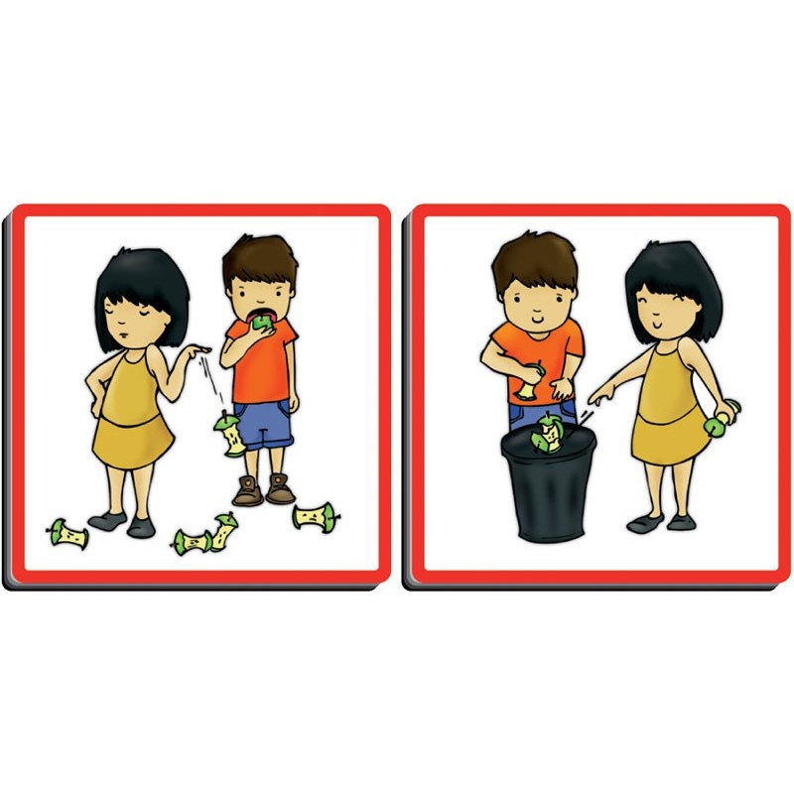
Do..
Don’t..
NEXT

Slide 9
Do…
Don’t…
NEXT

Slide 10
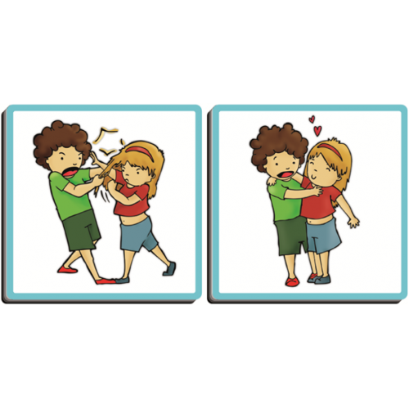
Do..
Don’t..
NEXT

Slide 11
Do…
Don’t..
NEXT

Slide 12
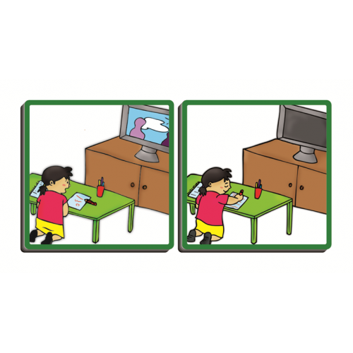
Do..
Don’t..
NEXT

Slide 13
Do…
Don’t..
NEXT

Slide 14
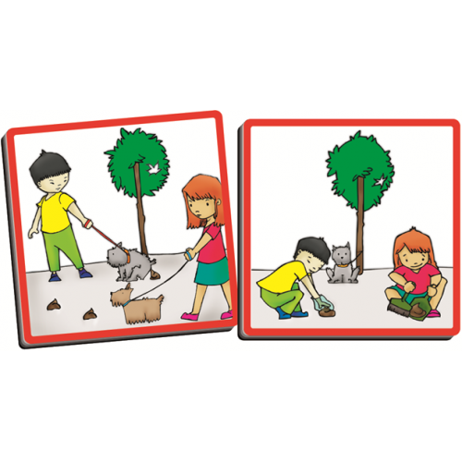
Do..
Don’t..
NEXT

Slide 15
Do…
Don’t..
NEXT

Slide 16
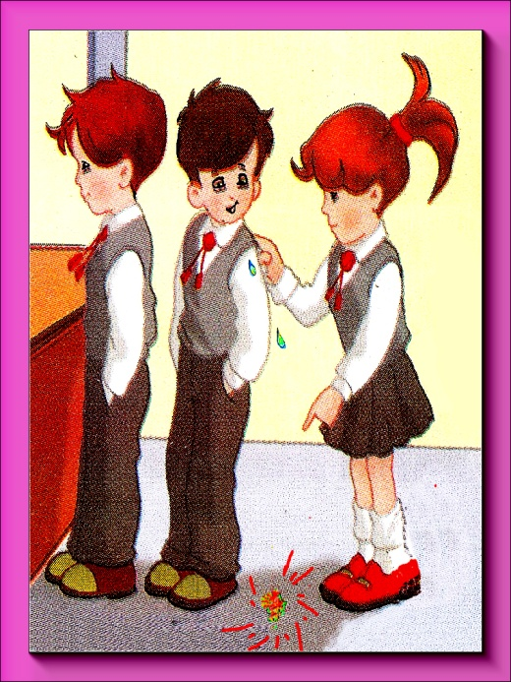
Do…
Don’t..
NEXT

Slide 17
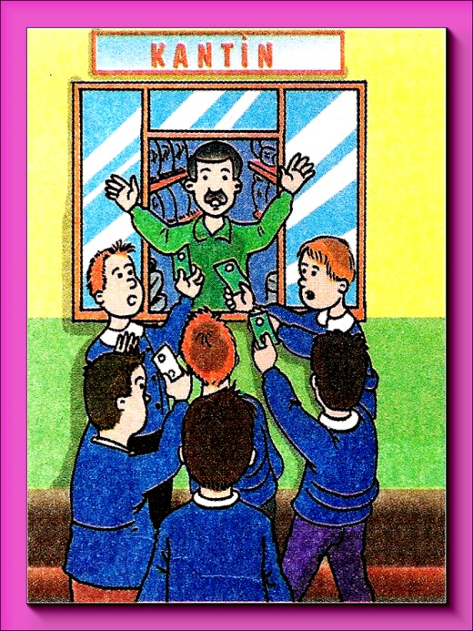
Do..
Don’t..
NEXT

Slide 18
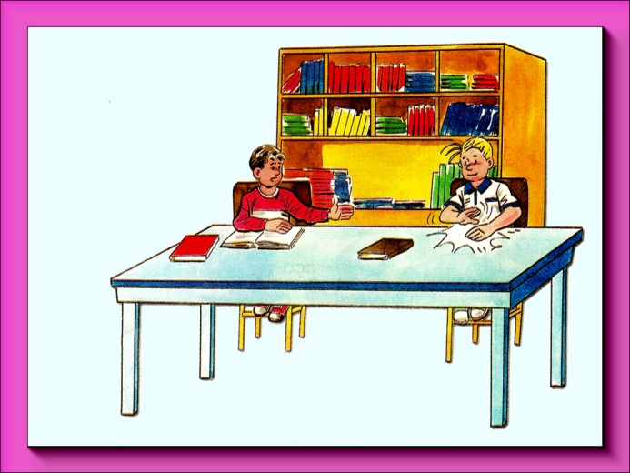
Do..
Don’t..
NEXT

Slide 19
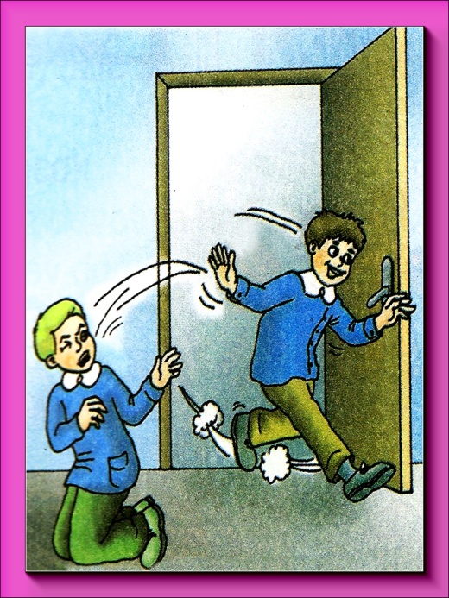
Do..
Don’t..
NEXT

Slide 20
Let’s sing
a song.
‘no, don’t’
Freelancepuppeteers
https://www.youtube.com/watch?v=LyDl1qNmNQM

Slide 21
Lets read a story

Slide 22
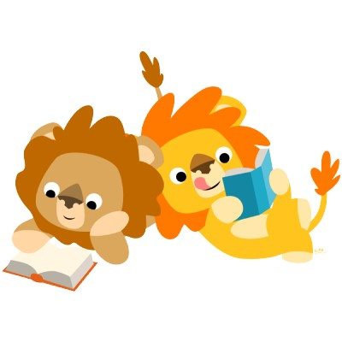
Lions don’t read books, but ...

Slide 23
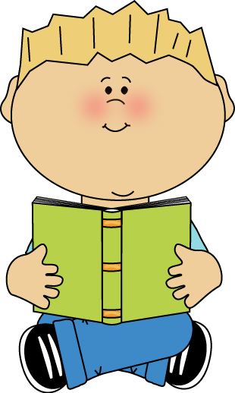
... I do.

Slide 24
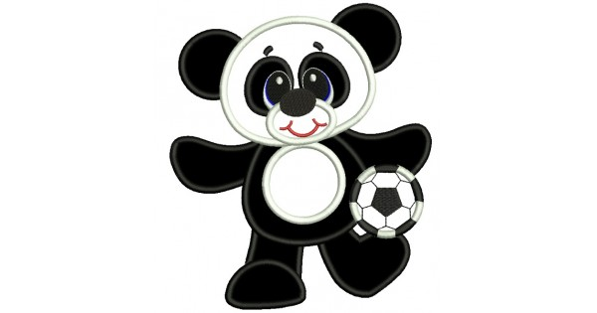
Pandas don’t play football (soccer), but …

Slide 25
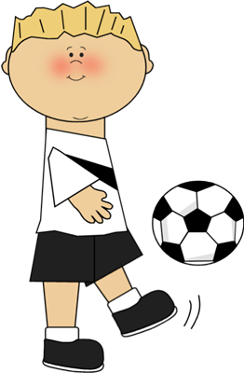
… I do.

Slide 26
Monkeys don’t sing, but …

Slide 27
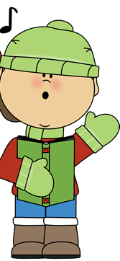
… I do.

Slide 28
Pigs don’t play on the computer, but ...

Slide 29
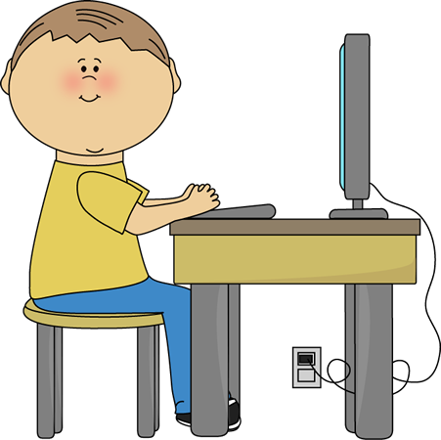
... I do.

Slide 30
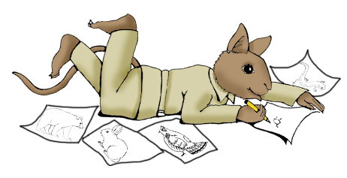
Rabbits don’t draw, but ...

Slide 31
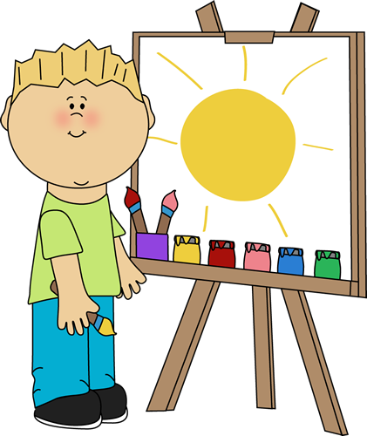
... I do.

Slide 32
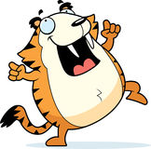

tigers don’t dance to music, but ...

Slide 33
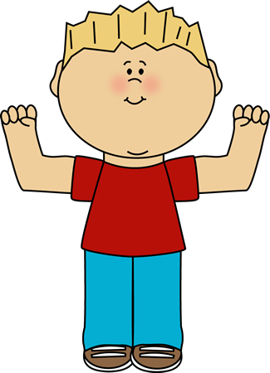
... I do.

Slide 34
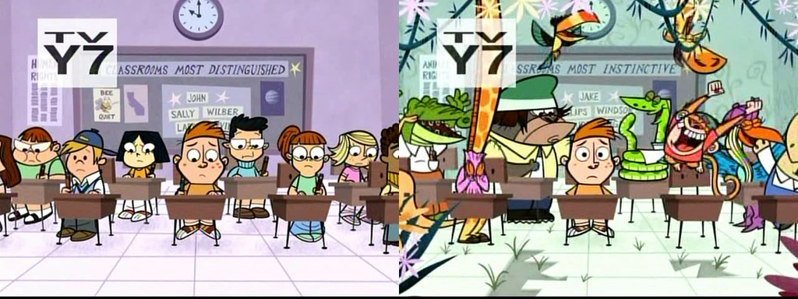
I go to school, but ...

Slide 35
... animals don’t!

Slide 36
Let’s sing
a song.
‘no, don’t’
Freelancepuppeteers
https://www.youtube.com/watch?v=LyDl1qNmNQM

Slide 37
Hidden
Picture
Game!!

Slide 42
Let’s sing
a song.
‘no, don’t’
Freelancepuppeteers
https://www.youtube.com/watch?v=LyDl1qNmNQM
Let’s sing
a song.
‘courtesy song’
Scratch garden
https://www.youtube.com/watch?v=LyDl1qNmNQM

Slide 43










Animal
Guess
Game
1 rabbit =
2 dog =
3 cat =
4 lion =
5 tiger =
6 bear =
7 monkey =
8 panda =
9 hippo =
10 pig =
It’s fat / thin.
It’s big / small
It likes meat / grass
Its tail is long/short
What is it?
It’s a …

Slide 44
Animal
Charades Game
1 rabbit =
2 dog =
3 cat =
4 lion =
5 tiger =
6 bear =
7 monkey =
8 panda =
9 hippo =
10 pig =
Is that a …. ?
Yes / No

