Slide 1
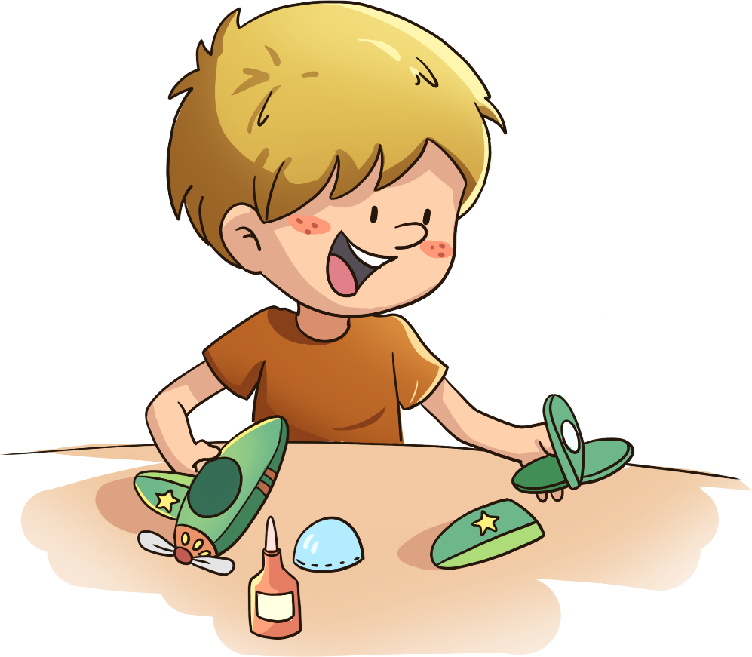
LO: Greet their partners; get a basic idea about the topic of today’s lesson.
Say hello to Ss; ask Ss to greet each other.
Guide Ss to describe the pictures on the first page.
Introduce the topic of the lesson.
TG
2:00
1/26

Slide 2
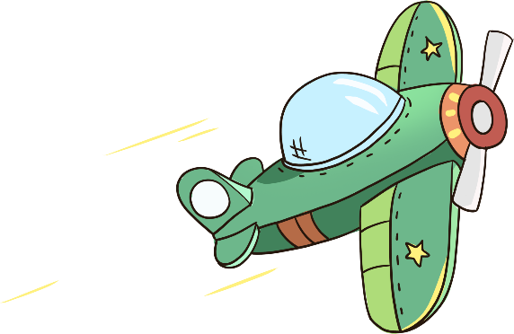
Learning
Goals
TG
LO: Get to know and understand what will be learned in this lesson.
Go through the learning goals with Ss.
We are going to …
Blend syllables in spoken words.
Learn the different words aeroplane, flew, houses, cry, and upstairs, and make sentences with them.
Read the story Biff’s Aeroplane, and identify the setting of a story by using pictures.
Practice using the sentence structure
___ looked for ___.
0:30
2/26

Slide 3
LO: Present and share writing assignments from last lesson;
Invite Ss to take turns presenting their homework. If time is limited, tell Ss they have one or two mins to present their writing.
Encourage Ss to listen carefully and to ask questions.
After both of the Ss have finished, give them feedback and awards (Click the picture of the book beside the boy or girl so that they can get some awards).
Click and give each S a trophy to mark their good performance.
Note: You can click the picture of the boy or the girl to give Ss the trophy.
TG
Presentation
Let’s show!
This is what I like to do in summer.
1:30
3/26

Slide 4
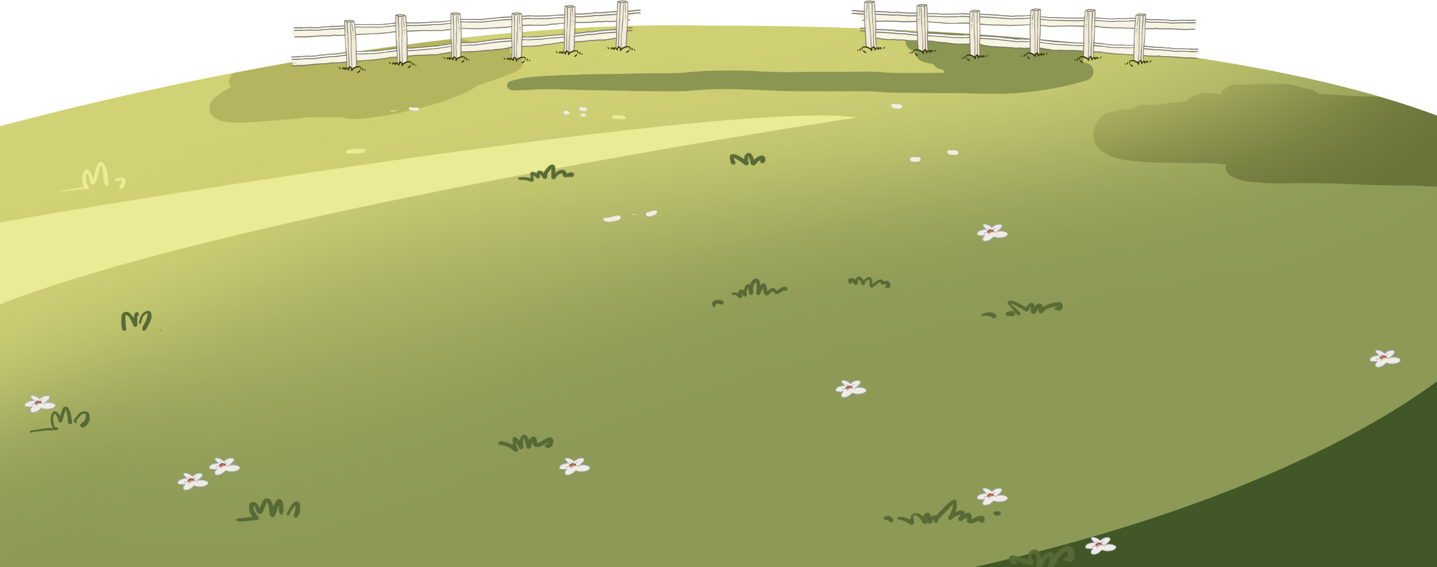
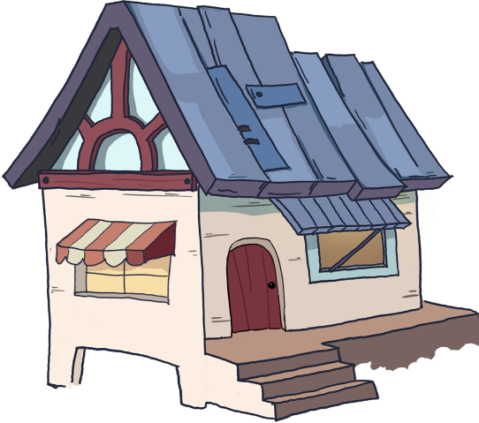
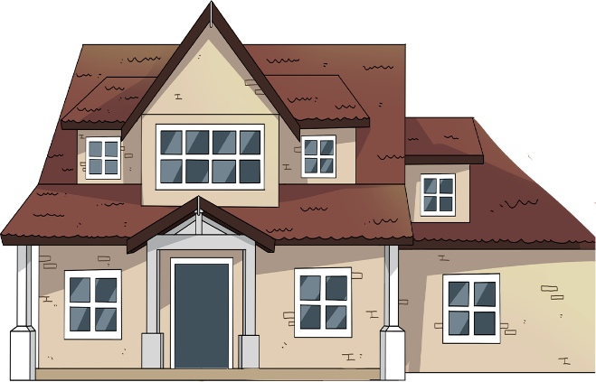
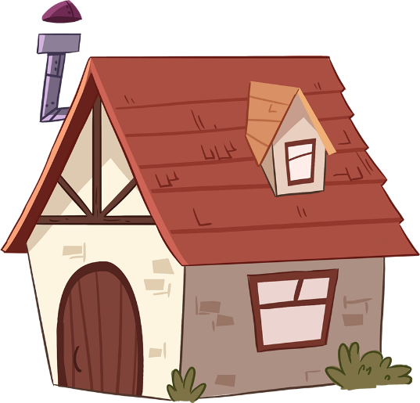
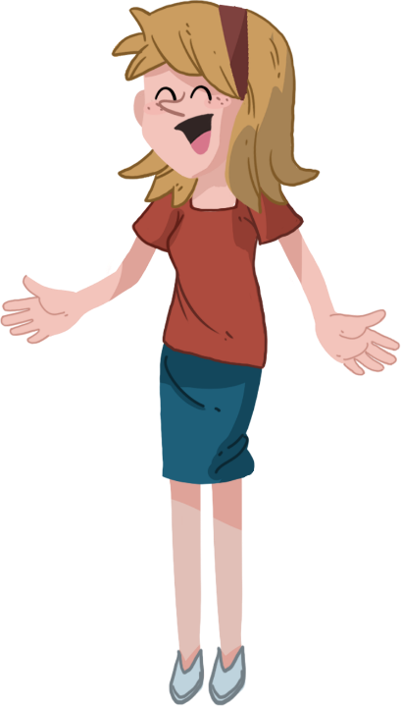
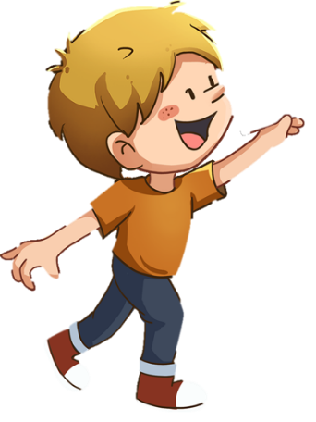
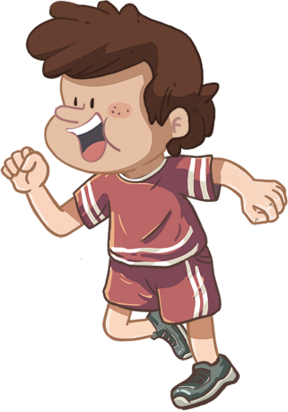
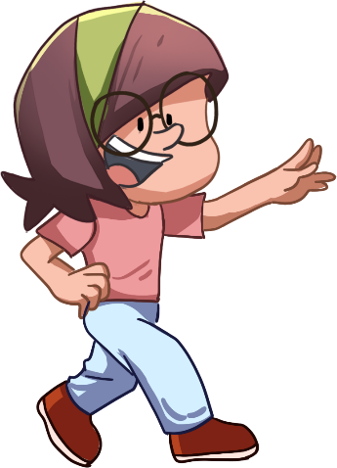
LO: Blend and pronounce the syllables in spoken words; read the words accurately.
Ask Ss to talk about what they can see in the picture; click and describe the picture of the children playing with the paper plane.
Click and read the syllables to Ss when the syllables appear; then guide Ss to take turns blending the syllables; model first; click to show the word and ask Ss to read it accurately.
Repeat practice for the rest of the vocabulary words.
Click and guide Ss to read each word in this way: in-vent, invent; give feedback.
TG
Phonics
Let’s listen and speak!
in
vent
ro
bot
break
fast
invent
robot
breakfast
Can you blend these words?
Can you read them?
Hooray!
Let’s play with our paper planes!
2:30
4/26

Slide 5
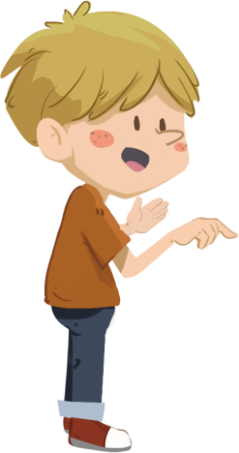
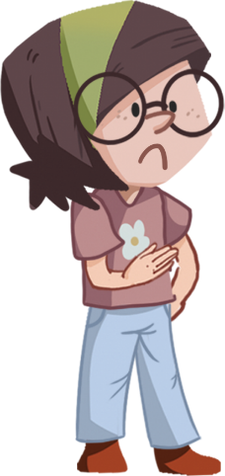
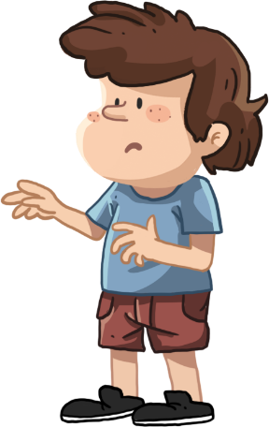
LO: Blend and pronounce the syllables in spoken words; read the words accurately.
Ask Ss to talk about what they can see in the picture; click and ask Ss to help the girl in the picture find her paper plane.
Click and read the syllables to Ss when the syllables appear; then guide Ss to take turns blending the syllables; model first; click to show the word and ask Ss to read it accurately.
Practice practice for the rest of the vocabulary words.
Click and guide Ss to read each word in this way: buck-et, bucket; give feedback.
Praise Ss for helping the girl in the picture find the paper plane.
TG
Phonics
Let’s listen and speak!
buck
et
mu
sic
mag
ic
bucket
music
magic
Oh, no!
My paper plane is gone.
Let’s read those words!
Oh, no!
Hooray!
2:30
5/26

Slide 6
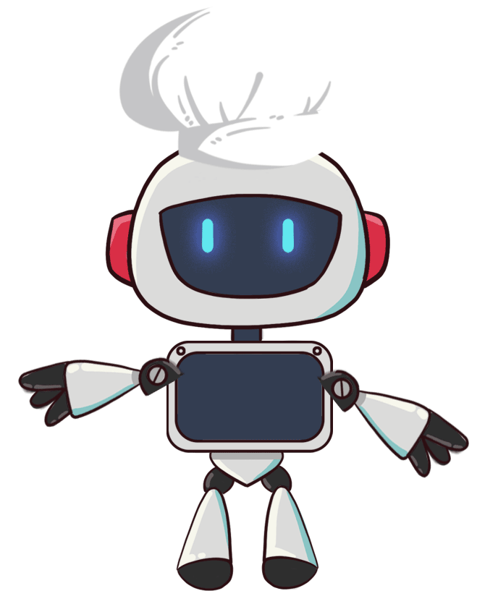
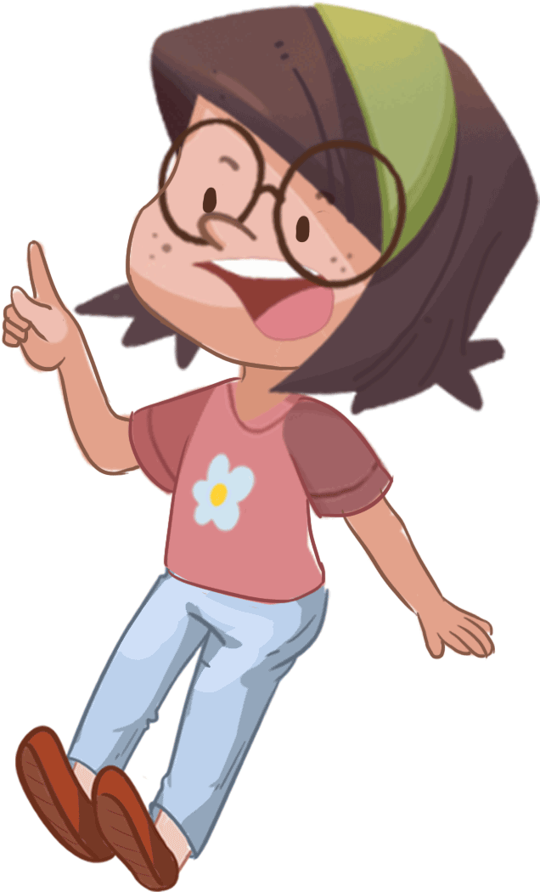
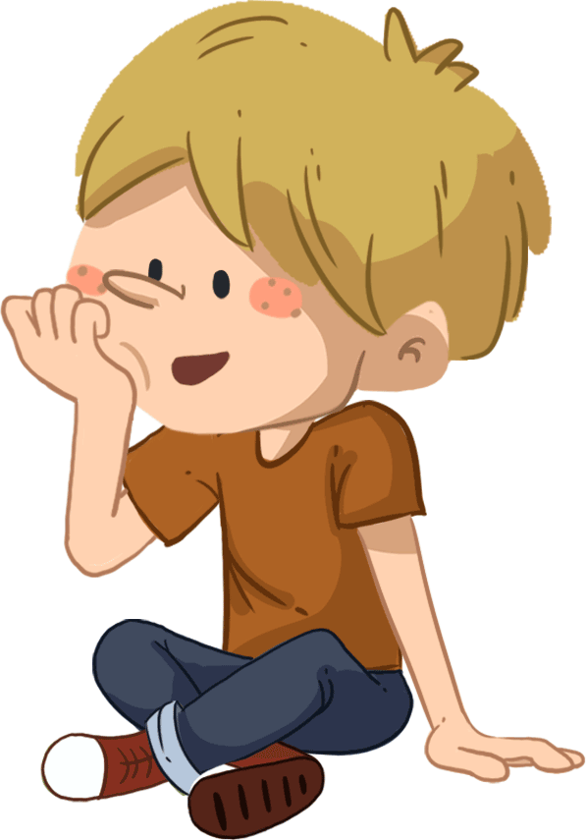
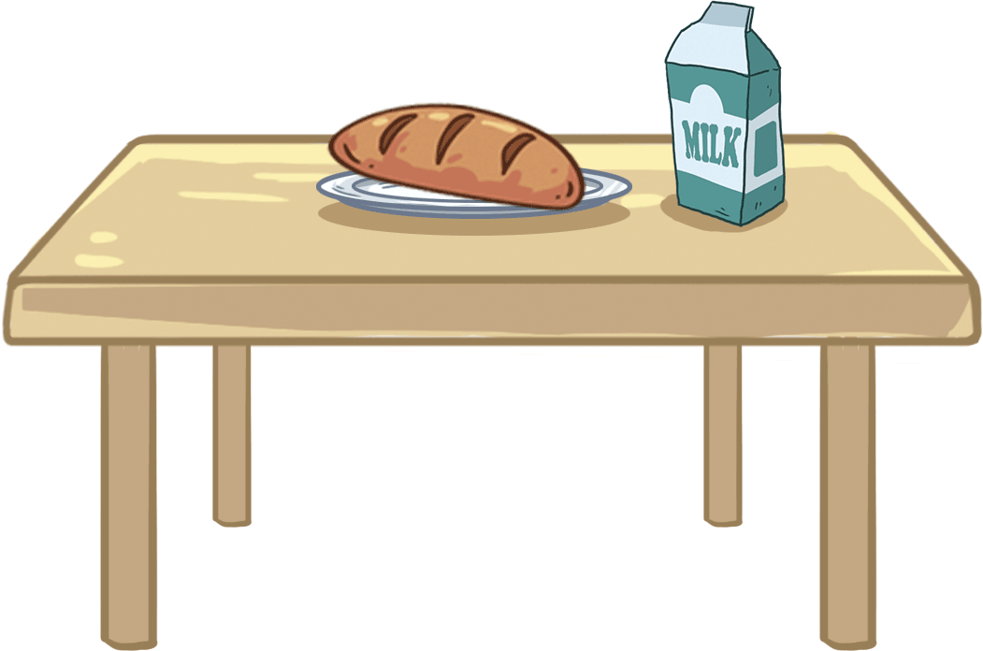
LO: Read the text fluently; blend and pronounce syllables in spoken words.
Click and read the text to Ss with rhythm.
Guide Ss to repeat after you; ask Ss to take turns reading each sentence until they finish reading the text; give feedback.
Ask Ss to take turns blending the words like this: ro-bot, robot; model first.
TG
Phonics
I want to invent a robot.
He can make breakfast.
He can play music.
He can help me lift a big bucket.
He can give me the magic.
Oh! What a good robot.
Let’s chant!
2:00
6/26

Slide 7
TG
LO: Activate Ss’ interest in reading; use the illustration and the title to identify details and to make predictions.
Have Ss look at the book cover closely and have Ss talk about the first two questions by using the illustration and the title.
Encourage Ss to talk about the connections questions.
TG
Lead-in
Before Reading
Look at the title and the illustration. What is Biff playing with?
Where is Biff playing with it? What will Biff do with it?
3. How does Biff look?
Connections
Did you play an aeroplane before? What kind of toys do you have?
Written by Roderick Hunt
Illustrated by Alex Brychta
2:00
7/26

Slide 8
Let’s predict!
LO: Identify details and make predictions about the story by using the illustration; activate Ss’ interest in reading.
Ask Ss to recall what it means to predict.
Have Ss observe the illustration carefully and have Ss talk about the given questions.
TG
Reading
Before Reading
What are Biff and Dad doing? How do they look?
What do you think Chip is looking at?
What do you think Mum is saying to the man?
1:30
8/26

Slide 9
Biff’s Aeroplane
LO: Understand the meaning of the vocabulary word aeroplane and make sentences with it; identify the setting on this page by using the illustration and textual clues; understand the text; read the text fluently.
Read the text aloud to Ss.
Ask one S to find the vocabulary word aeroplane in the text; click the penguin card and explain its purpose to Ss; have Ss read the word and have Ss make sentences with it.
Have Ss talk about the comprehension questions by using the text and illustration.
Guide Ss to talk about the setting question by using the illustration and text clues.
Ask Ss to take turns reading the text fluently; give feedback.
TG
Reading
Vocabulary
Comprehension
What did Biff do?
How did Biff feel about the aeroplane? Look at the illustration.
aeroplane
This is my favorite model aeroplane.
Setting
Where was Biff? How do you know?
Biff made an aeroplane.
aeroplane
2:30
9/26
Notes:
Was it a real aeroplane or a model aeroplane?

Slide 10
Biff’s Aeroplane
LO: Understand the text; make connections; read the text fluently.
Read the text to Ss.
Guide Ss to talk about the comprehension questions.
Encourage Ss to talk about the connections questions.
Ask Ss to take turns reading the text aloud; give feedback.
TG
Reading
Comprehension
Mum helped her.
Who helped Biff? How did she help Biff?
What did the aeroplane look like?
Connections
What model did you make before? How did you make it? Did you make it by yourself?
The aeroplane looked good.
2:30
10/26
Notes:
Did you make any toys before?

Slide 11
Biff’s Aeroplane
LO: Understand the text; identify the setting on this page by using the illustration and textual clues; read the text fluently.
Read the text to Ss.
Have Ss talk about the first comprehension question by using the text and the illustration.
Guide Ss to talk about the setting question by using the illustration and textual clues.
Encourage Ss to talk about the second comprehension question.
Ask Ss to take turns reading the text; give feedback.
TG
Reading
Comprehension
Biff wanted to fly it.
What did Biff want to do?
2. Do you think Biff’s
aeroplane would fly?
Why?
Setting
LO:
Where did Biff go to fly her aeroplane?
She went to the park.
2:30
11/26

Slide 12
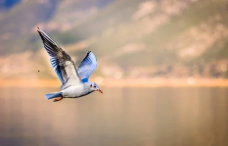
Biff’s Aeroplane
TG
Reading
LO: Understand the meaning of the vocabulary word flew and make sentences with it; understand the text; identify the setting on this page by using the illustration and textual clues; read the text fluently.
Read the text to Ss;
Ask Ss to look for the vocabulary word flew; click the penguin cards and explain the word to Ss by using body language; have Ss read the word and have Ss make sentences with it;
Ask Ss to take turns talking about the first comprehension question;
Guide Ss to talk about the setting question by using the illustration and textual clues.
Guide Ss to talk about the second comprehension question.
Have Ss read the text fluently; give feedback.
Comprehension
The aeroplane flew up.
Vocabulary
1. What happened to the
aeroplane?
2. What did Biff do when
her aeroplane flew up?
How did she feel?
flew
Setting
The bird flew over the sea yesterday.
Where did the aeroplane go?
It went over the trees.
flew
2:30
12/26

Slide 13
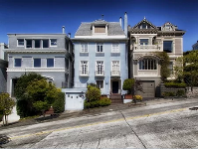
Biff’s Aeroplane
LO: Understand the meaning of the vocabulary word houses and make sentences with it; identify the setting on this page by using the illustration and textual clues; understand the text; read the text fluently.
Ask one S to read the text; give feedback.
Ask another S to look for the vocabulary word houses; click the penguin cards and explain their purpose; have Ss read the words and have Ss make sentences with them;
Guide Ss to talk about the first setting question by using the illustration and textual clues.
Guide Ss to talk about the comprehension questions by using the illustration.
Encourage Ss to talk about the second setting question.
Have Ss read the text fluently; give feedback.
TG
Reading
Setting
It went over the houses.
1. Where did the aeroplane
go?
Vocabulary
2. Where do you think Biff
might be?
houses
Comprehension
What happened to the aeroplane when it flew up? Look at the illustration.
What do you think would happen to the aeroplane next?
There are so many houses in this area.
2:30
houses
13/26

Slide 14
Biff’s Aeroplane
TG
LO: Understand the text; identify the setting on this page by using the illustration and textual clues; read the text fluently.
1. Read the text to Ss.
2. Guide Ss to talk about the comprehension questions.
3. Guide Ss to talk about the setting question by using the illustration and
textual clues.
4. Ask Ss take turns reading the text; give feedback.
Reading
Biff looked for the aeroplane.
Comprehension
What did Biff do? How did she feel? Who
helped her?
Setting
Where did they look for the aeroplane?
Everyone helped.
2:30
14/26

Slide 15
Biff’s Aeroplane
LO: Understand the text; identify the setting on this page by using the illustration and textual clues; read the text fluently.
Ask one S to read the text; give feedback.
Guide Ss to talk about the comprehension questions by looking at the illustration.
Guide Ss to talk about the first setting question by using the illustration and textual clues.
Encourage Ss to talk about the second setting question.
Ask Ss to read the text fluently; give feedback.
TG
Reading
Comprehension
Biff looked and looked.
1. What did Biff do? What was
the result?
2. How did Biff feel when she
couldn’t find the aeroplane?
Setting
Where did Biff, Chip, and Dad look for the aeroplane?
Where do you think Mum might be? What do you think Mum might be doing?
She couldn’t find it.
2:30
15/26

Slide 16
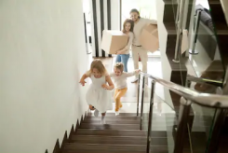
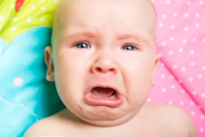
Biff’s Aeroplane
LO: Understand the meaning of the vocabulary words upstairs and cry and make sentences with them; identify the setting on this page by using the illustration and textual clues; understand the text; read the text fluently.
Read the text aloud to Ss;
Ask Ss to take turns looking for the vocabulary words upstairs and cry; click on the penguin cards and explain them; have Ss read the words and have Ss make sentences with them;
Guide Ss to talk about the setting question by using the illustration and text clues.
Guide Ss to talk about the first two comprehension questions by using the illustration.
Encourage Ss to talk about the last comprehension question.
Ask Ss to read the text fluently; give feedback.
TG
Reading
Setting
She wanted to cry.
Where were Biff and her family? Look at the illustration.
Vocabulary
Vocabulary
Comprehension
1. What did Biff do when
she got home? How did
she feel?
upstairs
cry
These two girls are going upstairs quickly.
She went upstairs.
The baby is going to cry.
2. What do you think would
happen after Biff went
upstairs?
cry
upstairs
2:30
16/26

Slide 17
Biff’s Aeroplane
LO: Identify the setting on this page by using the illustration and textual clues; understand the text; make connections; read the text fluently.
Read the text to Ss; guide Ss to talk about the setting question by using the illustration and textual clues;
Guide Ss to talk about the second comprehension question by looking at the illustration.
Guide Ss to talk about the comprehension question.
Encourage Ss to talk about the connections questions.
Have Ss read the text fluently; give feedback.
TG
Reading
Setting
Where did Biff find her aeroplane in the end?
Comprehension
How do you think the aeroplane got into Biff’s bedroom?
Connections
How do you feel when you lose something?
The aeroplane was on the bed.
2:30
17/26

Slide 18
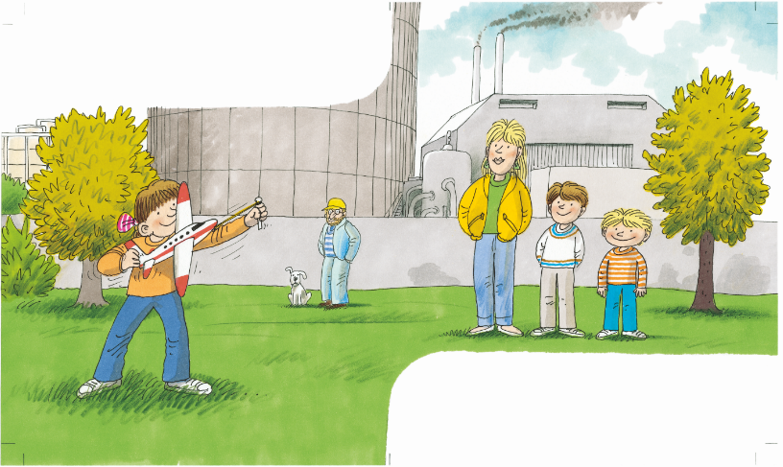
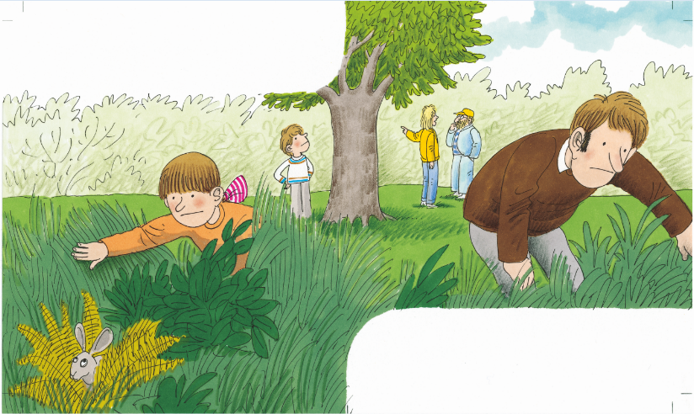
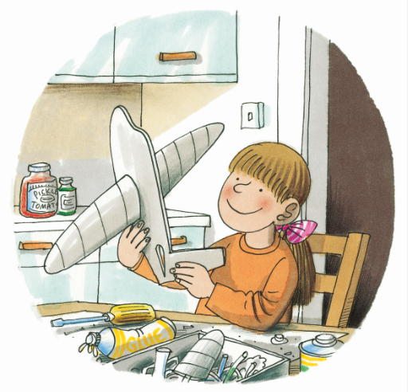
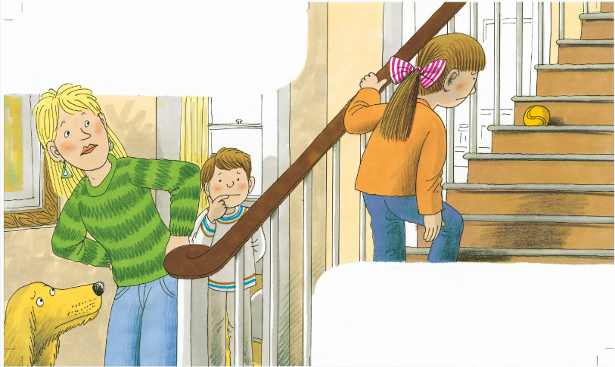
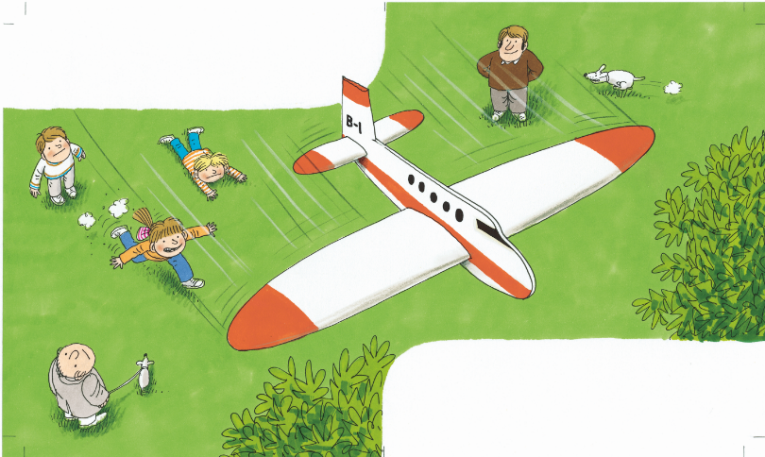
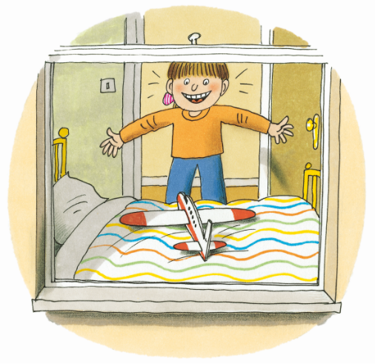
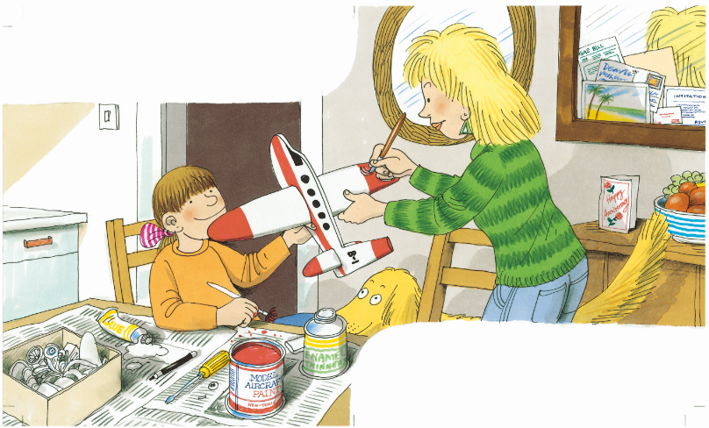
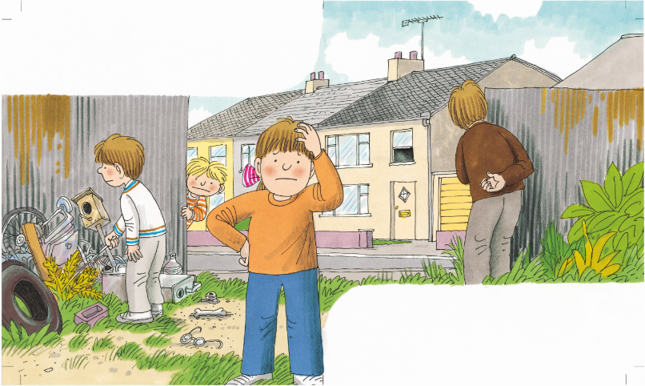
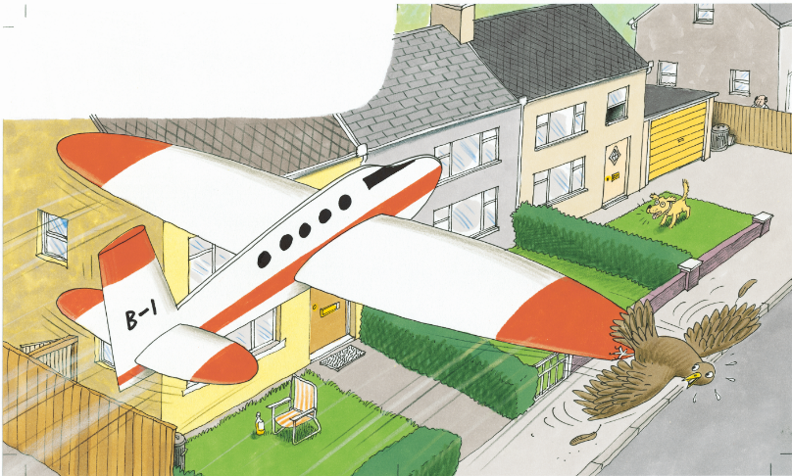
LO: Retell the story with the visual support and assistance;
Guide Ss to recall the story; model first.
Have Ss work together to retell the story in turns by using the visual aids.
TG
Reading
Let’s retell!
at home
at home
in the park
2:00
18/26

Slide 19
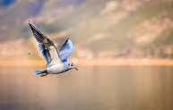
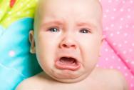
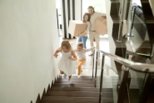
Let’s play!
TG
LO: Check Ss’ understanding of the words in this lesson.
Ask Ss to help the children in the picture to cross the river.
The steps are as follows:
Click and help the boy in the picture jump forward one step, and then a picture will
appear; ask Ss to identify the word that matches the picture; click again to help the
girl in the picture jump forward one step.
Note: There are five words on this slide and each word has the same operational
process.
Vocabulary
Vocabulary
aeroplane
flew
houses
cry
upstairs
2:00
19/26

Slide 20
Listening &
Speaking
TG
LO: Talk about the given question by utilizing the sentence structures.
Have Ss work in pairs to talk about the given illustration by using the sentence structures and helping words; model first.
Assist Ss if necessary.
Let’s talk!
—Where did ___ look for the aeroplane?
—___ looked for the aeroplane ____.
Helping Words
Biff
Chip
Dad
in the park
in the garbage
in the grass
a sandwich
2:00
20/26

Slide 21
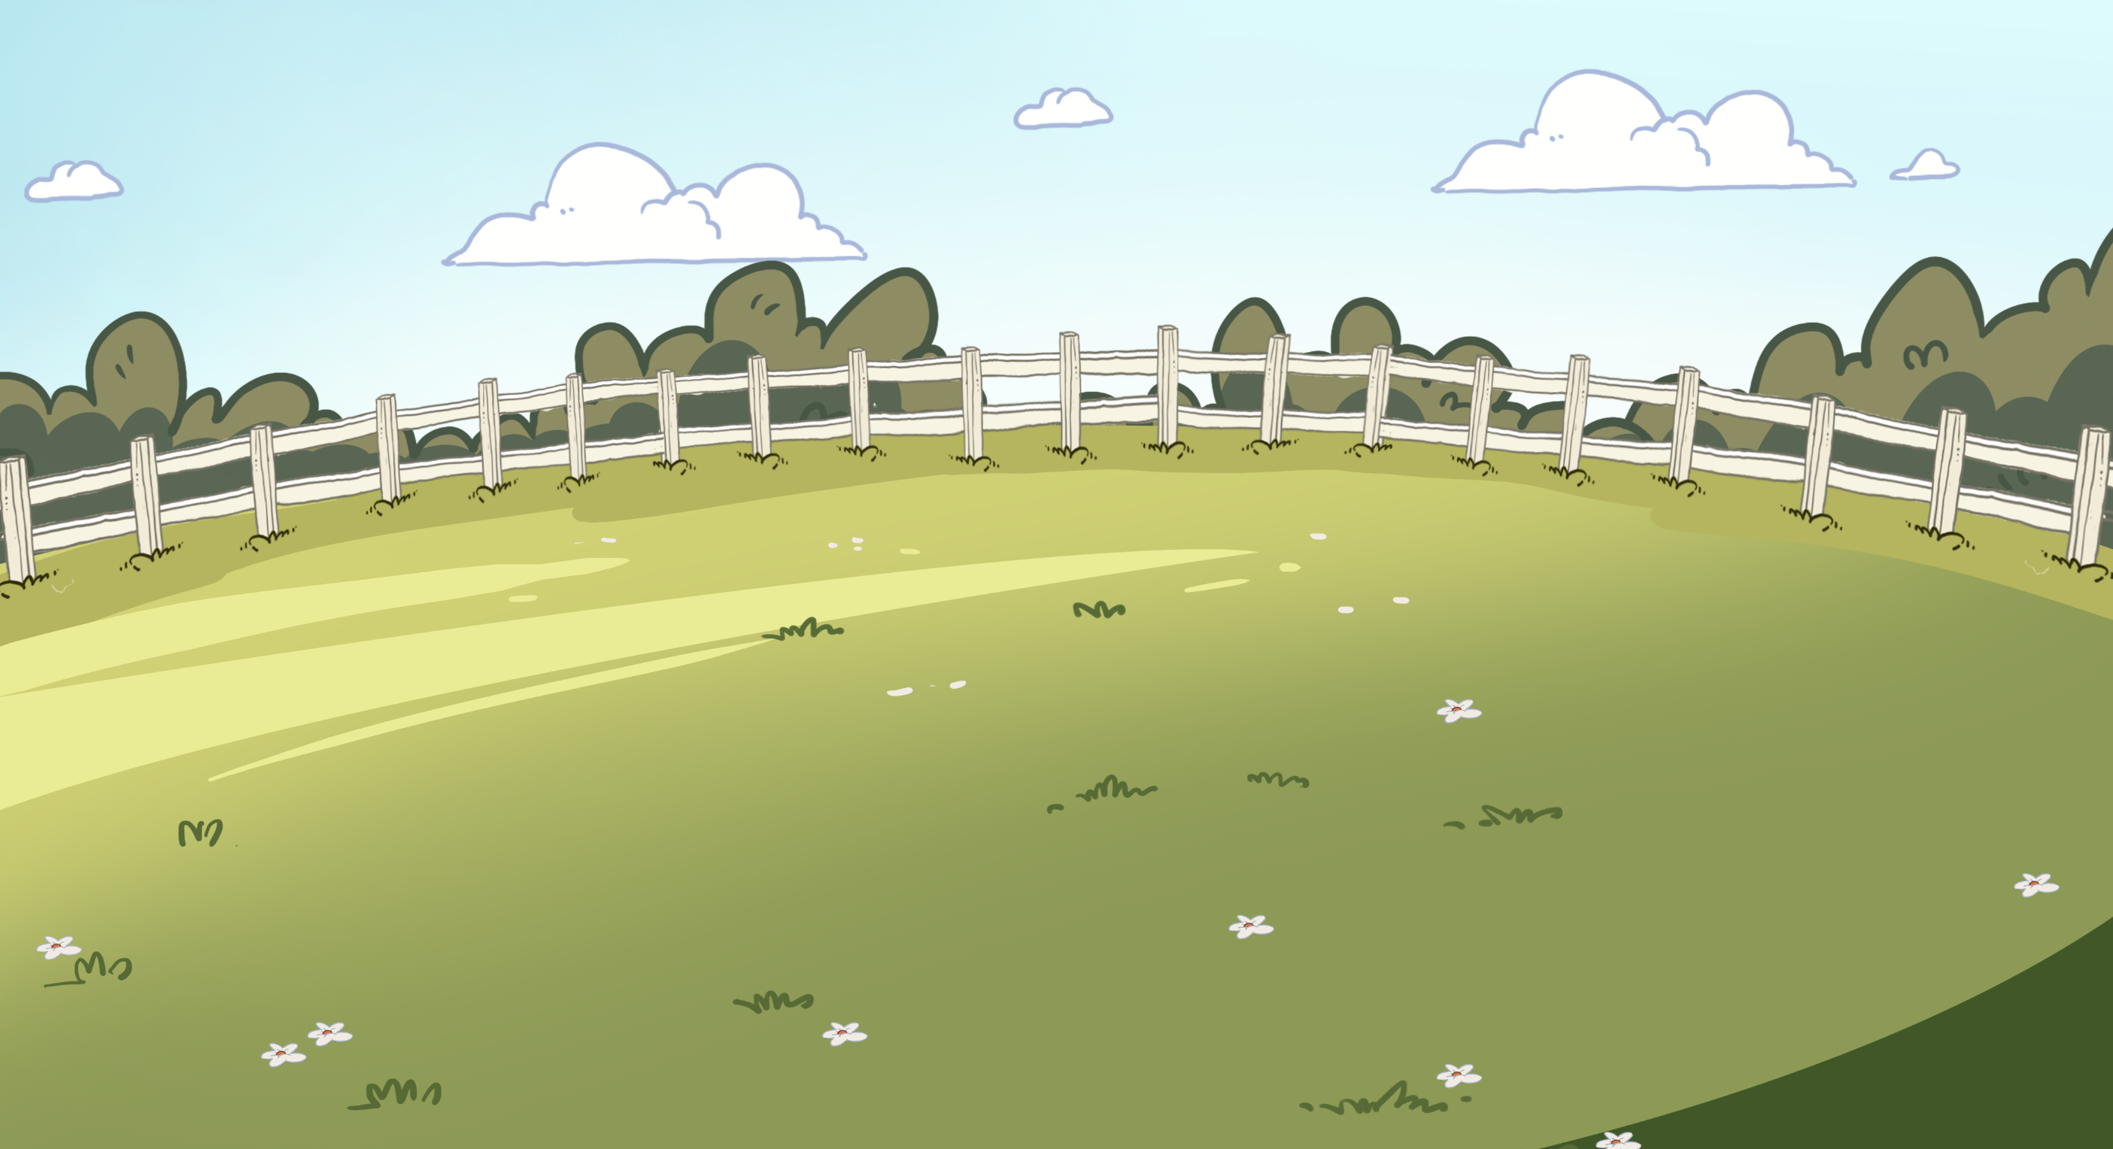
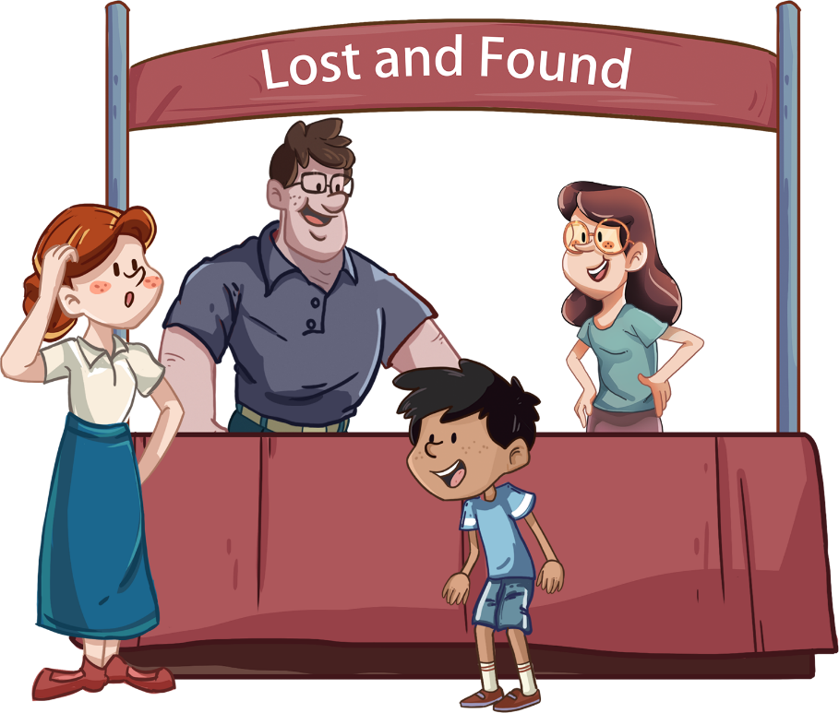
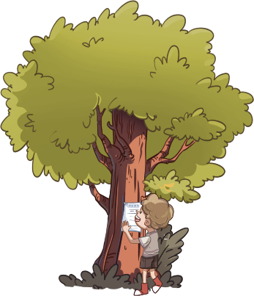
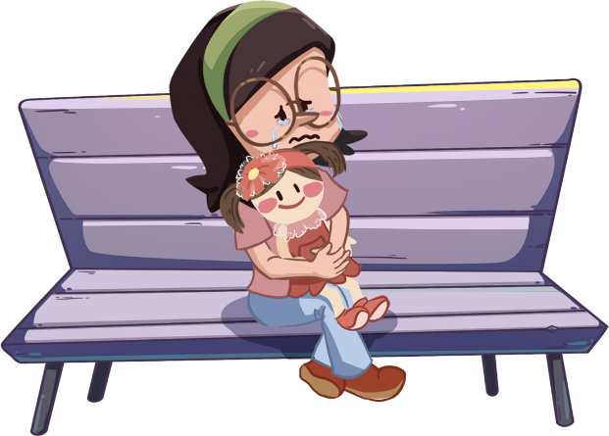
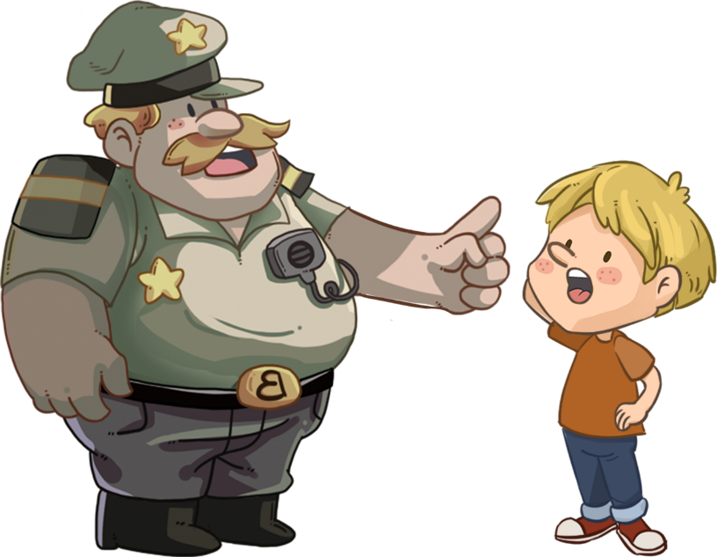
LO: Talk about what you would do if you lost something by using the given sentence structures and pictures.
Tell Ss to observe the picture carefully and to talk about what the children in the story would do if they lost something.
Have Ss take turns discussing at least three activities what they would do if they lost something; model first;
Guide Ss to work in pairs to ask and answer questions about the given picture by using the given language structures; assist Ss if necessary.
Notes: T can click Let’s Talk to present the sentence structure, and then click again to make it disappear.
TG
Listening &
Speaking
Let’s talk!
Please name at least three methods.
—What do you do when you lose
something?
—I _____.
cry;
go to the Lost and Found;
keep looking for it;
. . .
2:30
21/26

Slide 22
TG
Value
LO: Talk about the values presented in the lesson: try to think of different methods of finding lost items while also being optimistic.
1. Ask Ss the given question; model first.
2. Guide Ss to talk about the question by using the given pictures.
3. Encourage Ss to talk more about activities they can do when bad things happen.
What should you do when bad things happen?
be optimistic
ask your family for help
2:00
22/26

Slide 23
LO: Talk about what they’ve learned from the story by using the language support.
Guide Ss to talk about what they’ve learned from the book Biff’s Aeroplane by using the given question.
Help Ss to organize their ideas about the story with the given visual support.and tell them, “This is practice before your homework.”
Model the questions; ask Ss to work together to present their answers.
TG
Oral Writing
Get ready to present!
at home
Biff and Her Aeroplane
at home
in the park
Biff
Mum
Biff
Biff
Dad
Chip
The aeroplane flew over ___
What happened when Biff was playing with her aeroplane?
___ made/looked/helped/wanted ___.
2:00
23/26

Slide 24
TG
LO: Understand what the homework is.
1. Explain the writing task to Ss and check their understanding.
Tell Ss that they should finish their writing before next class. Make sure that they
know to upload their homework to the platform. They will present their work next class.
3. Remind Ss to watch the post-class video and to finish the writing task.
Writing
Let’s draw and write!
Now, please follow the steps to finish your homework, and present it in the next class:
Draw a picture of one place in the photos.
Write one complete sentence to describe it.
Watch the post-class video about the writing task.
2:00
24/26

Slide 25
TG
LO: Review today’s lesson.
Guide Ss to review the phonics by asking Ss to read the words.
Guide Ss to review the words by asking Ss to make sentences with them.
Guide Ss to review the sentence structures by asking each S to make a sentence with them.
Review
Let’s review!
Review
Phonics:
invent/robot/breakfast/ bucket/music/magic
Sentence Structure:
___ looked for___.
Vocabulary:
aeroplane/flew/
houses/cry/
upstairs
1:00
25/26

Slide 26
TG
LO: End the lesson and encourage Ss to prepare well for the next class.
1. Briefly comment on Ss.
2. Say goodbye to students.
3. Ask Ss to preview the next lesson.
0:30
26/26

