Slide 1

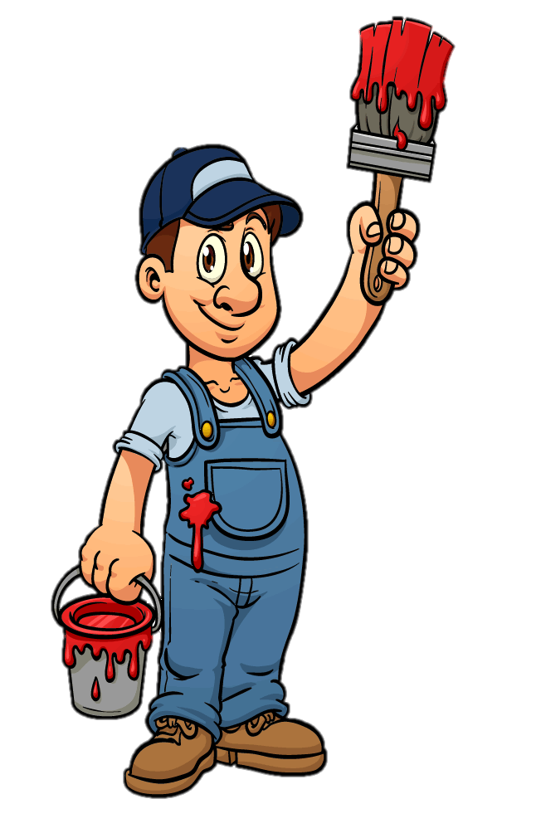







Slide 2



Slide 3

SHOW WORD

Slide 4

SHOW WORD

Slide 5

SHOW WORD

Slide 6

SHOW WORD

Slide 7

SHOW WORD

Slide 8

SHOW WORD

Slide 9

SHOW WORD

Slide 10

SHOW WORD

Slide 11

SHOW WORD

Slide 12

SHOW WORD

Slide 13

SHOW WORD

Slide 14























What colours do you like?
I like …and..

Slide 15
Let’s sing
“Rainbow colors“ by Singing Walrus
https://www.youtube.com/watch?v=SLZcWGQQsmg

Slide 16


What colour is it?
It’s orange.

Slide 17

What colour is it?
It’s
red and white.

Slide 18

What colour is it?
It’s violet, purple, blue, yellow, red and green.

Slide 19



Let‘s mix
RED + YELLOW = ?
white
orange
blue
pink
purple
green
brown
gray
ORANGE
black

Slide 20
Let‘s mix
GREEN + RED = ?
white
orange
yellow
pink
blue
brown
purple
gray
BROWN
black

Slide 21
Let‘s mix
BLUE + RED = ?
white
purple
yellow
pink
green
orange
brown
gray
PURPLE
black

Slide 22
Let‘s mix
WHITE + BLACK = ?
green
orange
yellow
brown
blue
gray
purple
pink
GREY
white

Slide 23
Let‘s mix
BLUE + YELLOW = ?
white
orange
red
pink
green
purple
brown
gray
GREEN
black

Slide 24
Let‘s mix
WHITE + RED = ?
green
orange
yellow
brown
blue
gray
purple
pink
PINK
black

Slide 25

1
2
This flower is …
3
4
5
6
7
8
9
It’s …
10

Slide 26
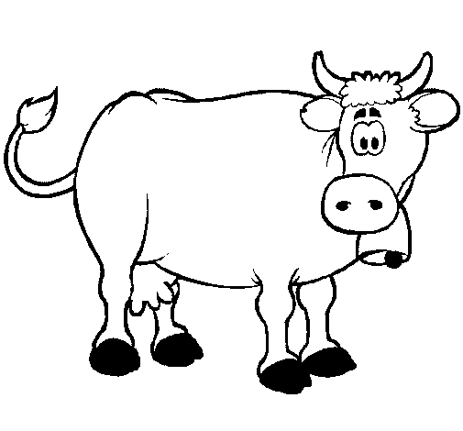
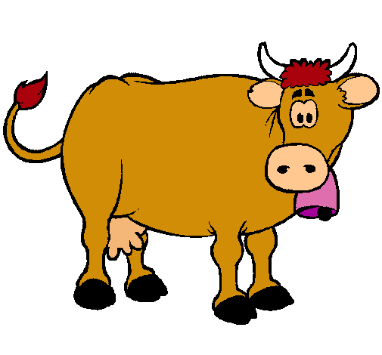
1
2
This cow is …
3
4
5
6
7
8
9
It’s …
10

Slide 27
1
2
This book is …
3
4
5
6
7
8
9
It’s …
10

Slide 28


1
2
This pen is …
3
4
5
6
7
8
9
It’s …
10

Slide 29
1
2
This ball is …
3
4
5
6
7
8
9
It’s …
10

Slide 30


1
2
This jumper is …
3
4
5
6
7
8
9
It’s …
10

Slide 31
1
2
This pencil is …
3
4
5
6
7
8
9
It’s …
10

Slide 32
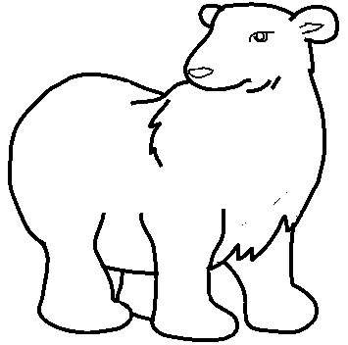
1
2
This bear is …
3
4
5
6
7
8
9
It’s …
10

Slide 33
1
2
This gift is …
3
4
5
6
7
8
9
It’s …
10

Slide 34

1
2
This snake is …
3
4
5
6
7
8
9
It’s …
10

Slide 35
Let’s sing
The Butterfly Colors song
by KidsTV123
https://www.youtube.com/watch?v=RPAZHVNVJp0

Slide 36

Painting a blank canvas
Instructions:
Choose a color to paint the picture and try to guess the verb. (What are they doing?)

Slide 37

swim

Slide 38
run.

Slide 39
Write.

Slide 40
climb a tree.

Slide 41
play football.

Slide 42
fly a kite.

Slide 43
eat an ice-cream.

Slide 44
read a book.

Slide 45
Throw a snowball.

Slide 46



What colour is your …
bag?
pencil?
book?
It’s ...

Slide 47
