Slide 1
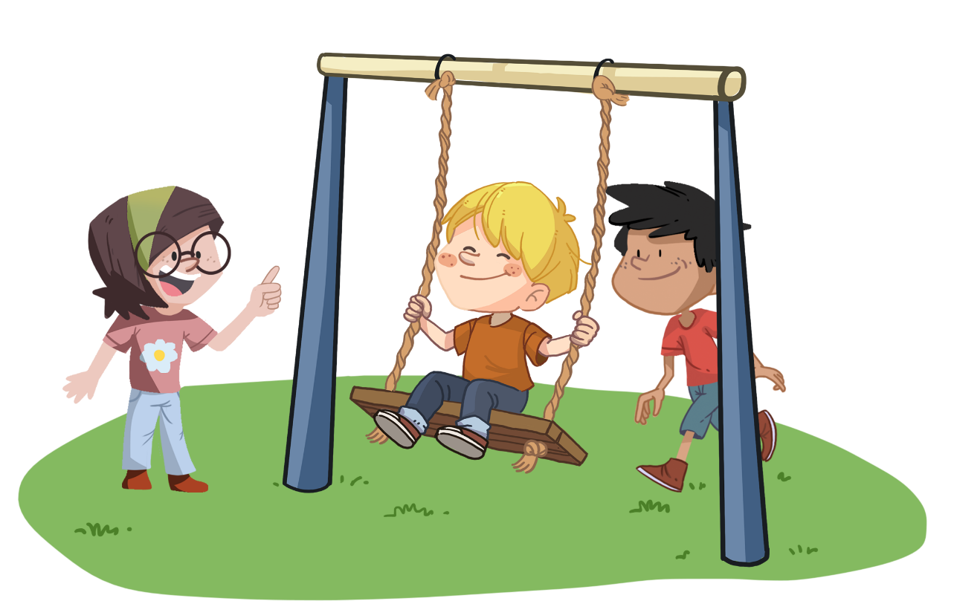
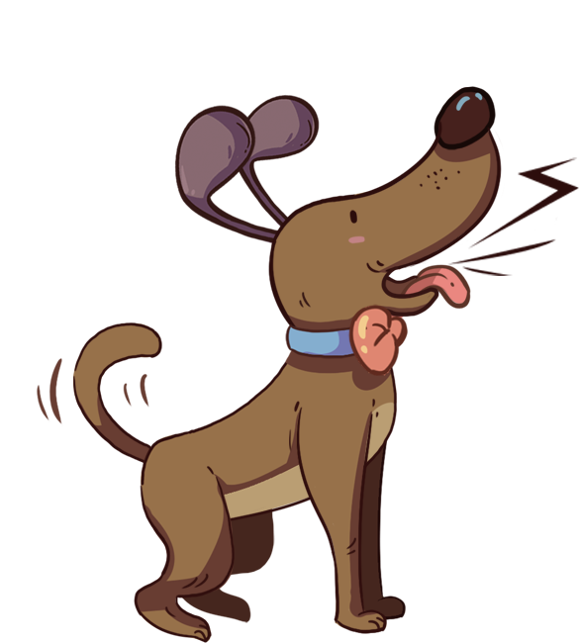
LO: Greet their partners; get a basic idea about the topic of
today’s lesson;
Say hello to Ss; ask Ss to greet each other.
Guide Ss to describe the pictures on the book cover.
Introduce the topic of the lesson.
TG
1:00
1/23

Slide 2
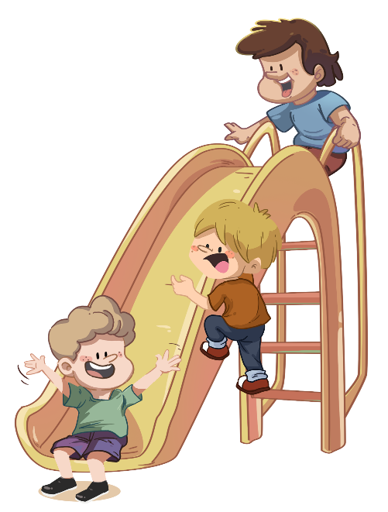
Learning
Goals
TG
LO: Get to know and understand what will be learned in this lesson.
Go through the learning goals with Ss.
We are
going to . . .
Identify the long and short vowel sounds in single-syllable words; identify, count, and pronounce syllables in spoken words; identify and pronounce words that rhyme with all and at; read the sight words wanted and came correctly and fluently; decode sentences fluently.
Read the story The Swing Rope and utilize some reading skills and strategies to help with story comprehension.
Practice using the sentence structure ____ climbed on ____.
0:30
2/23

Slide 3
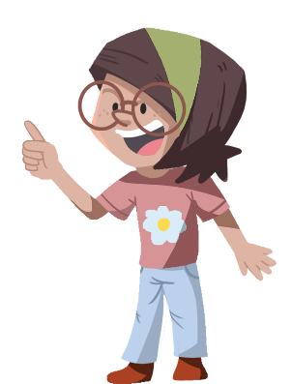
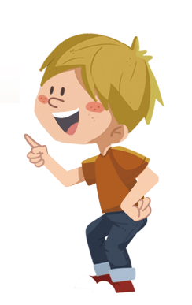
TG
Presentation
LO: Present and share writing assignment from last lesson;
1. Invite Ss to take turns presenting their homework. If time is limited, tell
Ss they have one or two mins to present their writing.
2. Encourage Ss to listen carefully and to ask questions.
3. After both of the Ss have finished, give them feedback and awards
(click the book picture beside the boy or the girl so that they can get
some awards).
4. Click and give each S a trophy to mark their good performance.
Note: You can click the picture of the boy or the girl to give Ss the trophy.
Let’s show!
This is one place in the photos.
1:30
3/23

Slide 4
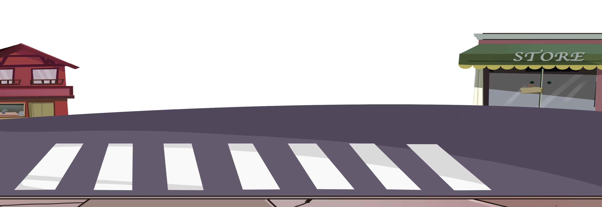
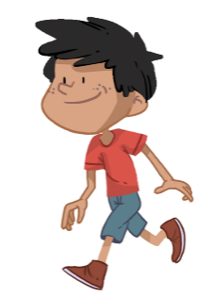
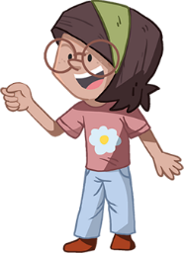
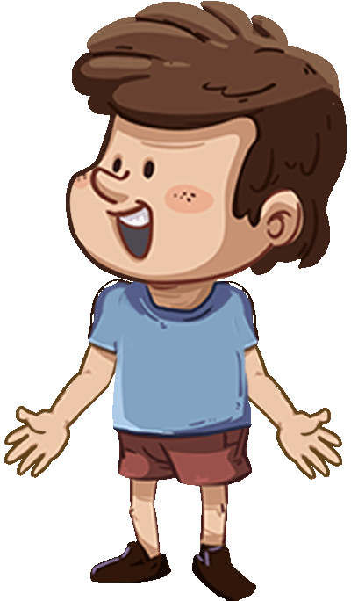
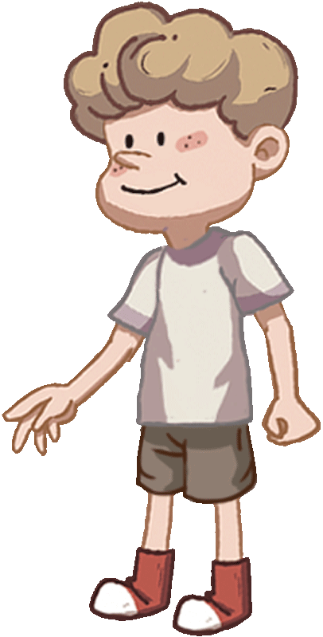
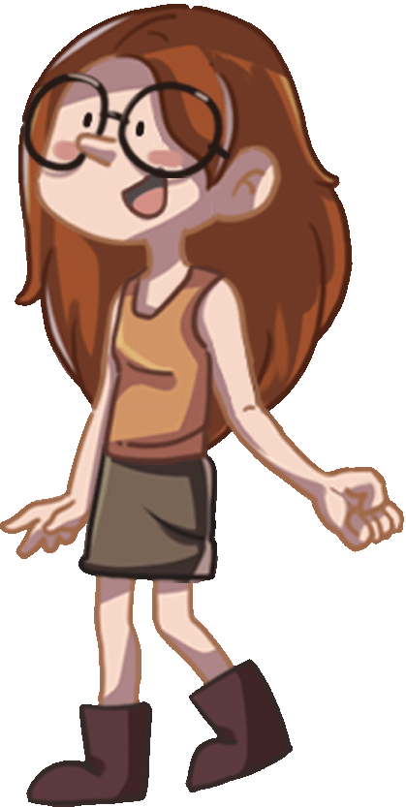
TG
Phonics
LO: Identify and pronounce the short or long vowel sounds a, o, and i in one-syllable words; know the spelling-sounds correspondence for the letters a, o, and i and the short or long vowels a, i, and o. Pronounce and decode the words with the short or long vowels i, o, and u.
Ask Ss to talk about what they see in the picture; ask them to help the children in the picture cross the road or help the cars go.
2. Click first and read the word cake to Ss when it appears, and ask Ss to identify the long
vowel sound a; then click again and guide Ss to decode the word cake like this: c-a-
ke, cake; click to help the children cross the road (or help the car go, or give Ss a star
as a prize);
3. Repeat the practice for the rest of the words.
Let’s listen and speak!
map
like
cake
map
home
dog
like
pig
dog
home
pig
cake
4/23
2:00

Slide 5
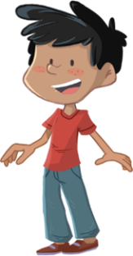
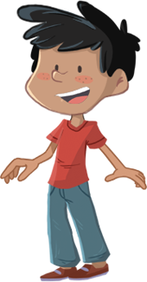
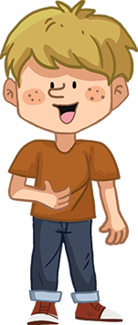
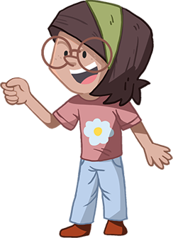
LO: Identify the short vowel sounds u and e and the long vowel sounds i and o, and count the syllables in the words sister and happy;
Ask Ss to talk about what they can see in the picture; ask them to help the children in the picture get on the bus and find their seats.
Click and ask Ss to answer the question on the board before each child; click and help the child find her or his seat on the bus; ask Ss to decode the words accurately; model first.
Repeat the practice for the rest of the words.
Click and help the children in the picture go to school together and ask them to guess what will happen in the school.
TG
Phonics
Let’s listen and speak!
duck
pet
happy
The bus is coming!
Let’s find our seats!
Let’s go to
school!
ride
home
sister
The number of
syllables: sister
2/3
The number of
syllables: happy
2/3
long o
sound
2
short u
sound
long i
sound
short e
sound
2
2
5/23
3:00

Slide 6
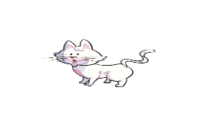
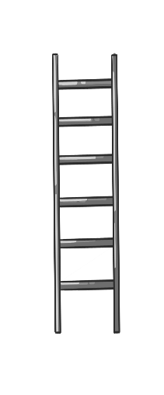
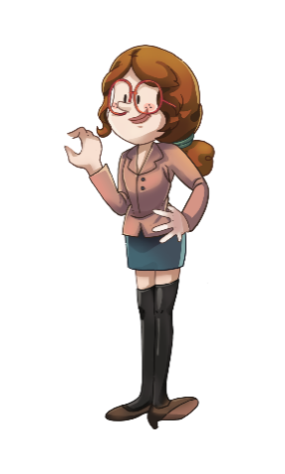
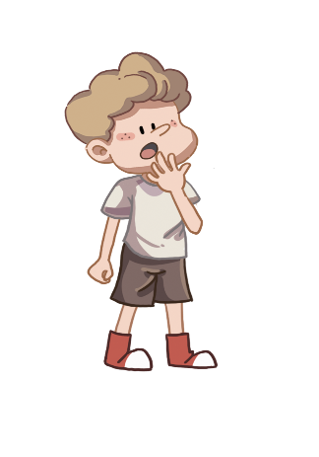
On this slide, test Ss’ foundational skills; each S should be tested; give each S a mark according to the assessment rubrics.
LO: Read the text fluently; identify and decode the long a and e sounds, the short o and u sounds, and the words that rhyme with at and all; read the sight words fluently.
Click and read the text to Ss with rhythm.
Guide Ss to read together after you; ask one S to read one sentence and the other to read the next until they finish reading the text; give feedback.
Note: the long a and e sounds: Kate, shame, she.
the short o and u sounds: Bob, but.
the sight words: wanted, came.
words that rhyme with at and all: cat, call.
TG
Phonics
Let’s read!
Bob wanted to catch the cat.
But he couldn’t come down.
Kate wanted to call Mrs. White for help.
Mrs. White came and helped Bob.
And she said, “Good children won’t do anything dangerous!”
“Oh! What a shame!” said Bob.
6/23
3:00

Slide 7
Lead-in
TG
LO: Activate Ss’ interest in reading; use the illustration and the title to
identify details and make predictions.
Have Ss look at the book cover closely and talk about the first two questions using the illustration and the title.
Ask Ss to talk more about the third question; assist them if necessary.
Before Reading
Who is on the rope swing? Does it look safe?
Why is Floppy barking at the children? Does he also want to get on the swing?
What do you think will happen in the story?
Written by Roderick Hunt
Illustrated by Alex Brychta
2:00
7/23

Slide 8
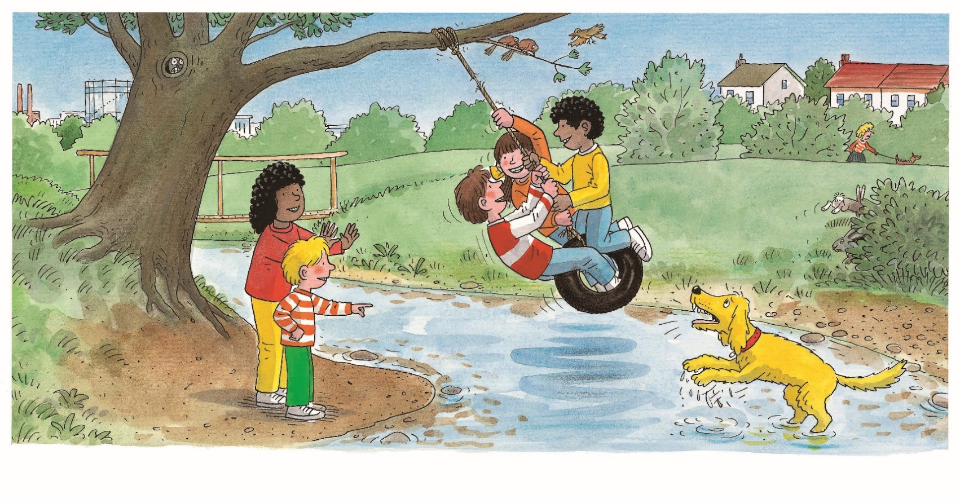
Let’s predict!
LO: Make predictions about the story by using the illustration; motivate Ss’ interest in reading the story.
Ask Ss to recall what it means to predict.
Have Ss observe the illustration carefully and have Ss talk about the given questions.
TG
Reading
Before Reading
What do you think Kipper is saying to Floppy?
What will happen to the rope swing?
2:00
8/23

Slide 9
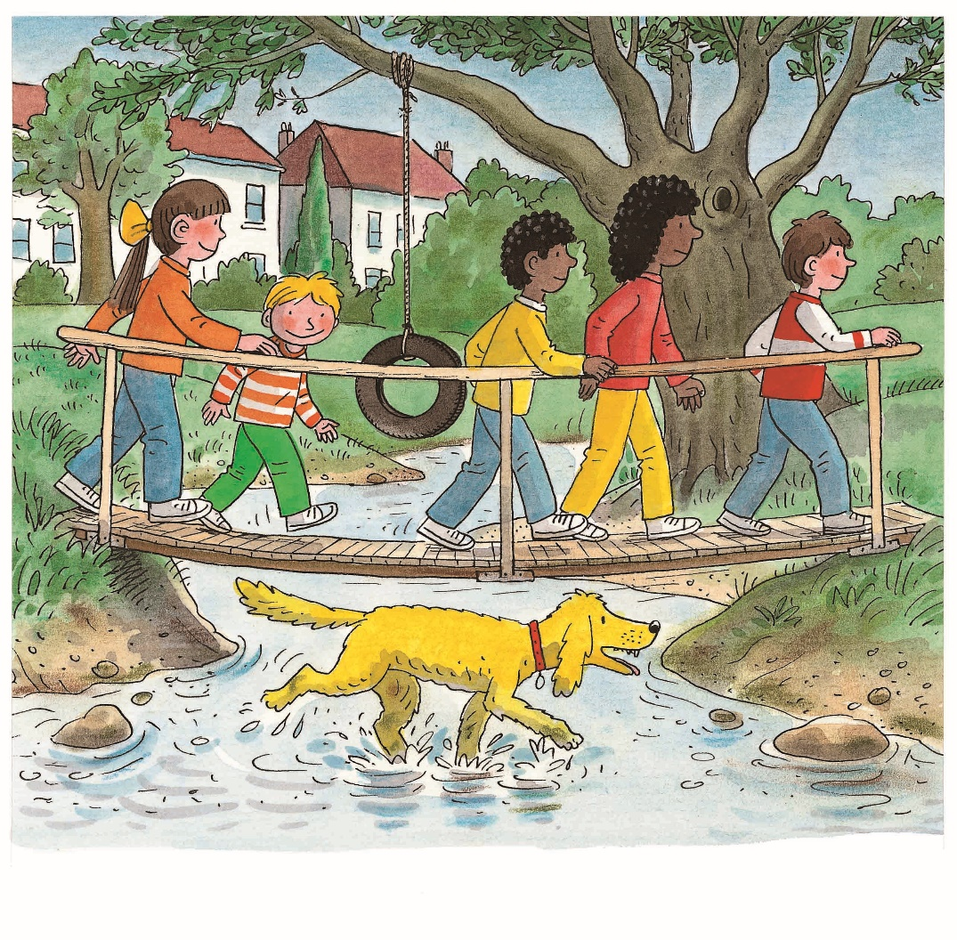
The Rope Swing
LO: Understand the text; read the text fluently.
Read the text aloud to Ss; have Ss talk about the frist comprehension question.
Ask Ss to observe the illustration carefully to talk about the last two questions and to get more clues by using the illustration.
Ask Ss to take turns reading the text aloud.
TG
Reading
Comprehension
Where did the children go?
How did the bridge look? Was it safe when all the children walked on the bridge together?
Which way did Floppy choose to go?
The children went to the stream.
2:30
9/23

Slide 10
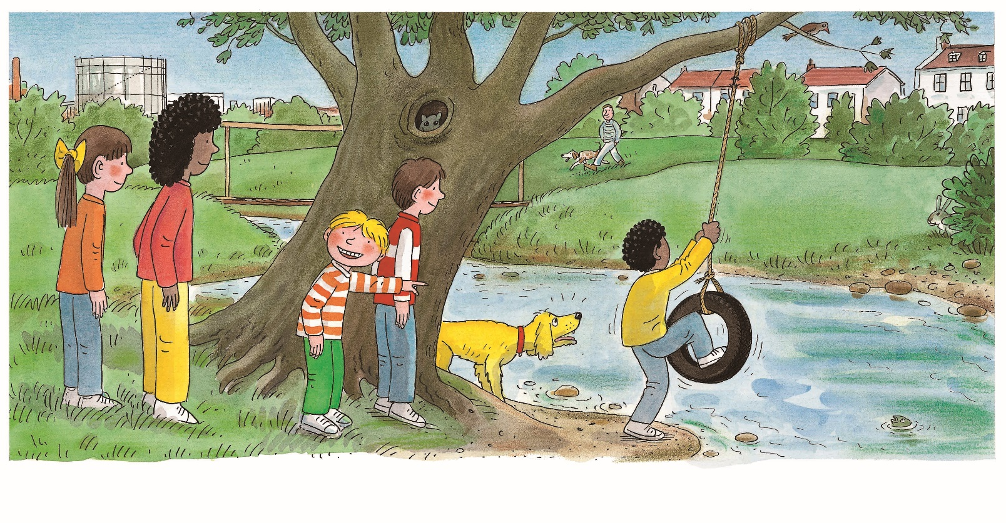
The Rope Swing
TG
LO: Understand the text; make connections; read the text fluently.
1. Read the text aloud to Ss; have Ss talk about the comprehension
questions by using the text and the illustration.
2. Encourage Ss to talk about the connections question. (Suggestion: You
can help Ss answer this question by sharing more pictures from the
internet.)
3. Ask Ss to take turns reading the text fluently.
Reading
Comprehension
Look for clues in the text and illustration.
What did the children look at?
What did Wilf want to do?
Connections
Did you play on a swing before? What did it look like?
They looked at the swing.
Wilf climbed on the swing.
2:30
10/23

Slide 11
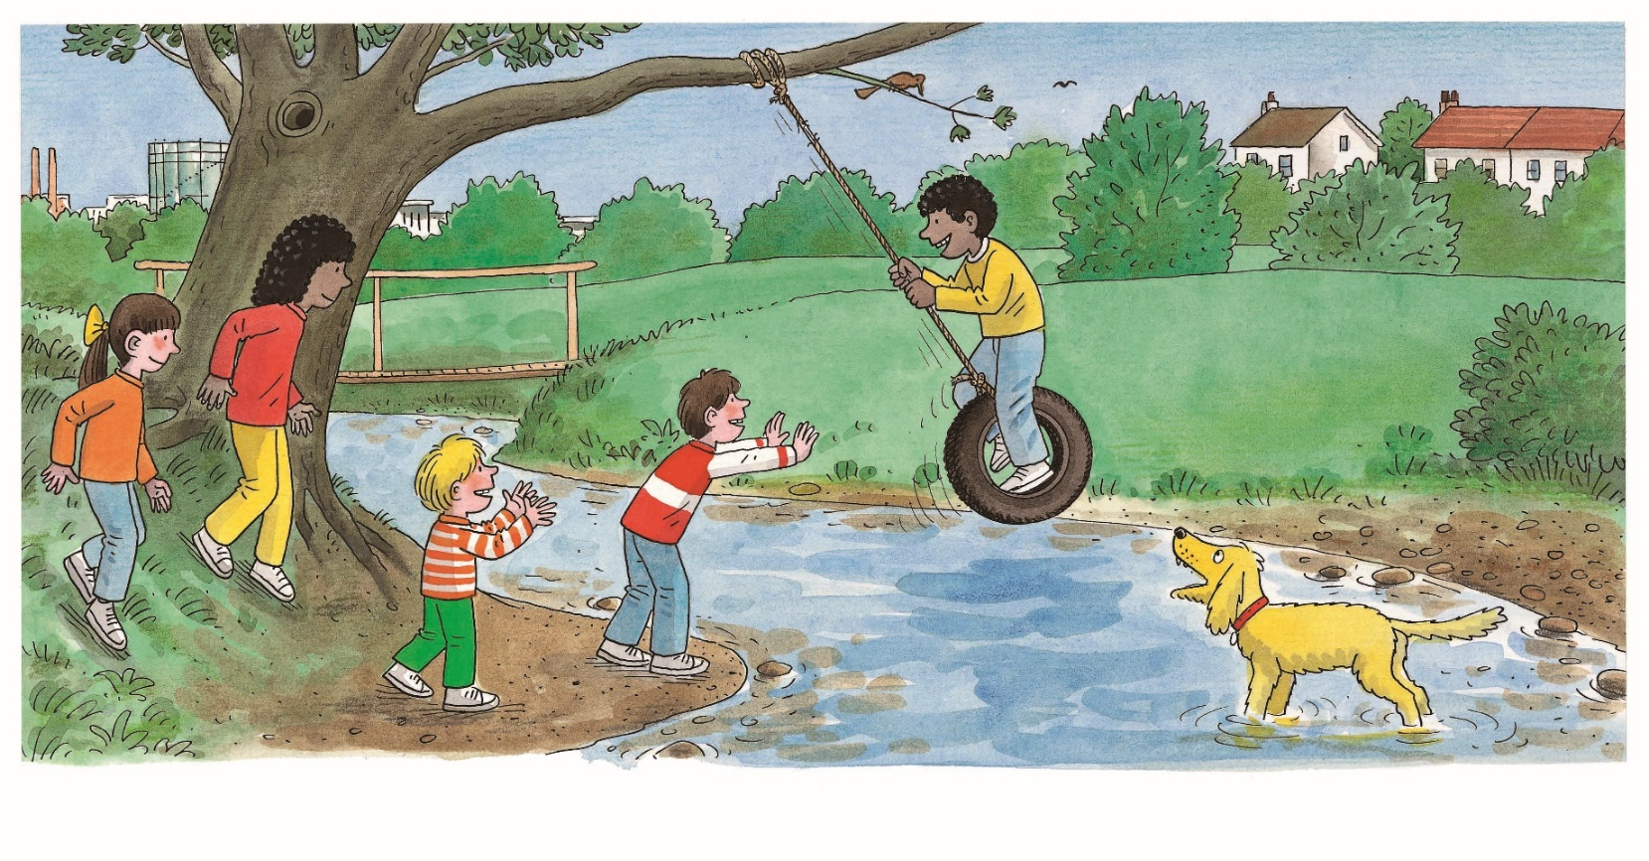
The Rope Swing
LO: Understand the text; read the text fluently.
Have one S read the first sentence of the text aloud; have Ss talk about the first comprehension question using the text;
Have another S read the second sentence of the text aloud; have Ss talk about the second comprehension question using the illustration and the text.
Ask Ss to observe the illustration carefully and to talk about the third question.
TG
Reading
Comprehension
What did Chip do?
What did Floppy look at? Why?
How did Kipper feel? How do you know?
Chip pushed Wilf.
Floppy looked at the rope.
2:30
11/23

Slide 12
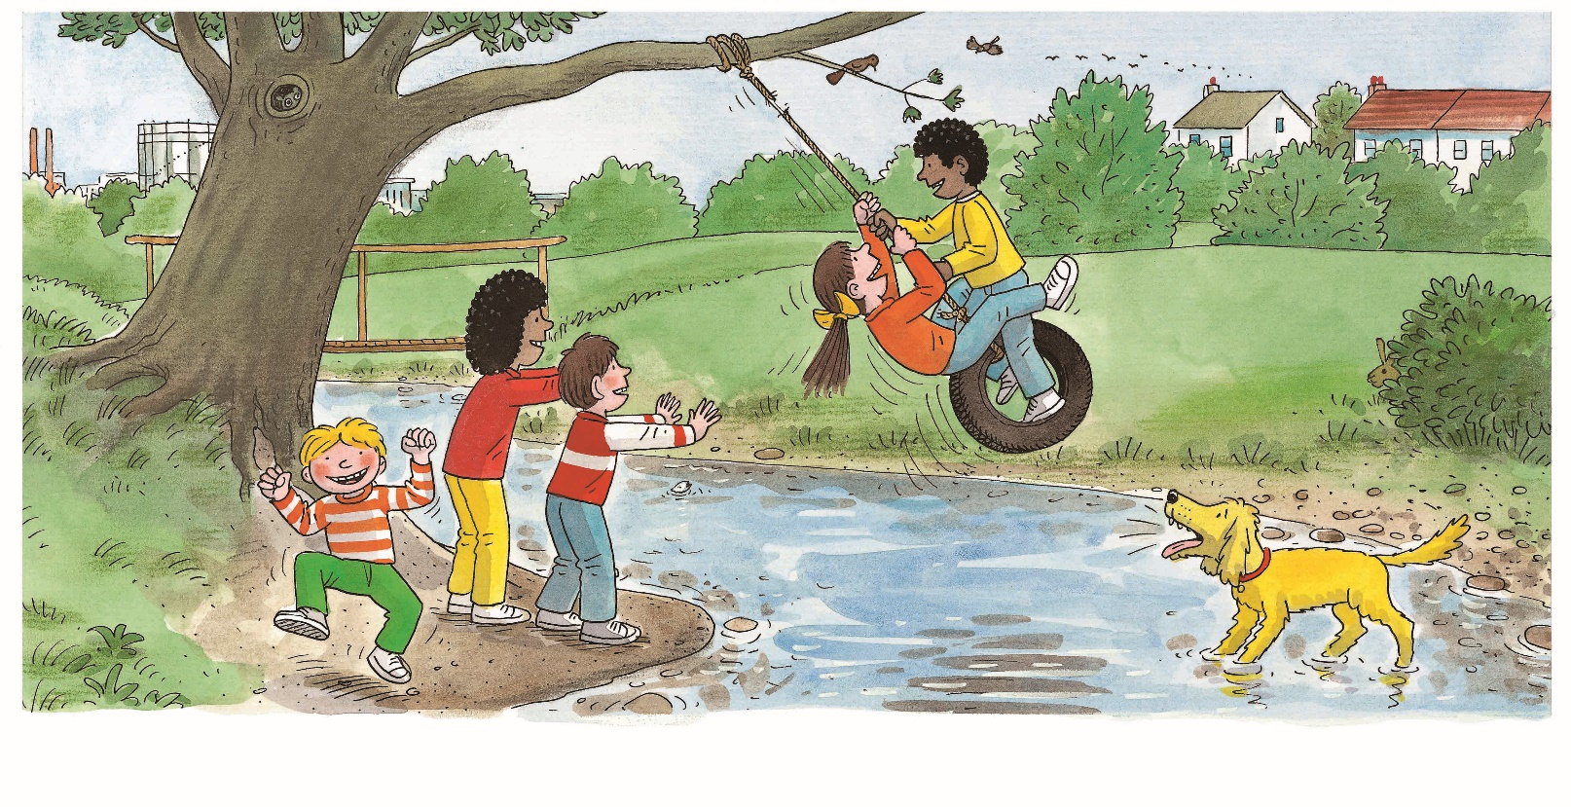
The Rope Swing
LO: Understand the text; read the text fluently.
Read the first sentence aloud to Ss; have them answer the first comprehension question.
Read the second sentence aloud to Ss and have them answer the second question using the text.
Have Ss observe Floppy carefully in the illustration; ask them to talk more about the third question using the text and the illustration. Sample answer: Floppy was standing with four feet in the water.
Have Ss observe Kipper carefully in the illustration and ask Ss to talk more about the fourth question.
Have Ss take turns reading the text.
TG
Reading
Comprehension
Who climbed on the swing?
How many times does the word barked appear in the text?
What did Floppy do? Look for clues in the text and the illustration.
How did the children feel when they were playing? How about Floppy?
Biff climbed on
the swing.
Floppy barked and barked.
2:30
12/23

Slide 13
The Rope Swing
LO: Understand the text; read the text accurately and fluently.
Read the first sentence aloud to Ss; have them talk more about the first question using the text and the illustration.
Read the second sentence aloud to Ss; have them talk more about the second question by using the text and the illustration. (Suggestion: Please click back to the last slide and help Ss make comparisons of Floppy’s actions.)
Sample answer: Floppy barked three times and he lifted his
front paws on this slide.
3. Have Ss read the text accurately and fluently.
TG
Reading
Comprehension
Did the other children get down from the swing when Chip climbed on it? Was it safe to play with the swing like that?
What did Floppy do? How did he look?
Chip climbed on
the swing.
Floppy barked and barked and barked.
Decoding
Fluency.
2:00
13/23

Slide 14
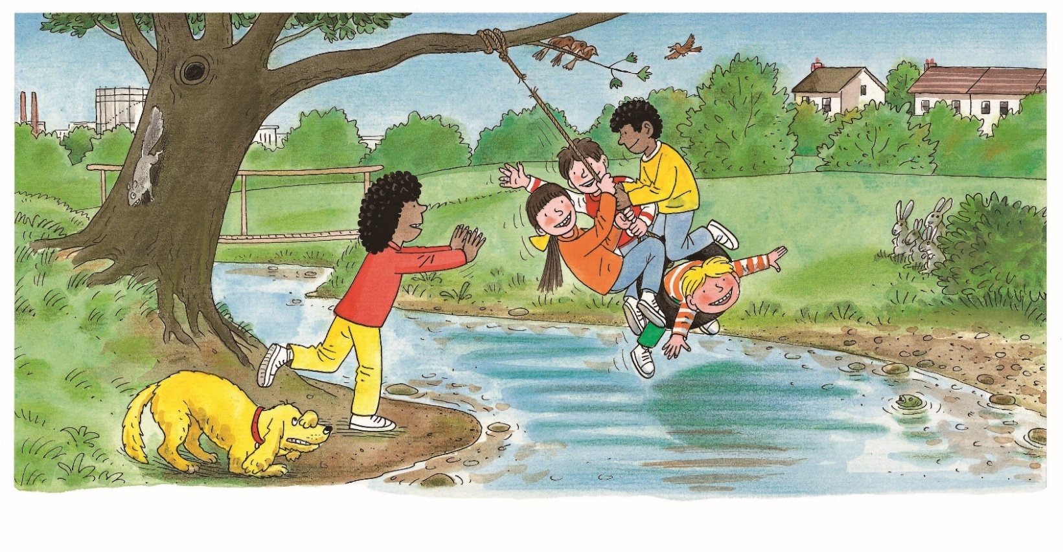
The Rope Swing
LO: Understand the text; make connections; read the text fluently.
Read the text aloud to Ss; have them observe the illustration carefully and talk about the comprehension questions.
Encourage Ss to talk about the connections question;
Have Ss take turns reading the text fluently.
TG
Reading
Comprehension
How many children were on the swing? Who went on the swing?
What did Kipper say to Floppy? Why?
Kipper went on
the swing.
“What a silly dog!” said Kipper.
Decoding
Fluency.
2:00
14/23

Slide 15
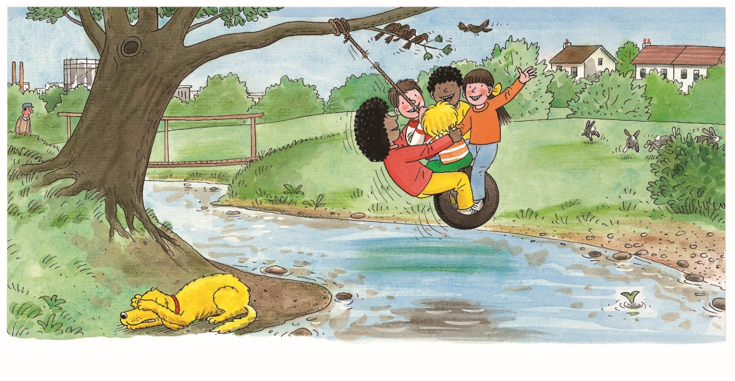
The Rope Swing
On this slide, test Ss’ reading skills; each S should be tested; give each S a mark according to the assessment rubrics.
LO: Understand the text; identify the details; identify the characters;
recognize the sequence of events in the story; make predictions; read the text fluently.
Read the text aloud to Ss;
Have Ss talk about the different reading strategy questions by using the text and the illustration.
Have Ss take turns reading the text fluently.
Note: Sample answers:
3 points (Details and Characters)
(1) Rabbits, dog, birds, fish, and squirrels (or some of them).
(2) Kipper and Wilma.
4 points (Details and Characters):
(1) I can see . . .
(2) Kipper and Wilma said Floppy was a silly dog.
4 points (Sequence and Prediction)
Wilf; Wilma.
Fell to the ground; afraid.
5 points (Sequence and Prediction)
Wilf was the first child and Wilma was the last child.
I think the children might fall to the ground. I think Floppy was afraid.
TG
Reading
Details
What animals can you see in the story?
Characters
Who said Floppy was a silly dog in the story?
Sequence
Who was the first child to climb on the rope swing? Who was the last one?
Prediction
Wilma went on too.
“What a silly dog!” said Wilma.
What might happen to the children next? Why was Floppy hiding his eyes?
6:00
15/23

Slide 16
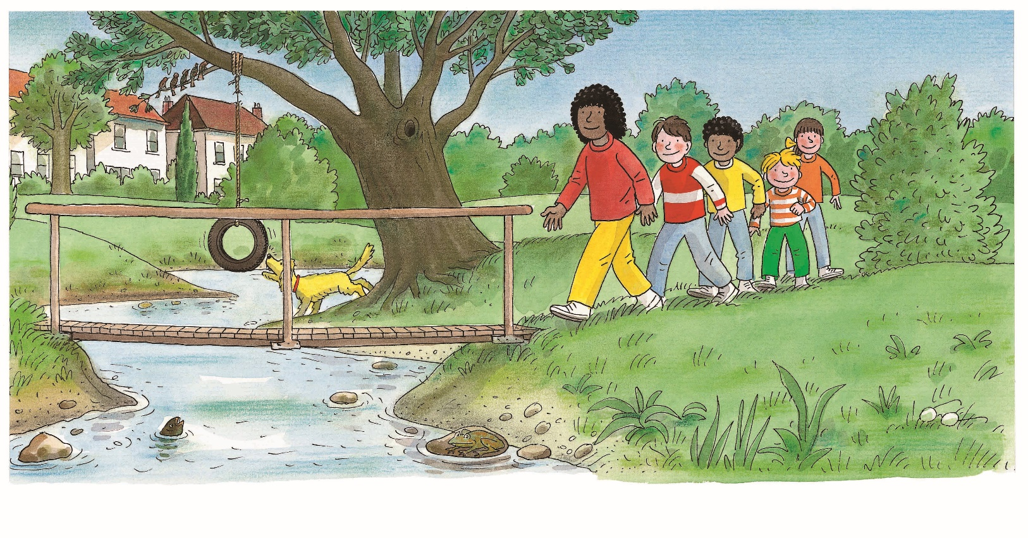
The Rope Swing
LO: Understand the text; make connections; read the text fluently.
Read the text aloud to Ss; have them observe the illustration carefully and talk about the comprehension questions.
Encourage Ss to talk about the connections question.
Have Ss take turns reading the text fluently.
TG
Reading
Comprehension
Where did the children go?
Why did Floppy look at the rope again?
Connections
What dangerous things should we not do in life? Can you name some of them?
The children went home.
Floppy looked at the rope.
2:00
16/23

Slide 17
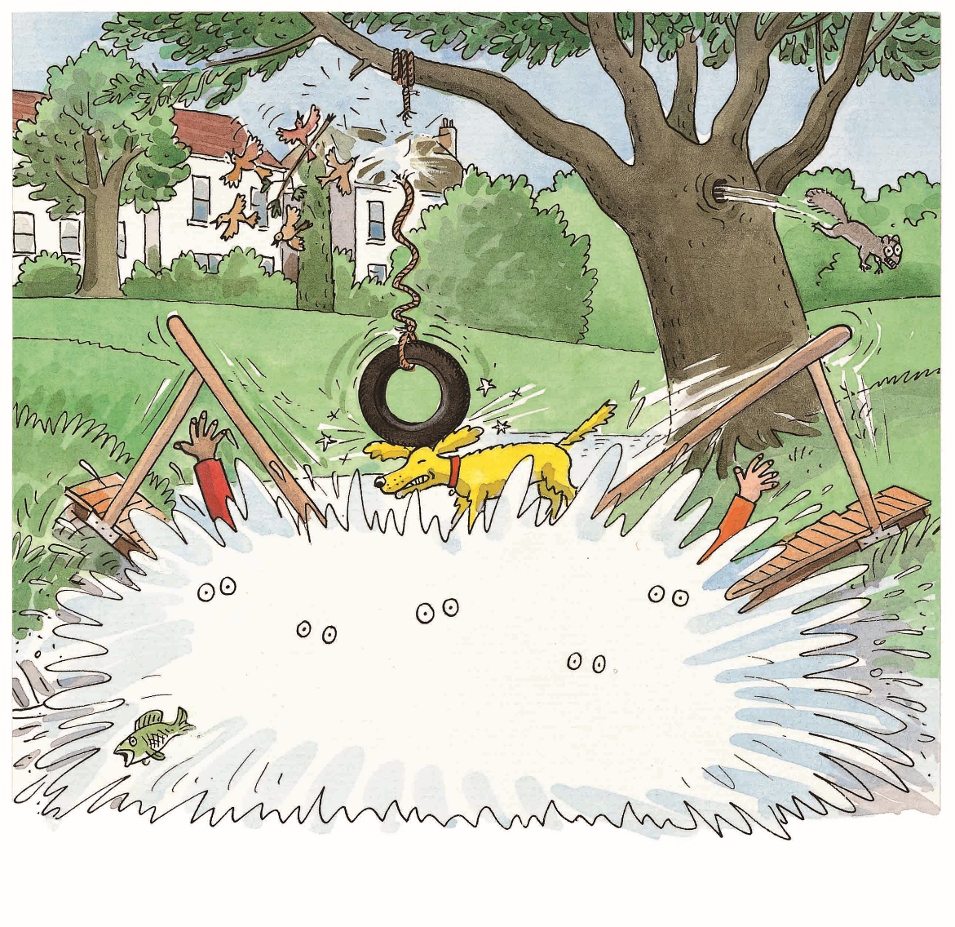
The Rope Swing
On this slide, test Ss’ classroom engagement; each S should be tested; give each S a mark according to the assessment rubrics.
LO: Understand the text; identify details; make predictions; discuss and
express some ideas about the text; read the text accurately and
fluently.
Read the text aloud to Ss;
Have Ss observe the illustration carefully and have Ss talk about the different reading strategy questions.
Have Ss take turns reading the text fluently.
TG
Reading
Details
Did the children walk across the bridge successfully? What happened to them?
Predictions
What would happen to the birds and the squirrels at the end of the story?
Discussion
Was it a surprise when the bridge broke? Why? What should the children do if they want to cross the bridge?
Splash! Oh no!
4:00
17/23

Slide 18
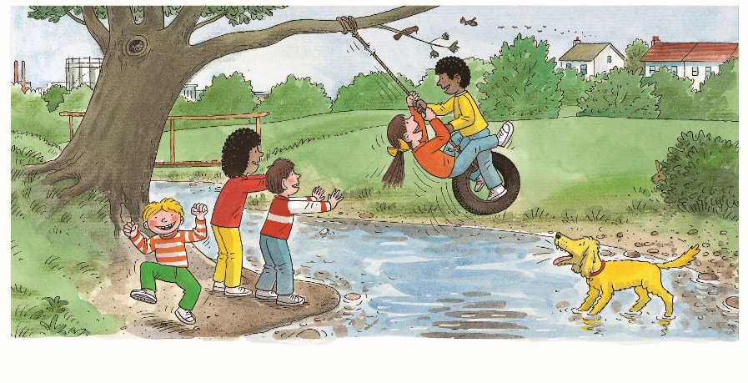
LO: Retell the story with the visual support and assistance.
1. Have Ss recall the story; model first.
2. Have Ss work together to retell the story using the visual aids. Help
them if necessary.
TG
Reading
Let’s retell!
1
2
4
3
5
____ climbed on/went on the swing.
2:00
18/23

Slide 19
LO: Talk about the given question with the sentence structures.
Have Ss work in pairs to talk about the given illustration by using the sentence structures and helping words; model first.
Assist Ss if necessary.
TG
Listening &
Speaking
Let’s talk!
—What did ____ do?
—____ ____ the swing.
Helping Words
Biff Chip Kipper Wilf Wilma | looked at pushed went on climbed on
Biff
Chip
Kipper
TV
2:00
19/23

Slide 20
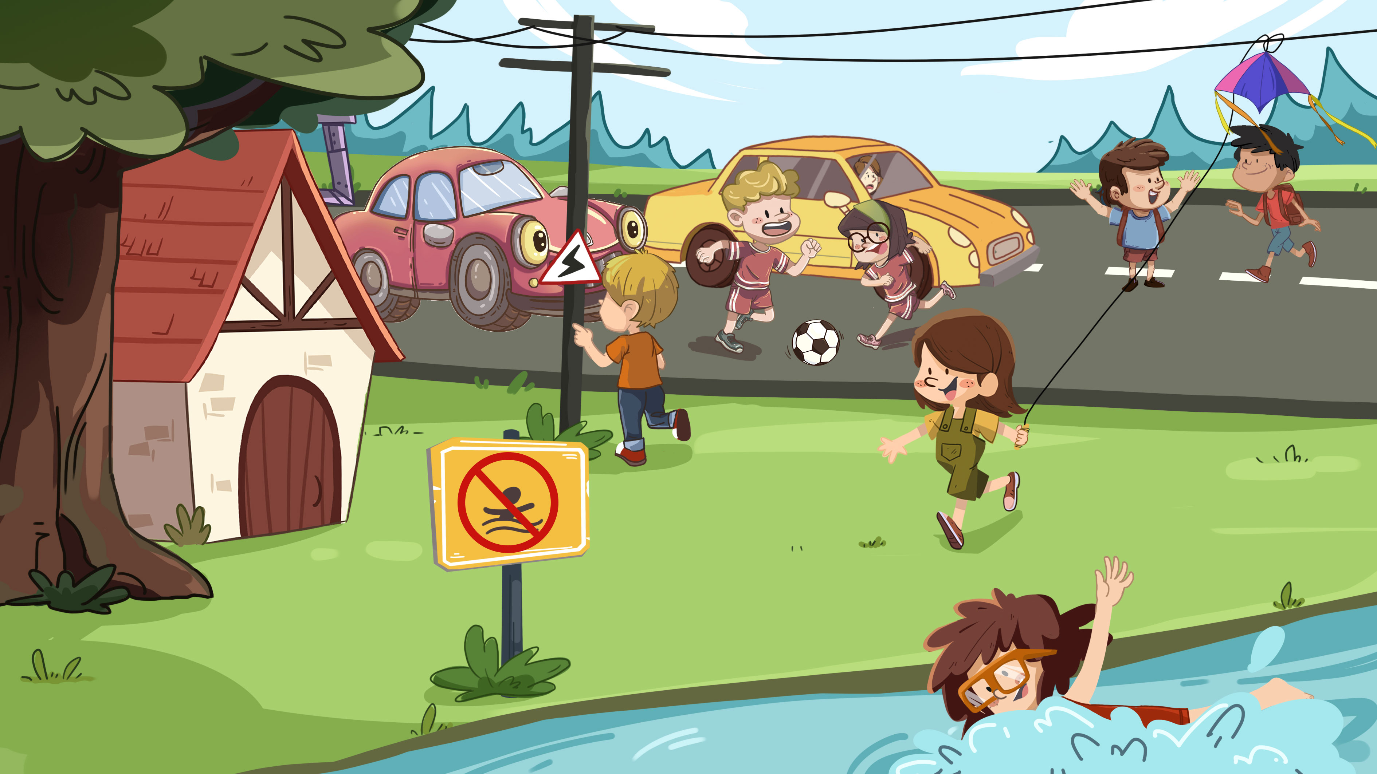
On this slide, test Ss’ listening and speaking skills; each S should be tested; give each S a mark according to the assessment rubrics.
LO: Talk about the dangerous activities the children are doing in the picture and tell Ss that they should play safely.
Ask Ss to observe the pictures carefully.
Have Ss talk about the dangerous activities the children are doing in the picture.
Click Let’s talk! and ask Ss to talk about the given pictures using the given language structure; model first. Assist Ss if necessary.
Notes: Sample answers:
3 points: Play football on the road. Fly a kite near the high-tension cable.
Climb on the wire pole.
4 points: Two boys are playing football on the road.
5 points: Hurt themselves; should play safely.
TG
Listening &
Speaking
Let’s talk!
Please talk about two dangerous activities in the picture.
—What dangerous things did the
children do?
— __________.
wire pole, high-tension cable, electricity . . .
2. Why are the activities in the picture
dangerous? What should they do?
4:00
20/23

Slide 21
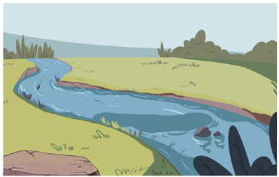
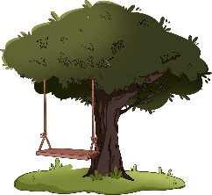
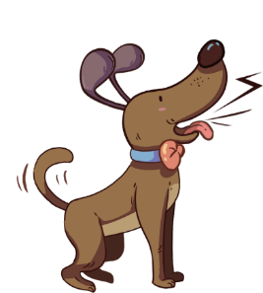
On this slide, test Ss’ foundational skills; each S should be tested; give each S a mark according to the assessment rubrics.
LO: Talk about what they’ve learned from the story by using the given
structure and language support.
Guide Ss to talk about what they’ve learned concerning The Rope Swing.
Ask Ss to think about the given questions; help Ss to organize ideas from the story by using the given visual support, and tell them, “This is practice before your homework.”
Model the questions, and then ask Ss to take turns presenting their answers.
TG
Oral Writing
Get ready to present!
?
Chip
Biff
Wilf
Kipper
Wilma
____ climbed on/went on the swing.
How did the children play with the rope swing? A. Together. B. One at a time.
What happened to the children at the end of the story? A. They fell into the river. B. They went across the bridge.
3:00
21/23

Slide 22
LO: Understand what the homework is.
1. Explain the writing task to Ss and check their understanding.
2. Tell Ss that they should finish their writing before next class. Make sure
they know they can upload their homework to the platform. They will
present their work next class.
3. Remind Ss to watch the post-class video and finish the writing task.
TG
Writing
Poster Writing
Let’s draw and write!
Describe a new and sturdy bridge.
Now, please follow the steps to finish your homework and present it in the next class:
Draw a picture of a new and sturdy bridge you want to make for the children in the story.
Write one complete sentence to describe it.
Watch the post-class video about the writing task.
0:30
22/23

Slide 23
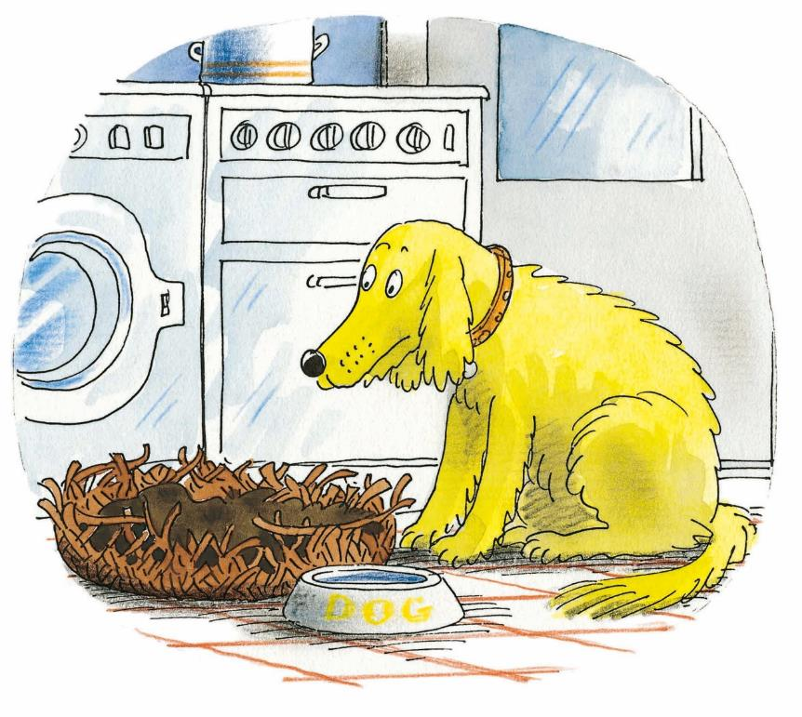
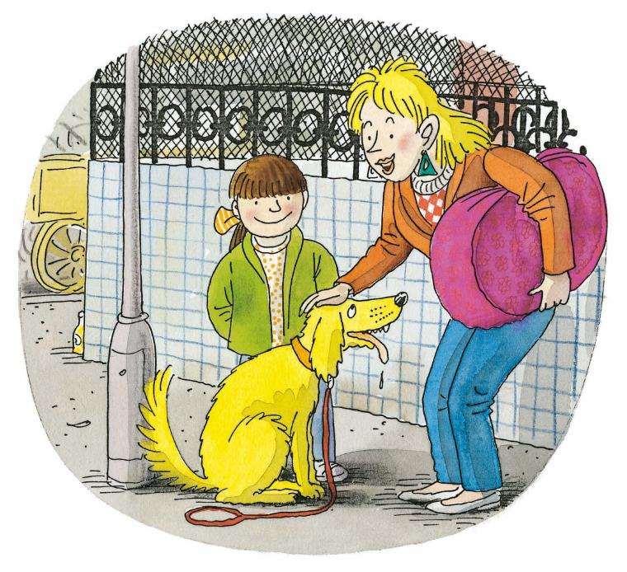
LO: End the lesson and encourage Ss to prepare well for the next class.
1. Briefly comment on Ss.
2. Say goodbye to students.
3. Ask Ss to preview the next lesson.
TG
1:00
23/23

