Slide 1
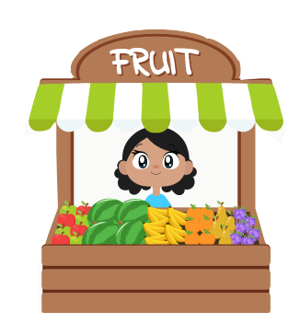
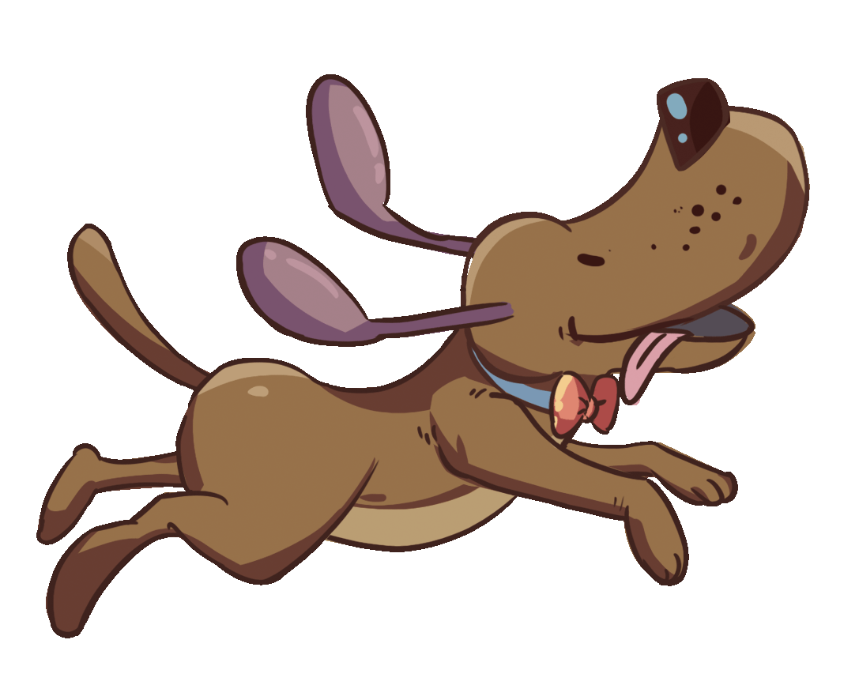
LO: Greet their partners; get a basic idea about the topic of today’s lesson.
Say hello to Ss; ask Ss to greet each other.
Guide Ss to describe the pictures on the cover.
Introduce the topic of the lesson.
TG
The Chase
ORT-GKA
Lesson 16
1:00
1/26

Slide 2
Learning
Goals
TG
LO: Get to know and understand what will be learned in this lesson.
Go through the learning goals with Ss.
We are
going to . . .
Blend syllables by saying words aloud.
Learn the different words market, toilet, plates, oranges, and clothes, and make sentences with them.
Read the story The Chase and identify the plot by using the text and pictures.
Practice using the sentence structure ____ jumped over the ____.
0:30
2/26

Slide 3
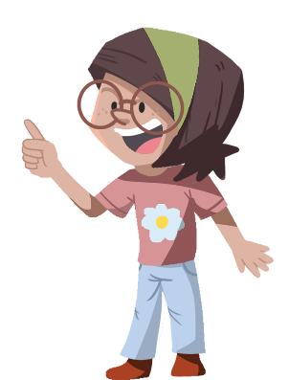
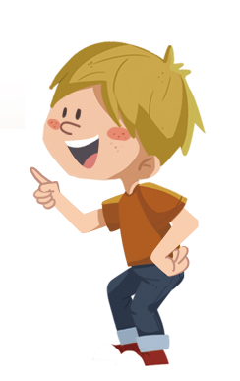
LO: Present and share writing assignment from last lesson.
Invite Ss to take turns presenting their homework. If time is limited, tell Ss they have one or two mins to present their writing.
Encourage Ss to listen carefully and to ask questions.
After both of the Ss have finished, give them feedback and awards (click the picture of the book beside the boy or the girl so that they can get some awards).
Note: You can click the picture of the boy or the girl to give each S a trophy to mark their good performance.
TG
Presentation
Let’s show!
This is a new and sturdy bridge that the children can use in the story.
2:00
3/26

Slide 4
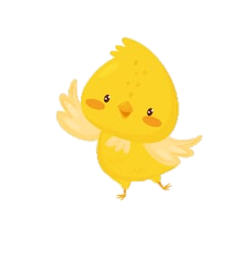
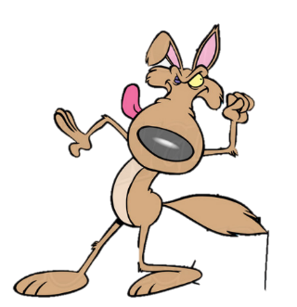
Phonics
TG
LO: Pronounce and blend the syllables while saying the words aloud.
Ask Ss to talk about what they see in the picture; tell them to help the dog in the picture find the kittens’ house.
Click and read the syllables to Ss; have Ss repeat after T; click and guide Ss to blend the syllables into words; click and ask Ss to help the dog in the picture knock on the window to see whether or not there are any kittens.
Note: Each of the three words has the same operational process; Ss will learn three words on this slide.
3. Click and tell Ss that they have helped the dog find its friends’ house; ask Ss to read the three words again.
Let’s listen and speak!
com
room
bedroom
Jer
Jerry
ry
computer
bed
put
er
Can you read and blend the syllables?
Help me find the kittens’ house !
2:30
4/26

Slide 5
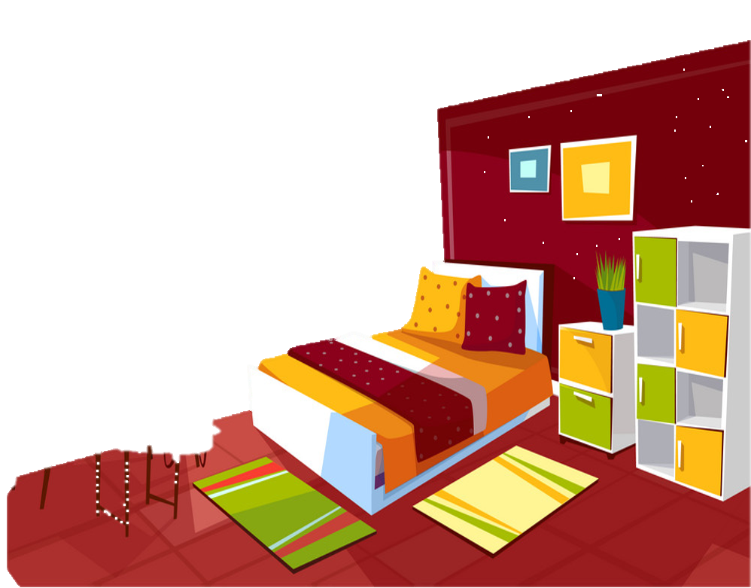
Phonics
TG
LO: Pronounce and blend the syllables while saying the words aloud.
Ask Ss to talk about what they see in the picture; tell them to help the dog find out where the kittens are hiding.
Click and read the syllables to Ss; have Ss repeat; click and guide Ss to blend the syllables into words; click and ask Ss to help the dog find a kitten.
Note: Each of the three words has the same operational process; Ss will learn three words on this slide.
3. Click to tell Ss that they have helped the dog find the kittens, and now the dogs and kittens can play together; ask Ss to read the three words again.
Let’s listen and speak!
playroom
bas
happy
ball
room
play
py
basketball
hap
ket
Can you read and blend the syllables?
Come on in! Can you find where the kittens are?
2:30
5/26

Slide 6
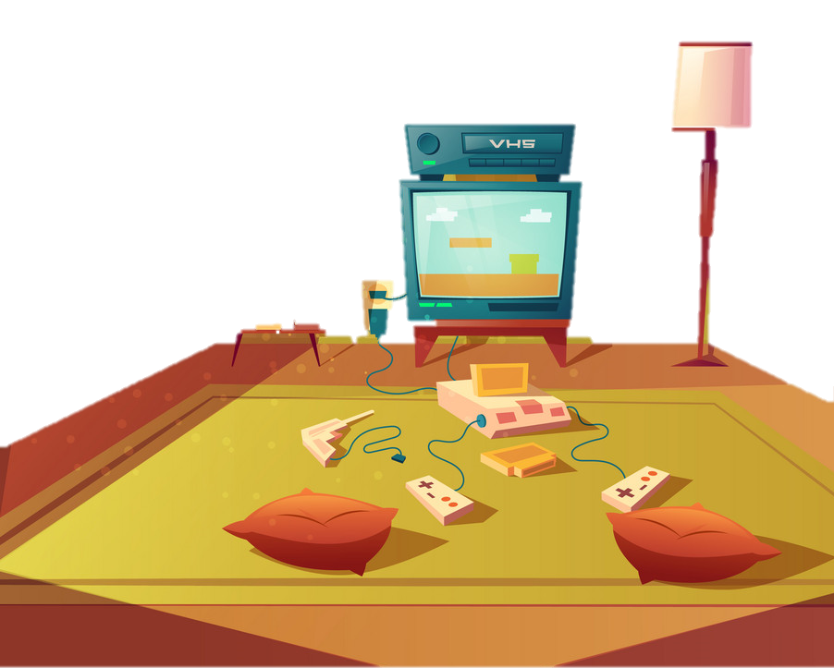
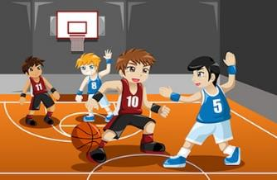
Phonics
TG
LO: Read the text fluently; blend the syllables in the words together.
Click and read the text to Ss with rhythm.
Guide Ss to repeat after you; ask one S to read one sentence, and the other to read the next until they finish reading the text; give feedback.
Guide Ss to blend the syllables in the words together.
Let’s chant!
Jerry came to where kittens stay.
There is a computer in their bedroom.
Did they play there?
No, they played in their playroom.
They watched a basketball game.
What a happy day!
2:00
6/26

Slide 7
Lead-in
TG
LO: Activate Ss’ interest in reading; use the illustration and the title to identify details and to make predictions; make connections.
Have Ss look at the book cover closely and have Ss talk about the first three questions by using the illustration and the title.
Ask Ss to talk about the connections question; assist them if necessary.
Before Reading
How does Floppy look on the book cover? Why?
What do you think the story will be about?
Connections
What funny things might happen between a dog and a cat?
Written by Roderick Hunt
Illustrated by Alex Brychta
2:00
7/26

Slide 8
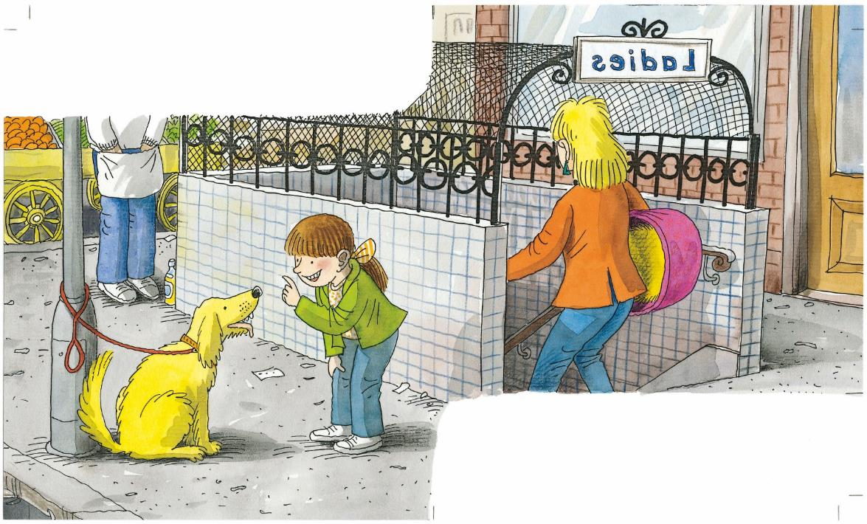
LO: Identify the details and make predictions about the story by using the illustration; motivate Ss’ interest in reading the story.
Ask Ss to recall what it means to predict.
Have Ss look at the illustration carefully and talk about the given questions.
TG
Reading
Let’s predict!
Before Reading
What are Mum and Biff going to do?
What do you think Biff is saying to Floppy?
1:00
8/26

Slide 9
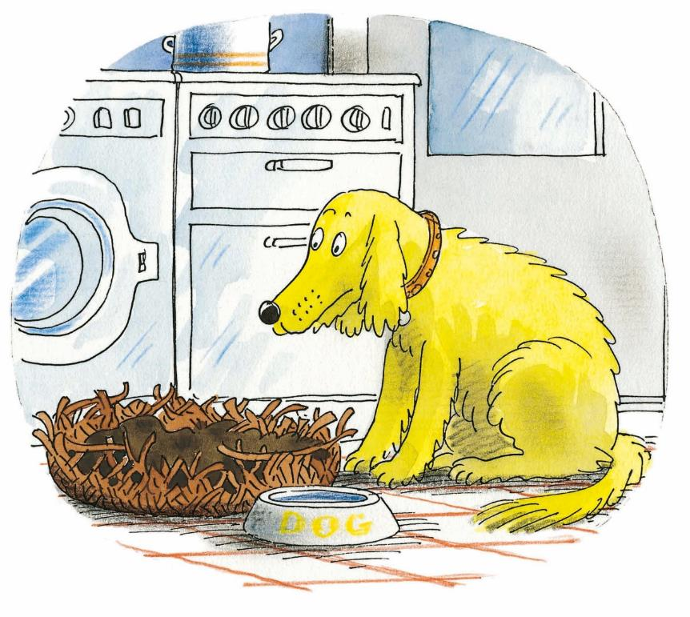
LO: Understand the text; read the text fluently.
Read the text aloud to Ss; have Ss talk about the first comprehension question.
Ask Ss to observe the illustration, to talk about the second question, and to get more clues by using the illustration.
Ask Ss to take turns reading the text aloud.
TG
Reading
The Chase
Comprehension
What did Floppy want at the beginning of the story? Why?
How did Floppy feel?
Floppy wanted a new basket.
1:30
9/26

Slide 10
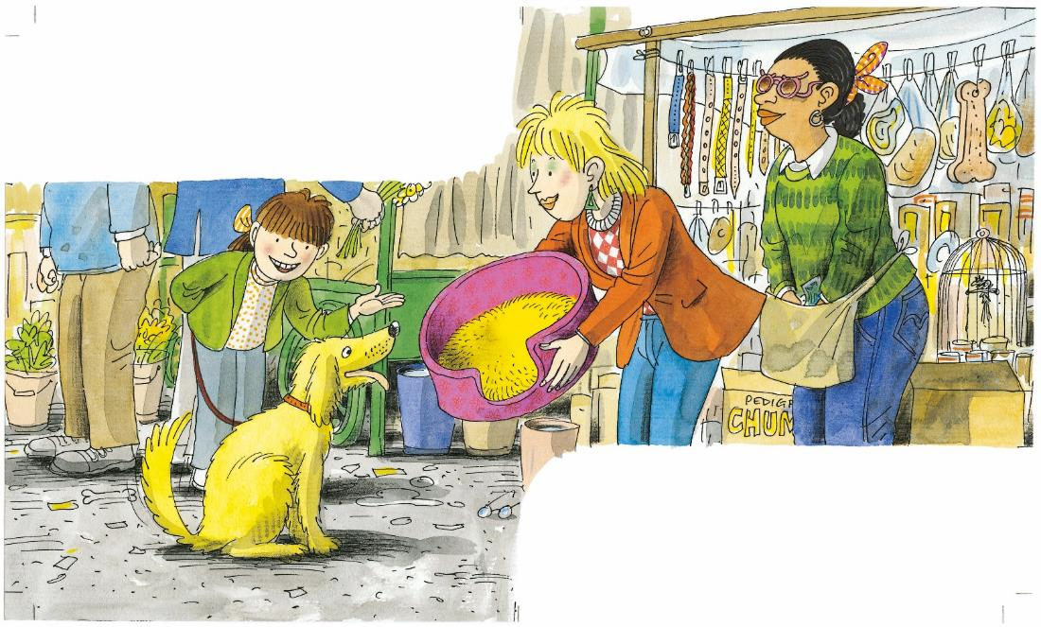
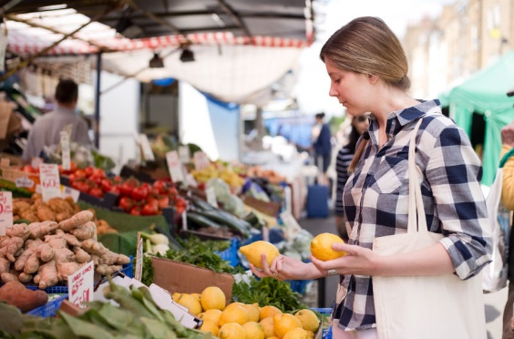
LO: Understand the meaning of the vocabulary word market, then make sentences with it; understand the text; make connections; read the text fluently.
Ask one S to read the first sentence in the text; click the penguin button and explain the word market; have Ss read it and make sentences with it; have Ss talk about the first comprehension question.
Ask another S to read the second sentence in the text; have Ss read it and make sentences with it; have Ss talk about the second comprehension question.
Ask Ss to talk about the connections question.
Have Ss read the text fluently.
TG
Reading
The Chase
Comprehension
Vocabulary
Where did Mum, Biff, and Floppy go? Why did they go there?
What did they get? How did Floppy feel?
Mum and Biff went to the market.
market
She is shopping in a market.
Connections
Do you like shopping at the market? What do you often buy there?
They got a new basket.
market
3:00
10/26

Slide 11
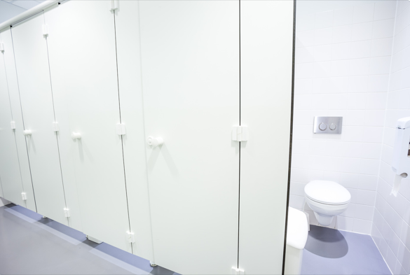
Reading
TG
LO: Understand the meaning of the vocabulary word toilet and make sentences with it; understand the text; identify the plot of the story by using the text and the illustration; read the text fluently.
Have Ss read the text together; click the penguin button and explain the word toilet; have Ss read it and make sentences with it; ask them to talk about the comprehension questions by using the text and the illustration.
Read the plot question to Ss; ask them to read through the options in turns and to identify the beginning plot of the story by using the illustration and context clues.
Have Ss read the text fluently.
The Chase
Comprehension
Vocabulary
“Stay Floppy,” said Biff.
Where did Mum and Biff go?
What did Biff tell Floppy to do?
Plot: beginning
toilet
At the beginning of the story, what happened?
Floppy stayed at home and slept in his basket.
Floppy got a new basket and waited for Mum and Biff.
People like to use a clean toilet.
Mum and Biff went to the toilet.
toilet
3:00
11/26

Slide 12
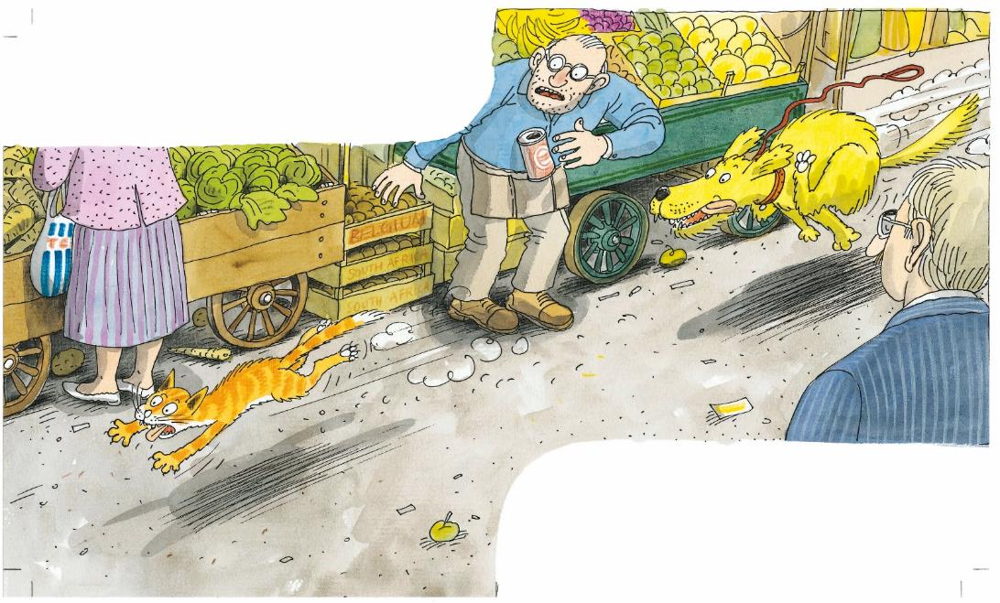
Reading
TG
LO: Understand the text; read the text automatically and fluently.
Have Ss identify the words they already know in turns ; have Ss read the vocabulary words accurately by asking, “Which words do you know in this sentence?" Have Ss read through the words quickly. Read the text aloud to them.
Ask them to talk about the comprehension question by using the text and the illustration.
Have Ss take turns reading the text automatically and fluently.
The Chase
Comprehension
Floppy saw a cat.
What did Floppy see?
What did Floppy do?
Decoding
Read with automaticity.
He chased it.
2:00
12/26

Slide 13
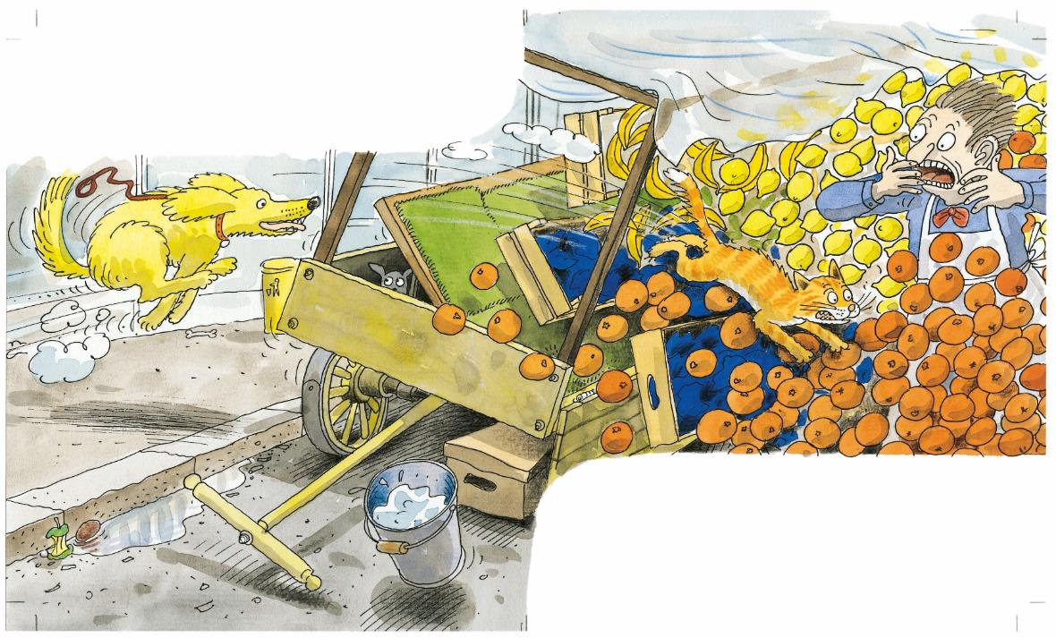
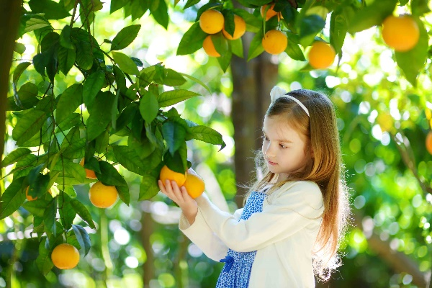
Reading
TG
LO: Understand the meaning of the vocabulary word oranges and make sentences with it; read the sight word accurately; understand the text; read the text fluently.
Read the text aloud to Ss.
Read the text aloud to Ss; click the penguin button and explain the word oranges; have Ss read it and make sentences with it.
Have Ss read the sight word accurately.
Ask Ss to talk about the comprehension questions by using the illustration.
Have Ss read the text fluently.
The Chase
Comprehension
Vocabulary
The cat jumped over the oranges.
Where did the cat go when Floppy chased it?
What happened to the oranges in the stall?
How did the man feel? Who was he? What did he think of Floppy?
oranges
The girl is picking oranges.
Crash went the oranges.
Sight Words
oranges
jumped
3:00
13/26

Slide 14
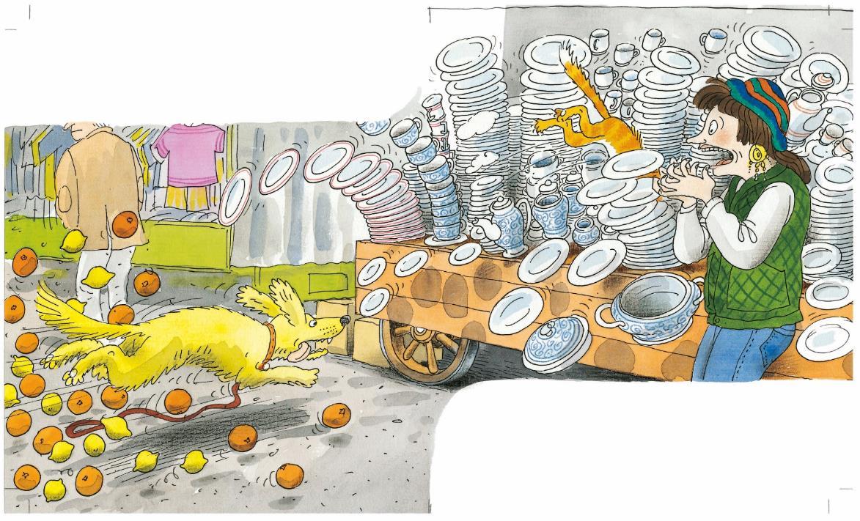
Reading
TG
LO: Understand the meaning of the vocabulary word plates and make sentences with it; understand the meaning of the unfamiliar word; understand the text; read the text fluently.
Read the text aloud to Ss.
Read the text aloud to Ss; click the penguin button and explain the word plates; have Ss read it and make sentences with it.
Explain the unfamiliar word crash.
Ask Ss to talk about the comprehension questions by using the illustration.
Have Ss read the text fluently.
Vocabulary
The Chase
Comprehension
The cat jumped over some plates.
Where did the cat go when Floppy chased it?
How did the woman feel when Floppy chased the cat? Why did she look like that?
plates
There are many colorful plates.
Crash went the plates.
plates
Unfamiliar Words
crash
3:00
14/26

Slide 15
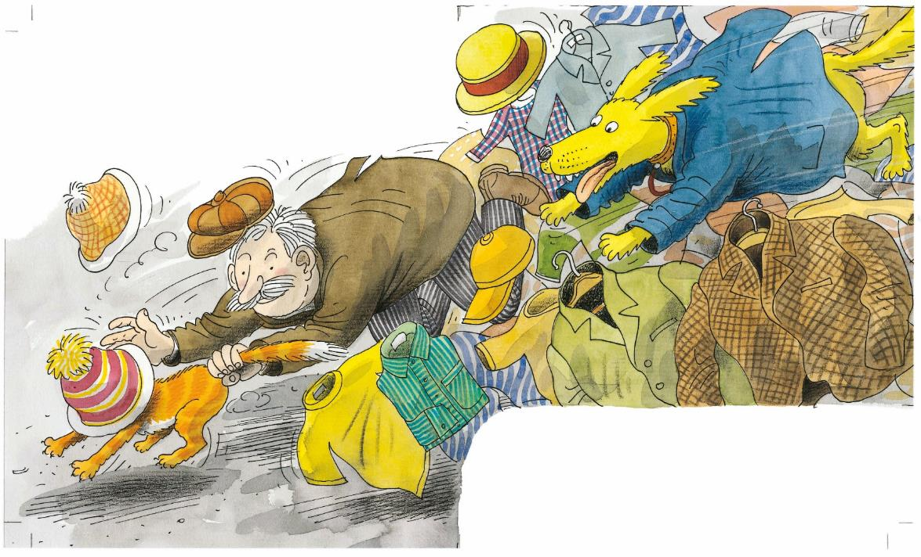
Reading
TG
LO: Understand the meaning of the vocabulary word clothes and make sentences with it; understand the text; identify the plot of the story by using the text and the illustration; read the text fluently.
Have Ss read the text together; click the penguin button and explain the word clothes; have Ss read it and make sentences with it; ask them to talk about the comprehension questions by using the text and the illustration.
Read the plot question to Ss; ask them to read the options in turns and to identify the middle plot of the story by using the illustration and context clues.
Have Ss read the text fluently.
The Chase
Comprehension
Vocabulary
Where did Floppy and the cat go?
What did the old man do to the cat? Why did he do that?
“Got you!” said a man.
clothes
She is choosing the clothes she wants to wear.
Plot: middle
In the middle of the story, what happened?
The cat jumped over many stalls.
Floppy caught the cat.
The cat jumped over some clothes.
clothes
3:30
15/26

Slide 16
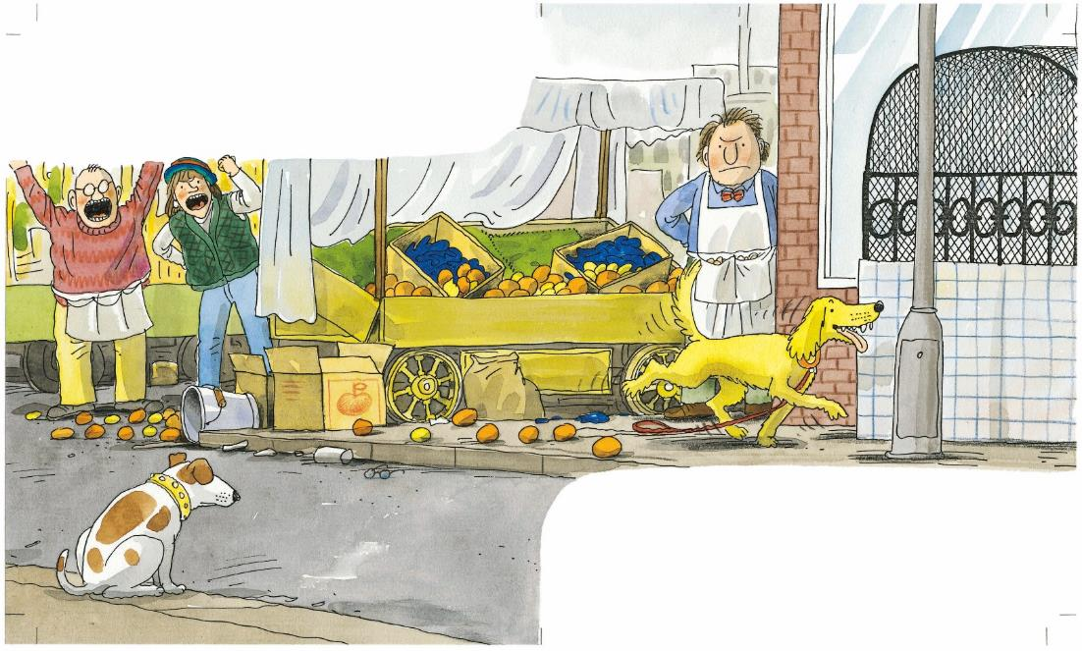
Reading
TG
LO: Understand the text; make connections; read the text automatically and fluently.
Have Ss identify in turns the words they already know; have Ss read the vocabulary words accurately by asking, “Which words do you know in this sentence?” Have Ss read the words quickly. Read the text aloud to them.
Ask them to talk about the comprehension question by using the text and the illustration.
Ask Ss to talk about the connections question.
Have Ss take turns reading the text automatically and fluently.
The Chase
Comprehension
Everyone was cross.
How did everyone feel? Why?
What did everyone think of Floppy? How did Floppy feel?
Decoding
“What a bad dog!”
everyone said.
Read with automaticity.
2:00
16/26

Slide 17
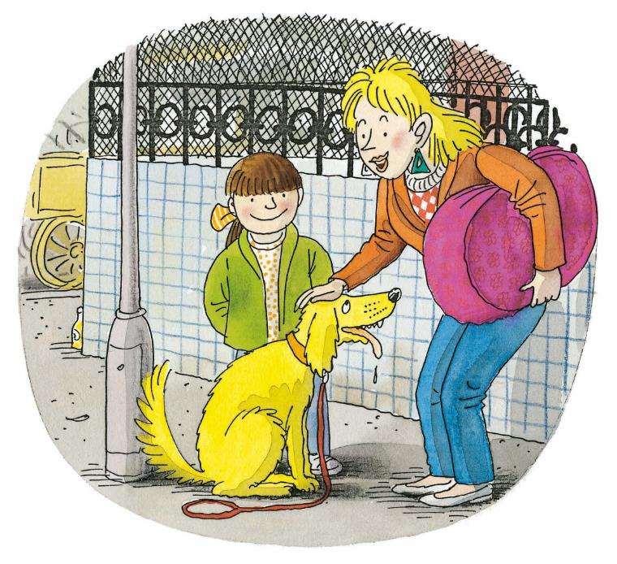
Reading
TG
LO: Understand the text; make discussions; identify the plot of the story by using the text and the illustration; read the text fluently.
Ask Ss to read the text aloud together; have them talk more about the two comprehension questions by using the text and the illustration clues.
Read the plot question to Ss; ask them to identify the ending plot of the story by using the illustration and context clues.
Ask them to talk more about the discussion question.
Have Ss read the text fluently.
The Chase
Comprehension
What did Mum think of Floppy? Why?
How did Floppy feel? Why?
How do you think Mum would feel if she found out about what happened?
Plot: end
At the end of the story, what happened?
People at the market: ___________.
Mum: __________.
Floppy: __________.
Discussions
“What a good dog!” said Mum.
Do you think Floppy was a good dog or a bad dog? Why?
3:30
17/26

Slide 18
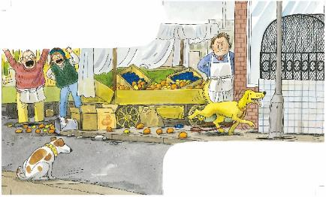
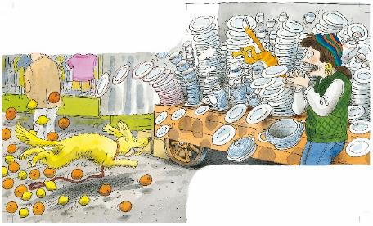
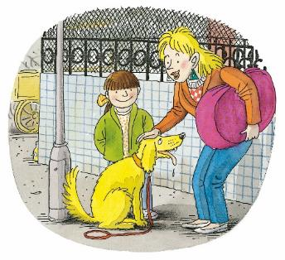
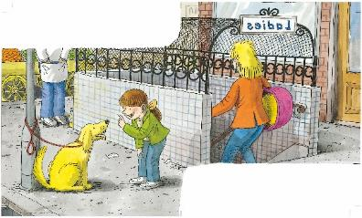
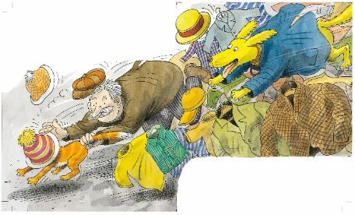
Reading
TG
LO: Retell the story with visual support and assistance.
Have Ss recall the story; model first.
Have Ss work together to retell the story by using the visual aids. Help them if necessary.
Let’s retell!
Beginning
Middle
End
Floppy wanted _____.
Mum went to _____.
People at the market said, “_____.”
Mum said, “_____.”
2:30
____ jumped over ____.
18/26

Slide 19
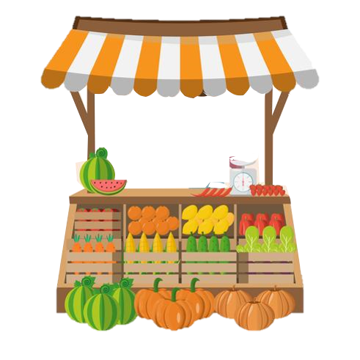
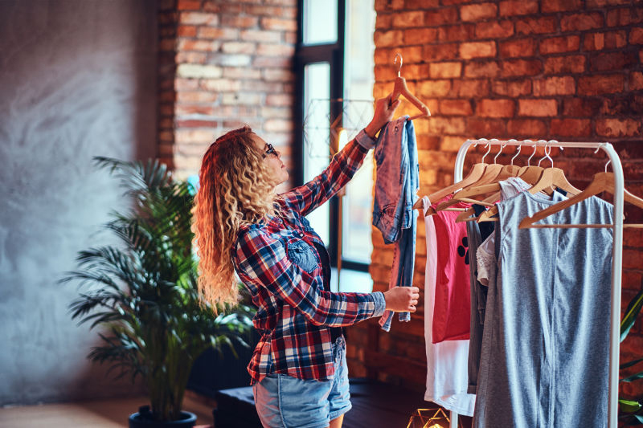
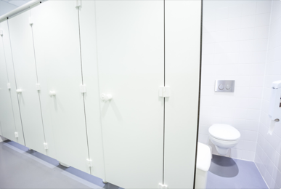
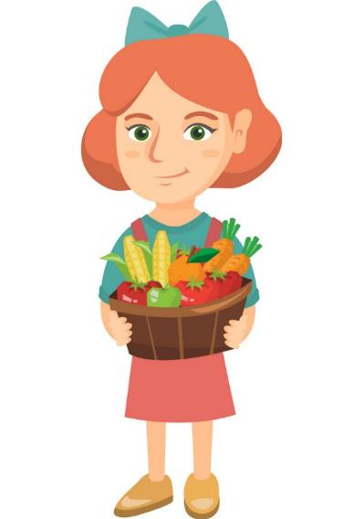
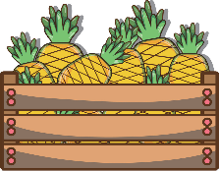
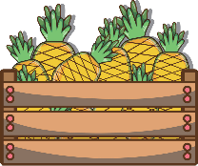
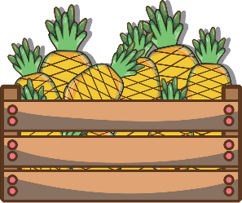
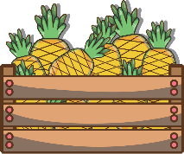
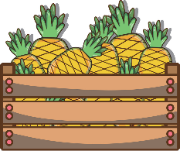
LO: Check Ss’ understanding of the words in this lesson.
Ask Ss to completely review all the learned words in this lesson.
Tell Ss to help the lady in the picture fill the baskets.
The steps are as follows:
First, click the picture and ask Ss to identify the picture with the capital letter. Then, click the picture to reveal the entire word. Next, click the picture again to make it disappear, and then the lady will show up to fill the basket.).
Announce the winner of the competition.
Note: If time is limited, skip this section.
TG
Vocabulary
Let’s guess!
C
clothes
M
market
plates
P
O
oranges
T
toilet
1:00
19/26

Slide 20
Listening &
Speaking
TG
LO: Talk about where Floppy and the cat went in the story.
Have Ss work in pairs to talk about the given illustration by using the sentence structure and helping words; model first.
Assist Ss if necessary.
Let’s talk!
—Where did _____ go when
Floppy chased the cat?
—_____ jumped over the _____.
Helping Words
Floppy the cat | oranges plates clothes
Biff
Chip
Kipper
TV
2:00
20/26

Slide 21
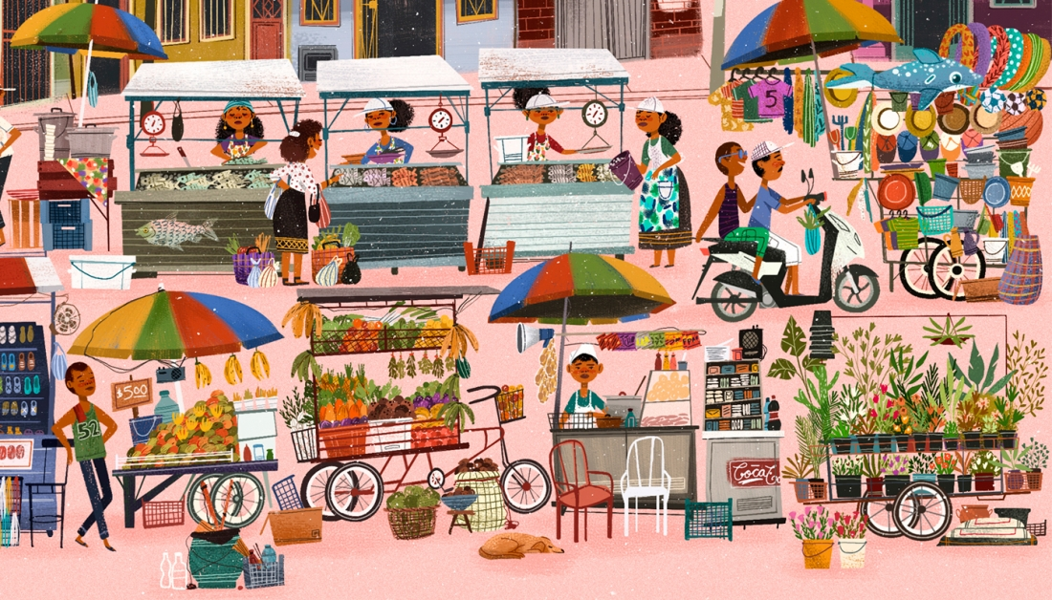
Listening &
Speaking
TG
LO: Talk about where else Floppy might go in the market.
Ask Ss to observe the pictures carefully.
Have Ss talk about where else Floppy might go in the market.
Click Let’s talk! and ask Ss to talk about the given pictures by using the given language structure; model first. Assist Ss if necessary.
Notes: T can click Let’s talk! to present the sentence structure, and then click it again to make it disappear.
Let’s talk!
—Where else might Floppy go
in the market?
—I think he might go to the _____.
fruit stall
flower stall
fish stall
. . .
2:30
21/26

Slide 22
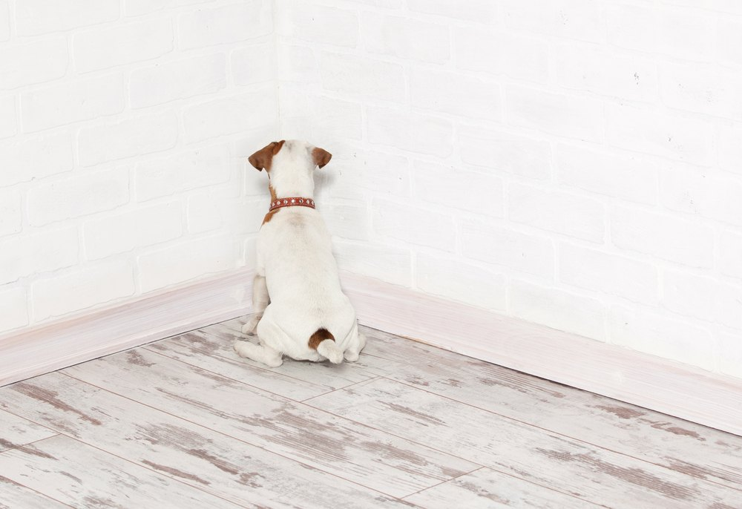
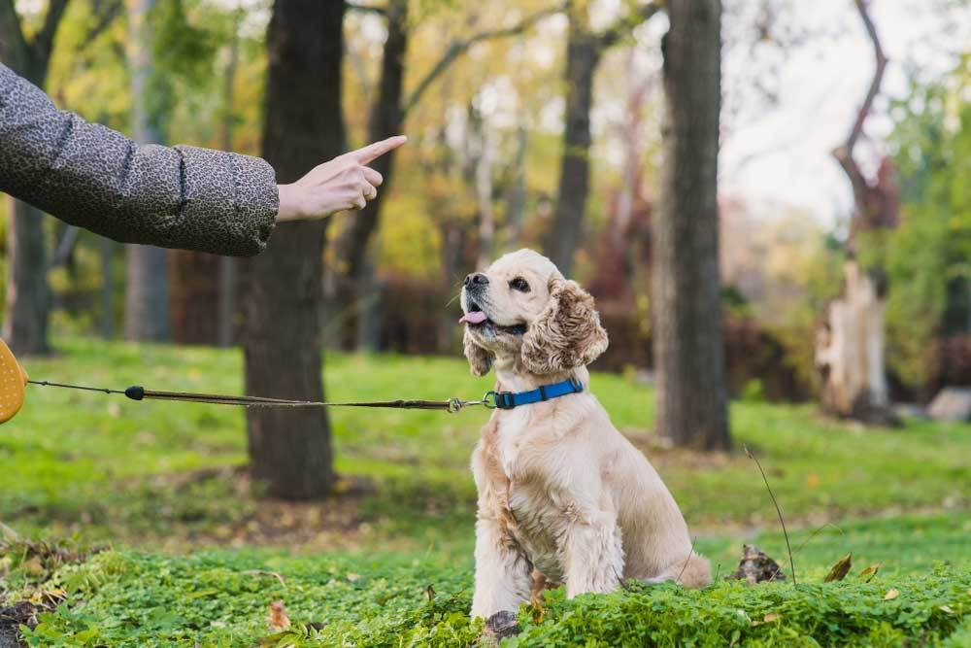
LO: Talk about the values in the story: disciplining a naughty dog.
Ask Ss about the given task; model first.
Guide Ss to talk about the question with the help of the given pictures.
Encourage Ss to talk more about the following question: what can you do when your dog is naughty?
TG
Value
When your dog is very naughty, what do you do?
make it stand in a corner as a punishment
train it
2:00
22/26

Slide 23
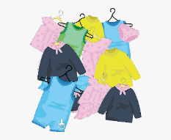
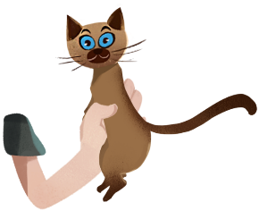
LO: Talk about what they learned from the story by using the given structure and language support.
Guide Ss to talk about what they learned from The Chase.
Ask Ss to think about the given questions; help Ss to organize ideas from the story with the given visual support and tell them, “This is practice before your homework.”
Model the first question, and then ask Ss to take turns presenting their answers.
TG
Oral Writing
Get ready to present!
plates
oranges
clothes
caught
chased
?
saw
beginning
middle
end
Floppy _____ a cat.
What did Floppy do in the market?
Floppy and the cat jumped over _____.
A man _____ the cat, and Floppy went back.
2:00
23/26

Slide 24
LO: Understand what the homework is.
Explain the writing task to Ss and check their understanding.
Tell Ss that they should finish their writing before next class. Make sure that they know to send their homework to the platform. They will present their work next class.
Remind Ss to watch the post-class video and to finish the writing task.
TG
Writing
A Postcard
Let’s draw and write!
Describe a new basket for Floppy.
Now, please follow the steps to finish your homework and present it in the next class:
Describe Floppy’s new basket.
Write at least one complete sentence describing it.
Watch the post-class video about the writing task.
0:30
24/26

Slide 25
LO: Review today’s lesson.
Guide Ss to review the phonics by asking Ss to read the words.
Guide Ss to review the words by asking Ss to make sentences with some of them.
Guide Ss to review the sentence patterns by asking each S to make sentences with them.
TG
Review
Review
Let’s review!
Phonics:
Jerry/computer/
bedroom/playroom/
basketball/happy
Sentence Structure:
____ jumped over the ____.
Vocabulary: market/toilet/plates/oranges/clothes
1:30
25/26

Slide 26
LO: End the lesson and encourage Ss to be well prepared for the next class.
Briefly comment on Ss.
Say goodbye to students.
Ask Ss to preview the next lesson.
TG
0:30
26/26

