Slide 1
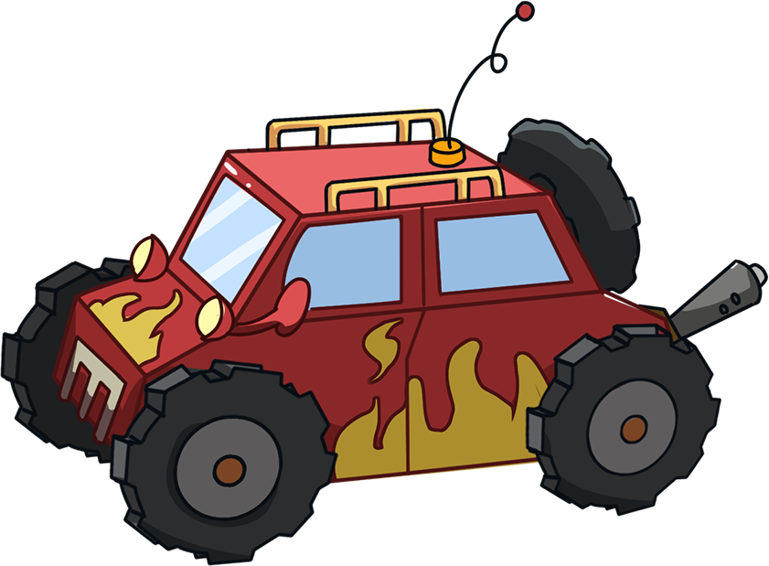
LO: Get to know their partners; get a basic idea about the topic of today’s
lesson.
Say hello to Ss; ask Ss to introduce themselves and to greet each other.
Introduce the topic of the lesson.
TG
ORT-GKB
Lesson 16
Road Burner
0:30

Slide 2
Learning
Goals
TG
LO: Get to know and understand what will be learned in this lesson. Go
through the learning goals with Ss.
We are
going to . . .
Add individual sounds (phonemes) to simple, single-syllable words to make new words.
Learn the key words zoom, turn, plan, scooter, wallet, and yelled, and make sentences with them.
Read the story Road Burner and develop reading comprehension skills by asking and answering questions throughout the reading process.
Practice using the sentence structure
_____ put/sent _____.
0:30
2/29

Slide 3
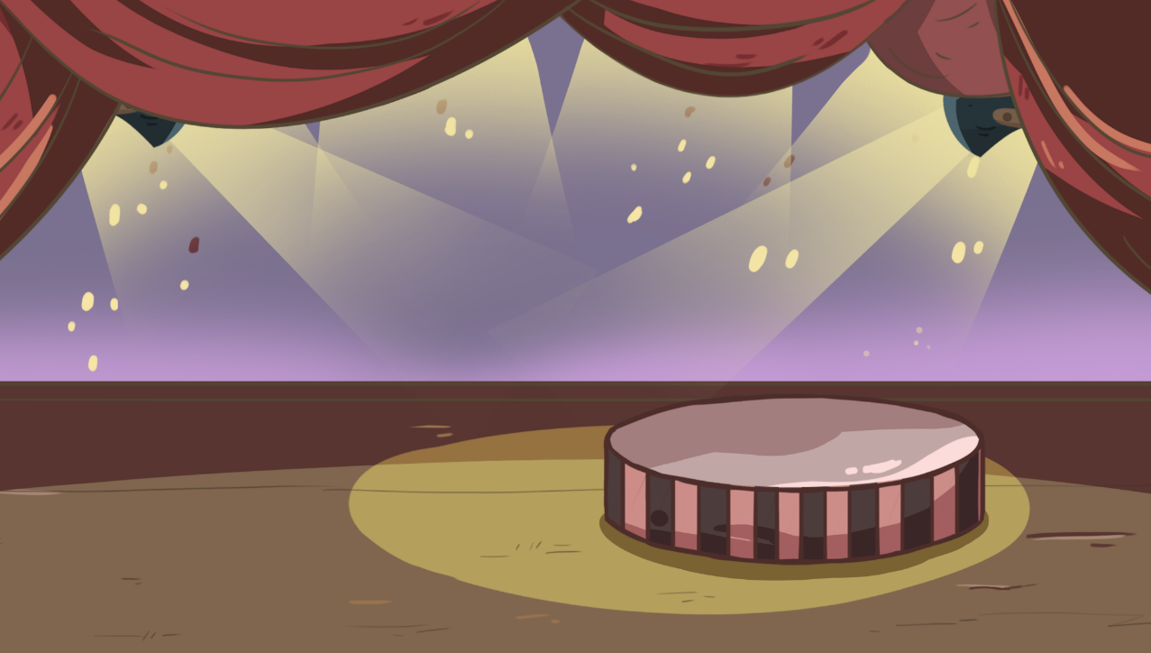
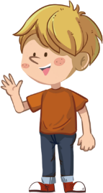
TG
LO: Present the writing that was assigned last lesson.
Let Ss present in turns.
Give feedback.
Presentation
Let’s show!
Share your writing from last lesson with your partner!
2:00
3/29

Slide 4
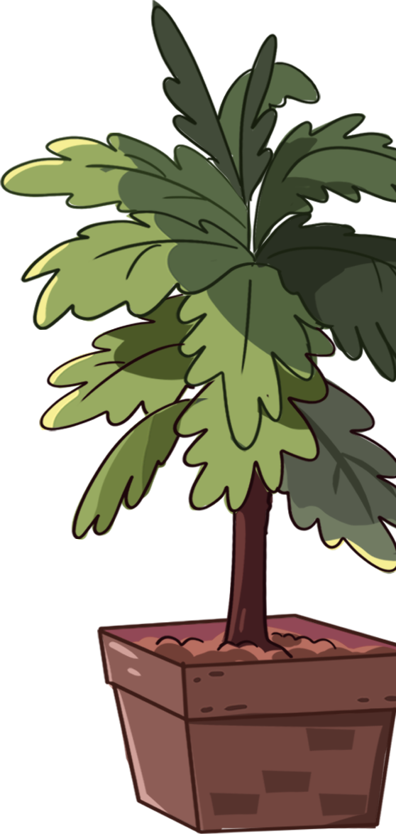
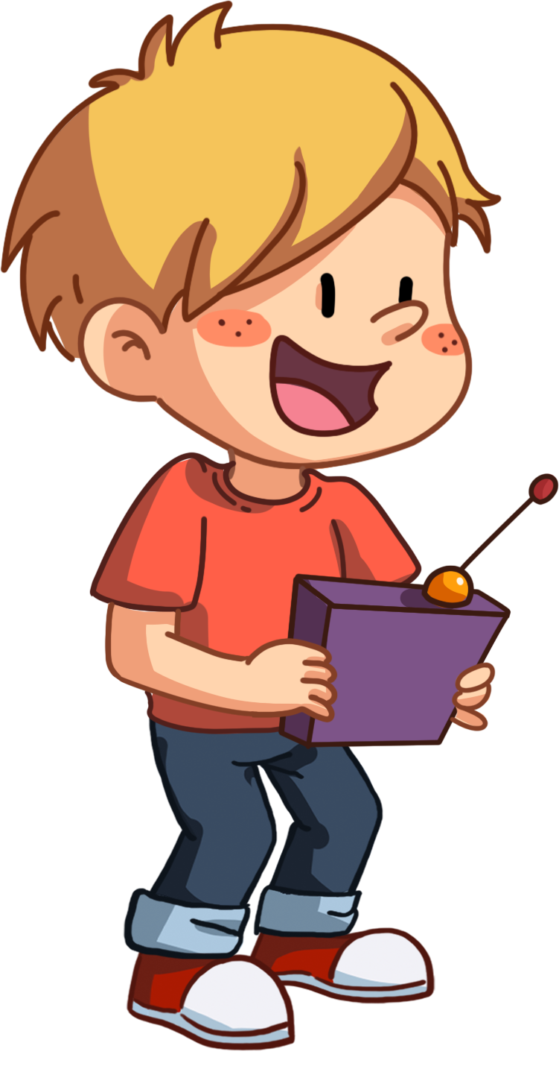
TG
LO: Add individual sounds (phonemes) to simple, single-syllable words to
make new words; decode the words accurately.
Have Ss help the boy in the picture play with the toy car by adding one sound before the word ear or at to make new words.
Read the single-syllable word ear to Ss first; then read the individual sound h to Ss; guide Ss to try and add the sound h before the word ear to make a new word; click and show the word hear; read the word hear in this way: h-ear, hear; ask Ss to repeat it; then click and make the toy car move.
Repeat this practice for the rest of the words.
Phonics
Let’s listen and speak!
hear
tear
rat
Hi! This is my new toy car. Let’s play with it together!
Can you make a new word?
r
h
t
at
ear
2:00
4/29

Slide 5
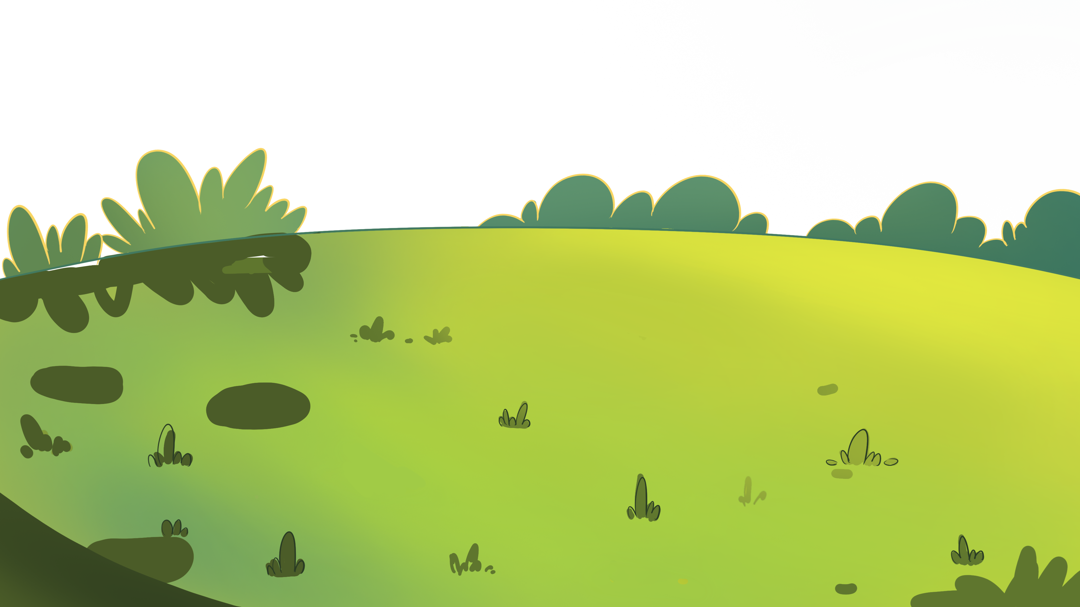
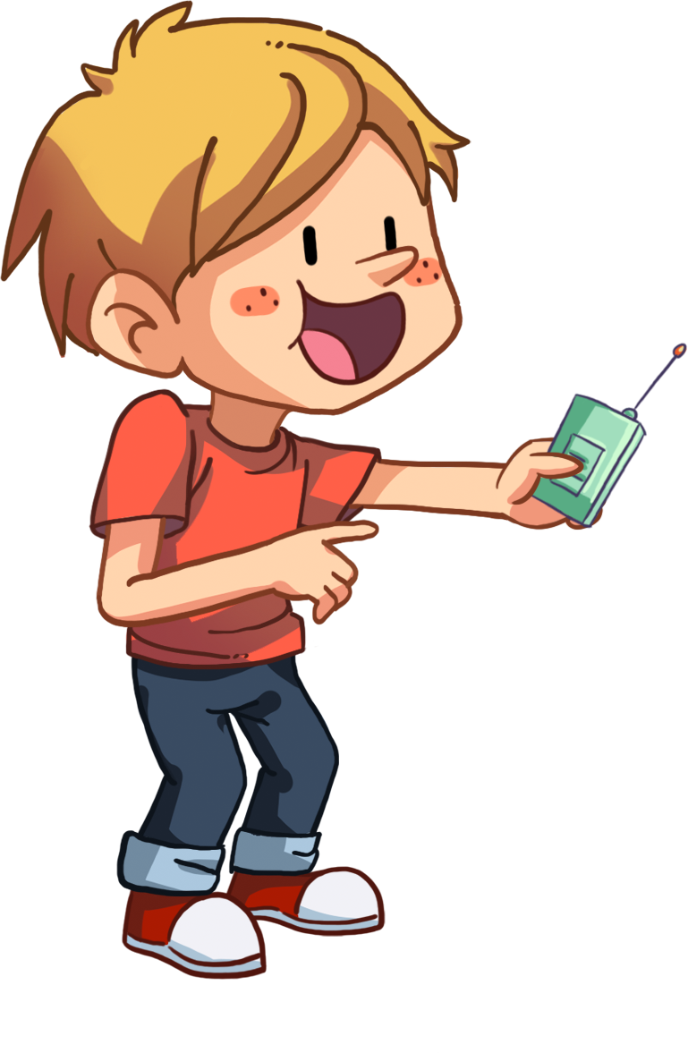
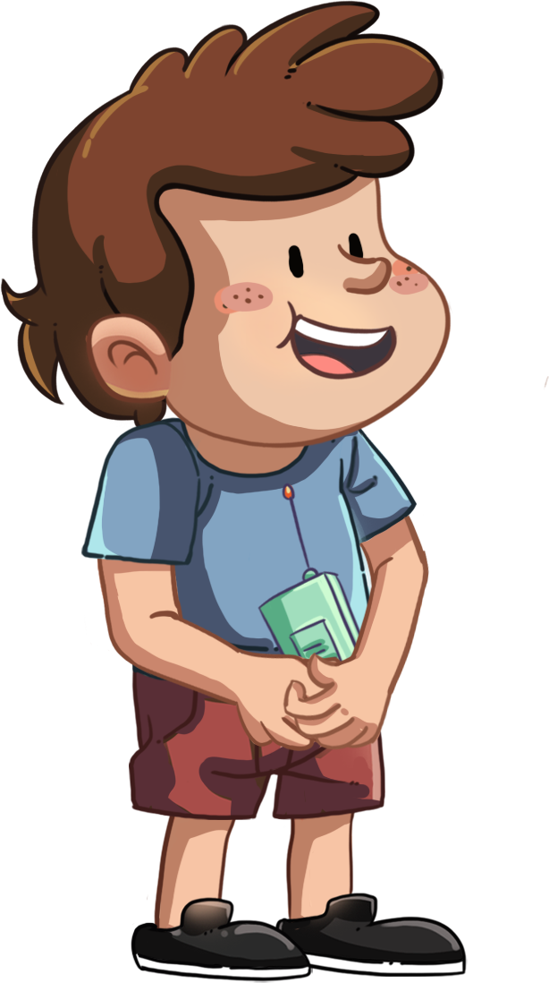
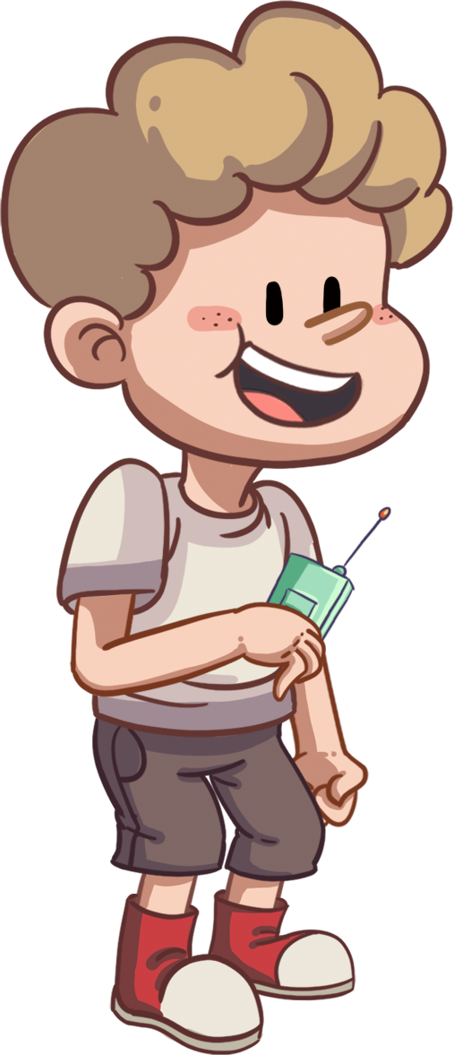
LO: Add individual sounds (phonemes) to simple, single-syllable words to
make new words; decode the words accurately.
Ask Ss to help the children in the picture have a race by adding one sound before word at to make new words.
Read one syllable word at to Ss first; click and read the individual sound f to Ss; guide Ss to try and add the sound f before the word at to make a new word; click and show the word fat; read the word fat in this way: f-at, fat; ask Ss to repeat it; then click and make the toy car move.
Repeat this practice for the rest of the words.
TG
Phonics
Let’s listen and speak!
at
c
at
h
at
f
Can you make a new word?
Let’s have a race together.
c
at
h
f
2:00
5/29

Slide 6
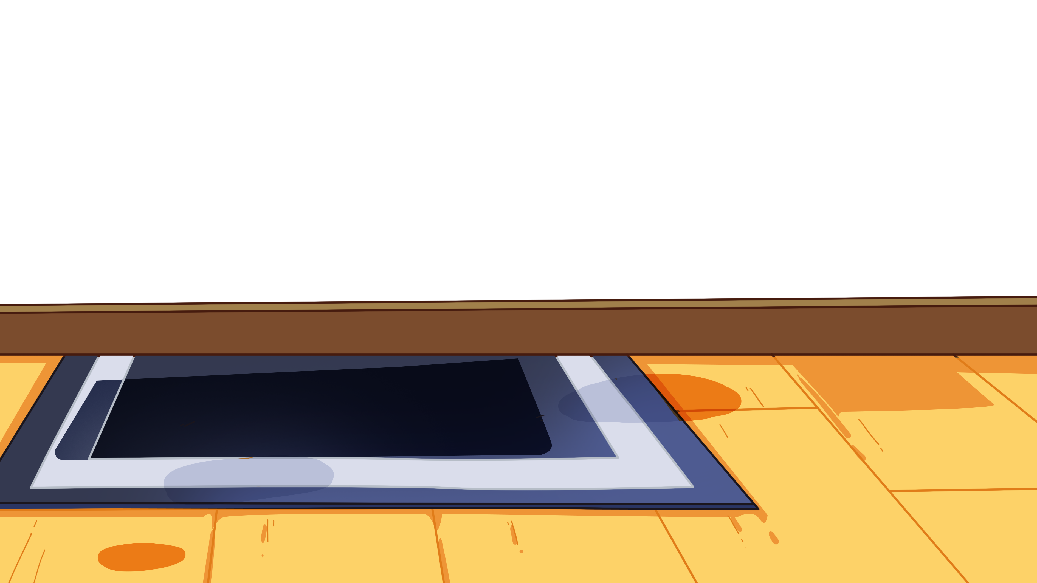
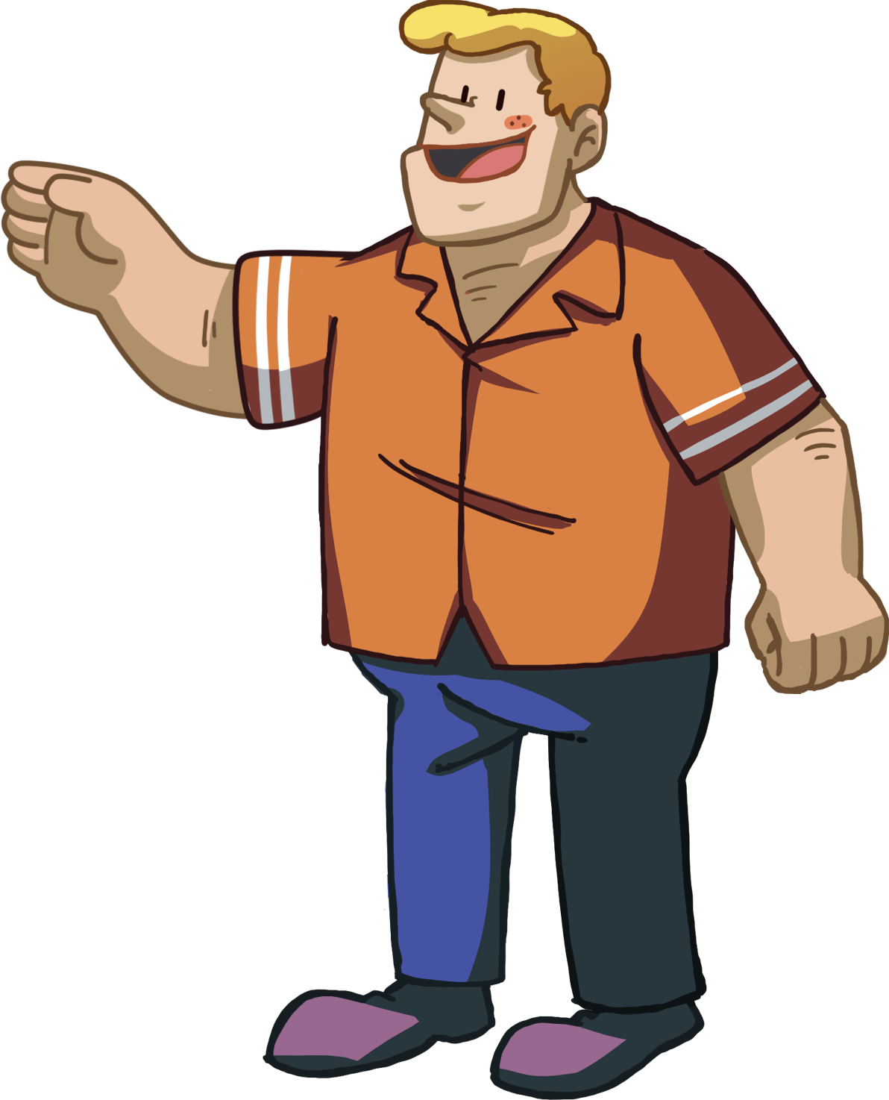
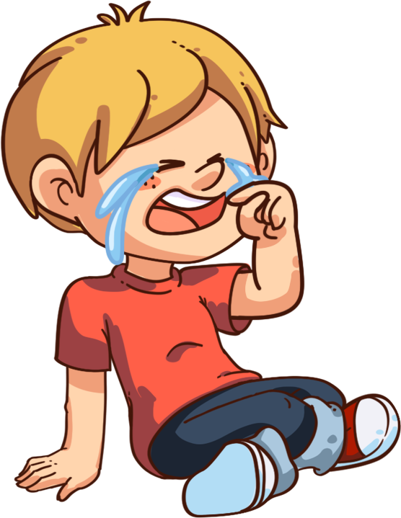
LO: Read the chant fluently; decode the words learned in the text.
Read the chant to Ss with rhythm; have Ss observe the picture and the highlighted words.
Guide Ss to repeat after you; ask them to take turns reading each sentence at a time.
Give feedback.
TG
Phonics
Let’s chant!
Dad is near the drawer.
He is playing with the fat cat.
I’m wiping away the tear.
I lost my hat.
There is a noise inside.
It may be a bad rat.
2:00
6/29

Slide 7
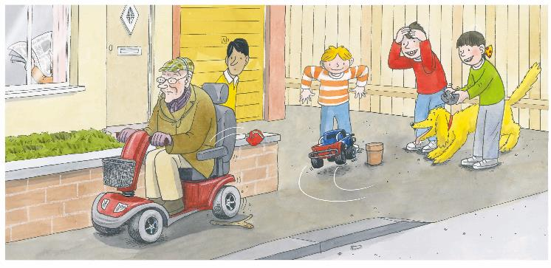
LO: Get to know the main characters in the story .
Guide Ss to recognize the main characters in the story.
Ask Ss to name the characters they know in the picture and match the characters with their names on the right.
TG
Introduction
Let’s meet the characters!
Who are in the story?
Nadim
Biff
Chip
Kipper
an old man
0:30
7/29

Slide 8
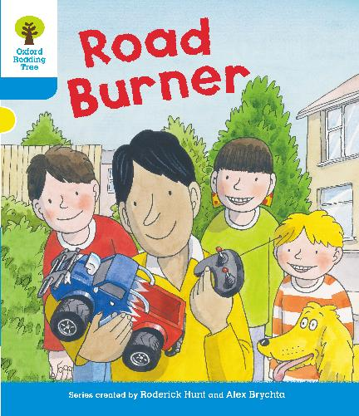
LO: Use the book cover to identify details and to make predictions.
Guide Ss to look at the book cover closely and to talk about the given questions.
Encourage Ss to talk more about the connections question.
TG
Lead-in
Before Reading
Look at the title and the book cover. What do you think a Road Burner is?
What do you think the story is about?
Connections
What toys do you have? Which one is your favorite?
Written by Roderick Hunt
Illustrated by Alex Brychta
1:30
8/29

Slide 9
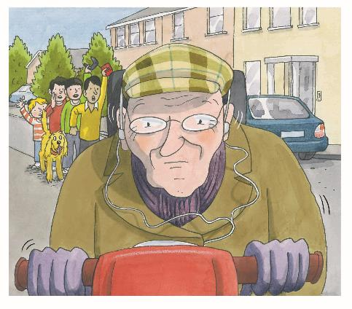
Let’s predict!
TG
LO: Make predictions about the story by using the illustration; motivate Ss’
interest in reading the story.
Guide Ss to recall what it means to predict and ask them to make guesses prior to reading the story by looking at the pictures.
Guide Ss to talk about the given questions.
Reading
Reading
Before Reading
What are the children doing?
Why are the children yelling at the old man?
What will the children do next?
1:30
9/29

Slide 10
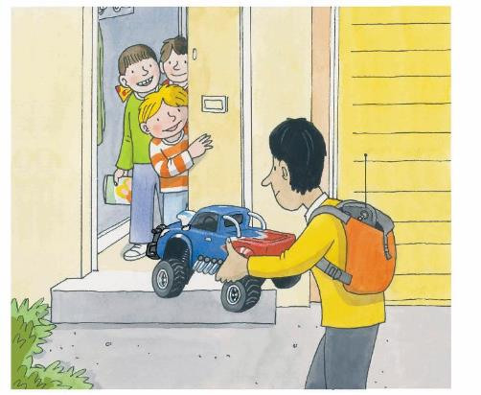
Road Burner
TG
LO: Understand the text; make connections; read the text fluently.
Read the text aloud to Ss.
Have Ss talk about the comprehension questions by using the illustration and the text.
Encourage Ss to talk more about the connections question.
Have Ss read the text fluently and give feedback.
Reading
Comprehension
What did Nadim have for his birthday?
Did the other children like the car? How do you know?
What would the children do next with the car?
Connections
What presents did you get for your birthday?
Nadim had a car for his birthday.
2:00
10/29

Slide 11
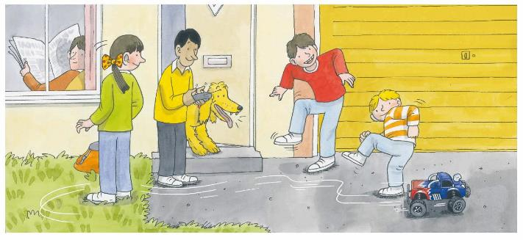
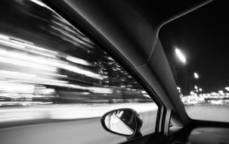
Road Burner
TG
LO: Understand the meaning of the key vocabulary word zoom, and make sentences
with it; understand the text; develop the ability of asking and answering questions
as a way to self-check reading comprehension; read the text fluently.
Read the text aloud to Ss.
Ask Ss to find zoom in the text and the illustration; have Ss read the word and have them make sentences with it.
Have Ss observe the illustration and text; talk about the comprehension questions.
Encourage Ss to talk more about the Monitoring Question; if they know how to answer the question, ask them to explain it; if they don’t know how to answer this question, help them find the answers by using clues from the text; tell them to learn to ask themselves questions to themselves when reading. (Clue: Because the toy car can go very fast).
Have Ss read the text fluently and give feedback.
Note: Click the penguin button to show the vocabulary card.
Reading
Comprehension
Vocabulary
What was the name of Nadim’s toy car?
What kind of features did Nadim’s toy car have? What sound might it make?
Monitoring
zoom
Ask yourself:
Do I understand why the car is called the Road Burner?
(Tips: You can look for clues
in the text.)
“It’s called the Road Burner,” he said. “It
can go fast!”
“Wow! It can zoom!”
said Kipper.
This car can zoom.
2:00
zoom
11/29

Slide 12
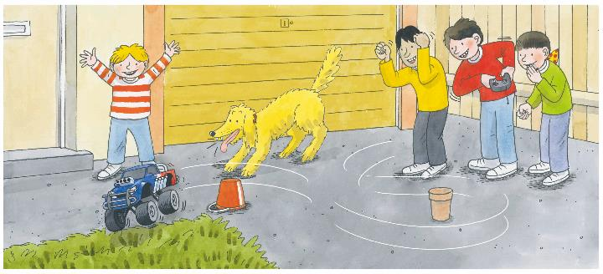
Road Burner
LO: Understand the meaning of the key vocabulary word turn, and make sentences with it; understand the text; develop the ability of asking and
answering questions as a way to self-check reading comprehension; read the text fluently.
Read the text aloud to Ss.
Ask Ss to find zoom in the text and the illustration; have Ss read the word and have them make sentences with it.
Have Ss talk about the comprehension questions by using the illustration and the text.
Encourage Ss to talk more about the Monitoring Question; if they know how to answer the question, ask them to explain it; if they don’t know how to answer this question, help them find the answers by using clues from the text; tell them to learn to ask themselves questions to themselves when reading.
Have Ss read the text fluently and give feedback.
Note: Click the penguin button to show the vocabulary card.
TG
Reading
Vocabulary
Comprehension
What did the children do?
What problem did Chip find with the Road Burner?
Monitoring
turn
Ask yourself:
Do I understand the meaning of turn here?
(Tips: You can look for clues
in the illustration.)
The children had
a go.
“It is hard to turn,” said
Chip, “if you go too fast.”
We can't turn right here.
2:00
turn
12/29

Slide 13
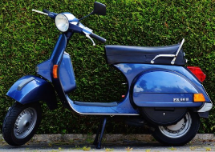
Road Burner
TG
LO: Understand the meaning of the key vocabulary word scooter, and make sentences with it; understand the text; read the text fluently.
Have Ss take turns reading the text; give feedback and correct them if necessary.
Ask Ss to find scooter in the text and the illustration; have Ss read the word and have them make sentences with it.
Have Ss talk about the comprehension questions by using the illustration and the text.
Note: Click the penguin button to show the vocabulary card.
Reading
Vocabulary
Comprehension
What happened while the children were playing with the Road Burner?
Who do you think noticed the wallet? Did the old man notice? Look for clues in the illustration.
scooter
I like this beautiful blue scooter so much.
A man went past on a scooter.
His wallet fell out of
his pocket.
scooter
2:00
13/29

Slide 14
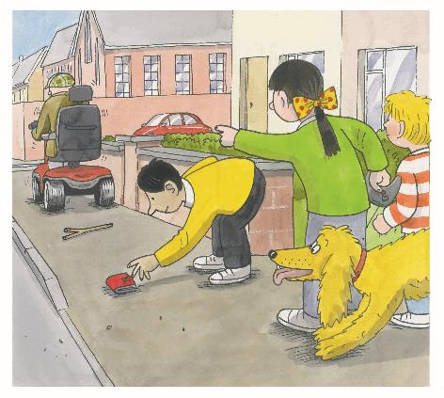
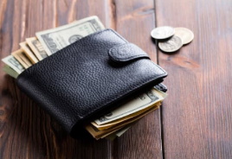
Road Burner
TG
LO: Understand the meaning of the key vocabulary word wallet, and make sentences with it; understand the text; read the text fluently.
Read the text aloud to Ss.
Ask Ss to find wallet in the text and the illustration; have Ss read the word and make sentences with it.
Have Ss talk about the comprehension questions by using the illustration and the text.
Have Ss read the text fluently and give feedback.
Note: Click the penguin button to show the vocabulary card.
Reading
Vocabulary
Comprehension
Why didn’t the children continue to play with the Road Burner?
What was Biff’s idea? What do you think the children would do next?
wallet
There is a lot of money in this wallet.
The children saw the wallet.
“We need to stop him,” said Biff.
wallet
2:00
14/29

Slide 15
Road Burner
TG
LO: Understand the meaning of the key vocabulary word yelled, and make sentences with it; understand the text; read the text fluently; decode the sight
word accurately.
Read the text aloud to Ss.
Ask Ss to find the sight word hear in the text and guide them to read it accurately.
Ask Ss to find yelled in the text and the illustration; have Ss read the word and make sentences with it.
Have Ss talk about the comprehension questions by using the illustration and the text.
Have Ss read the text fluently and give feedback.
Note: Click the penguin button to show the vocabulary card.
Reading
Comprehension
Vocabulary
What did the children do to help the man? What was the result?
Why didn’t the old man stop to get his wallet? Look for clues in the illustration.
yelled
She yelled in the center of the square.
Sight Word
hear
“Stop!” they yelled.
“He cannot hear us,” said Chip.
yelled
15/29
2:00

Slide 16
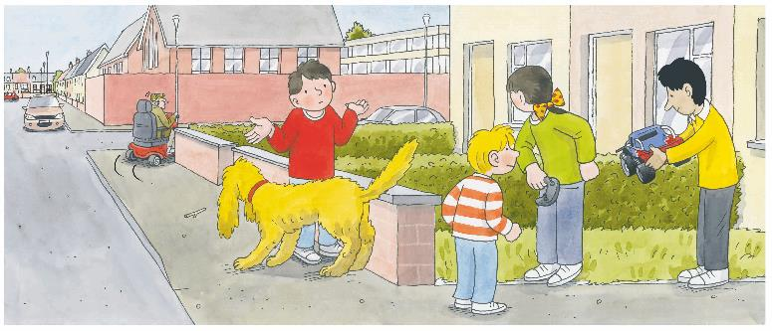
Road Burner
TG
LO: Understand the meaning of the key vocabulary words plan, and make sentences with it; understand the text; read the text fluently.
Have Ss take turns reading the text; give feedback and correct them if
necessary.
Ask Ss to find plan in the text and the illustration; have Ss read the word and make sentences with it.
Have Ss talk about the comprehension questions by using the illustration and the text.
Note: Click the penguin button to show the vocabulary card.
Reading
Vocabulary
Comprehension
What did the old man do when the children yelled at him?
What do you think Nadim’s plan might be?
plan
But the man did not
stop. He did not look
back.
Nadim had a plan.
He chose plan B at last.
plan
2:00
16/29

Slide 17
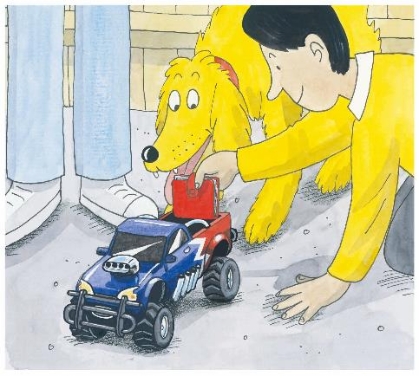
Road Burner
LO: Understand the text; read the text fluently.
Read the text aloud to Ss.
Have Ss talk about the comprehension questions by using the illustration and the text.
Have Ss read the text fluently and give feedback.
TG
Reading
Comprehension
What was the first step of Nadim’s plan?
What do you think Nadim would do next?
He put the wallet on the Road Burner.
2:00
17/29

Slide 18
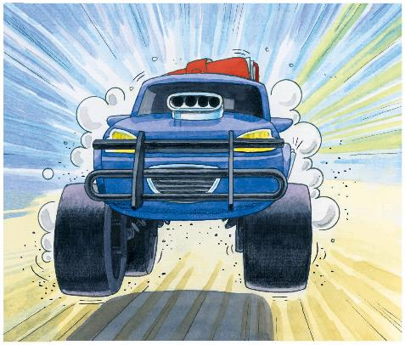
Road Burner
TG
LO: Understand the text; read the text fluently.
Read the text aloud to Ss.
Have Ss talk about the comprehension questions by using the illustration and the text.
Have Ss read the text fluently and give feedback.
Reading
Comprehension
What was the next step of Nadim’s plan?
What do you think would happen next?
Then he sent it off.
2:00
18/29

Slide 19
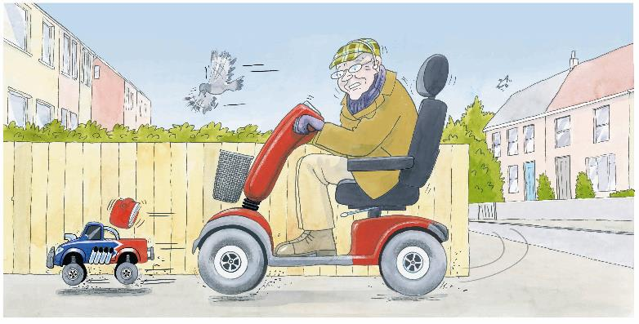
Road Burner
LO: Understand the text; read the text fluently.
Read the text aloud to Ss.
Have Ss talk about the comprehension questions by using the illustration and the text.
Have Ss read the text fluently and give feedback.
TG
Reading
Comprehension
What do you think about the Road Burner? Do you think the Road Burner was a good name for the toy car? Why?
Did the old man see his wallet? Where did the man see his wallet?
The scooter was fast,
but the Road Burner
was faster.
The man saw his
wallet on the Road
Burner.
2:00
19/29

Slide 20
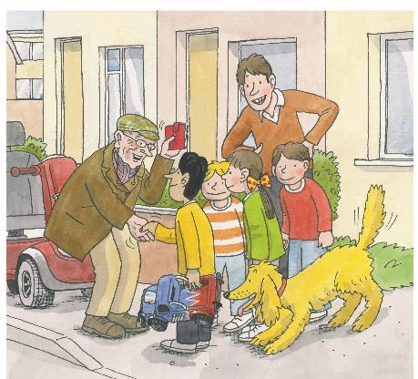
Road Burner
TG
LO: Understand the text; develop the ability of asking and answering questions
as a way to
self-check reading comprehension; read the text fluently.
Read the text aloud to Ss.
Have Ss talk about the comprehension questions by using the illustration and the text.
Encourage Ss to talk more about the Monitoring Question; if they know how to answer the question, ask them to explain it; if they don’t know how to answer this question, guide them to find the answers by using clues from the text; tell them to learn to ask themselves questions to themselves when reading..
Have Ss read the text fluently and give feedback.
Reading
Comprehension
How do you think the man felt to have his wallet back?
How do you think the children felt at that moment?
Monitoring
Ask yourself:
Do I understand the meaning of “You did me a good turn”?
(Tips: You can recall the story
and ask your partner.)
“Thank you,” he said.
“You did me a good turn.”
2:00
20/29

Slide 21
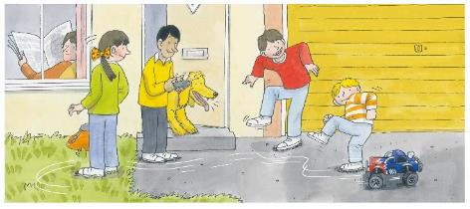
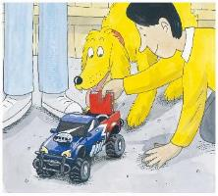
TG
LO: Retell the story with the visual support and assistance.
Ask Ss to work in pairs and talk about the given questions; have them work in pairs to retell the story in the correct sequential order by identifying the key details; model first.
Have Ss take turns retelling the story by using the visual aids.
Reading
Let’s retell!
1
2
What did the children play?
What kind of features did the
toy car have?
What happened to the man?
What did the children do with
the wallet?
3
4
What was Nadim’s plan?
What did Nadim do?
Where did the man see his wallet?
How did the man feel about Nadim?
2:00
21/29

Slide 22
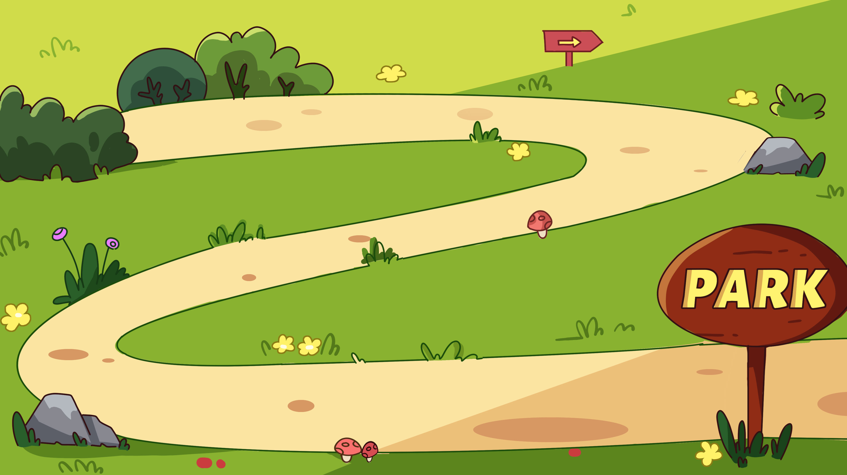
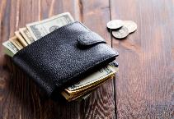
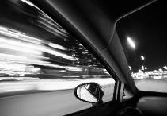
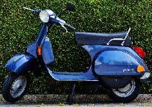
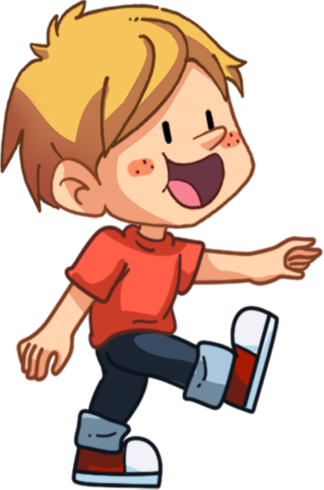
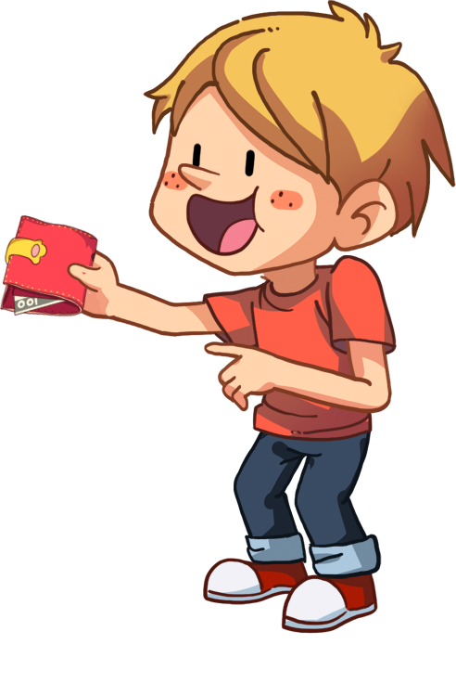
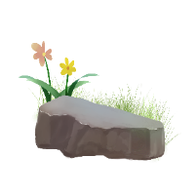
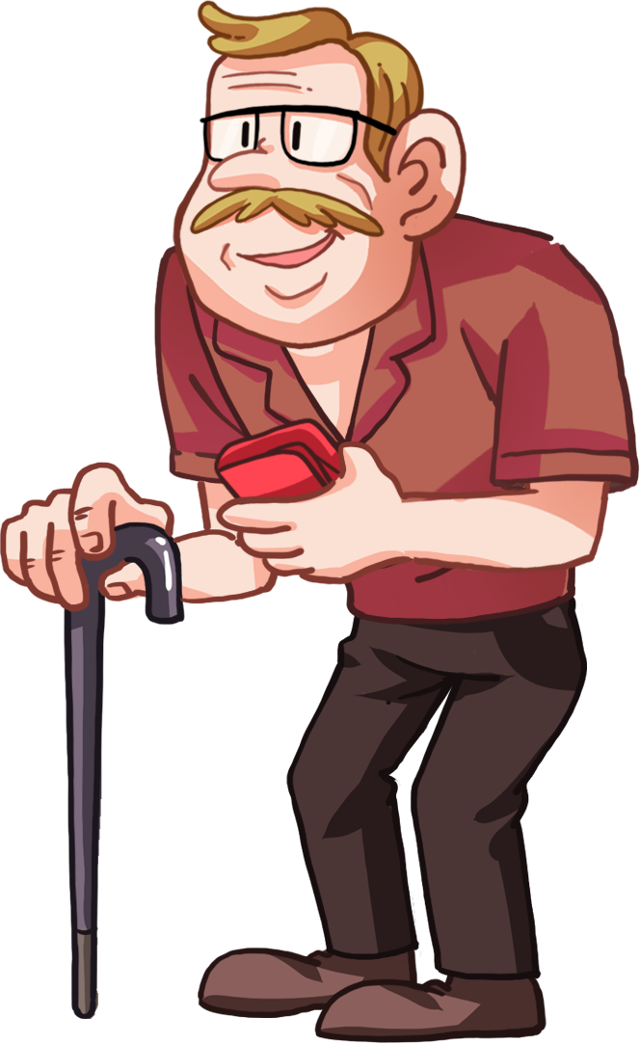
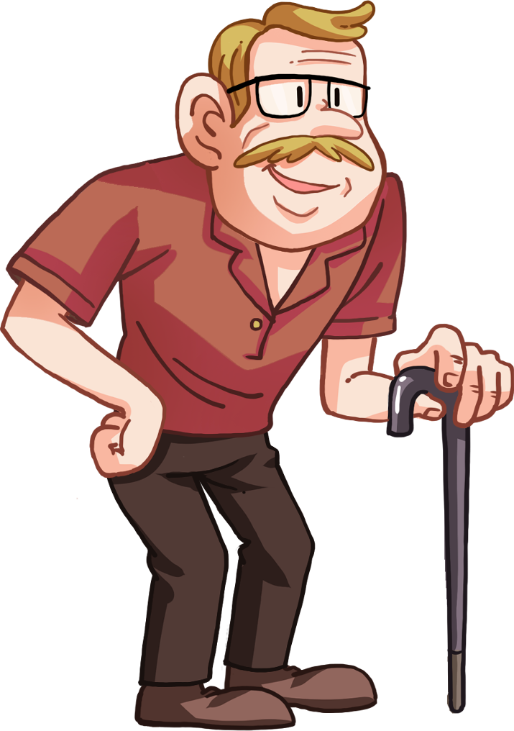
Let’s review the words!
TG
LO: Check their understanding of the words in this lesson.
Have Ss help the boy in the picture send the wallet back to the old man by identifying the pictures and vocabulary words.
Click to show the picture and ask Ss to say the word; click to show the answer; click to help the boy walk forward.
Repeat this practice for the rest of the words.
Vocabulary
turn
zoom
plan
scooter
yelled
wallet
1:30
22/29

Slide 23
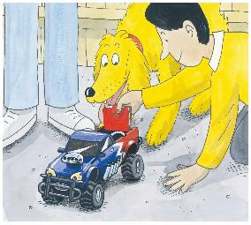
Let’s talk!
LO: Talk about what Nadim did to help the man who lost his wallet by using the given sentence structure.
Have Ss work in pairs to talk about the given illustration by using the sentence structure and the helping words; model first.
Assist Ss if necessary.
TG
Listening & Speaking
—What did Nadim do to help the man who lost his wallet?
— Nadim ______ to help the man.
Helping Words
put the wallet on the Road Burner
sent the Road Burner off
1:30
23/29

Slide 24
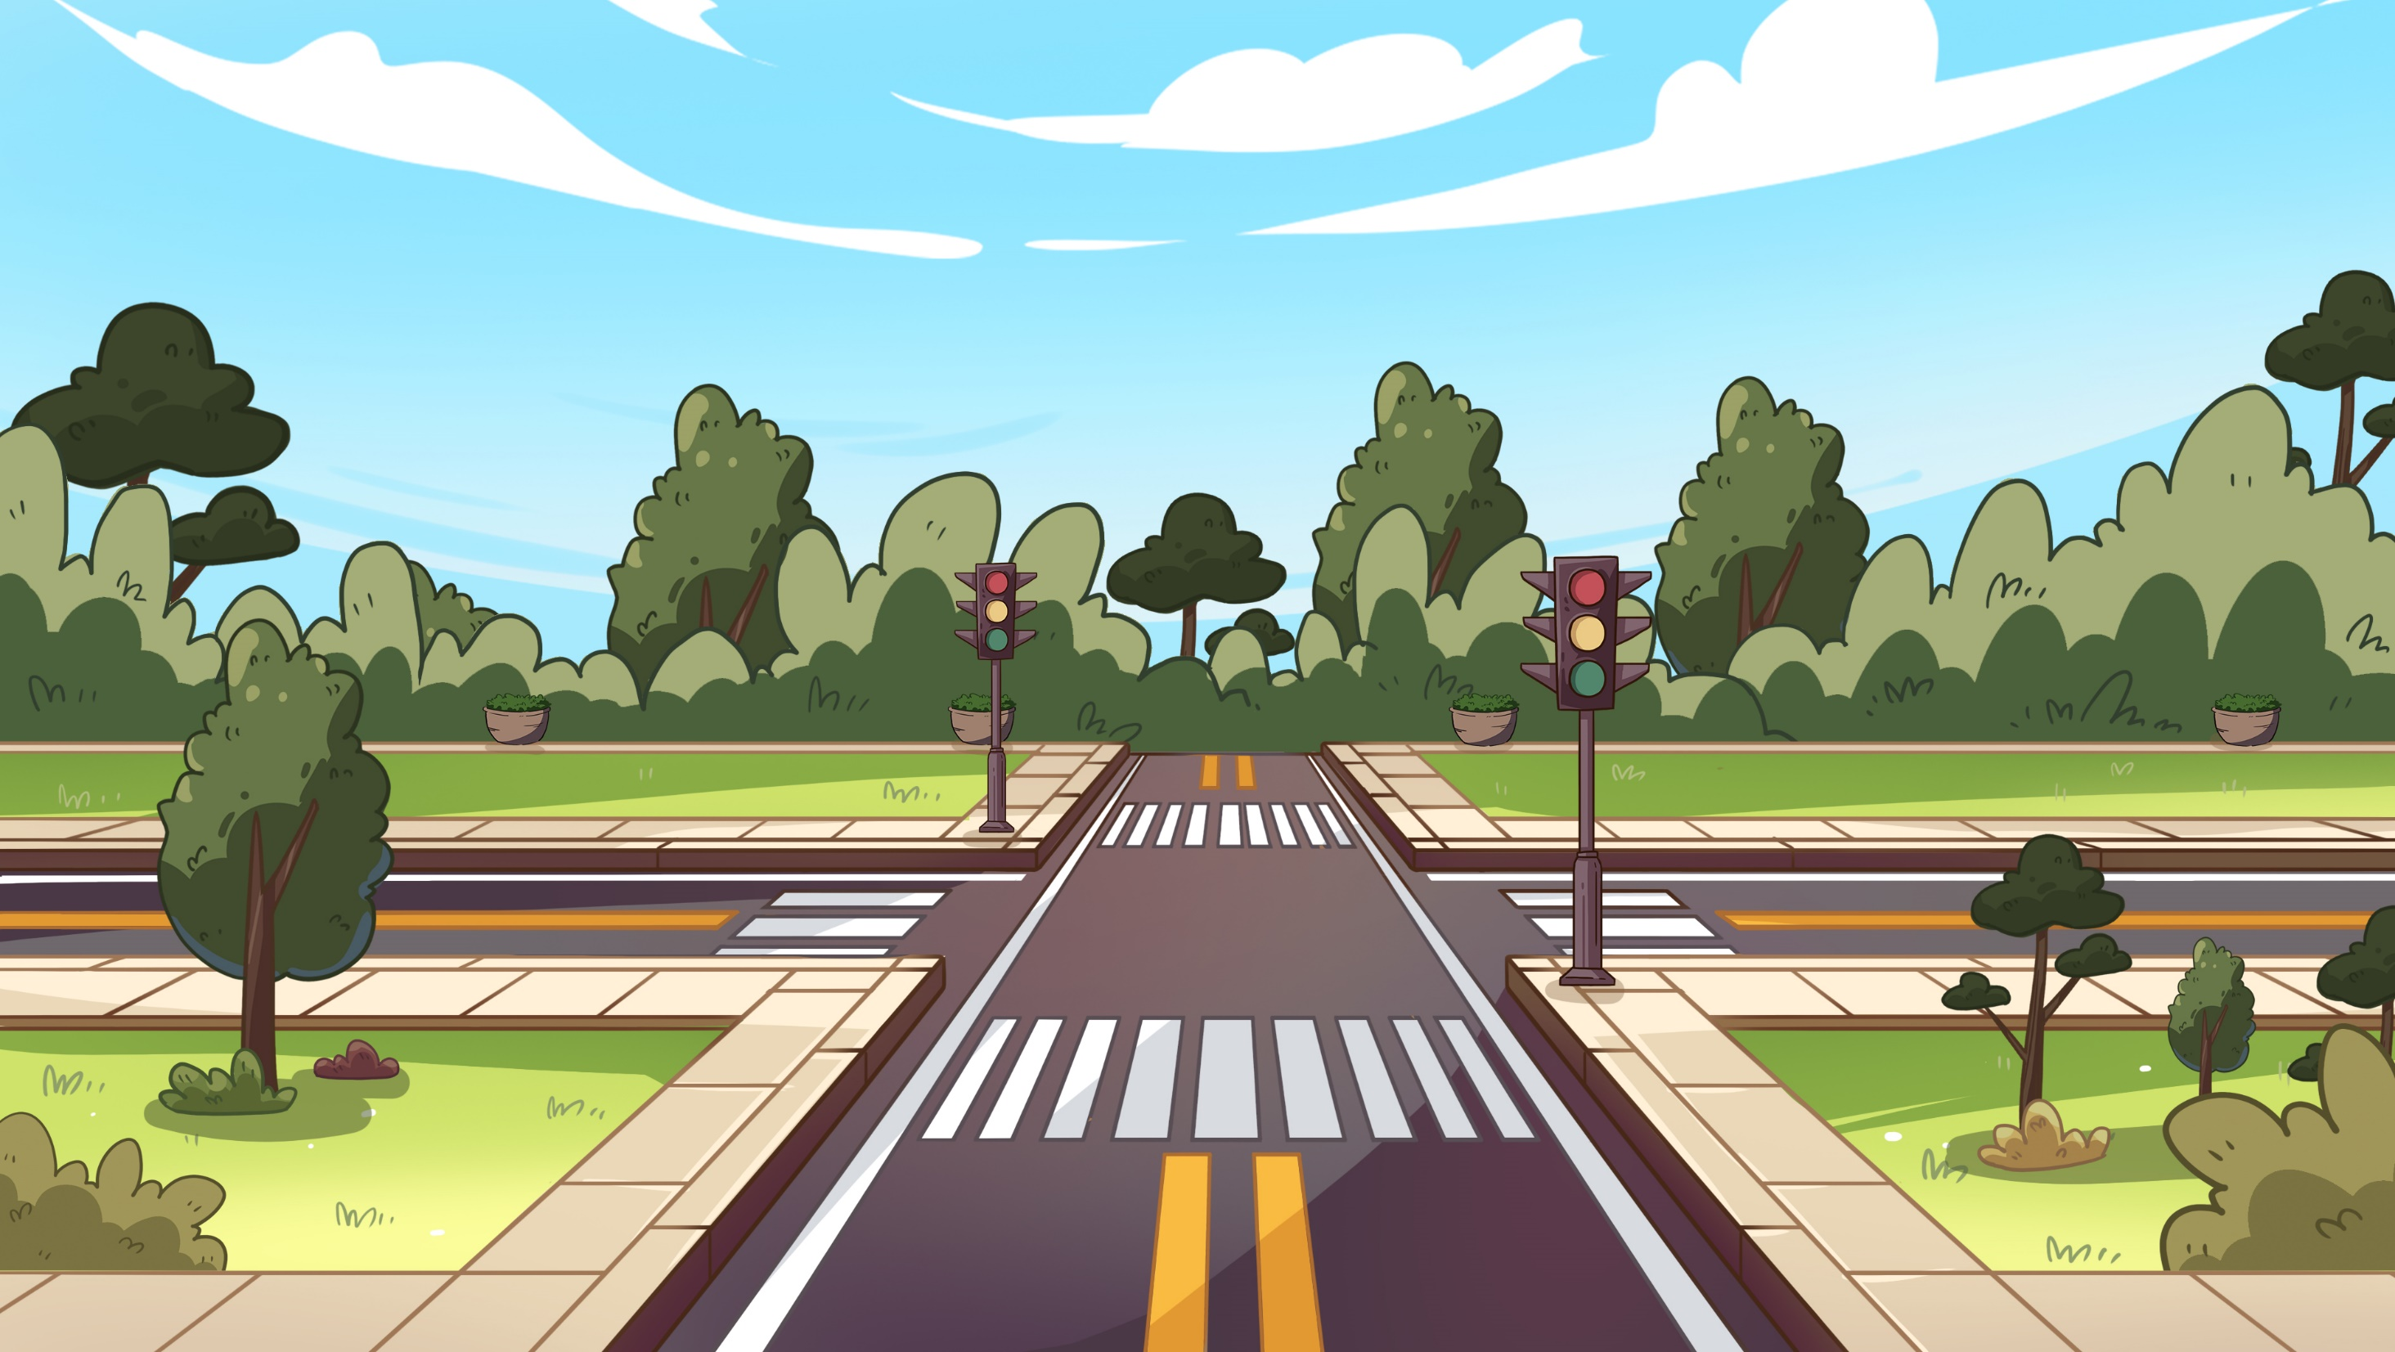
TG
LO: Talk about how to help people in need by using the given sentence structure.
Ask Ss to observe the picture carefully; have them talk about the people in the picture and their problems, and have Ss discuss how they could help; encourage them to speak more.
Ask Ss to work in pairs to talk about the given picture by using the given sentence structure; each S has at least three chances to talk; model first.
Assist Ss if necessary.
Notes: T can click Let’s Talk to present the sentence structure, and T can click again to make it
disappear.
Let’s talk!
—What will you do when you see someone in need?
—I will _____.
show him the right way help him lift heavy things
24/29

Slide 25
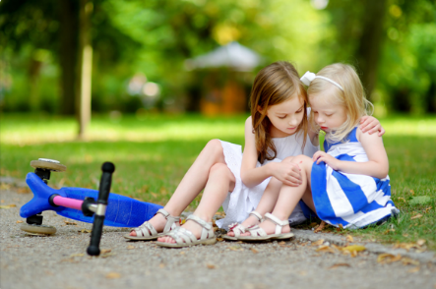
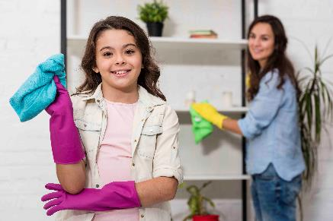
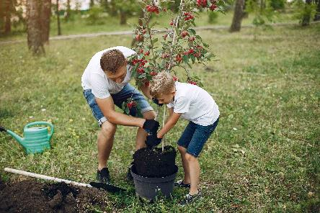
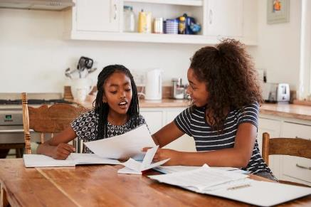
TG
LO: Talk about the following topic: how you help your friends in life..
Ask Ss to think about the given question; model first.
Guide Ss to talk about the question with the help of the given pictures. Encourage Ss to talk more about the topic.
Value
How do you help your friends in life?
help my friends study
comfort my friends when they fall down
2:00
25/29

Slide 26
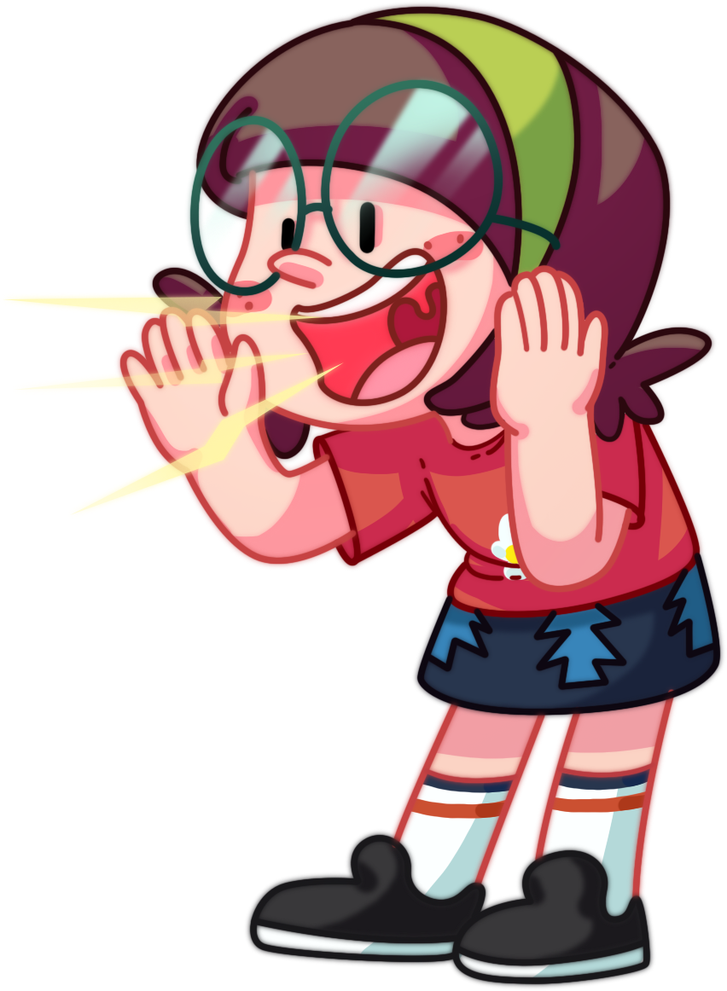
LO: Talk about how the children helped the man.
Guide Ss to talk about what they’ve learned from the story.
Ask Ss to think about the given questions; help Ss to organize their ideas with the given visual support; model the first question, and then ask Ss to complete the task in turns.
TG
Oral Writing
Get ready to present!
Talk about how the children helped the man.
1. picked up the wallet
4. sent the Road Burner off
2. yelled “stop” to the man
3. put the wallet on the Road Burner
2:00
26/29
Notes:
她们的

Slide 27
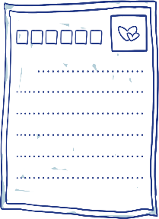
LO: Understand what the homework is.
Explain the writing task to Ss and check their understanding.
Tell Ss that they should finish their writing before next class; make sure they know they can upload their homework to the platform; they will present their homework next class.
Remind Ss to watch the post-class video and finish the writing task.
TG
Writing
Let’s write!
Thank-You Letter Writing
Let’s write a thank-you letter!
Directions:
Write a thank-you letter to Nadim in three sentences pretending you are the old man’s grandchild.
Watch the post-class video about the writing task.
0:30
27/29

Slide 28
TG
LO: Review today’s lesson.
Guide Ss to review the phonics by asking Ss to read the words aloud.
Guide Ss to review the words by inviting Ss to read and explain some of the words.
Guide Ss to review the sentence structures by asking each S to make sentences with them.
Review
Let’s review!
Review
Phonics:
tear/near/fat/
cat/hat/rat
Sentence Structure:
_____ put/sent _____.
Vocabulary:
zoom/turn/wallet/
scooter/plan/yelled
1:00
28/29

Slide 29
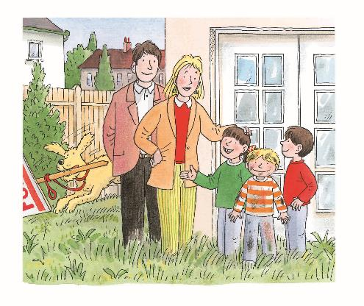
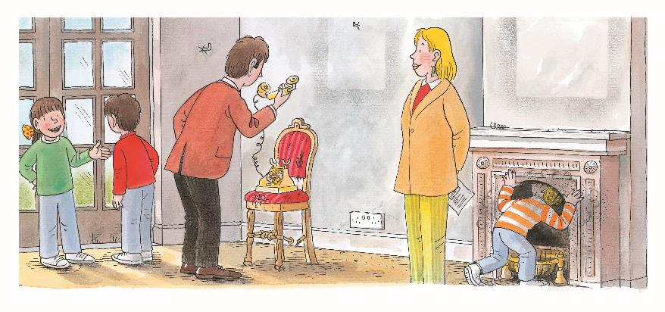
LO: End the lesson and encourage Ss to perform better in the next class.
Briefly comments on Ss.
Say goodbye to students.
Ask Ss to preview the next lesson.
TG

