Slide 1
Move your…. - Pancake Manor https://www.youtube.com/watch?v=CNMyh5OyfGE&pbjreload=10
Let’s sing a song.

Slide 2
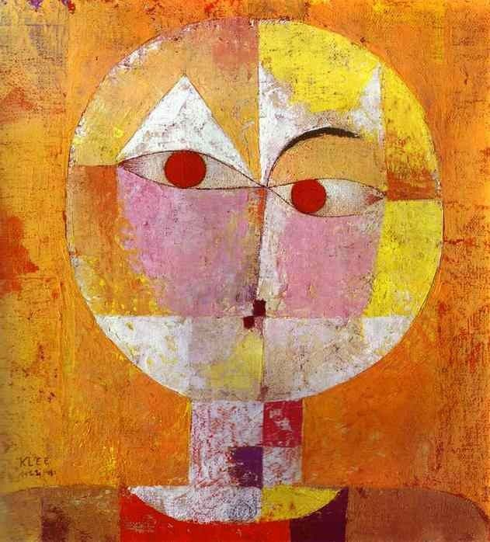
PARTS
OF THE
BODY

Slide 3
body

Slide 4
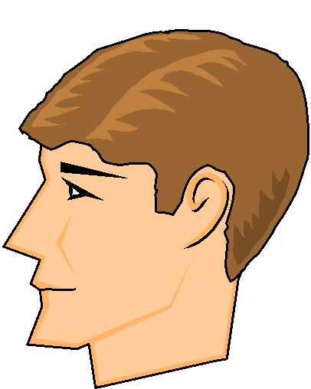
head

Slide 5
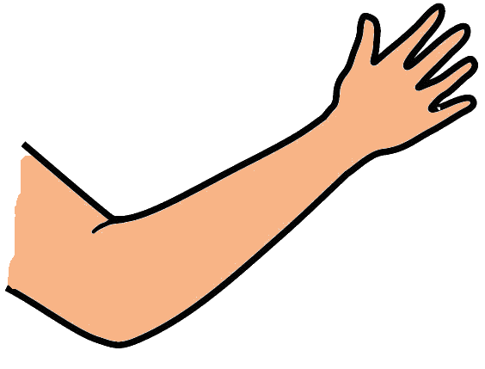
arm

Slide 6
hand

Slide 7
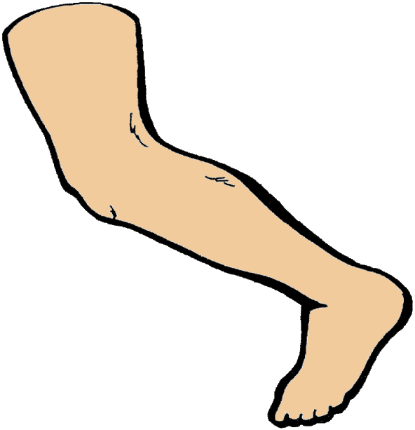
leg

Slide 8
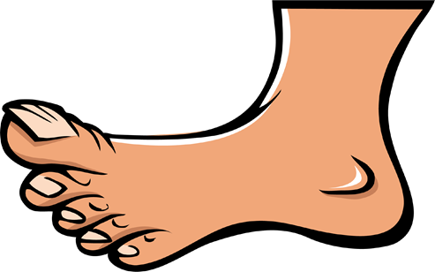
foot

Slide 9
feet

Slide 10
What do you have??
I have a big head.
I have a long arms.
I have a small head.
I have a big hands.
I have a short arms.
I have a long body.
I have a small hands.
I have a short body.
I have a long legs.
I have a short legs.
I have a small feet.
I have a big feet.

Slide 11
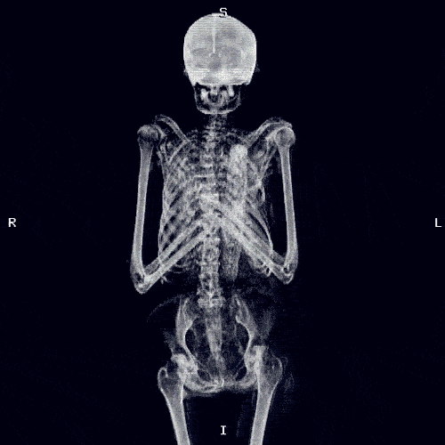
“Skeleton Dance” - Super Simple Song https://www.youtube.com/watch?v=qeSSmNRBlgY
Let’s sing a song.

Slide 12
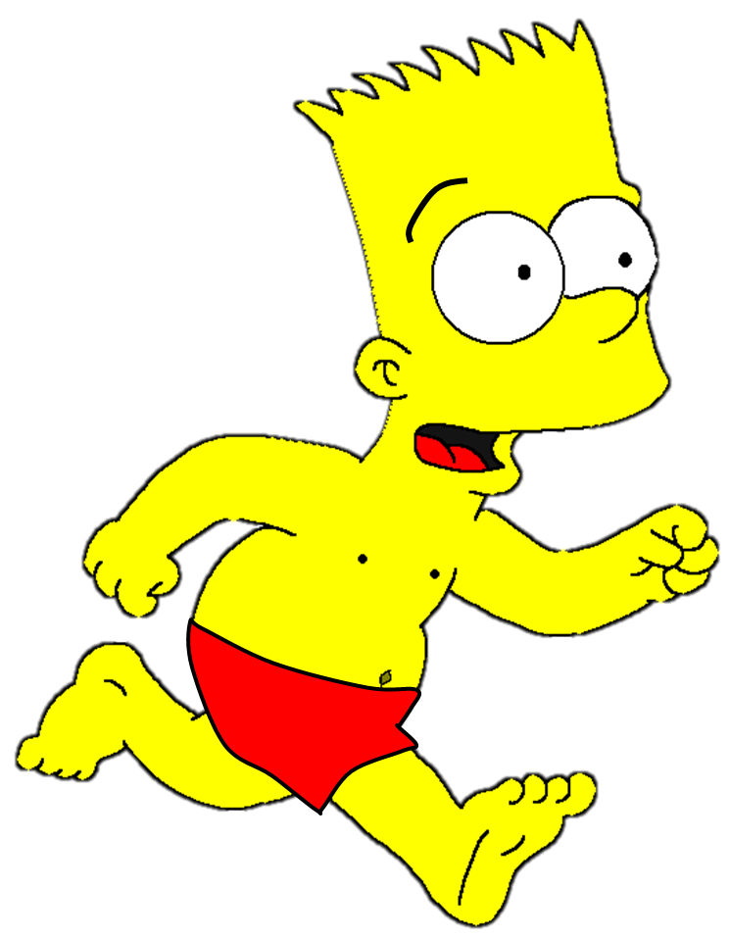

Slide 13
The bee stung the boy’s…
1.leg
2.foot
3.hand

Slide 14
The bee stung the boy’s…
1.arm
2.hand
3.foot

Slide 15
The bee stung the boy’s…
1.hand
2.leg
3.arm

Slide 16
The bee stung the boy’s…
1.hand
2.arm
3.leg

Slide 17
The bee stung the boy’s…
1.arm
2.head
3.body

Slide 18
Let’s read a book.

Slide 19
The boy has a box.

Slide 20
“This is my robot”

Slide 21
“This is a leg.”

Slide 22
“This is an arm.”

Slide 23
“Can you see the robot? No!”

Slide 24
“This is the head.

Slide 25
“Can you see the robot? Yes! “

Slide 26
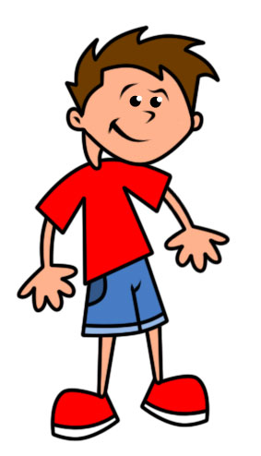
head
Let’s sing a song. ‘Head, Shoulders..”
shoulders
shoulders
knees
knees
toes
toes

Slide 27
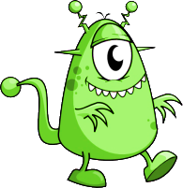
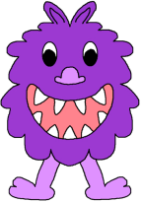
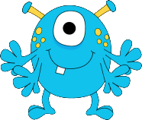
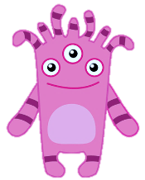
NEXT
PARTS OF THE BODY

Slide 28
I’m travelling to the PINK PLANET
NEXT

Slide 29
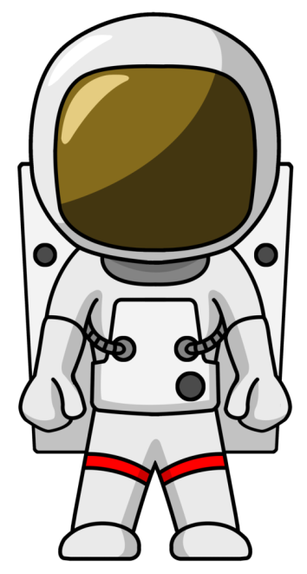
Let’s see how its inhabitants look like.
NEXT

Slide 30
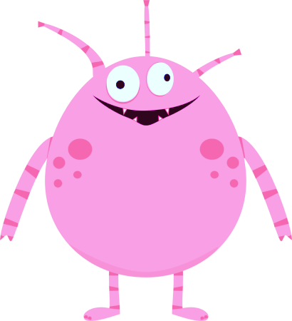
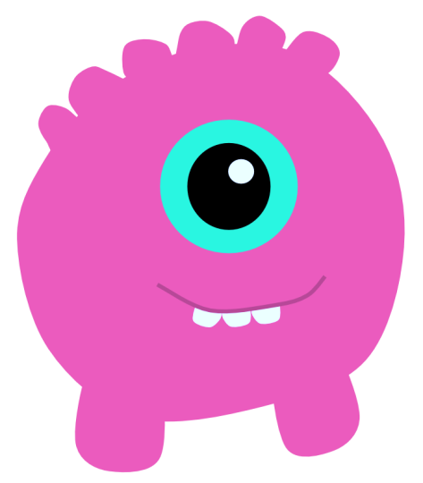
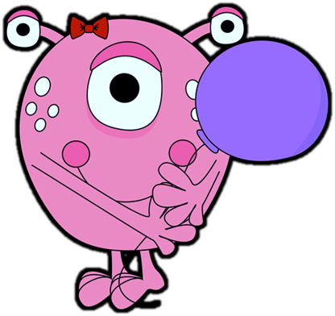
It has got two eyes, two hands
with three fingers, and two horns.
It has also got two big feet and a hairy body.
Yes, it’s me.
1
3
2
4
6
5
NEXT

Slide 31
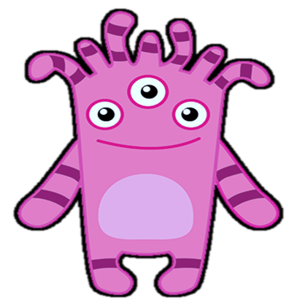
It has got three eyes, two arms,
two feet, some hair, and a light tummy.
1
3
2
Yes, it’s me.
4
6
5
NEXT

Slide 32
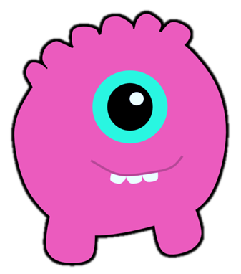
It has got one big eye, a mouth with three teeth, and two short legs.
1
3
Yes, it’s me.
2
4
6
5
NEXT

Slide 33
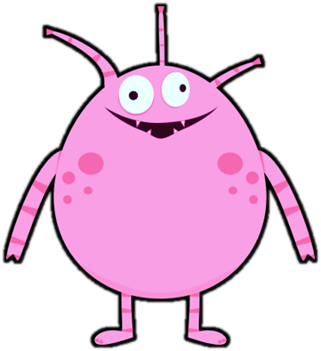
It has got two eyes, a mouth with small teeth, and three antennas. It has also got two long arms and two short legs with small feet.
1
3
2
Yes, it’s me.
4
6
5
NEXT

Slide 34
I’m travelling to the GREEN PLANET
NEXT

Slide 35
Let’s see how its inhabitants look like.
NEXT

Slide 36
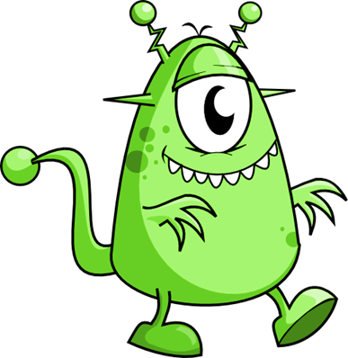
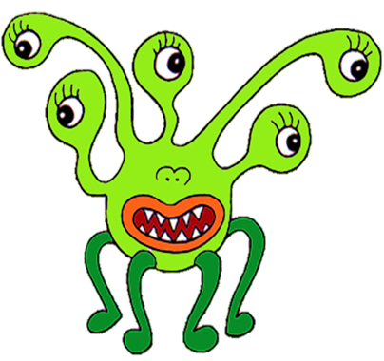
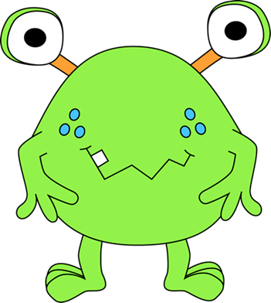
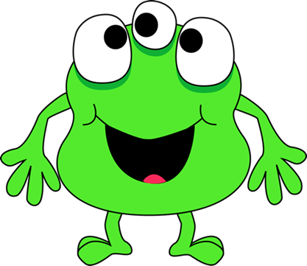
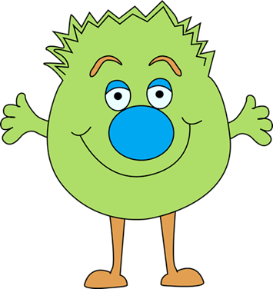
It has got a big mouth, a small nose, and five eyes. It has also got four legs with small feet.
1
3
2
Yes, it’s me.
4
6
5
NEXT

Slide 37
It has got two eyes and a mouth with one tooth. It has also got two hands with three fingers and two feet with three toes.
1
3
2
Yes, it’s me.
4
6
5
NEXT

Slide 38
It has got two eyes, a big nose, and a big mouth.
It has also got two hands with four fingers, two long legs, and two small feet.
1
3
2
Yes, it’s me.
4
6
5
NEXT

Slide 39
I’m travelling to the PURPLE PLANET
NEXT

Slide 40
Let’s see how its inhabitants look like.
NEXT

Slide 41
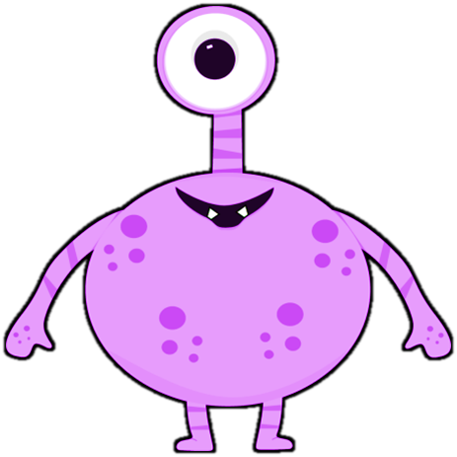
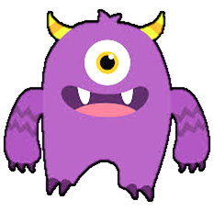
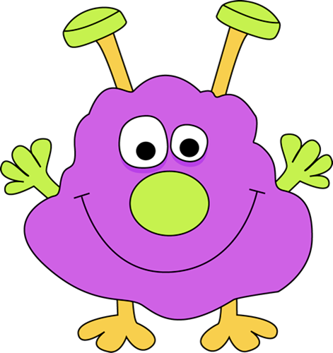
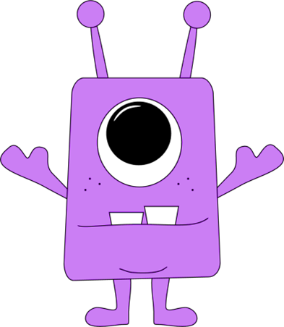
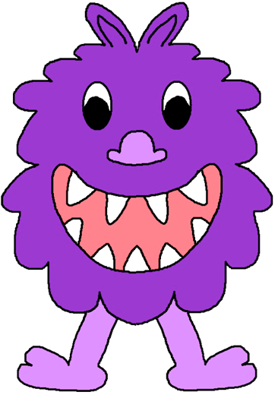
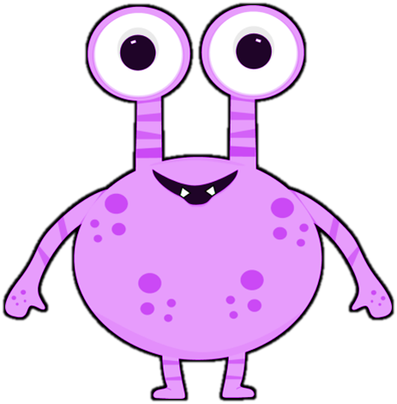
It has got two eyes, a small mouth with two small teeth, two arms, and two short legs with small feet.
It has also got some spots on its body.
1
3
2
Yes, it’s me.
4
6
5
NEXT

Slide 42
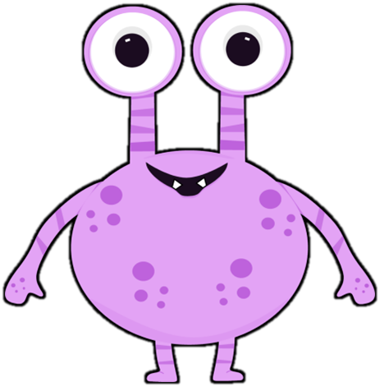
It has got one big eye, a mouth with two small teeth,
two arms, two short legs, and two small feet.
Yes, it’s me.
1
3
2
4
6
5
NEXT

Slide 43
It has got two eyes, two ears, a nose, and a big mouth with nine teeth. It has also got two legs, two feet with two toes, and a hairy body.
1
3
2
Yes, it’s me.
4
6
5
NEXT

Slide 44
I’m travelling to the BLUE PLANET
NEXT

Slide 45
Let’s see how its inhabitants look like.
NEXT

Slide 46
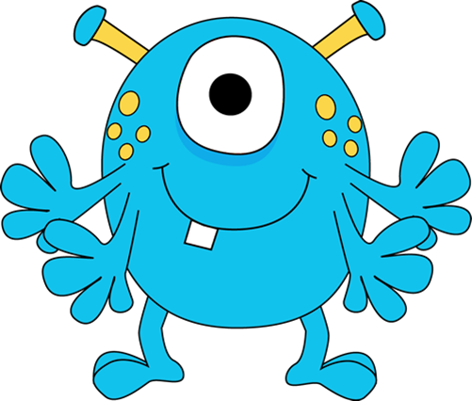
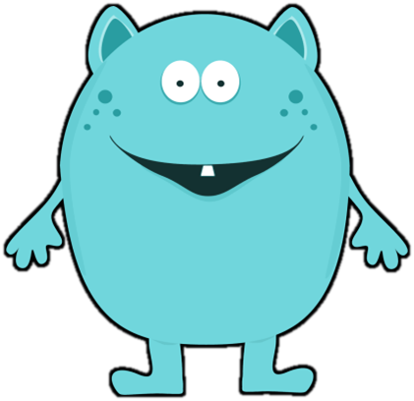
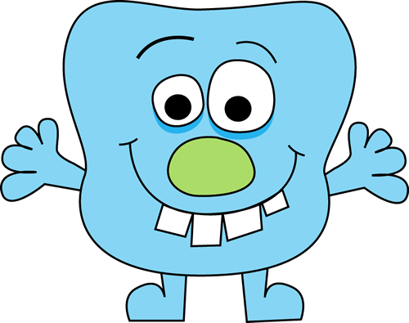
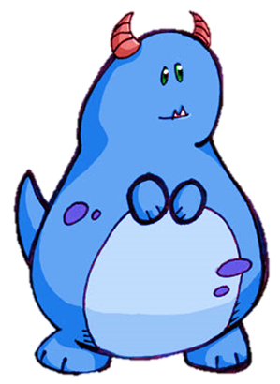
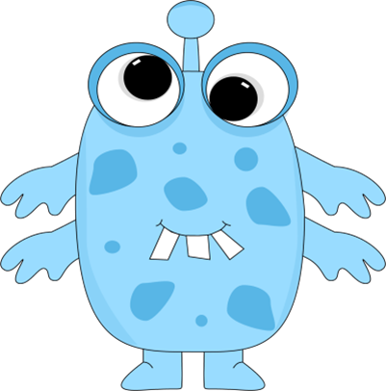
It has got one big eye, two small eyes, and some spots. It has also got two legs and two black feet.
It hasn’t got any mouth.
3
1
2
Yes, it’s me.
4
5
6
NEXT

Slide 47
It has got two eyes, one big green nose, and a big mouth with four teeth. It has also got two hands with four fingers and two feet.
Yes, it’s me.
3
1
2
4
5
6
NEXT

Slide 48
It has got two eyes, two ears, and a mouth with one small tooth. It has also got two hands with four fingers and two feet.
Yes, it’s me.
3
1
2
4
5
6
NEXT

Slide 49
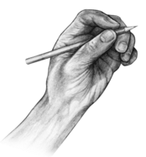
Let’s describe and draw a monster !

Slide 50
For example, What do you have??
I have a 2 long heads.
I have 2 big eyes.
I have 2 small mouths.
I have a long body.
I have no arms.
I have 3 big feet.
I have 3 long legs.

Slide 51
What do you have??
I have a big head.
I have a long arms.
I have a small head.
I have a big hands.
I have a short arms.
I have a long body.
I have a small hands.
I have a short body.
I have a long legs.
I have a short legs.
I have a small feet.
I have a big feet.

Slide 52
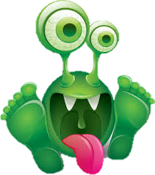
Bye!
EXIT

