Slide 1
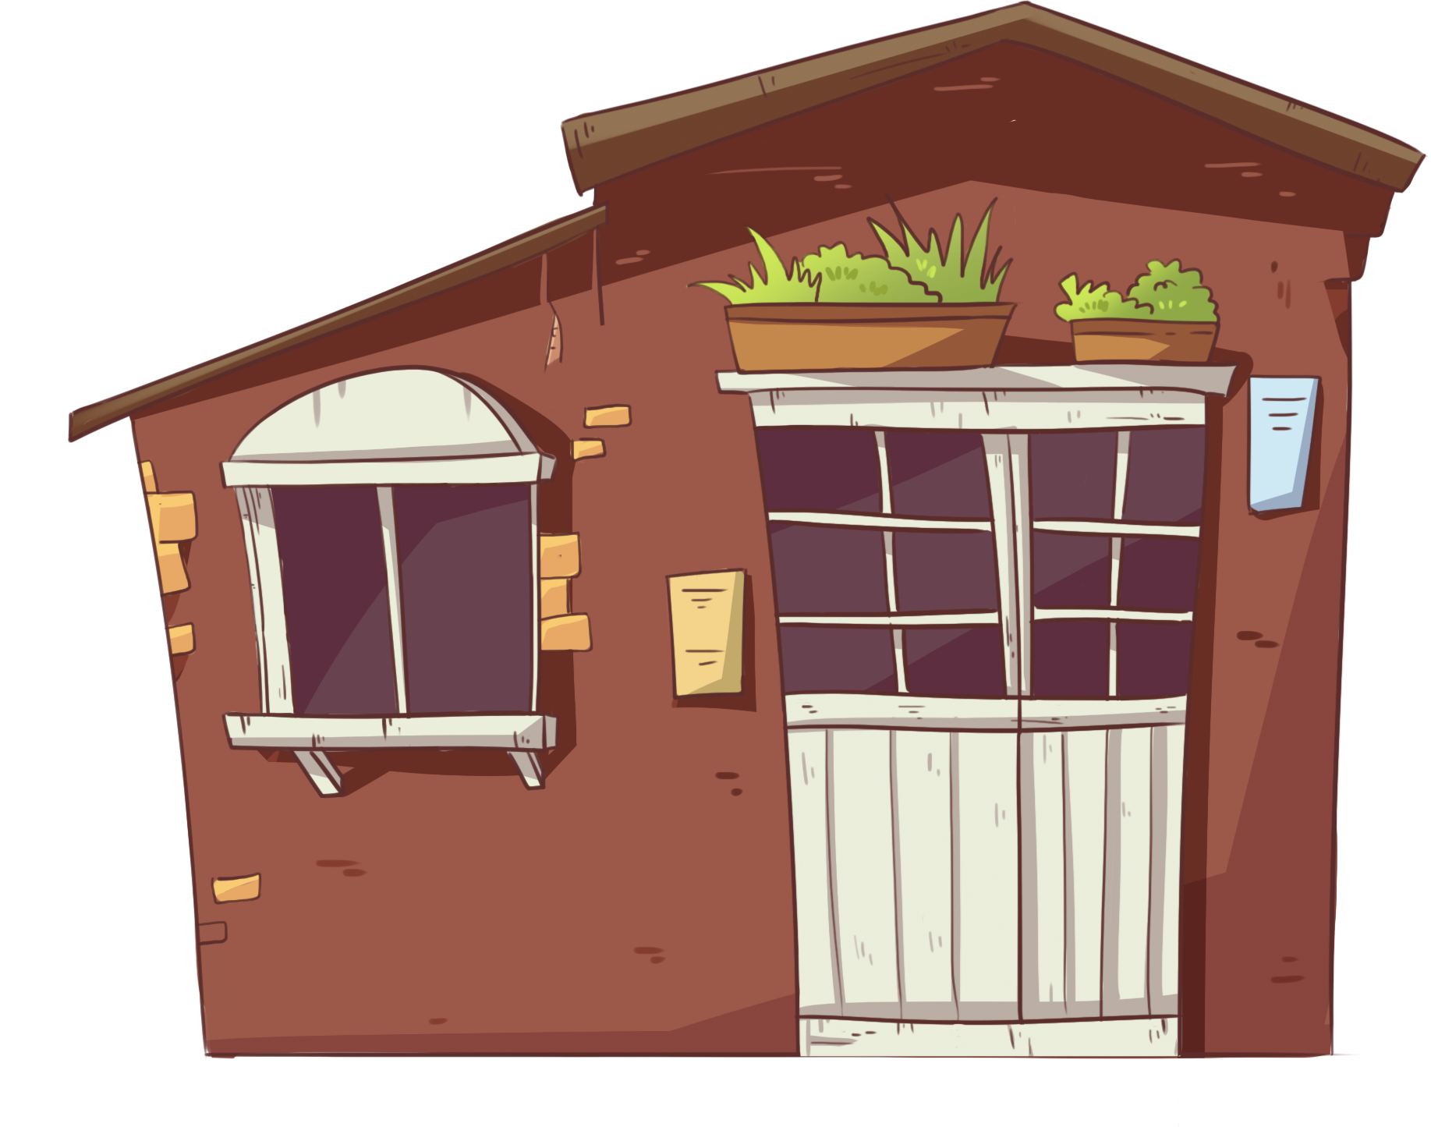
LO: Get to know their partners; get a basic idea about the topic of today’s lesson.
1. Say hello to Ss; ask Ss to introduce themselves and to greet each other.
2. Introduce the topic of the lesson.
House for Sale
ORT-GKB
Lesson 17
0:30
1/26

Slide 2
Learning
Goals
LO: Get to know and understand what will be learned in this lesson.
Go through the learning goals with Ss.
We are going to . . .
Add individual sounds (phonemes) to simple, single-syllable words to make new words.
Learn the key words climbed, bedroom, sat, chimney, chair, and tree house, and make sentences with them.
Read the story House for Sale and ask and answer questions about key details.
Practice using the sentence structure
_____ pulled _____.
0:30
2/26

Slide 3
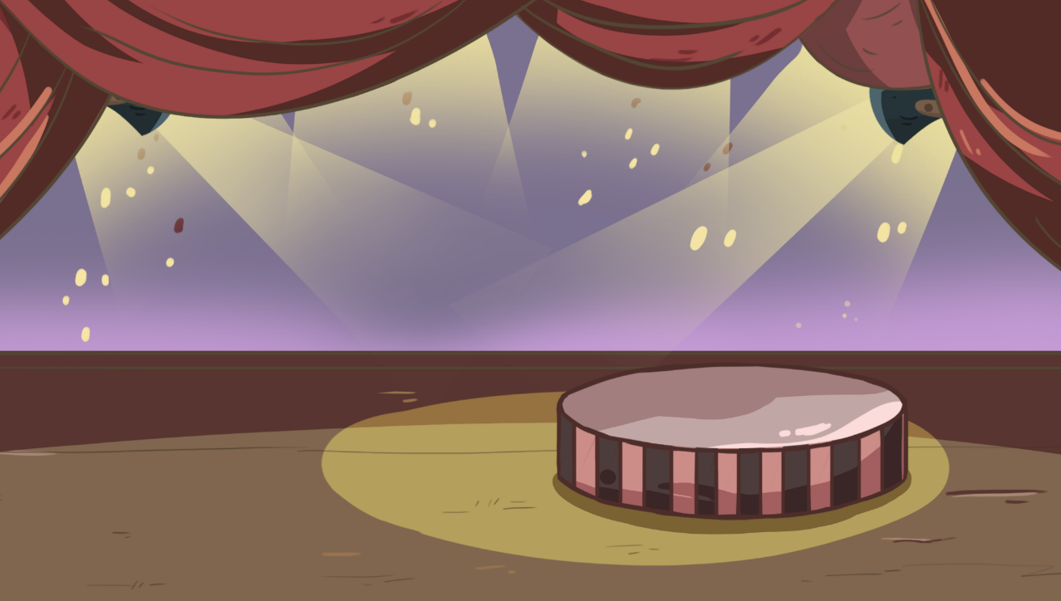
LO: Present the writing that was assigned last lesson.
1. Let Ss present in turns.
2. Give feedback.
Presentation
Let’s show!
Share your writing from last lesson with your partner!
2:00
3/26

Slide 4
LO: Add individual sounds (phonemes) to simple, single-syllable words to make new
words; decode the words accurately.
Have Ss help the girl in the picture hang photos on the wall by adding one sound before the
word air to make new words.
2. Read the single-syllable word air to Ss first; then read the individual sound f to Ss;
guide Ss to try and add the sound f to the word air to make the new word fair; click
and show the word fair; read the word fair in this way: f-air, fair; ask Ss to repeat it;
then click and hang one photo on the wall.
3. Repeat this practice for the rest of the words.
Phonics
Let’s listen and speak!
air
h
p
pair
f
fair
hair
air
air
Wow! Look, how beautiful my room is!
2:00
4/26

Slide 5
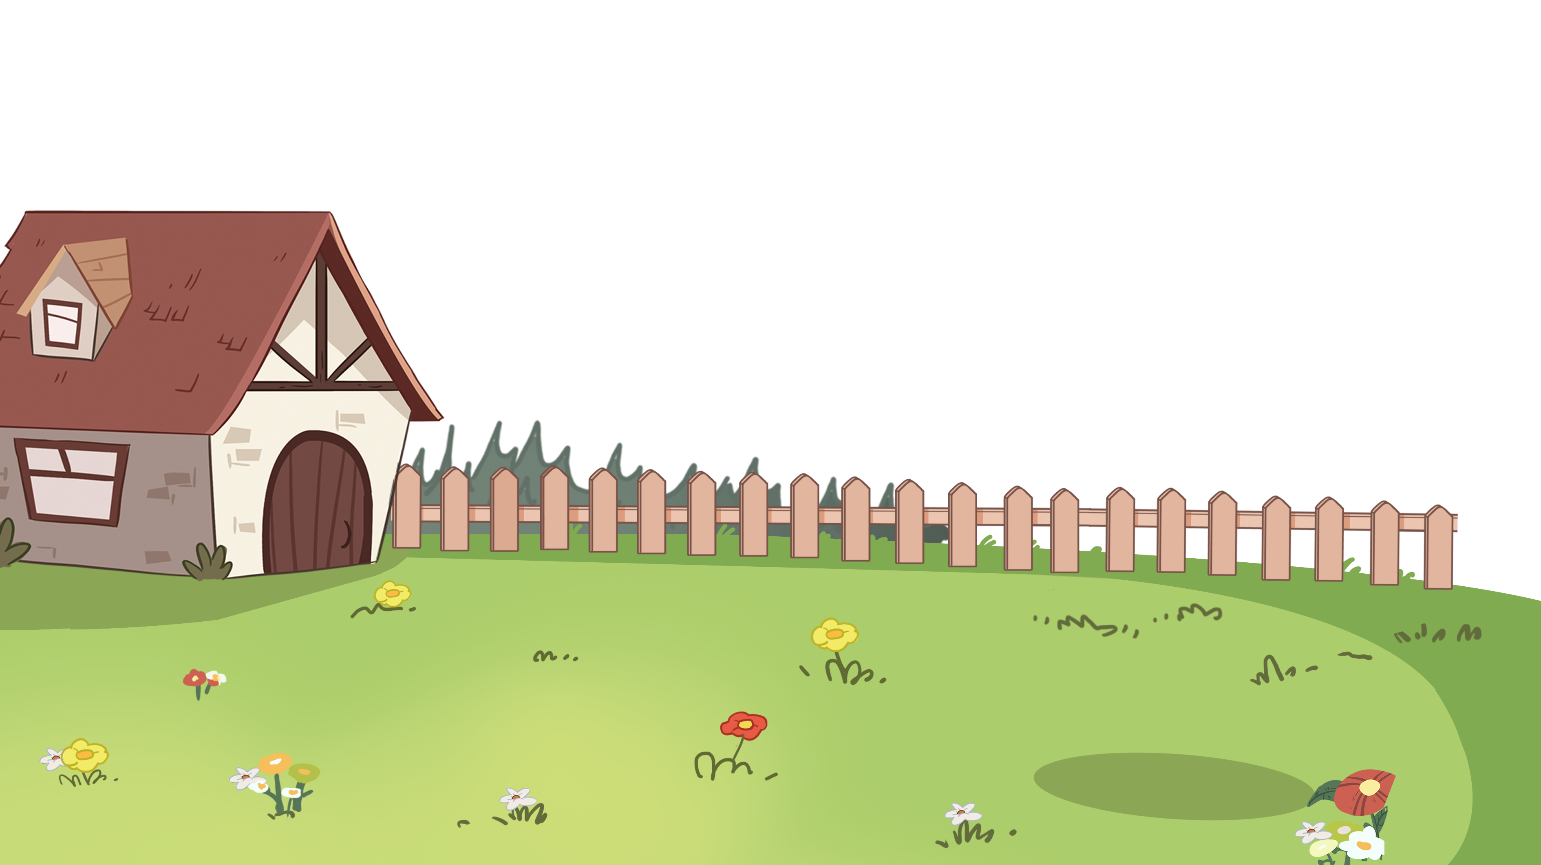
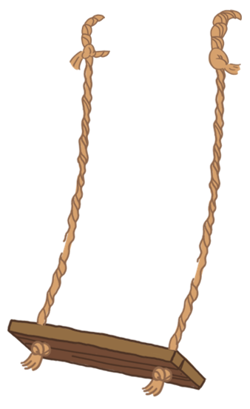
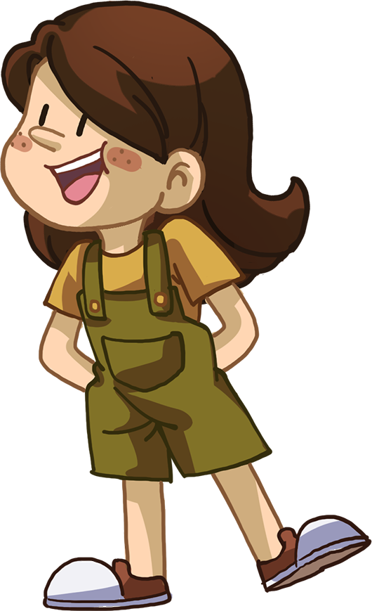
LO: Add individual sounds (phonemes) to simple, single-syllable words to make new
words; decode the words accurately.
Ask Ss to help the children in the picture play with the swing by adding one sound
to the words air and up to make new words.
2. Read the single-syllable word up to Ss first; click and read the individual sound c to
Ss; guide Ss to try and add the sound c to the word up to make a new word; click
and show the word cup; read the word cup in this way: c-up, cup; ask Ss to repeat
it; then click and make one of the children play with the swing.
3. Repeat this practice for the rest of the words.
Phonics
Let’s listen and speak!
cup
p
up
up
c
pup
air
chair
ch
2:00
5/26

Slide 6
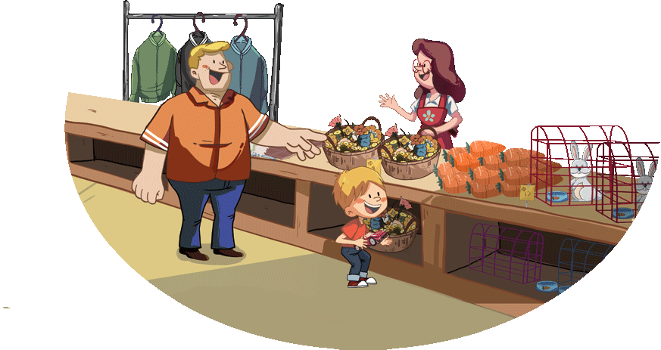
LO: Read the chant fluently; decode the words learned in the text.
Read the chant to Ss with rhythm; have Ss observe the picture and the highlighted
words.
2. Guide Ss to repeat after you; ask them to take turns reading each sentence.
3. Give feedback.
Phonics
Let’s chant!
There is a room almost bare.
There is only a girl sitting on the chair.
The girl has long hair.
The girl has a pair of beautiful ears.
She wanted a pup and a new cup.
So she wanted to buy them at the fair.
2:00
6/26

Slide 7
LO: Use the book cover to identify details and to make predictions.
1. Guide Ss to look at the book cover closely and to talk about the given questions.
2. Encourage Ss to talk more about the connections question.
Lead-in
Before Reading
Where is the family? What do you think the family is doing here? Look for clues on the book cover.
2. What will the story be about?
Connections
What does your house look like?
Written by Roderick Hunt
Illustrated by Alex Brychta
2:00
7/26

Slide 8
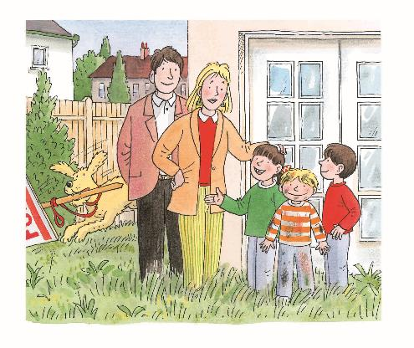
LO: Make predictions about the story by using the illustration; motivate Ss’ interest in
reading the story.
Guide Ss to recall what it means to predict and ask them to make guesses prior to
reading the story by looking at the pictures.
2. Guide Ss to talk about the given questions.
Reading
Reading
Let’s predict!
Before Reading
How does Kipper look? What might he do in this place?
2. Do you think the family
likes this house? Why?
Look for clues in the
illustration.
2:30
8/26

Slide 9
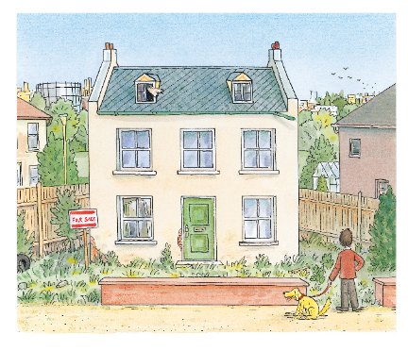
House for Sale
LO: Understand the text; read the text fluently.
1. Read the text aloud to Ss.
2. Have Ss talk about the comprehension questions by using the illustration and the
text.
3. Have Ss read the text fluently and give feedback.
Reading
Comprehension
Do you think anyone was living in the house? Why do you think so?
What did the house look like? Look for clues in the illustration.
Who stood in front of the house? What do you think the man would do next?
This house was for sale.
2:30
9/26

Slide 10
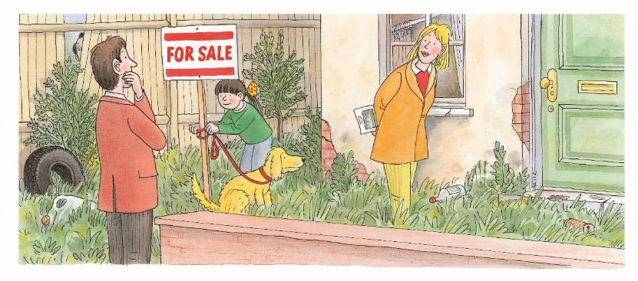
House for Sale
LO: Understand the text; read the text fluently; decode the sight word accurately.
1. Read the text aloud to Ss.
2. Have Ss talk about the comprehension questions by using the illustration and the
text.
3. Ask Ss to find the sight word liked in the text and guide them to read it accurately.
4. Have Ss read the text fluently and give feedback.
Reading
Comprehension
What did Dad and Mum think of the house?
What was Biff doing? Why did she do that?
What would the family do next?
Sight Word
Dad liked the house.
Mum liked it too.
liked
2:30
10/26

Slide 11
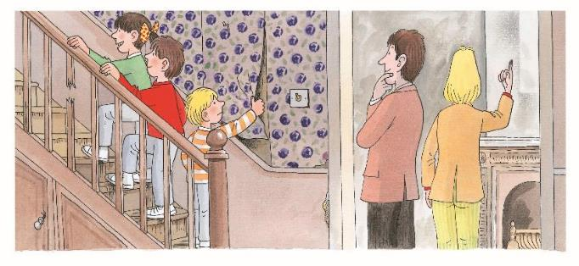
LO: Understand the text; ask and answer questions about key details by using the pictures
and the text; make connections; read the text fluently; decode the sight word accurately.
1. Read the text aloud to Ss.
2. Have Ss talk about the comprehension questions by using the illustration and the
text.
3. Encourage Ss to talk more about the questioning question; help them ask their
partner at least
one question; if they know how to ask questions, help them add details and create
clarify; if they don’t know how to ask questions, help them ask questions by using
the illustration, the text and the following words: what, where, when, how, who, or
why.
4. Encourage Ss to talk more about the connections question.
5. Ask Ss to find the sight word liked in the text and guide them to read it accurately.
6. Have Ss read the text fluently and give feedback.
Reading
House for Sale
Comprehension
Where were the children on this page? What did everyone think of the house?
Connections
Questioning
Can you find another word made up of two words?
(Tips: bed, moon, room,
cake)
Please ask your partner a question about Kipper.
(Tips: What? Where? When?
Who? Why? How?)
Biff and Chip looked
at the house.
Everyone liked it.
Kipper pulled the
wallpaper.
Sight Word
liked
2:30
11/26

Slide 12
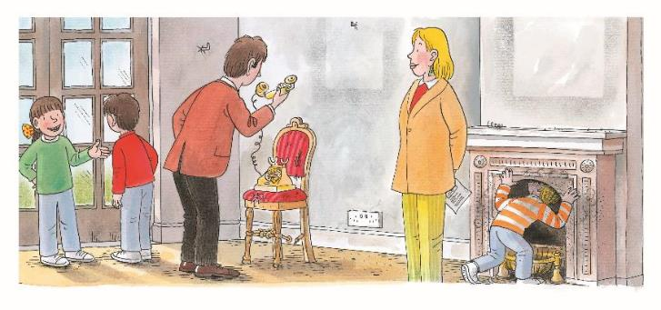
House for Sale
LO: Understand the meaning of the key vocabulary word chimney, and make sentences
with it; Understand the text; make connections; read the text fluently; decode the sight word accurately.
1. Have Ss take turns reading the text; give feedback and correct them if necessary.
2. Ask Ss to find chimney in the text and the illustration; have Ss read the word and
have them make sentences with it.
3. Have Ss talk about the comprehension questions by using the illustration and the
text.
4. Ask Ss to find the sight word liked in the text and guide them to read it accurately.
5. Encourage Ss to talk more about the connections question..
Note: Click the penguin button to show the vocabulary card.
Reading
Comprehension
Vocabulary
Where did the family go? How did they feel about this place? How do you know?
What did Kipper do in this place?
What did everyone think of this room?
Connections
Where can you see a chimney? What is it used for?
chimney
There are many books near the chimney.
Sight Word
They went into a room. Everyone liked this
room.
Kipper looked up the
chimney.
liked
chimney
2:30
12/26

Slide 13
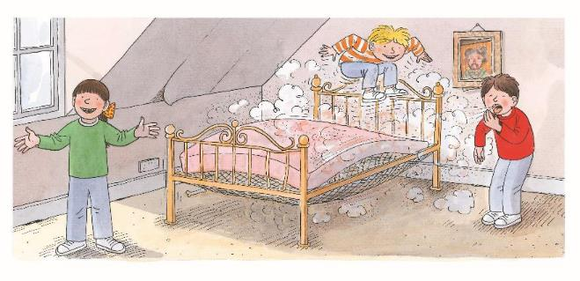
House for Sale
LO: Understand the meaning of the key vocabulary word bedroom, and make sentences
with it; understand the text; warm up with phrases from the book and practice reading them in a single breath.
1. Have Ss take turns reading the text; give feedback and correct them if necessary.
2. Ask Ss to find bedroom in the text and the illustration; have Ss read the word and
have them make sentences with it.
3. Have Ss talk about the comprehension questions by using the illustration and the
text.
4. Ask Ss to find the word on from the text; then guide them to understand that the
noun phrase the bed should follow; read the group of words on the bed as a
phrase; lastly, guide Ss to read the phrase in one breath. Model first.
Note: Click the penguin button to show the vocabulary card.
Reading
Vocabulary
Comprehension
What kind of room were the children in? Look for clues in the illustration.
Who wanted this room? How did this room look?
What did Kipper do? What do you think Mum and Dad would say to him if they saw him do that?
bedroom
This is a clean and cozy bedroom.
Decoding
Biff wanted this
bedroom.
It was a big room.
Kipper jumped on
the bed.
Phrasing-Warm-up phrases
bedroom
2:30
13/26

Slide 14
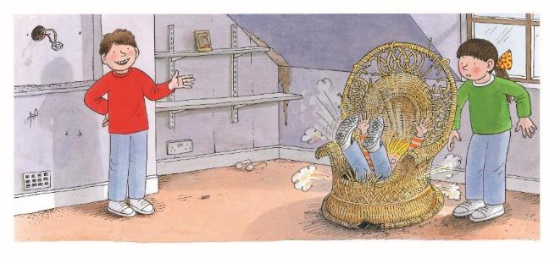
House for Sale
LO: Understand the meaning of the key vocabulary words sat and chair, and make
sentences with them; understand the text; ask and answer questions about key details by using the pictures and the text; warm up with phrases from the book and practice reading them in a single breath.
1. Read the text aloud to Ss.
2. Ask one of the Ss to find sat in the text and the illustration; have Ss read the word 、
and make sentences with it.
3. Ask another Ss to find chair in the text and the illustration; have Ss read the word
and make sentences with it.
4. Have Ss talk about the comprehension questions by using the illustration and the
text.
5. Encourage Ss to talk more about the questioning question; help them ask their
partner at least one question; if they know how to ask questions, help them add
details and create clarify; if they don’t know how to ask questions, help them ask
questions by using the illustration, the text, and the following words: what, where,
when, how, who, or why.
6. Ask Ss to find the word on from the text; then guide them to understand that the
noun phrase a chair should follow; read the group of words on a chair as a phrase;
lastly, guide Ss to read the phrase in one breath. Model first.
Note: Click the penguin button to show the vocabulary cards.
Reading
Comprehension
Who wanted this big bedroom?
What was in the room on this page?
What kind of person do you think Kipper was? Why?
Vocabulary
Vocabulary
sat
chair
Questioning
Ask your partner a question using the text or illustration.
He sat on the steps to rest.
There is only a chair in this room.
Chip wanted this
bedroom.
It was a big room.
Kipper sat on a chair.
Decoding
Phrasing-Warm-up phrases
sat
chair
2:30
14/26

Slide 15
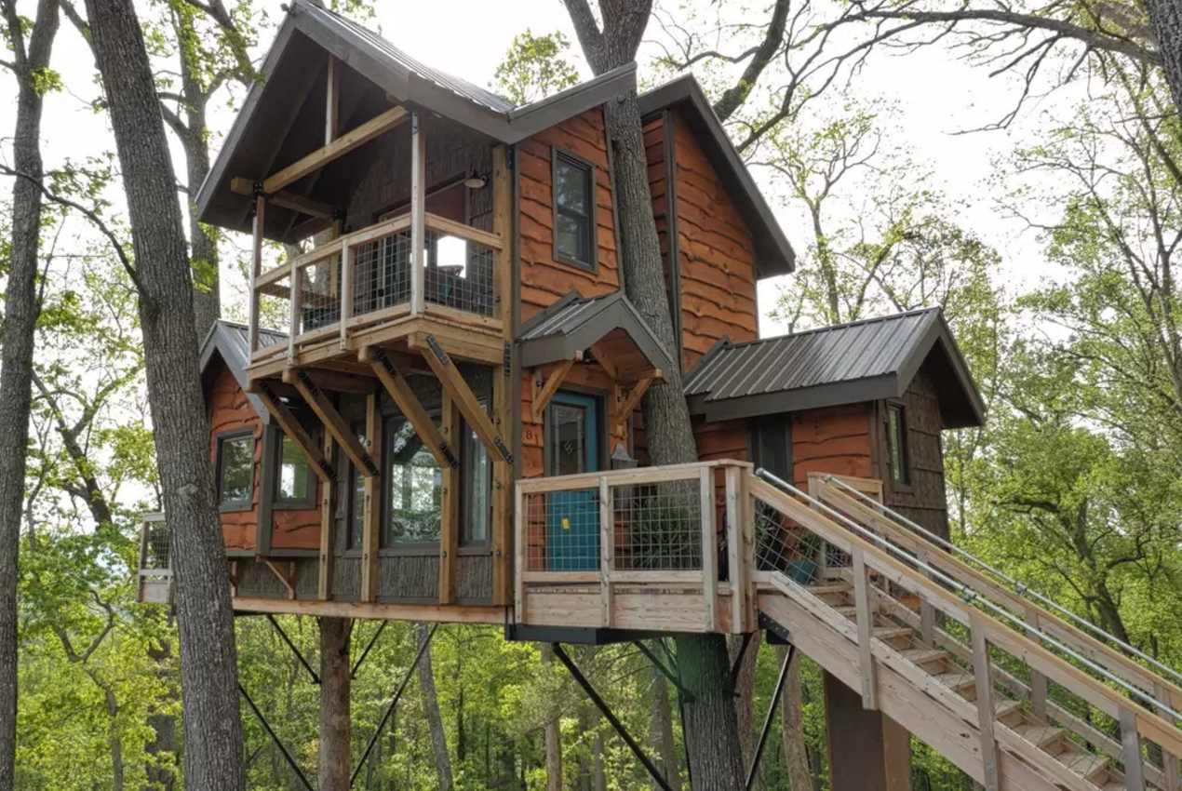
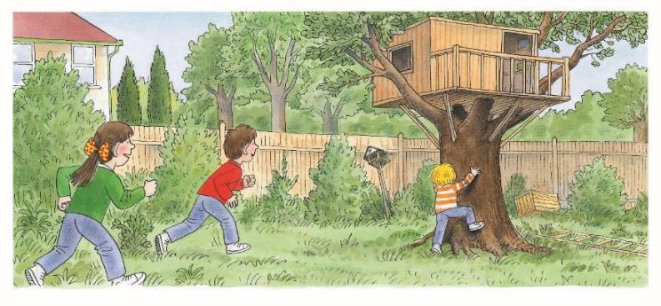
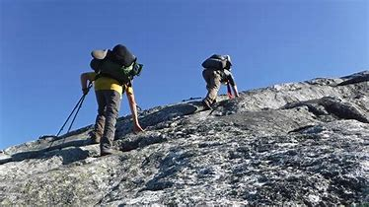
House for Sale
LO: Understand the meaning of the key vocabulary words climbed and tree house, and
make sentences with them; understand the text; read the text fluently.
1. Read the text aloud to Ss.
2. Ask one of the Ss to find climbed in the text and the illustration; have Ss read the
word and make sentences with it.
3. Ask another S to find tree house in the text and the illustration; have Ss read the
phrase and make sentences with it.
4. Have Ss talk about the comprehension questions by using the illustration and the
text.
5. Have Ss read the text fluently and give feedback.
Note: Click the penguin button to show the vocabulary cards.
Reading
Vocabulary
Vocabulary
Comprehension
Where did the children go? What did they do?
What was special about the garden? Was it a good garden for the family? Why?
climbed
tree house
They climbed the mountain together yesterday.
There is a tree house in the tree.
They went down the
garden.
They looked at the tree
house. Kipper climbed
the tree.
climbed
tree house
2:30
15/26

Slide 16
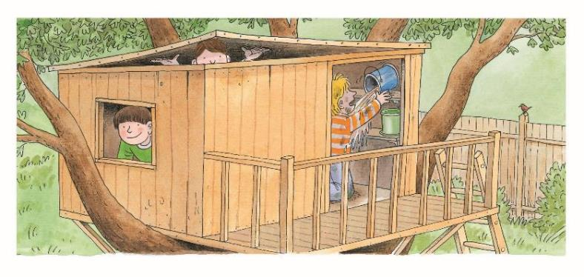
House for Sale
LO: Understand the text; ask and answer questions about key details by using the pictures
and the text.
1. Have Ss take turns reading the text; give feedback and correct them if necessary.
Have Ss talk about the comprehension questions by using the illustration and the
text.
3. Encourage Ss to talk more about the questioning question; help them ask their
partner at least one question; if they know how to ask questions, help them add
details and create clarify; if they don’t know how to ask questions, help them ask
questions by using the illustration, the text,and the following words: what, where,
when, how, who, or why.
Reading
Comprehension
What did Chip and Biff do?
What did Kipper do?
Questioning
What can you tell your partner about the story so far?
Biff and Chip climbed
the tree. They went in
the tree house.
Kipper pulled a can
down.
2:30
16/26

Slide 17
House for Sale
LO: Understand the text; make connections; read the text fluently; decode the sight word accurately.
1. Read the text aloud to Ss.
2. Have Ss talk about the comprehension questions by using the illustration and the
text.
3. Encourage Ss to talk more about the connections question.
4. Ask Ss to find sight word liked in the text and guide them to read it accurately.
5. Have Ss read the text fluently and give feedback.
Reading
Comprehension
What did the family like about this house?
Do you think the family would move into this house? What would Mum and Dad need to do before they move in?
Connections
Did you move into a new house before? What did you do before you moved into your new house?
Everyone liked the house. Floppy liked it too.
Sight Word
liked
2:30
17/26

Slide 18
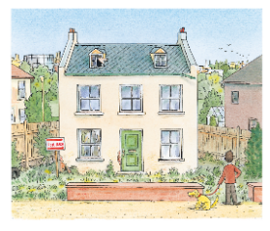
LO: Retell the story with the visual support and assistance.
Ask Ss to work in pairs and talk about the given questions; have them work in pairs
to recall the details of the story in the correct sequence order; model first.
2. Have Ss take turns retelling the story by using the visual aids.
Reading
Let’s retell!
1
2
Why did they look at the house?
Which rooms did they go and see?
3
4
What did the children do in the house?
What did they think of this house?
2:00
18/26

Slide 19
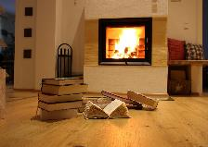
Let’s review the words!
LO: Check their understanding of the words in this lesson.
1. Have Ss play the Fun Catch game by identifying the pictures and vocabulary words.
2. Click to show the picture and ask Ss to identify the word that match the picture;
click to show the answer; click to help Ss catch the toys in the picture.
3. Repeat this practice for the rest of the words.
Vocabulary
chimney
climbed
tree house
sat
bedroom
chair
1:30
19/26

Slide 20
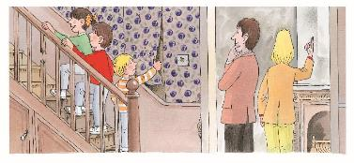
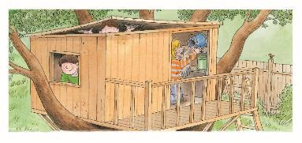
Let’s talk!
LO: Talk about what Kipper did when he was in the house that was for sale by using the given sentence structure.
Have Ss work in pairs to talk about the given illustration by using the sentence
structure and the helping words; model first.
2. Assist Ss if necessary.
Listening & Speaking
—What did Kipper do when he was in the house for sale?
—Kipper pulled ______.
Helping Words
the wallpaper
a can
1:30
20/26

Slide 21
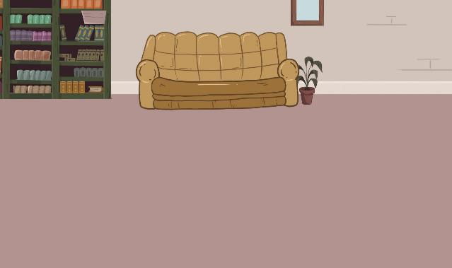
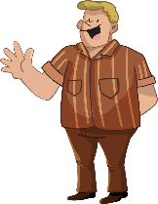
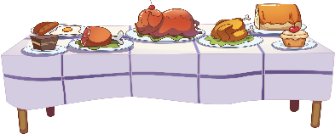
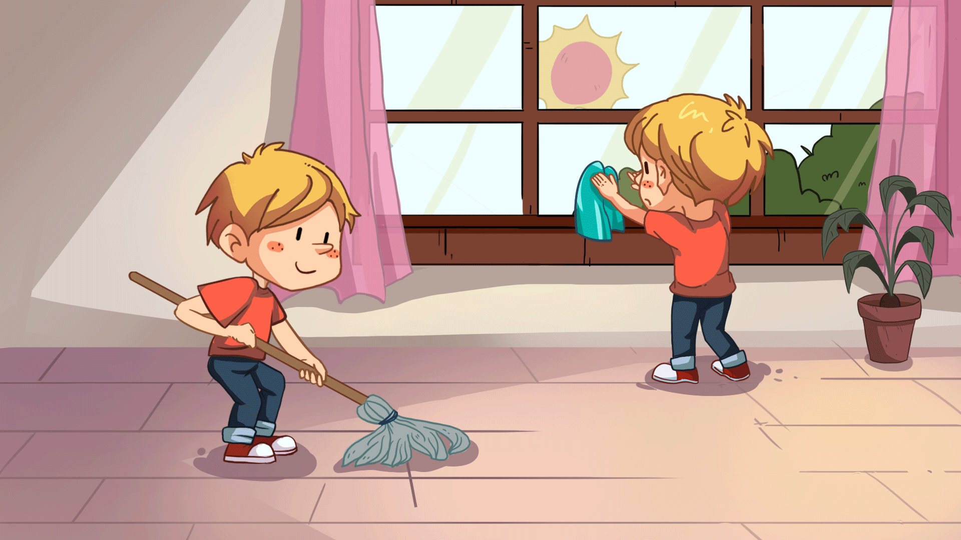
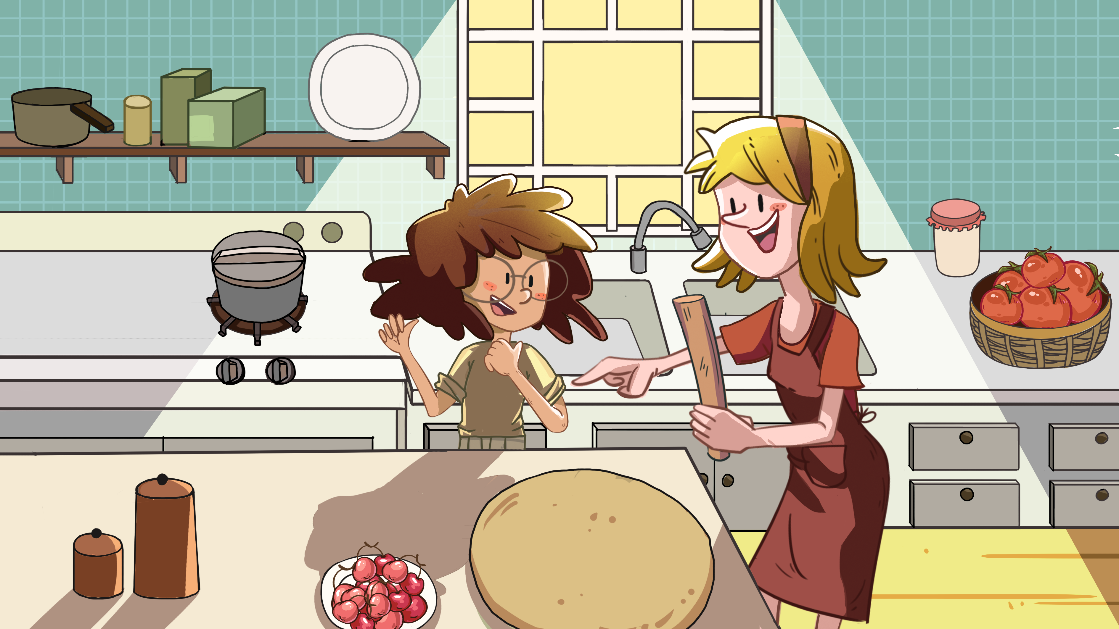
LO: Use the sentence structure to discuss the following question: What can you do when
you move into a new house?
Ask Ss to observe the picture carefully; have them talk about what things they can
do when moving into a new house, and have Ss discuss what they would do;
encourage them to speak more.
Ask Ss to work in pairs to talk about the given picture by using the given sentence
structure; each S has at least three chances to talk; model first.
3. Assist Ss if necessary.
Notes: T can click Let’s Talk to present the sentence structure, and T can click
again to make it disappear.
Let’s talk!
Listening & Speaking
—What would you do if you moved into a new
house?
—I would _____.
sweep the floor have a party keep a pet
3:00
21/26
3:00
21/26

Slide 22
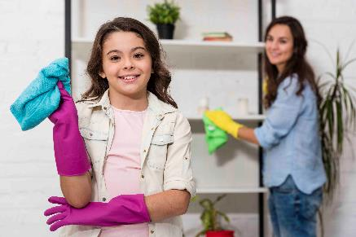
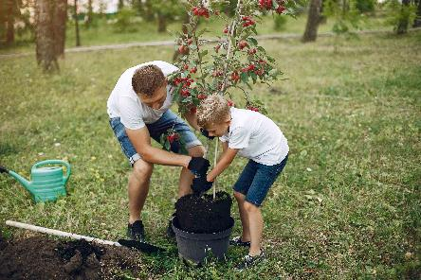
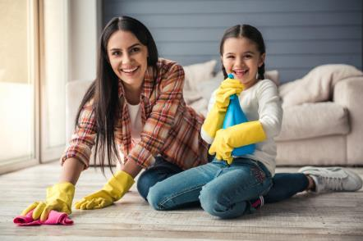
LO: Talk about the following topic: what cacn we do to make our home look more beautiful.
1. Ask Ss to think about the given question; model first.
2. Guide Ss to talk about the question with the help of the given pictures.
3. Encourage Ss to talk more about the topic.
Value
Value
What should we do to make our home look more beautiful?
arrange flowers with family
help clean the house
2:00
22/26

Slide 23
LO: Talk about what Kipper did in the house that was for sale.
1. Guide Ss to talk about what they’ve learned from the story.
2. Ask Ss to think about the given questions; help Ss to organize their ideas with the
given visual support; model the first question, and then ask Ss to complete the task
in turns.
Oral Writing
Get ready to present!
Talk about what Kipper did in the house for sale.
looked up the chimney
pulled the wallpaper
climbed the tree
Kipper
jumped on the bed
sat on a chair
pulled a can down
2:00
23/26
Notes:
她们的

Slide 24
LO: Understand what the homework is.
1. Explain the writing task to Ss and check their understanding.
2. Tell Ss that they should finish their writing before next class; make sure they know
they can upload their homework to the platform; they will present their homework
next class.
3. Remind Ss to watch the post-class video and finish the writing task.
Writing
Let’s write!
Thank-You Letter Writing
Let’s write a thank-you letter!
Directions:
Write a thank-you letter to Dad or Mum in three sentences, pretending you are one of the children from the story.
Watch the post-class video about the writing task.
0:30
24/26

Slide 25
LO: Review today’s lesson.
1. Guide Ss to review the phonics by asking Ss to read the words aloud.
2. Guide Ss to review the words by inviting Ss to read and explain some of the words.
3. Guide Ss to review the sentence structures by asking each S to make sentences
with them.
Review
Let’s review!
Review
Phonics:
fair/chair/hair/
pair/cup/pup
Sentence Structure:
_____ pulled _____.
Vocabulary:
chair/climbed/bedroom/sat/chimney/tree house
1:00
25/26

Slide 26
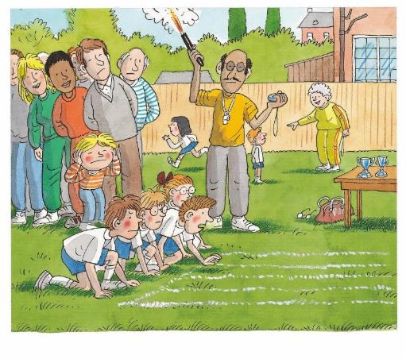
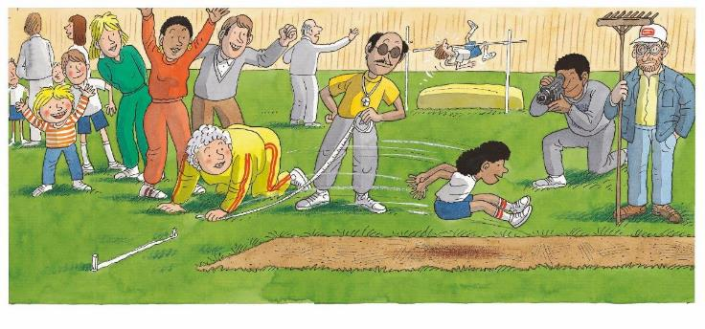
LO: End the lesson and encourage Ss to perform better in the next class.
1. Briefly comments on Ss.
2. Say goodbye to students.
3. Ask Ss to preview the next lesson.
0:30
26/26

