Slide 1
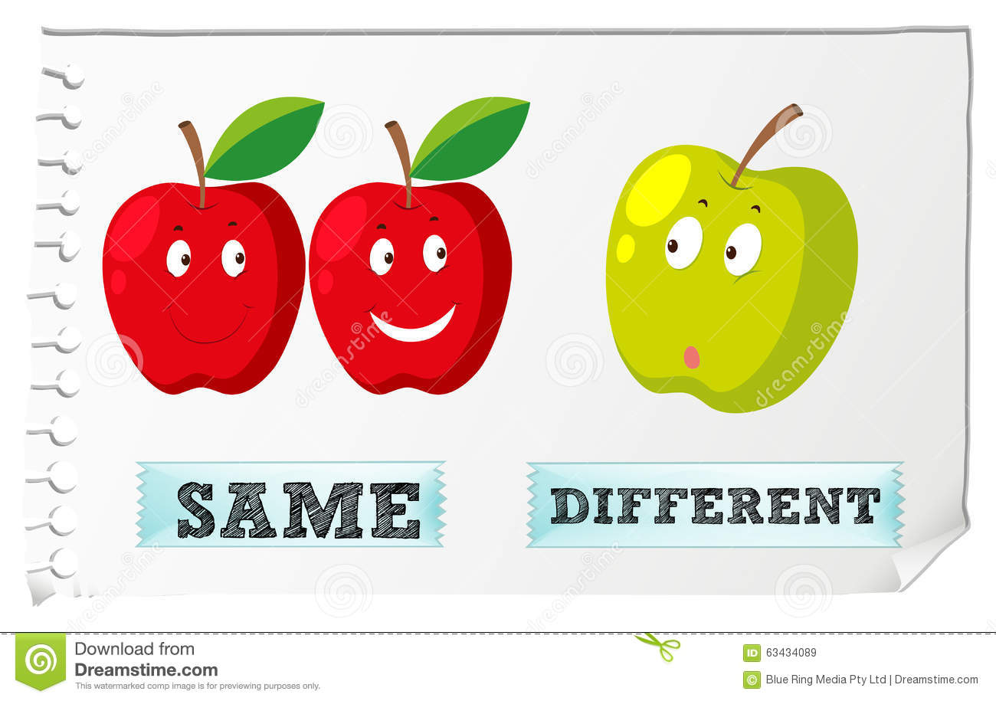
NEXT

Slide 2
We are two apples.
NEXT
BOTH

Slide 3
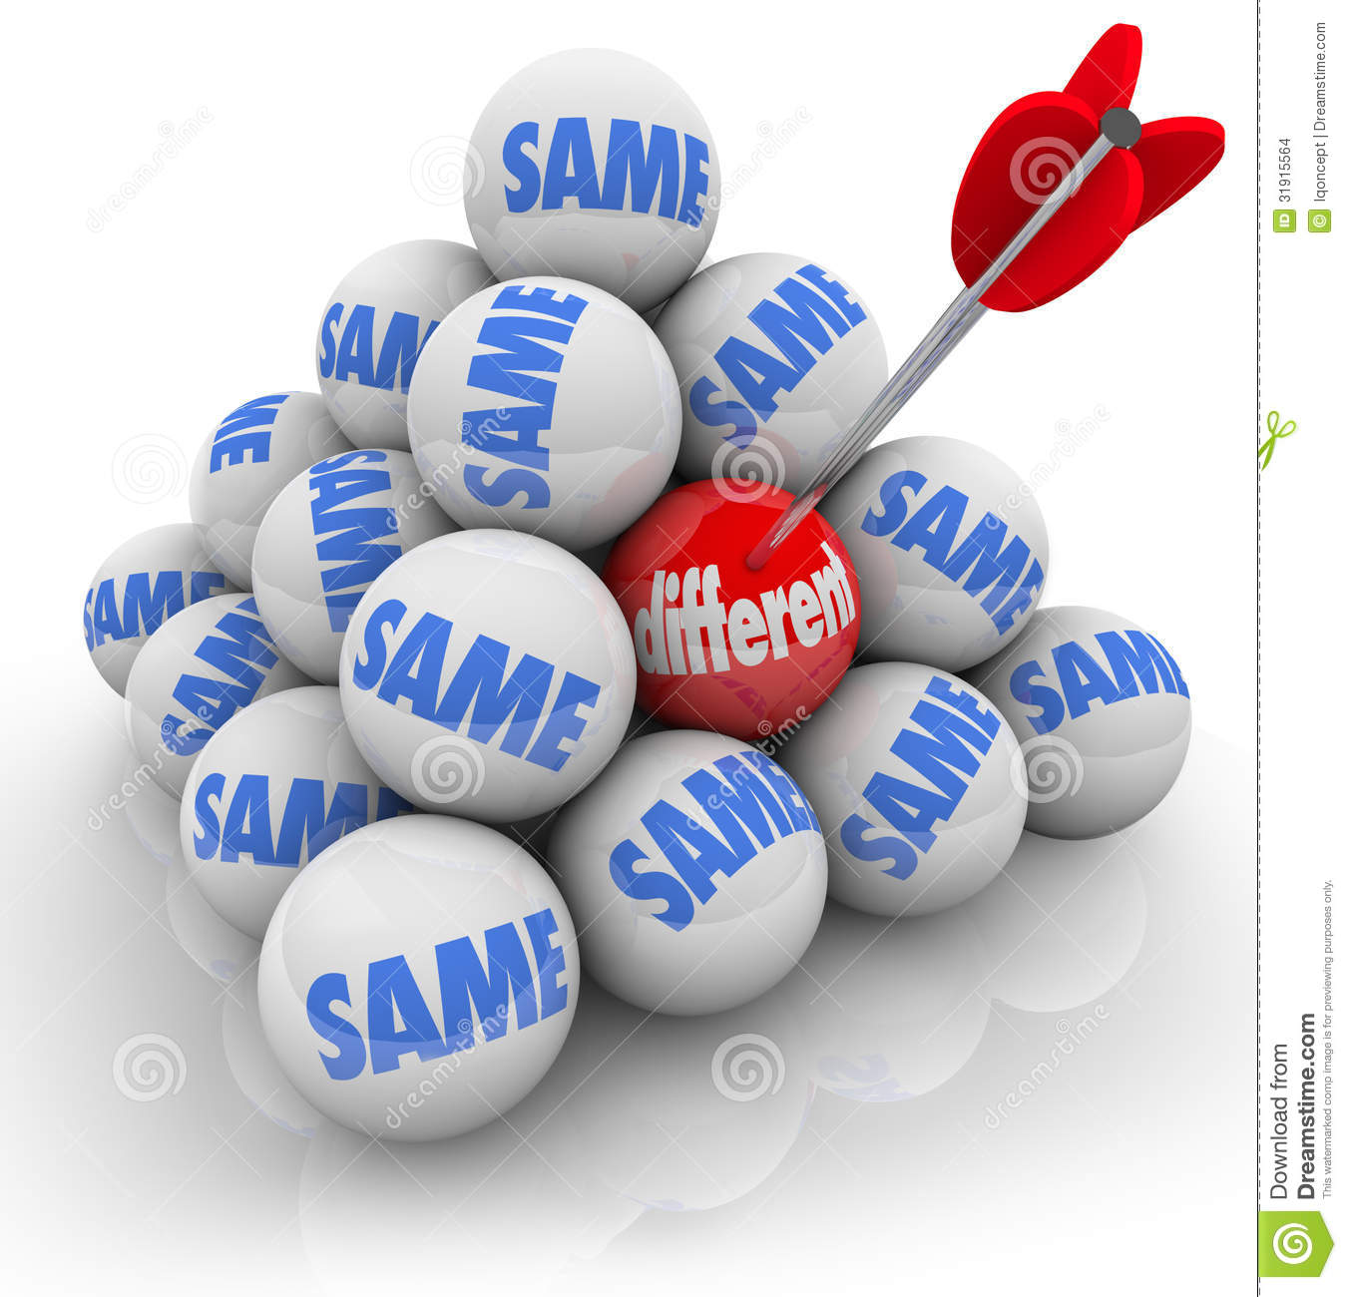
NEXT

Slide 4
We are not two balls.
BOTH
NEXT

Slide 5

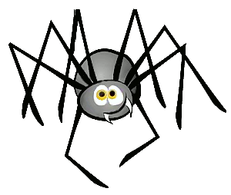
What is different? Game!
PLAY

Slide 6

1/15
two
six
first
Why?
one
CHECK
NEXT
Because it is not a cardinal number.

Slide 7
2/15
pink
blue
red
big
Why?
CHECK
NEXT
Because it is not a colour.

Slide 8
3/15
sad
tired
happy
tall
Why?
CHECK
NEXT
Because it is not an adjective of feeling.

Slide 9
4/15
July
June
Sunday
Why?
April
CHECK
NEXT
Because it is not a month.

Slide 10
5/15
blouse
skirt
dress
shirt
Why?
Because a girl doesn’t wear it.
CHECK
NEXT

Slide 11
6/15
son
sister
aunt
friend
Why?
CHECK
NEXT
Because it is not a family member.

Slide 12
7/15
Friday
May
Why?
Monday
Sunday
Because it is not a day of the week.
CHECK
NEXT

Slide 13
Click on the odd-one-out
8/15
Click on the odd-one-out
nose
mouth
leg
Why?
eye
CHECK
NEXT
Because it is not a part of the face.

Slide 14
9/15
teacher
girl
Why?
taxi driver
doctor
Because it is not a job.
CHECK
NEXT

Slide 15
10/15
apple
pear
peach
candy
Why?
CHECK
NEXT
Because it is not a piece of fruit.

Slide 16
11/15
lion
cow
Why?
snake
tiger
Because it is not a forest animal.
CHECK
NEXT

Slide 17
12/15
sheep
pig
horse
panda
Why?
Because it is not a farm animal.
CHECK
NEXT

Slide 18
13/15
pencil
ruler
pen
chopstick
Why?
CHECK
NEXT
Because it is not a school item.

Slide 19
14/15
bike
bus
car
ship
Why?
Because it has not got wheels.
CHECK
NEXT

Slide 20
15/15
football
tennis
skating
Why?
basketball
EXIT
Because you don’t need a ball for this sport.
CHECK

Slide 21
Lets read a story.
READ

Slide 22
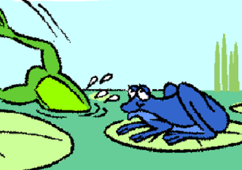
Both are Frogs but they are different.
READ

Slide 23
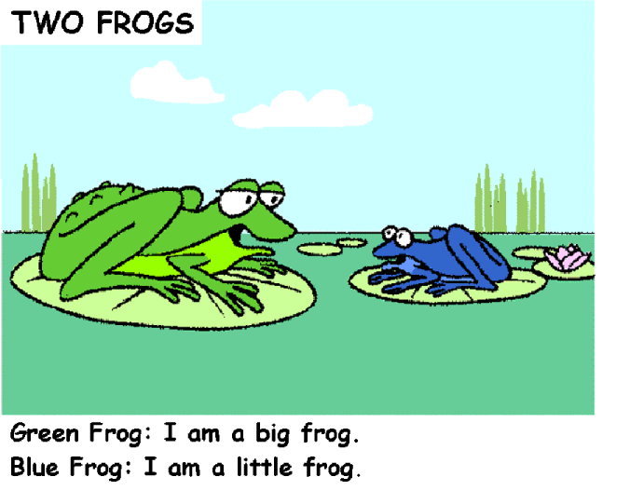
There are two frogs talking. They are sitting on leaves at the pond.
READ

Slide 24
READ

Slide 25
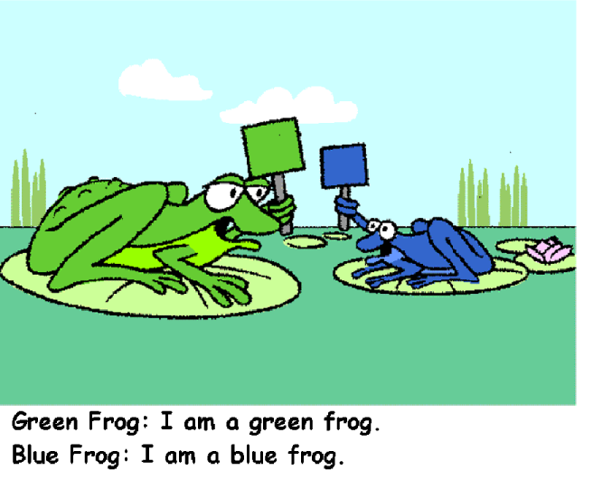
READ

Slide 26
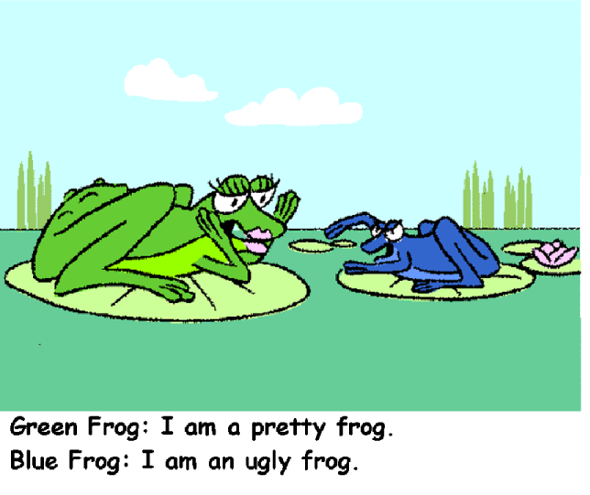
READ

Slide 27
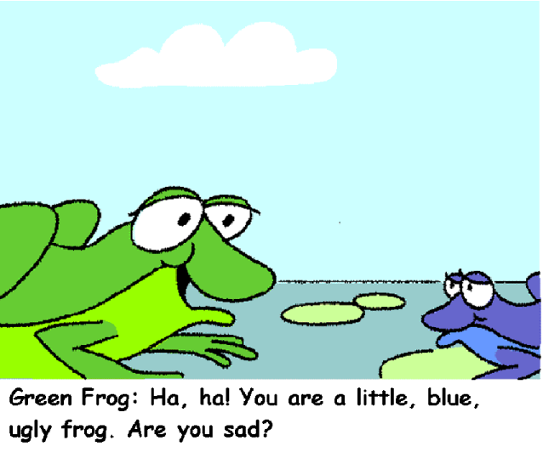
READ

Slide 28
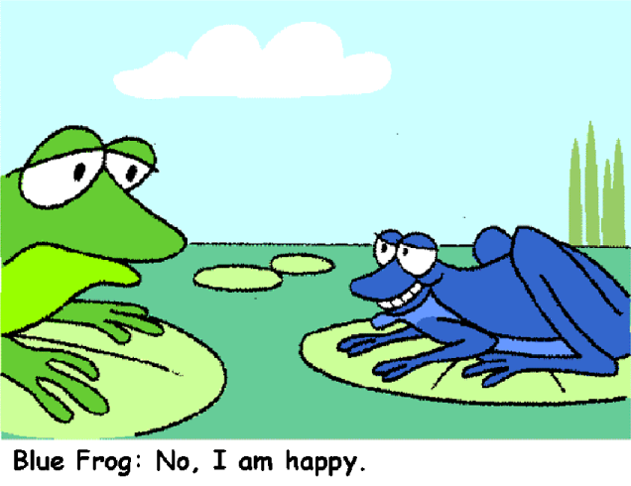
READ

Slide 29
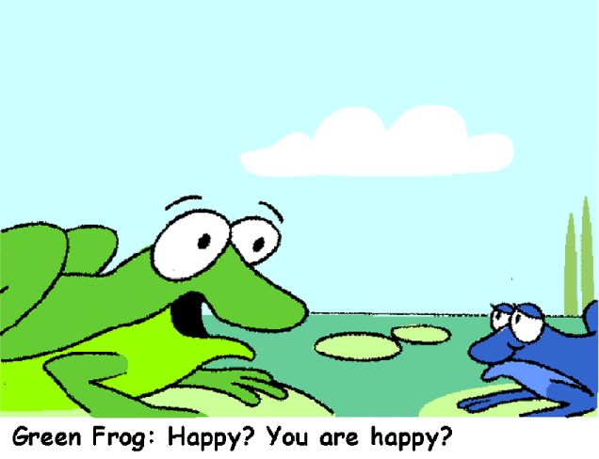
READ

Slide 30
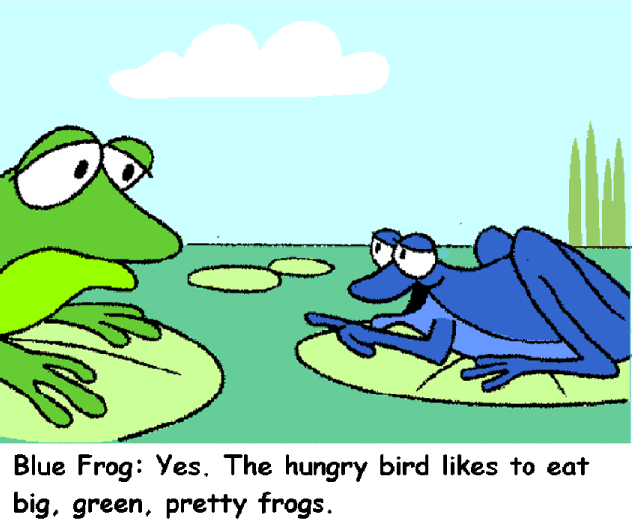
READ

Slide 31
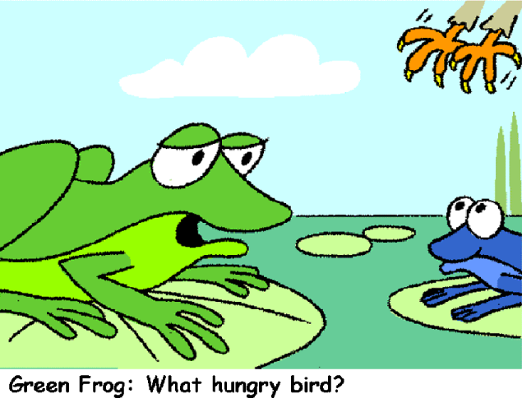
READ

Slide 32
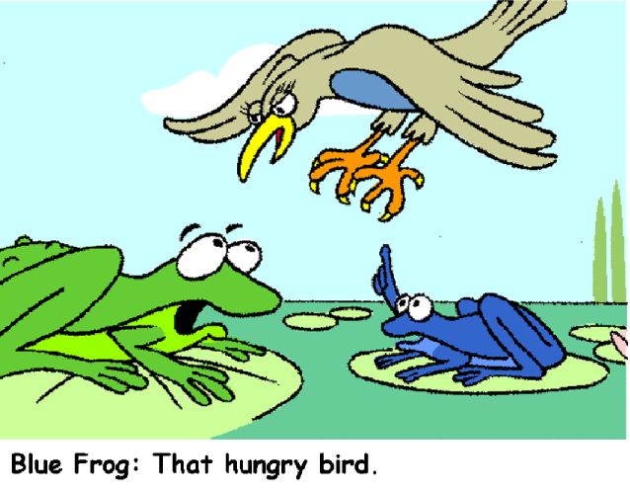
READ

Slide 33
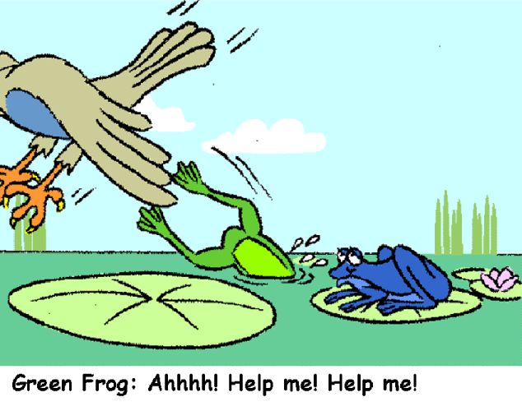
READ

Slide 34
Blue Frog: Haha! I am a small, blue, ugly,
HAPPY frog. Are you happy now?
READ

Slide 35
THE END!
READ

Slide 36
Let’s watch a video
same or different kidstv
https://www.youtube.com/watch?v=Gng5a5FCSZc
PLAY

Slide 37
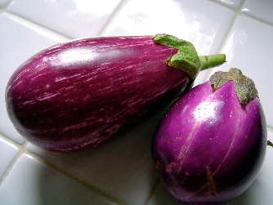

Say what u c!
eggplant

Slide 38





open!

Slide 39

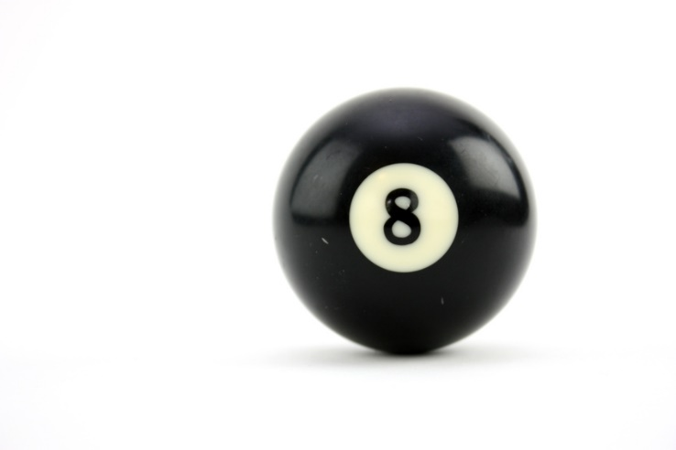
snowball!

Slide 40
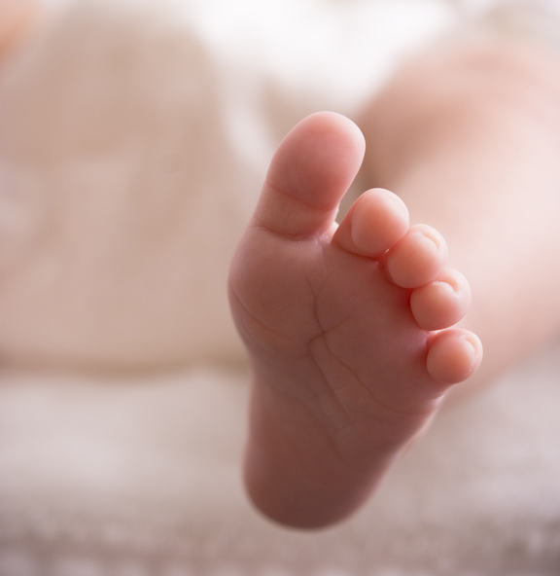
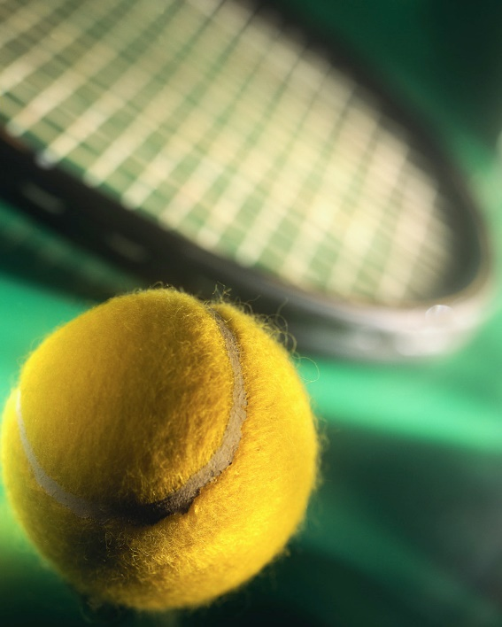
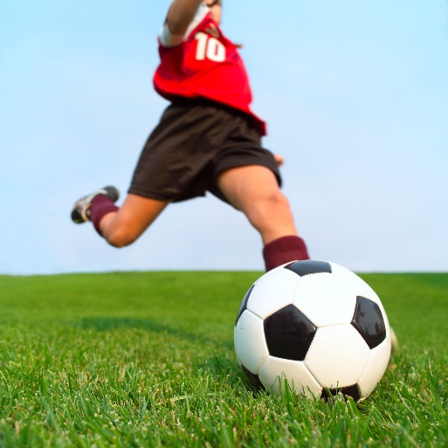
football!

Slide 41
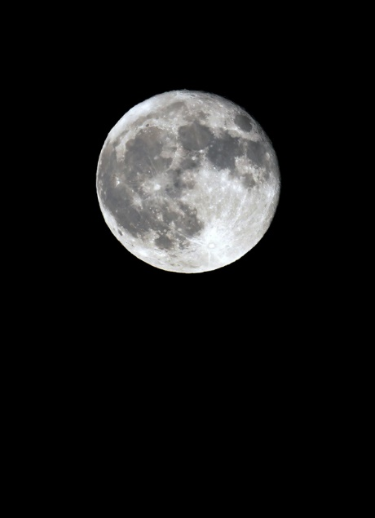
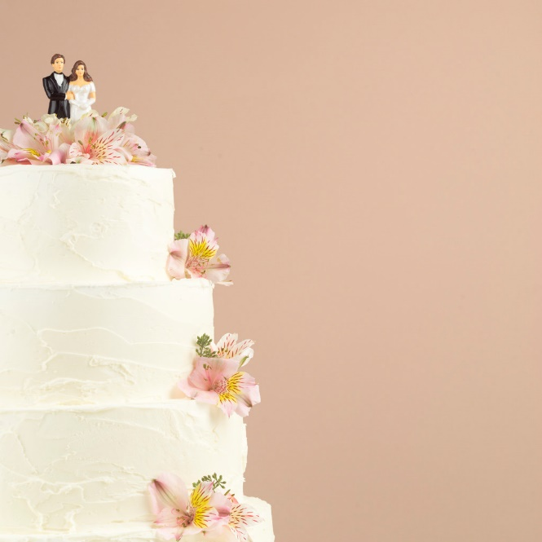
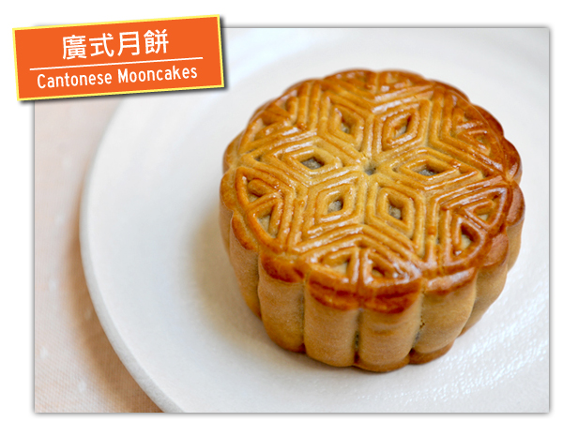
mooncake!

Slide 42
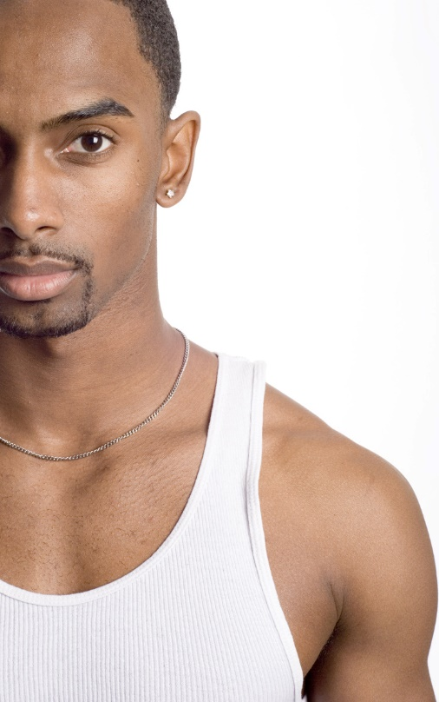

Spiderman!

Slide 43
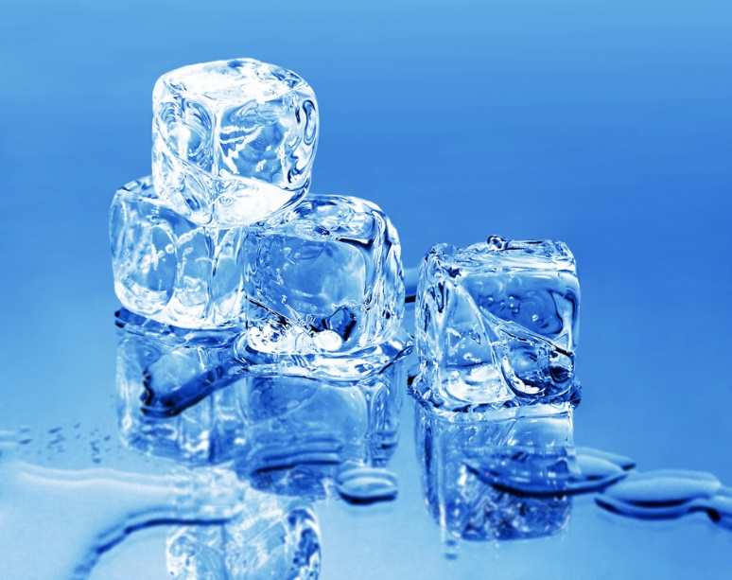
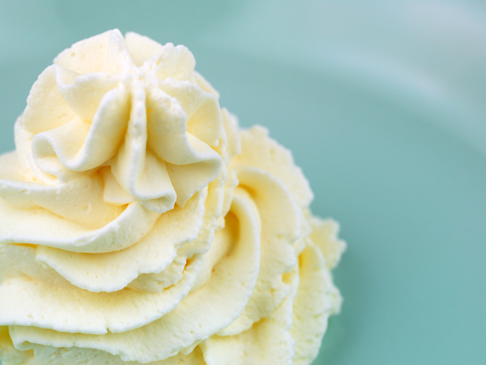
icecream!

Slide 44

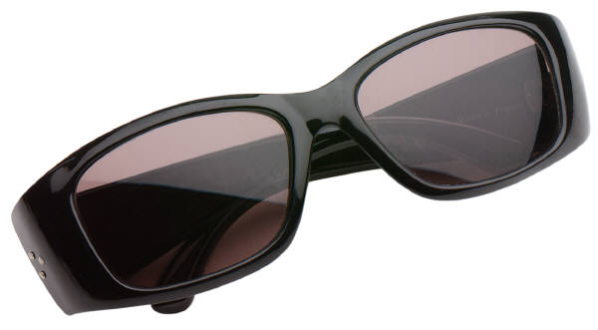
sunglasses!

Slide 45
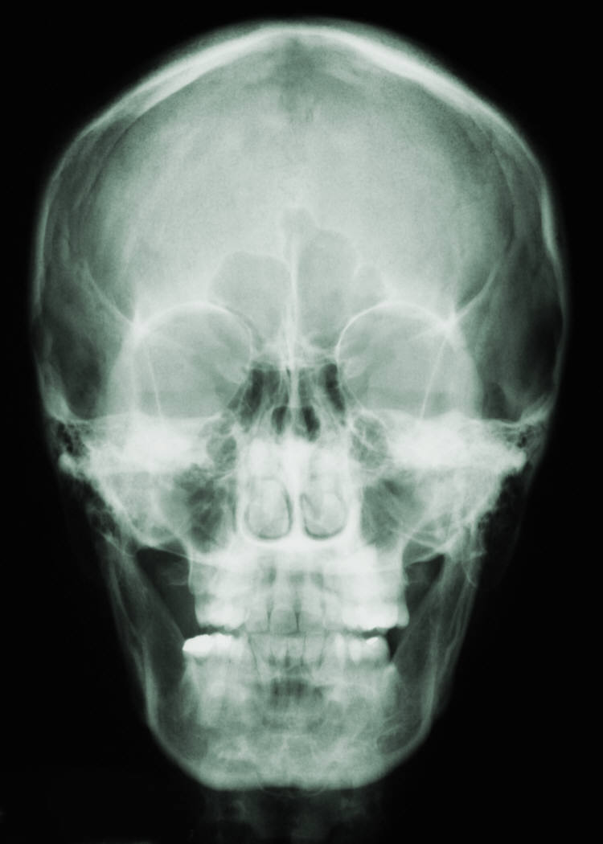
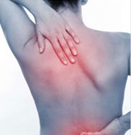
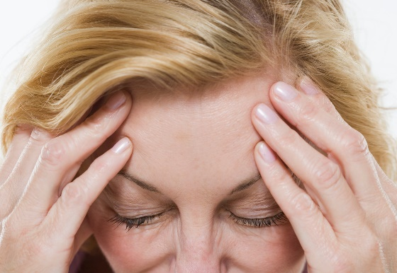
headache!

Slide 46
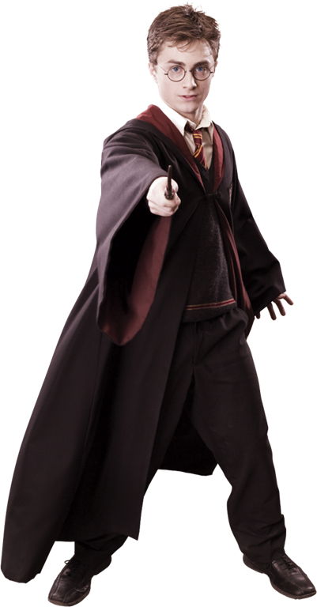
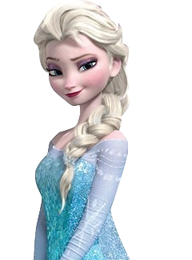
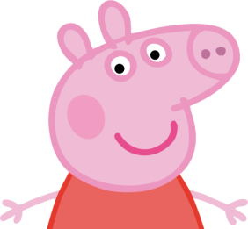

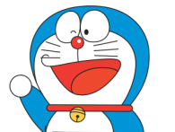
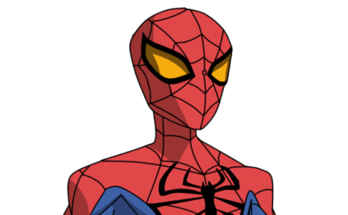
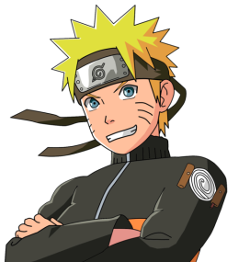
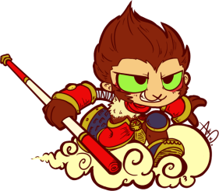
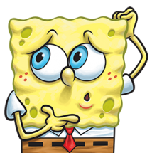

He/She likes... . We both like …
He likes going to the park. | He likes eating. | She likes dancing. | She likes singing. | He likes playing chess.
He likes helping people. | He likes playing sport. | He likes playing tennis | He likes reading. | He likes sleeping.

