Slide 1
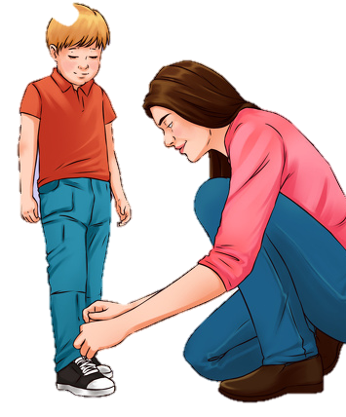
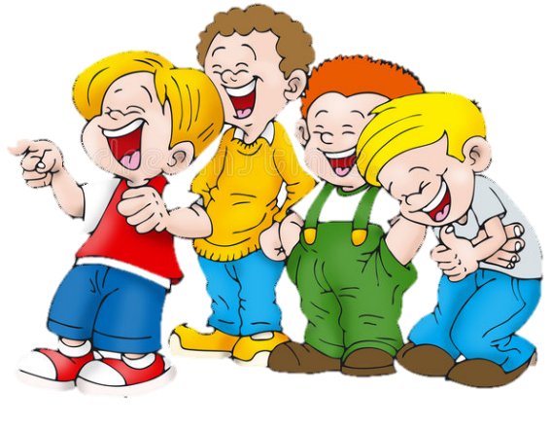
LO: Greet their partners; get a basic idea about the topic of today’s lesson.
Say hello to Ss; ask Ss to greet each other.
Guide Ss to describe the pictures on the cover.
Introduce the topic of the lesson.
TG
1:00
1/26

Slide 2
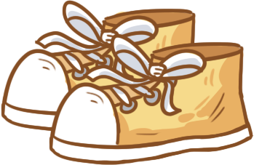
Learning
Goals
TG
LO: Get to know and understand what will be learned in this lesson.
Go through the learning goals with Ss.
We are
going to . . .
Identify the rimes of single-syllable words by reading words aloud.
Learn the following different words school, laces, shoes, PE, tie, and make sentences with them.
Read the story Kipper’s Laces and use the monitoring strategy to understand the story.
Practice using the sentence structure He told/tried/did up ____.
0:30
2/26

Slide 3
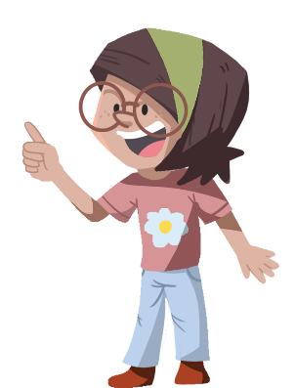
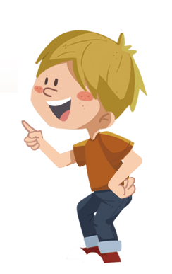
LO: Present and share the writing assignment from last lesson.
Invite Ss to take turns presenting their homework. If time is limited, tell Ss they have one or two mins to present their writing.
Encourage Ss to listen carefully and to ask questions.
After both of the Ss have finished, give them feedback and awards (click the picture of the book beside the boy or the girl so that they can get some awards).
Note: You can click the picture of the boy or the girl to give each S a trophy to mark their good performance.
TG
Presentation
Let’s show!
This is a job I would want to do in the future.
2:00
3/26

Slide 4
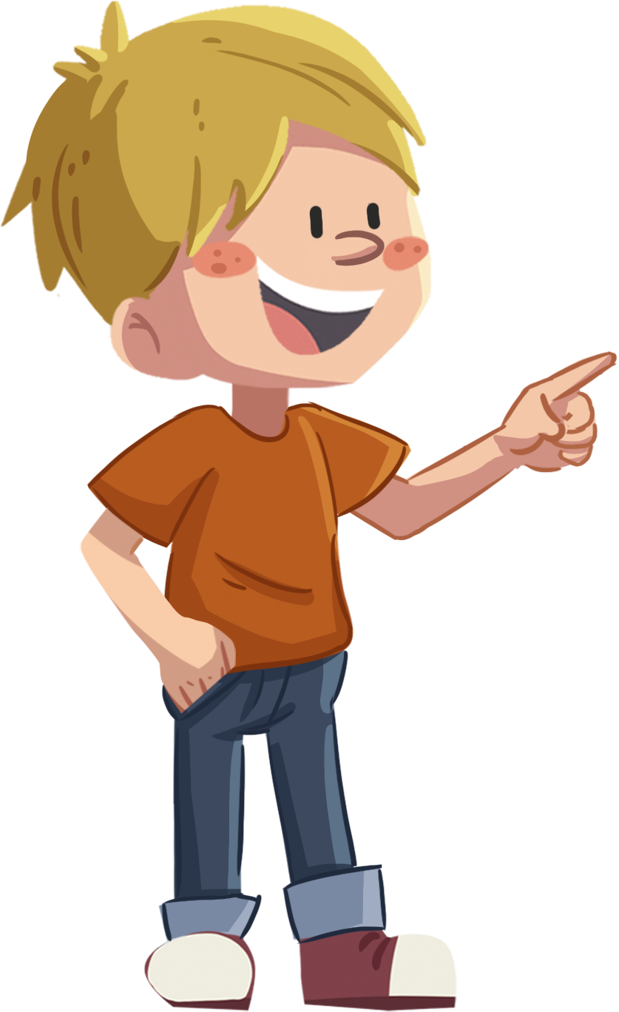
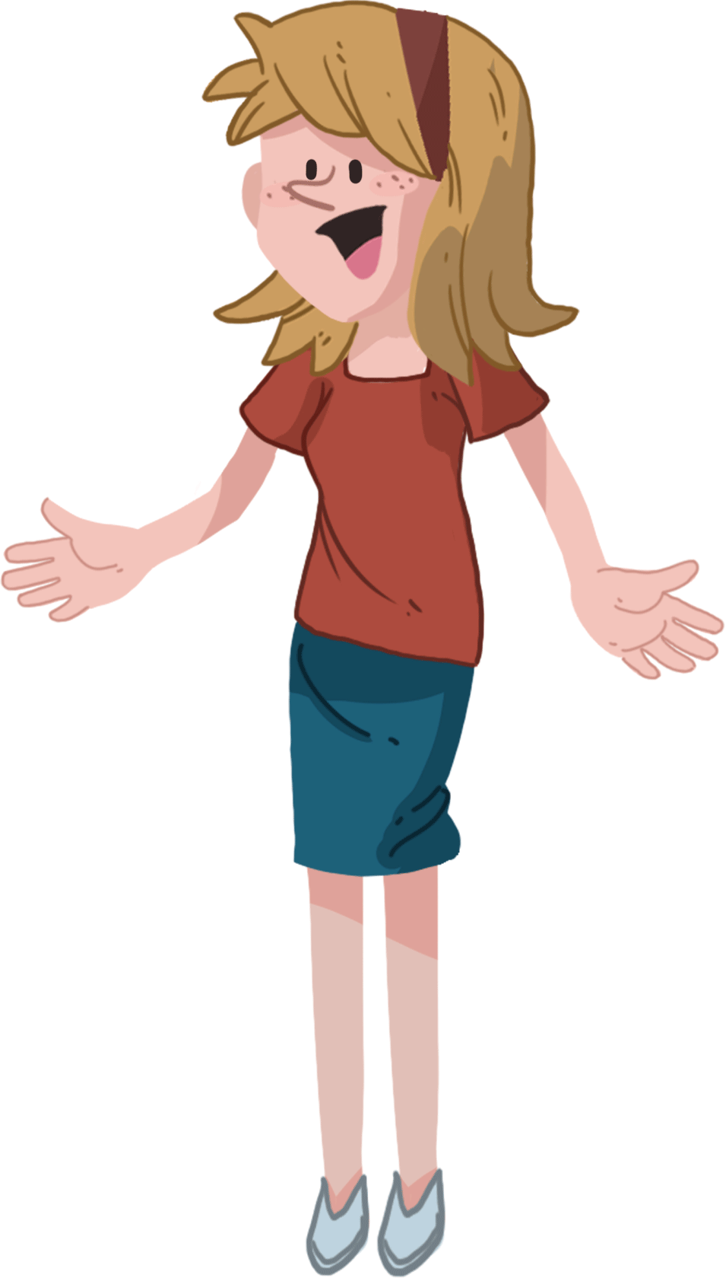
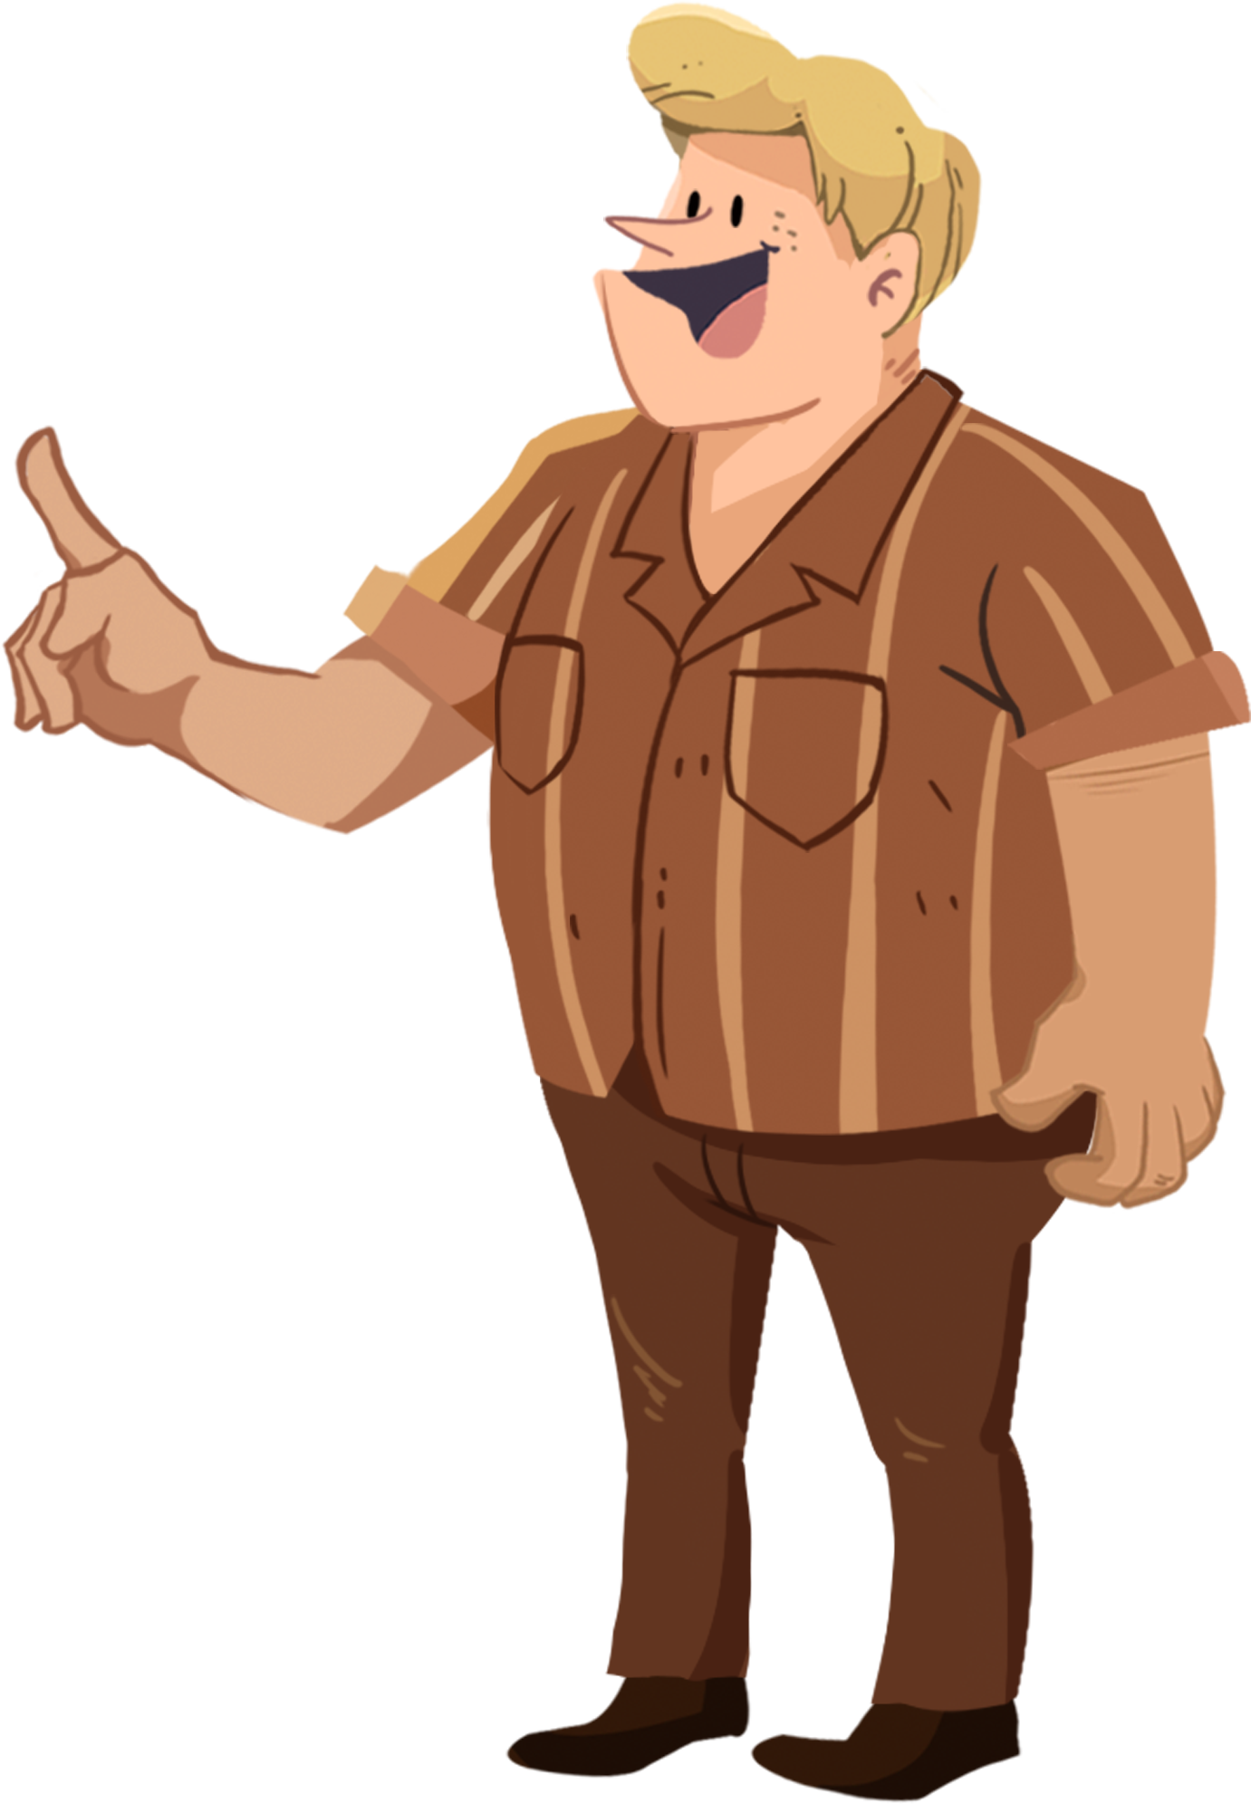
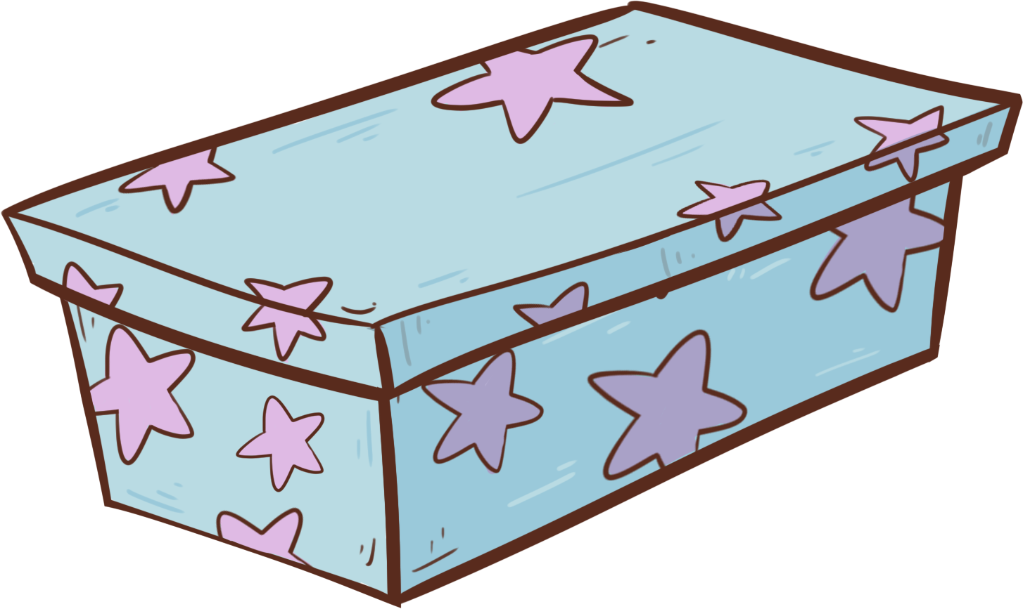
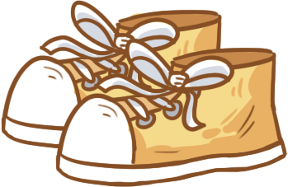
Phonics
TG
LO: Identify and pronounce the rime by saying words aloud.
Ask Ss to talk about what they see in the picture; click and tell them to help the people in the picture open their presents.
Click and read each word like this: w-ide, wide; and ask Ss to repeat; click and ask Ss to identify the rime of the word (T should explain the meaning of rime first: rime refers to the string of letters that follow an onset); click and guide Ss to identify and pronounce the following rime: ide; click and ask Ss to help the people in the picture open their presents.
Note: Each of the three words has the same operational process; Ss will learn three words on this slide; lastly, tell Ss that the rime ide is pronounced the same way in all three words.
Click and tell Ss that they have helped the people in the picture open their presents; ask Ss to read the three words and their rimes again.
Let’s listen and speak!
wide
ide
ride
Can you say the rime of the word?
Can you read the word?
Let’s open our presents!
side
2:30
4/26

Slide 5
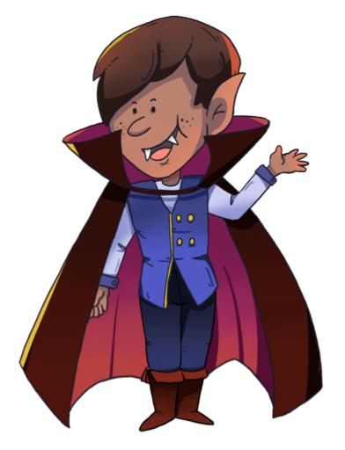
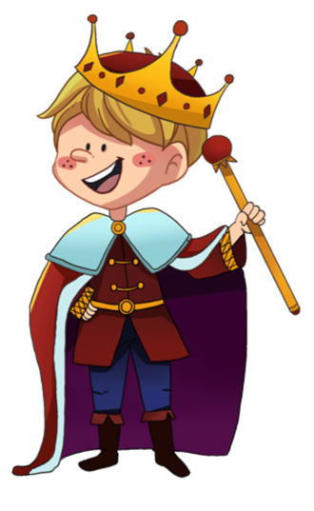
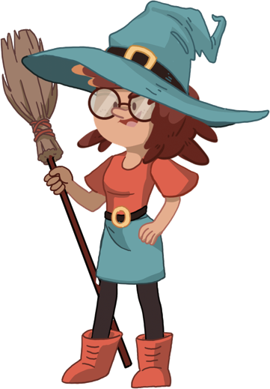
Phonics
TG
LO: Identify and pronounce the rime by saying words aloud.
Ask Ss to talk about what they see in the picture; click and tell them to help the people in the picture change their costumes.
Click and read each word like this: t-ide, tide; and ask Ss to repeat; click and ask Ss to identify the rime of the word (T should explain the meaning of rime first: rime refers to the string of letters that follow an onset); click and guide Ss to identify and pronounce the following rime: ide; click and ask Ss to help the people in the picture change their costumes.
Note: Each of the three words has the same operational process; Ss will learn three words on this slide; lastly, tell Ss that the rime ide is pronounced the same way in all three words.
3. Click and tell Ss that they have helped the people in the picture
change their costumes; ask Ss to read the three words and their
rime again.
Let’s listen and speak!
tide
ide
hide
Can you say the rime of the word?
Let’s change our costumes!
Can you read the word?
pride
2:30
5/26

Slide 6
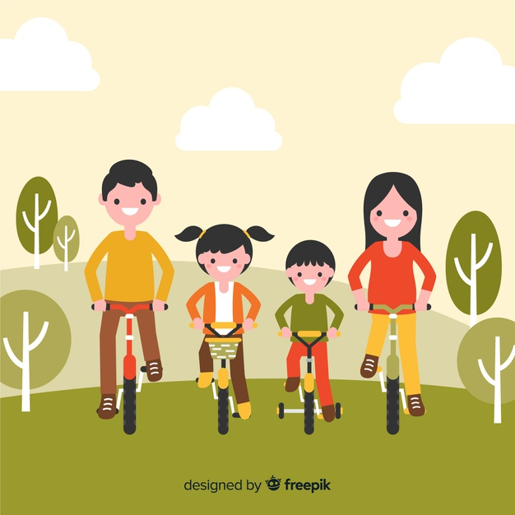
Phonics
TG
LO: Read the text fluently; decode words together.
Click and read the text to Ss with rhythm.
Guide Ss to repeat after you; ask one S to read one sentence, and the other to read the next until they finish reading the text; give feedback.
Guide Ss to decode the words together.
Let’s chant!
The road is wide.
We can ride side by side.
I always run the fastest when I’m by the seaside, but I show no pride.
I always enjoy the beautiful tide.
Tomorrow, we will have a ride.
Will the sea hide its tide?
2:00
6/26

Slide 7
Lead-in
TG
LO: Activate Ss’ interest in reading; use the illustration and the title to identify details and to make predictions; make connections.
Have Ss look at the book cover closely and have Ss talk about the first two questions by using the illustration and the title.
Ask Ss to talk about the connections question; assist them if necessary.
Before Reading
How does Kipper feel? Why?
What do you think might happen in the story?
Connections
What makes you feel upset?
Written by Roderick Hunt
Illustrated by Alex Brychta
2:00
7/26

Slide 8
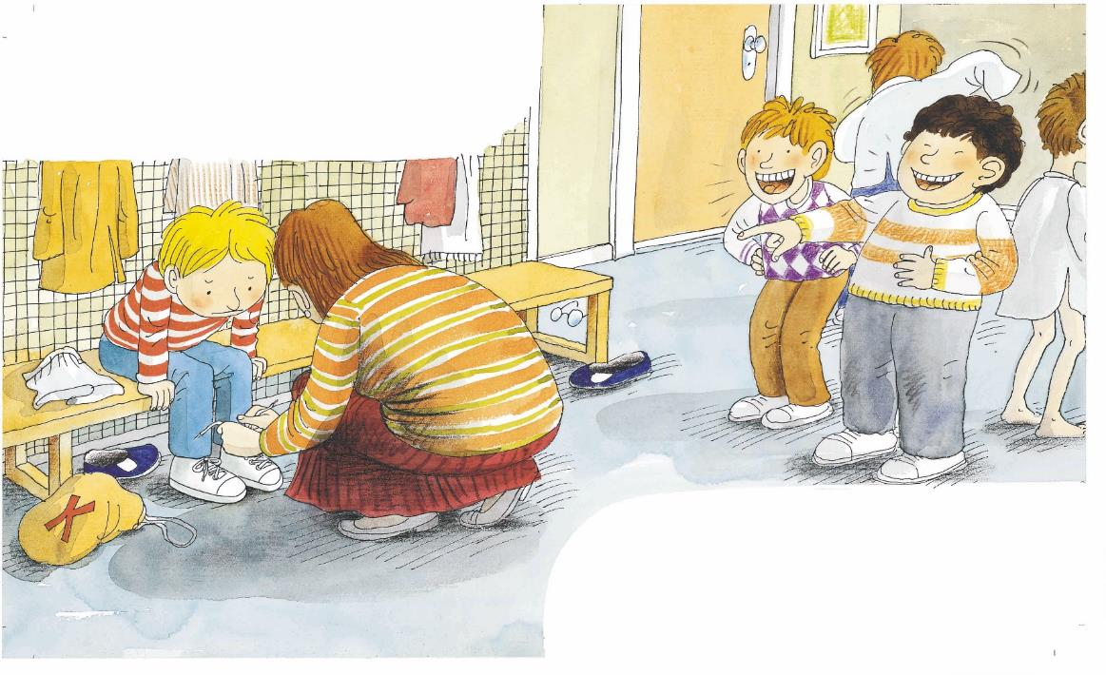
LO: Identify the details and make predictions about the story by using the illustration; motivate Ss’ interest in reading the story.
Ask Ss to recall what it means to predict.
Have Ss look at the illustration carefully and to talk about the given questions.
TG
Reading
Let’s predict!
Before Reading
What is the woman doing for Kipper? Why is she doing that?
What are the two boys doing? How do you think Kipper feels?
2:00
8/26

Slide 9
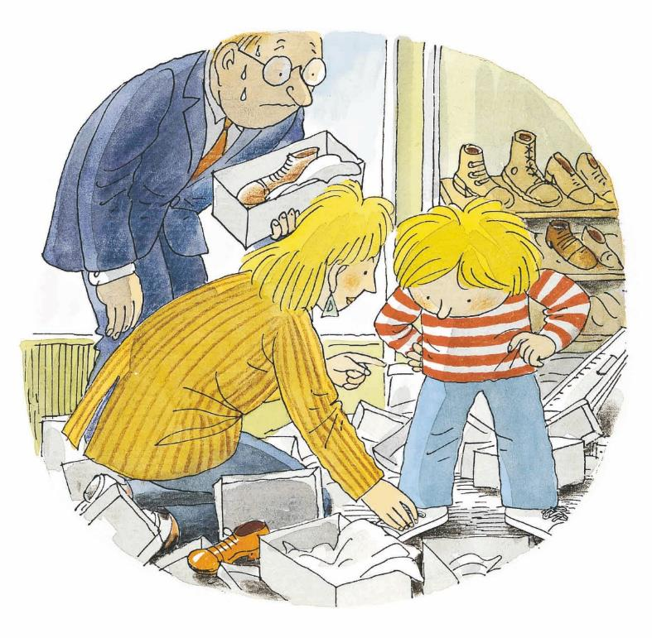
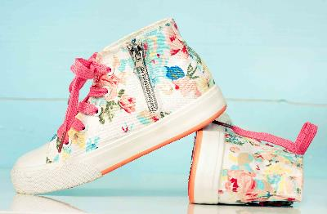
LO: Understand the text; understand the meaning of the vocabulary word shoes, and make sentences with it; read the text fluently.
Have Ss read the text together; click the penguin button and explain the word shoes; have Ss read the vocabulary word and have Ss make sentences with it; ask them to talk about the comprehension questions by using the text and the illustration.
Ask Ss to take turns reading the text aloud.
TG
Reading
Kipper’s Laces
Comprehension
Vocabulary
What did Kipper want? Where was he?
What might Kipper’s new shoes look like? Did his new shoes have laces?
shoes
This is a pair of beautiful shoes for girls.
Kipper wanted new shoes.
shoes
3:00
9/26

Slide 10
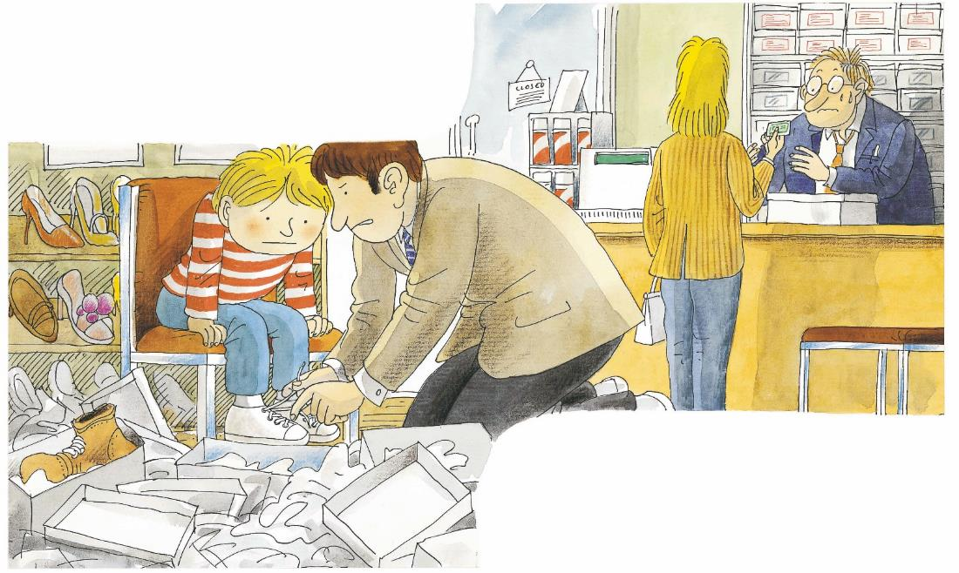
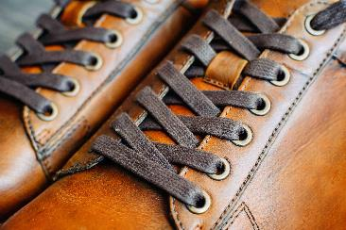
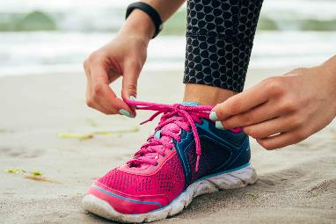
LO: Understand the text; understand the meaning of the vocabulary words tie and laces, and make sentences with them; read the sight word accurately; make connections; read the text fluently.
Have Ss read the text together; click the penguin button and explain the words tie and laces; have Ss read the vocabulary words and have Ss make sentences with them; ask them to talk about the comprehension questions by using the text and the illustration.
Encourage Ss to talk more about the connections question.
Have Ss read the sight word accurately.
Have Ss read the text fluently.
TG
Reading
Kipper’s Laces
Comprehension
He couldn’t tie his laces.
Vocabulary
Vocabulary
Was it easy for Kipper to wear the new shoes himself? Why?
Who helped Kipper tie his laces?
laces
tie
Connections
There are laces on a pair of leather shoes.
She bent down to tie her shoe laces.
Do you like to wear shoes with laces? What kind of shoes do you like to wear? Why?
Dad helped him.
Sight Words
laces
tie
couldn’t
3:30
10/26

Slide 11
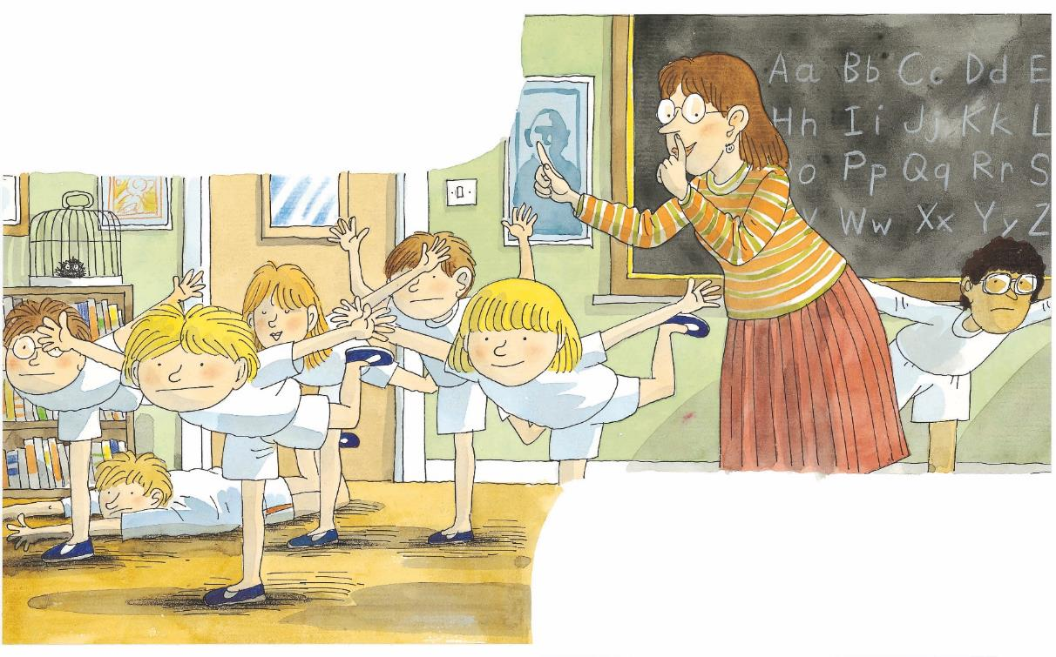
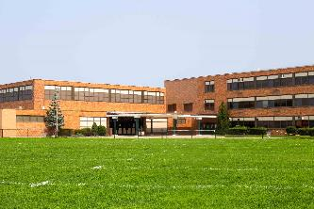
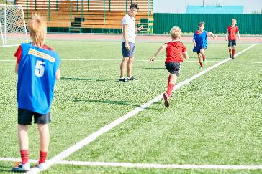
Reading
TG
LO: Understand the text; understand the meaning of the vocabulary words school and P.E., and make sentences with them; read the text fluently.
Have Ss read the text together; click the penguin button and explain the words school and PE; have Ss read the vocabulary words and have Ss make sentences with them.
Ask Ss to talk about the comprehension questions by using the text and the illustration.
Have Ss read the text fluently and give feedback.
Kipper’s Laces
BrE. P.E.
AmE. PE
P.E. vs. PE
Comprehension
Vocabulary
Kipper was at school.
Vocabulary
Where was Kipper? What class was he having?
What kind of shoes were Kipper and the other children wearing? Look for clues in the illustration.
PE
school
This is a big and beautiful school.
The children are running in PE.
The class had P.E.
Decoding
Read fluently.
school
PE
2:30
11/26

Slide 12
Reading
TG
LO: Understand the text; make connections; read the text fluently.
Read the text aloud to Ss.
Ask Ss to talk about the comprehension questions by using the illustration.
Guide Ss to talk about the connections question.
Have Ss read the text fluently.
Kipper’s Laces
Comprehension
Kipper couldn’t tie his laces.
Why were the two children laughing at Kipper? Do you think what the two boys did was right? Why?
Who helped Kipper tie his laces at school?
Connections
What should you do or not do when your classmates have some difficulties at school?
Miss Green helped him.
2:30
12/26

Slide 13
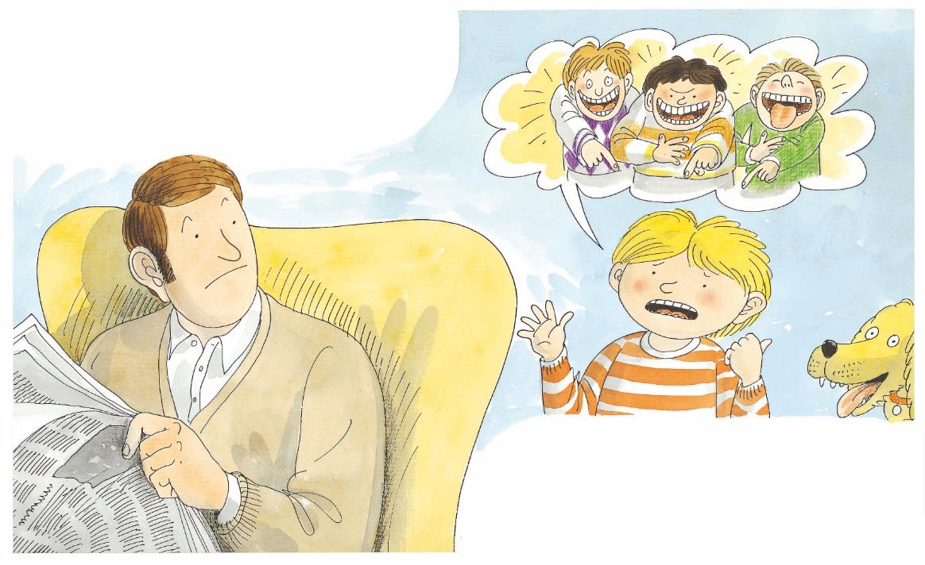
Reading
TG
LO: Understand the text; use the monitoring strategy to understand the plot on this page and to know what to do next when meaning is disrupted; read the text fluently.
Read the text aloud to Ss.
Ask them to talk about the comprehension questions by using the text and the illustration.
Ask Ss to talk about the monitoring question; if they know how to answer this question, ask them to explain it; if they don’t know how to answer this question, guide them to answer this question by using the illustration and the text clues; tell them to learn to ask themselves questions when reading. (Clue: Kipper’s classmates teased him at school.)
Have Ss take turns reading the text fluently.
Kipper’s Laces
Comprehension
Kipper was upset.
How was Kipper? What happened to him?
Monitoring
Ask yourself:
Do I understand what Kipper told Dad?
A. Yes. He told Dad that ___.
B. No.
(Tips: You can look for clues in the illustration.)
He told Dad.
2:00
13/26

Slide 14
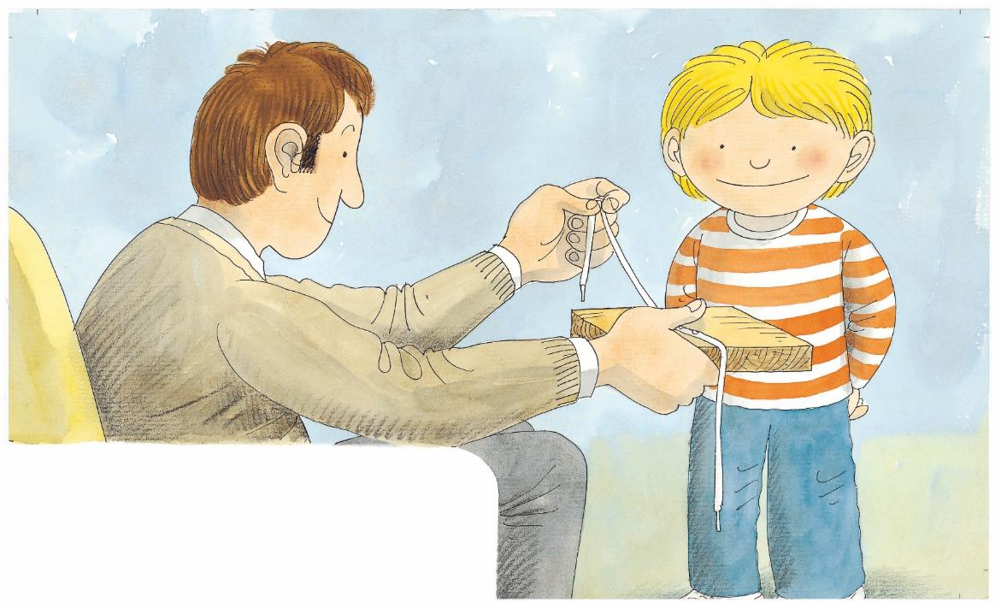
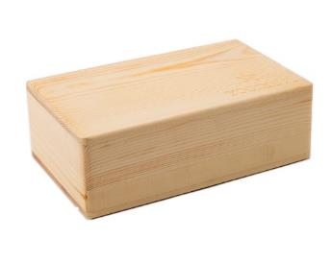
Reading
TG
LO: Understand the text; understand the meaning of the vocabulary word block, and make sentences with it; read the text fluently.
Have Ss read the text together; click the penguin button and explain the word block; have Ss read the vocabulary word and have Ss make sentences with it;
Ask Ss to talk about the comprehension questions by using the text and the illustration.
Have Ss read the text fluently and give feedback.
Kipper’s Laces
Comprehension
Vocabulary
What did Dad do to help Kipper?
What would Kipper do next? Would it be easy for him to tie his laces next time?
block
This is a wooden block.
Decoding
Dad made a block.
Read fluently.
block
2:00
14/26

Slide 15
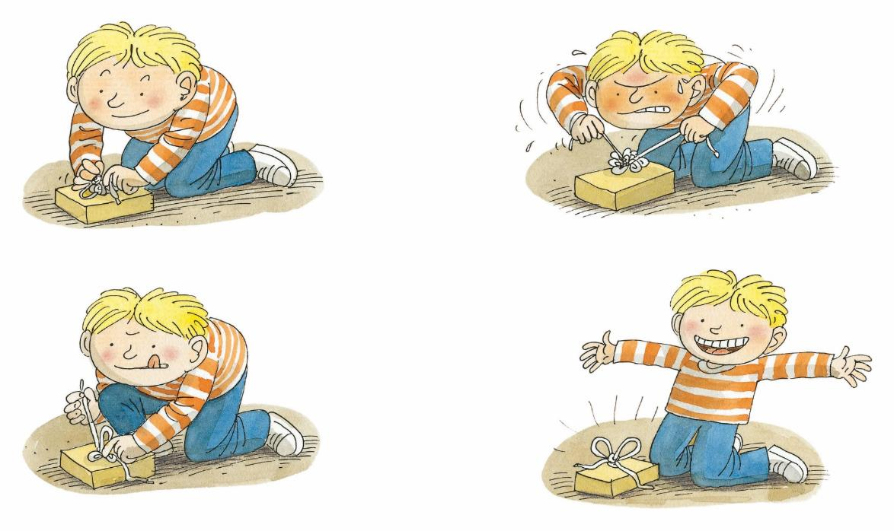
Reading
TG
LO: Understand the text; use the monitoring strategy to understand the meaning of the word Hooray on this page and to know what to do next when meaning is disrupted; read the text fluently.
Read the text aloud to Ss.
Ask them to talk about the comprehension questions by using the text and the illustration.
Ask Ss to talk about the monitoring question; if they know how to answer this question, ask them to explain it; if they don’t know how to answer this question, guide them to answer this question by using the illustration and the text clues; tell them to learn to ask themselves questions when reading. (Clue: Kipper’s excited expression and action.)
Have Ss take turns reading the text fluently.
Kipper’s Laces
Comprehension
What did Kipper do? Did he work hard? Why did he work hard to do that?
Why did Kipper say, “Hooray”?
Kipper tried . . .
and tried and tried.
Monitoring
Ask yourself:
Do I understand the meaning of the word Hooray here?
A. Yes. It means ___.
B. No.
and tried . . .
“Hooray!” said Kipper.
2:00
15/26

Slide 16
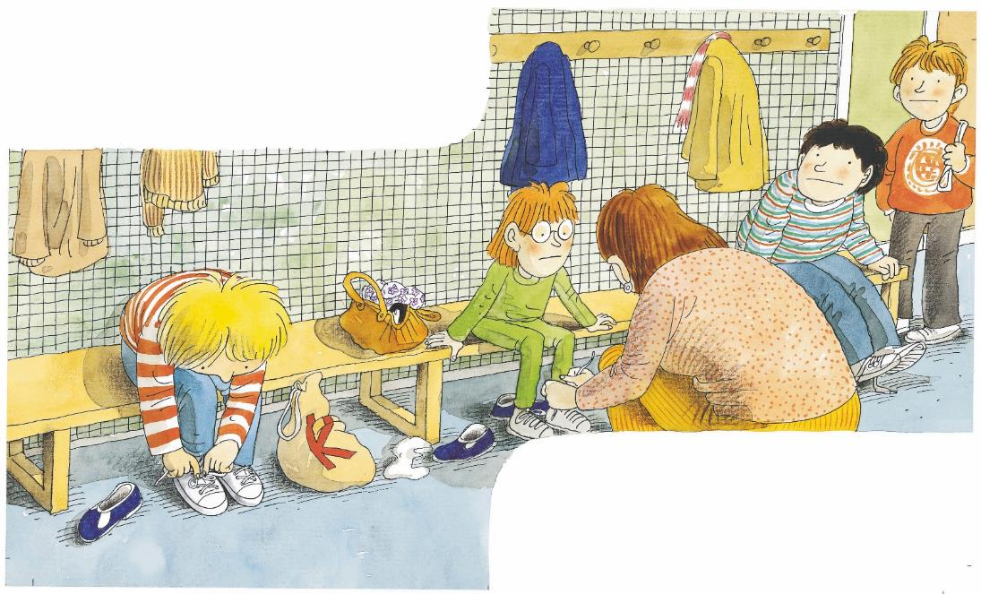
Reading
TG
LO: Understand the text; read the text fluently.
Read the text aloud to Ss.
Ask them to talk about the comprehension questions by using the text and the illustration.
Have Ss take turns reading the text fluently.
Kipper’s Laces
Comprehension
Kipper was at school.
Where was Kipper?
Why were the two big boys not laughing? What was Kipper doing? Did he need Miss Green’s help?
Do you think Kipper can tie his laces successfully?
He did up his laces.
2:00
16/26

Slide 17
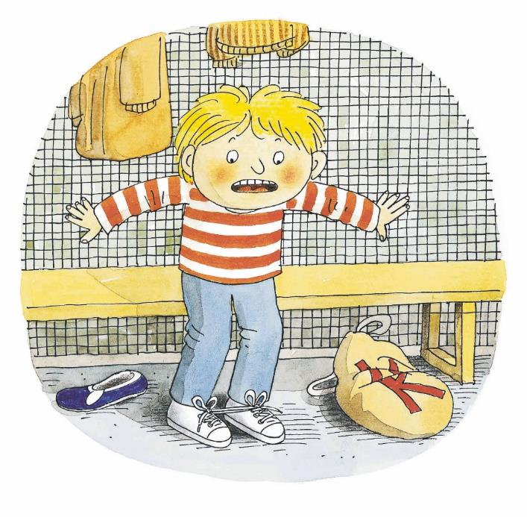
Reading
TG
LO: Understand the text; use the monitoring strategy to understand the plot on this page and to know what to do next when meaning is disrupted; read the text fluently.
Read the text aloud to Ss.
Ask Ss to talk about the comprehension question by using the text and the illustration.
Ask Ss to talk about the monitoring question; if they know how to answer this question, ask them to explain it; if they don’t know how to answer this question, guide them to answer this question by using the illustration and the text clues; tell them to learn to ask themselves questions when reading. (Clue: Kipper’s shoe laces were tied together.)
Have Ss take turns reading the text fluently.
Kipper’s Laces
Comprehension
What happened at the end of the story?
Monitoring
Ask yourself:
Do I understand why Kipper said, “Oh no”?
A. Yes, because he_______.
B. No.
(Tips: You can look for clues
in the illustration.)
“Oh no!” said Kipper.
2:30
17/26

Slide 18
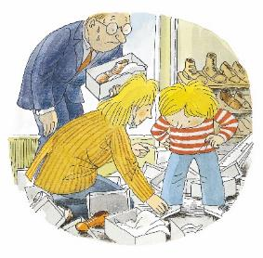
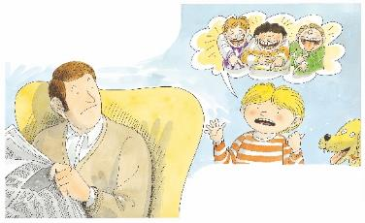
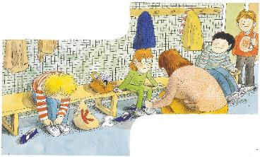
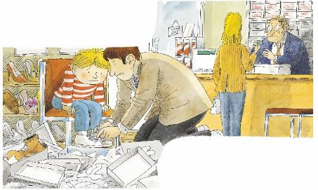
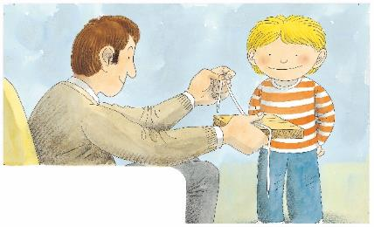
Reading
TG
LO: Retell the story with visual support and assistance.
Have Ss recall the story; model first.
Have Ss work together to retell the story by using the visual aids. Help them if necessary.
Let’s retell!
3
4
5
8
1
2
6
7
9
He couldn’t _____.
_____ helped him.
_____ helped him.
Dad made a _____.
“_____!” said Kipper.
2:00
18/26

Slide 19
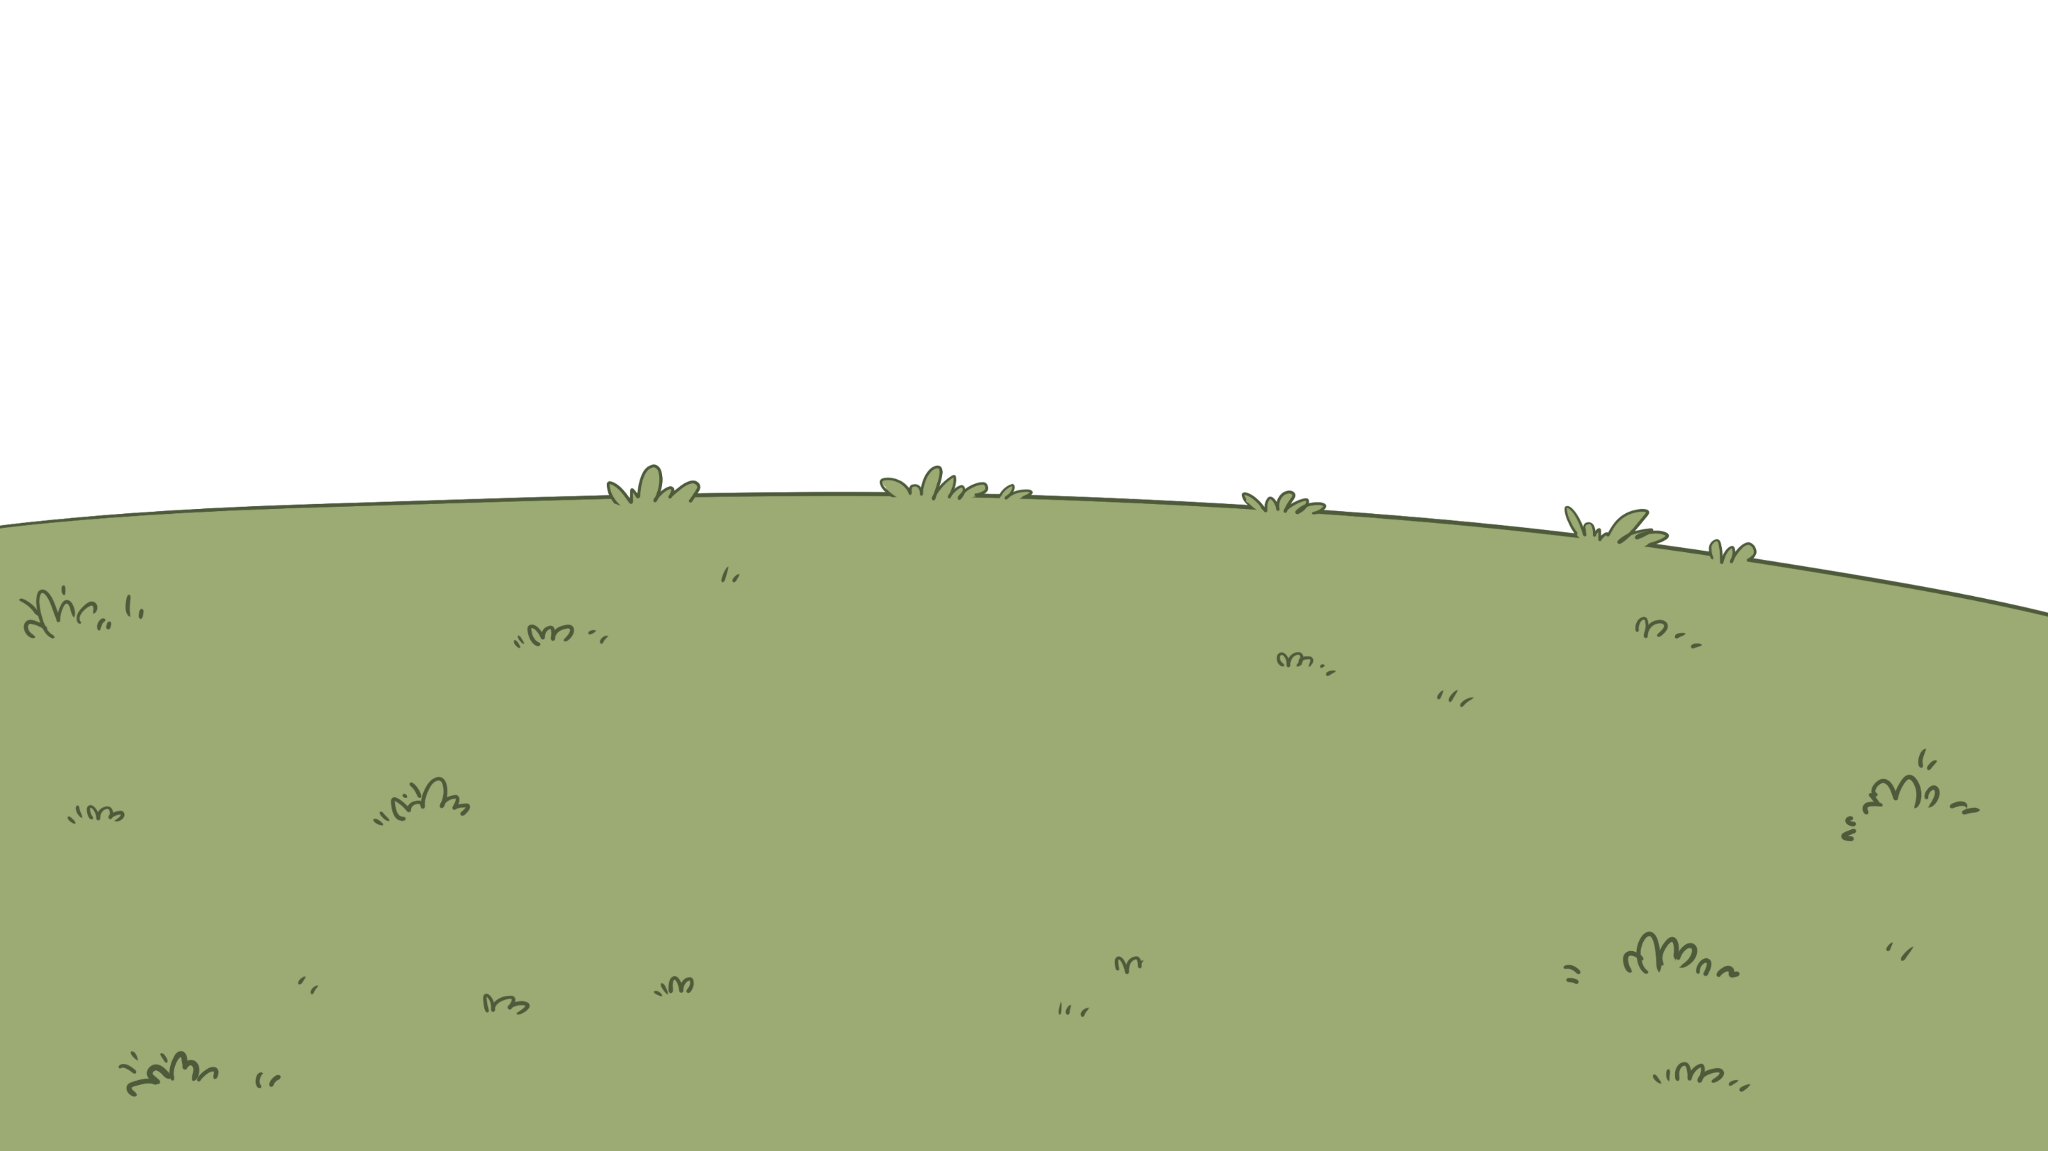
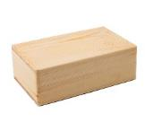
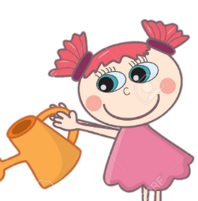
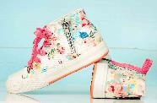
LO: Check Ss’ understanding of the words in this lesson.
Ask Ss to completely review all the learned words in this lesson.
Tell Ss to help the girl in the picture water the flowers.
The steps are as follows:
First, click and ask Ss to identify the picture. Then, click to reveal the entire word. Next, click again to make it disappear, and then the girl in the picture will water a flower.
4. Announce the winner of the competition.
Note: If time is limited, skip this section.
TG
Vocabulary
Let’s guess!
laces
school
PE
shoes
tie
block
1:00
19/26

Slide 20
Listening &
Speaking
TG
LO: Talk about what Kipper did to tie his laces by himself.
Have Ss work in pairs to talk about the given illustration by using the sentence structure and helping words; model first.
Assist Ss if necessary.
Let’s talk!
—What did Kipper do to tie his
laces by himself?
—He _____.
Helping Words
told tried did up
Biff
Chip
Kipper
TV
2:00
20/26

Slide 21
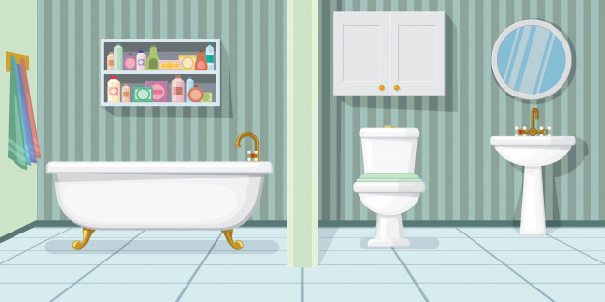
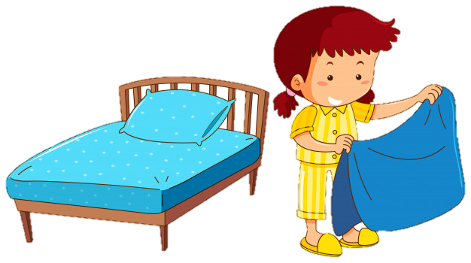
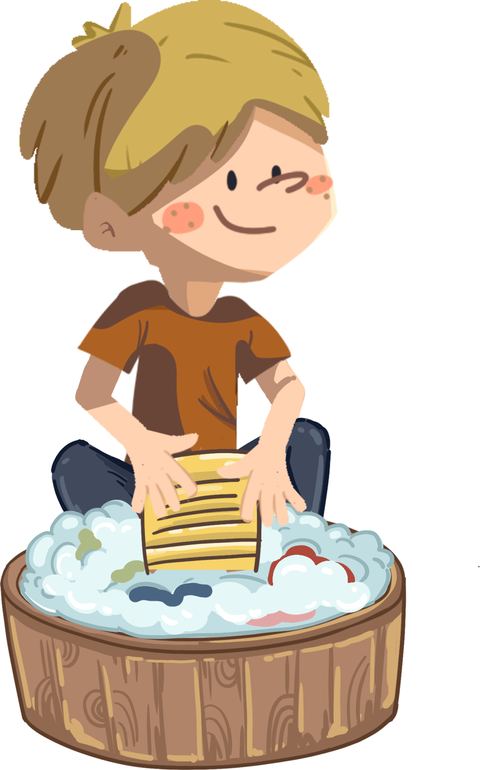
Listening &
Speaking
TG
LO: Ask Ss to consider what they can do by themselves.
Ask Ss to observe the pictures carefully.
Have Ss talk about the different things they can do by themselves.
Click Let’s talk! and ask Ss to talk about the given pictures by using the given language structure; model first. Assist Ss if necessary.
Notes: T can click Let’s talk! to present the sentence structure, and then click it again to make it disappear.
Let’s talk!
—What can you do by yourself?
—I can ____ by myself.
pick up toys
brush my teeth
wear shoes . . .
2:30
21/26

Slide 22
LO: Talk about the values of finding ways to do when they find something is hard to do by yourself.
Ask Ss about the given task; model first.
Guide Ss to talk about the question with the help of the given pictures.
Encourage Ss to talk more about the following question: what else can we do?
TG
Value
What can you do when you find something is hard to do by yourself?
ask for help
learn
2:00
22/26

Slide 23
LO: Talk about what they learned from the story by using the given structures and language support.
Guide Ss to talk about what they learned from Kipper’s laces.
Ask Ss to think about the given questions; help Ss to organize their ideas about the story with the given visual support, and tell them, “This is practice before your homework.”
Model the first question, and then ask Ss to take turns presenting their answers.
TG
Oral Writing
Get ready to present!
1
3
Why did he learn?
Kipper Learned to Tie Laces
Did he make it in the end?
How did he learn?
2
couldn’t tie
made
helped
tried
was upset
Hooray!
2:00
23/26

Slide 24
LO: Understand what the homework is.
Explain the writing task to Ss and check their understanding.
Tell Ss that they should finish their writing before next class. Make sure that they know to send their homework to the platform. They will present their work next class.
Remind Ss to watch the post-class video and to finish the writing task.
TG
Writing
An Explanatory Article
Let’s draw and write!
Describe a pair of shoes you often wear in PE class.
Now, please follow the steps to finish your homework and present it in the next class:
Describe a pair of shoes you often wear in PE class.
Write at least one complete sentence to describe it.
Watch the post-class video about the writing task.
0:30
24/26

Slide 25
LO: End the lesson and encourage Ss to be well prepared for the next class.
Briefly comment on Ss.
Say goodbye to students.
Ask Ss to preview the next lesson.
TG
Review
Review
Let’s review!
Phonics:
wide/ride/side/
pride/tide/hide
Sentence Structure:
He told/tried/
did up ____.
Vocabulary: school/laces/shoes/PE/tie
1:00
25/26

Slide 26
LO: End the lesson and encourage Ss to be well prepared for the next class.
Briefly comment on Ss.
Say goodbye to students.
Ask Ss to preview the next lesson.
TG
0:30
26/26

