Slide 1
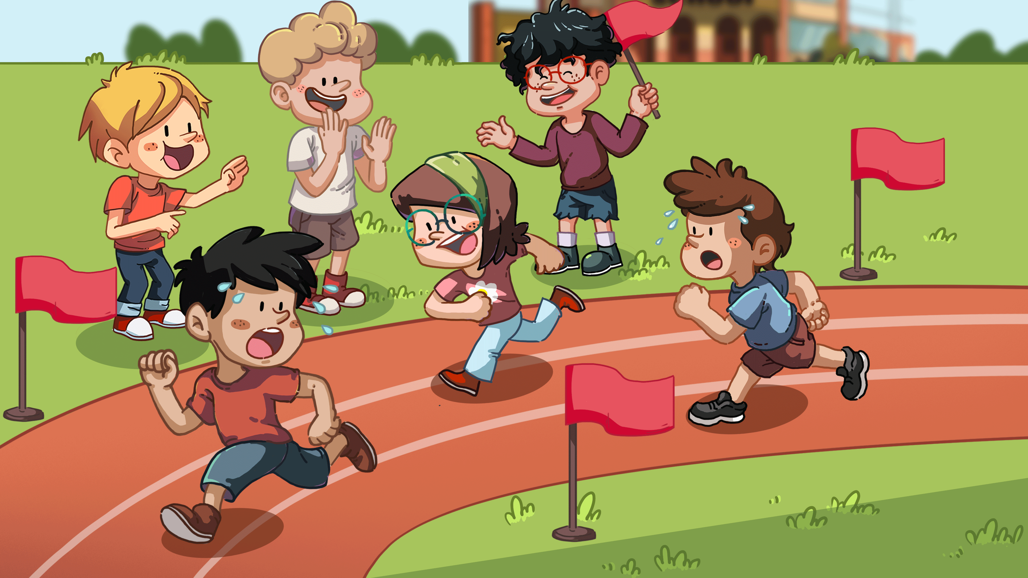
LO: Get to know their partners; get a basic idea about the topic of today’s lesson.
1. Say hello to Ss; ask Ss to introduce themselves and to greet each other.
2. Introduce the topic of the lesson.
TG
0:30
1/26

Slide 2
Learning
Goals
TG
LO: Get to know and understand what will be learned in this lesson. Go through the
learning goals with Ss.
We are going to . . .
Add individual sounds (phonemes) to simple, single-syllable words to make new words.
Learn the following key words and phrases sports, long jump, first, spoon, blindfold, and surprise, and make sentences with them.
Read the story Poor Old Mum! and define the role of each character in the story.
Practice using the sentence structure
_____ took part in _____.
0:30
2/26

Slide 3
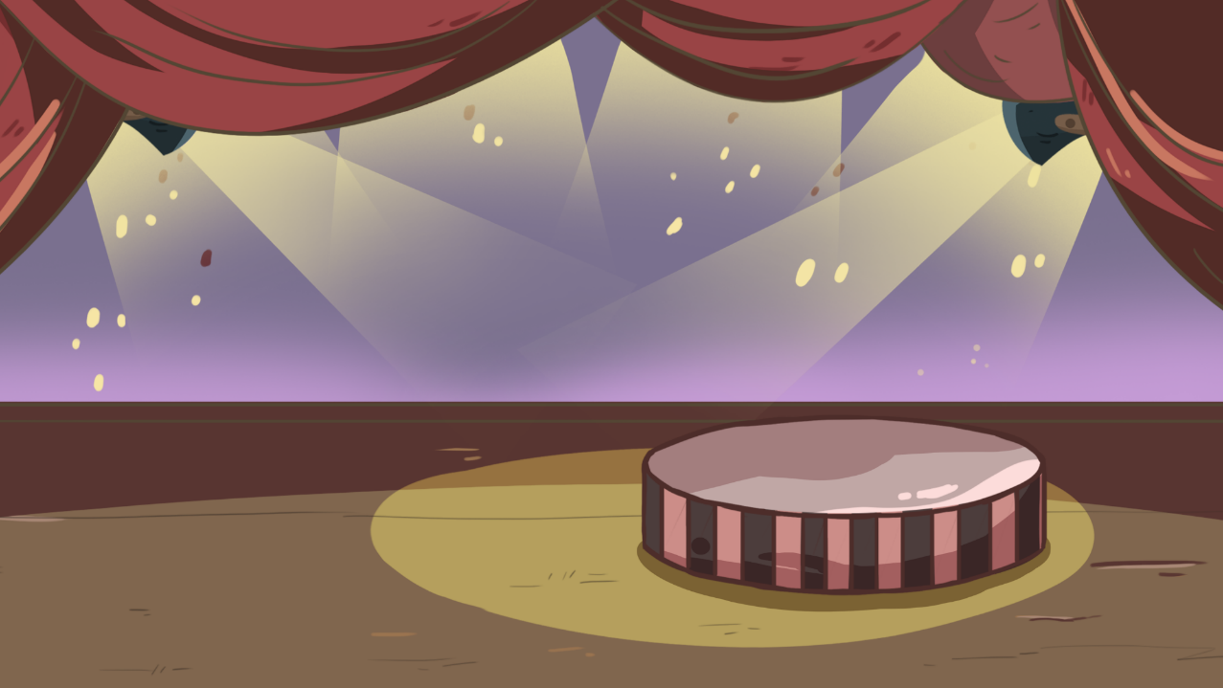
LO: Present the writing that was assigned last lesson.
1. Let Ss present in turns.
2. Give feedback.
TG
Presentation
Let’s show!
Share your writing from last lesson with your partner!
2:00
3/26

Slide 4
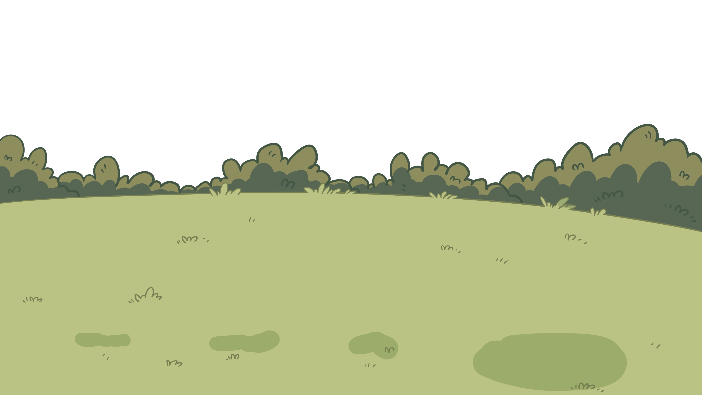
TG
LO: Add individual sounds (phonemes) to simple, single-syllable words to make new words; decode the words accurately.
1. Have Ss help the children in the picture kick the footballs into the net by adding one sound
before the word all to make new words.
2. Read the single-syllable word all to Ss first; then read the individual sound b to Ss; guide Ss to try
and add the sound b to the word all to make the new word ball; then check if Ss make the right
word; click and make the children kick the football into the net, then the word ball will appear;
read the word ball in this way: b-all, ball; ask Ss to repeat it.
3. Repeat this practice for the rest of the words.
Phonics
Let’s speak!
ball
hall
wall
all
h
b
w
2:00
4/26

Slide 5
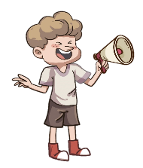
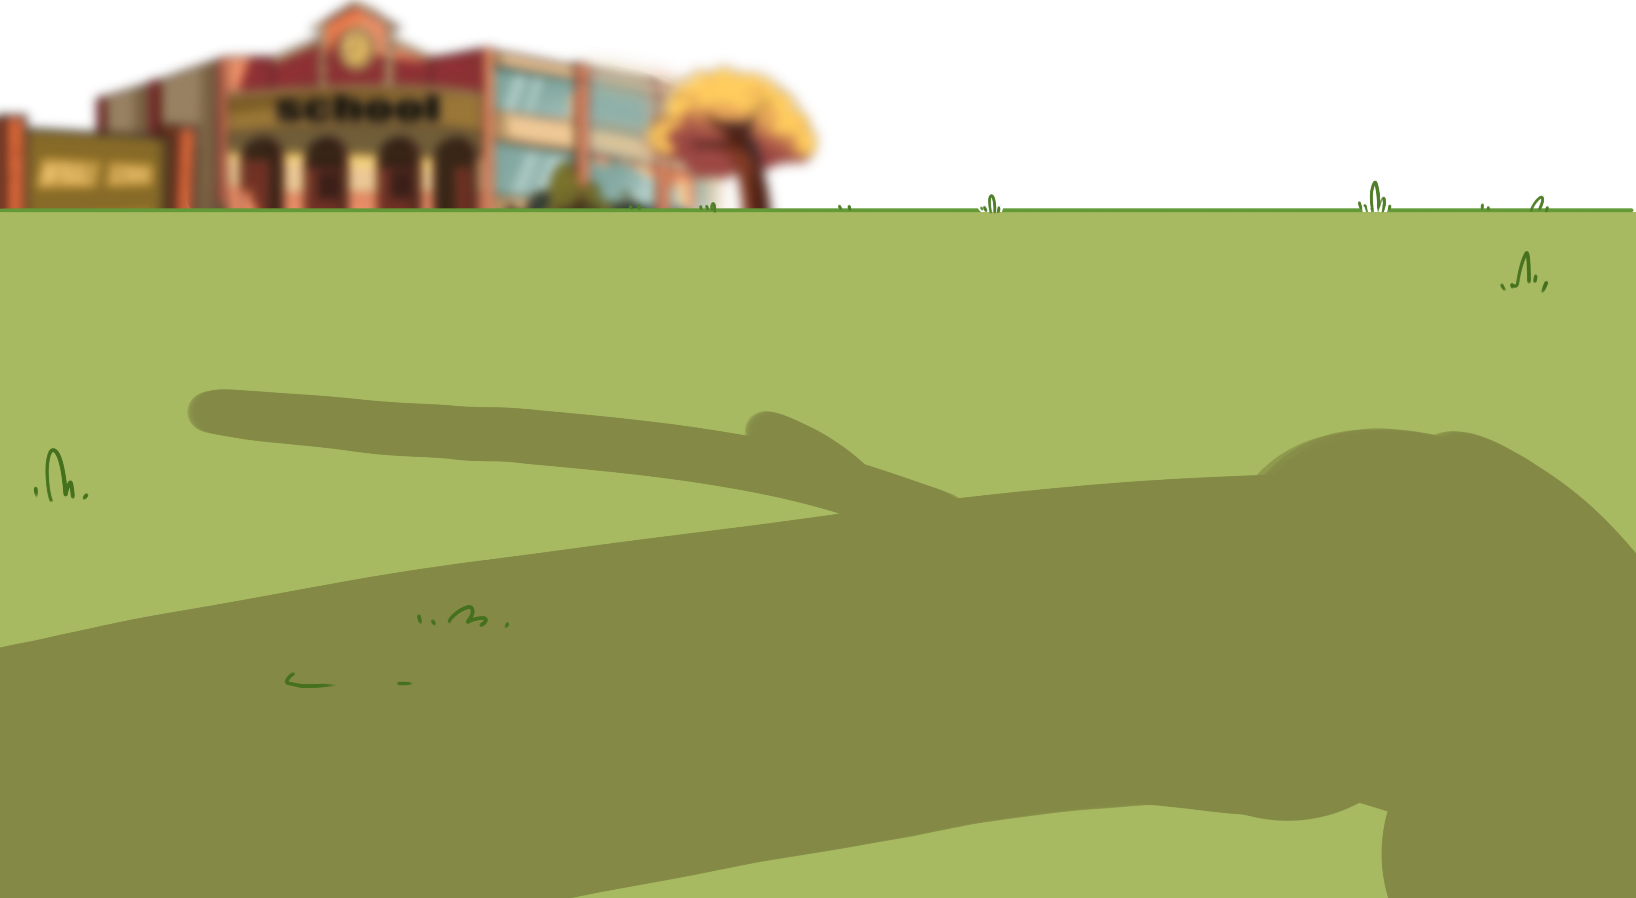
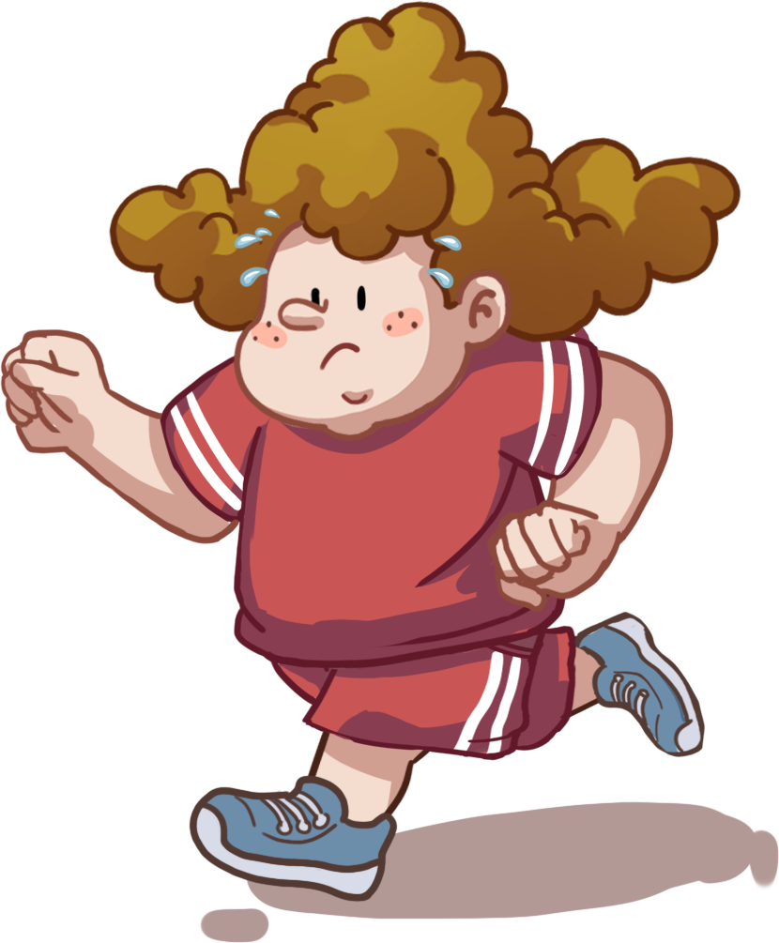
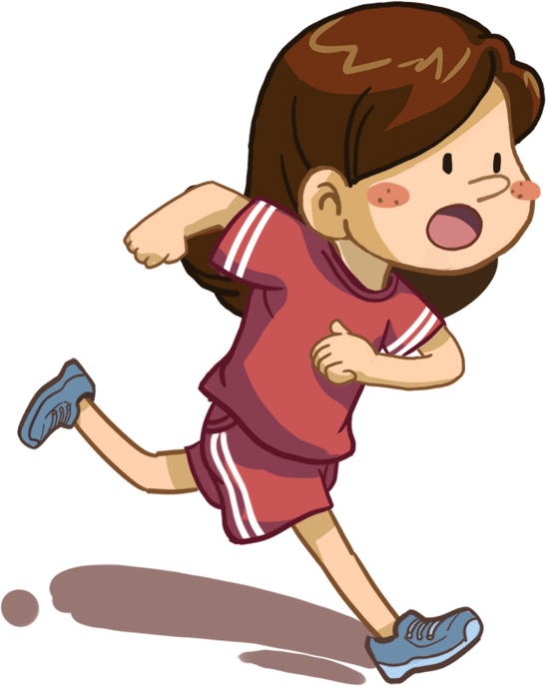
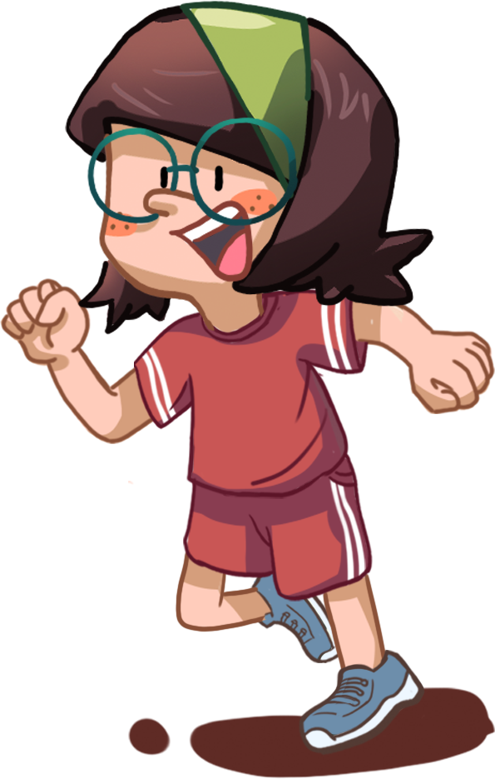
TG
LO: Add individual sounds (phonemes) to simple, single-syllable words to make new words;
decode the words accurately.
1. Ask Ss to help the children in the picture win the story book in the relay race by adding one
sound to the word aid to make new words.
2. Read the single-syllable word aid to Ss first; click and read the individual sound m to Ss; guide Ss
to try and add the sound m to the word aid to make a new word; click and show the word maid;
read the word maid in this way: m-aid, maid; ask Ss to repeat it; then click and make one of the
children run.
3. Repeat this practice for the rest of the words.
Phonics
m
p
aid
l
Let’s listen!
maid
paid
laid
2:00
5/26

Slide 6
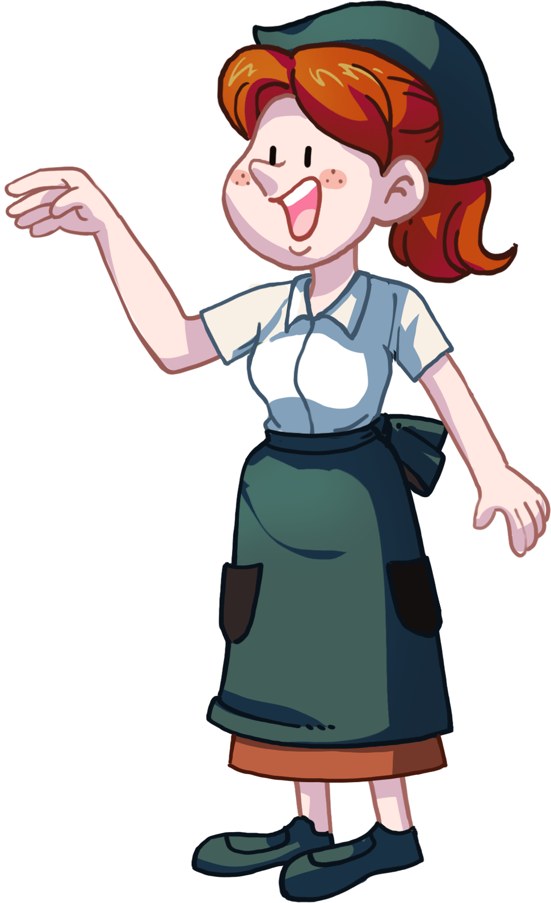
LO: Read the chant fluently; decode the words learned in the text.
1. Read the chant to Ss with rhythm; have Ss observe the picture and the highlighted words.
2. Guide Ss to repeat after you; ask them to take turns reading each sentence.
3. Give feedback.
TG
Phonics
Let’s chant!
Yesterday was sunny.
The maid paid for the honey.
She laid the honey down in the hall.
Then she wanted to play with a ball.
But she had to paint the wall.
2:00
6/26

Slide 7
LO: Use the book cover to identify details and to make predictions.
1. Guide Ss to look at the book cover closely and to talk about the given questions.
2. Encourage Ss to talk more about the connections question.
TG
Lead-in
Before Reading
What’s Dad wearing? What’s on Dad’s clothes? What might that number mean?
What do you think Mum and Dad are doing?
Look at the title. Why do you think Mum is “poor”?
Written by Roderick Hunt
Illustrated by Alex Brychta
1:30
7/26

Slide 8
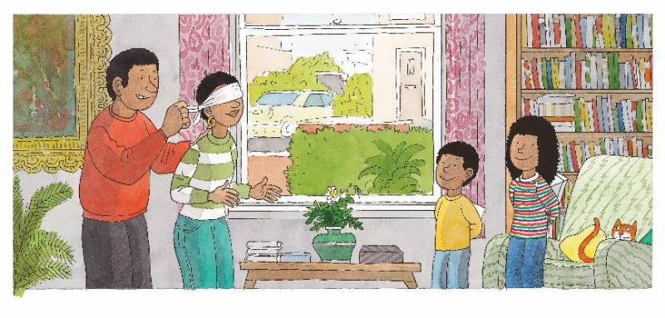
Let’s predict!
LO: Make predictions about the story by using the illustration; motivate Ss’ interest in
reading the story.
1. Guide Ss to recall what it means to predict and ask them to make guesses prior to reading
the story by looking at the pictures.
2. Guide Ss to talk about the given questions.
TG
Reading
Reading
Before Reading
What is Dad doing to Mum? Why is Dad doing that?
What do you think Wilf and Wilma might do next?
1:30
8/26

Slide 9
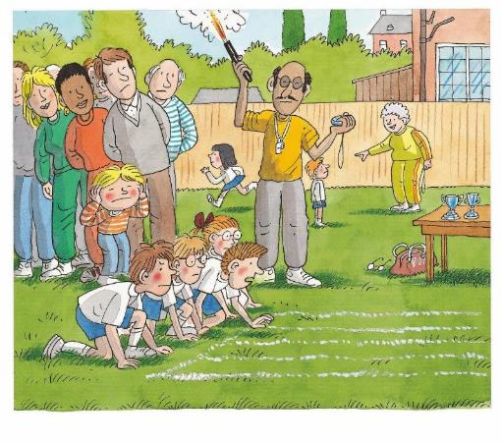
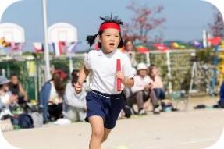
Poor Old Mum!
TG
LO: Understand the meaning of the key vocabulary word sports, and make sentences with it; understand the text; make connections; read the text fluently.
1. Read the text aloud to Ss.
2. Ask Ss to find sports in the text and the illustration; have Ss read the word and have them make sentences with it.
3. Have Ss talk about the comprehension questions by using the illustration and the text.
4. Encourage Ss to talk more about the connections question.
5. Have Ss read the text fluently and give feedback.
Note: Click the penguin button to show the vocabulary card.
Reading
Vocabulary
Comprehension
What kind of day was it that day?
What race do you think the children were taking part in? Look for clues in the illustration.
sports
Connections
Today is sports day.
What kind of races are there on sports day?
It was sports day.
sports
2:00
9/26

Slide 10
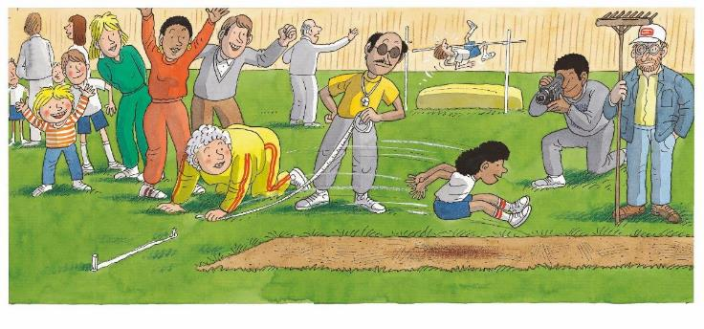
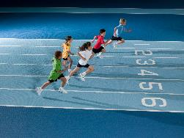
Poor Old Mum!
LO: Understand the meaning of the key vocabulary words and phrases long jump and first, and make sentences with them; understand the text; make connections; read the text fluently.
1. Read the text aloud to Ss.
2. Ask one of the Ss to find long jump in the text and the illustration; have Ss read the word and
make sentences with it.
3. Ask another Ss to find first in the text and the illustration; have Ss read the word and make
sentences with it.
4. Have Ss talk about the comprehension questions by using the illustration and the text.
5. Encourage Ss to talk more about the connections question.
6. Have Ss read the text fluently and give feedback.
Note: Click the penguin button to show the vocabulary card.
TG
Reading
Comprehension
Vocabulary
Vocabulary
What did Wilma do on sports day? Was she good at doing that sports? Why do you think so?
What did Dad do?
What other sports can you see in the illustration?
first
long jump
Wilma was in the long jump.
She came first.
The boy in blue came in first in the running race.
Connections
She took part in a long jump race.
came first and came in first both mean to get the first place. In British English, came first is widely used. In American English, came in first is commonly used.
What kind of sports are you good at?
long jump
first
came first vs. came in first
2:00
10/26

Slide 11
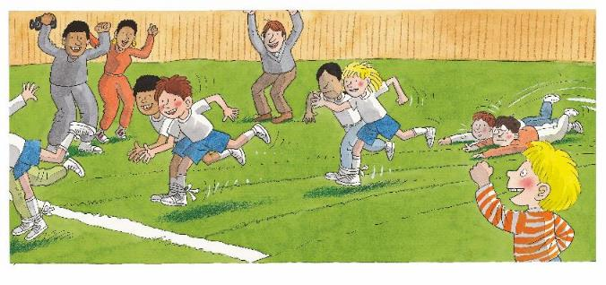
Poor Old Mum!
TG
LO: Understand the text; make connections; read the text in a voice that matches the character’s emotions.
1. Read the text aloud to Ss.
2. Have Ss talk about the comprehension questions by using the illustration and the text.
3. Ask Ss to think about how the characters might be feeling based on the illustration and the text
on this page, then ask Ss to read the text in a voice that matches the character’s emotions..
4. Have Ss read the text fluently and give feedback.
Reading
Comprehension
What did Wilf and Chip do on sports day? Did Wilf and Chip win their race? What were the results?
What did Kipper do when Wilf and Chip were in the race? What did Kipper think of their results?
Wilf and Chip were
in a race. They came second.
“Hooray!” shouted Kipper.
Decoding
Expression-Make your voice match the feelings
2:00
11/26

Slide 12
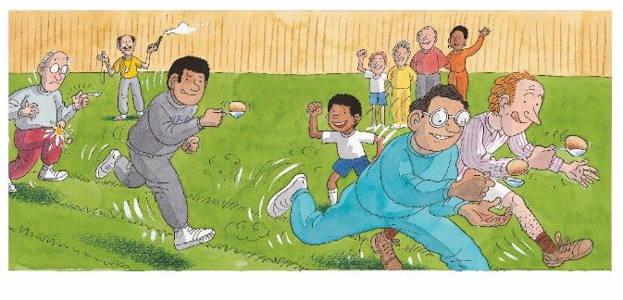
Poor Old Mum!
LO: Understand the meaning of the key vocabulary word spoon, and make sentences with it; understand the text; read the text fluently.
1. Have Ss take turns reading the text; give feedback and correct them if necessary.
2. Ask Ss to find spoon in the text and the illustration; have Ss read the word and have them
make sentences with it.
3. Have Ss talk about the comprehension questions by using the illustration and the text.
4. Have Ss read the text fluently and give feedback.
Note: Click the penguin button to show the vocabulary card.
TG
Reading
Vocabulary
Comprehension
Who was in the egg and spoon race?
How did Dad rank in the race? Was it easy for Dad to do it? How do you know?
spoon
Dad was in the egg and spoon race. He came third.
“Well done, Dad,” shouted Wilf.
The girl is eating with a spoon.
How did Wilf cheer for Dad?
spoon
2:00
12/26

Slide 13
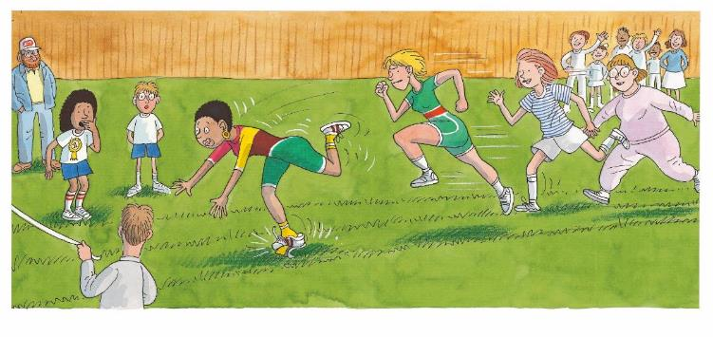
Poor Old Mum!
LO: Understand the text; read the text fluently.
1. Read the text aloud to Ss.
2. Have Ss talk about the comprehension questions by using the illustration and the text.
3. Have Ss read the text fluently and give feedback.
TG
Reading
Comprehension
1. What race was Mum in?
2. What happened to
Mum when she was in
the race?
3. How did Wilma feel when
she saw Mum fall down?
4. What results would Mum
get?
Mum was in a race.
“Oh no,” said Wilma.
2:00
13/26

Slide 14
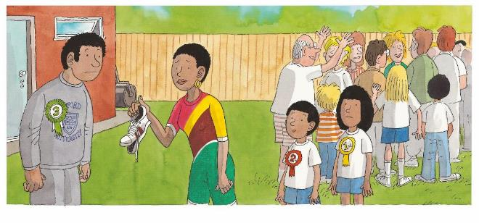
Poor Old Mum!
TG
LO: Understand the text; define the role of each character in the story; read the text fluently;
decode the sight word accurately.
1. Read the text aloud to Ss.
2. Have Ss talk about the comprehension questions by using the illustration and the text.
3. Encourage Ss to talk more about the Point of View Question; if they know how to answer the
question, check their answers. If they don’t know how to answer the question, give them some
support; let them know if one of the characters is telling the story, they’ll see words such as I, me,
we, my and so on; if someone who’s not in the story is telling the story, they’ll see words such as
he, she and they, and also character names; then guide Ss to find the right answer.
4. Ask Ss to find the sight word last in the text and guide them to read it accurately.
5. Have Ss read the text fluently and give feedback.
Reading
Comprehension
Why did Mum come last?
How did Wilf and Wilma feel when Mum came last?
Point of View
Who is telling the story?
Wilf
Someone who is not in this story.
Mum came last.
“Poor old Mum,” said
Wilf.
Sight Word
last
2:00
14/26

Slide 15
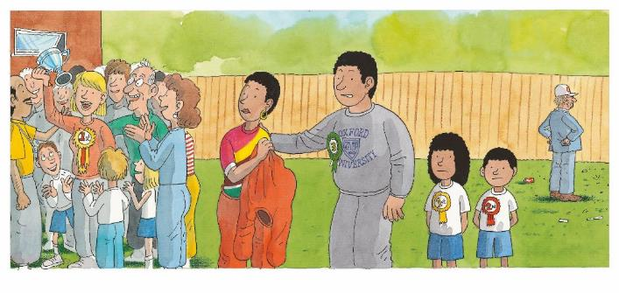
Poor Old Mum!
LO: Understand the text; define the role of each character in the story; read the text in a
voice that matches the character’s emotions.
1. Read the text aloud to Ss.
2. Have Ss talk about the comprehension questions by using the illustration and the text.
3. Encourage Ss to talk more about the Point of View Question; if they know how to answer the
question, guide them to use complete sentences; if they don’t know how to answer the
question, guide them to discuss the following aspects: the experiences of characters in the
story, the feelings of characters in the story; then guide Ss to use complete sentences.
4. Ask Ss to think about how the characters might be feeling based on the illustration and the
text on this page, then ask Ss to read the text in a voice that matches the character’s
emotions.
5. Have Ss read the text fluently and give feedback.
TG
Reading
Comprehension
How did Mum feel? Why did she feel that way?
What did Dad think of the results?
Point of view
Retell what happened from Wilma’s point of view.
Mum was disappointed.
“What a shame!” said Dad.
Decoding
Expression-Make your voice match the feelings
2:00
15/26

Slide 16
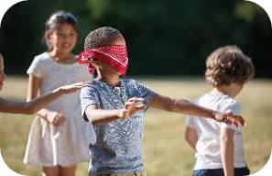
Poor Old Mum!
LO: Understand the meaning of the key vocabulary words blindfold and surprise, and
make sentences with them; understand the text; make connections; read the text fluently.
1. Have Ss take turns reading the text; give feedback and correct them if necessary.
2. Ask one of the Ss to find blindfold in the text and the illustration; have Ss read the word and
make sentences with it.
3. Ask another S to find surprise in the text and the illustration; have Ss read the word and
make sentences with it.
4. Have Ss talk about the comprehension questions by using the illustration and the text.
5. Encourage Ss to talk more about the connections question.
TG
Reading
Vocabulary
Vocabulary
Comprehension
What did Dad do to Mum? Why did he do that?
What surprise would Wilf and Wilma prepare for Mum?
blindfold
surprise
Connections
The children put a blindfold on the boy.
She got a big surprise.
Did you give a surprise to anyone before? How did you surprise them?
Dad put a blindfold on Mum.
Wilf and Wilma had a surprise.
blindfold
surprise
2:00
16/26

Slide 17
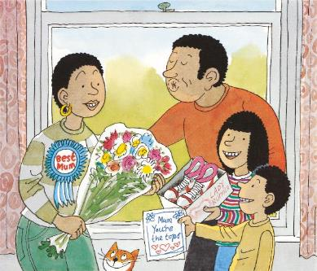
Poor Old Mum!
TG
LO: Understand the text; define the role of each character in the story; read the text fluently.
1. Read the text aloud to Ss.
2. Have Ss talk about the comprehension questions by using the illustration and the text.
3. Encourage Ss to talk more about the Point of View question. If they know how to answer the
question, guide them to use complete sentences. If they don’t know how to answer the question,
guide them to discuss the following aspects: the experience of characters in the story, the feelings
of character in the story; then guide Ss to use complete sentences.
4. Have Ss read the text fluently and give feedback.
Reading
Comprehension
What surprise did Wilf and Wilma give to Mum? Look for clues in the illustration.
Why did Dad and the children give Mum a surprise?
How did Mum feel at last?
Point of view
Describe how the family cheered Mum up from Dad’s point of view.
“Good old Mum,” said everyone.
2:00
17/26

Slide 18
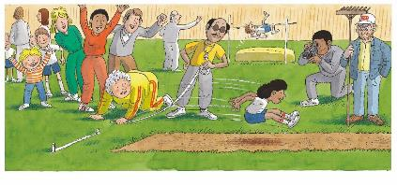
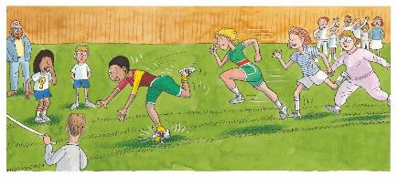
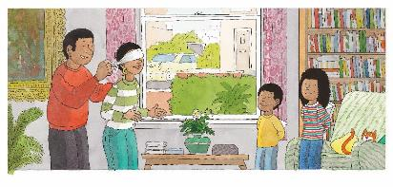
LO: Retell the story with the visual support and assistance.
1. Ask Ss to work in pairs and to talk about the given questions; have them work in pairs
to recall details from the story in the correct sequential order; model first.
2. Have Ss take turns retelling the story by using the visual aids.
TG
Reading
Let’s retell!
1
2
What day was it that day?
What did the children do?
What did Dad do on sports day?
How did Dad rank in the race?
3
4
What did Mum do on sports day?
What happened to Mum?
What did the family prepare for
Mum?
2. What happened at last?
2:00
18/26

Slide 19
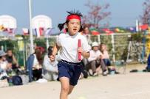
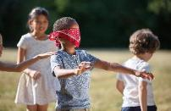
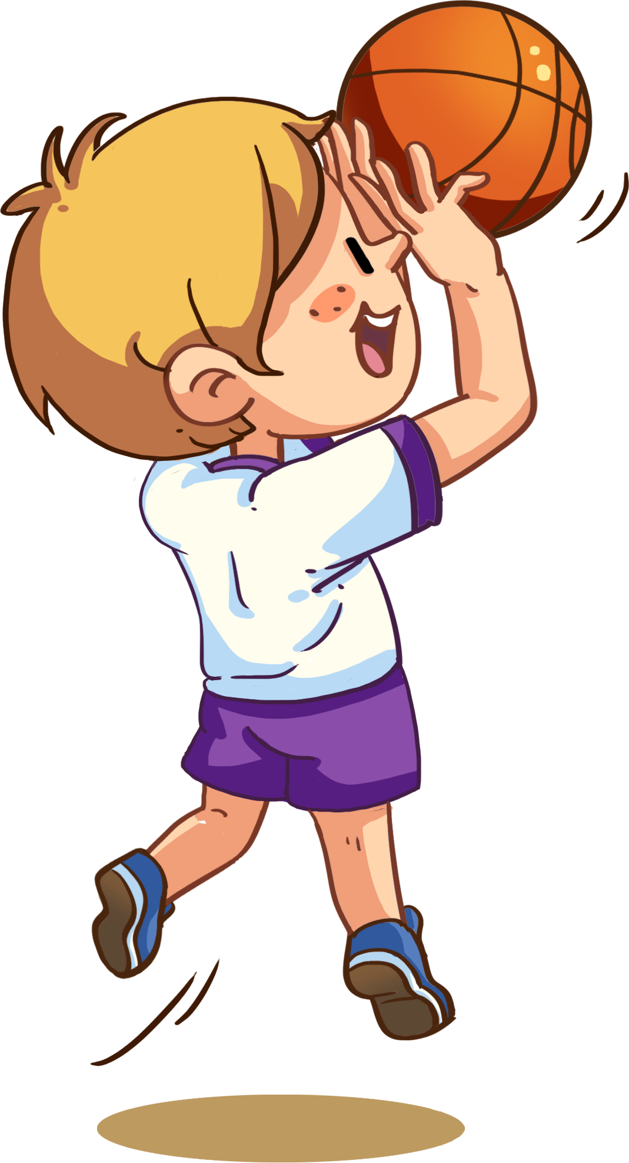
Let’s review the words!
LO: Check their understanding of the words in this lesson.
1. Have Ss play the shooting game by identifying the pictures and vocabulary words.
2. Click to show the picture and ask Ss to identify the word that matches the picture; click to
show the answer; click to help Ss shoot accurately in the picture.
3. Repeat this practice for the rest of the words.
TG
Vocabulary
spoon
sports
blindfold
long jump
surprise
first
1:30
19/26

Slide 20
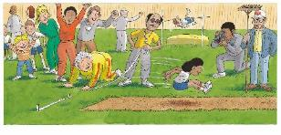
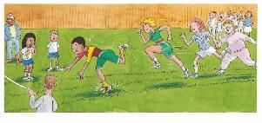
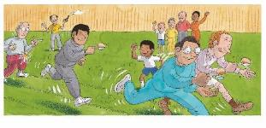
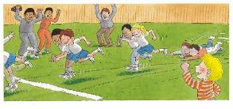
Let’s talk!
LO: Talk about what events the family took part in by using the given sentence structure.
1. Have Ss work in pairs to talk about the given illustration by using the sentence structure
and the helping words; model first.
2. Assist Ss if necessary.
TG
Listening & Speaking
Wilma, Wilf, Dad, Mum
—What race did ______ take part in?
—____ took part in the _______.
Helping Words
long jump
running race
egg and spoon race
three-legged race
1:30
20/26

Slide 21
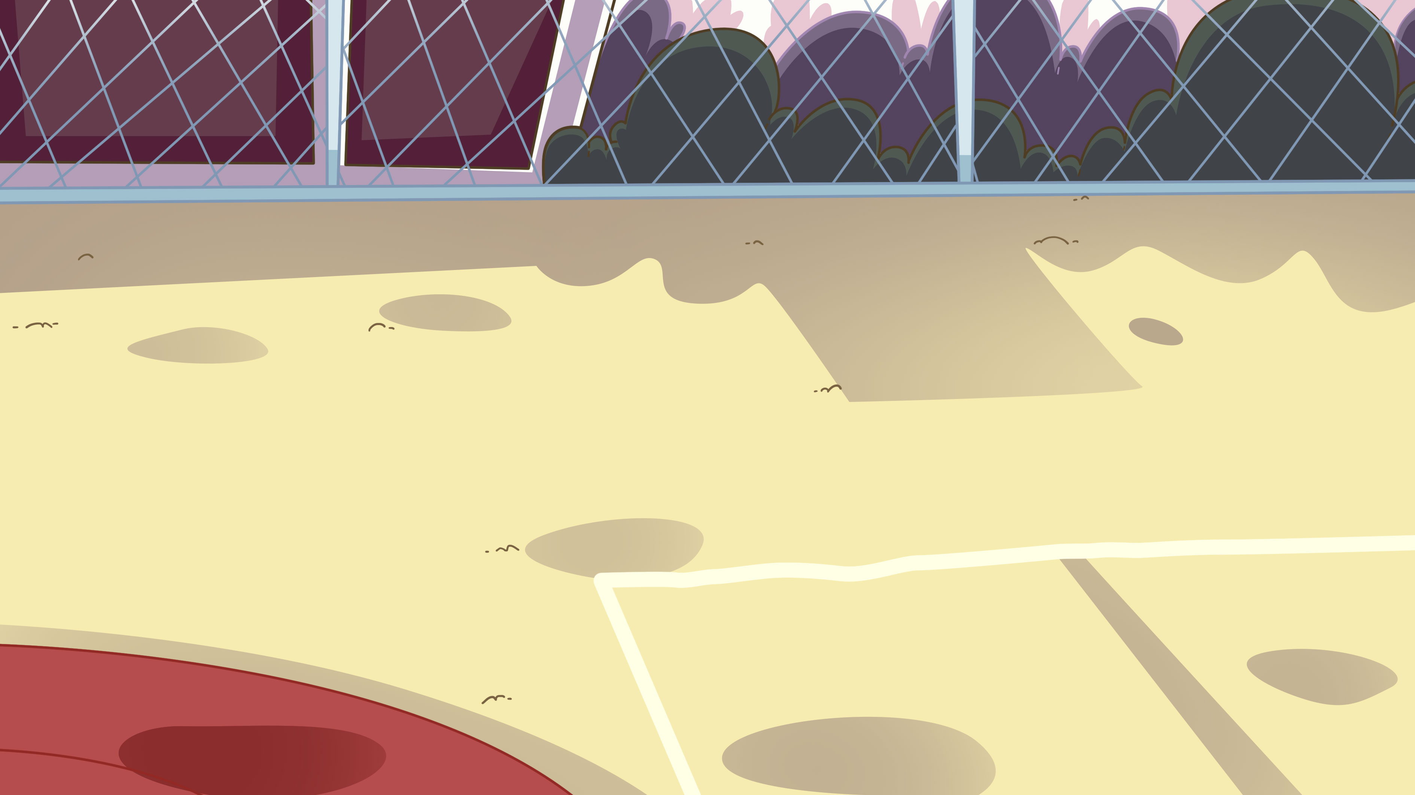
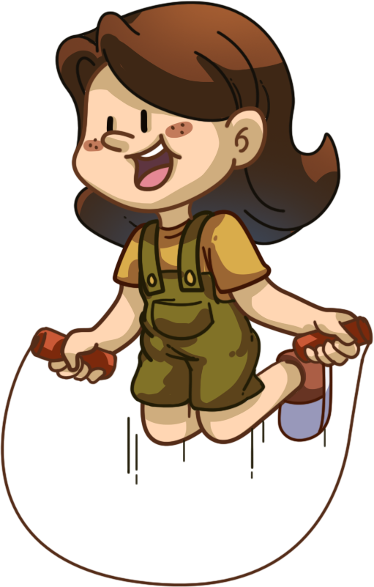
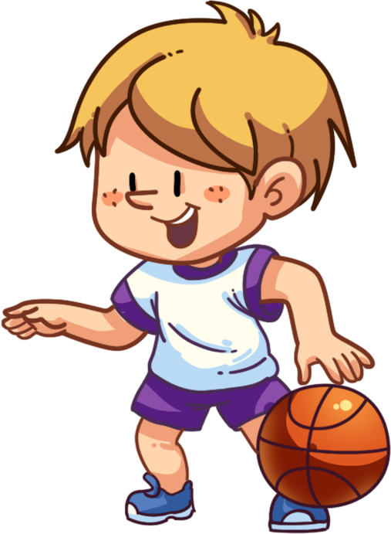
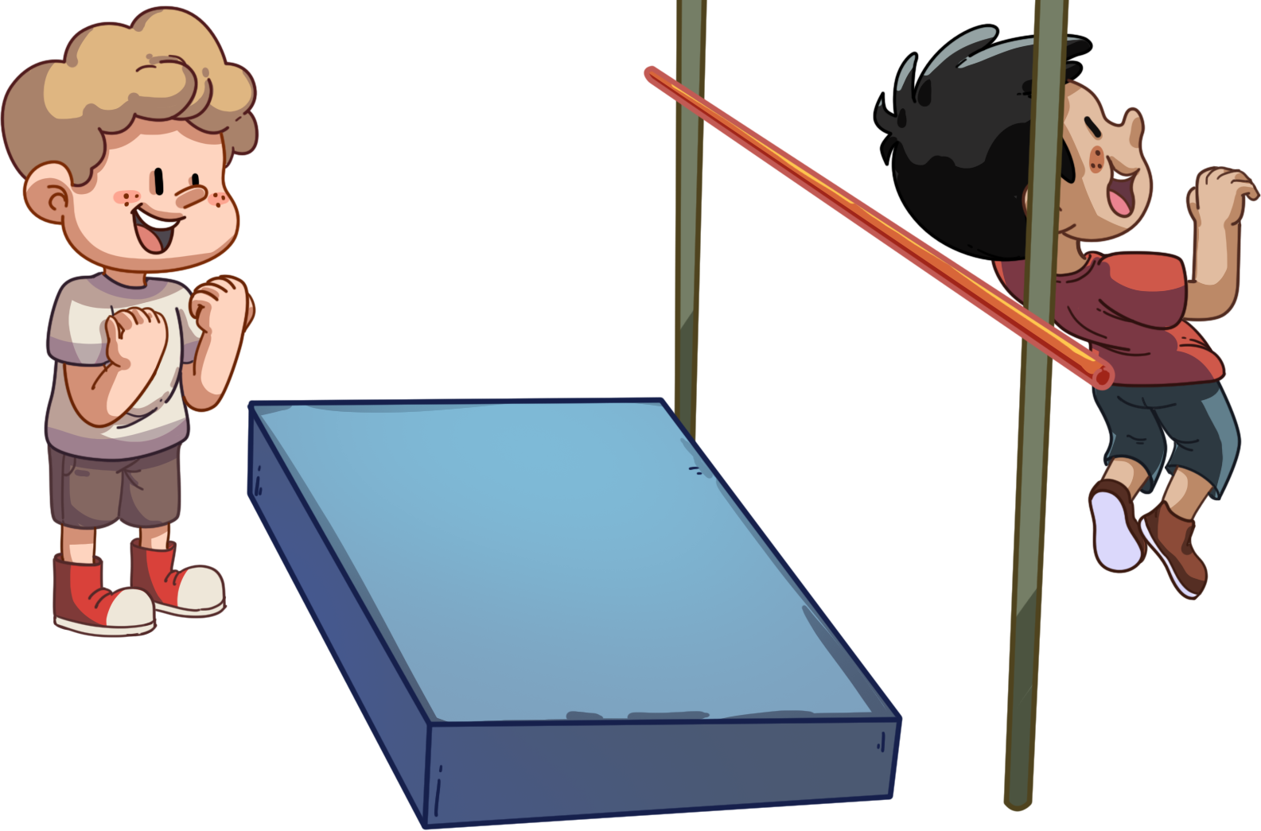
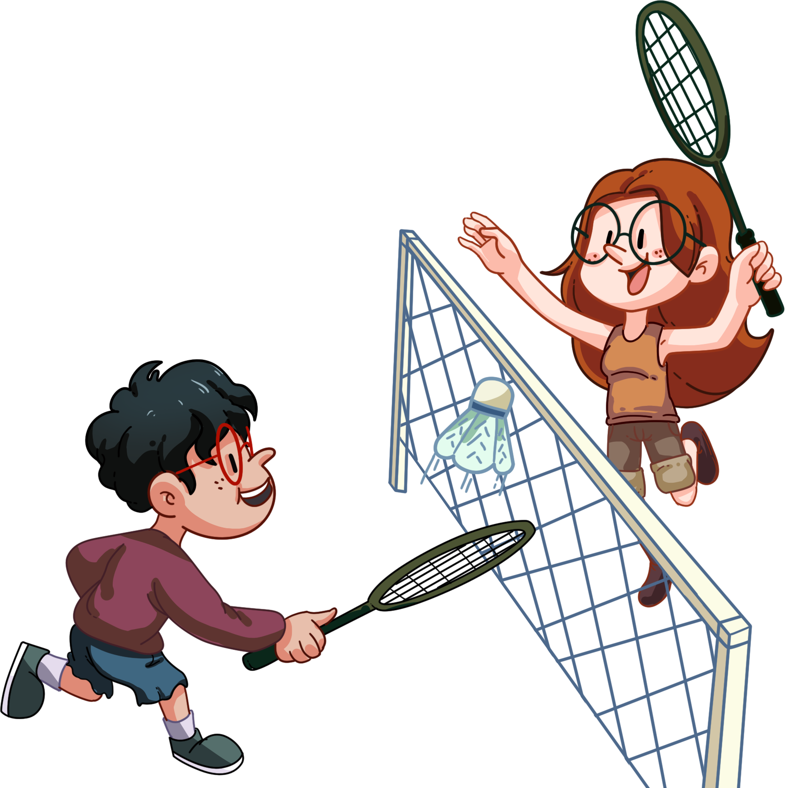
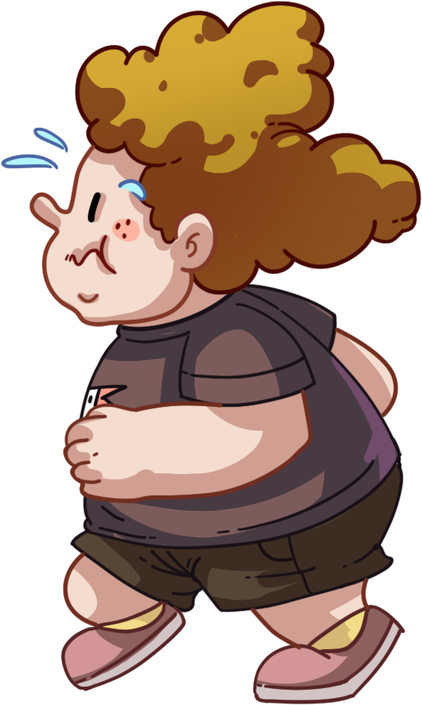
TG
LO: Use the sentence structure to discuss the following question: What race do you want to
take part in on a sports day?
1. Ask Ss to observe the picture carefully; have them talk about what races they know on a
sports day, and have Ss discuss what they would want to take part in; encourage them to
speak more.
2. Ask Ss to work in pairs to talk about the given picture by using the given sentence structure;
each S has at least three chances to talk; model first.
3. Assist Ss if necessary.
Notes: T can click Let’s talk to present the sentence structure, and T can click again to make it
disappear.
Listening & Speaking
Let’s talk!
—What race do you want to take part in on
sports day?
—I want to take part in the _______.
high jump long jump
-
3:00
21/26

Slide 22
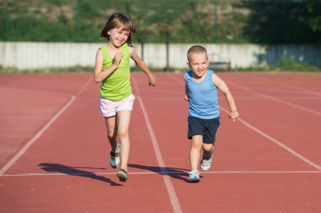
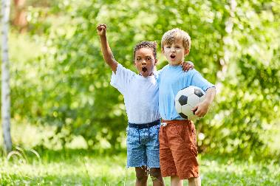
LO: Talk about the following topic: what should you do if you can’t win while playing sports?
Ask Ss to stay positive no mater what the results are.
1. Ask Ss to think about the given question; model first.
2. Guide Ss to talk about the question with the help of the given pictures.
3. Encourage Ss to talk more about the topic.
TG
Value
Value
What should you do if you can’t win while playing sports?
practice more if I have time
never say die
2:00
22/26

Slide 23
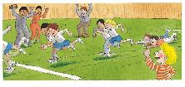
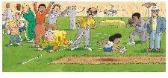
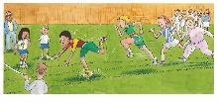
LO: Talk about the different events that took place on sports day.
1. Guide Ss to talk about what they’ve learned from the story.
2. Ask Ss to think about the given questions; help Ss to organize their ideas with the given
visual support; model the first question, and then ask Ss to complete the task in turns.
TG
Oral Writing
Get ready to present!
Talk about the different events that took place on sports day.
Wilf
Dad
three-legged race
second
egg and spoon race
third
sports day
Wilma
Mum
long jump race
first
running race
last
2:00
23/26
Notes:
她们的

Slide 24
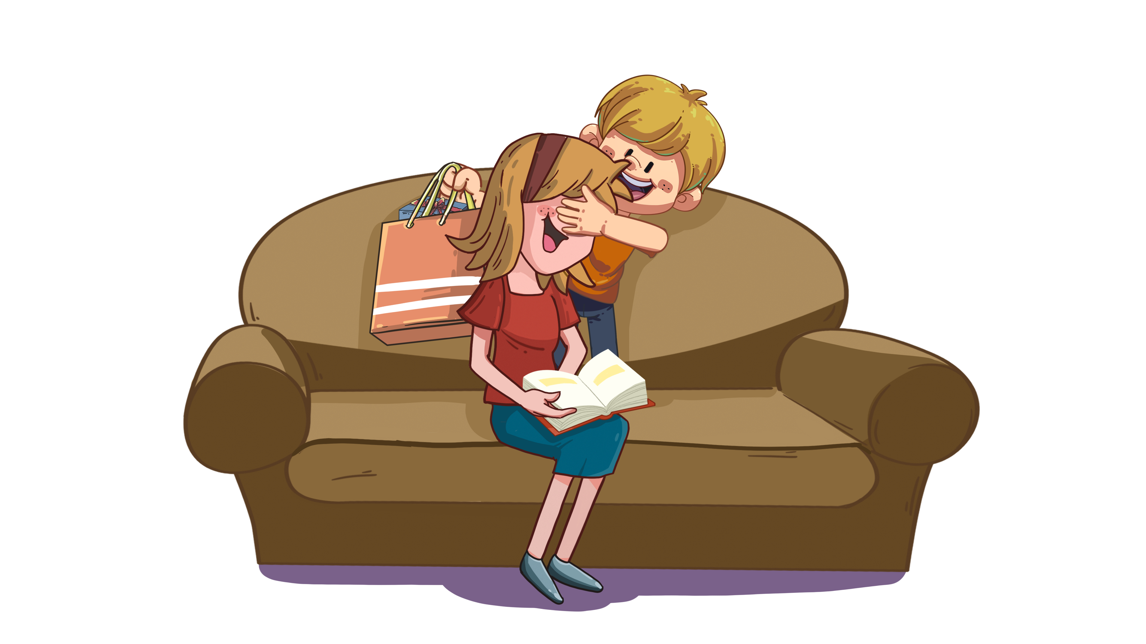
LO: Understand what the homework is.
1. Explain the writing task to Ss and check their understanding.
2. Tell Ss that they should finish their writing before next class; make sure they know they can
upload their homework to the platform; they will present their homework next class.
3. Remind Ss to watch the post-class video and to finish the writing task.
TG
Writing
Let’s draw and write!
Picture Story Writing
Let’s write a picture story!
Directions:
Create a story about how to give a surprise to your mom by drawing three pictures.
Write a sentence for each picture.
Watch the post-class video about the writing task.
0:30
24/26

Slide 25
LO: Review today’s lesson.
1. Guide Ss to review the phonics by asking Ss to read the words aloud.
2. Guide Ss to review the words by inviting Ss to read and explain some of the words.
3. Guide Ss to review the sentence structures by asking each S to make sentences with them.
TG
Review
Let’s review!
Review
Phonics:
maid/paid/laid/
hall/ball/wall
Sentence Structure:
_____ took part in _____.
Vocabulary:
first/sports/long jump/
spoon/blindfold/
surprise
1:00
25/26

Slide 26
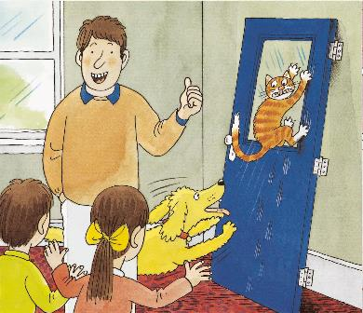
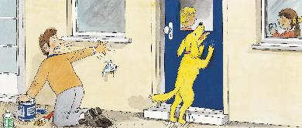
LO: End the lesson and encourage Ss to perform better in the next class.
1. Briefly comments on Ss.
2. Say goodbye to students.
3. Ask Ss to preview the next lesson.
TG

