Slide 1
My pencil case
Chapter 4, Book 1A
Longman Welcome to English Gold

Slide 2
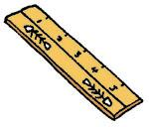
What do you have?
I have a pen.
It is blue.
I have two rulers.
They are yellow.

Slide 3
What do you have?
I have a pencil.
It is red.

Slide 4
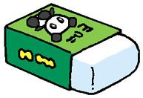
What do you have?
I have three erasers.
They are green and white.

Slide 5
What does he have?
He has a pen. It is blue.

Slide 6
What does he have?
He has two rulers. They are yellow.

Slide 7
What does she have?
She has a pencil.
It is red.

Slide 8
What does she have?
She has three erasers.
They are green and white.

Slide 9
It / They
a ruler
a pen
an eraser
it
two rulers
three pens
ten erasers
they

Slide 10
Fill in the blanks.
six pencils
I have ______________ .
They are _______ .
green

Slide 11
Fill in the blanks.
five sharpeners
Billy has ______________ .
They are _______ .
brown

Slide 12
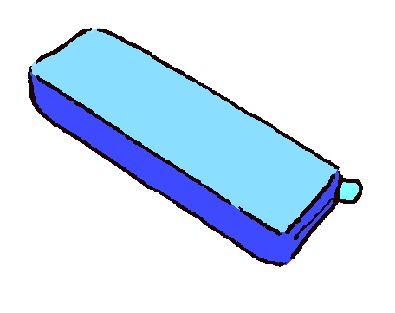
Fill in the blanks.
a pencil case
May has ______________ .
It is _______ .
blue

Slide 13
Fill in the blanks.
has eight pens
Sam __________________ .
_______________________
They are red.

Slide 14
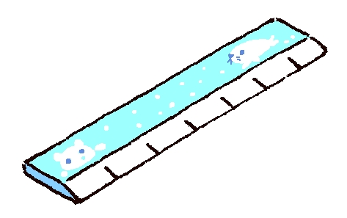
Fill in the blanks.
have one ruler
I __________________ .
_____________________
It is blue and white.

Slide 15
THE END

