Slide 1
We can do it!
Chapter 5, Book 1A
Longman Welcome to English Gold

Slide 2
Can you …?
I can climb.

Slide 3
Can you …?
I can’t climb.

Slide 4
Can you …?
Can you climb?
Yes, I can.

Slide 5
Can you …?
Can you climb?
No, I can’t.

Slide 6
Can he / she …?
Can he climb?
Yes, he can.

Slide 7
Can he / she …?
Can she climb?
No, she can’t.

Slide 8
Can, cannot / can’t
I
He
She
can
can’t
climb.
you
he
she
Can
climb?
I
he
she
I
he
she
Yes,
can.
No,
can’t.
can’t = cannot

Slide 9
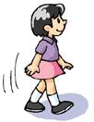
Fill in the blanks.
1 Can he draw?
Yes, he _____
can.
2 Can she walk?
Yes, _________
she can.

Slide 10
Fill in the blanks.
3 Can you read?
__________
Yes, I can.
Can
4 ______ he swim?
No, __________
he can’t.

Slide 11
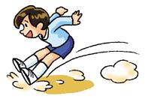
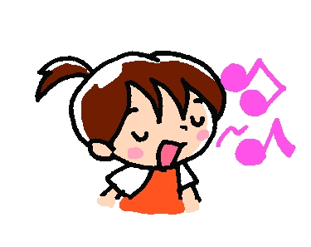
Fill in the blanks.
Can
jump
5 _____ you _____?
_____________
No, I can’t.
Can
sing
6 ____ she _____?
____________
Yes, she can.

Slide 12
THE END

