Slide 1
People at work
Chapter 4, Book 2A
Longman Welcome to English Gold

Slide 2
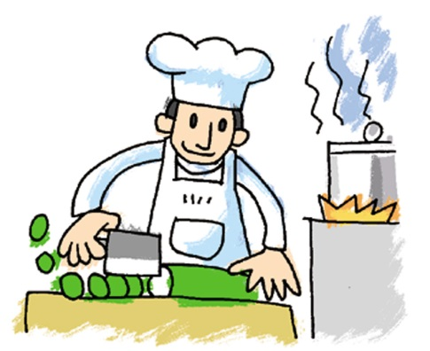
Jobs
What’s your father’s job?
He’s a cook.

Slide 3
Jobs
What’s your mother’s job?
She’s a teacher.

Slide 4
Asking and answering questions about people’s jobs.
mother’s
father’s
What is your
job?
He is
She is
a teacher.

Slide 5
Fill in the blanks.
1
2
What is your mother’s job?
She is _____________ .
a doctor
What is your father’s job?
He is ______________ .
a waiter

Slide 6
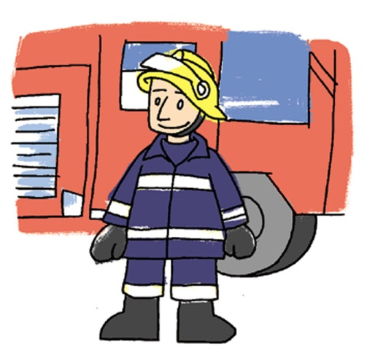
Fill in the blanks.
3
4
What is your mother’s job?
She is ______________ .
a housewife
What is your father’s job?
He is ______________ .
a fireman

Slide 7
THE END

