Slide 1
Happy moments
Chapter 5, Book 1B
Longman Welcome to English Gold

Slide 2
Present Continuous Tense
We use ‘am/is/are + ing’ for actions that people are doing NOW.
The girl is singing.

Slide 3
Present Continuous Tense
Sometimes we have to omit the letter e!
make
making
ride
riding
write
writing
dance
dancing

Slide 4
Present Continuous Tense
What
are
you
we
they
doing?
am
I
is
he
she
it
You
We
They
are
eating.
I
am
He
She
It
is

Slide 5
Now you try.
are
doing
What ____ the children _______? ______________________ (play)
They are playing.

Slide 6
are
doing
A: What ____ you _______, Tom? B: __________________ (read)
I am reading.

Slide 7
are
doing
What ____ Jack and Ken _______? ______________________
They are fighting.

Slide 8
is
doing
What ____ Lily _______? ______________________
She is skipping.

Slide 9
are
doing
What ___ you _____, Jo and Jill? ______________________
We are dancing.

Slide 10
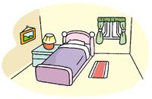
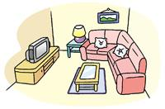
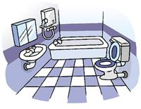
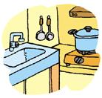
Where are the people?
What are they doing?
living room
bedroom
kitchen
bathroom

Slide 11
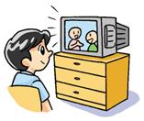
Eric is watching TV in the living room.

Slide 12
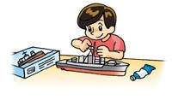
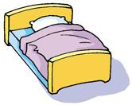
is making
Tom __________ a model in the bedroom.

Slide 13
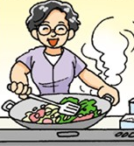
is cooking
Mum __________ in the kitchen.

Slide 14
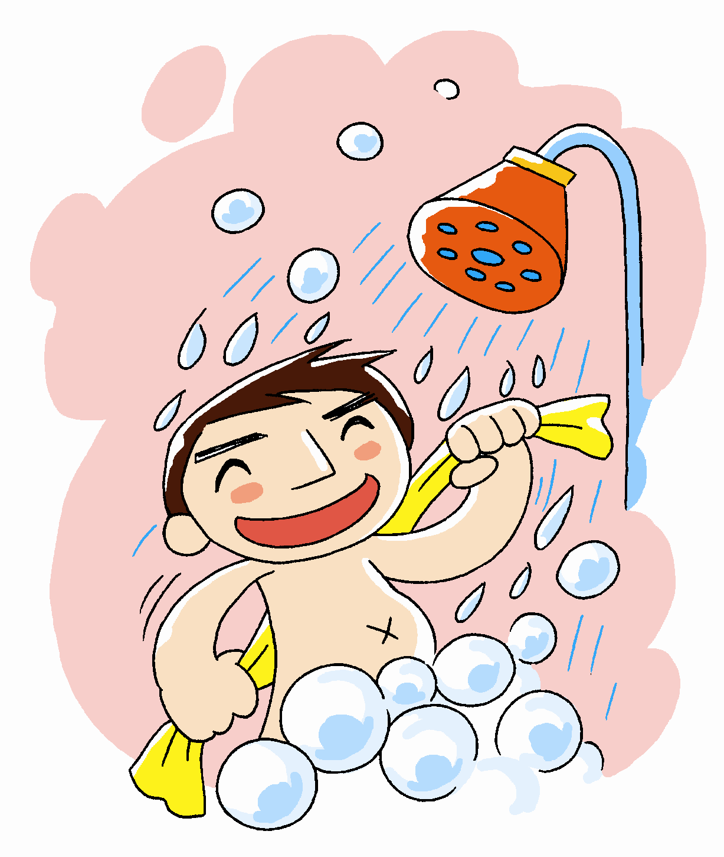
is singing
Dad __________ in the bathroom.

Slide 15
THE END

