Slide 1
A fashion show
Chapter 6, Book 1B
Longman Welcome to English Gold

Slide 2
red

Slide 3
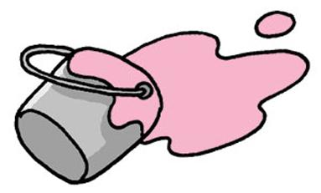
pink

Slide 4
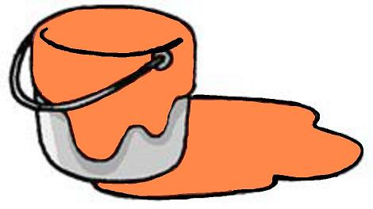
orange

Slide 5
yellow

Slide 6
green

Slide 7
blue

Slide 8
purple

Slide 9
brown

Slide 10
black

Slide 11
white

Slide 12
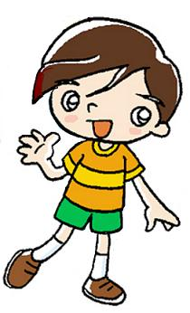
Here is Ben.
His T-shirt is orange.
His shorts are green.
His shoes are brown.

Slide 13
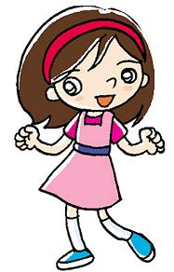
Here is May.
Her dress is pink. Her shoes are blue.

Slide 14
We use his to talk about something
that belongs to a boy or man.
e.g. His hair is short.
His T-shirt is green.
We use her to talk about something
that belongs to a girl or woman.
e.g. Her hair is long.
Her T-shirt is yellow.

Slide 15
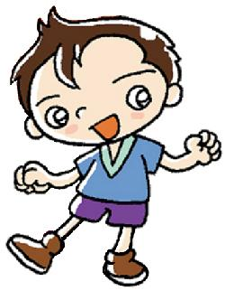
Now you try.
Here is Paul.
_____ T-shirt is blue.
_____ shoes are brown.
His
His

Slide 16
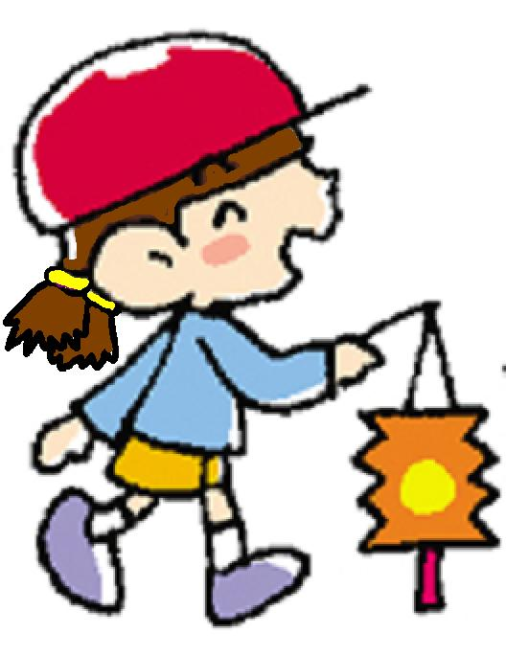
Here is Gloria.
_____ cap is red.
_____ skirt is orange.
Her
Her

Slide 17
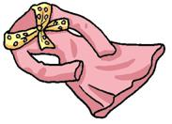
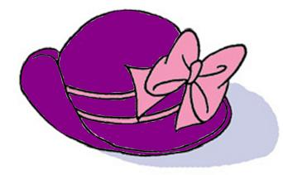
What colour
is
the dress?
the hat?
the shirt?
It
is
pink.
purple and pink.
blue.
dress
shirt
hat

Slide 18
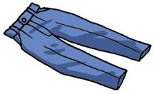
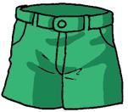
What colour
are
the trousers?
the jeans?
the shorts?
They
are
blue.
green.
jeans
shorts
trousers

Slide 19
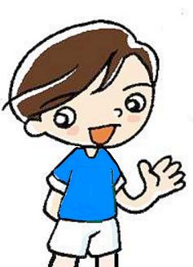
What is Tom wearing?
He is wearing __________
____________________.
a T-shirt
and shorts
What colour is his T-shirt?
It is ________________.
What colour are his shorts?
They are _____________.
blue
white

Slide 20
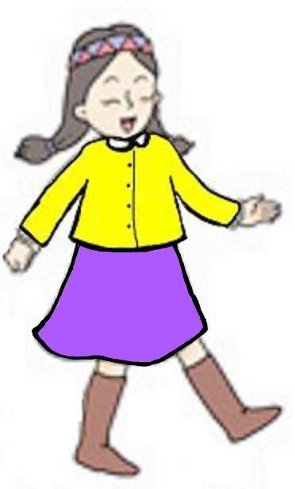
What is Amy wearing?
She is wearing _________
____________________.
a shirt
and a skirt
What colour is her shirt?
It is _________________.
What colour is her skirt?
It is _________________.
yellow
purple

Slide 21
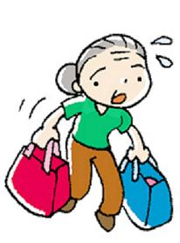
What is Grandma wearing?
She is wearing _________
____________________.
a T-shirt
and trousers
is
What colour ___ her T-shirt?
_____________________
What colour ____ her trousers?
_____________________
It is green.
are
They are brown.

Slide 22
THE END

