Slide 1
About me
Chapter 2, Book 2A
Longman Welcome to English Gold

Slide 2
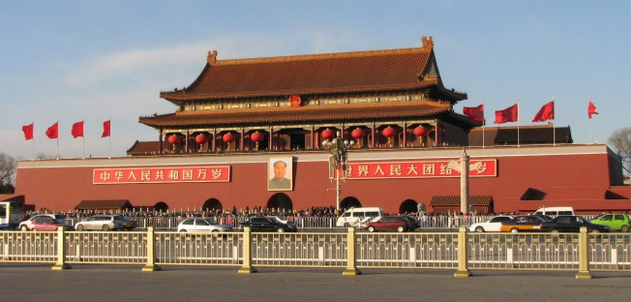
Where do you live?
Where do you live?
I live in Beijing.

Slide 3
Where do you live?
Where do you live?
I live in Shanghai.

Slide 4
Where do you live?
Where do you live?
I live in Nanjing.

Slide 5
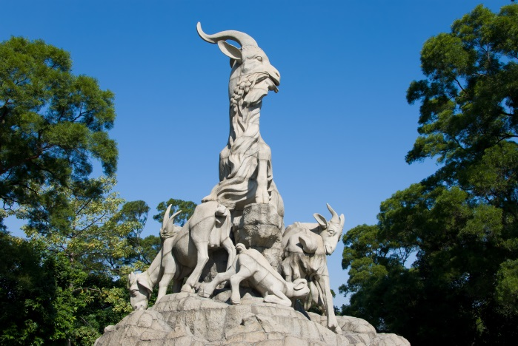
Where do you live?
Where do you live?
I live in Guangzhou.

Slide 6
Where do you live?
Where do you live?
Beijing.
Shanghai.
Nanjing.
I live in

Slide 7
Read and make a note.
My name is Sally.
I live in Hangzhou.
I come to school by school bus.
Name | Lives in … | Comes to school …
Sally
Hangzhou
by school bus

Slide 8
THE END

