Slide 1
Our pet friends
Chapter 2, Book 1B
Longman Welcome to English Gold

Slide 2
Where
We use the question word Where to ask for the location of something.
We can use these words to answer Where questions:
in, on, under, near

Slide 3
Where is the cat?
It is on the box.

Slide 4
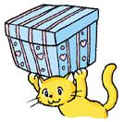
Where is the cat?
It is under the box.

Slide 5
Where is the cat?
It is near the box.

Slide 6
Where is the cat?
It is in the box.

Slide 7
Now you try.

Slide 8
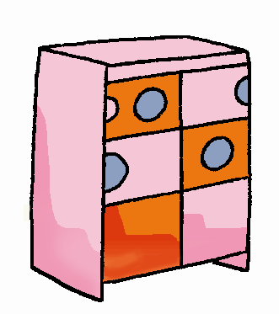
Where is Beeno?
near
He is _____ the cupboard.

Slide 9
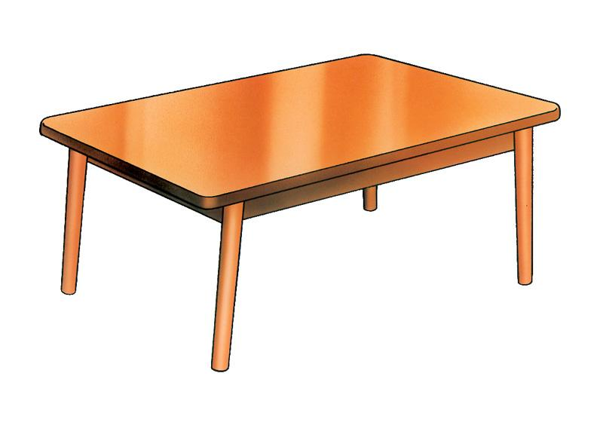
Where is Beeno?
on
He is _____ the table.

Slide 10
Where is Beeno?
under the table
He is ___________________.

Slide 11
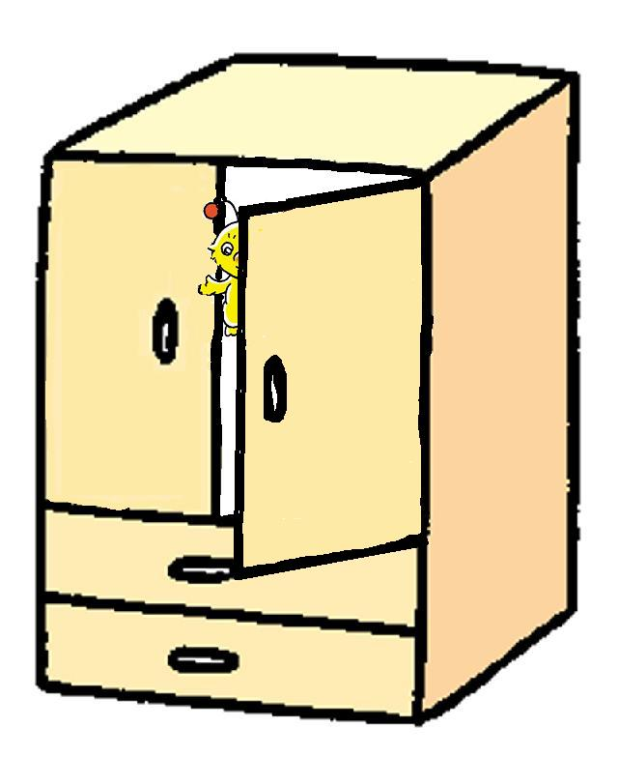
Where is Beeno?
in the cupboard
He is ___________________.

Slide 12
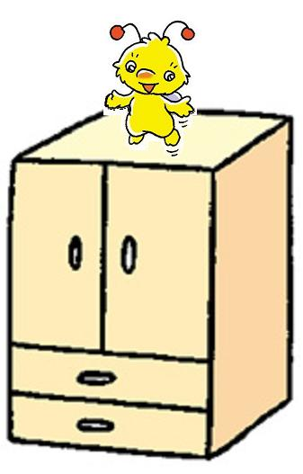
Where is Beeno?
on the cupboard
He is ___________________.

Slide 13
THE END

