Slide 1
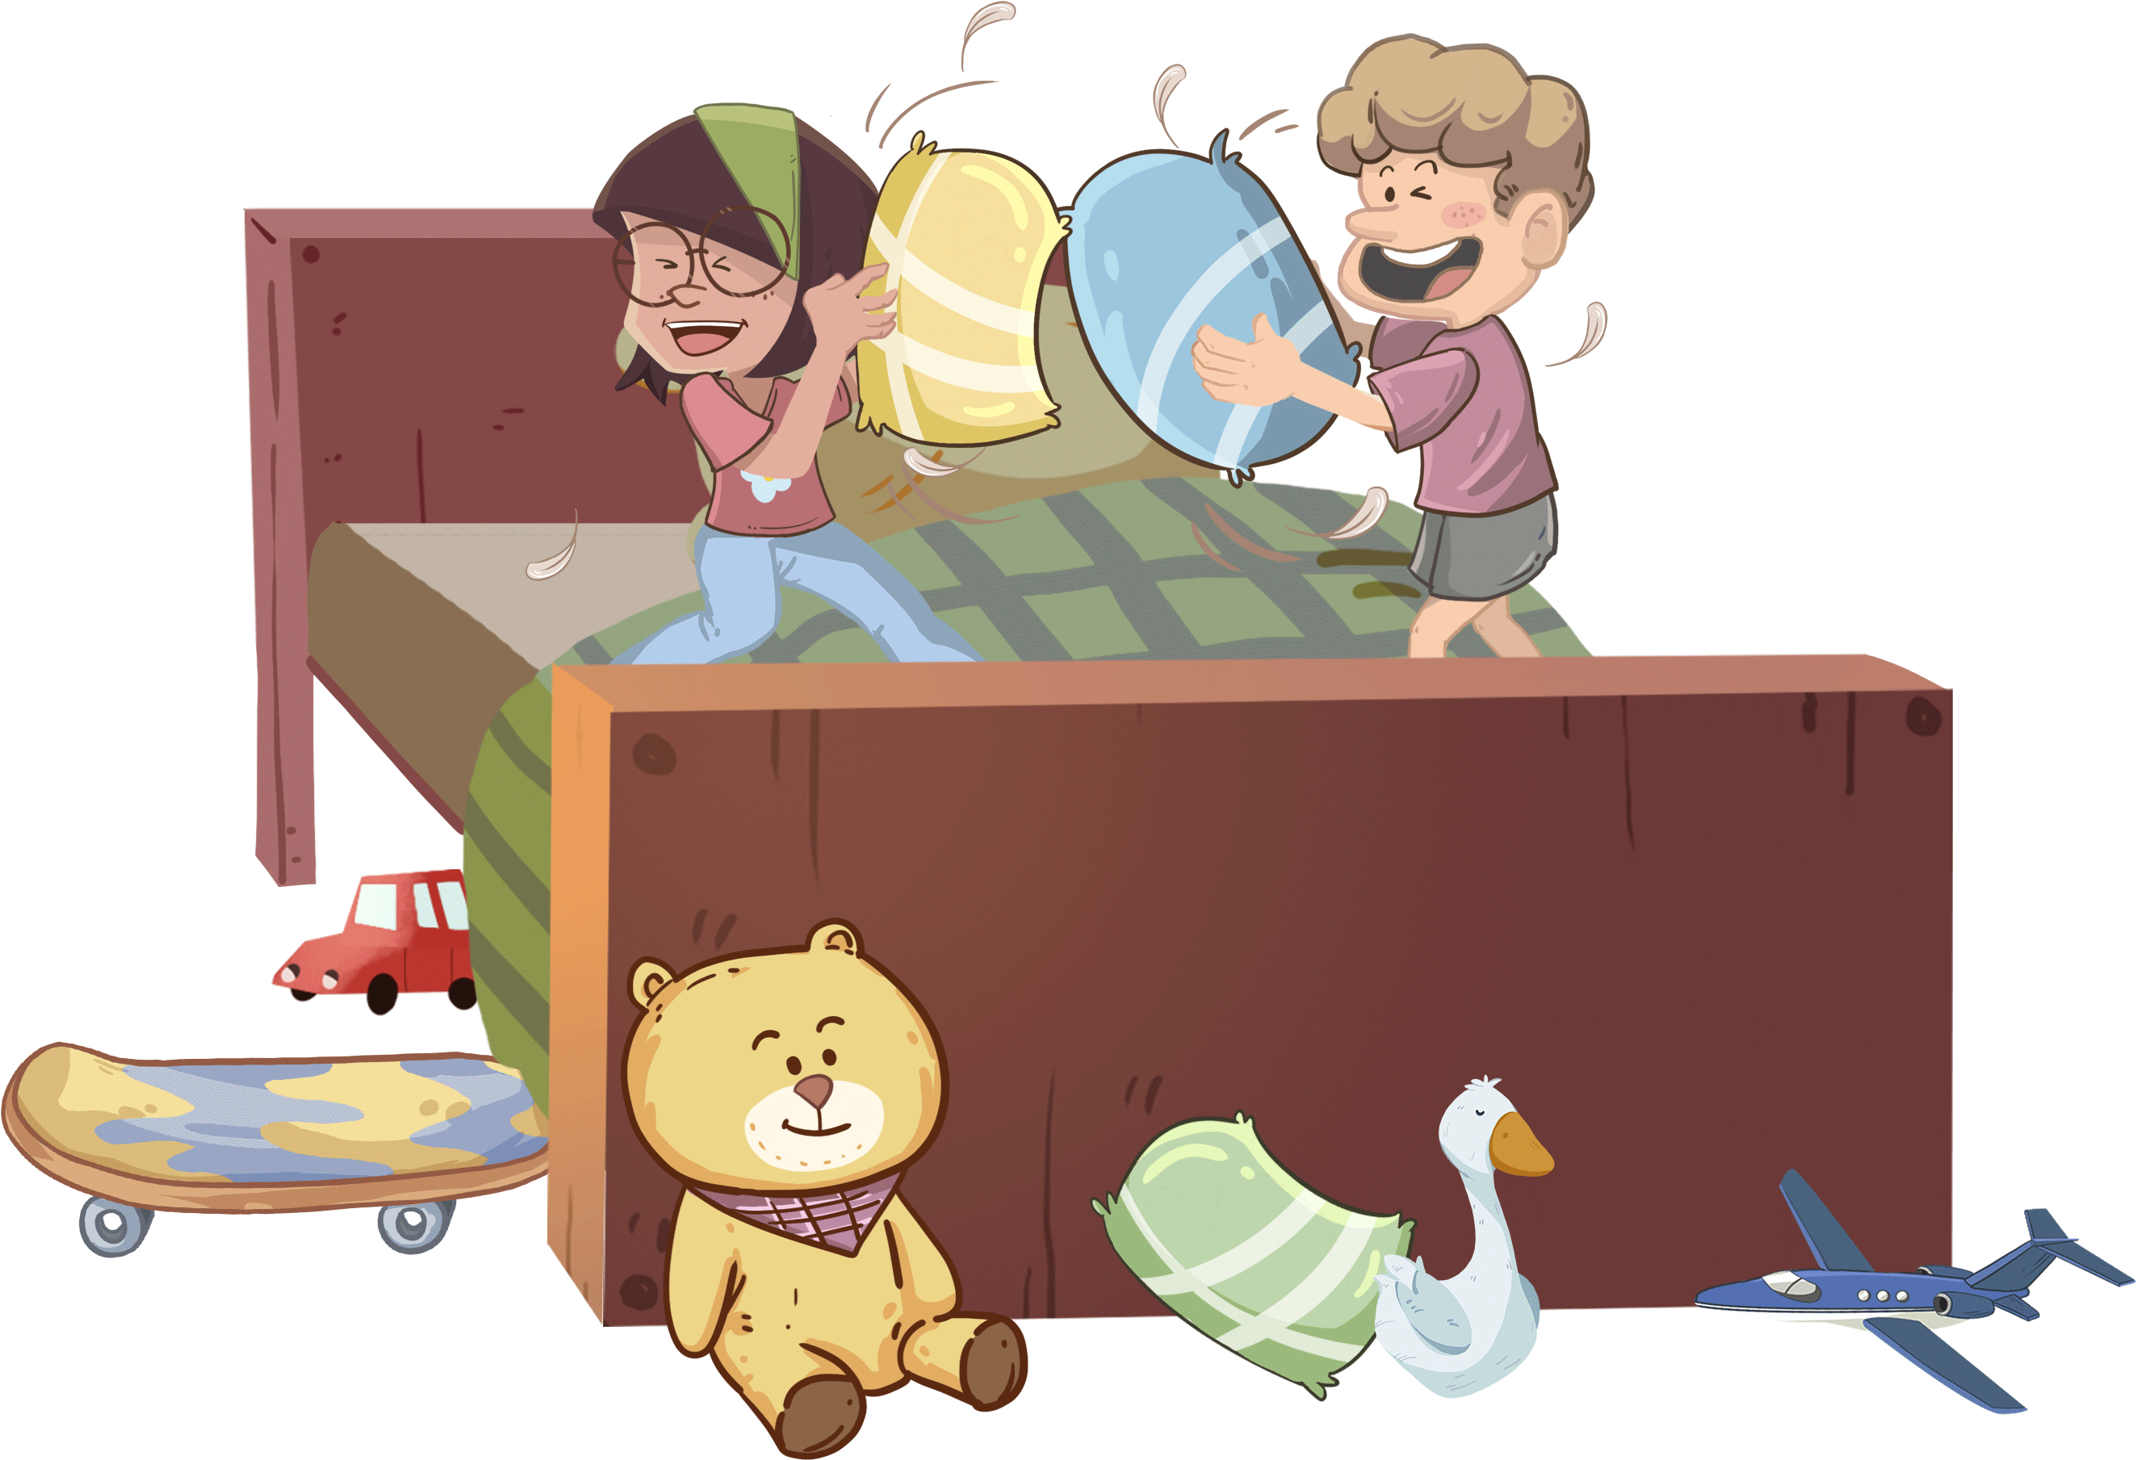
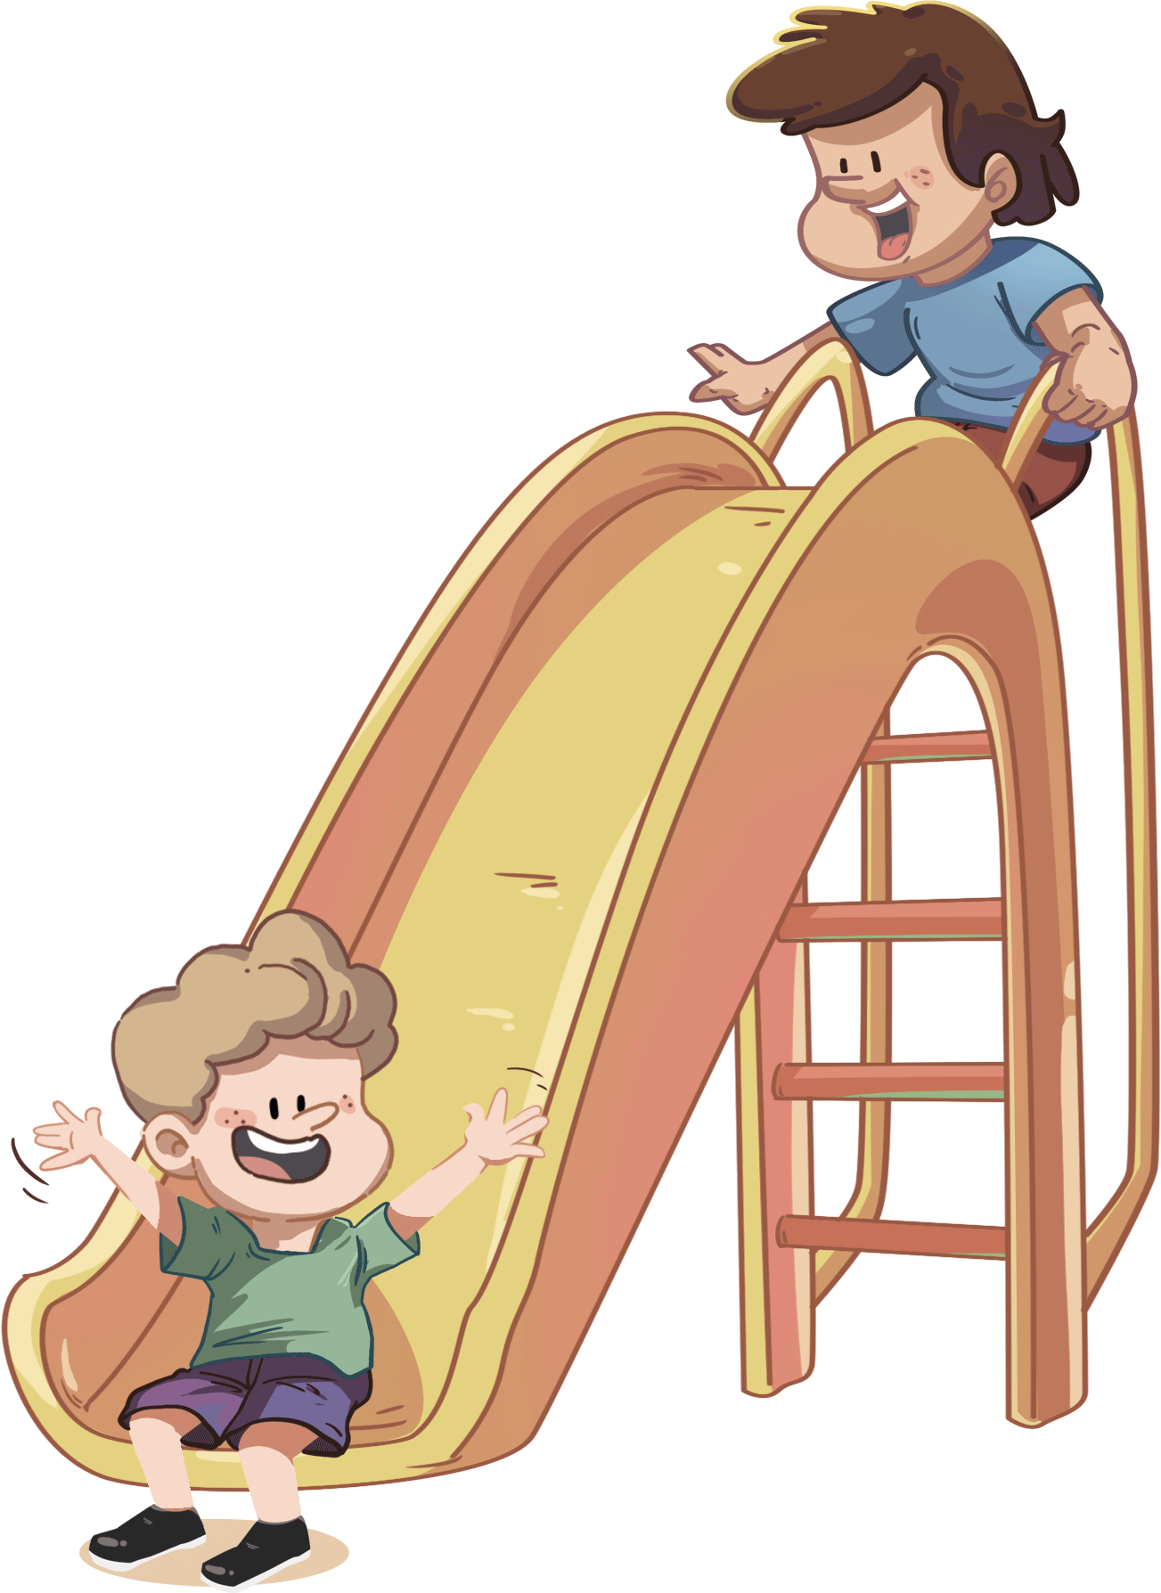
TG
LO: Get to know their partners; get a basic idea about the
topic of today’s lesson;
Say hello to Ss; ask Ss to greet each other.
Introduce the topic of the lesson.
1:00
1/28

Slide 2
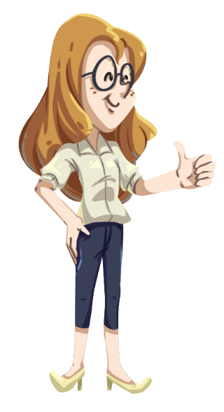
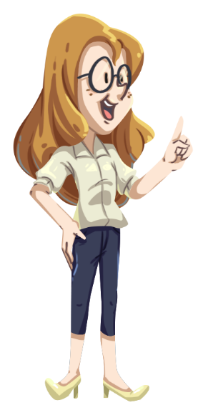
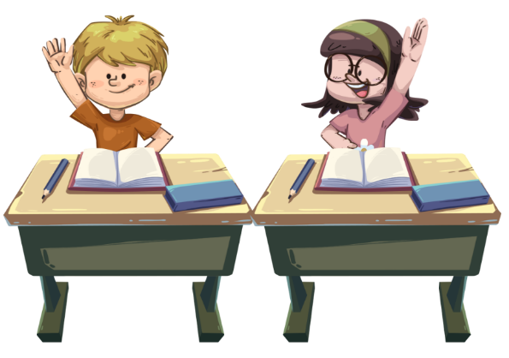
TG
Class Rules
LO: Get to know and understand the class rules.
Go through and explain the class rules by doing the actions.
Demonstrate the actions and ask Ss to follow you.
Check Ss’ understanding of these rules by doing actions.
Please
Listen when someone is
talking.
2. Follow directions quickly.
3. Be nice to your classmate.
0:30
2/28

Slide 3
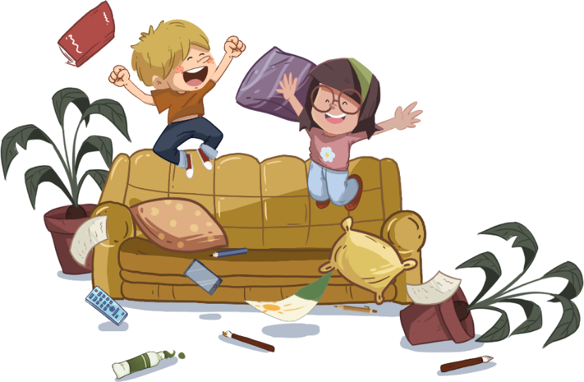
Learning
Goals
TG
LO: Get to know and understand what will be learned in
this lesson.
Go through the learning goals with Ss.
We are going to . . .
Identify and pronounce the long vowel e in some words.
Learn different words sofa, curtains, ladder, wall, log, and net, and make sentences with them.
Read the story Naughty Children and identify the main characters of a story.
Practice using the sentence structures
____ climbed on/up ____.
____ jumped on/off ____.
0:30
3/28

Slide 4
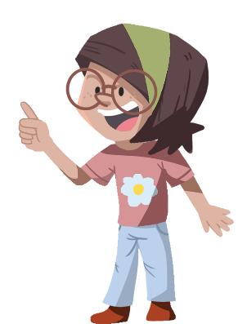
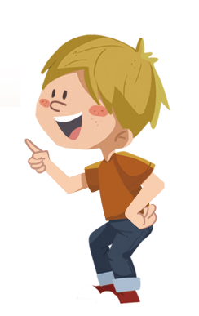
Presentation
TG
LO: Present and share the writing with the teacher and partner;
Invite Ss to take turns presenting their homework. If time is limited, tell Ss they have at most 1.5 mins to present their writing.
2. Encourage the other S to listen carefully and ask one question to the
presenter. After both of the Ss have finished, give them feedback and
awards (click the book picture beside the boy or the girl so that they
can get some awards).
3. Click and give each S a trophy to mark their good performance.
Note: You can click the picture of the boy or the girl to give Ss the
trophy so that they can get the cup.
Let’s show!
This is my favorite zoo.
1:30
4/28
Notes:
Suggested time: 1.5 mins （application: the lowest standard）
Learning Objectives: Ss will be able to chant the given example and talk about other animals with the given sentences.
TD:
Clap hands and read the chant with rhythm.
Ask Ss to follow T and do the choral reading.
Guide Ss to talk about other animals they know with the given sentences.

Slide 5
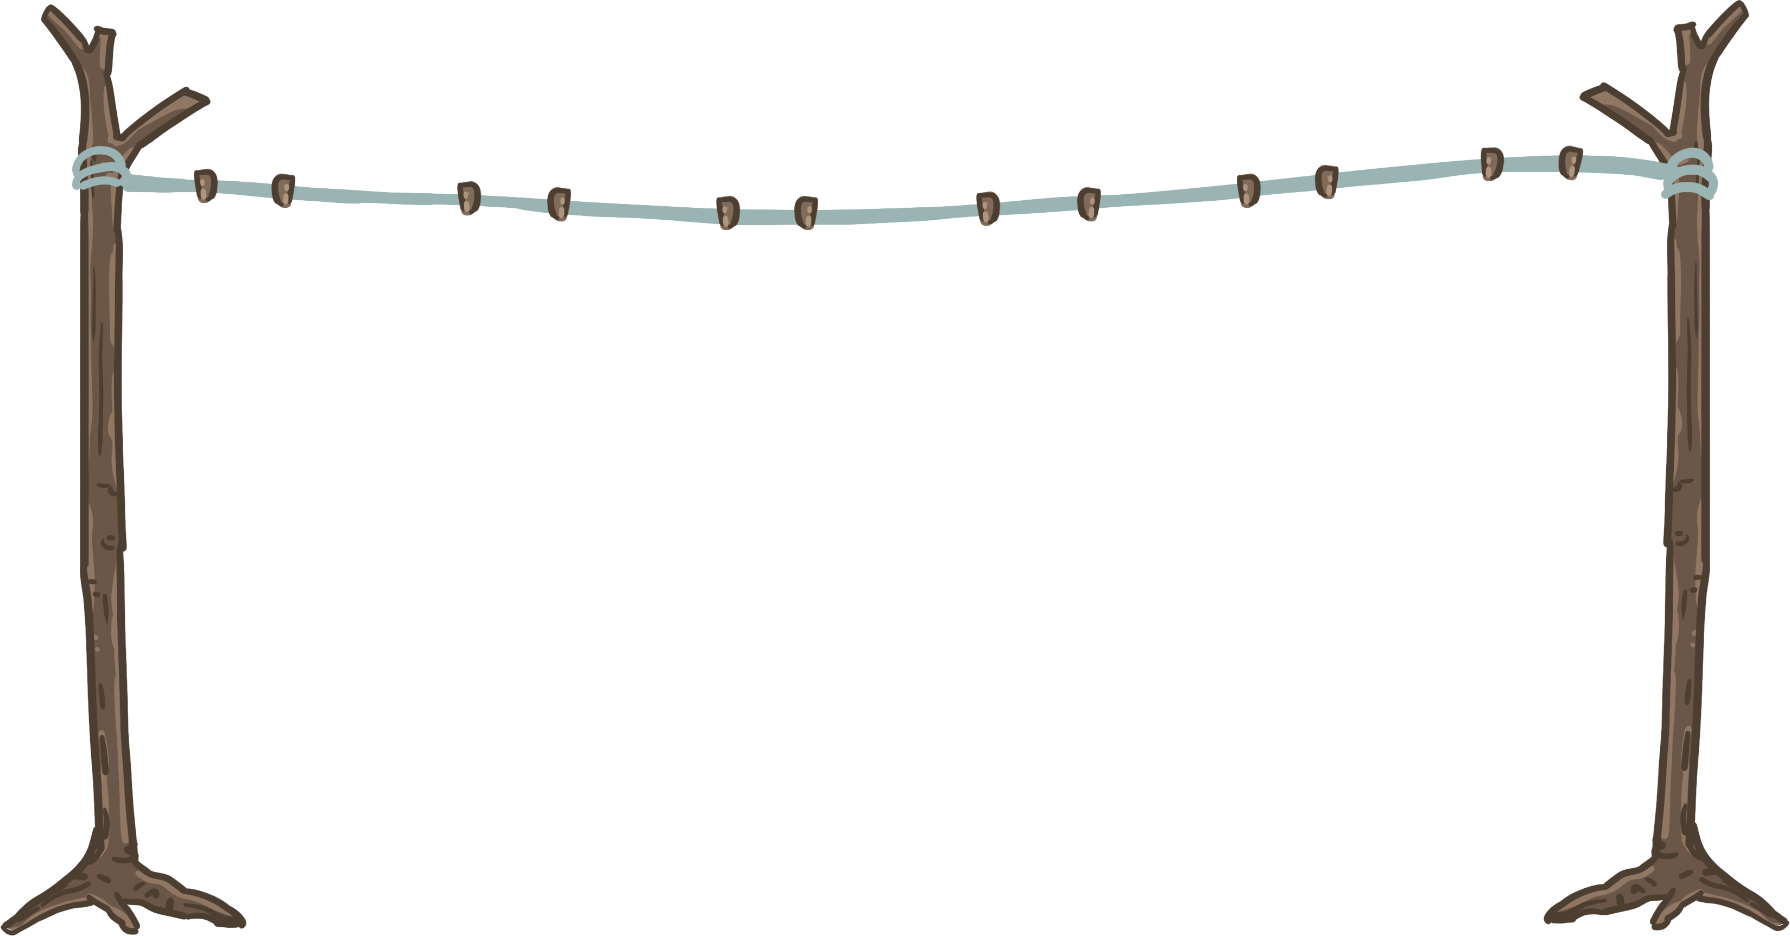
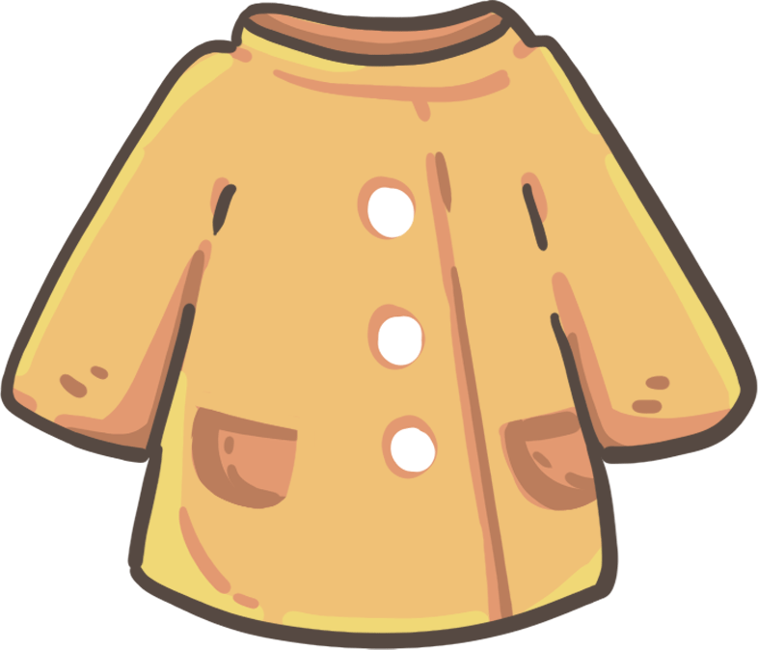
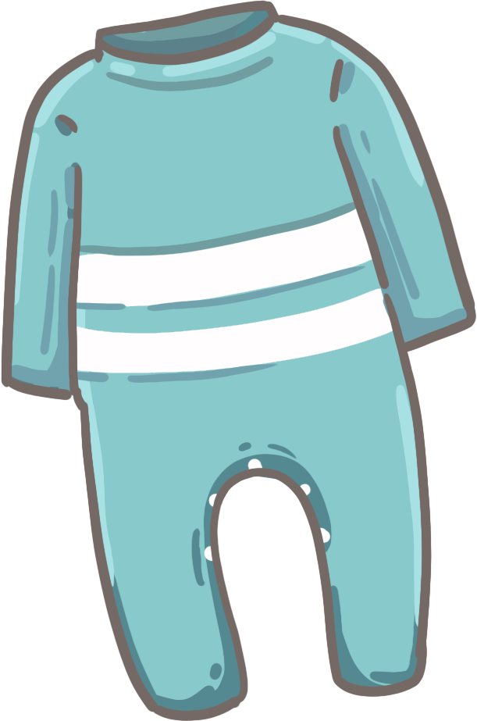
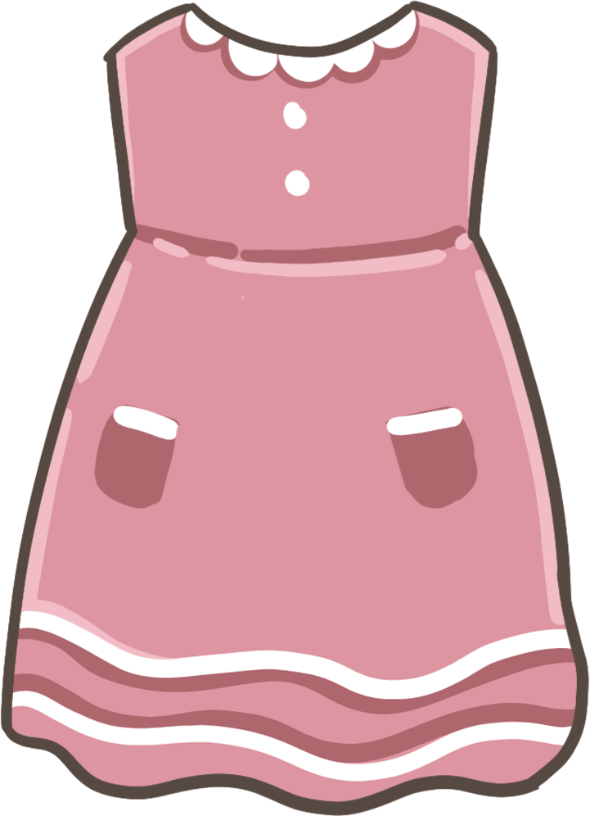
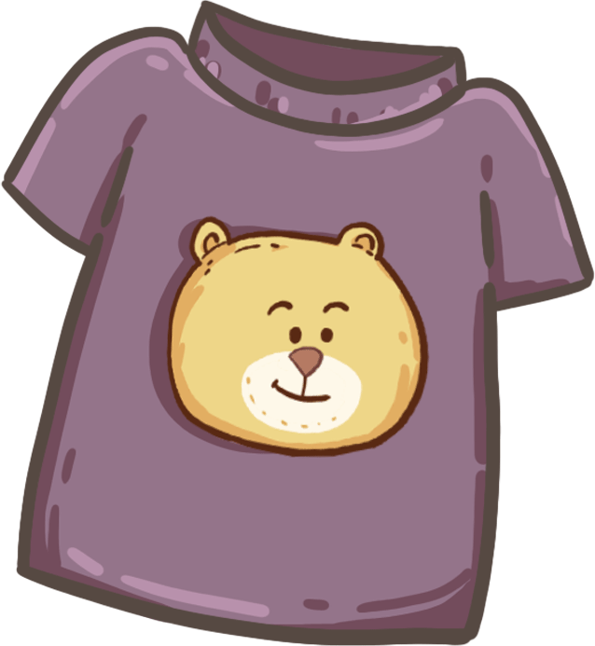
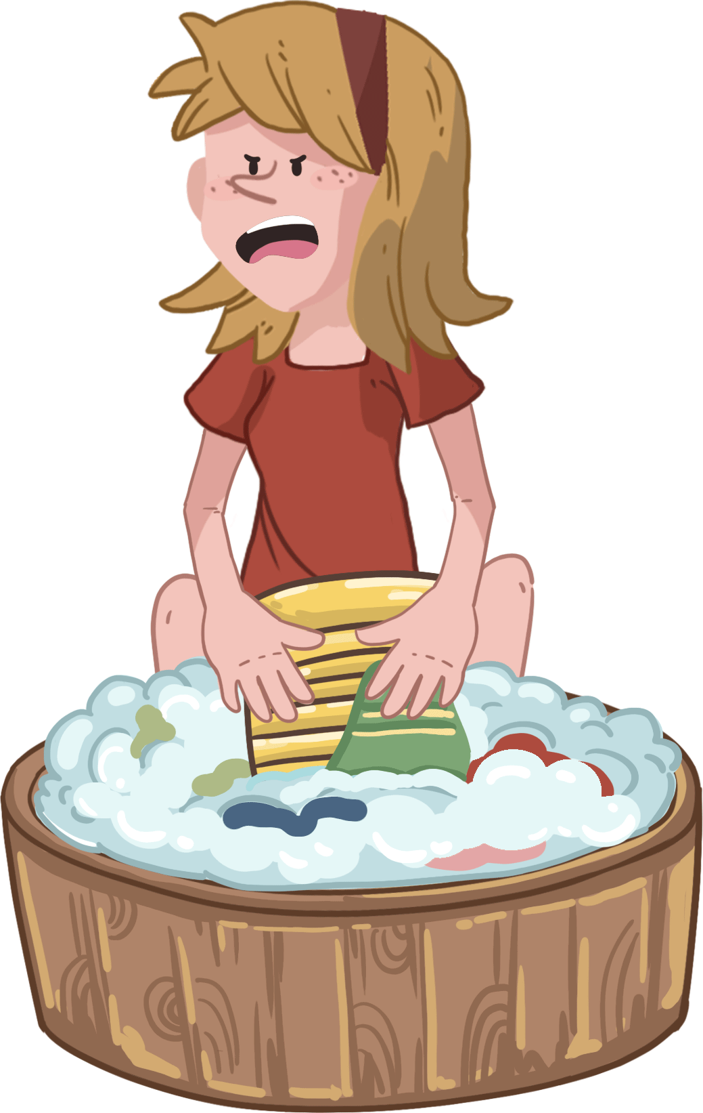
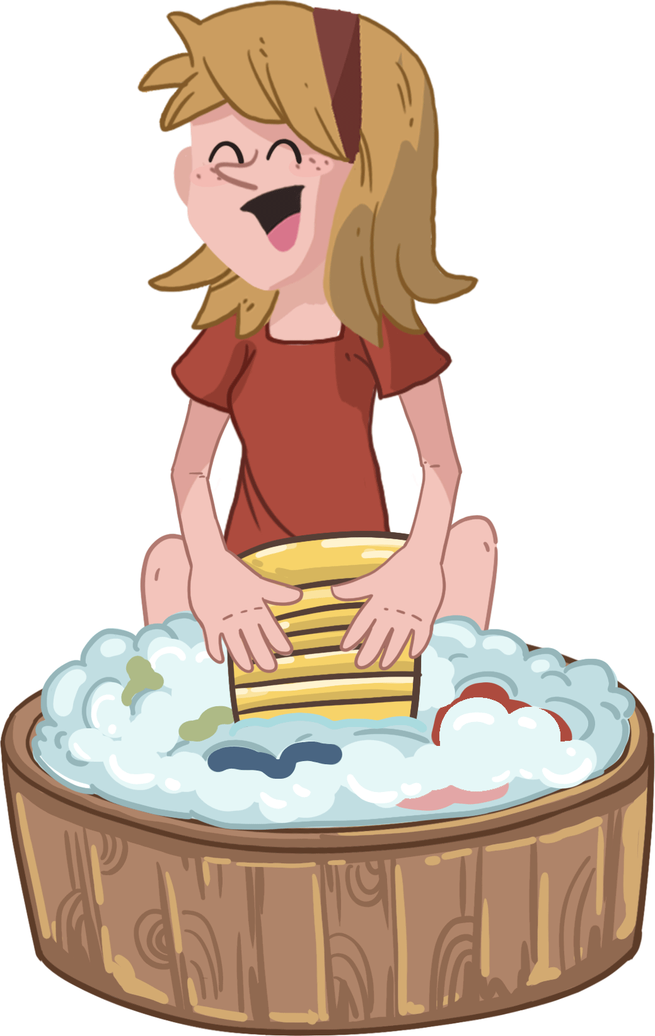
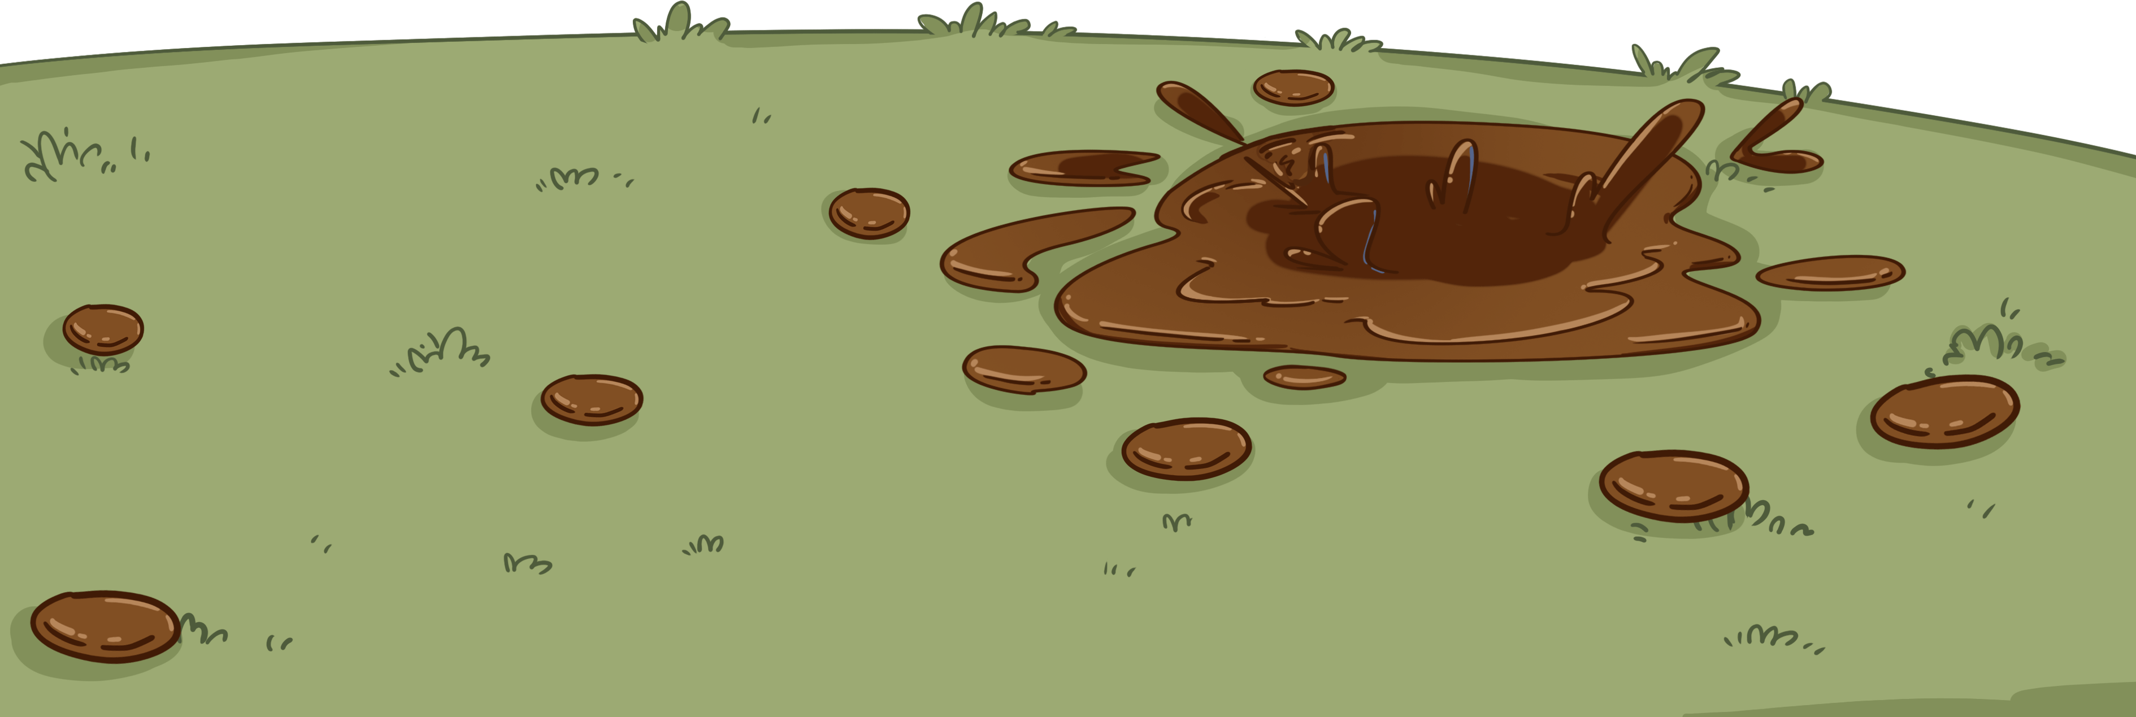
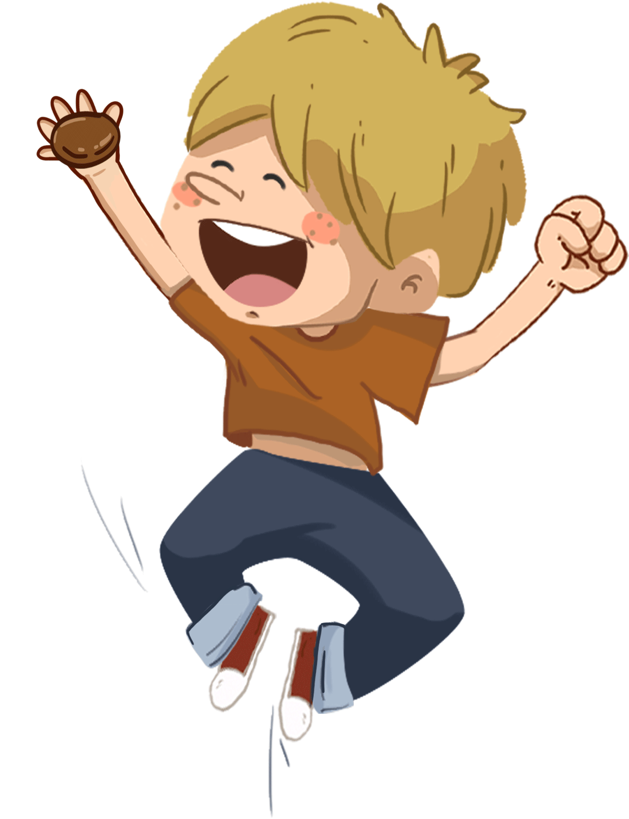
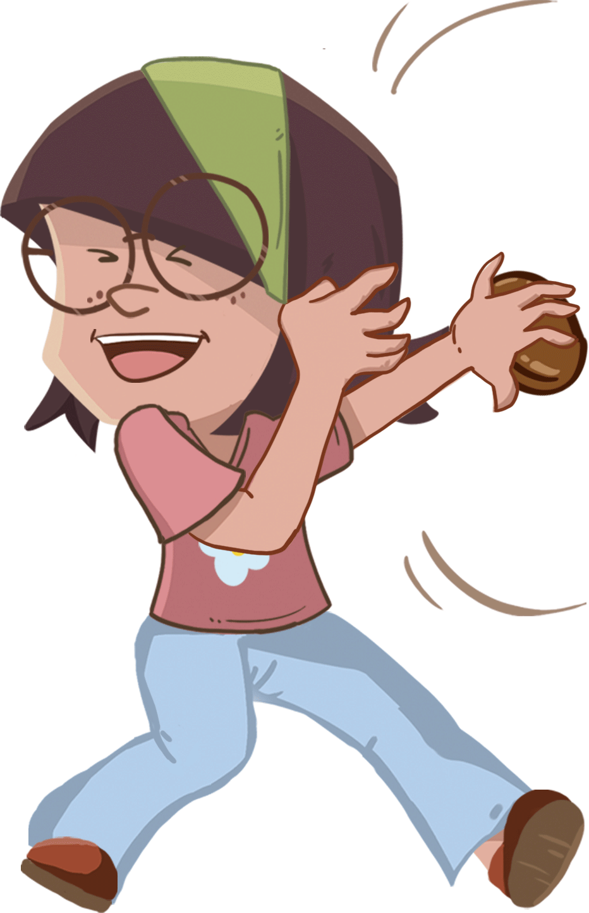
Phonics
TG
LO: Identify and pronounce the long vowel sound e in one-syllable words; know the spelling-
sound correspondences for the letter e and the long vowel sound e.
1. Ask Ss to talk about what they can see in the picture and to guess what the two children are
going to do; click and describe the action briefly.
2. Click and read the first three words to Ss; click and ask Ss the given question; guide Ss to
identify the sound of the letter e after reading the first three words; ask Ss to read the sound
of the letter e after you.
3. Click and read the rest of the words to Ss; ask Ss to say what sound the letter e makes.
4. Click and tell Ss that Mom is unhappy; guide Ss to find out that Mom is not happy because
the kids made the clothes dirty; ask Ss to answer the following question: “What should the
two children do next?”
Let’s listen!
What sound does the
letter e make?
we
he
Peter
Eve
me
she
Oh no!
2:30
5/28

Slide 6
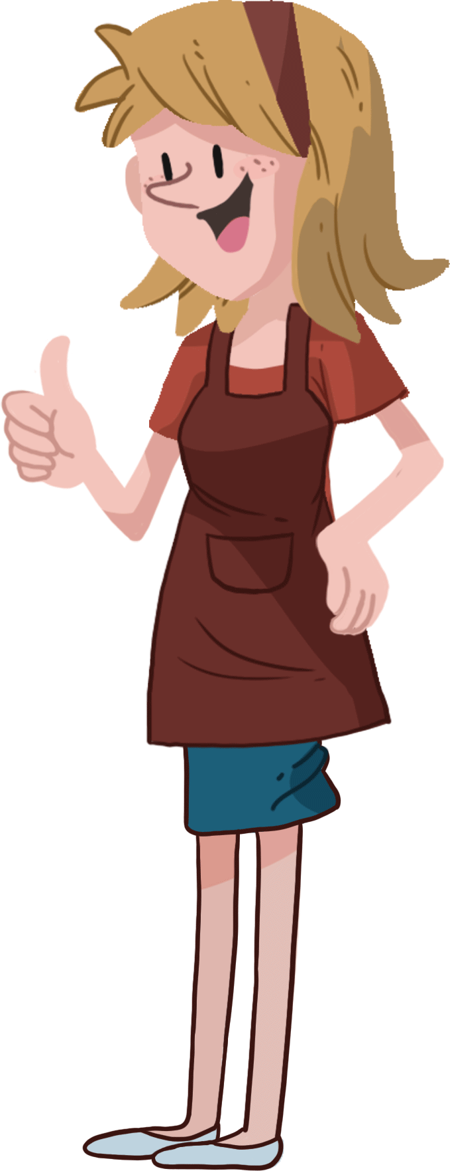
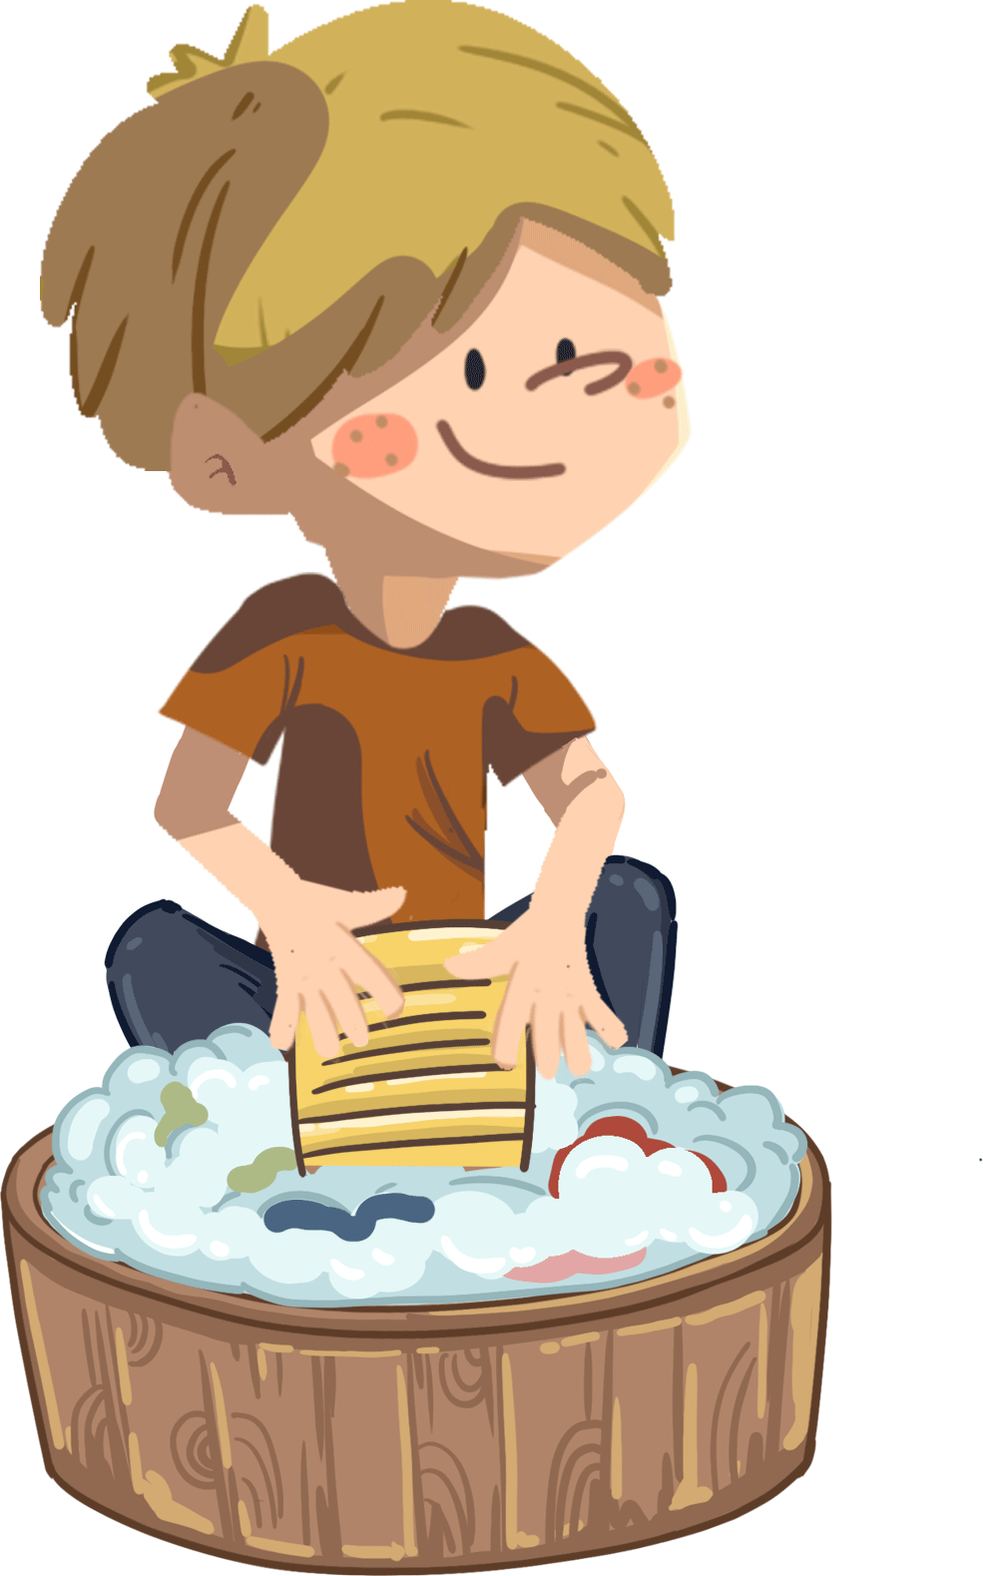
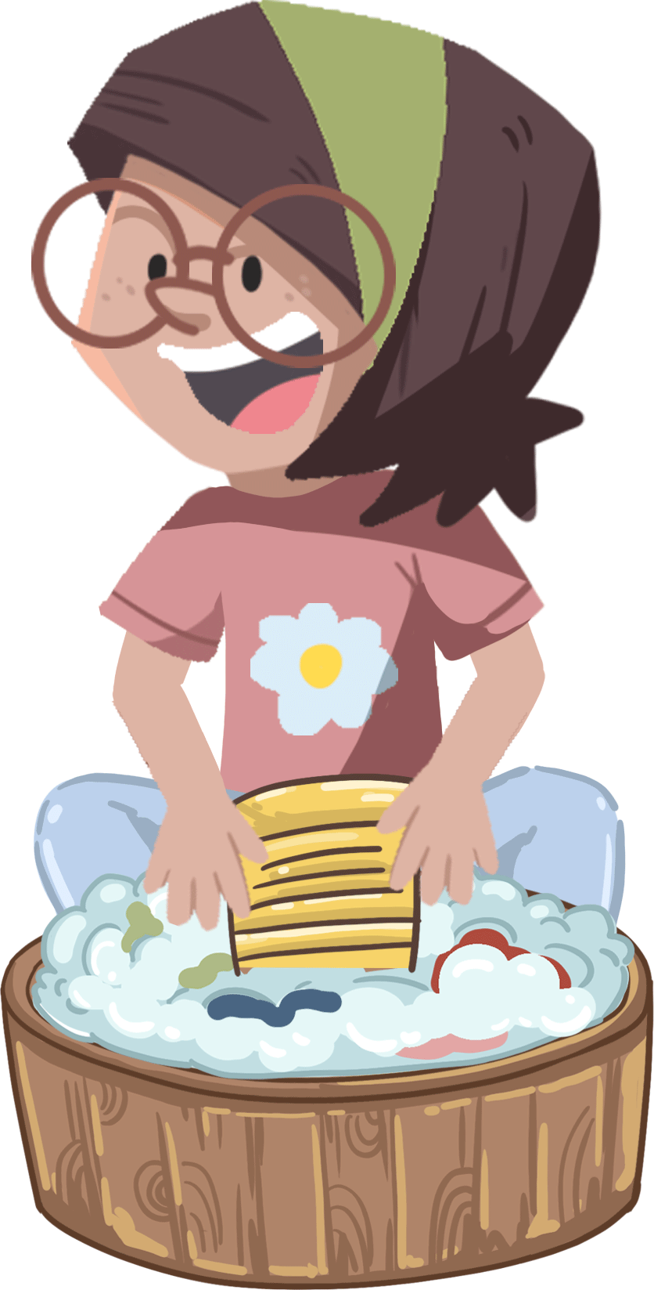
Phonics
TG
LO: Pronounce and decode the words with the long vowel sound e.
Decode the words like: e-we.
Ask Ss to talk about what the kids are doing; tell Ss that the two children are washing clothes to make their mom happy.
Click and then read the first word to Ss like: e-we; ask them to take turns repeating it; have Ss read the other words using the same method; help Ss to decode the words Eve and Peter if necessary.
Guide Ss to figure out if their mom is happy or not; guide Ss and help them see that their mom is happy because the kids made the clothes clean again. Encourage Ss to help their moms do some house chores.
Let’s speak!
we
he
Eve
me
she
Peter
What good children!
2:30
6/28

Slide 7
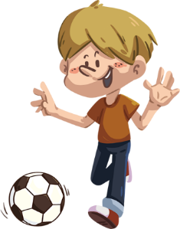
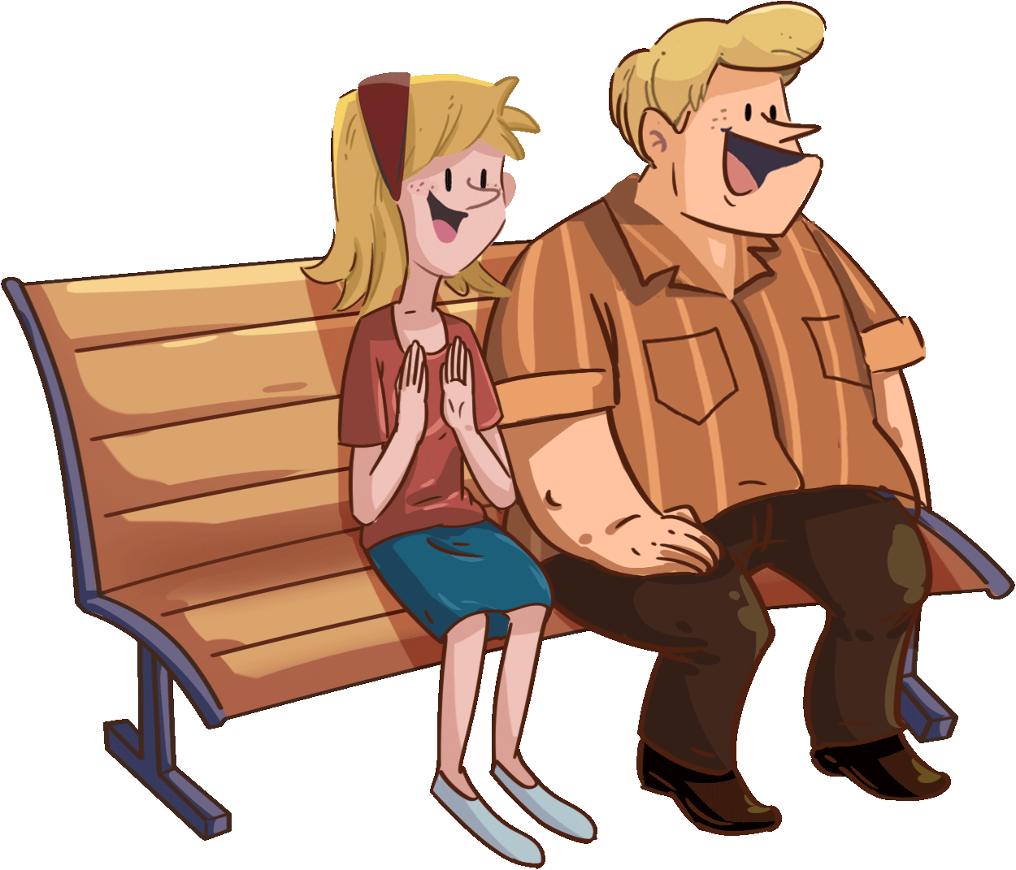
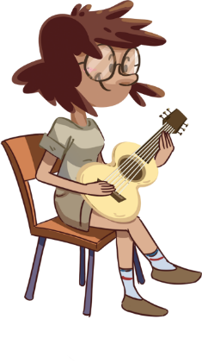
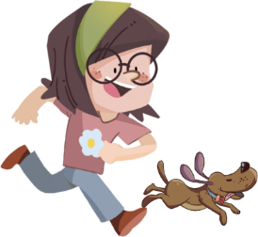
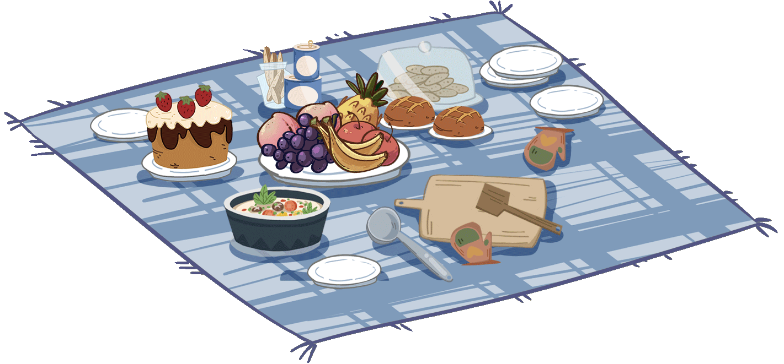
Phonics
TG
LO: Read the phonic story fluently; decode the words learned in the
text.
Click and read the phonics story to Ss with rhythm.
Guide Ss to take turns reading the highlighted words. Guide Ss to read together after you; ask them to take turns reading one sentence at a time; give feedback.
Let’s chant!
Peter and Eve, they like me.
One, two, three.
Meet my family.
Daddy and Mommy, he and she.
They all like me.
We are a happy family!
2:00
7/28

Slide 8
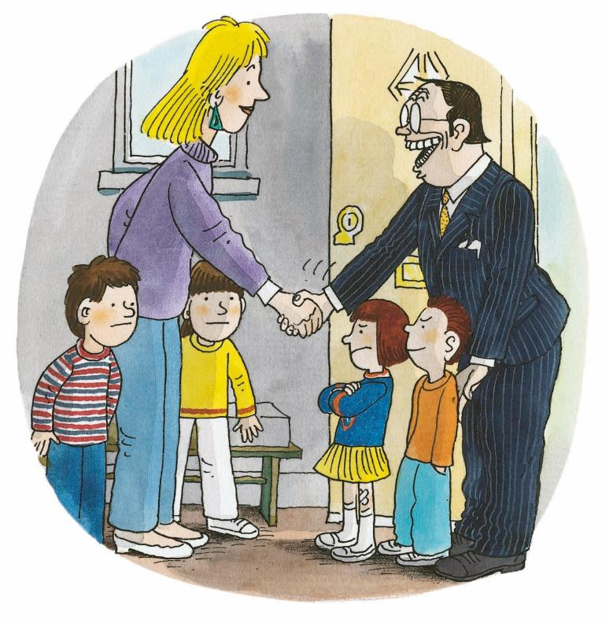
Let’s meet the characters!
Introduction
TG
LO: Get to know the main characters in the story.
1. Help Ss to recognize the main characters in the story.
2. Ask Ss to name the characters they know in the pictures
and match the pictures with their names on the right.
Mum
Chip
Biff
the boy
the girl
the man
0:30
8/29

Slide 9
LO: Get to know the title, author, and illustrator of the book; use
pictures to identify details and make predictions.
1. Ask Ss to think about what the author and illustrator refer to in
a book and ask Ss to point them out; click and display the
answer.
2. Have Ss look at the book cover closely and talk about what
and who they can see on the book cover.
3. Encourage Ss to talk about the given questions to make
some predictions and self-connections.
TG
Lead-in
Title: _________________
Author: _________________
Illustrator: _________________
Naughty Children
Roderick Hunt
Alex Brychta
Who do you think the naughty children are?
Connections
What naughty things did you do?
Written by Roderick Hunt
Illustrated by Alex Brychta
2:00
9/28

Slide 10
Let’s predict!
TG
Reading
LO: Make predictions about the story using the pictures; motivate
Ss’ interest in reading the story.
1. Ask Ss to explain what predicting means; remind them to make guesses
prior to reading the story by looking at the illustrations.
2. Model using They are . . . and Biff and Kipper will . . . to make predictions.
3. Have Ss talk about the given questions using the given sentence structures.
Before Reading
1. What are the children
doing in the picture?
2. Who will Biff and Kipper
tell about the naughty
children?
?
They are ____.
?
Biff and Kipper will ____.
2:00
10/28

Slide 11
Naughty Children
Reading
TG
LO: Identify the character and some details with prompts and support; read the text accurately.
1. Ask Ss to observe the illustration and identify the characters
they know; have Ss talk about the character questions and tell
them that characters are one of the main elements in a story.
2. Ask Ss to take turns reading the text. Have Ss talk about the
connections question.
Character
Who came to Biff’s home? What clothes were they wearing?
Look for clues in the illustration.
Connections
What do you do when you visit your friends?
Two children came.
2:00
11/28

Slide 12
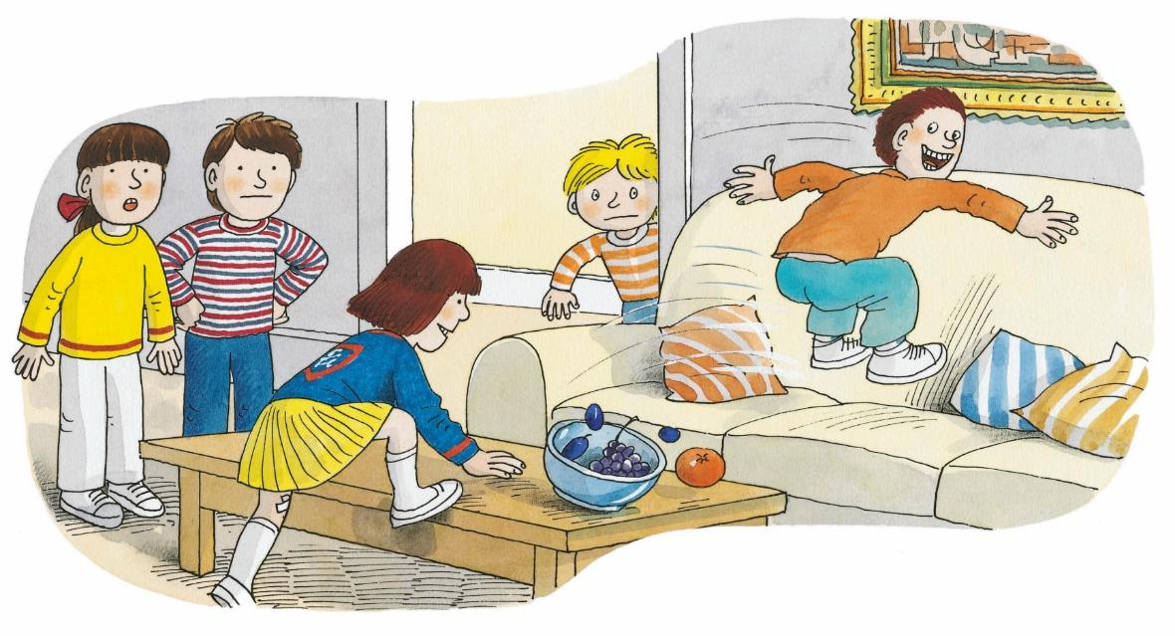
Naughty Children
TG
LO: Understand the meaning of the vocabulary word sofa and make
sentences with it; understand the meaning of the word furniture using
the illustration; identify the character and some details with prompts
and support; read the text accurately.
1. Read the text aloud to Ss.
2. Guide Ss to find the unfamiliar word furniture in the text. Guide Ss to figure out
its meaning using the illustration and context clues; guide Ss to find the word
sofa in the text; click the penguin button, explain it and have Ss read the word
and make sentences with it. Guide Ss to talk about the character question;
have Ss think and talk about the following question: “Were they naughty when
they climbed in the house?”
3. Ask Ss to work in pairs to talk about the connection questions.
Reading
Character
They climbed on the furniture.
Vocabulary
Who jumped on the sofa? What did he look like?
Connections
sofa
Did you climb on the furniture or jump on the sofa? How did you feel?
There is a red sofa in my home.
They jumped on the sofa.
sofa
2:30
12/28

Slide 13
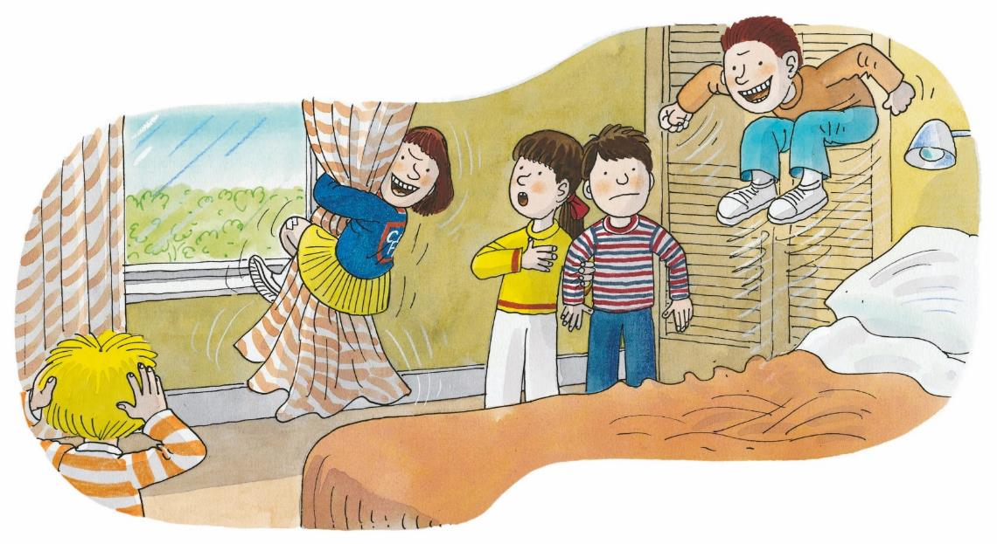
Naughty Children
LO: Understand the meaning of the vocabulary word curtains and make
sentences with it; identify the character and some details with prompts and
support; decode the sight word climbed accurately in the text.
1. Read aloud the text and ask Ss to look at the illustration;
2. Ask Ss to find the word curtains in the text and figure out what it refers to in
the illustration; click the penguin button and explain it; have Ss read the
word and make sentences with it.
3. Have Ss take turns talking about the comprehension question first; guide Ss
to talk about the character question; ask Ss to find the sight words in the text
and guide them to read it accurately;
4. Ask Ss to take turns reading the text fluently.
TG
Reading
Comprehension
Vocabulary
They climbed up the curtains.
What did the visiting children do?
Character
Which children do you think were naughty?
curtains
The curtains in my room are pink.
Sight words
climbed
They jumped on the bed.
curtains
2:30
13/28

Slide 14
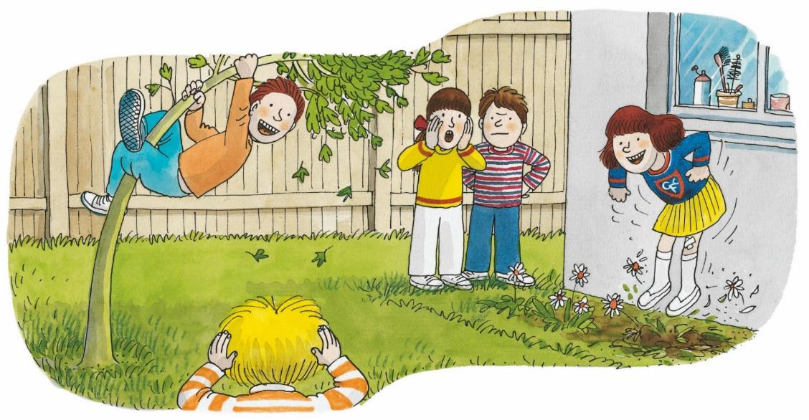
Naughty Children
Reading
TG
LO: Identify the details with prompts and support; read the text accurately.
1. Ask one S to read the text aloud and the other S to look at the
illustration.
2. Invite one S to talk about the first comprehension question; have Ss
take turns talking about the second comprehension question.
3. Have Ss do the decoding practice; give feedback.
Comprehension
They climbed up the tree.
Where were the naughty children? What did the naughty children do?
How did Biff, Chip, and Kipper feel?
Decoding
They jumped on the flowers.
Read accurately.
2:30
14/28

Slide 15
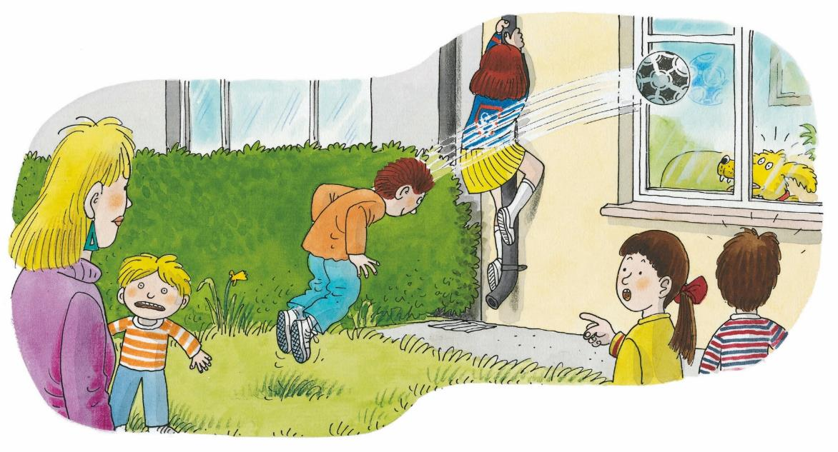
vs
Reading
TG
LO: Identify the character and some key details with prompts and support;
consolidate their realization about the theme of the story; read the text
fluently.
1. Have Ss observe the illustration carefully and talk about the character
question in turns.
2. Ask Ss to observe the illustration and answer the first question; encourage
them to find more clues about the first question. (Samples answers: The
window would be broken. The boy played with a ball. Floppy felt scared.);
guide Ss to answer the following question: “Were they naughty when they
kicked the ball in the yard?”
3. Ask Ss to talk about the second comprehension question with the help of
illustration and the text; have Ss read the text fluently in turns.
Naughty Children
Character
“Oh no!” said Mum.
Who can you see in the picture?
Comprehension
What do you think would happen to the window?
How did Mum feel when she said “Oh no”?
Biff had an idea.
2:00
15/28

Slide 16
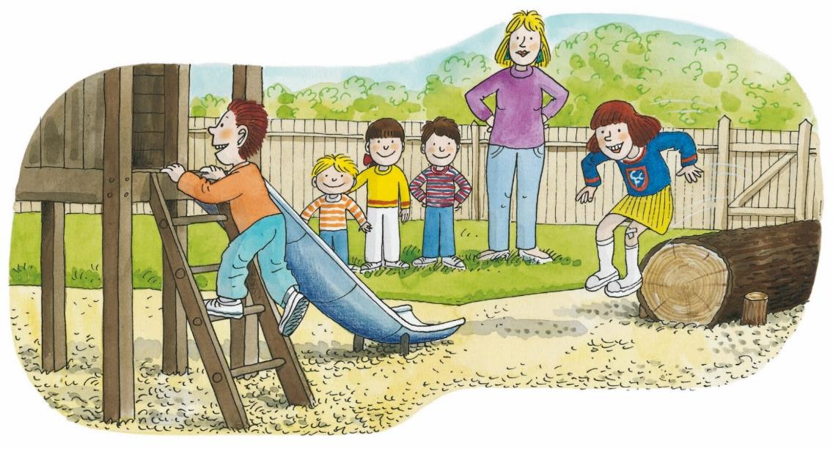
Naughty Children
Reading
TG
LO: Understand the meaning of the vocabulary words ladder and log and make
sentences with them; identify some details with prompts and support; decode the
sight word climbed accurately.
1. Read the text aloud and ask Ss to look at the illustration; ask each S to find the word
ladder or log in the text; click the penguin buttons and explain the words; have Ss read
the words and make sentences with them.
2. Guide Ss to talk about the two comprehension questions; guide Ss to talk about the
following question: “Were they naughty when they climbed in the playground?”
(Sample answer: No, they were not naughty children.)
3. Have Ss find the sight word climbed and read it accurately in text;
have Ss read the text aloud to each other accurately and fluently.
Comprehension
Vocabulary
They climbed up the ladder.
Vocabulary
What did the naughty children do? Where were they?
How were Chip, Biff, and Kipper feeling on this page?
log
ladder
There is an old log in my yard.
There is a ladder in my home.
Sight words
climbed
They jumped off the log.
2:30
ladder
log
16/28

Slide 17
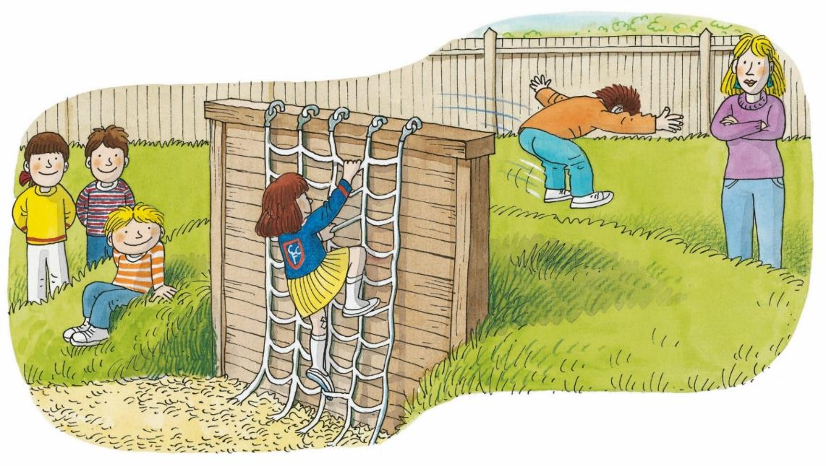
Naughty Children
LO: Understand the meaning of the vocabulary words net and wall and make
sentences with them; identify some details with prompts and support; read the
text accurately.
1. Have Ss read the text in turns and talk about the first comprehension question;
2. Ask each S to find one of the following words: net or wall; click the penguin buttons
and explain the key words; have Ss read the words and make sentences with them.
3. Guide Ss to talk about the second comprehension question using the illustration.
TG
Reading
Comprehension
Vocabulary
Vocabulary
They climbed on the net.
What did the naughty children do? Which words in the story tell us this?
How did Mum feel?
wall
net
Connections
The wall in my home is very old .
There is a blue net in my yard.
Did you jump off the wall? What fun things do you like to do outside?
They jumped off the wall.
3:00
net
wall
17/28

Slide 18
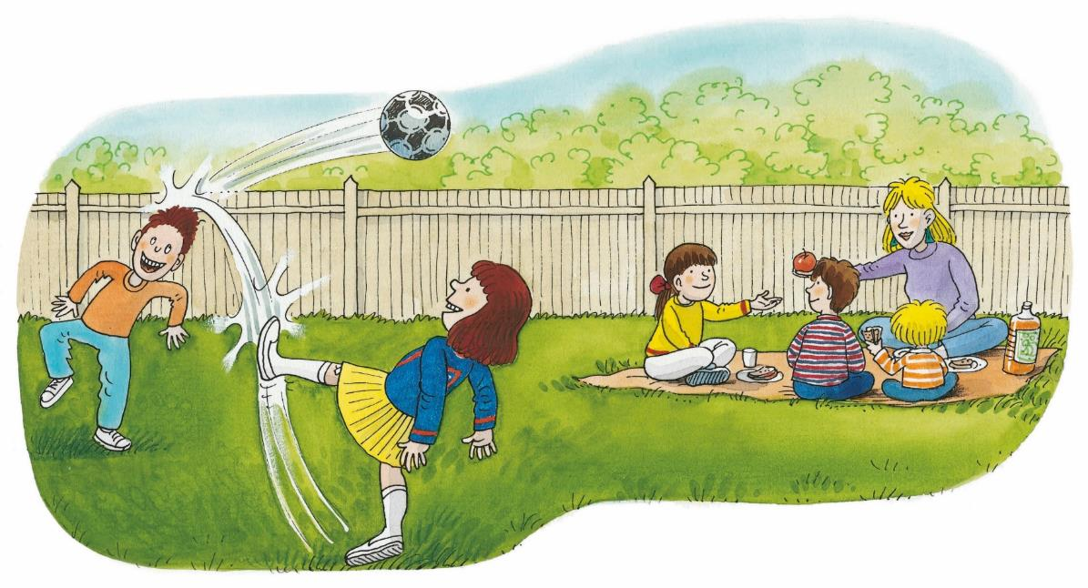
Naughty Children
Reading
TG
LO: Identify key details with prompts and support; read the text
accurately and fluently.
1. Read the first sentence to Ss and ask them to look at the illustration
closely; encourage Ss to talk more about the first question;
2. Ask Ss to read the second sentence in unison; have them talk about the second
comprehension question;
3. Have Ss do the decoding practice in turns and read the text accurately and
fluently.
Everyone was happy.
Comprehension
1. Was Biff’s idea good?
How did everyone
feel?
2. What did Mum say?
Decoding
“What good children!”
said Mum.
Read accurately.
2:00
18/28

Slide 19
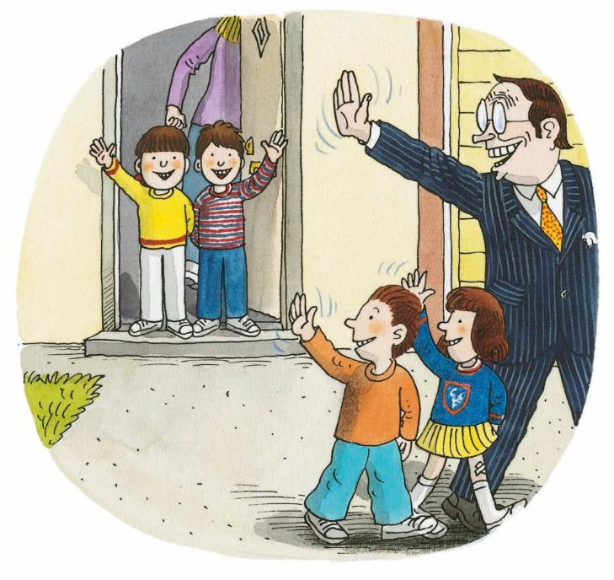
Naughty Children
Reading
TG
LO: Identify key details with prompts and support; read the text fluently.
1. Ask Ss to take turns reading the text aloud.
2. Have Ss observe the illustration and talk about the first
comprehension question in pairs;
3. Have Ss talk about the second comprehension question using the
illustration and text; Have Ss work in pairs to discuss the last question.
Comprehension
Would Biff and Chip want the naughty children to come to their home again? Why?
Why do you think the book is called Naughty Children?
The children went home.
2:00
19/28

Slide 20
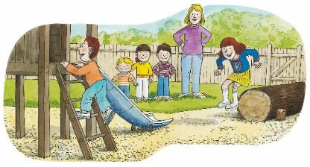
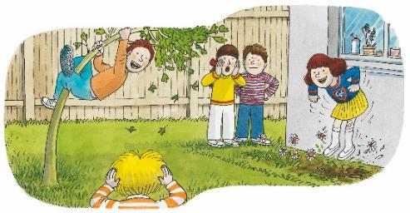
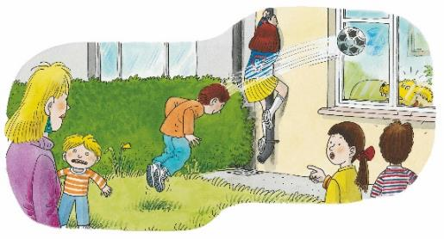
Let’s retell!
Reading
TG
LO: Retell the story with the visual support and assistance; help Ss
to consider the moral of this lesson: behave properly.
1. Guide Ss to recall the story; model first.
2. Have Ss work together to retell the story in turns using the
illustrators and the sentence structures. Assist them if
necessary.
They climbed on/up ____. They jumped on/off ____.
2:30
20/28

Slide 21
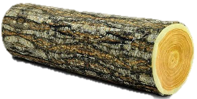
TG
Vocabulary
LO: Check their understanding of the words in this lesson.
1. Ask Ss to compete and review all the learned words in this lesson by
playing the turntable game. The first step: click the needle first and ask Ss
to guess what the word is with the help of the capital letter when the
needle stops.
2. The second step: click to show the picture to help Ss name the words. The
third step: click to show the word and ask Ss to read the sentences in
pairs. (Tips: 1. Six words; 2. click the needle first before guessing the words
each time.)
3. Announce the winner of the competition. If time is limited, skip this section.
.
Let’s play!
L(3)
curtains
W
sofa
C
wall
net
log
L(6)
N
ladder
S
1:00
21/28

Slide 22
Listening &
Speaking
TG
LO: Use the given sentence patterns to talk about what the
naughty children did in the story.
Have Ss work in pairs to talk about the given illustration using the sentence structure and helping words; model first.
Assist Ss if necessary.
Let’s talk!
—What did the naughty children do?
climbed on/up _____.
jumped on/off _____.
—They
Helping Words
sofa
curtains
wall
net
log
ladder
2:00
22/28

Slide 23
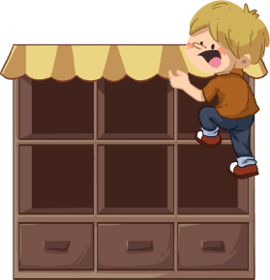
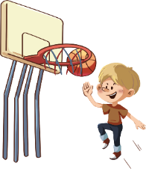
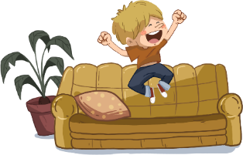
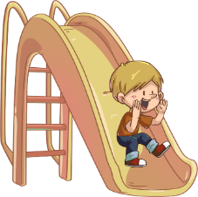
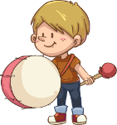
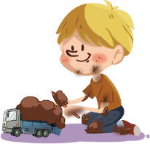
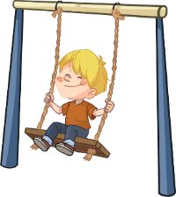
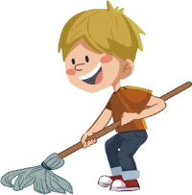
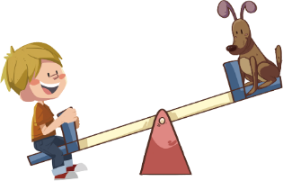
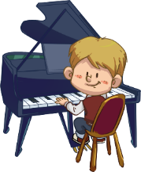
Listening &
Speaking
TG
LO: Use the sentence patterns to talk about the picture and what the
boy does at home.
1. Ask Ss to talk about where it is; encourage them to look at the
illustration closely and find as many of the boy’s home activities as
they can. Ask each of them to name at least three activities.
2. Ask Ss to work in pairs to ask and answer questions about the given
illustration using the given language structure; model first.
3. Assist Ss if necessary.
Notes: T can click Let’s Talk to present the sentence structure, and T
can click again to make it disappear.
Let’s talk!
—What do you do at home?
—I ________ at home.
Please name at least three
activities.
play on the swing;
jump on the sofa;
play basketball
. . .
2:30
23/28

Slide 24
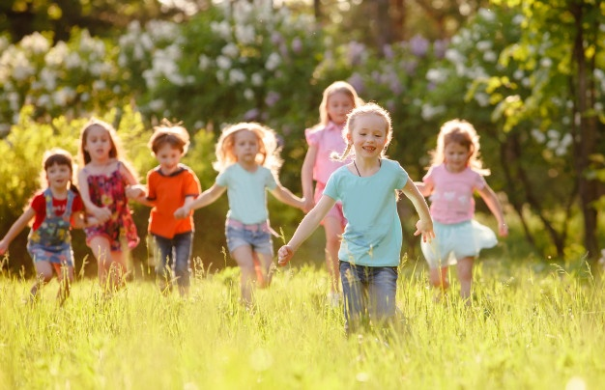
TG
Value
LO: Talk about the value of behaving properly as shown
in this lesson.
1. Ask Ss about the given task; model first.
2. Guide Ss to talk about the question with the help of the
given pictures. Encourage Ss to talk more about
behaving properly.
Name the things you can do outside the classroom but not in the classroom.
run in the classroom
run outside the classroom
2:00
24/28

Slide 25
LO: Talk about what they’ve learned from the story using the
given structure and language support.
1. Guide Ss to talk about what they’ve learned about the naughty
children.
2. Ask Ss to think about the given questions; help Ss to organize ideas
from the story with the given visual support and tell them, “This is a
practice before your homework.”
3. Model the first question, and then ask Ss to take turns presenting
their answers.
TG
Oral Writing
Get ready to present！
They climbed
up the ______.
They jumped off the _____.
They climbed
on the ______.
They jumped on the ____.
What did the naughty children do on the playground?
What did the naughty children do in the house?
2:00
25/28

Slide 26
LO: Understand what the homework is.
1. Explain the writing task to Ss and check their understanding.
2. Tell Ss that they should finish their writing before next class.
Make sure they know they can send their homework to the
platform. They will present their work next class.
3. Remind Ss to watch the post-class video and finish the
writing task.
TG
Writing
Opinion Writing
Let’s draw and write!
What’s your favorite place
at home?
Now, please follow the steps to finish your homework, and present it in the next class:
Draw a picture of your favorite place at home.
Write at least two words to describe it.
Watch the post-class video about the writing task.
0:30
26/28

Slide 27
TG
Review
LO: Review today’s lesson.
1. Guide Ss to review the phonics.
2. Guide Ss to review the words.
3. Guide Ss to review the sentence structures.
Let’s Review
Review
Phonics:
Eve/he/she/we
Peter/me
Sentence Structures:
They climbed on/up ____.
They jumped on/off ____.
Vocabulary: sofa/curtains/ladder
wall/net/log
27/28
1:00

Slide 28
LO: End the lesson and encourage Ss to perform
better in the next class.
1. Give brief comments on Ss.
2. Say goodbye to students.
3. Ask Ss to preview the next lesson.
TG
0:30
28/28

