Slide 1
Look at me!
Chapter 6, Book 1A
Longman Welcome to English Gold

Slide 2
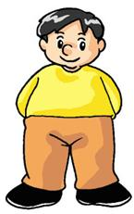
About yourself
I am fat.
I have small ears.
I have a big nose.

Slide 3
About yourself
He is short.
He has big ears.
He has small eyes.

Slide 4
Describing people
fat.
thin.
tall.
short.
I
am
He
She
is
long
short
big
small
I
have
hair.
eyes.
ears.
He
She
has
big
small
nose.
mouth.
a

Slide 5
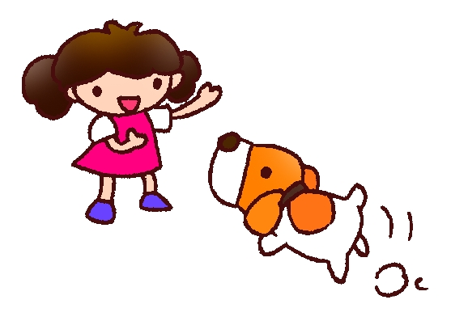
Click the correct words.
1 I am (tall / short).
2 She is (tall / short).

Slide 6
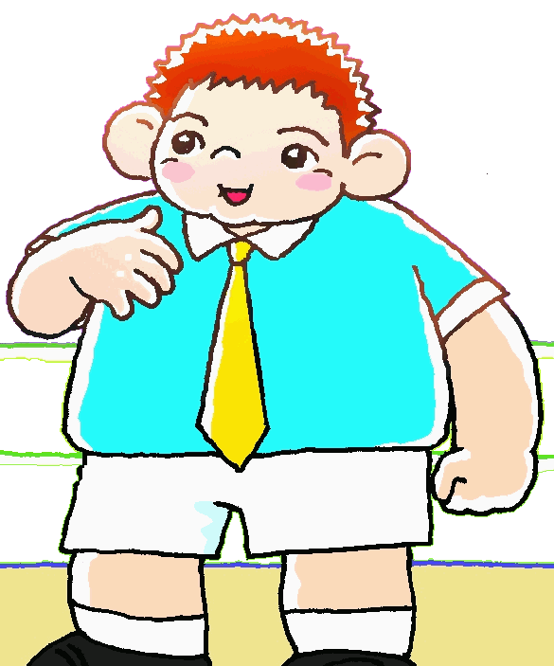
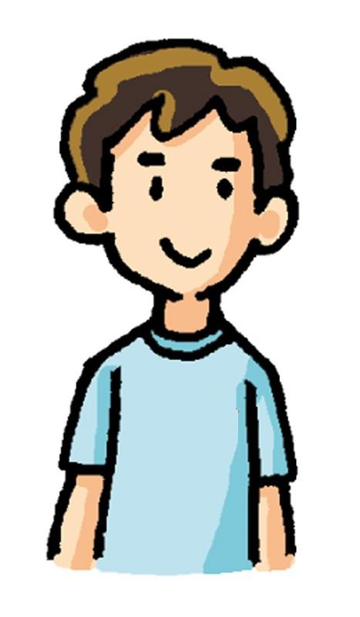
Click the correct words.
3 I am (fat / thin).
4 He is (fat / thin).

Slide 7
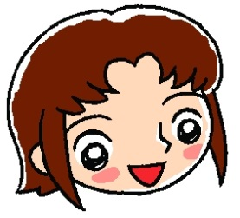
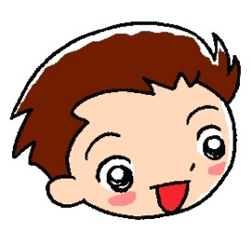
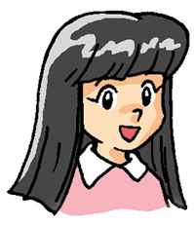
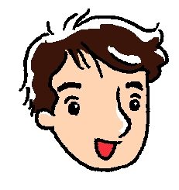
Click the correct words.
5 She has (big / small) eyes.
6 He has a (small / big) nose.
7 She has (long / short) hair.
8 He has (big / small) ears.

Slide 8
THE END

