Slide 1
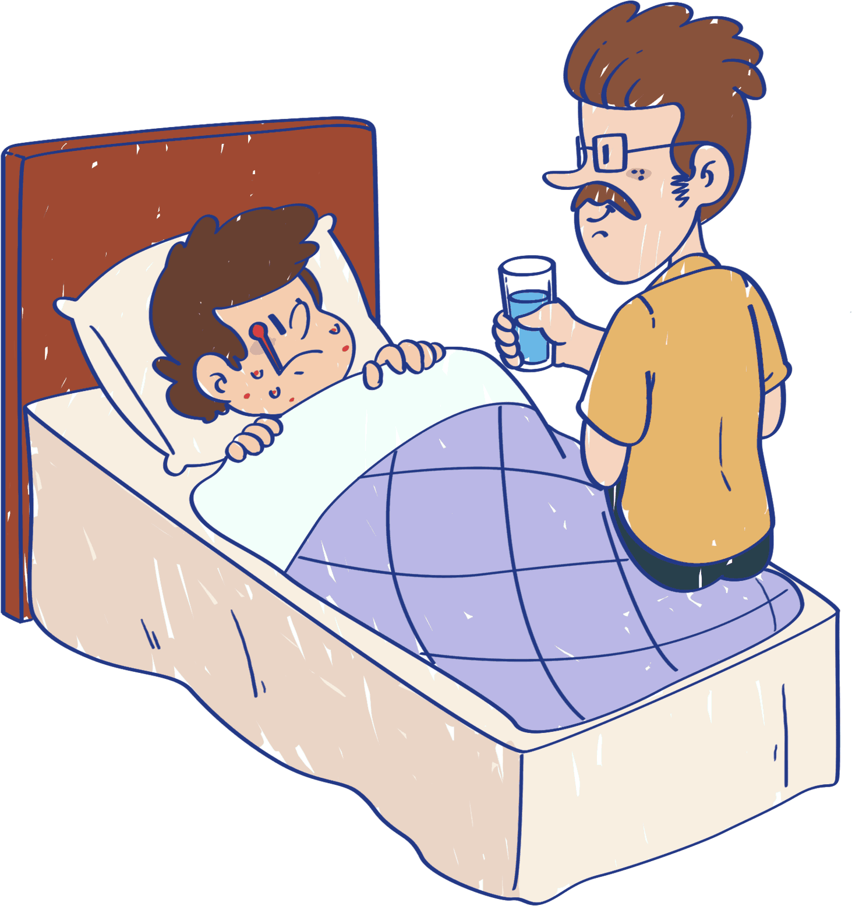
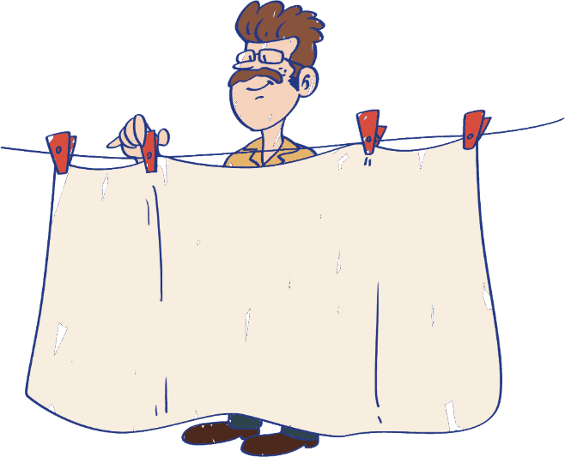
LO: Greet their partners; get a basic idea about the topic of today’s lesson.
Say hello to Ss; ask Ss to greet each other.
Guide Ss to describe the pictures on the cover.
Introduce the topic of the lesson.
TG
ORT-GKA
Lesson 20
Spots!
1:00
1/26

Slide 2
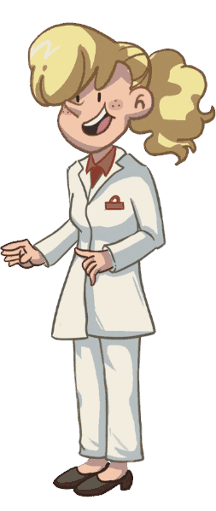
Learning
Goals
TG
LO: Get to know and understand what will be
learned in this lesson.
Go through the learning goals with Ss.
We are
going to . . .
Blend and segment onsets and rimes by saying words aloud.
Learn the different words and phrases spots, doctor, washing, looked after, and better, and make sentences with them.
Read the story Spots! and identify the characters in the story.
Practice using the sentence structure Dad put _____ out. & Dad went _____.
0:30
2/26

Slide 3
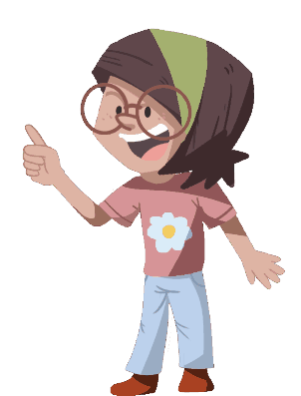
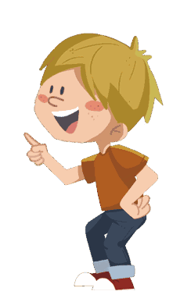
LO: Present and share the writing assignment from last lesson.
Invite Ss to take turns presenting their homework. If time is limited, tell Ss they have one or two mins to present their writing.
Encourage Ss to listen carefully and to ask questions.
After both of the Ss have finished, give them feedback and awards (click the picture of the book beside the boy or the girl so that they can get some awards).
Note: You can click the picture of the boy or the girl to give each S a trophy to mark their good performance.
TG
Presentation
Let’s show!
This is something we can use to take care of our teeth.
2:00
3/26

Slide 4
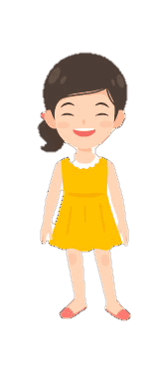
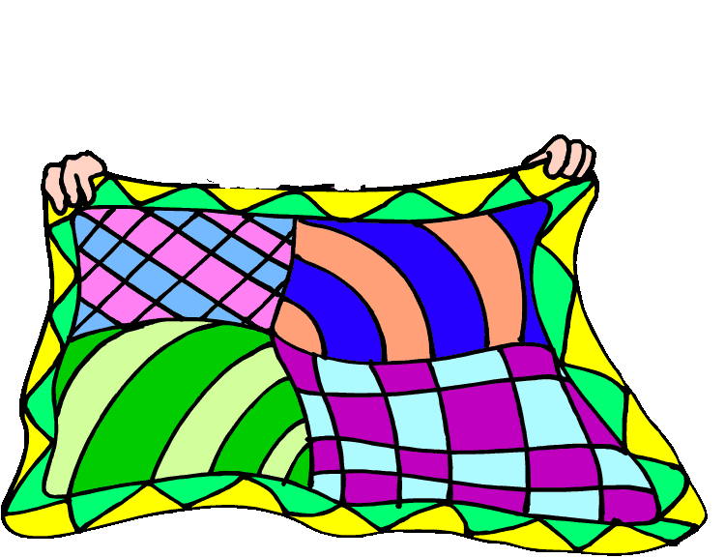
Phonics
TG
LO: Blend and segment onsets and rimes of single-syllable words.
Ask Ss to talk about what they see in the picture; click and tell them to help the mom cheer up the sick boy in the picture.
Click and read each word; and ask Ss to repeat.
Click and guide Ss to identify and pronounce the onsets and rimes of words like this: c-ar, car; click and show the toys for the sick boy in the picture.
Click and ask Ss to blend the onsets and the rimes again; click and ask Ss to help the mom cheer up the sick boy in the picture.
Note: Each of the three words has the same operational process; Ss will learn three words on this slide.
Let’s listen and speak!
car
c
ar
cat
c
at
Can you blend the onsets and rimes?
Can you say the onsets and rimes of the words?
Let’s cheer him up!
Can you read the words?
can
c
an
2:30
4/26

Slide 5
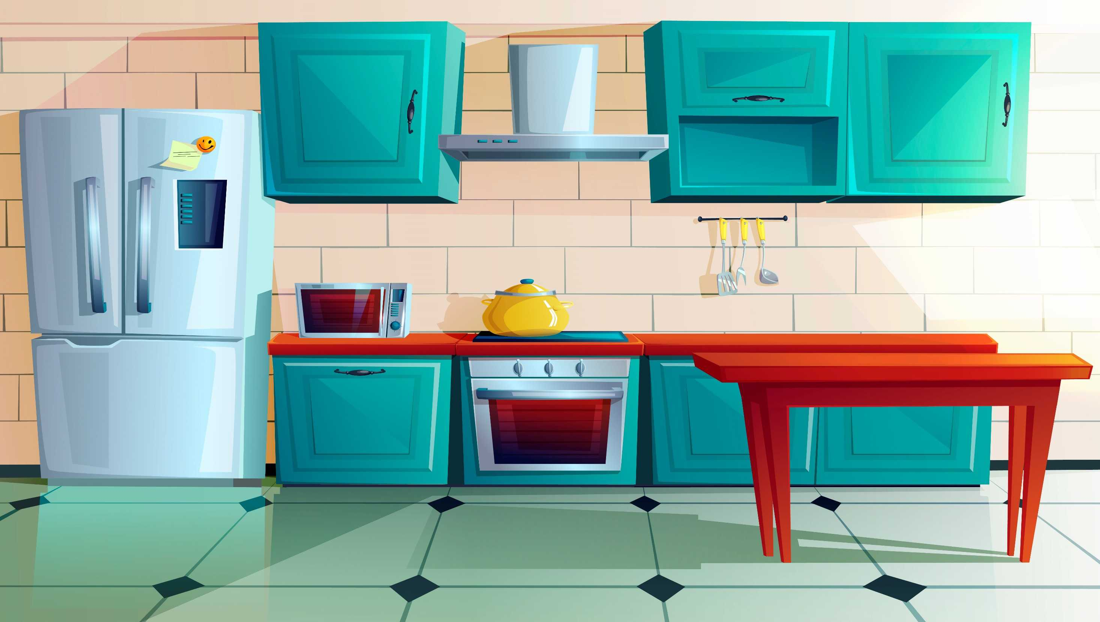
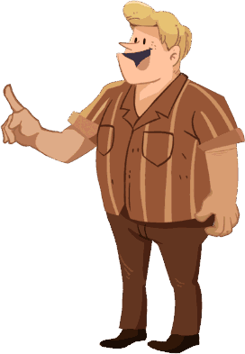
Phonics
TG
LO: Blend and segment onsets and rimes of single-syllable words.
Ask Ss to talk about what they see in the picture; click and tell them to help dad peel the fruit for the sick boy in the picture.
Click and read each word; and ask Ss to repeat.
Click and guide Ss to identify and pronounce the onsets and rimes of words like this: pl-ain, plain; click and peel the fruit for the sick boy in the picture.
Click and ask Ss to blend the onsets and the rimes again; click and ask Ss to give the fruit to the sick boy in the picture.
Note: Each of the three words has the same operational process; Ss will learn three words on this slide.
Let’s listen and speak!
plain
pl
ain
train
tr
ain
vain
v
ain
Can you say the onsets and rimes of the words?
Can you blend the onsets and rimes?
Let’s peel the fruit for the boy!
Can you read the words?
2:30
5/26

Slide 6
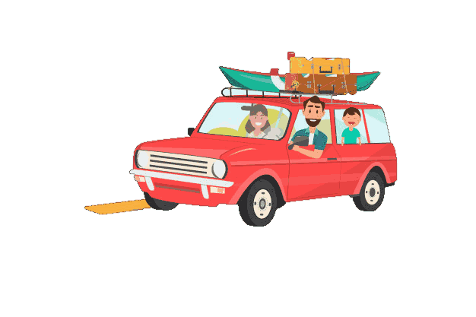
Phonics
TG
LO: Read the text fluently; decode words together.
Click and read the text to Ss with rhythm.
Guide Ss to repeat after you; ask one S to read one sentence, and the other to read the next until they finish reading the text; give feedback.
Guide Ss to decode the words together.
Let’s chant!
There is a plain.
On the plain runs a car and a train.
In the car sits a cat.
Cat, cat, can the car catch up to the train?
Oh, no, it will be in vain.
2:00
6/26

Slide 7
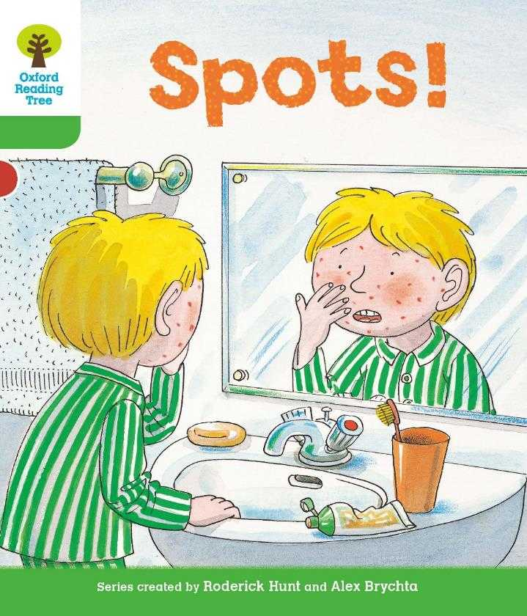
Lead-in
TG
LO: Activate Ss’ interest in reading; use the illustration and the title to identify details and to make predictions; make connections.
Have Ss look at the book cover closely and have Ss talk about the first two questions by using the illustration and the title.
Ask Ss to talk about the connections question; assist them if necessary.
Before Reading
What is wrong with Kipper?
What do you think Kipper is thinking when he looks in the mirror?
Connections
When was the last time you were sick? What was wrong? How did you get better? Who helped you?
Written by Roderick Hunt
Illustrated by Alex Brychta
2:00
7/26

Slide 8
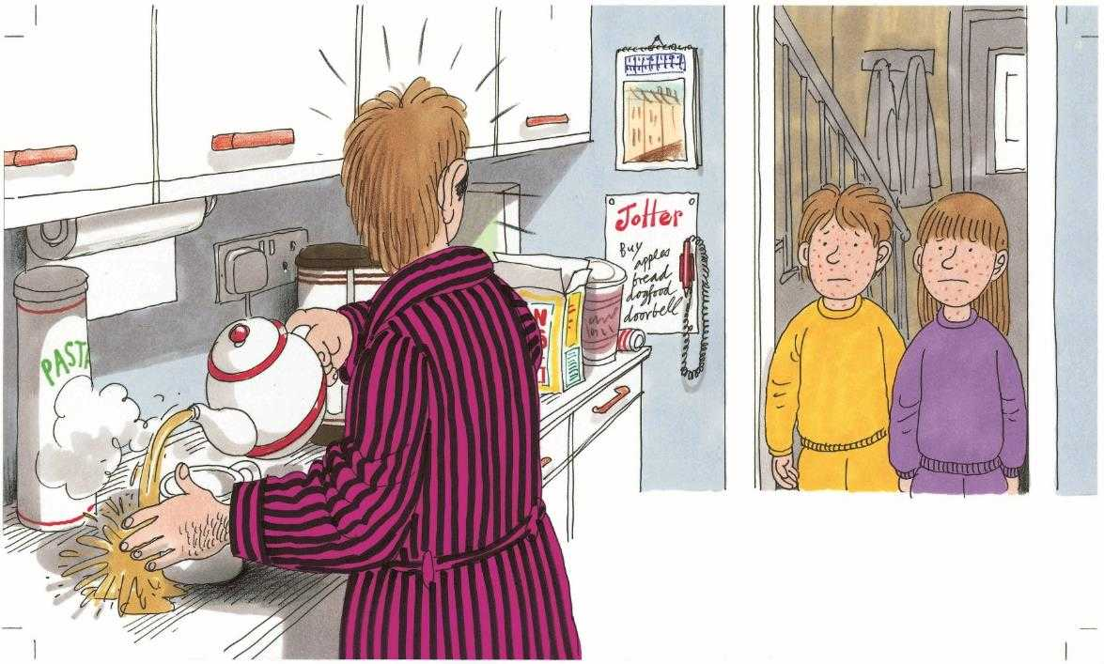
LO: Identify details and make predictions about the story by using the illustration; motivate Ss’ interest in reading the story.
Ask Ss to recall what it means to predict.
Have Ss look at the illustration carefully and have Ss talk about the given questions.
TG
Reading
Let’s predict!
Before Reading
What is wrong with Biff and Chip?
What do you think Dad will do next?
2:00
8/26

Slide 9
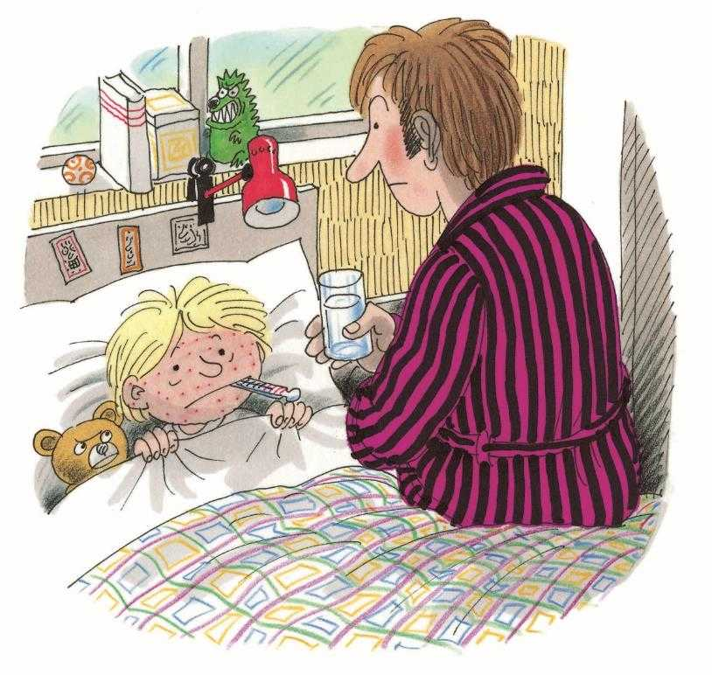
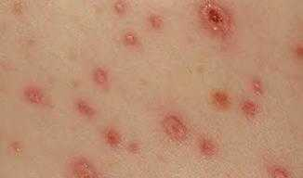
LO: Understand the text; understand the meaning of the vocabulary word spots, and make sentences with it; identify the characters of the story by using the text and the illustration; read the text fluently;
Have Ss read the text together; click the penguin button and explain the word spots; have Ss read the vocabulary word and have Ss make sentences with it.
Ask Ss to identify the character of the story by using the illustration and context clues.
Ask Ss to talk about the comprehension questions by using the text and the illustration.
Ask Ss to take turns reading the text aloud.
TG
Reading
Spots!
Characters
Who had spots first in the family?
Vocabulary
Comprehension
How did Kipper feel?
What did Dad do? How did he feel? Why?
spots
There are some red spots on the skin.
Kipper had spots.
spots
2:30
9/26

Slide 10
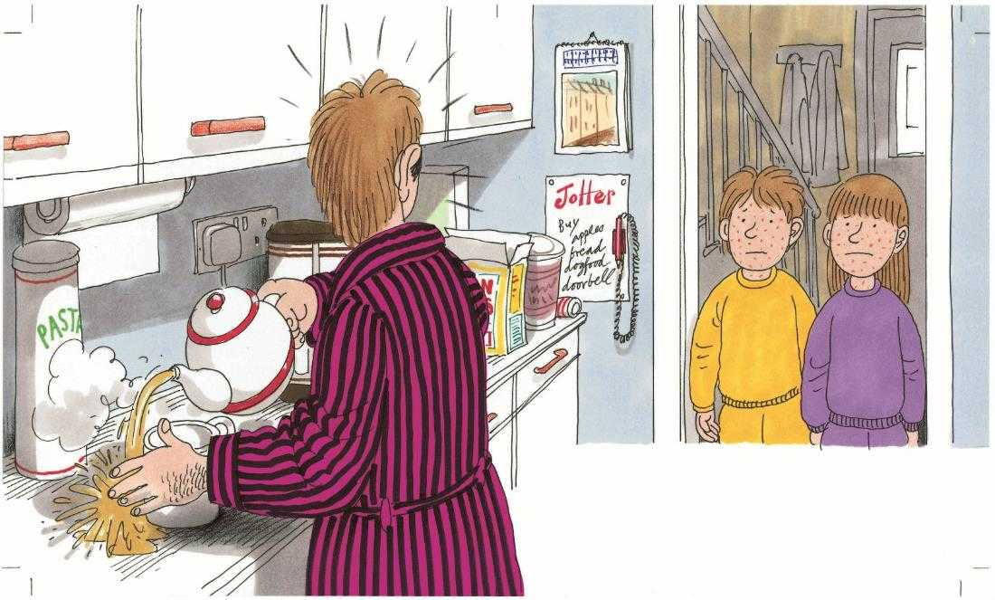
LO: Understand the text; identify the characters of the story by using the text and the illustration; read the text automatically and fluently.
Have Ss take turns identifying the words in the text that they know in turns and have Ss read them accurately by asking them the following question “Which words do you know in this sentence? Please read them as quickly as you can.” Read the text aloud to them.
Ask Ss to identify the character of the story by using the illustration and context clues.
Ask Ss to talk about the comprehension questions by using the text and the illustration.
Have Ss take turns reading the text accurately and fluently.
TG
Reading
Spots!
Characters
Who had spots next?
Comprehension
What do you think Dad might be feeling when he saw Biff and Chip? How do you know?
Decoding
Biff and Chip had spots too.
Read with automaticity.
2:30
10/26

Slide 11
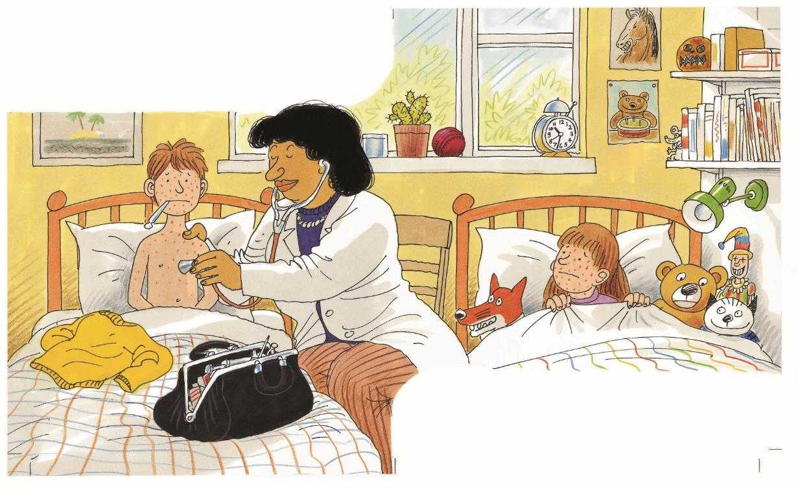
Reading
TG
LO: Understand the text; understand the meaning of the vocabulary word doctor, and make sentences with it; identify the characters of the story by using the text and the illustration; read the sight word accurately; read the text fluently.
Read the text aloud to Ss; click the penguin button and explain the word doctor; have Ss read the vocabulary word and have Ss make sentences with it.
Ask Ss to identify the characters of the story by using the illustration and context clues.
Have Ss read the sight word accurately.
Ask Ss to talk about the comprehension questions by using the text and the illustration.
Have Ss read the text fluently.
Spots!
Characters
Vocabulary
Who came to help these children?
The doctor came.
Comprehension
What was the doctor’s advice for Biff and Chip?
doctor
The doctor works at a hospital.
Sight Words
stay
“Stay in bed,” she said.
doctor
3:00
11/26

Slide 12
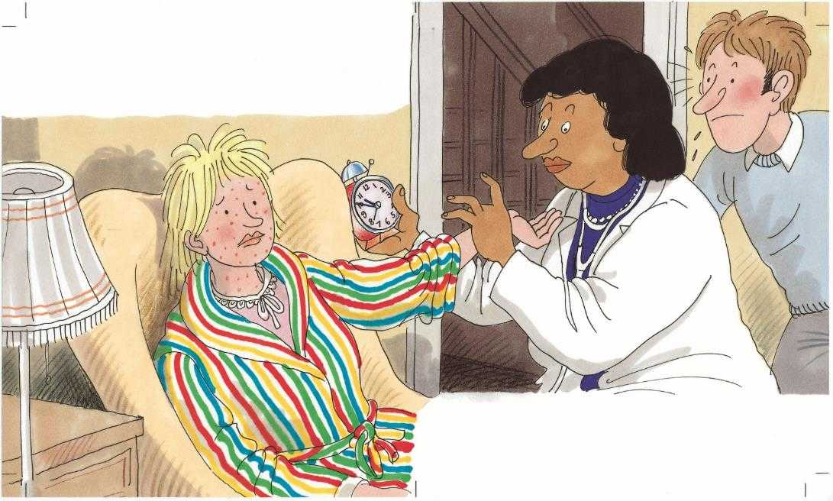
Reading
TG
LO: Understand the text; identify the characters of the story by using the text and the illustration; read the text fluently.
Have Ss read the text together.
Ask Ss to talk about the comprehension questions by using the text and the illustration.
Ask Ss to identify the character of the story by using the illustration and context clues.
Have Ss take turns reading the text fluently.
Spots!
Comprehension
What did the doctor say to Mum? Why did the doctor say that?
Mum had spots.
What do you think Dad
might do next?
Characters
“Stay in bed, too,” said the doctor.
Who didn’t have spots in the family?
2:30
12/26

Slide 13
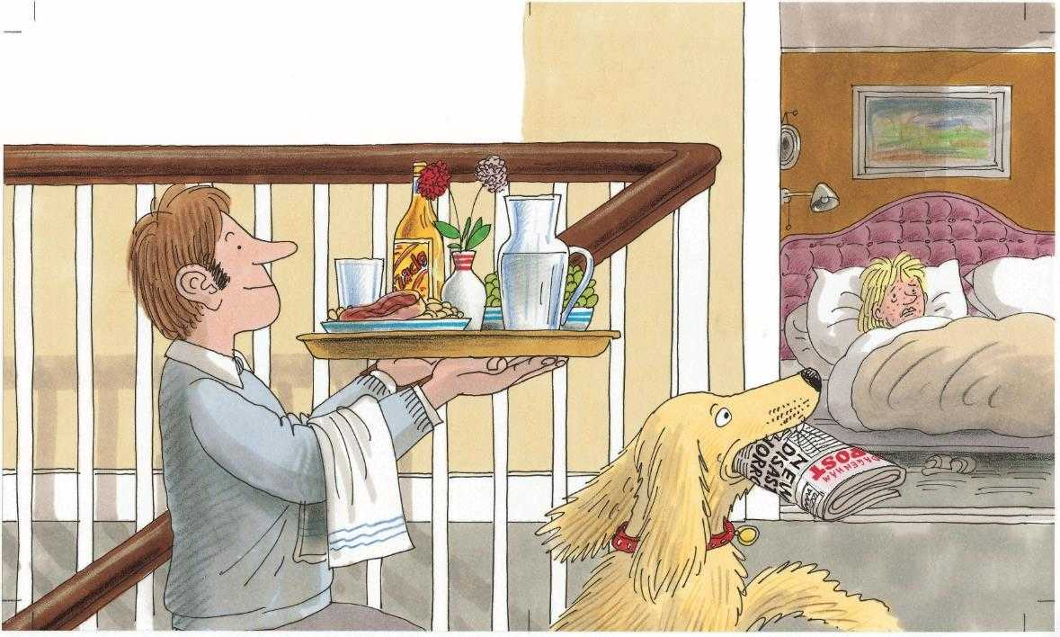
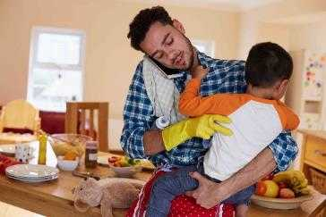
Reading
TG
LO: Understand the text; understand the meaning of the phrase looked after, and make sentences with it; read the text automatically and fluently.
Have Ss take turns identifying the words in the text that they know in turns and have Ss read them accurately by asking them the following question “Which words do you know in this sentence? Please read them as quickly as you can.” Read the text aloud to them.
Click the penguin button and explain the phrase looked after; have Ss read the phrase and have Ss make sentences with it.
Ask Ss to talk about the comprehension questions by using the text and the illustration.
Have Ss take turns reading the text accurately and fluently.
Spots!
Comprehension
Dad looked after everyone.
Vocabulary
What did Dad do to look after everyone on this page? Look for clues in the illustration.
What else do you think Dad might do to look after everyone?
looked after
The man looked after his son and did chores.
Decoding
Read with automaticity.
looked after
3:00
13/26

Slide 14
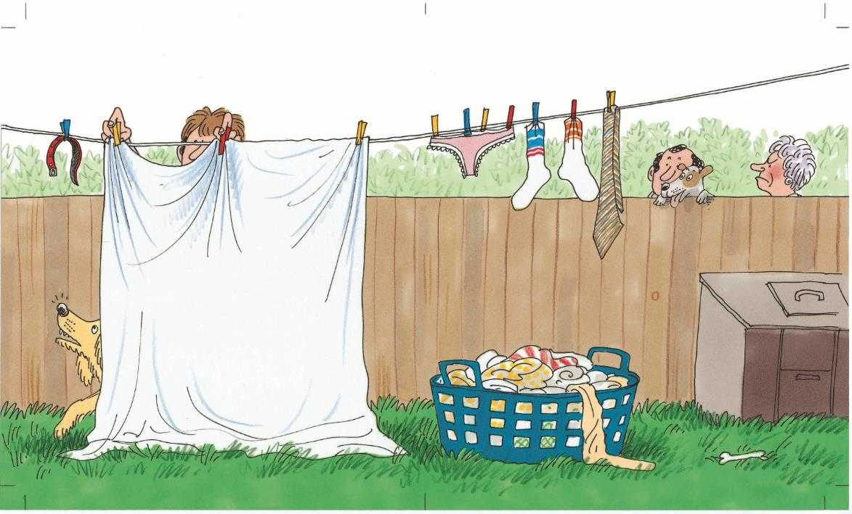
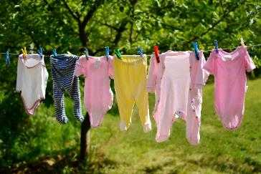
Reading
TG
LO: Understand the text; understand the meaning of the vocabulary word washing, and make sentences with it; make connections; read the text fluently.
Have Ss read the text together; click the penguin button and explain the word washing; have Ss read the vocabulary word and have Ss make sentences with it.
Ask Ss to talk about the comprehension questions by using the text and the illustration.
Ask Ss to talk more about the connections questions.
Ask Ss to take turns reading the text aloud.
Spots!
Comprehension
Vocabulary
He put the washing out.
What was the second thing that Dad did to look after his family?
What else do you think Dad might do?
washing
There is some washing on a line.
Connections
Did you have spots before? How did everyone in your family look after you?
washing
2:30
14/26

Slide 15
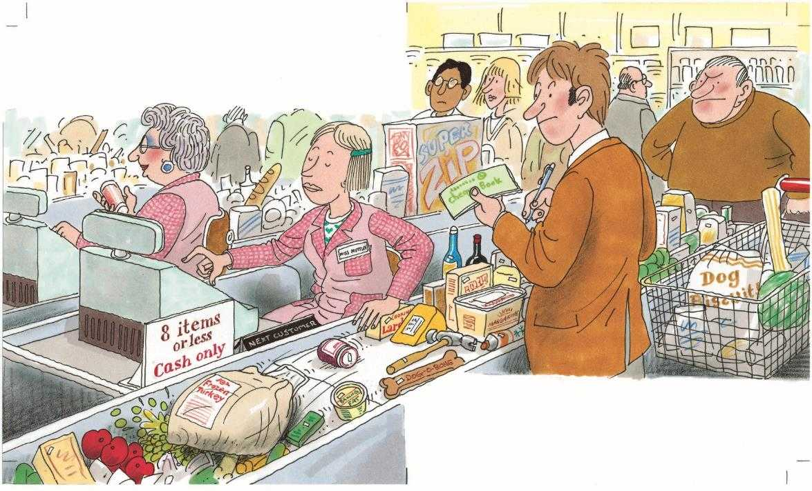
Reading
TG
LO: Understand the text; read the text automatically and fluently.
Have Ss take turns identifying the words in the text that they know in turns and have Ss read them accurately by asking them the following question “Which words do you know in this sentence? Please read them as quickly as you can.” Read the text aloud to them.
Ask them to talk about the comprehension questions by using the text and the illustration.
Have Ss take turns reading the text accurately and fluently.
Spots!
Comprehension
He went shopping.
What was the third thing that Dad did to look after his family?
What did Dad say? Why? Was it easy to look after everyone?
Decoding
“What a job!” said Dad.
Read with automaticity.
2:00
15/26

Slide 16
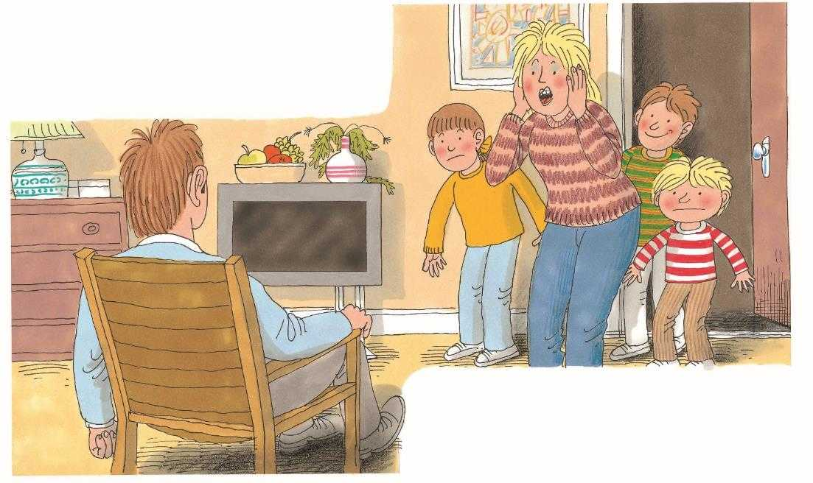
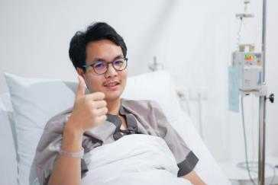
Reading
TG
LO: Understand the text; understand the meaning of the vocabulary word better, and make sentences with it; read the text fluently.
Have Ss read the text together; click the penguin button and explain the word better; have Ss read the vocabulary word and have Ss make sentences with it.
Ask Ss to talk about the comprehension questions by using the text and the illustration.
Ask Ss to take turns reading the text aloud.
Spots!
Comprehension
Vocabulary
Everyone got better.
How was everyone? Did they still have spots?
Look at Mum’s expression. What do you think might happen to Dad?
better
He is sick, but he feels better now.
“Oh no!” said Mum.
better
2:00
16/26

Slide 17
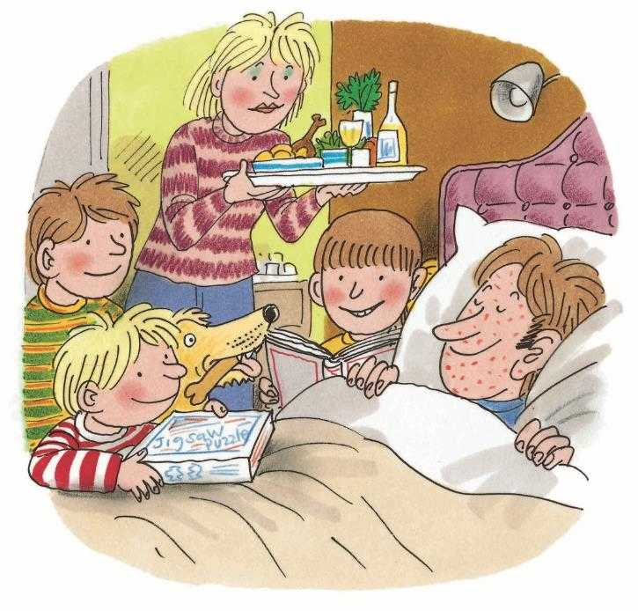
Reading
TG
LO: Understand the text; identify the characters of the story by using the text and the illustration; read the text fluently.
Have Ss read the text together.
Ask Ss to talk about the comprehension questions by using the text and the illustration.
Ask Ss to identify the characters of the story by using the illustration and context clues.
Have Ss take turns reading the text fluently.
Spots!
Characters
Who had spots last?
Comprehension
How did everyone look after Dad? How might Dad feel in this moment?
Dad had spots.
2:00
17/26

Slide 18
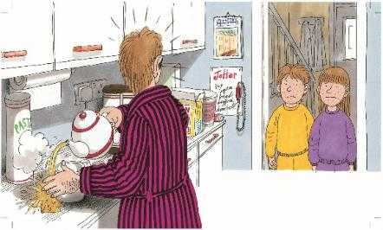
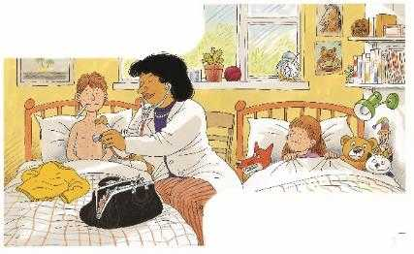
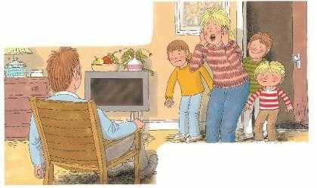
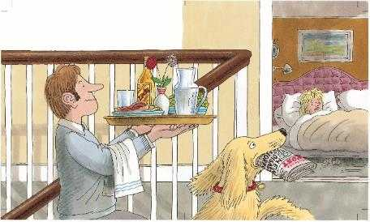
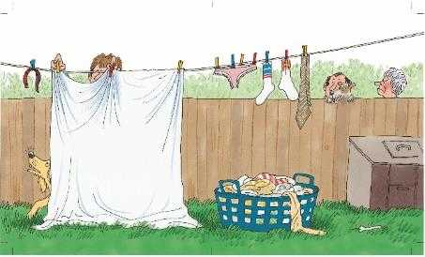
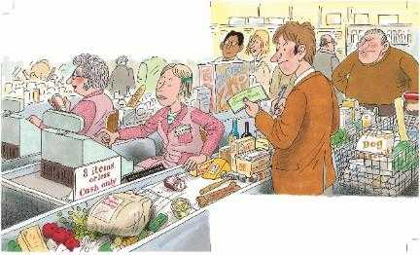
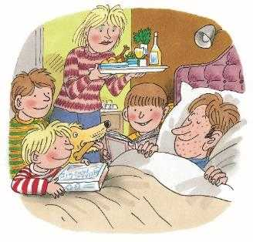
Reading
TG
LO: Retell the story with visual support and assistance.
Have Ss recall the story; model first.
Have Ss work together to retell the story by using the visual aids. Help them if necessary.
Let’s retell!
1
3
2
2:00
18/26

Slide 19
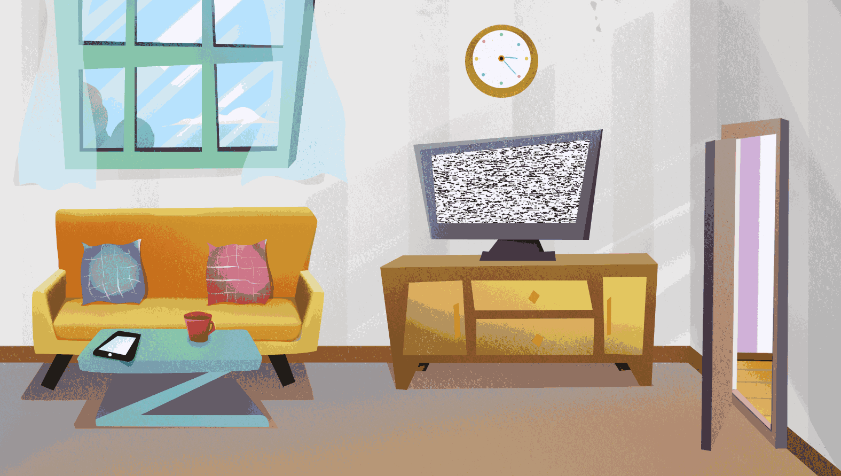
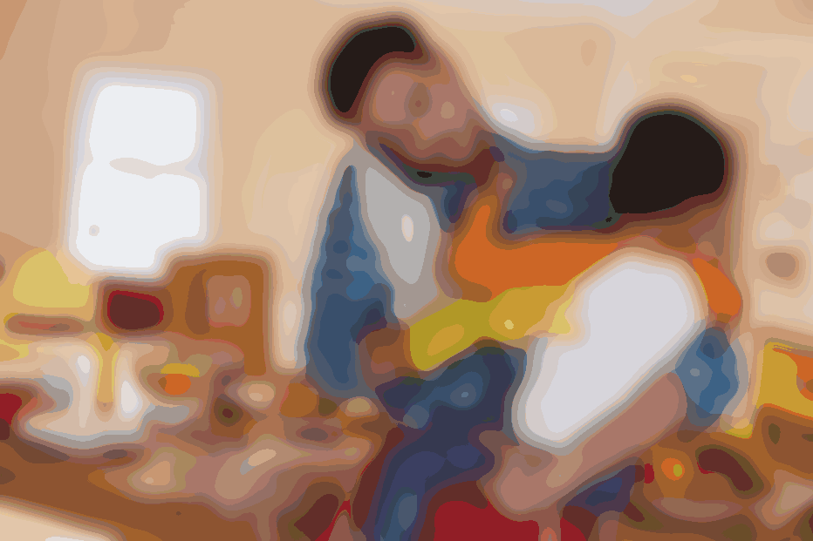
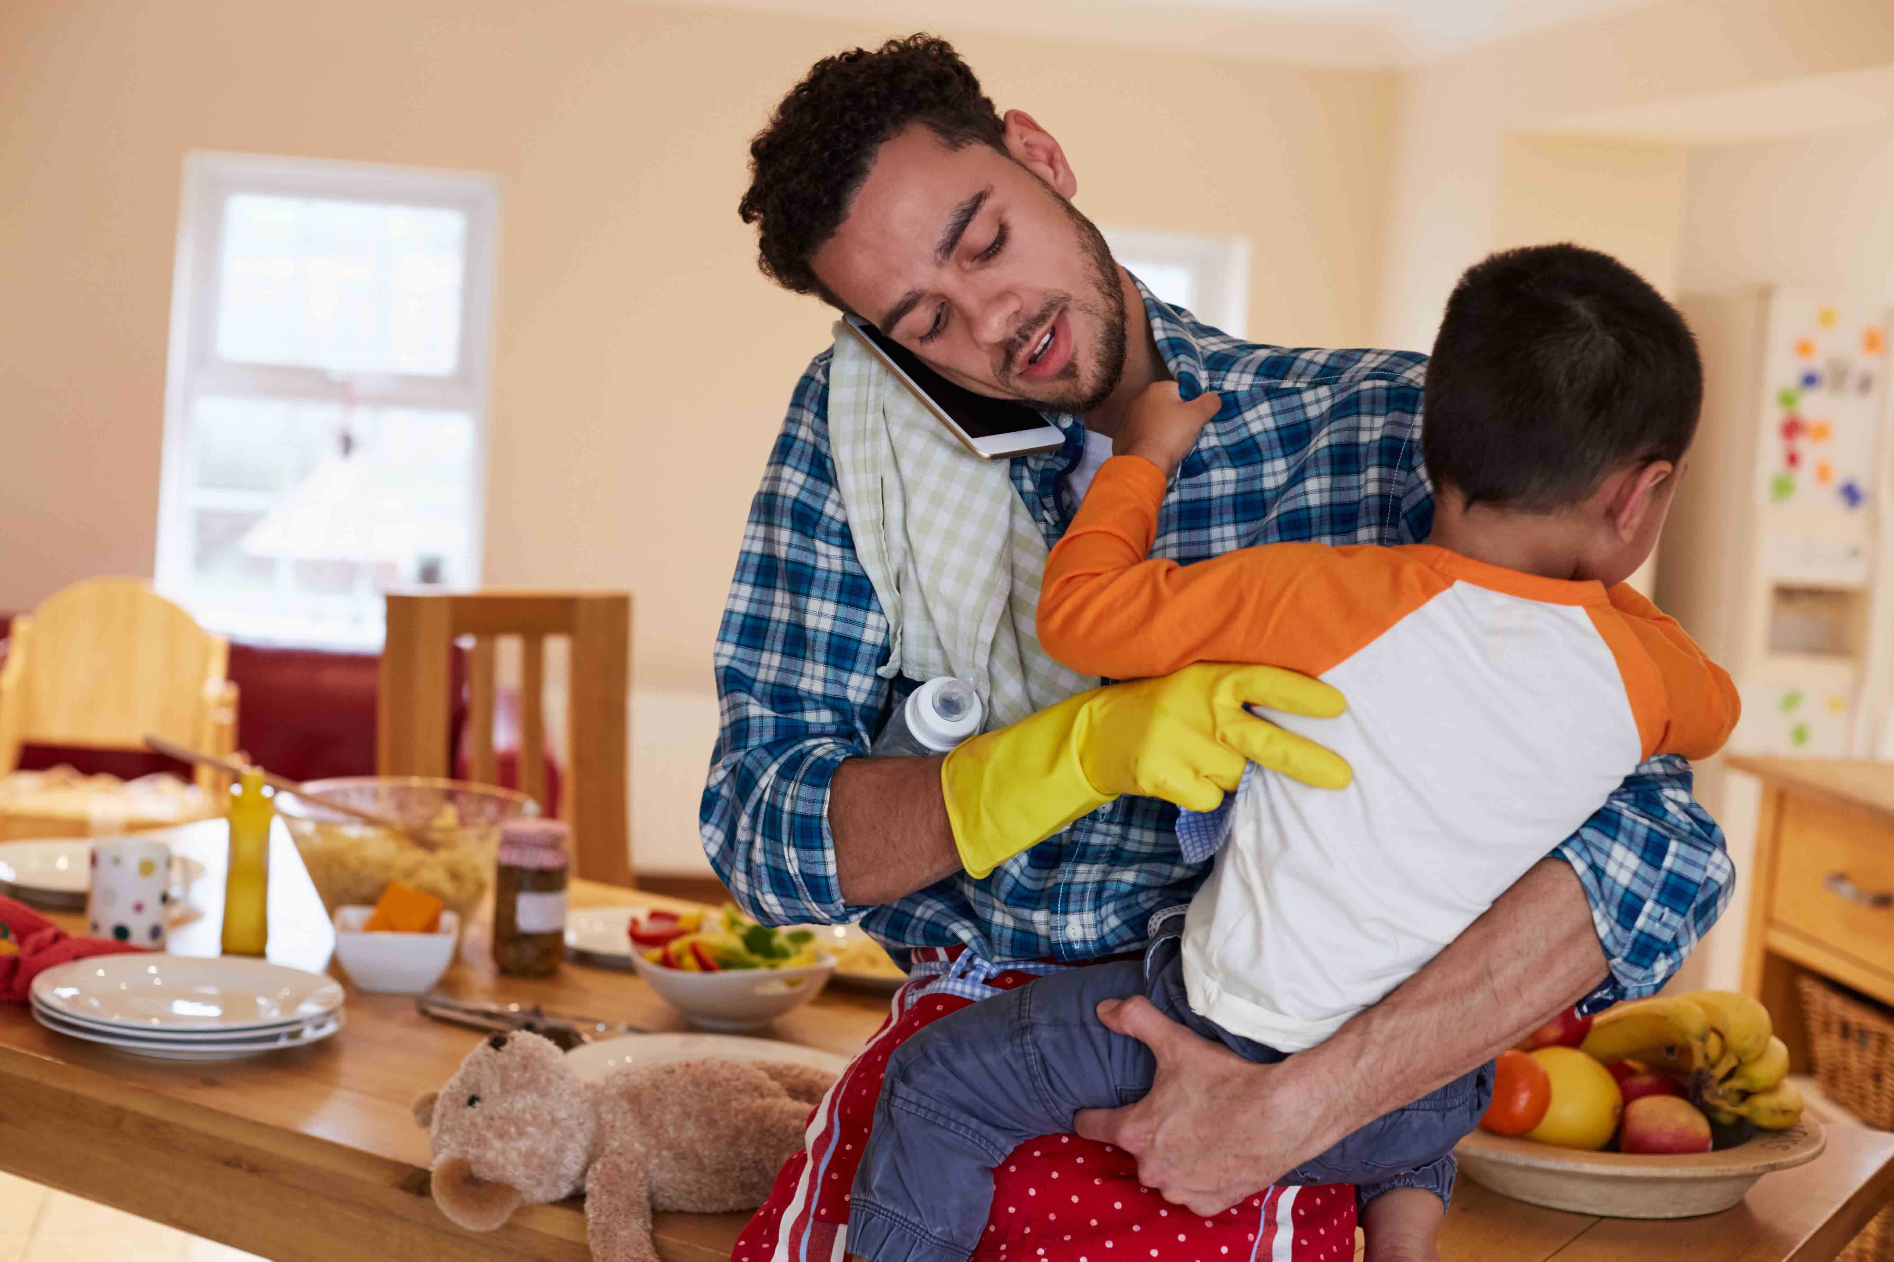
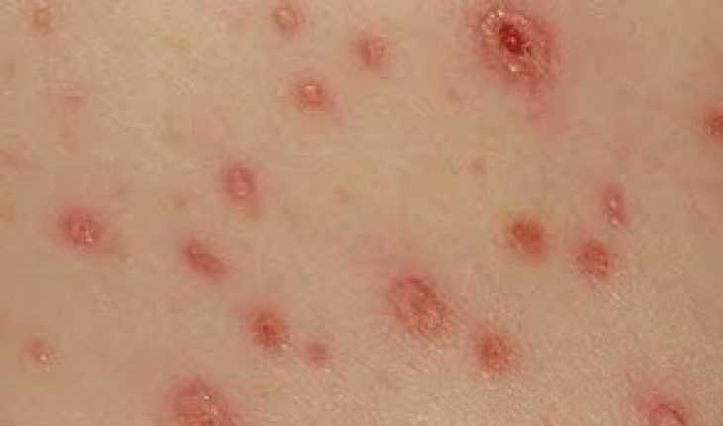
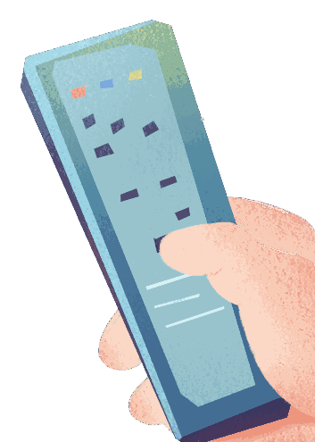
LO: Check Ss’ understanding of the words in this lesson.
Ask Ss to completely review all the learned words in this lesson.
The steps are as follows:
First, click and ask Ss to identify the picture. Then, click to reveal the entire word.
Announce the winner of the competition.
Note: If time is limited, skip this section.
TG
Vocabulary
Let’s guess!
looked after
better
washing
doctor
spots
1:00
19/26

Slide 20
Listening &
Speaking
TG
LO: Talk about what Dad did to look after his family when they had spots.
Have Ss work in pairs to talk about the given illustration by using the sentence structure and helping words; model first.
Assist Ss if necessary.
Let’s talk!
—What did Dad do to look after his
family when they had spots?
—Dad ____.
Helping Words
put the washing out went shopping
Biff
Chip
Kipper
TV
2:00
20/26

Slide 21
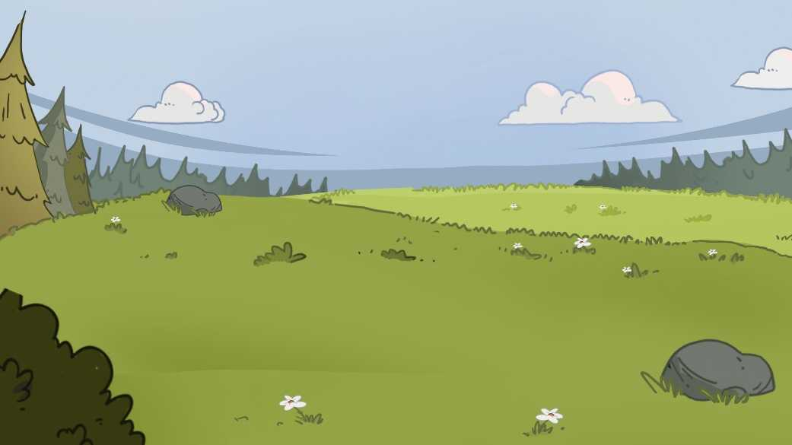
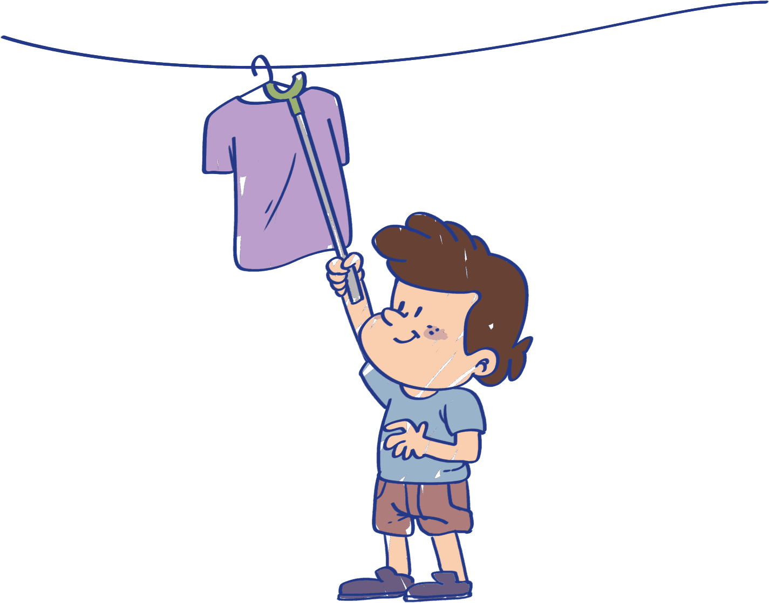
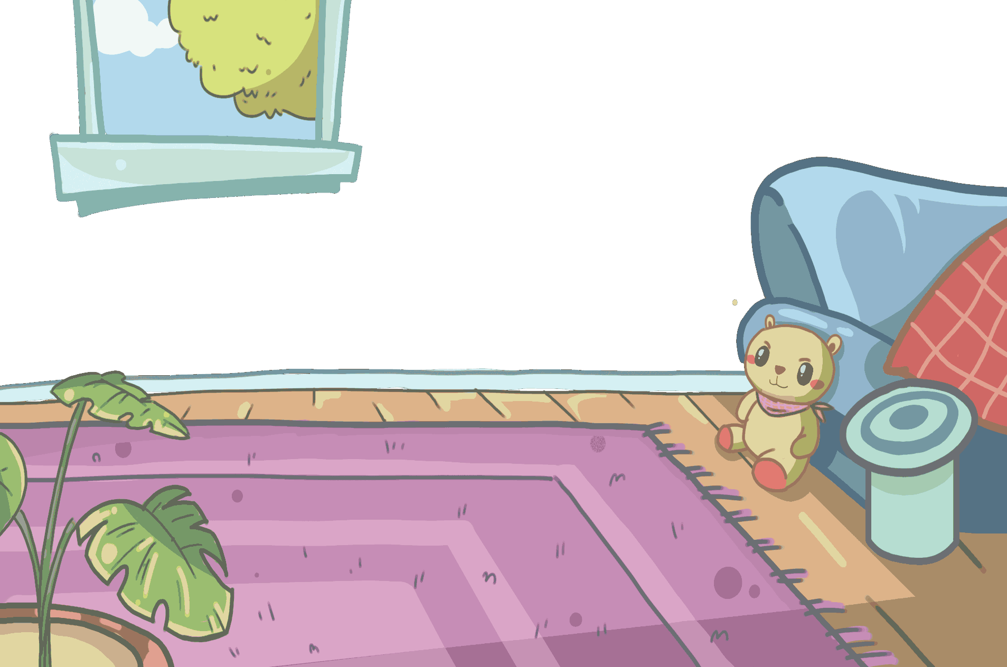
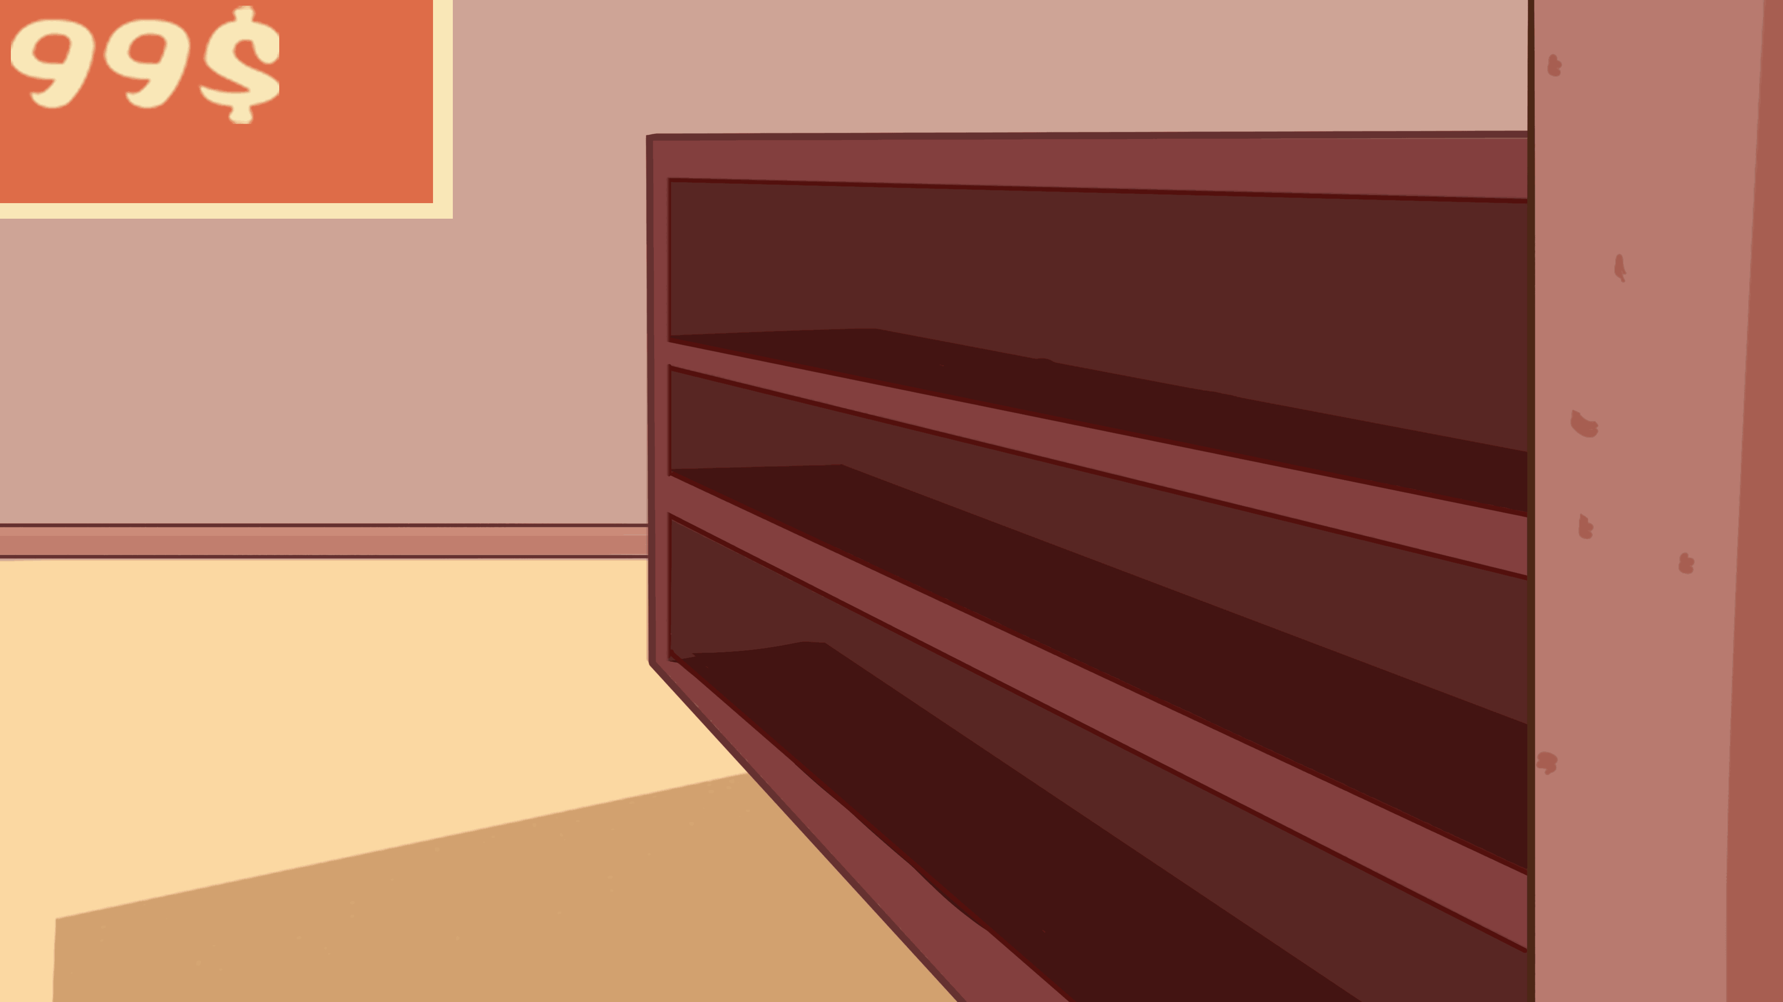
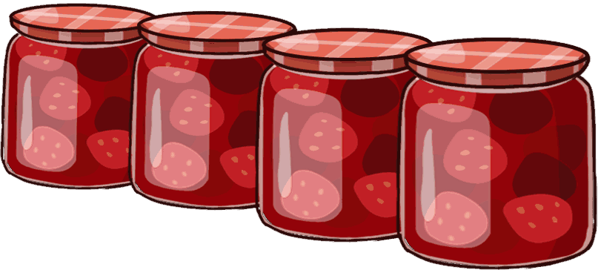
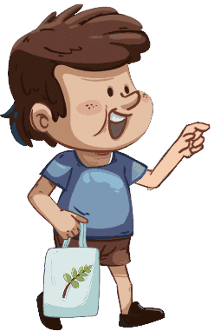
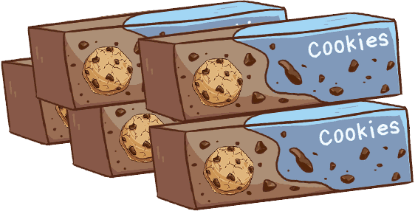
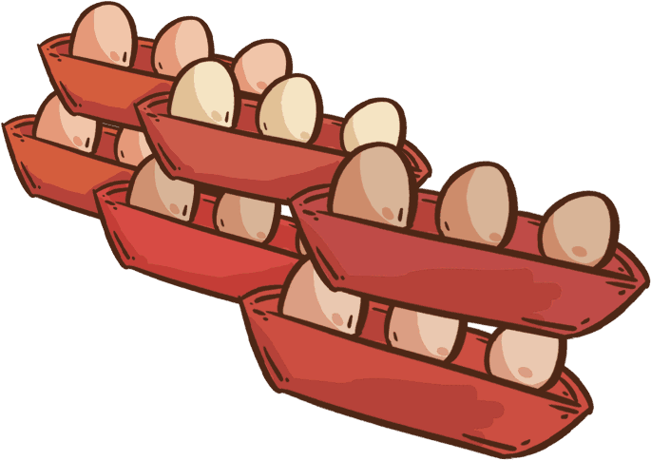
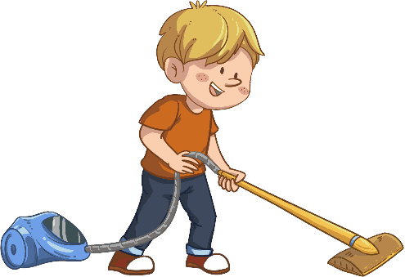
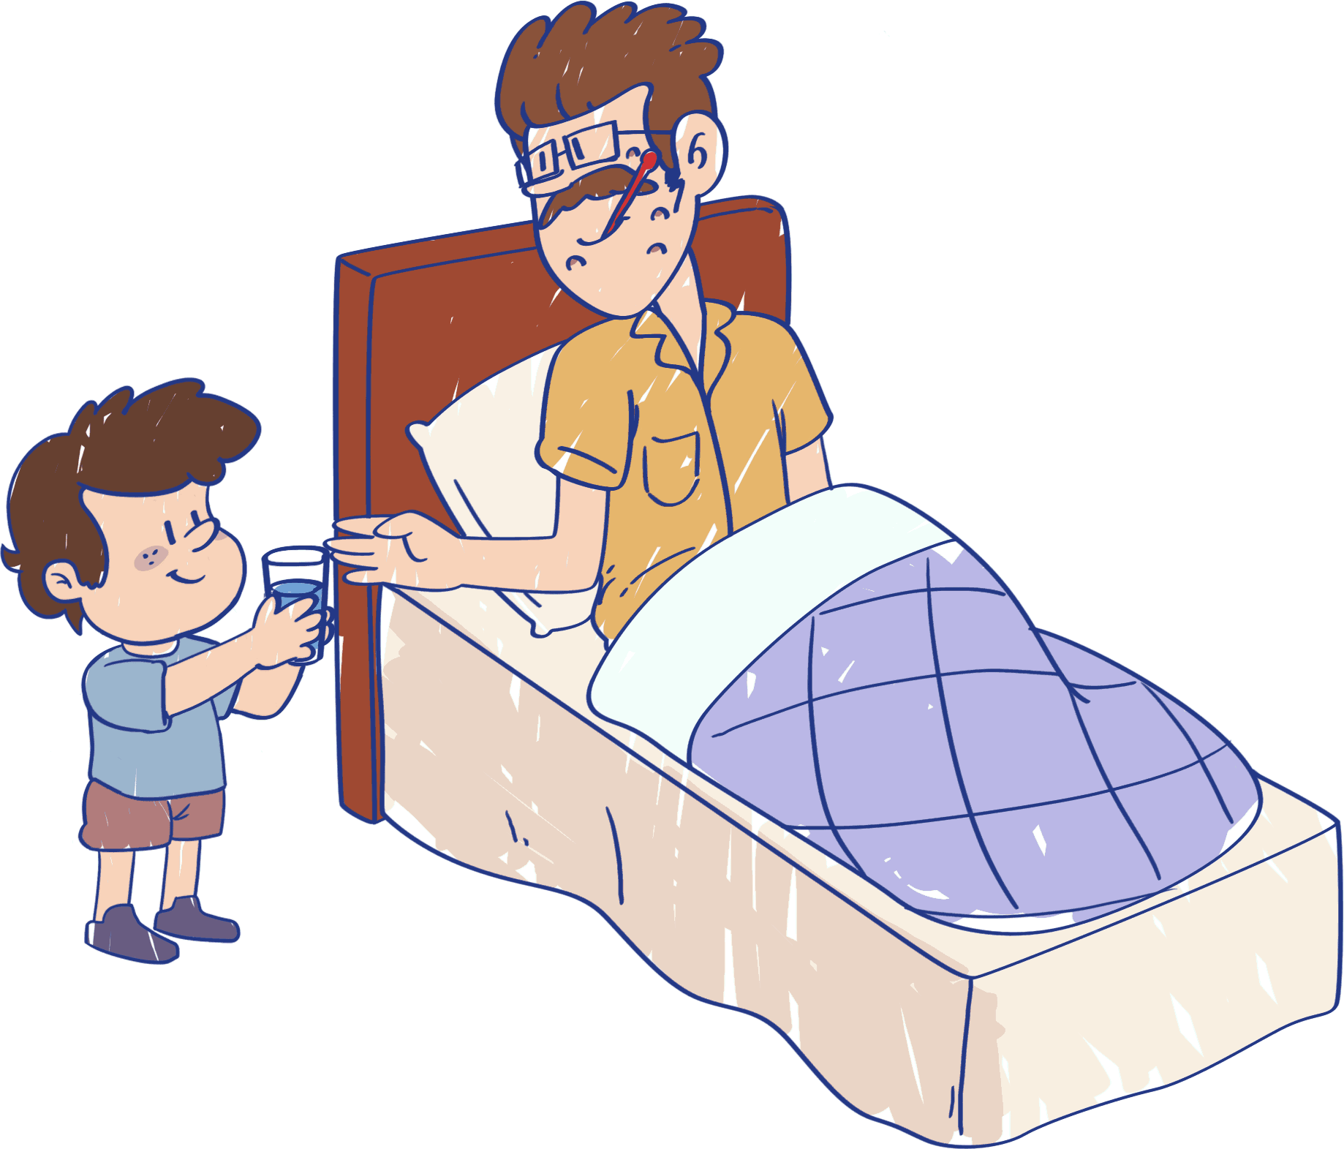
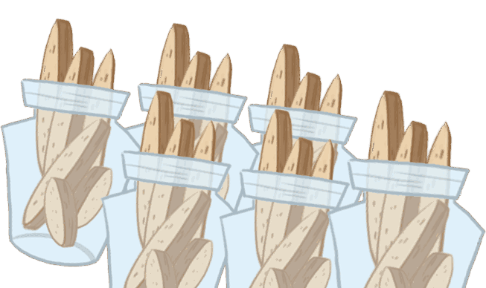
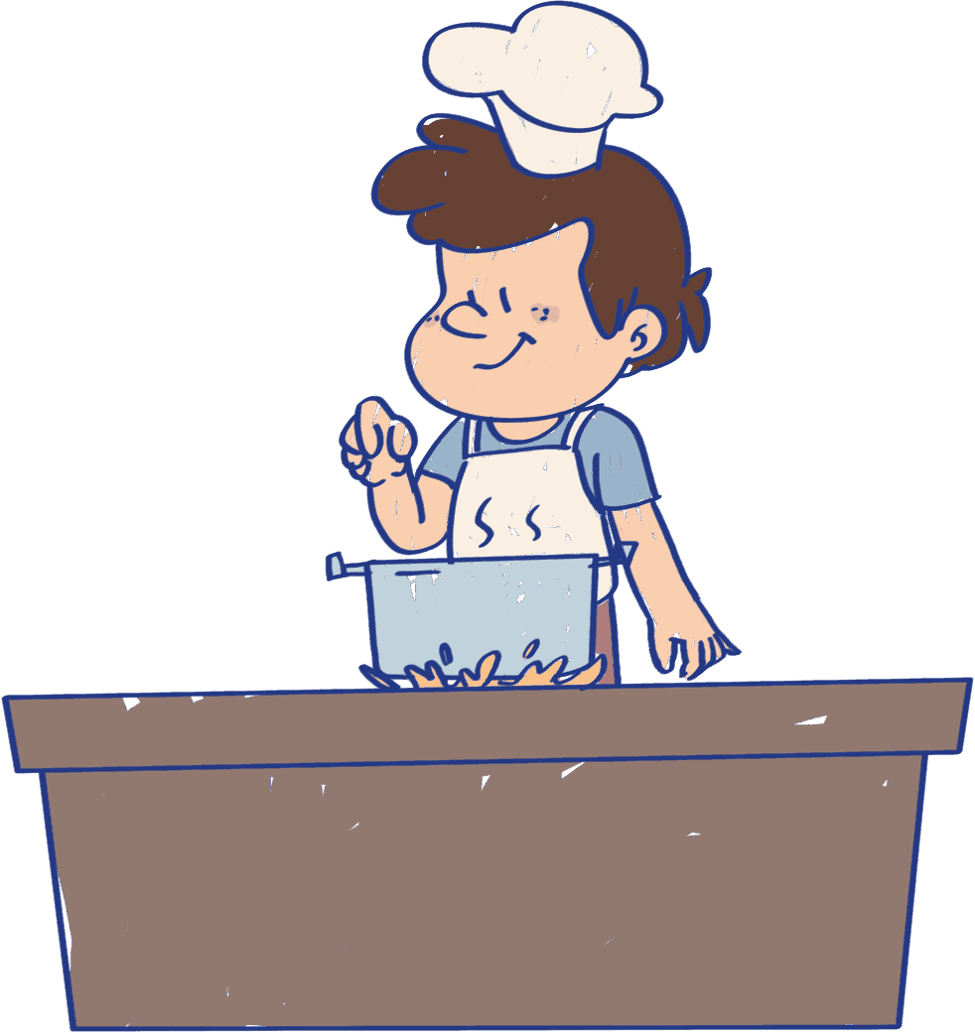
Listening &
Speaking
TG
LO: Ask Ss to consider what they will do to look after their family when they are sick.
Ask Ss to observe the pictures carefully.
Have Ss talk about what they can do to look after their family.
Click Let’s talk! and ask Ss to talk about the given pictures by using the given language structure; model first. Assist Ss if necessary.
Notes: T can click Let’s talk! to present the sentence structure, and can click it again to make it disappear.
Let’s talk!
—What will you do to look after
your family when they are sick?
—I will ______.
read stories to them
keep the room clean
make them happy
. . .
2:30
21/26

Slide 22
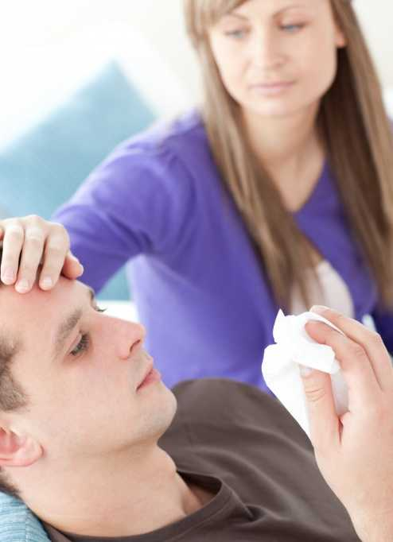
LO: Talk about the values of caring for their family.
Ask Ss about the given question; model first.
Guide Ss to talk about the question with the help of the given pictures.
Encourage Ss to talk more about the following question: what else can we do to care for our family?
TG
Value
How do you care for your family in your daily life?
look after your family when they are sick
stay with your family when they are upset
2:00
22/26

Slide 23
LO: Talk about what they learned from the story by using the given structures and language support.
Guide Ss to talk about what they learned from Spot!.
Ask Ss to think about the given questions; help Ss to organize their ideas about the story with the given visual support, and tell them, “This is practice before your homework.”
Model the first question, and then ask Ss to take turns presenting their answers.
TG
Oral Writing
Get ready to present!
Who got spots? Who looked after them? What did they do to help?
—served water
—cooked food
—put the washing out
—went shopping
Kipper
Biff and Chip
Mum
—came and helped
2:00
23/26

Slide 24
LO: Understand what the homework is.
Explain the writing task to Ss and check their understanding.
Tell Ss that they should finish their writing before next class. Make sure that they know to upload their homework to the platform. They will present their work next class.
Remind Ss to watch the post-class video and to finish the writing task.
TG
Writing
Opinion Writing
Let’s draw and write!
Describe the most helpful way you think to look after Dad.
Now, please follow the steps to finish your homework and present it in the next class:
Describe the most helpful way you think to look after Dad.
Write at least one complete sentence to describe it.
Watch the post-class video about the writing task.
0:30
24/26

Slide 25
LO: Review today’s lesson.
Guide Ss to review the phonics by asking Ss to read the words.
Guide Ss to review the words by asking Ss to make sentences with some of them.
Guide Ss to review the sentence pattern by asking each S to make sentences with it.
TG
Review
Review
Let’s review!
Phonics:
cat/can/car/
plain/vain/train
Sentence Structure:
Dad put _____ out.
Dad went _____.
Vocabulary:
spots/better/doctor/
washing/looked after
1:00
25/26

Slide 26
LO: End the lesson and encourage Ss to be well prepared for the next class.
Briefly comment on Ss.
Say goodbye to students.
Ask Ss to preview the next lesson.
TG
0:30
26/26

