Slide 1
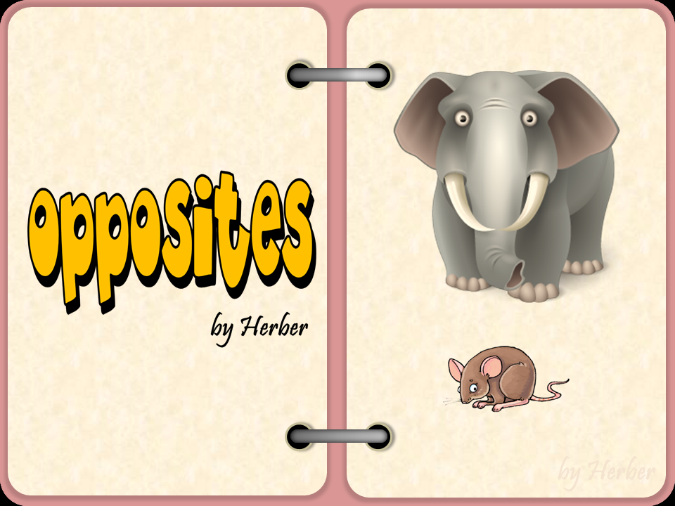


Slide 2

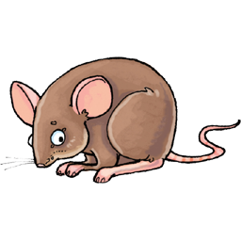
small
big

Slide 3
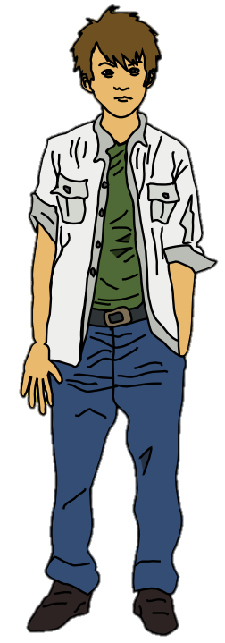
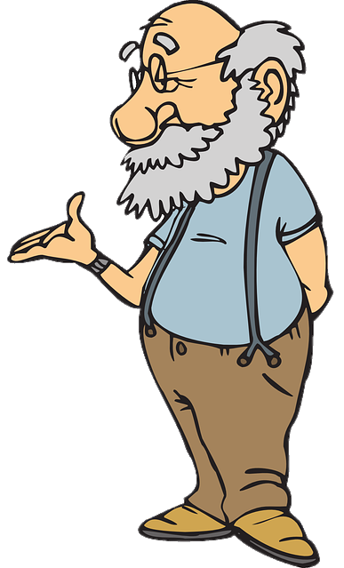
young
old

Slide 4
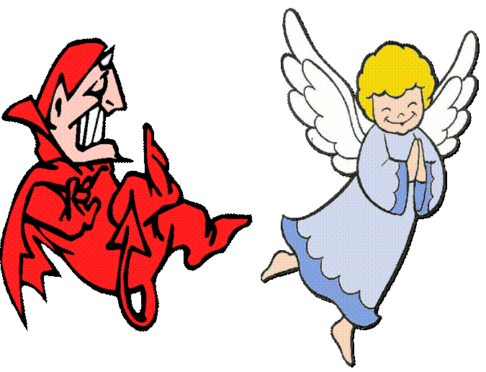
bad
good

Slide 5
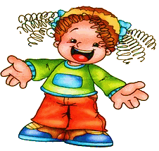
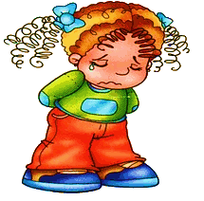
sad
happy

Slide 6
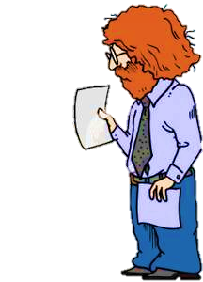
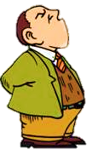
short
tall

Slide 7
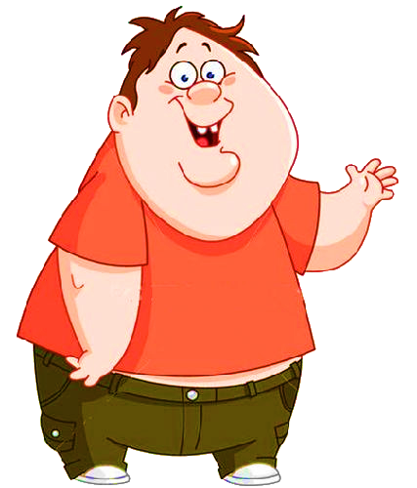
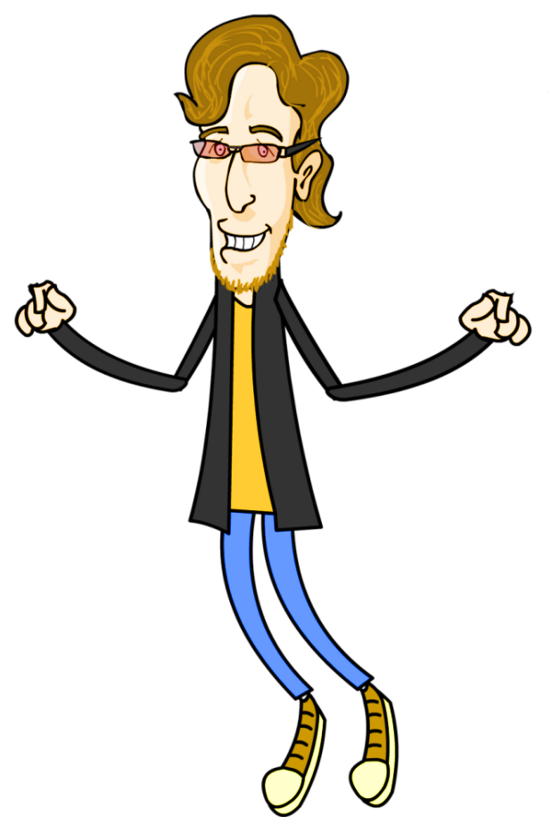
fat
thin

Slide 8
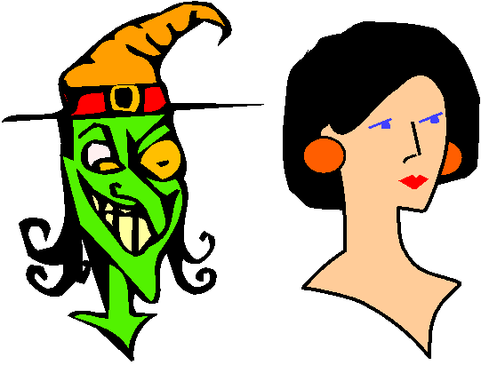
ugly
beautiful

Slide 9


short
long

Slide 10
Let’s sing
a song.
‘opposites’ by learning station
https://www.youtube.com/watch?v=TW4OQxUVjiE

Slide 11

OPPOSITE ADJECTIVES

Slide 12

What is the opposite of big?
small

Slide 13
What is the opposite of tall?
short

Slide 14
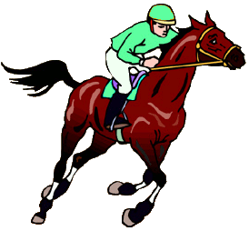
What is the opposite of thin?
fat

Slide 15

What is the opposite of old?
young

Slide 16
What is the opposite of soft?
hard

Slide 17
What is the opposite of hot?
cold

Slide 18
5
What is the opposite of sad?
happy

Slide 19
Let’s sing
a song.
‘opposites’ by rocking english https://www.youtube.com/watch?v=UGggDSBvLXs

Slide 20
Let’s read
a story

Slide 21
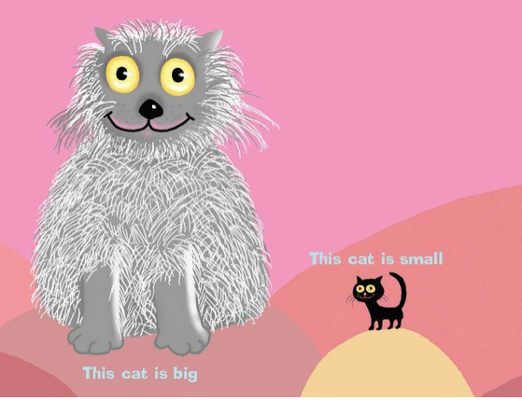
small

Slide 22
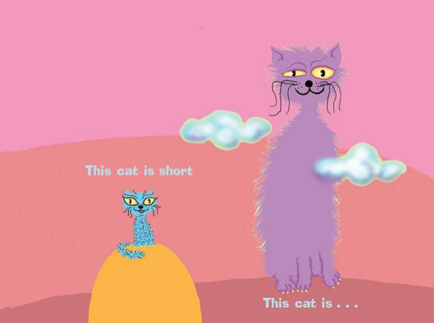
tall
tall

Slide 23
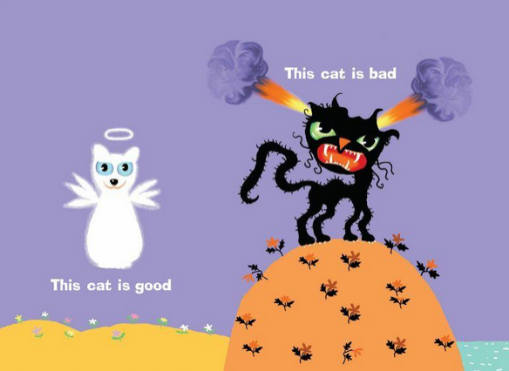
bad

Slide 24
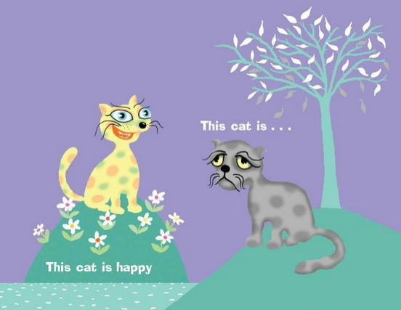
sad

Slide 25
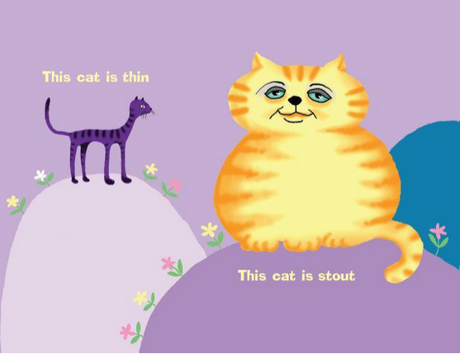
fat

Slide 26
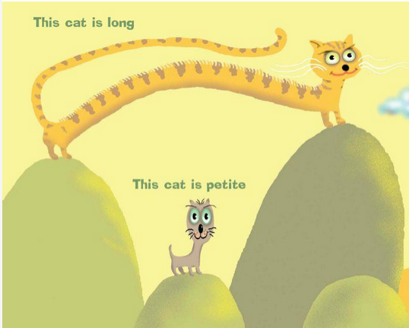
short

Slide 27
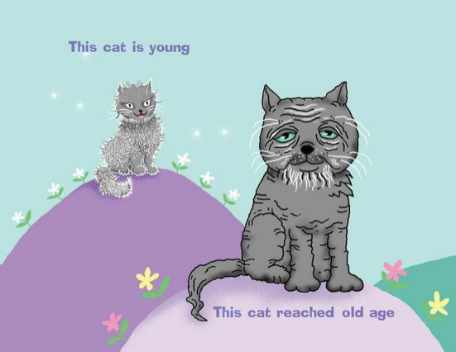
old

Slide 28
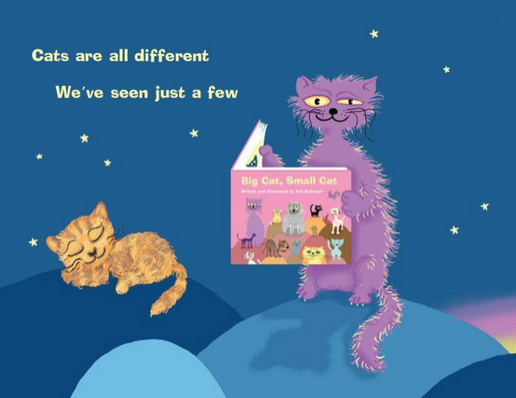

Slide 29
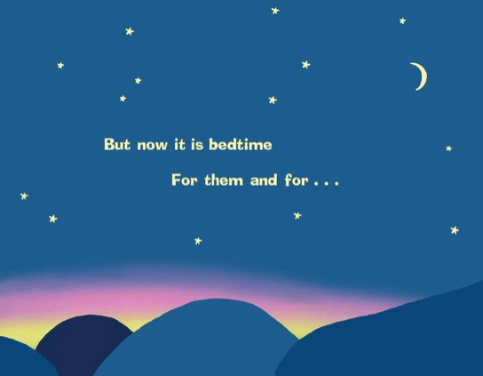
you

Slide 30
Let’s watch
a video
‘adjectives’ by hello felix https://www.youtube.com/watch?v=uzADSEuJpLQ

Slide 31
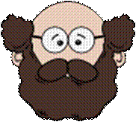




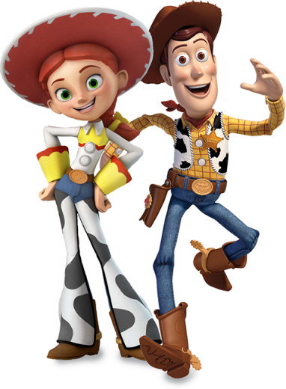
WANTED
Read the descriptions
and help the police
identify the criminals.

Slide 32

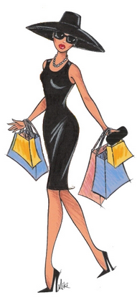
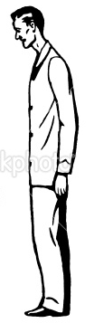
WANTED
TRY AGAIN!
A
TRY AGAIN!
B
C
GOOD JOB!
He is a boy.
He is tall.
He is thin.

Slide 33



WANTED
TRY AGAIN!
TRY AGAIN!
A
B
C
GOOD JOB!
She is a girl.
She is short.
She is fat.

Slide 34


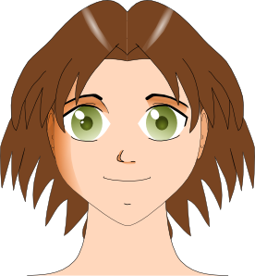
WANTED
TRY AGAIN!
TRY AGAIN!
A
B
C
GOOD JOB!
She has short hair.
She has big eyes.

Slide 35


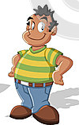
WANTED
TRY AGAIN!
TRY AGAIN!
A
B
C
GOOD JOB!
He is a boy.
He is tall.
He is thin.

Slide 36
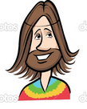


WANTED
TRY AGAIN!
TRY AGAIN!
A
B
C
GOOD JOB!
He is a boy.
He has big eyes.
He has long hair.

Slide 37


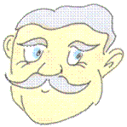
WANTED
TRY AGAIN!
TRY AGAIN!
A
B
C
GOOD JOB!
She is a girl.
She has small eyes.
She has long hair.

Slide 38



WANTED
TRY AGAIN!
TRY AGAIN!
A
B
C
GOOD JOB!
She is a girl.
She is tall.
She is thin.

Slide 39


WANTED
TRY AGAIN!
TRY AGAIN!
A
B
C
GOOD JOB!
He is a boy.
He has short hair.
He has small eyes.

Slide 40
Let’s sing
a song.
‘she’s tall’ esl song
https://www.youtube.com/watch?v=oxsWI8C30TE

Slide 41
How’s he/she..? Game
He’s small

Slide 42
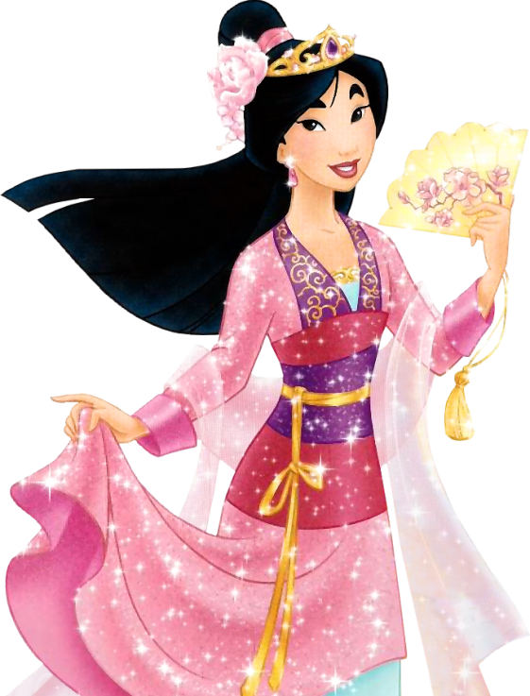
He’s … big
She’s … small
tall
short
fat
thin
young
old
beautiful
ugly

Slide 43
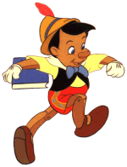
He’s … big
She’s … small
tall
short
fat
thin
young
old
beautiful
ugly

Slide 44
He’s … big
She’s … small
tall
short
fat
thin
young
old
beautiful
ugly

Slide 45
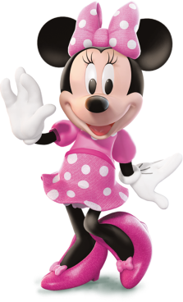
He’s … big
She’s … small
tall
short
fat
thin
young
old
beautiful
ugly

Slide 46
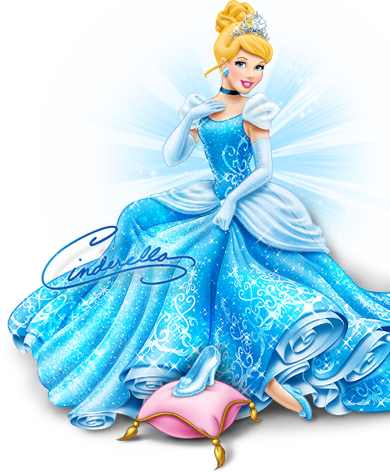
He’s … big
She’s … small
tall
short
fat
thin
young
old
beautiful
ugly

Slide 47
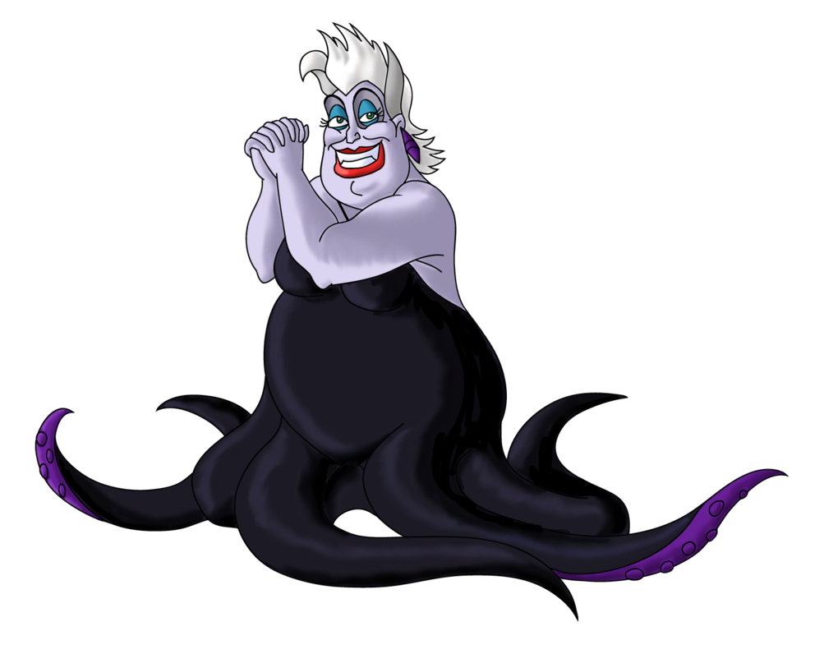
He’s … big
She’s … small
tall
short
fat
thin
young
old
beautiful
ugly

Slide 48
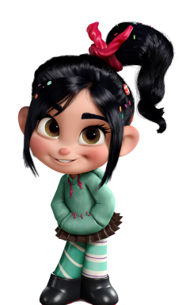
He’s … big
She’s … small
tall
short
fat
thin
young
old
beautiful
ugly

Slide 49
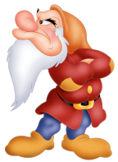
He’s … big
She’s … small
tall
short
fat
thin
young
old
beautiful
ugly

Slide 50
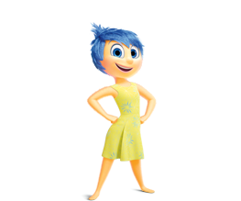
He’s … big
She’s … small
tall
short
fat
thin
young
old
beautiful
ugly

Slide 51
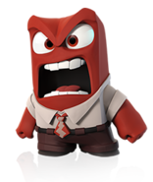
He’s … big
She’s … small
tall
short
fat
thin
young
old
beautiful
ugly

Slide 52
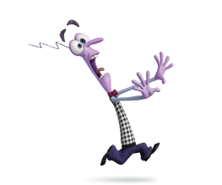
He’s … big
She’s … small
tall
short
fat
thin
young
old
beautiful
ugly

Slide 53
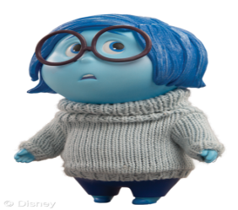
He’s … big
She’s … small
tall
short
fat
thin
young
old
beautiful
ugly

Slide 54

He’s … big
She’s … small
tall
short
fat
thin
young
old
beautiful
ugly

Slide 55
Let’s sing
a song
‘hot&cold song’ by
katy perry

