Slide 2
HAPPY

Slide 3
SAD

Slide 4
TIRED

Slide 5
THIRSTY

Slide 6
HUNGRY

Slide 7
FULL

Slide 8
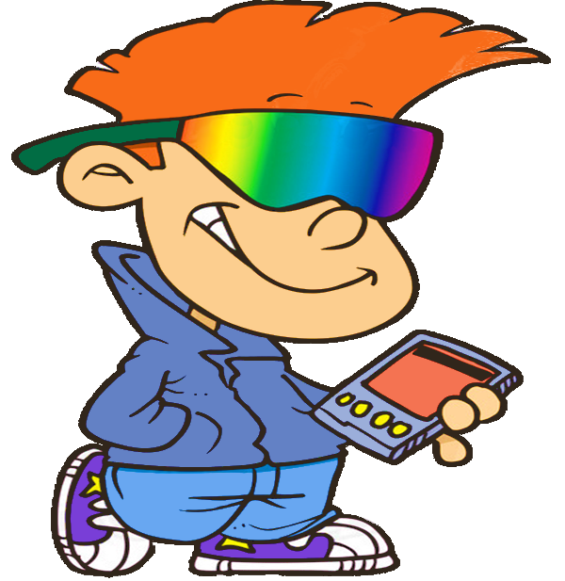
How are you feeling?
GREAT!
Feelings Game

Slide 9
How are you feeling?
full
hungry
thirsty

Slide 10
How are you feeling?
happy
sad
full

Slide 11
How are you feeling?
happy
thirsty
sad

Slide 12
How are you feeling?
sad
tired
happy

Slide 13
How are you feeling?
thirsty
full
hungry

Slide 14
How are you feeling?
thirsty
hungry
full

Slide 15
Lets chant How do you feel? By kids picture show https://www.youtube.com/watch?v=52QXu8Sisf4

Slide 21
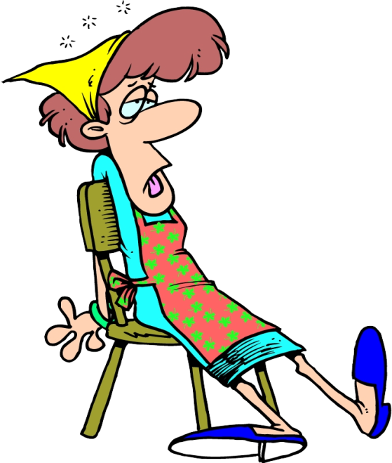
I run and play football all day. I’M …
I feel tired..
1 2 3 4

Slide 22
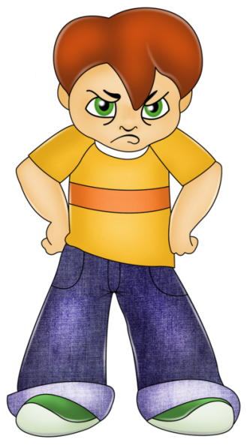
I have no friends. I’M …
I feel sad..
1 2 3 4

Slide 23
My mother gives me an ice cream. I’M …
I feel happy..
1 2 3 4

Slide 24
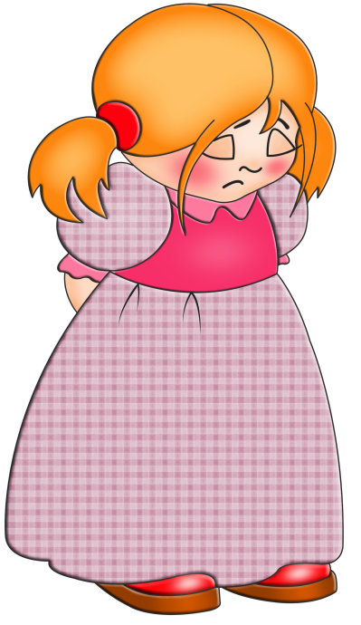
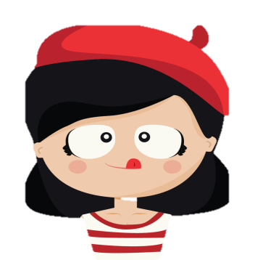
I have no food for breakfast or lunch. I’M …
I feel hungry.
1 2 3 4

Slide 25
Lets read a story

Slide 26
Are you angry, dad? Yes, I am.

Slide 27
Are you sad, brother? Yes, I am.

Slide 28
Are you happy, sister? Yes, I am.

Slide 29
I’m hungry!

Slide 30
Let’s play name that feeling game with sesame street https://www.youtube.com/watch?v=ZxfJicfyCdg

Slide 31
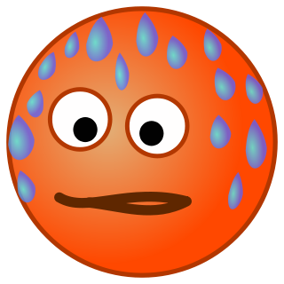
Making faces game
Are you…
sad?
happy?
tired?
cold?
hungry?
hot?
thirsty?

Slide 32
Memory game
example

Slide 33
1 2 3 4 5
6 7 8 9 10

Slide 34
Making faces game
Are you…
sad?
happy?
tired?
cold?
hungry?
hot?
thirsty?

