Slide 1
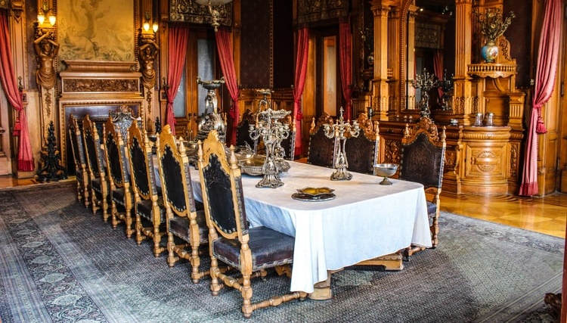
LO: Introduce the topic and get to know each other.
Say hello to Ss and ask Ss to introduce themselves to each other.
Introduce the topic and ask Ss to discuss the given question.
TG
What do you know is in a palace?
1:30
1/33

Slide 2
TG
LO: Get to know the learning objectives.
Go through the learning goals with the Ss. Make sure they know what they’re going to learn in the lesson.
Note: Don’t read the goals to the Ss.
Learning Goals
Decode words with the prefix: im-.
Learn the key words and phrases grandchild, hide-and-seek, grown-up, allow, lock . . . up, send for, tea, and home-made, and understand them in context.
Apply the different reading strategies and skills when analyzing and comprehending the content; describe how the ending concludes the story.
Talk about the story and discuss what you often do in your friends’ homes?
0:30
2/33

Slide 3
TG
LO: Present the writing assignment from the last lesson.
Let Ss take turns presenting their writing assignment from the last lesson.
Give feedback.
Presentation
Presentation Time
Did you finish the homework you were assigned in the last lesson?
Give your presentation and tell us about your adventure back in time.
1:30
3/33

Slide 4
LO: Identify and pronounce the sounds of the prefix im-.
Click and read the first three words to Ss; have them identify what sound the prefix im- makes.
Click and ask Ss to read the remaining words; ask them to identify what the prefix im- makes.
Guide Ss to read the words together.
Phonics Learning
Phonics
What words have the prefix im-?
impolite
impossible
impatient
improper
imperfect
immature
1:30
4/33

Slide 5
LO: Decode the words in the text accurately and fluently; read the text fluently.
Guide Ss to read the story aloud together and with rhythm.
Ask Ss to take turns reading the text one sentence at a time.
Phonics
Read on Your Own
Tim was impolite and impatient as a child. His improper behavior always made others stay away from him. However, it is practically impossible for a person to be immature all the time and still succeed in life. Years later, Tim improved himself a lot. Though he is still imperfect, many people like to be friends with him.
1:00
5/33

Slide 6
LO: Review the first part of the story.
Review what happened in the first part of the story.
Discuss the given questions and give feedback.
Background
Story Review
In our previous lesson we read that the children had arrived in London.
Who was Vicky? How did Vicky help the children get some bread to eat?
Who was Jack? What did the children do together with Jack?
1:30
6/33

Slide 7
LO: Use details from the picture to make predictions.
Guide Ss to make predictions by using the provided questions.
Ask them to make guesses prior to reading the story by looking at the pictures.
Make Predictions
Lead-in
Use details from the illustration to make guesses.
What do you think the policemen are doing? What do you think will happen to the children in this part of the story?
Make two predictions based on the given picture from the book.
1:30
7/33

Slide 8
TG
Victorian Adventure 2
LO: Define the unfamiliar word grandchild in context.
Have Ss use the illustration and context clues to define the word grandchild; give feedback.
Note: If Ss can present a correct understanding of the unfamiliar word(s), it’s not necessary to teach the word(s) on the next slide.
Reading
Vocabulary
Use the illustration and context clues to define the word grandchild.
Pages 16-17
1:00
8/33

Slide 9
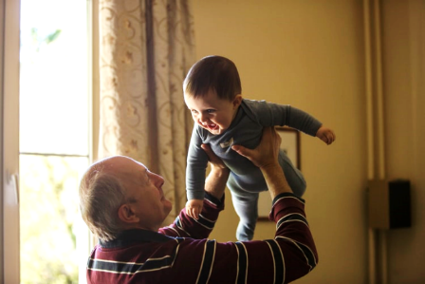
TG
Victorian Adventure 2
LO: Apply the reading strategies and skills for reading comprehension; understand the word grandchild in context.
If the Ss can present a good understanding of the word grandchild from the previous slide, skip the vocabulary teaching part. If not, explain the word with the sample sentence and ask Ss to make new sentences with it.
Ask Ss to take turns discussing the comprehension questions; give feedback.
Reading
Read Pages 16-17
Comprehension
Who were the three children in the palace? Why did Vicky and Jack go to the palace every night?
How did the three children feel when they saw Biff, Chip, and Kipper? What games do you think they might play together?
grandchild
(n.)
Definition: the child of one’s son or daughter
Every time the old man lifts up his grandchild, the baby smiles at him.
1:00
9/33

Slide 10
TG
Victorian Adventure 2
LO: Define the unfamiliar phrase hide-and-seek in context.
Have Ss use the illustration and context clues to define the phrase hide-and-seek; give feedback.
Note: If Ss can present a correct understanding of the unfamiliar word(s), it’s not necessary to teach the word(s) on the next slide.
Reading
Vocabulary
Use the illustration and context clues to define the phrase hide-and-seek.
Pages 18-19
1:00
10/33

Slide 11
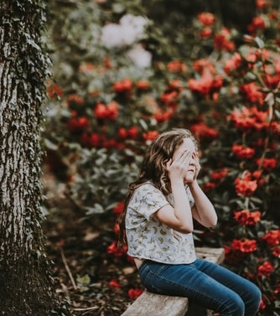
TG
Victorian Adventure 2
LO: Apply the reading strategies and skills for reading comprehension; understand the phrase hide-and-seek
in context.
If the Ss can present a good understanding of the phrase hide-and-seek from the previous slide, skip the vocabulary teaching part. If not, explain the phrase with the sample sentence and ask Ss to make new sentences with it.
Ask Ss to take turns discussing the comprehension questions; give feedback.
Reading
Read Pages 18-19
Comprehension
What games did the children play in the palace?
Which game did Biff and Chip teach the Queen’s grandchildren? Why didn’t Jack know what Chip meant when Chip said, “We saw it on television”?
hide-and-seek
Definition: a children’s game where one player covers the eyes while the others hide to avoid being found
The girl who covered her eyes was playing hide-and-seek with her friends.
1:00
11/33

Slide 12
TG
Victorian Adventure 2
LO: Define the unfamiliar word grown-up in context.
Have Ss use the illustration and context clues to define the word grown-up; give feedback.
Note: If Ss can present a correct understanding of the unfamiliar word(s), it’s not necessary to teach the word(s) on the next slide.
Reading
Vocabulary
Use the illustration and context clues to define the word grown-up.
Pages 20-21
1:00
12/33

Slide 13
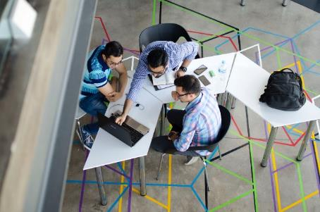
TG
Victorian Adventure 2
LO: Apply the reading strategies and skills for reading comprehension; understand the word grown-up
in context.
If the Ss can present a good understanding of the word grown-up from the previous slide, skip the vocabulary teaching part. If not, explain the word with the sample sentence and ask Ss to make new sentences with it.
Ask Ss to take turns discussing the comprehension questions; give feedback.
Have Ss discuss the question in the connection section.
Reading
Read Pages 20-21
Comprehension
Why didn’t Vicky want to see Queen Victoria?
Why did everyone say, “Trouble”?
grown-up
Definition: a person who is fully grown; adult
Connections
What games do you like to play in your home? Do your parents allow you to do that? Why or why not?
Grown-ups are usually busy with work every day in modern society.
1:00
13/33

Slide 14
TG
Victorian Adventure 2
LO: Define the unfamiliar word allow in context.
Have Ss use the illustration and context clues to define the word allow; give feedback.
Note: If Ss can present a correct understanding of the unfamiliar word(s), it’s not necessary to teach the word(s) on the next slide.
Reading
Vocabulary
Pages 22-23
Use the illustration and context clues to define the word allow.
1:00
14/33

Slide 15
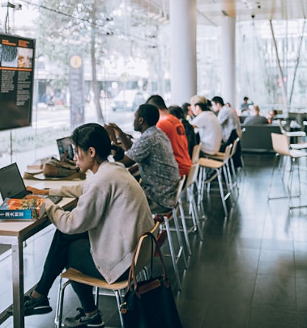
TG
Victorian Adventure 2
LO: Apply the reading strategies and skills for reading comprehension; understand the word allow in context.
If the Ss can present a good understanding of the word allow from the previous slide, skip the vocabulary teaching part. If not, explain the word with the sample sentence and ask Ss to make new sentences with it.
Ask Ss to take turns discussing the comprehension questions; give feedback.
Reading
Read Pages 22-23
Comprehension
Why were the grown-ups so angry? What happened to the royal grandchildren?
Why did the policeman say, “You’re not allowed to play with the Queen’s grandchildren”? What did the policeman do?
allow (v.)
Definition: to permit someone to do something
People are allowed to study and work in the café.
1:00
15/33

Slide 16
TG
Victorian Adventure 2
LO: Define the unfamiliar phrase lock . . . up in context.
Have Ss use the illustration and context clues to define the phrase lock . . . up; give feedback.
Note: If Ss can present a correct understanding of the unfamiliar word(s), it’s not necessary to teach the word(s) on the next slide.
Reading
Vocabulary
Pages 24-25
Use the illustration and context clues to define the phrase lock . . . up.
1:00
16/33

Slide 17
TG
Victorian Adventure 2
LO: Apply the reading strategies and skills for reading comprehension; understand the phrase lock . . . up in context.
If the Ss can present a good understanding of the phrase lock . . . up from the previous slide, skip the vocabulary teaching part. If not, explain the phrase with the sample sentence and ask Ss to make new sentences with it.
Ask Ss to take turns discussing the comprehension questions; give feedback.
Reading
Read Pages 24-25
Comprehension
lock . . . up
When the children were locked up in the police station, why did Biff think they would be there forever?
What did Kipper hope would happen, and why?
Definition: to put (someone) in prison
The man stole a necklace from his neighbor, so he will be locked up for several months.
1:00
17/33

Slide 18
TG
Victorian Adventure 2
LO: Define the unfamiliar phrase send for in context.
Have Ss use the illustration and context clues to define the phrase send for; give feedback.
Note: If Ss can present a correct understanding of the unfamiliar word(s), it’s not necessary to teach the word(s) on the next slide.
Reading
The next day, an important man came to see the children.
“The Queen has sent for you,” he said. “Come with me.”
The policeman let them out.
Vocabulary
Use the illustration and context clues to define the phrase send for.
Pages 26-27
1:00
18/33

Slide 19
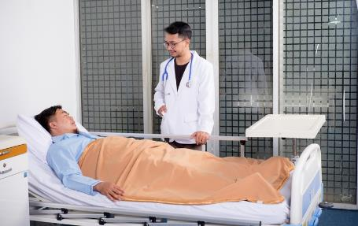
LO: Apply the reading strategies and skills for reading comprehension; understand the phrase send for in context.
If the Ss can present a good understanding of the phrase send for from the previous slide, skip the vocabulary teaching part. If not, explain the phrase with the sample sentence and ask Ss to make new sentences with it.
Ask Ss to take turns discussing the comprehension questions; give feedback.
Victorian Adventure 2
TG
Reading
Read Pages 26-27
Comprehension
send for
How long did the children stay in the police station? Why did the policeman let them out?
Where were the children taken? How did Kipper feel? How do you know?
Definition: to ask or tell someone to come to a place
The patient sent for his doctor because he felt a little uncomfortable at night.
2:00
19/33

Slide 20
Victorian Adventure 2
LO: Define the unfamiliar word tea in context.
Have Ss use the illustration and context clues to define the word tea; give feedback.
Note: If Ss can present a correct understanding of the unfamiliar word(s), it’s not necessary to teach the word(s) on the next slide.
Reading
Vocabulary
Pages 28-29
Use the illustration and context clues to define the word tea.
1:00
20/33

Slide 21
LO: Utilize the reading strategies and skills to assist in reading comprehension; understand the word tea in context.
If Ss can present a good understanding of word tea from the previous slide, skip the vocabulary teaching part. If not, explain the word with the sample sentences and ask Ss to make new sentences with it.
Ask Ss to discuss the comprehension questions; give feedback.
Victorian Adventure 2
Reading
Read Pages 28-29
Comprehension
Who were the children surprised to see? How did the person come to the palace?
Why did the Queen say the children could play with her grandchildren after all?
tea (v.)
Definition: to have a light meal or snack with tea in the late afternoon
The girl likes to read and tea when she is at home alone.
2:00
21/33

Slide 22
Victorian Adventure 2
LO: Define the unfamiliar word home-made in context.
Have Ss go through the text quickly and have them use the illustration and context clues to define the phrase home-made.
Note: If Ss can present a correct understanding of the unfamiliar word(s), it’s not necessary to teach the word(s) on the next slide.
Reading
Vocabulary
Use the illustration and context clues to define the word home-made.
Page 30-32
1:00
22/33

Slide 23
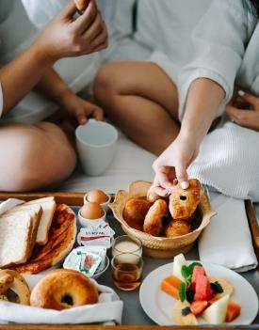
LO: Apply the reading strategies and skills for reading comprehension; understand the word home-made
in context.
If the Ss can present a good understanding of the word home-made from the previous slide, skip the vocabulary teaching part. If not, explain the word with the sample sentence and ask Ss to make new sentences with it.
Ask Ss to take turns discussing the comprehension questions; give feedback.
Have Ss discuss the question in the connection section.
Victorian Adventure 2
Reading
Read Pages 30-32
Comprehension
What did the children play and where did they play it? Explain how to play this game based on the pictures.
How do you think everyone felt when the adventure ended?
home-made
Definition: made at home rather than bought in a store
Connections
She shared her home-made bread with her friends when they came to visit.
If you were one of the children, would you come to visit Queen Victoria again? Why?
1:00
23/33

Slide 24
LO: Introduce the structure of a story and the three
elements that end a story. Teach Ss how to describe the end of a story.
Introduce the structure of a story and the three
elements that end a story.
Reading Strategy
Describe the End of a Story
The structure of a complete story consists of a beginning, a middle, and an end. At the end of a story, the action is concluded, the problems are solved, and the conflict is resolved.
The action is concluded.
The conflict is resolved.
End
The problems are solved.
Modeling
3:00
24/36

Slide 25
LO: Utilize the reading strategies and skills to assist in describing the end of a story.
Model how to describe the end of a story.
Click and have Ss work together to describe the end of a story.
Give feedback.
Describe the End of a Story
The Action | The Problem | The Conflict
What was the action? | What was the problem? | What was the conflict?
How was the action concluded? | How was the problem solved? | How was the conflict resolved?
The children couldn’t play with the Queen’s grandchildren.
There was a conflict between the Queen and the children.
It was the children’s adventure.
The magic key began to glow. It was time for the adventure to end.
It’s your turn.
It’s your turn.
Modeling
25/36

Slide 26
LO: Check if Ss understand the words in context.
Ask Ss to take turns reading the words aloud.
Ask Ss to fill in the blanks and read the sentences.
Read & Choose
It’s wrong for children to lie to their parents and to other _____________.
Students are not ____________ to eat in class.
I had one of those _____________ cookies and found that they were delicious.
John lives in New York with his several ______________.
grown-ups
allowed
home-made
grandchildren
grandchild, grown-up, allow, home-made
Complete the sentences. Use the correct form of the words in the box.
1:00
26/33

Slide 27
T
LO: Talk about what the children did in the palace.
Instruct Ss to discuss the given question.
Encourage Ss to answer questions using the given clues and to present their answers with at least three complete sentences; assist Ss if necessary.
Listening & Speaking
What did the children do in the palace?
played hide-and-seek
played tag
played hop-scotch
played basketball
had a sack race
had tea
1:30
27/33

Slide 28
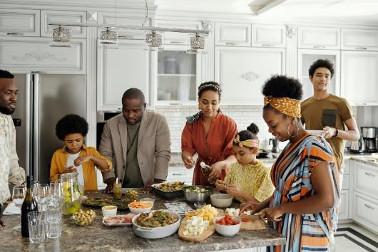
TG
LO: Talk about what you often do in your friends’ homes.
Ask Ss to talk about what you often do in your friends’ homes.
Encourage Ss to answer the question in complete sentences with the given clues; assist Ss if necessary.
Listening & Speaking
What do you often do in your friends’ homes?
chat
have a meal
watch TV
play video games
look at photo albums
1:30
28/33

Slide 29
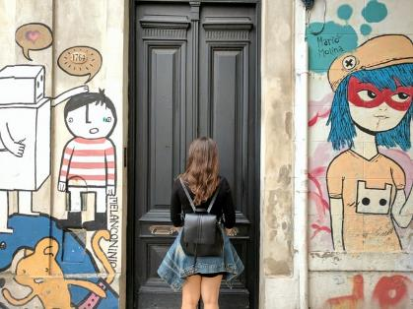
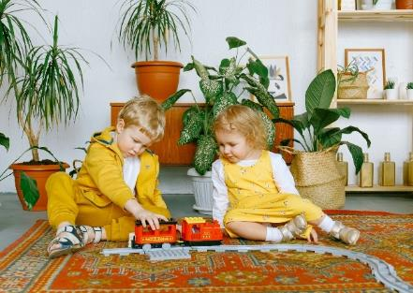
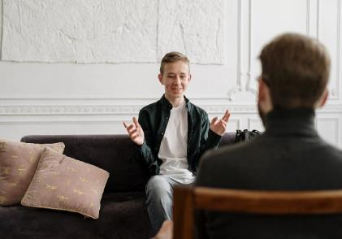
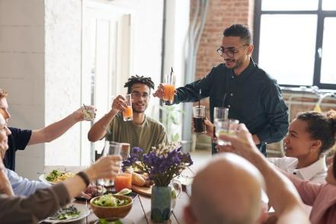
LO: Have Ss talk about how you should behave when visiting other people’s homes.
Guide Ss to look at the pictures; have Ss talk about the given question.
Guide Ss to realize the importance of behaving well; assist Ss if necessary.
Value
How should you behave when visiting other people’s homes?
2:00
29/33

Slide 30
LO: Describe how the grown-ups’ treatment of the children changed throughout the story by using the visual aids and given guide.
Explain the task to Ss.
Model first; have Ss describe the grown-ups’ treatment of the children changed throughout the story by using the sequence chart below.
Give feedback.
Get Ready to Present
Writing
Describe how the grown-ups’ treatment of the children changed throughout the story by answering the following questions in the sequence chart.
Work together to complete the task.
How did the grown-ups feel when they saw the children in the palace?
What did the policeman do and say to the children?
What did the policeman do after the important man came?
What did Queen Victoria say after she talked with Gran?
What did Queen Victoria say when the children were leaving?
30/33
2:30

Slide 31
TG
LO: Understand what the writing task is; know to complete the writing task with the help of the post-class instructional video.
Introduce and explain the writing task to Ss.
Ask Ss to finish the task before the next class and to be ready to present.
Remind Ss to watch the post-class video before writing.
LO: Understand what the writing task is; know they can complete the writing task with the help of the post-class instructional video.
Introduce and explain the writing task to Ss.
Ask Ss to finish the task before the next class and be ready to present it in the next class; remind Ss to watch the post-class video before writing.
Homework: A Short Story:
Writing
Write a short story about an adventure back in time in three paragraphs.
Step 4. Revise: Change Your Writing
Step 5. Edit: Check Your Writing
Step 6. Publish: Make Your Final Copy
Watch the post-class video before you start writing.
1:30
31/33

Slide 32
LO: Review the whole lesson.
Review the key words with Ss by asking Ss to make sentences.
Review the story with Ss by asking the given questions.
Let’s Review
Story: Victorian Adventure 2
Key Words:
grandchild, hide-and-seek, grown-up, allow, lock . . . up, send for, tea, home-made
Key Questions:
What did the children do in the palace?
What do you often do in your friends’ homes?
32/33

Slide 33
TG
LO: End the lesson and encourage Ss to perform better
in the next class.
Briefly comment on Ss’ performance.
Say goodbye to Ss.
Ask Ss to preview the next lesson.
0:30
33/33

