Slide 1
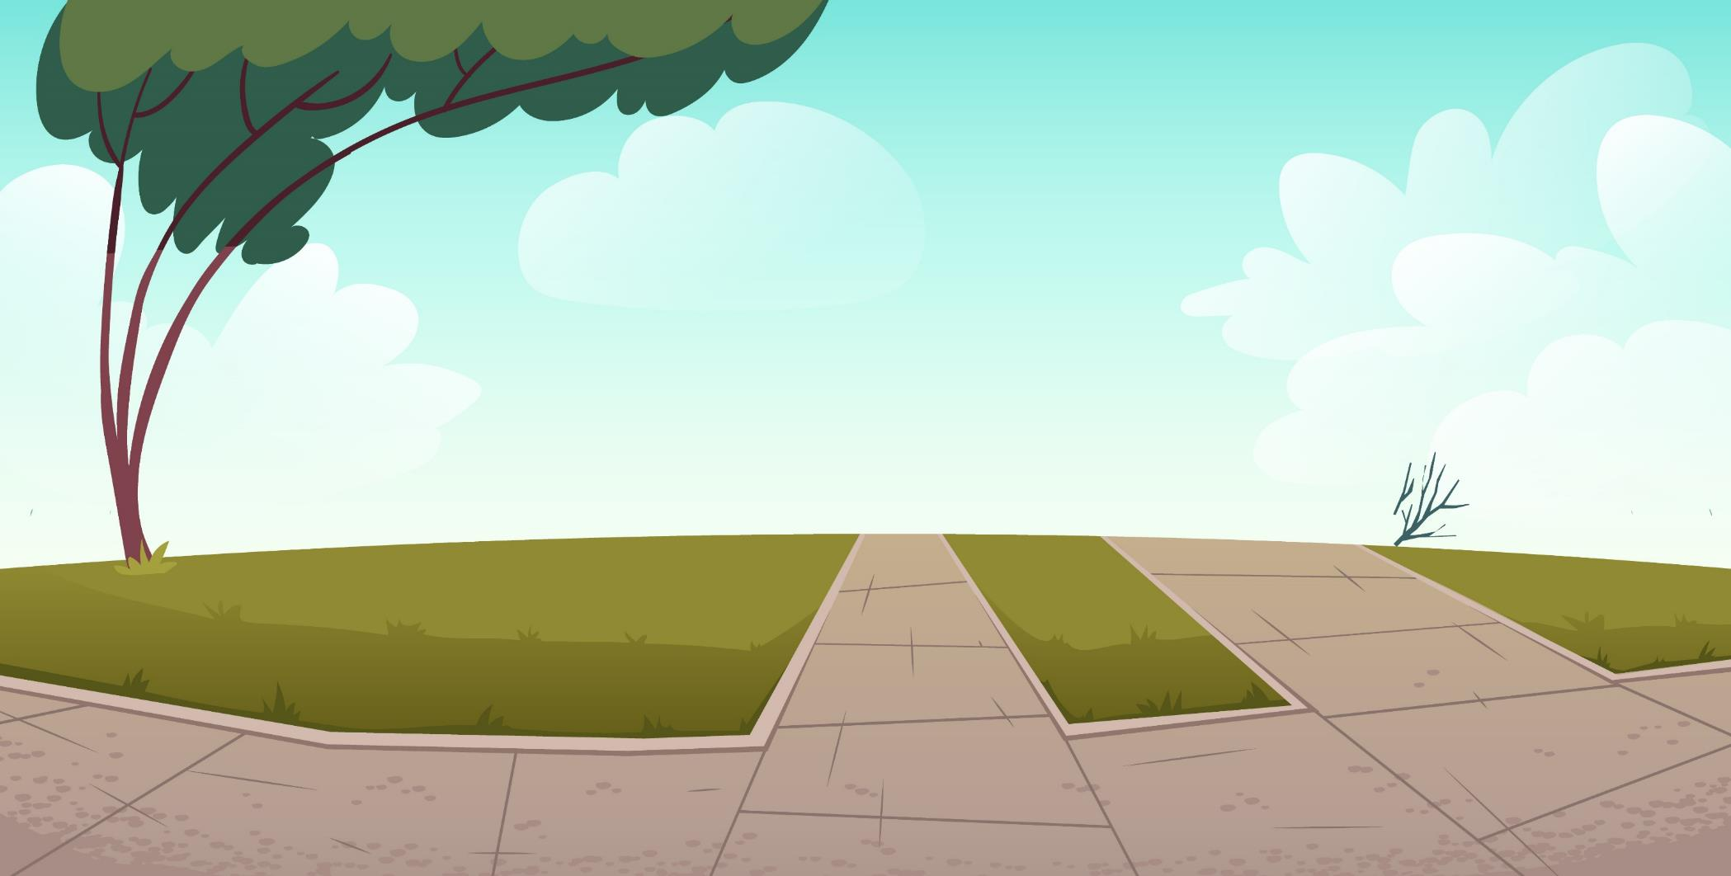
LO: Greet their partners; get a basic idea about the topic of today’s lesson.
Say hello to Ss; ask Ss to greet each other.
Guide Ss to describe the pictures on the cover.
Introduce the topic of the lesson.
TG
1:00
1/26

Slide 2
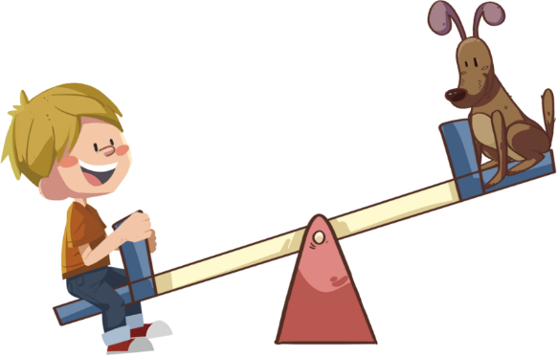
Learning
Goals
TG
LO: Get to know and understand what will be learned in this lesson.
Go through the learning goals with Ss
We are
going to . . .
Isolate and pronounce the final sounds in CVC words.
Learn the following different words rocket, spaceman, bicycle, spiderman, and cowboy, and make sentences with them.
Read the story Nobody Wanted to Play, and learn to ask and answer questions about the story by using the text or the illustrations.
Practice using the sentence structure He played on _____.
0:30
2/26

Slide 3
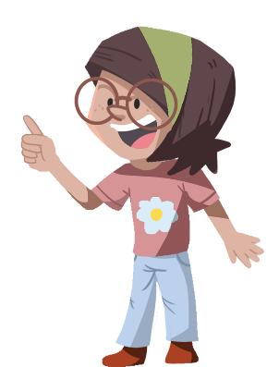
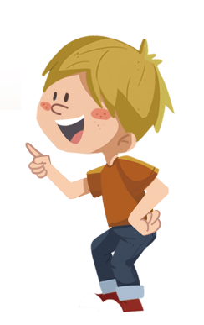
Presentation
TG
LO: Present and share the writing assignment from last lesson.
Invite Ss to take turns presenting their homework. If time is limited, tell Ss they have one or two mins to present their writing.
Encourage Ss to listen carefully and to ask questions.
After both of the Ss have finished, give them feedback and awards (click the picture of the book beside the boy or the girl so that they can get some awards).
Note: You can click the picture of the boy or the girl to give each S a trophy to mark their good performance.
Let’s show!
This is a good thing I can do for a dog.
2:00
3/26

Slide 4
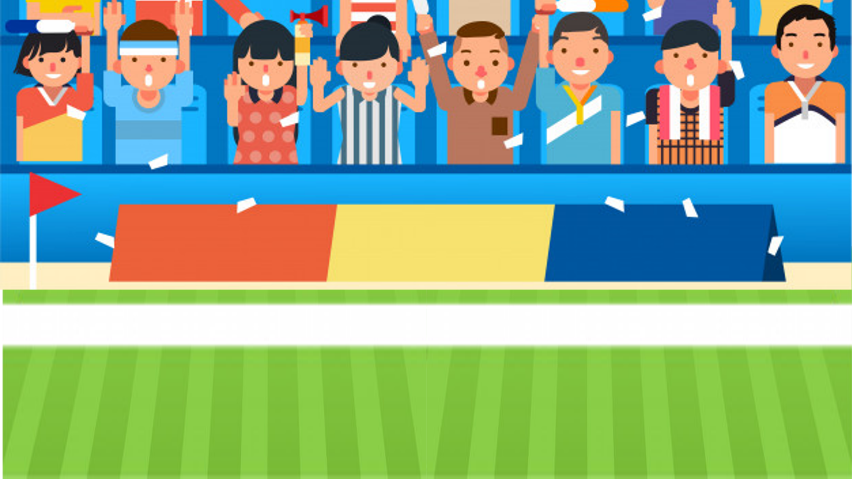
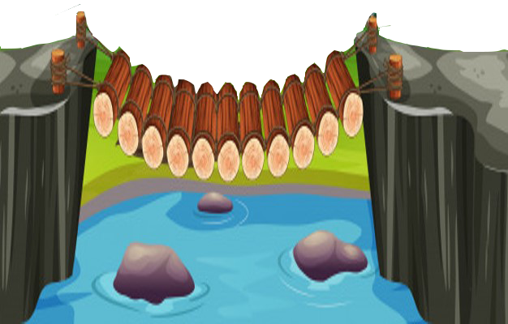
Phonics
TG
LO: Isolate and pronounce the ending consonant sounds in CVC words.
Ask Ss to talk about what they see in the picture; click and tell them to help the boy in the picture finish his race.
First, click and read each word like this: m-a-n, man; then ask Ss to repeat after T; after that, click and ask Ss to say the ending consonant sound of the word (T can explain the meaning of ending consonant sound first: the ending consonant sound is the sound at the end of a word); next, click to show the ending consonant sound of the word and guide Ss to identify and pronounce the ending consonant; lastly, click and tell Ss to help the boy in the picture finish his race.
Note: Each of the three words has the same operational process; Ss will learn three words on this slide.
3. Ask Ss to read the three words and their ending consonant sounds again.
Presentation
Let’s listen and speak!
ma
man
n
ca
p
cap
Can you say the final sound of the word?
Let’s watch the motor show!
Can you read the word?
da
d
dad
2:30
4/26

Slide 5
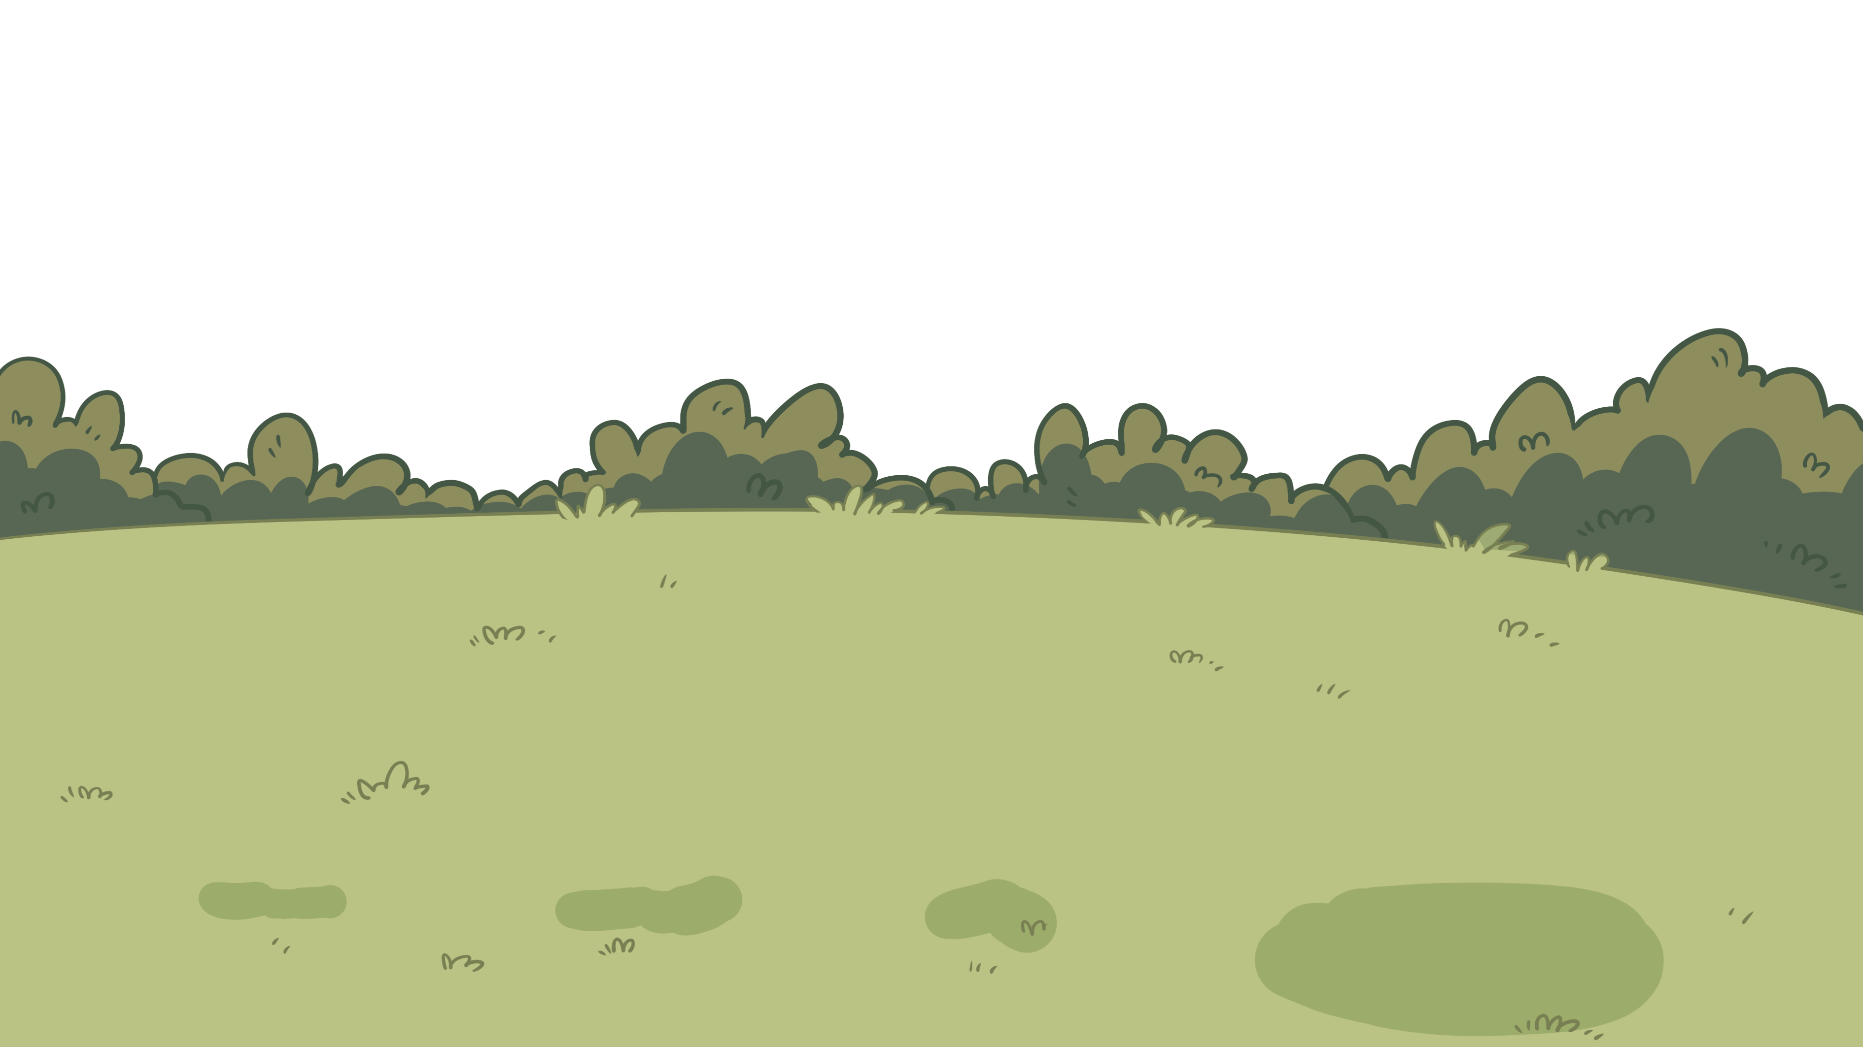
Phonics
TG
LO: Isolate and pronounce the ending consonant sounds in CVC words.
Ask Ss to talk about what they see in the picture; click and tell them to help the man in the picture finish his competition.
First, click and read each word like this: f-i-t, fit; then ask Ss to repeat after T; after that, click and ask Ss to say the ending consonant sound of the word (T can explain the meaning of ending consonant sound first: the ending consonant sound is the sound at the end of a word); next, click to show the ending consonant letter of the word and guide Ss to identify and pronounce the ending consonant sound; lastly, click and ask Ss to help the man in the picture finish his competition.
Note: Each of the three words has the same operational process; Ss will learn three words on this slide.
2. Ask Ss to read the three words and their ending consonant sounds again.
Presentation
Let’s listen and speak!
Can you say the final sound of the word?
Let’s watch the dart show!
Can you read the word?
fit
t
fi
pan
n
pa
ham
m
ha
2:30
5/26

Slide 6
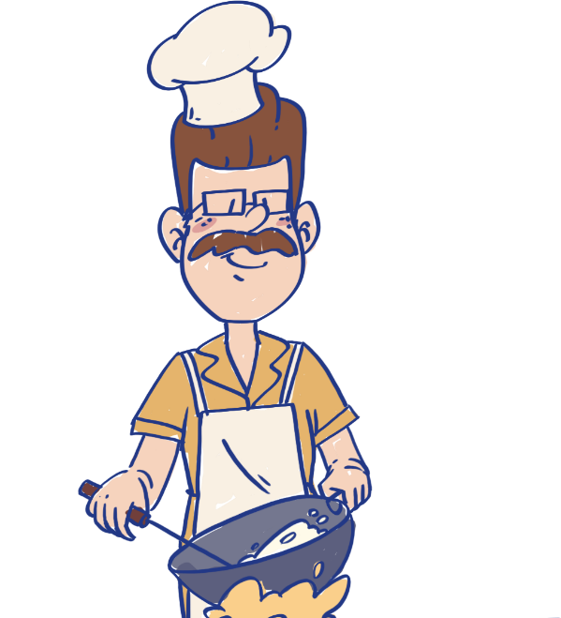
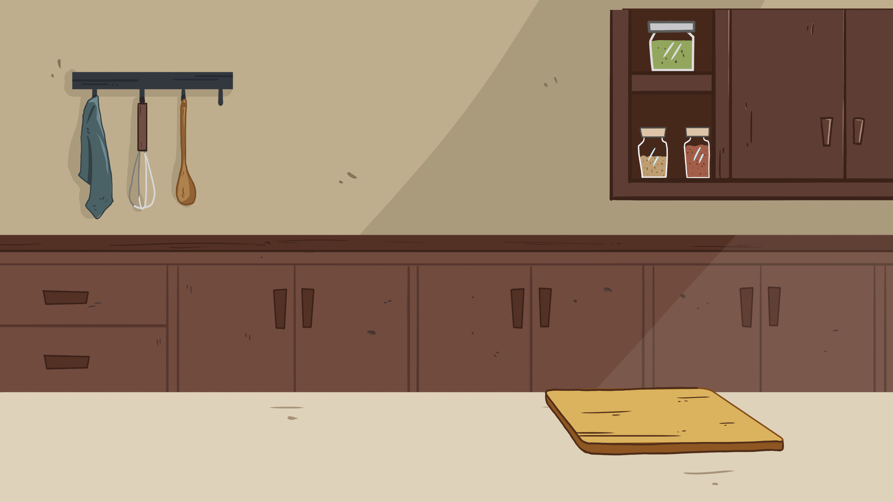
Phonics
TG
LO: Read the text fluently; decode words together.
Click and read the text to Ss with rhythm.
Guide Ss to repeat after you; ask one S to read one sentence, and the other to read the next until they finish reading the text; give feedback.
Guide Ss to decode the words together.
Presentation
Let’s chant!
The man wearing a cap is my dad Dell.
The cap seems to fit him well.
Everyone says he likes to cook.
He can cook with a pan.
But I think he likes to read books.
He likes books about yummy ham.
2:00
6/26

Slide 7
Lead-in
TG
LO: Activate Ss’ interest in reading; use the illustration and the title to identify details and to make predictions; make connections.
Have Ss look at the book cover closely and have Ss talk about the first two questions by using the illustration and the title.
Ask Ss to talk about the connections question; assist them if necessary.
Before Reading
Who is staying with Wilf? Why doesn’t Wilf stay with the other children?
Where do you think Wilf will go?
Connections
How do you feel if nobody to play with you? What do you do?
Written by Roderick Hunt
Illustrated by Alex Brychta
2:00
7/26

Slide 8
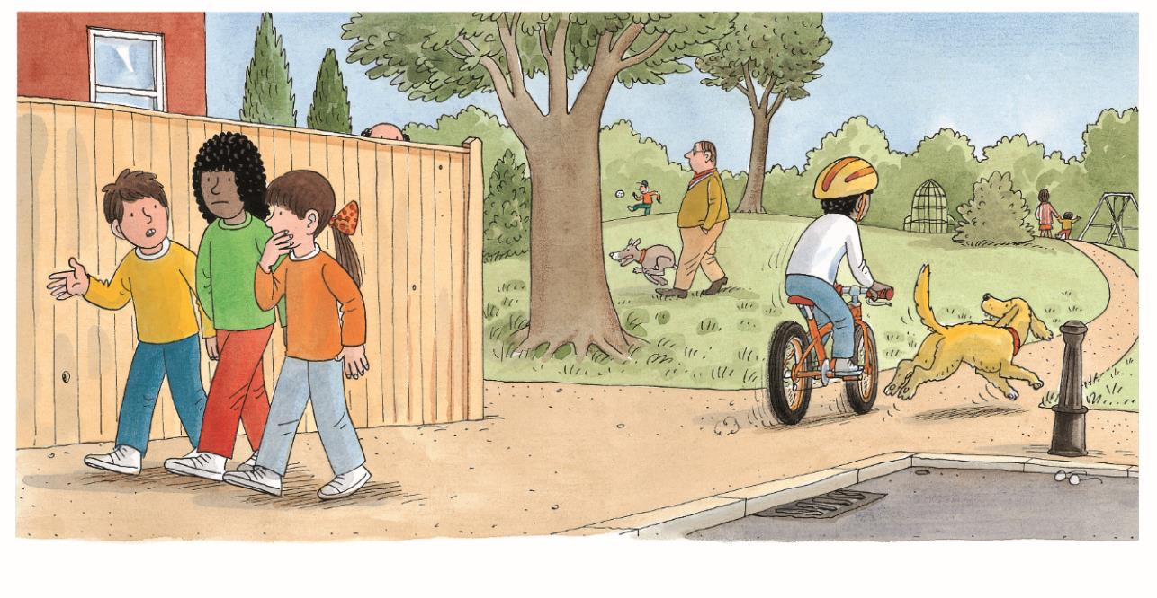
Reading
TG
LO: Identify the details and make predictions about the story by using the illustration; motivate Ss’ interest in reading the story.
Ask Ss to recall what it means to predict.
Have Ss look at the illustration carefully and have Ss talk about the given questions.
Let’s predict!
Before Reading
How do Chip, Biff, and Wilma look? What do you think they are talking about?
What do you think Wilf will do on his own?
2:00
8/26

Slide 9
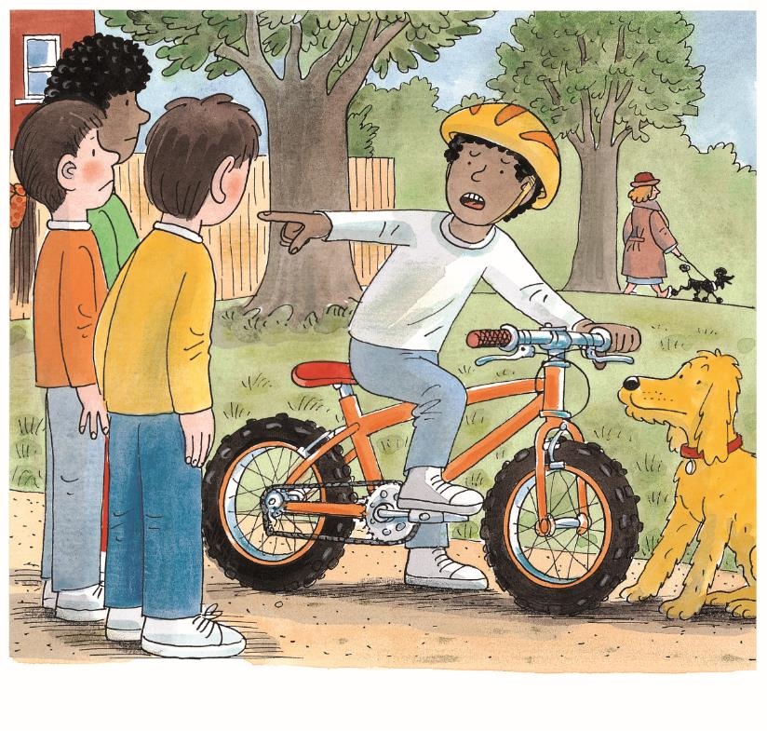
LO: Understand the text; read the text fluently; make connections.
Read the text aloud to Ss; click the hand on the top and explain the differences between the words cross and angry; have Ss talk about the comprehension questions.
Encourage Ss to talk more about the connection questions.
Ask Ss to take turns reading the text aloud.
TG
Reading
Nobody Wanted to Play
BrE. cross
AmE. angry
cross vs. angry
Comprehension
How did Wilf feel?
Why do you think Wilf was angry?
What do you think Wilf was saying?
Connections
What do you feel angry about? What do you do when you are angry?
Wilf was cross.
2:30
9/26

Slide 10
LO: Understand the text; ask questions using the illustration and the context clues; read the text fluently.
Read the text aloud to Ss.
Ask Ss to talk about the comprehension questions by using the text and the illustration.
Have Ss talk about the deep-thinking question; help them ask their partner at least one question. (Note: the reader must use clues such as pictures or the text to figure out the answer to the question.)
Have Ss read the text fluently.
TG
Reading
Nobody Wanted to Play
Comprehension
Where did Wilf go? Why did he go there on his own?
What do you think Wilf would do in the park?
Questioning
Please ask your partner a question about the illustration.
(Tips: What? Where? When? Who? Why? How?)
Nobody wanted to play.
e. g. , What did people do in the park?
He went to the park.
4:00
10/26

Slide 11
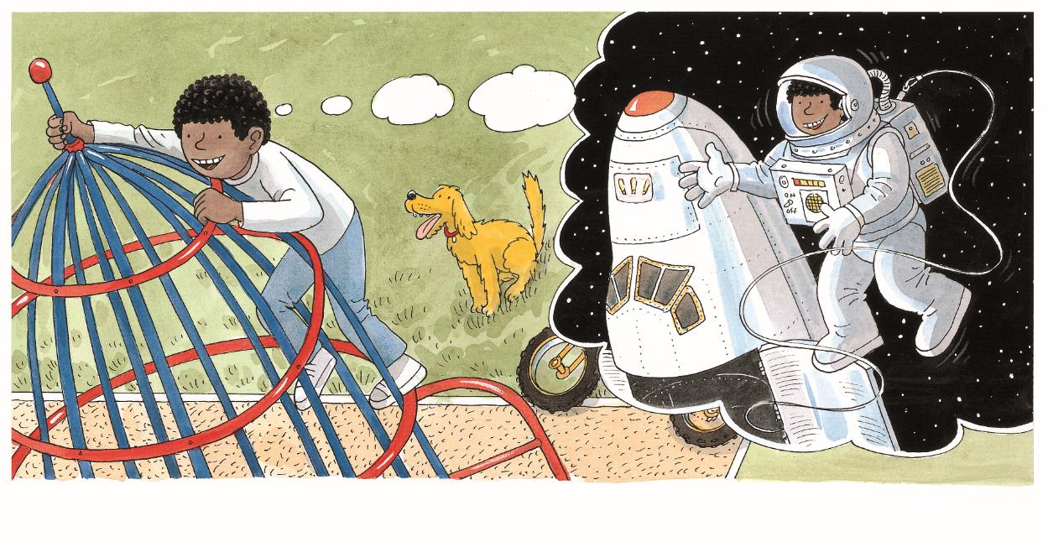
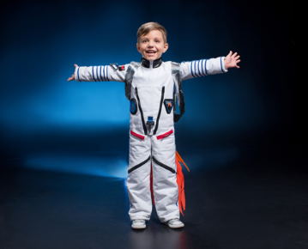
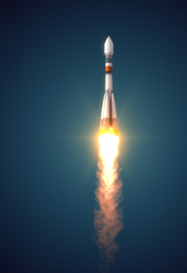
LO: Understand the text; understand the meaning of the vocabulary words spaceman and rocket, then make sentences with them; read the text fluently.;
Have Ss read the first sentence of the text together and give feedback; click the penguin button and explain the word rocket; have Ss read the vocabulary word and have Ss make sentences with it. Then have Ss talk about the first comprehension question.
Have Ss read the second sentence of the text together and give feedback; click the penguin button and explain the word spaceman; have Ss read the vocabulary word and have Ss make sentences with it; have Ss talk about the second comprehension question.
Ask Ss to talk about the third comprehension question by using the text and the illustration.
TG
Reading
Nobody Wanted to Play
Vocabulary
Comprehension
Vocabulary
What play equipment did Wilf play on?
What did Wilf pretend to be?
How do you think Wilf felt when he played on his own?
spaceman
The boy dresses as a spaceman.
rocket
The rocket soared into outer space.
Wilf played on the rocket.
spaceman
“I am a spaceman,” he said.
rocket
2:30
11/26

Slide 12
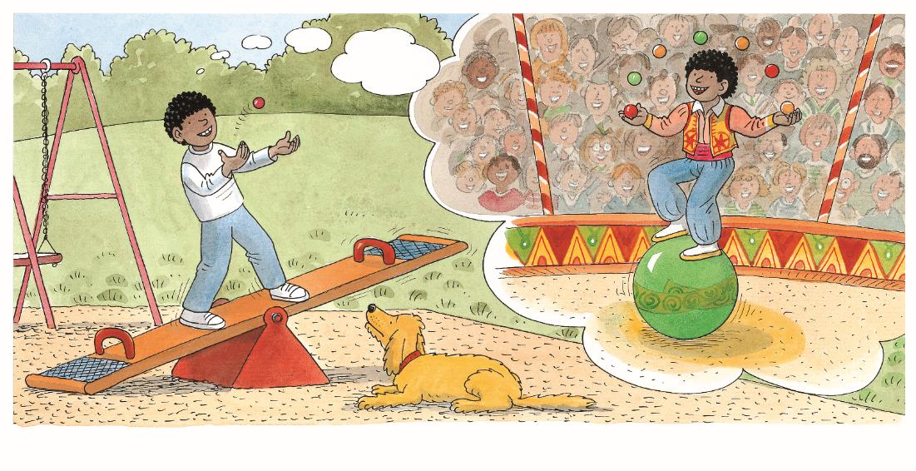
LO: Understand the text; make connections; read the text fluently.
Have Ss read the first sentence of the text together; click the hand on the top and explain the differences between the words see-saw and seesaw; then have them talk about the first comprehension question.
Click and guide Ss to talk about the second question; then click to show the second sentence of the text and check their answers; have Ss read the second sentence.
Click and encourage Ss to talk more about the third comprehension question.
Click and have Ss talk more about the connection questions.
Have Ss take turns reading the text accurately and fluently, and give feedback.
Reading
TG
Nobody Wanted to Play
BrE. see-saw
AmE. seesaw
see-saw vs. seesaw
Comprehension
What play equipment did Wilf play on?
What did Wilf pretend to be?
Did Wilf use the seesaw correctly? How can we play on the seesaw safely?
He played on the see-saw.
Connections
“I am a juggler,” he said.
What does a juggler do? Where might you see a juggler?
Decoding
Fluency.
2:30
12/26

Slide 13
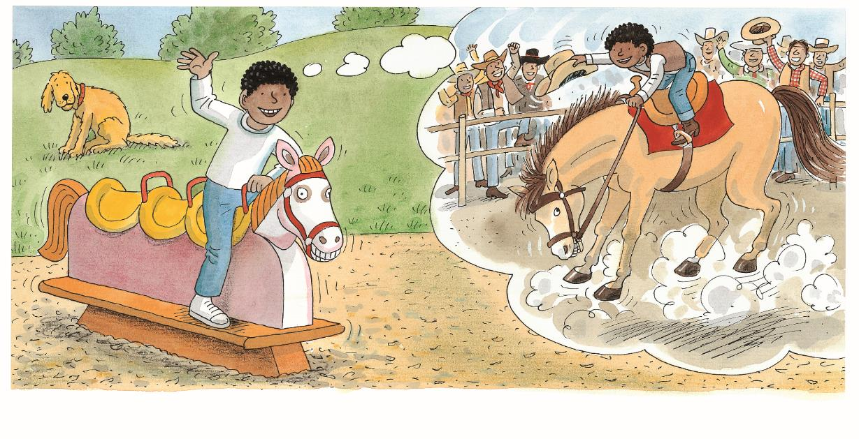
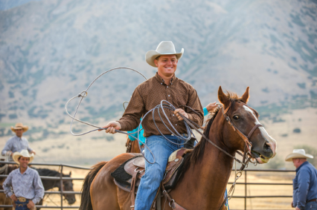
TG
LO: Understand the text; understand the meaning of the vocabulary word cowboy and make sentences with it; read the text fluently.
Read the second sentence of the text aloud to Ss; click the penguin button and explain the word cowboy; have Ss read the vocabulary word and have Ss make sentences with it; then ask Ss to talk about the first comprehension question
Click and guide Ss to talk about the second question; then click to show the first sentence of the text and check their answers; have Ss read the first sentence of the text.;
Click and ask Ss to talk more about the third comprehension question by using the text and the illustrations.
Have Ss read the text fluently.
Reading
Nobody Wanted to Play
Comprehension
Vocabulary
What did Wilf pretend to be?
What play equipment did Wilf play on?
Did Wilf still enjoy himself? How do you think Floppy felt? Why?
cowboy
The cowboy is happy to ride a horse.
He played on the horse.
“I am a cowboy,” he said.
cowboy
2:00
13/26

Slide 14
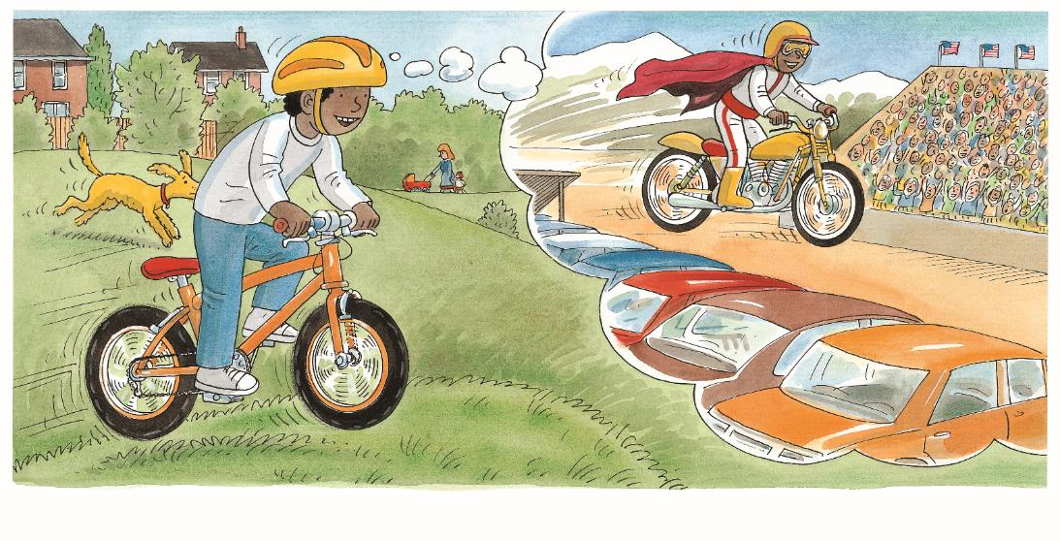
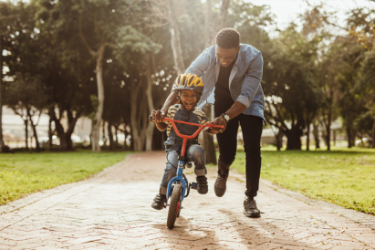
LO: Understand the text; understand the meaning of the vocabulary word bicycle and make sentences with it; ask questions about the story by using the illustration and the text clues; read the text fluently.
Read the second sentence of the text aloud to Ss; click the penguin button and explain the word bicycle; have Ss read the vocabulary word and have Ss make sentences with it; then ask Ss to talk about the first comprehension question
Click and guide Ss to talk about the second question; then click to show the first sentence of the text and check their answers; have Ss read the first sentence of the text.;
Have Ss talk about the deep-thinking question; help them ask their partner at least one question. (Note: the reader must use clues such as pictures or the text to figure out the answer to the question.)
Have Ss read the text fluently.
TG
Reading
Nobody Wanted to Play
Comprehension
What did Wilf pretend to be?
Vocabulary
What play equipment did Wilf play on? How did he feel?
Questioning
Please ask your partner a question about the stuntman.
e. g. , What did a stuntman ride?
(Tips: What? Where? When? Who? Why? How?)
bicycle
He played on his bicycle.
The father is teaching his son to ride a bicycle.
“I am a stuntman,” he said.
bicycle
2:00
14/26

Slide 15
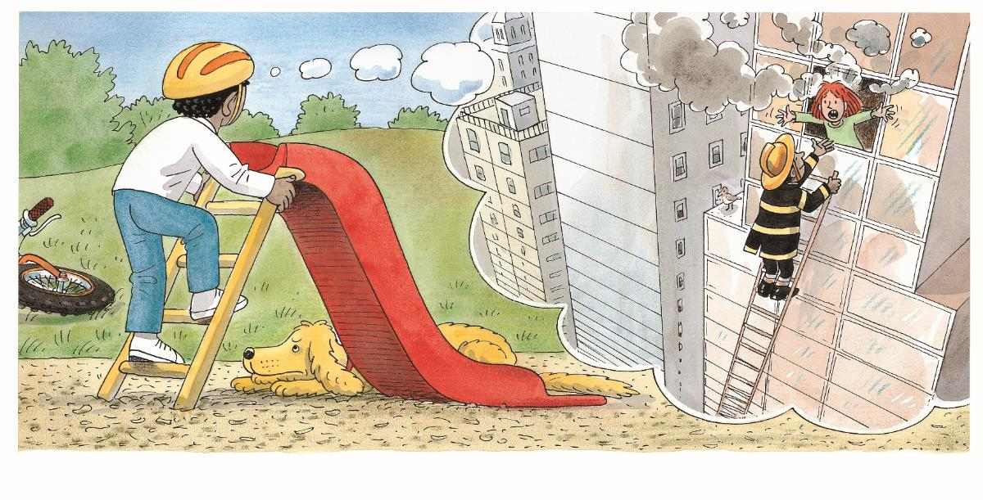
LO: Understand the text; read the text fluently.
Read the text aloud to Ss. Guide students to talk about the first comprehension questions.
Click and guide students to talk about the second comprehension question. Then click to show the second sentence of the text and the other half of the picture, and check their answers; have Ss read the second sentence of the text;
Have Ss read the text fluently and give feedback.
TG
Reading
Nobody Wanted to Play
Comprehension
What play equipment did Wilf play? How did he feel?
What do you think Wilf
pretended to be?
He climbed up the ladder.
Decoding
“I am a fireman,” he said.
Fluency.
2:00
15/26

Slide 16
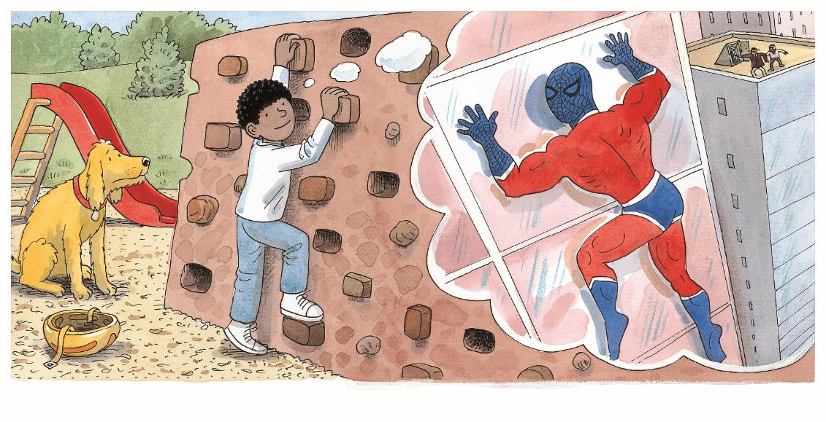
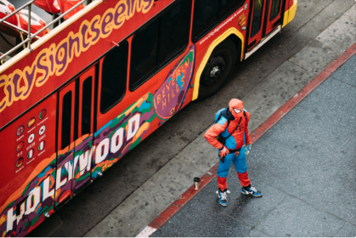
LO: Understand the text; understand the meaning of the vocabulary word spiderman and make sentences with it; make connections; read the text fluently.
Read the first sentence aloud to Ss. Guide students to talk about the first comprehension question.
Click and have students to talk about the second comprehension question. Then click to show the second sentence of the text and the other half of the picture, and check their answers; have Ss read the second sentence of the text.
Click and encourage Ss to talk about the third question
Click and encourage Ss to talk about the connection questions.
Have Ss take turns reading the text fluently.
TG
Reading
Nobody Wanted to Play
Comprehension
Vocabulary
What play equipment did Wilf play on? How did he feel?
What do you think might happen to Wilf next?
What do you think Wilf
pretended to be?
spiderman
The man is wearing a spiderman costume.
He climbed on the wall.
“I am a spiderman,” he said.
Connections
If you were Wilf, what would you pretend to be? Why?
spiderman
2:00
16/26

Slide 17
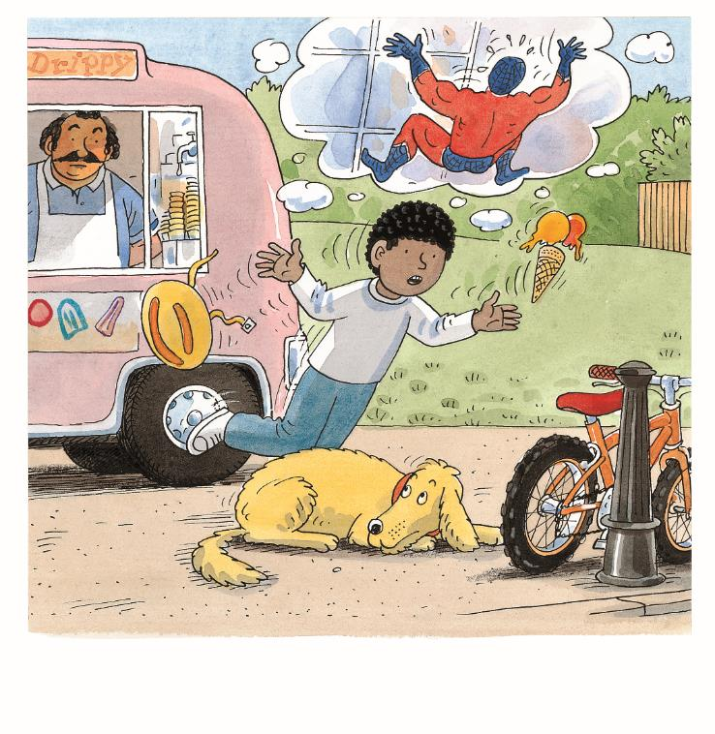
LO: Understand the text; ask questions about the story by using the illustration and the context clues; read the text fluently.
Read the text aloud to Ss.
Ask them to talk about the comprehension questions by using the text and the illustration.
Have Ss talk about the deep-thinking question; help them ask their partner at least one question. (Note: the reader must use clues such as pictures or the text to figure out the answer to the question.)
Have Ss take turns reading the text fluently.
TG
Reading
Nobody Wanted to Play
Comprehension
What happened to Wilf?
What was Wilf thinking when he fell down?
Questioning
Please ask your partner a question about the details of the illustration.
(Tips: What? Where? When? Who? Why? How?)
Whoops!
2:30
17/26

Slide 18
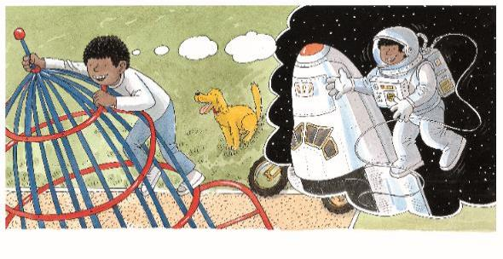
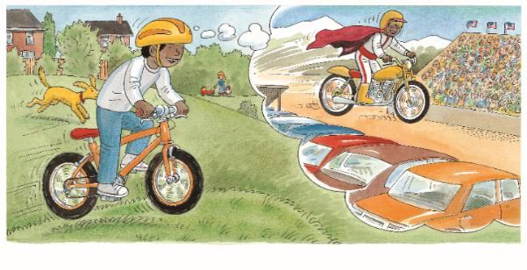
Reading
TG
LO: Retell the story with visual support and assistance.
Have Ss recall the story; model first.
Have Ss work together to retell the story by using the visual aids. Help them if necessary.
Let’s retell!
1
2
3
4
4
5
6
2:00
18/26

Slide 19
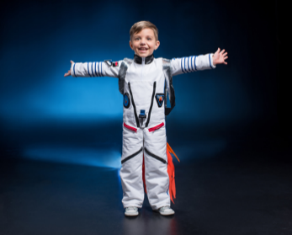
LO: Check Ss’ understanding of the words in this lesson.
Ask Ss to completely review all the learned words in this lesson.
Tell Ss to help the man in the picture print photos and words.
The steps are as follows:
First, click and ask Ss to identify the picture. Then, click to reveal
the entire word.
3. Announce the winner of the competition.
Note: If time is limited, skip this section.
TG
Vocabulary
Let’s guess!
spiderman
spaceman
cowboy
rocket
bicycle
1:00
19/26

Slide 20
Listening &
Speaking
TG
LO: Talk about what play equipment Wilf played on in the park.
Have Ss work in pairs to talk about the given illustrations by using the sentence structure and helping words; model first.
Assist Ss if necessary.
Let’s talk!
—What play equipment did Wilf
play on in the park?
—He played on _____.
Helping Words
the rocket the seesaw the horse his bicycle
Biff
Chip
Kipper
TV
2:00
20/26

Slide 21
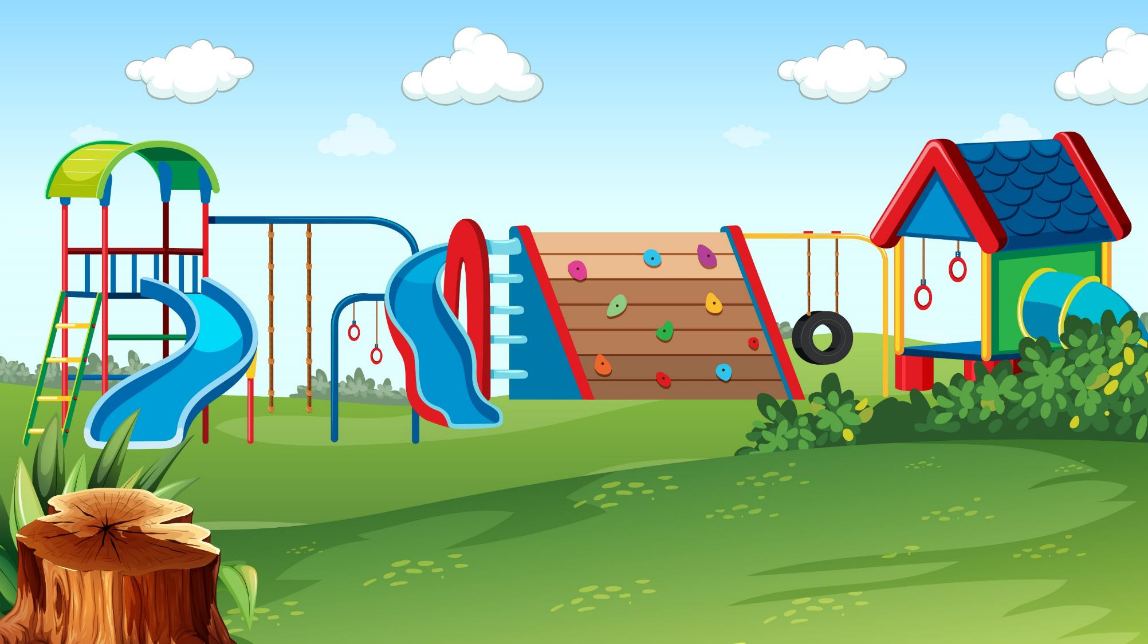
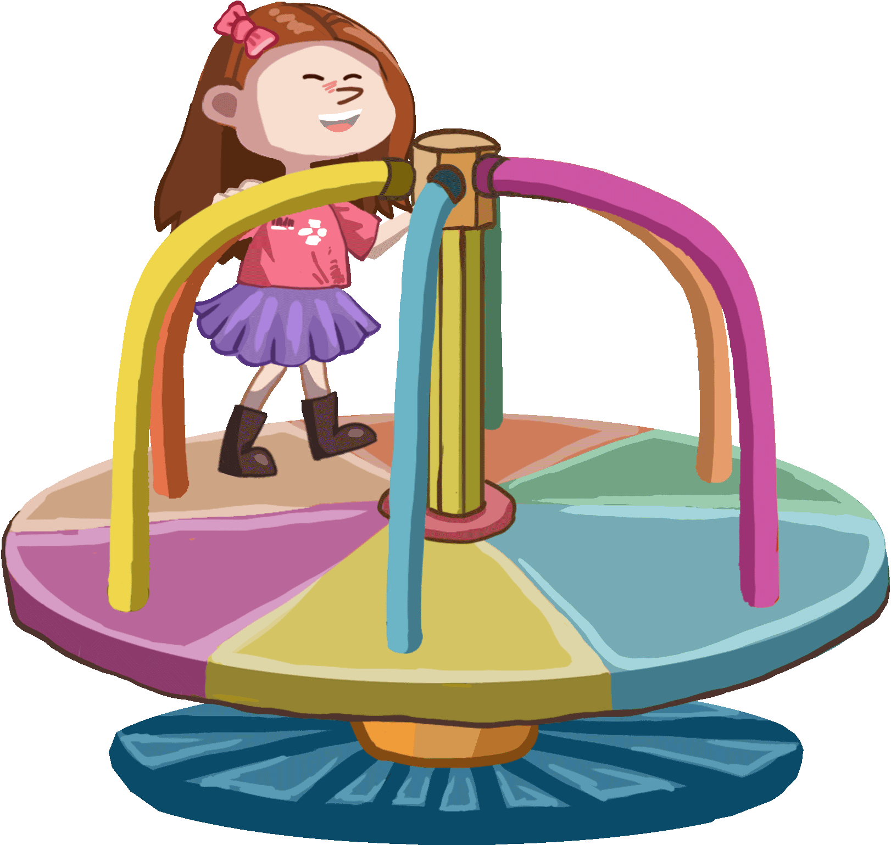
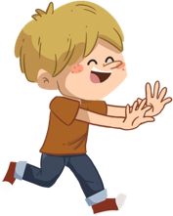
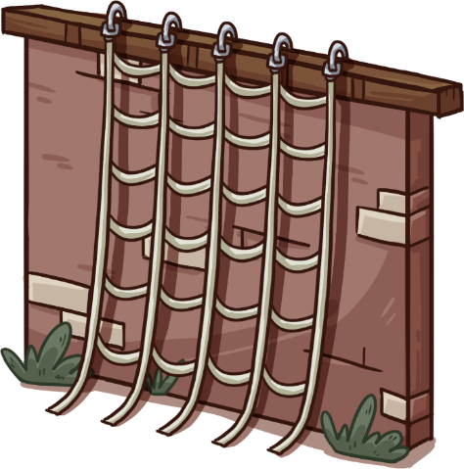
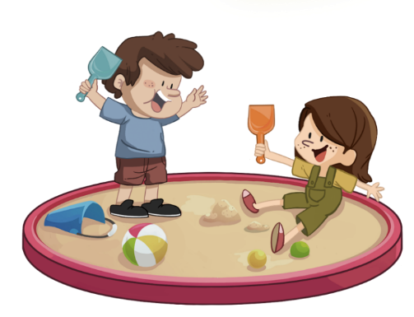
Listening &
Speaking
LO: Ask Ss to talk about what play equipment they like to play on.
Ask Ss to observe the pictures carefully.
Have Ss talk about what play equipment they like to play on, or have Ss choose the play equipment that they want to talk about.
Click Let’s talk! and ask Ss to talk about the given pictures by using the given language structure; model first. Assist Ss if necessary.
Notes: T can click Let’s talk! to present the sentence structure, and then click it again to make it disappear.
TG
Let’s talk!
—What play equipment do
you want to play on in the park?
—I want to ____.
play on the swing
play on the rings
play on the slide
play in the sandpit
jump on a trampoline
play on the merry-go-round
. . .
2:30
21/26

Slide 22
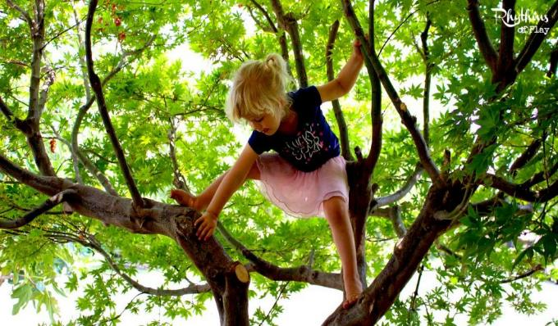
LO: Talk about the values in the story: tell Ss to pay more attention to their safety when they are playing in the park.
Ask Ss about the given task; model first.
Guide Ss to talk about the question with the help of the given pictures.
Encourage Ss to talk more about the following question: What else should we not do in the park?
TG
Value
What shouldn’t you do in the park?
go too high
play near the river
2:00
Play safely!
22/26

Slide 23
LO: Talk about what they learned from the story by using the given structures and language support.
Guide Ss to talk about what they learned from Wilf.
Ask Ss to think about the given questions; help Ss to organize their ideas about the story with the given visual support, and tell them, “This is practice before your homework.”
Model the first question, and then ask Ss to take turns presenting their answers; lastly, click to show them the correct answers
TG
Oral Writing
Get ready to present!
What did Wilf say when he played on the different play equipment?
1. fireman 2. spaceman 3. spiderman 4. juggler 5. cowboy 6. stuntman | A. play on the horse B. play on the rocket C. play on the seesaw D. play on the bicycle E. climb up the ladder F. climb on the wall
I am a _____ when I _____.
E
B
F
1. ____
2. ____
3. ____
C
A
D
4. ____
5. ____
6. ____
2:00
23/26

Slide 24
LO: Understand what the homework is.
Explain the writing task to Ss and check their understanding.
Tell Ss that they should finish their writing before next class. Make sure that they know to send their homework to the platform. They will present their homework next class.
Remind Ss to watch the post-class video and to finish the writing task.
TG
Writing
A Book Review
Write a book review about the book Nobody Wanted to Play.
Let’s draw and write!
Now, please follow the steps to finish your homework, and then present it in the next class:
Draw a picture of one of the people that Wilf pretended to be in the book Nobody Wanted to Play.
Write two complete sentences to fill in the book review.
Watch the post-class video about the writing task.
0:30
24/26

Slide 25
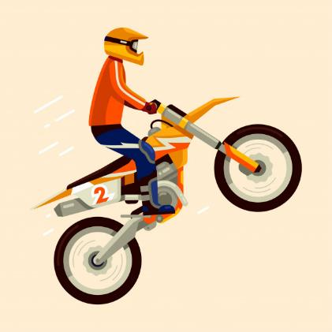
LO: Review today’s lesson.
Guide Ss to review the phonics by asking Ss to read the words.
Guide Ss to review the words by asking Ss to make sentences with some of them.
Guide Ss to review the sentence patterns by asking each S to make sentences with them.
TG
Review
Review
Let’s review!
Phonics:
man/cap/dad/
fit/pan/ham
Sentence Structure:
He played on _____.
Vocabulary:
rocket/spaceman/
bicycle/spiderman/
cowboy
1:00
25/26

Slide 26
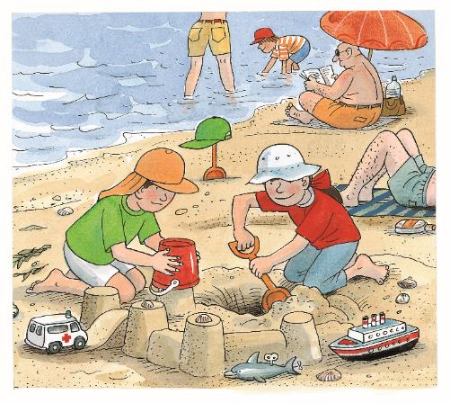
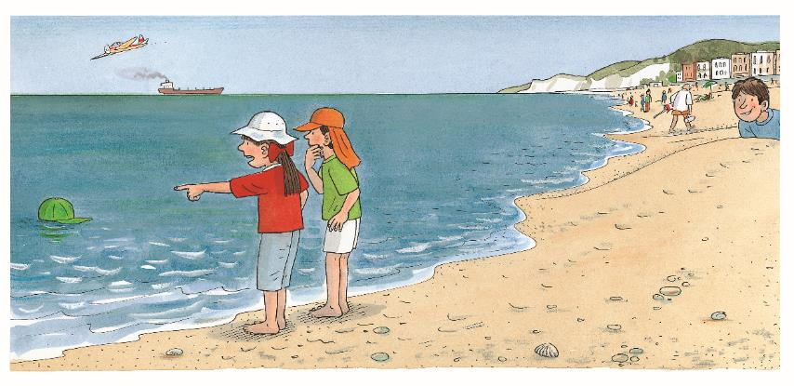
LO: End the lesson and encourage Ss to be well prepared for the next class.
Briefly comment on Ss.
Say goodbye to students.
Ask Ss to preview the next lesson.
TG
0:30
26/26

