Slide 1
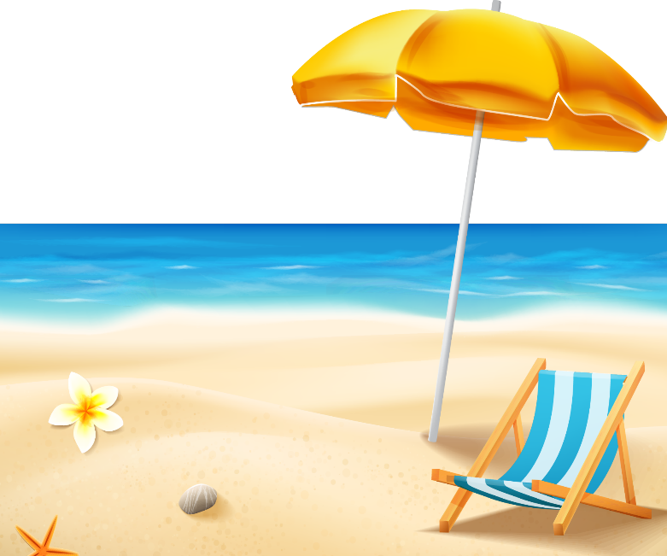
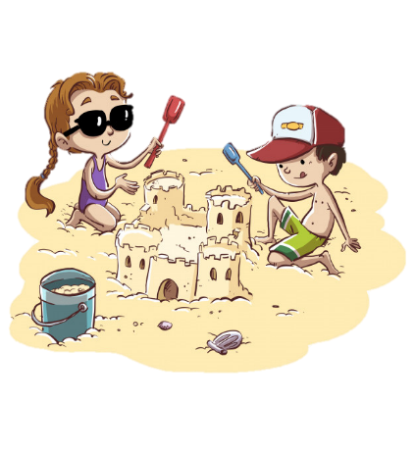
TG
LO: Get to know their partners; get a basic idea about the topic of today’s lesson.
1. Say hello to Ss; ask Ss to introduce themselves and to greet each other.
2. Guide Ss to describe the pictures on the first page.
3. Introduce the topic of the lesson.
ORT-GKA
Lesson 24
On the Sand
1:00
1/26

Slide 2
Learning
Goals
TG
LO: Get to know and understand what will be learned in this lesson.
Go through the learning goals with Ss.
We are
going to . . .
Isolate and pronounce the initial, medial vowel, and final sounds (phonemes) in three-phoneme (CVC) words
Learn the different words hiding, ice cream, donkeys, boat, and go-karts, and make sentences with them.
Read the story On the Sand and recognize the sequence of events.
Practice using the sentence structure _____ looked at _____.
0:30
2/26

Slide 3
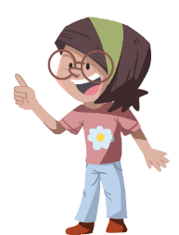
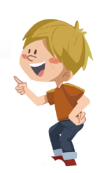
TG
LO: Present and share the writing that was assigned last lesson.
1. Let Ss present in turns.
2. Encourage Ss to listen carefully and to ask questions.
3. After both of the Ss have finished, give them feedback and awards (Click the picture of
the book beside the boy or girl so that they can get some awards). Click and give each
S a trophy to mark their good performance.
Note: You can click the picture of the boy or the girl to give Ss the trophy.
Presentation
Let’s show!
This is my book review about the book Nobody Wanted to Play.
2:00
3/26

Slide 4
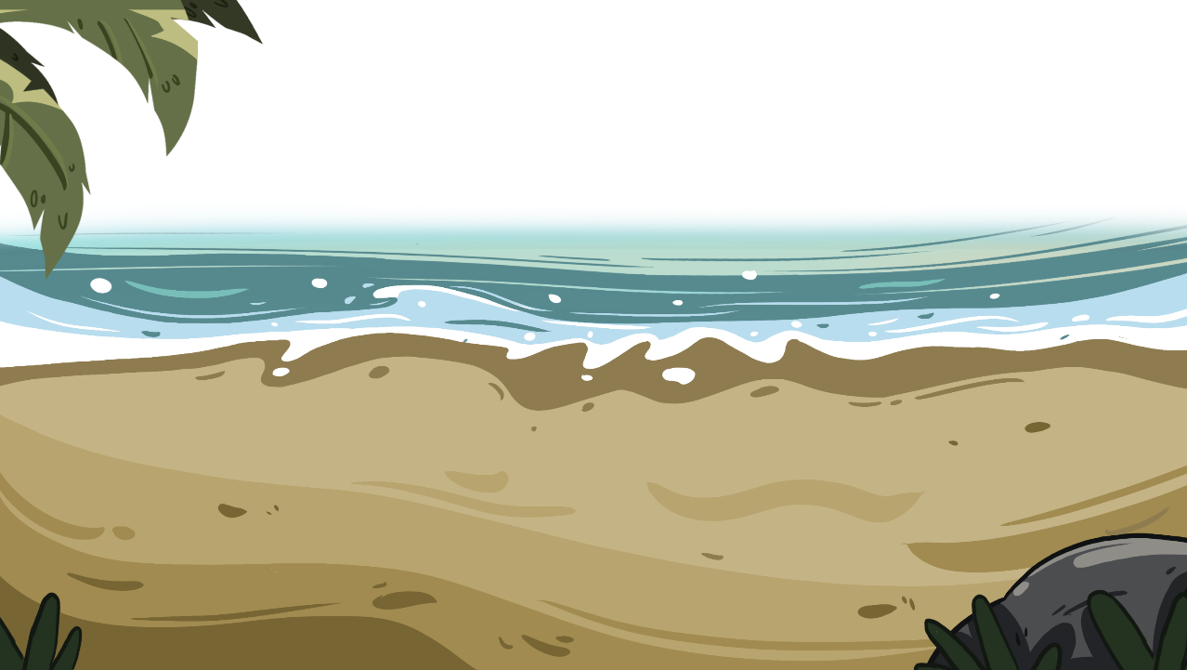
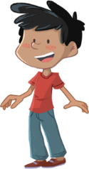
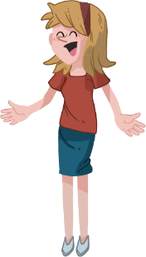
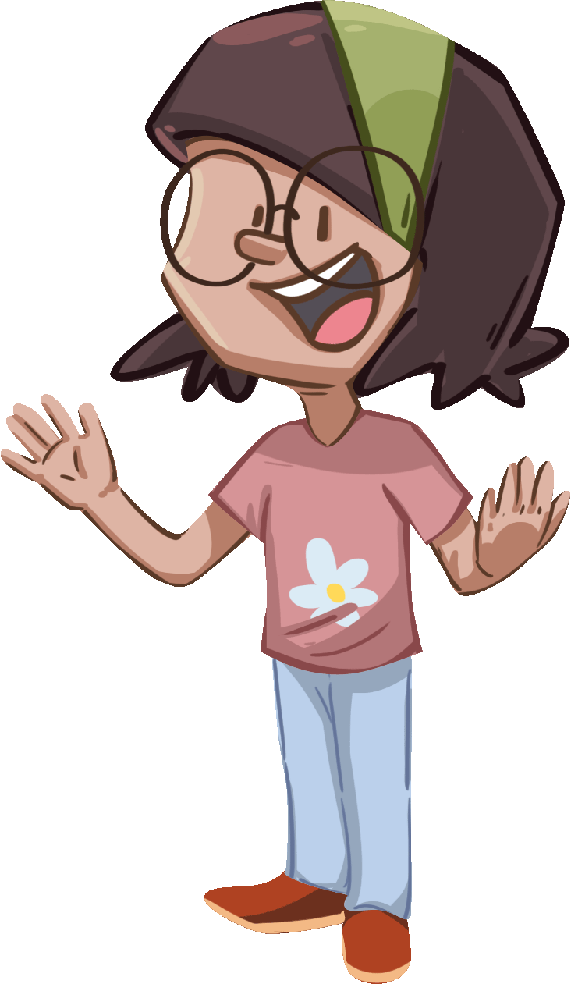
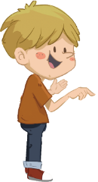
Phonics
TG
LO: Isolate and pronounce the initial, medial vowel, and final sounds (phonemes) in three-phoneme
(CVC) words
1. Ask Ss to talk about what they see in the picture; click and tell them to help the children in the picture
have an egg-and-spoon race by isolating and pronouncing the initial, medial vowel, and final sounds in
three-phoneme words.
2. First click and show the word bad to Ss; then ask Ss to read the word bad; next guide Ss to read the
initial, medial vowel, and final sounds in the word bad; give feedback and click to show the initial,
medial vowel, and final sounds in the word bad; guide Ss to read in this way: b-a-d, bad; last click and
help the children in the picture move forward.
3. Repeat this practice for the rest of the words; Ss will learn three words on this slide.
Phonics
Let’s listen and speak!
Help the children play egg and spoon race!
bad
pig
fox
What’s the initial, medial, and final sound of this word?
f
x
Can you read the word?
b
d
p
g
a
i
o
2:30
4/26

Slide 5
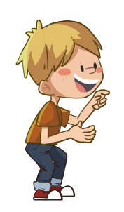
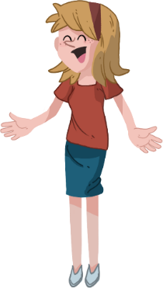
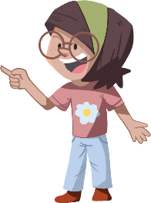
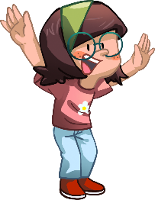
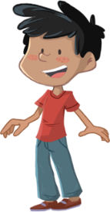
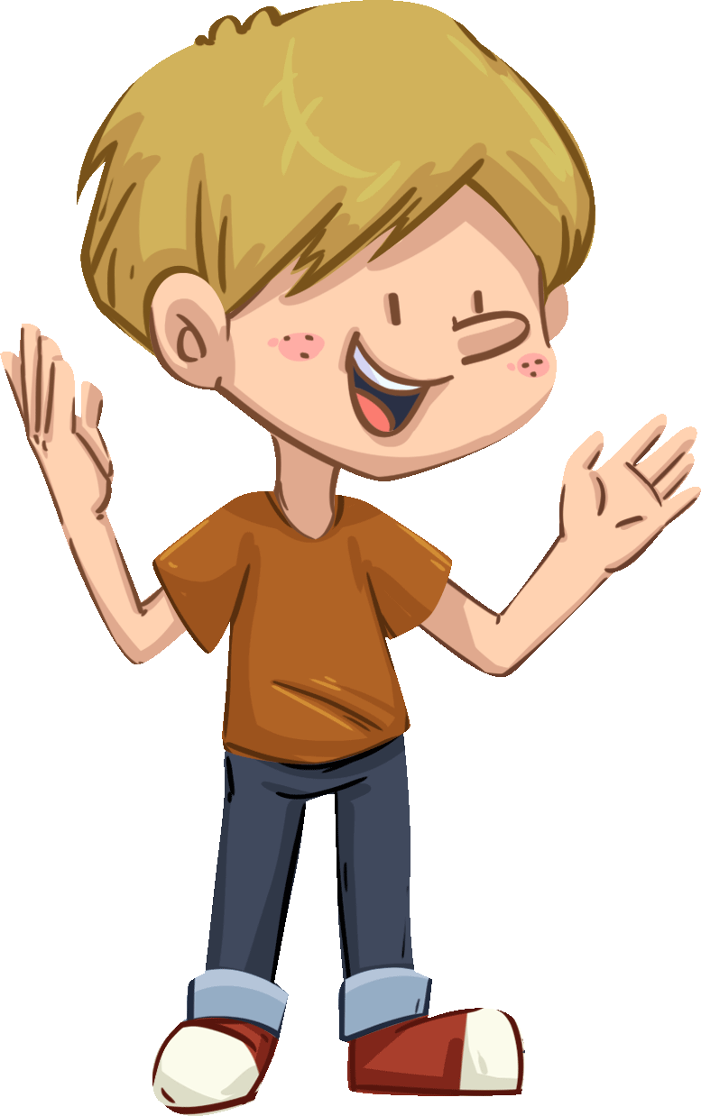
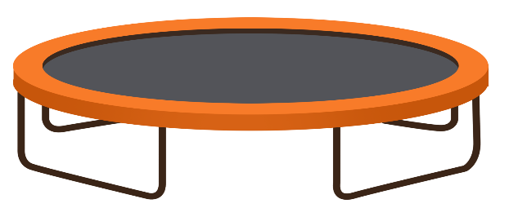
LO: Isolate and pronounce the initial, medial vowel and final sounds (phonemes) in three-phoneme
(CVC) words
1. Ask Ss to talk about what they see in the picture; click and tell them to help the children in the picture
jump on the trampoline by isolating and pronouncing the initial, medial vowel and final sounds in three
-phoneme words.
2. First click and show the word fog to Ss; then ask Ss to read the word fog; next guide Ss to read the initial,
medial vowel and final sounds in the word fog; give feedback and click to show the initial, medial vowel
and final sounds in the word fog; guide Ss to read in this way: f-o-g, fog; last click and help the one of the
children jump on the trampoline.
3. Repeat this practice for the rest of the words; Ss will learn three words on this slide.
Phonics
TG
Let’s listen and speak!
What’s the initial, medial, and final sounds of this word?
fog
but
bag
b u t
b a g
Can you read the word?
f o g
Help the children
play trampoline!
2:30
5/26

Slide 6
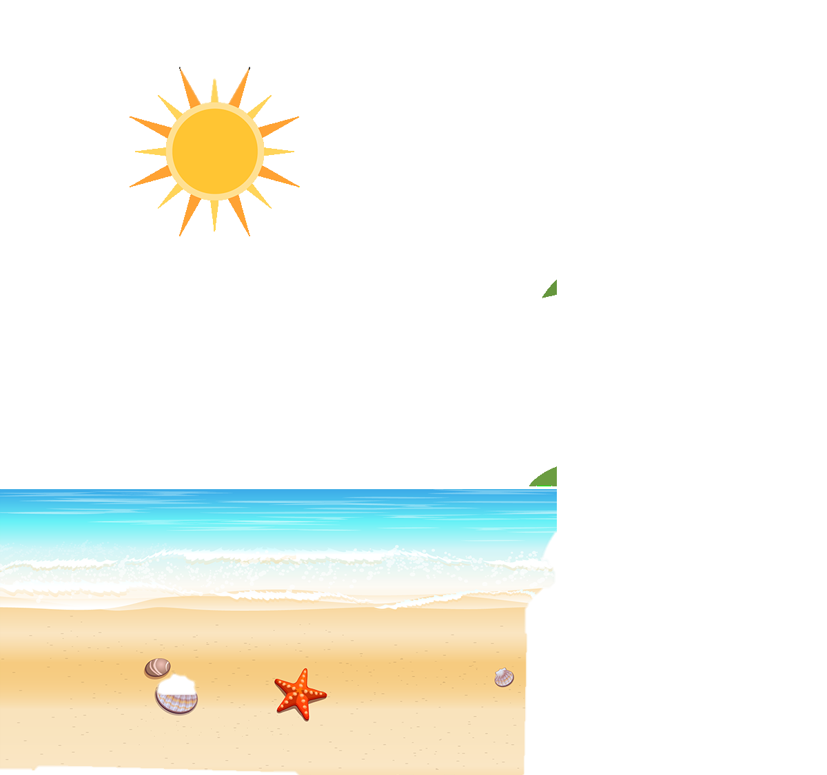
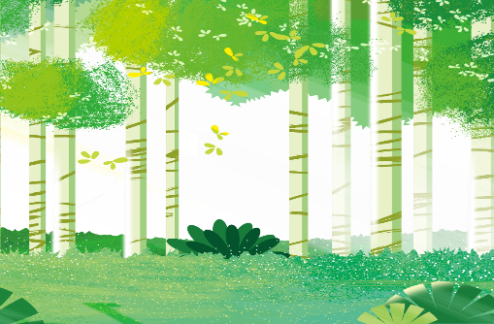
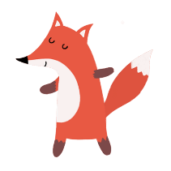
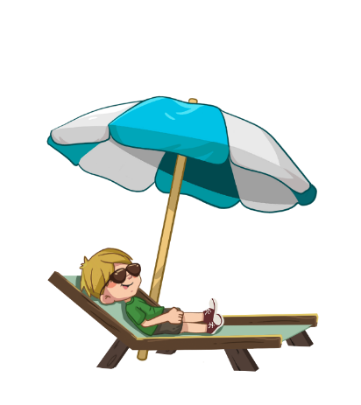
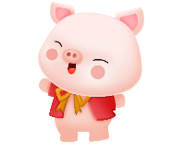
LO: Read the chant fluently; decode the words learned in the text.
Read the chant to Ss with rhythm; have Ss observe the picture and the highlighted words.
Guide Ss to repeat after you; ask them to take turns reading each sentence.
Give feedback.
TG
Phonics
Let’s chant!
This is a story about a big pig and a bad fox.
They went to a forest for a trip
They were lost because of the thick fog.
But they didn’t feel worried.
The pig took out a compass from his bag.
So they could always find their way back.
?
?
?
?
?
?
2:00
6/26

Slide 7
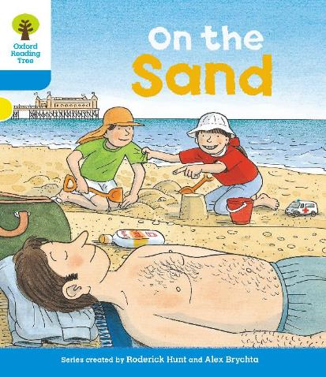
TG
LO: Use the book cover to identify details and to make predictions.
1. Guide Ss to look at the book cover closely and to talk about the given
questions.
2. Encourage Ss to talk more about the connections question.
Lead-in
Before Reading
Where are Dad, Biff, and Chip?
What do you think might happen between Biff, Chip, and Dad in the story?
Connections
What do you like to play on the sand?
Written by Roderick Hunt
Illustrated by Alex Brychta
2:00
7/26

Slide 8
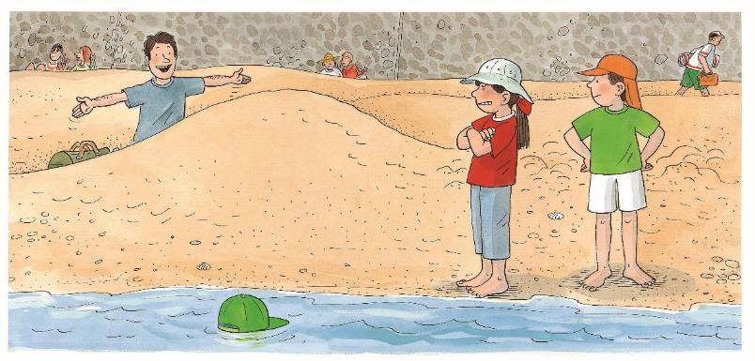
TG
LO: Make predictions about the story by using the illustration; motivate Ss’ interest in
reading the story.
1. Help Ss recall what it means to predict and ask them to make guesses prior to reading
the story by looking at the pictures.
2. Guide Ss to talk about the given questions.
Reading
Let’s predict!
Before Reading
What’s the look on
Biff? How about
Dad?
What do you think Dad might do to Biff and Chip? What will Biff and Chip do next?
2:00
8/26

Slide 9
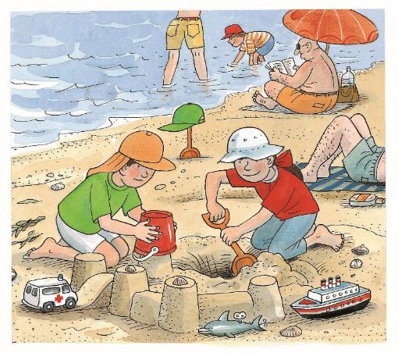
TG
LO: Understand the text; read the text fluently.
1. Read the text aloud to Ss.
2. Have Ss talk about the comprehension questions by using the illustration and the text.
3. Have Ss read the text fluently and give feedback.
Reading
On the Sand
Comprehension
What did Biff and
Chip do?
Where was the
green hat? Look for
clues in the
illustration.
Biff and Chip played on the sand.
2:30
9/26

Slide 10
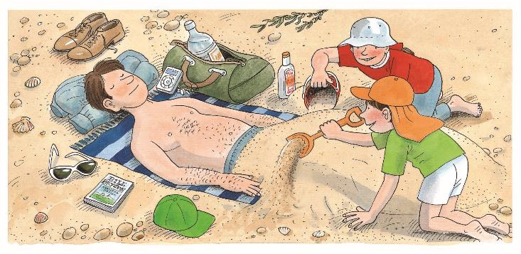
TG
LO: Understand the text; read the text automatically and fluently.
1. Have Ss identify the words they already know in turns; have Ss read the vocabulary
words accurately by asking, “Which words do you know in this sentence?” Have Ss
read the words quickly. Read the text aloud to them.
2. Ask Ss to talk about the comprehension questions by using the text and the illustration.
3. Have Ss read the text automatically and fluently and give feedback.
Reading
On the Sand
Comprehension
What did Dad do?
What did Biff and
Chip do to Dad?
Why did they do that?
Where was the green
hat? What do you think
the children would do
with it next?
Dad went to sleep.
Decoding
Biff and Chip put
sand on Dad.
Read with automaticity.
4:00
10/26

Slide 11
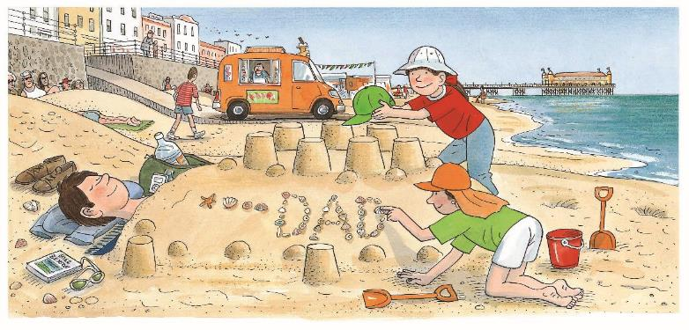
Reading
TG
LO: Understand the text; recognize the sequence of events; read the text automatically
and fluently.
Have Ss identify they already know in turns the words they already know; have Ss read the vocabulary words accurately by asking, “Which words do you know in this sentence?” Have Ss read the words quickly. Read the text aloud to them.
Have Ss talk about the comprehension questions by using the illustration and the text.
Have Ss read the text automatically and fluently and give feedback.
On the Sand
Comprehension
Sequence
What did the children make with sand? What did Biff do with the green hat?
Was Dad near or far from the sea? Do you think Dad was dangerous? Why? What do you think would happen to Dad next?
Put the following events in the right order.
Biff and Chip made a sandcastle.
Biff and Chip put sand on Dad.
Biff and Chip put Dad’s hat on top.
Answer: B-A-C
They made a sandcastle.
They put Dad’s hat on top.
Decoding
Read with automaticity.
2:30
11/26

Slide 12
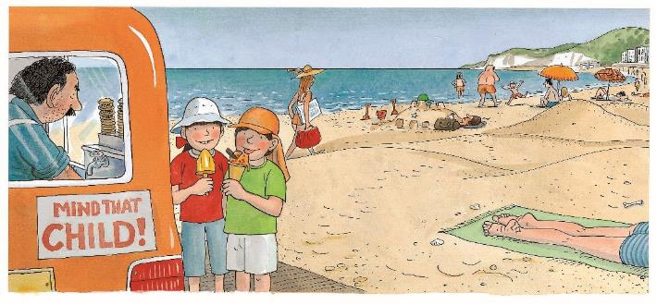
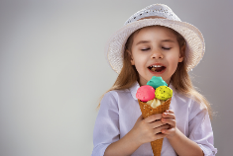
TG
LO: Understand the meaning of the key vocabulary phrase ice cream, and make sentences with it; understand the text; read the text fluently.
1. Read the text aloud to Ss.
2. Ask Ss to find ice cream in the text and the illustration; have Ss read the phrase and
have Ss make sentences with it.
3. Have Ss talk about the comprehension questions by using the illustration and the text.
4. Have Ss read the text fluently and give feedback.
Note: Click the penguin button to show the vocabulary card.
Reading
On the Sand
Comprehension
Vocabulary
Where did the children go? What did they do there?
Did Dad wake up? What would Dad do if he woke up?
What does “Mind that Child” mean on the ice cream van?
ice cream
She is enjoying the ice cream.
Dad was still asleep.
They went to get an
ice cream.
ice cream
2:30
12/26

Slide 13
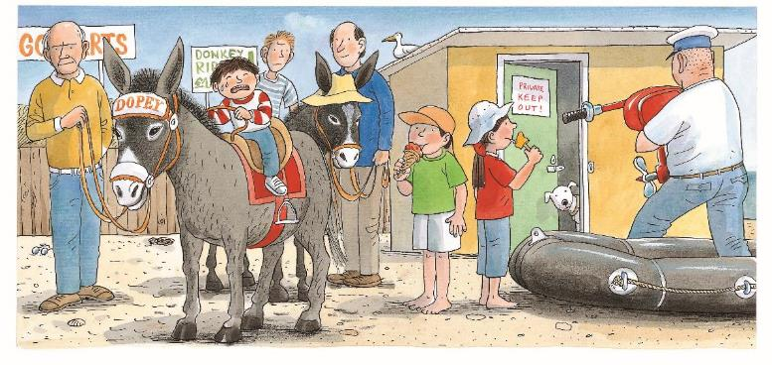
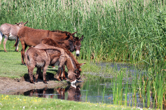
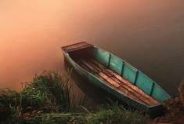
TG
LO: Understand the meaning of the key vocabulary words donkeys and boat, and
make sentences with them; understand the text; read the text fluently; decode the
sight words accurately.
1. Read the text aloud to Ss.
2. Ask one of the Ss to find donkeys in the text and the illustration; have Ss read the word
and have Ss make sentences with it.
3. Ask the other Ss to find boat in the text and the illustration; have Ss read the word and
have Ss make sentences with it.
4. Have Ss talk about the comprehension questions by using the illustration and the text.
5. Ask Ss to find the sight word looked at in the text and guide them to read it accurately
6. Have Ss read the text fluently and give feedback.
Note: Click the penguin button to show the vocabulary card.
Reading
On the Sand
Vocabulary
Vocabulary
Comprehension
What did Chip and Biff look at on the sand?
boat
donkeys
Sight Word
Donkeys are drinking water in a puddle.
There is a boat on the shore.
looked at
Biff looked at the boat.
Chip looked at the donkeys.
donkeys
boat
2:00
13/26

Slide 14
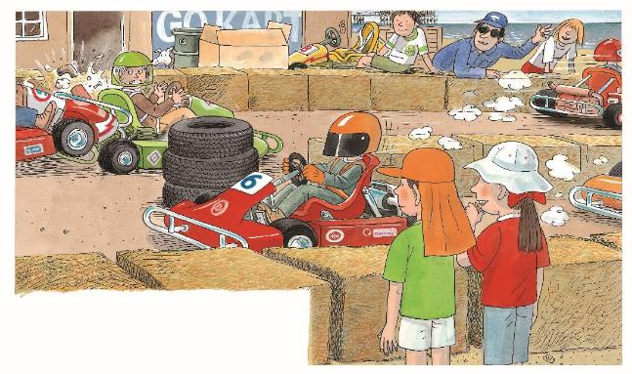
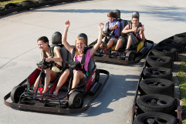
TG
LO: Understand the meaning of the key vocabulary word go-karts, and make sentences
with it; understand the text; recognize the sequence of events; read the text fluently.
1. Read the text aloud to Ss.
2. Ask Ss to find go-karts in the text and the illustration; have Ss read the word and have Ss
make sentences with it.
3. Have Ss talk about the comprehension questions by using the illustration and the text.
4. Encourage Ss to talk more about the sequence of events in the sequence section.
5. Have Ss read the text fluently and give feedback.
Note: Click the penguin button to show the vocabulary card.
Reading
On the Sand
Comprehension
What did the children look at together?
Vocabulary
Sequence
Put the following events in the right order.
Biff and Chip looked at Dad’s hat.
Biff and Chip looked at go-karts.
Biff and Chip went to get an ice cream.
go-karts
They looked at the
go-karts.
They are driving go-karts happily.
Answer: C-B-A
go-karts
2:00
14/26

Slide 15
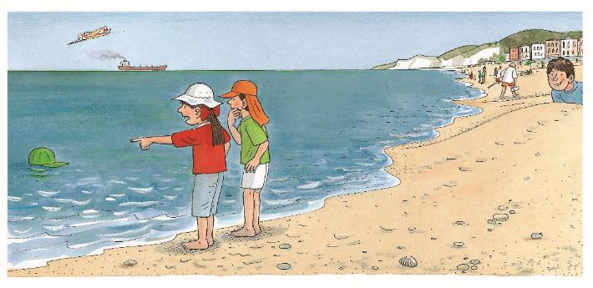
TG
LO: Understand the text; read the text fluently; decode the sight words accurately.
1. Read the text aloud to Ss.
2. Have Ss talk about the comprehension questions by using the illustration and the text.
3. Ask Ss to find the phrase word looked at in the text and guide them to read it accurately.
4. Have Ss read the text fluently and give feedback.
Reading
On the Sand
Comprehension
What did the children find in the sea? Why was it there?
What did Biff mean by saying “Oh no”? What did the children think might happen to Dad?
They looked at Dad’s hat.
“Oh no,” said Biff.
Sight Word
looked at
2:00
15/26

Slide 16
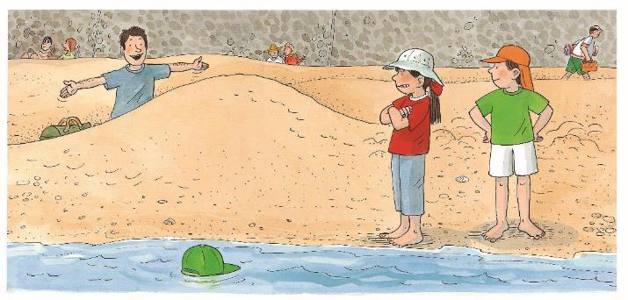
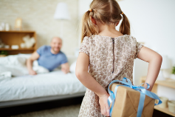
TG
LO: Understand the meaning of the key vocabulary word hiding, and make sentences
with it; understand the text; read the text fluently.
1. Read the text aloud to Ss.
2. Ask Ss to find hiding in the text and the illustration; have Ss read the word and have Ss make
sentences with it.
3. Have Ss talk about the comprehension questions by using the illustration and the text.
4. Have Ss read the text fluently and give feedback.
Reading
On the Sand
Vocabulary
Comprehension
How did Dad play the trick on the children? Why did Dad do that?
How did Biff feel? Why did she feel like that?
hiding
The girl is hiding a present behind her.
Dad was hiding.
Biff was cross.
hiding
2:00
16/26

Slide 17
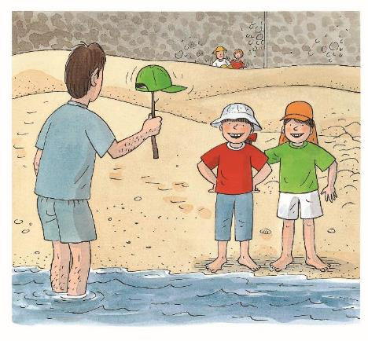
TG
LO: Understand the text; recognize the sequence of events; read the text fluently.
1. Read the text aloud to Ss.
2. Have Ss talk about the comprehension questions by using the illustration and the text.
3. Encourage Ss to talk more about the sequence of events in the sequence section.
4. Have Ss read the text fluently and give feedback.
Reading
On the Sand
Sequence
Comprehension
Put the following events in the right order.
The green hat was on the sea.
The green hat was on the shovel .
The green hat was on the top of the sandcastle.
Where did Dad put the hat?
Do you think it was a good trick? Why?
Connections
Did you play a trick on someone before? What trick was that?
Answer: B-C-A
The hat was on a stick.
2:30
17/26

Slide 18
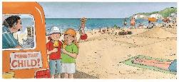
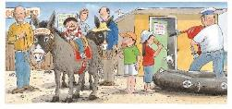
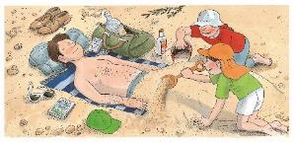
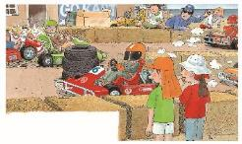
TG
LO: Retell the story with the visual support and assistance.
1. Guide Ss to recall the story; model first.
2. Have Ss work together to retell the story in turns by using the visual aids.
Reading
Let’s retell!
2:00
18/26

Slide 19
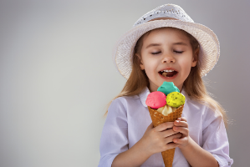
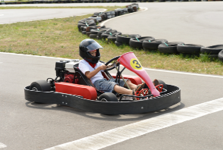
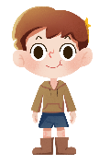
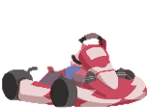
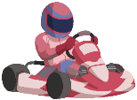
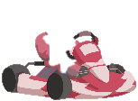
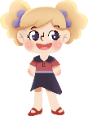
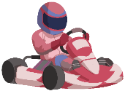
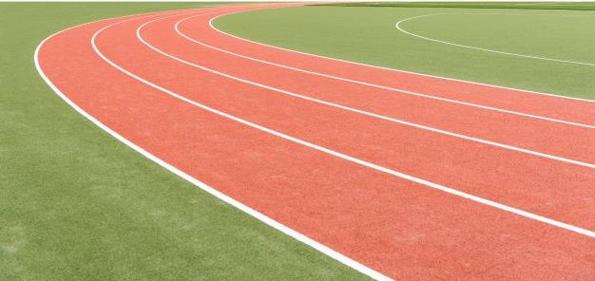
TG
LO: Check their understanding of the words in this lesson.
1. Have Ss help the children in the picture ride go-karts by identifying the pictures and
vocabulary words.
2. Ask Ss to identify the word that matches the picture; click to show the answer; click to
help one of the children in the picture ride the go-kart.
3. Repeat this practice for the rest of the words.
Vocabulary
Let’s guess!
Let’s play go-karts together.
donkeys
go-karts
ice cream
boat
hiding
1:00
19/26

Slide 20
Listening &
Speaking
TG
LO: Talk about what the children looked at on the sand.
Have Ss work in pairs to talk about the given illustration by using the sentence structure and the helping words; model first.
Assist Ss if necessary.
Let’s talk!
—What did _____ look at on the sand?
—_____ looked at the _____.
Helping Words
Biff Chip
Biff
Chip
Kipper
TV
donkeys
boat
go-karts
2:00
20/26

Slide 21
Listening &
Speaking
TG
LO: Use the sentence structure to discuss the following question: What interesting things
would you like to see if you were on the sand?
1. Ask Ss to observe the picture carefully; have Ss talk about what interesting things they
would like to see if they were on the sand; encourage them to speak more.
2. Ask Ss to work in pairs and to talk about the given picture by using the given sentence
structure; each S will have at least three chances to talk; model first.
3. Assist Ss if necessary.
Notes: T can click Let’s talk! to present the sentence structure, and T can click again to
make it disappear.
Let’s talk!
—What interesting things do you
want to see if you were on the
sand?
—I want to see ____.
a tug of war
seagulls
beach balls
kite race
a clown show
. . .
2:30
21/26

Slide 22
TG
LO: Talk about the following topic: How can you play safely when you are on the sand?
1. Ask Ss to think about the given question; model first.
2. Guide Ss to talk about the question with the help of the given pictures.
3. Encourage Ss to talk more about the topic.
Value
How can you play safely when you on the sand?
stay away from the sea at high tide
use sun cream
2:00
22/26

Slide 23
TG
LO: Talk about what the children are doing on the sand.
1. Guide Ss to talk about what they’ve learned from the story.
2. Ask Ss to think about the given questions; help Ss to organize their ideas with the given
visual support; model the first question, and then ask Ss to complete the task in turns.
Oral Writing
Get ready to present!
What did the children do on the sand?
They made ________________.
a sandcastle
They put ___________________.
Dad’s hat on top
get an ice cream
They went to _______________.
Biff & Chip
Chip looked at _____________.
donkeys
Biff looked at _____________.
boat
go-karts
They looked at _____________.
2:00
23/26

Slide 24
TG
LO: Understand what the homework is.
1. Explain the writing task to Ss and check their understanding.
2. Tell Ss that they should finish their writing before next class; make sure they know they
can upload their homework to the platform; they will present their homework next class.
3. Remind Ss to watch the post-class video and to finish the writing task.
Writing
A Book Review
Let’s draw and write!
Write a book review about the book On the Sand.
Now, please follow the steps to finish your homework, and then present it in the next class:
Draw a picture of one thing you found interesting in the book On the Sand.
Write two complete sentences to fill in the book review.
Watch the post-class video about the writing task.
0:30
24/26

Slide 25
TG
LO: Review today’s lesson.
1. Guide Ss to review the phonics by asking Ss to read the words aloud.
2. Guide Ss to review the words by inviting Ss to read and explain some of the words.
3. Guide Ss to review the sentence structures by asking each S to make sentences with
them.
Review
Review
Let’s review!
Phonics:
bad/pig/fox/
fog/but/bag
Sentence Structure:
_____ looked at _____.
Vocabulary:
hiding/ice cream/
donkeys/boat/
go-karts
1:00
25/26

Slide 26
TG
LO: End the lesson and encourage Ss to perform better in the next class.
1. Briefly comments on Ss.
2. Say goodbye to students.
3. Ask Ss to preview the next lesson.
0:30
26/26

